Slide 1
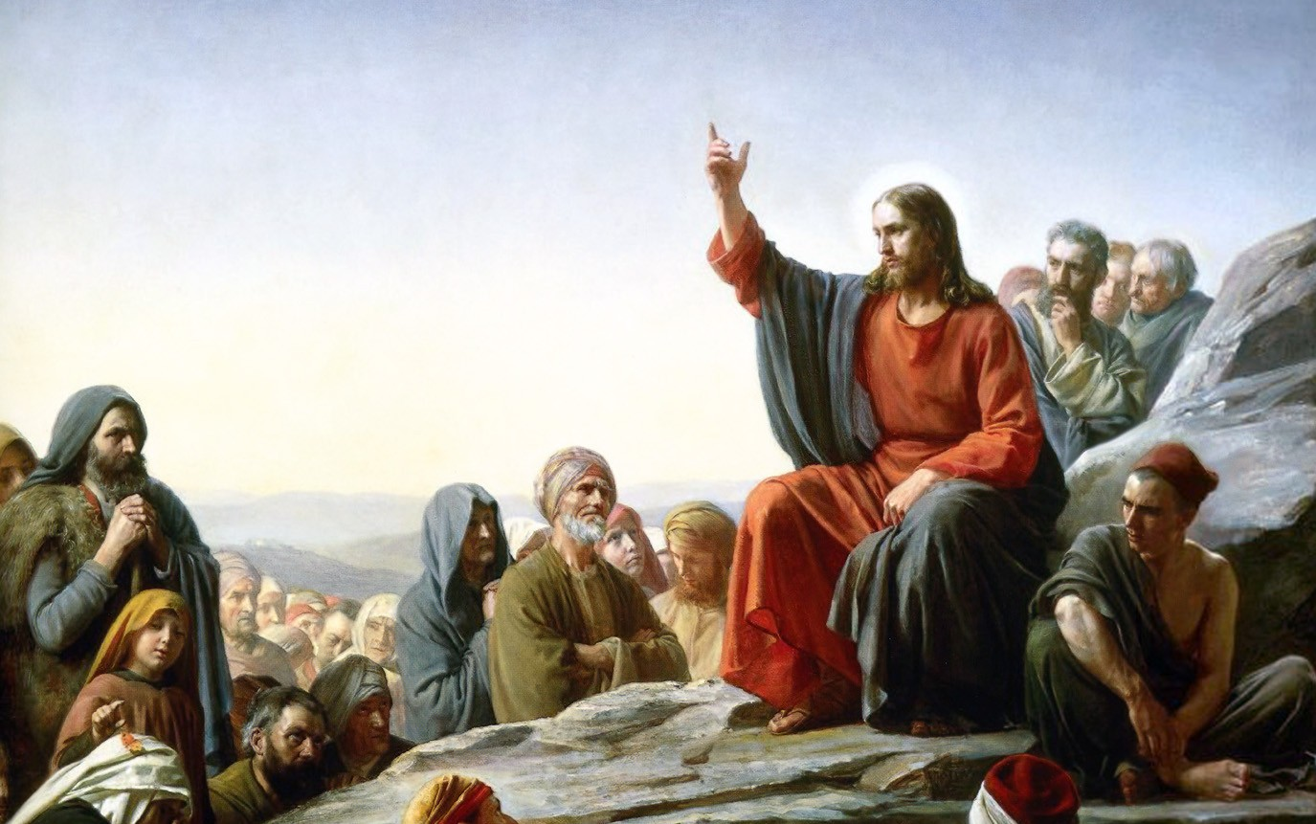
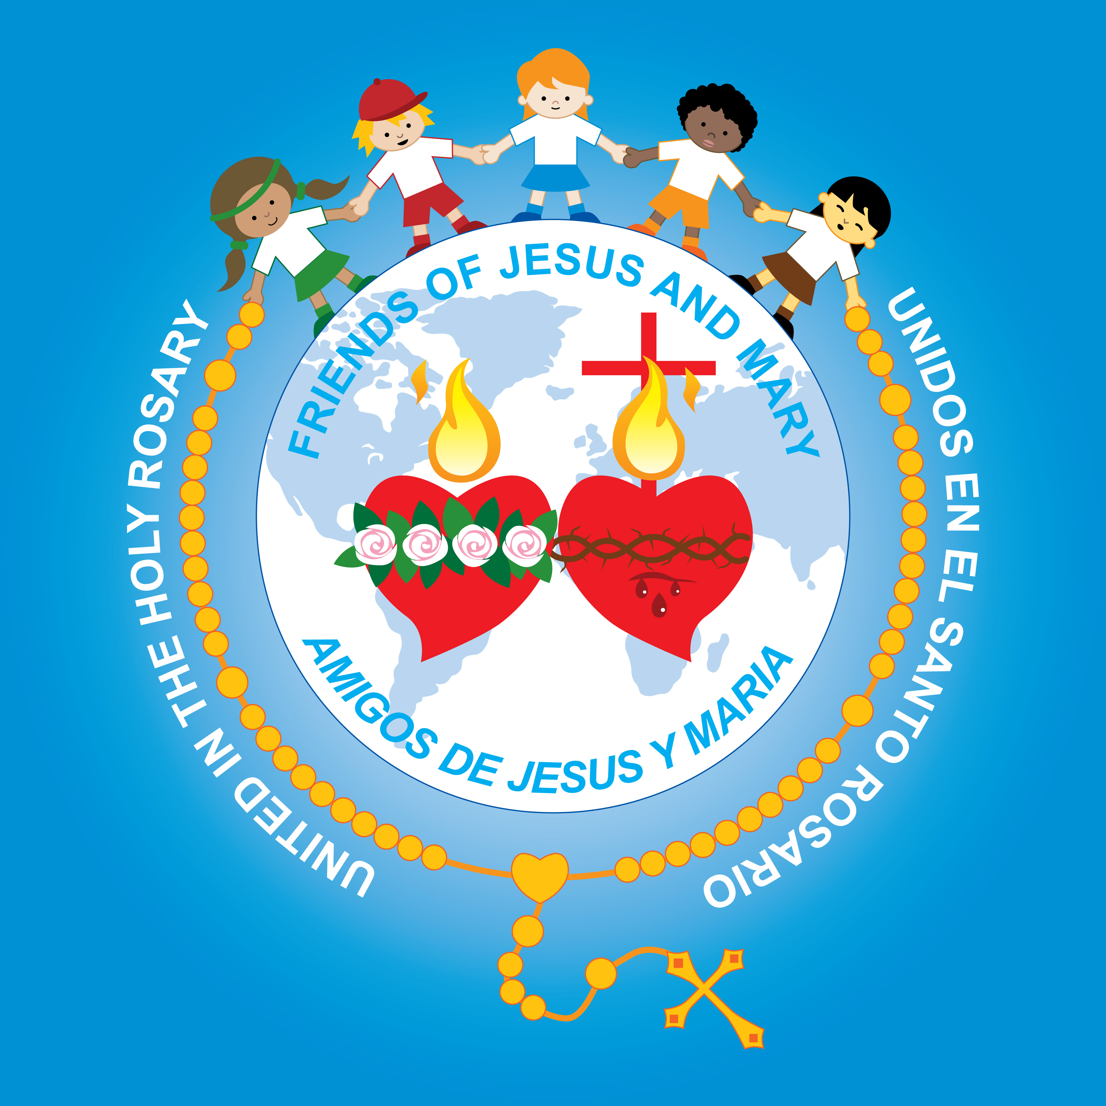
Friends of Jesus and Mary
Cycle C - VI Sunday in Ordinary Time
The Beatitudes-Luke 6, 17. 20-26

Slide 2
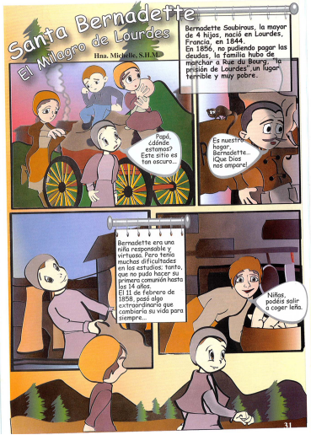
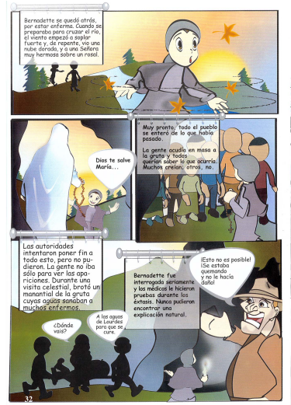
St. Bernadette
Feast Day: February 11
The Miracle at Lourdes
Bernadette Soubirous, the eldest of 4 children, was born in Lourdes, France in 1844. In 1856, not being able to pay their debts, the family moved to Rue du Bourg, the prison, a poor and terrible place.
Bernadette stayed behind since she was sick. When she prepared to cross the river, the wind began to howl and suddenly, she saw a gold cloud and a beautiful Lady.
Father, Where are we? This place is so dark!
It is our home, Bernadette. May God help us!
Soon the whole town knew what had happened.
The people gathered in crowds at the grotto and all wanted to know what was happening. Some believed; some didn’t.
Hail Mary, Full of Grace…
Bernadette was a responsible and virtuous girl. But she had a difficult time learning in school, so much so that she could not do her First Communion until she was 14 years old. On February 11th, something extraordinary would happen that would change her life…
This is not possible. She was being burned and nothing happened to her.
The authorities tried to end everything, but couldn’t. The people did not go only to see the apparitions. During a celestial visit, a spring of water appeared in the grotto, and the water cured many sick people.
Girls, can you get some firewood?
Bernadette was interrogated and doctors did tests during her ecstasies. They never found a natural explanation for them.
Where are you going…
To the waters at Lourdes to be cured.

Slide 3
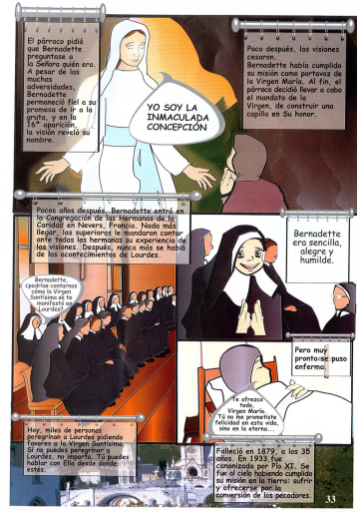
The parish pastor asked Bernadette to ask the Lady who she was. Despite all the difficulties, Bernadette remained faithful to her promise to return to the grotto and on the 16th apparition, the vision revealed her name.
Soon after, the apparitions stopped. Bernadette had fulfilled her mission to be the Virgin’s Mary’s messenger. The parish pastor finally decided to do what Mary asked: to build a chapel in her honor.
I AM THE IMMACULATE CONCEPTION.
A few years later, Bernadette entered the Congregation of the Sisters of Charity in Nevers, France. On arriving, her superiors asked her to tell all the sisters her experience with Mary’s apparitions. After, it was never discussed again.
Bernadette was kind, joyful and humble.
Bernadette, Can you tell us how the Virgin Mary revealed herself to you in Lourdes?
But soon she became ill.
I offer up everything. Virgin Mary, You did not promise me happiness in this world, but in the next.
Today, thousands of people go to Lourdes yearly asking for favors from the Holy Virgin. If you cannot go to Lourdes, that’s OK. You can speak to her from where you are.
She died in 1879, when she was 35 years old. In 1933, Pope Pius XI canonized her. She went to Heaven having completed her mission on earth: to suffer and offer herself for the conversion of sinners.

Slide 4
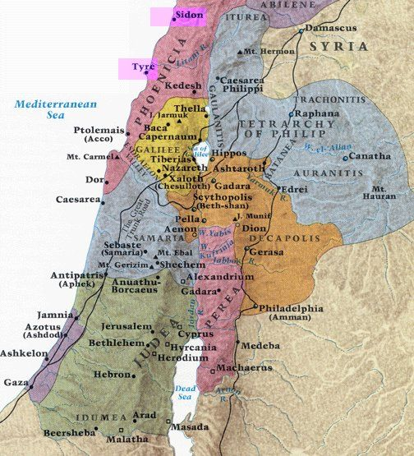
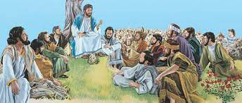
The Beatitudes
Luke 6, 17. 20-26
Jesus came down with the twelve and stood on a stretch of level ground with a great crowd of his disciples and a large number of the people from all Judea and Jerusalem and the coastal region of Tyre and Sidon.

Slide 5
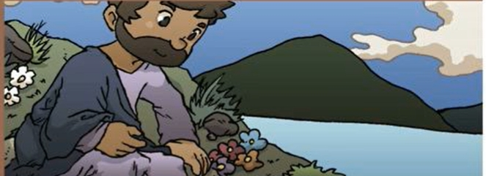
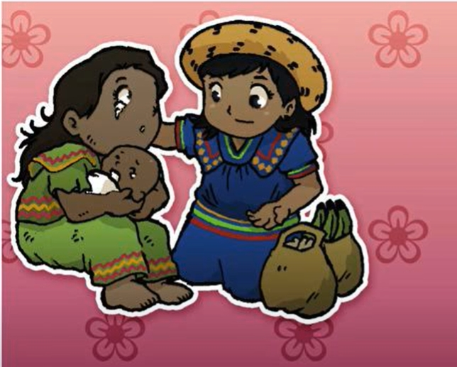
And raising his eyes toward his disciples he said: “Blessed are you who are poor, for the kingdom of God is yours.”

Slide 6
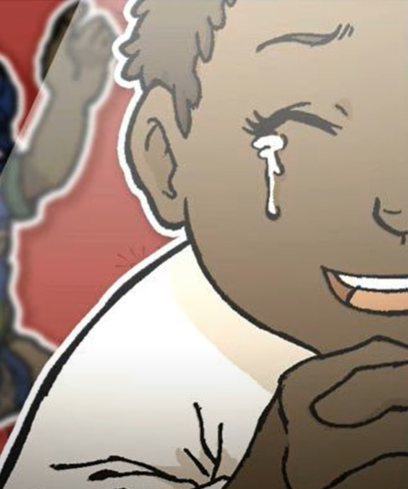
Blessed are you who are now hungry, for you will be satisfied.
Blessed are you who are now weeping, for you will laugh.

Slide 7
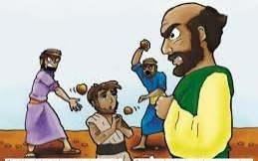
Blessed are you when people hate you, and when they exclude and insult you, and denounce your name as evil on account of the Son of Man.
Rejoice and leap for joy on that day! Behold, your reward will be great in heaven. For their ancestors treated the prophets in the same way.

Slide 8
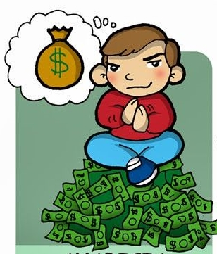
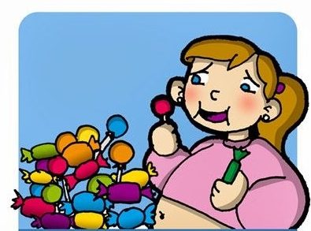
Woe to you who laugh now, for you will grieve and weep!
But woe to you who are rich, for you have received your consolation!
Woe to you when all speak well of you, for their ancestors treated the false prophets in this way.”
Woe to you who are filled now, for you will be hungry!

Slide 9
Reflection

Slide 10
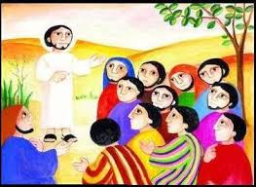
Jesus says to His disciples:
“Blessed are you who are poor,”
Why are the apostle’s poor?
They left their work and their families to follow Jesus.
Jesus then explains why they have made a good decision to leave everything and follow Him:
“For the kingdom of God is yours”.

Slide 11
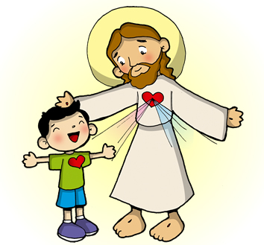
Where is the kingdom of God?
In the hearts of those who love and follow Jesus the King.
Jesus continues:
“Blessed are you who are now hungry,
for you will be satisfied.”
What does Jesus mean?
Those who are hungry for God, like Jesus’ followers, will be satisfied because God will fill them with love and joy.

Slide 12
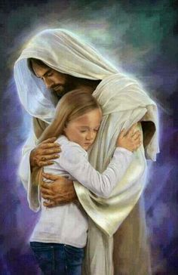
Jesus says:
“Blessed are you who are now weeping, for you will laugh.”
Sometimes we have sufferings in our lives, but Jesus helps us carry them making them lighter; and in the end He takes us to Eternal Life where there is only happiness.

Slide 13
Jesus continues:
“Blessed are you when people hate you…on account of the Son of Man.”
Why do some people hate the followers of Jesus?
The followers of Jesus, by their good behavior, remind them that they are doing wrong, but they do not want to change.

Slide 14
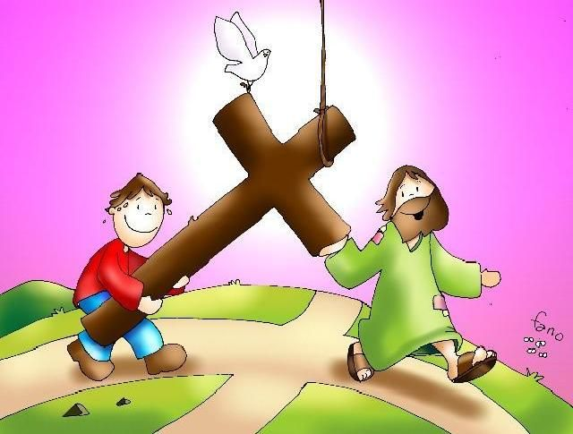
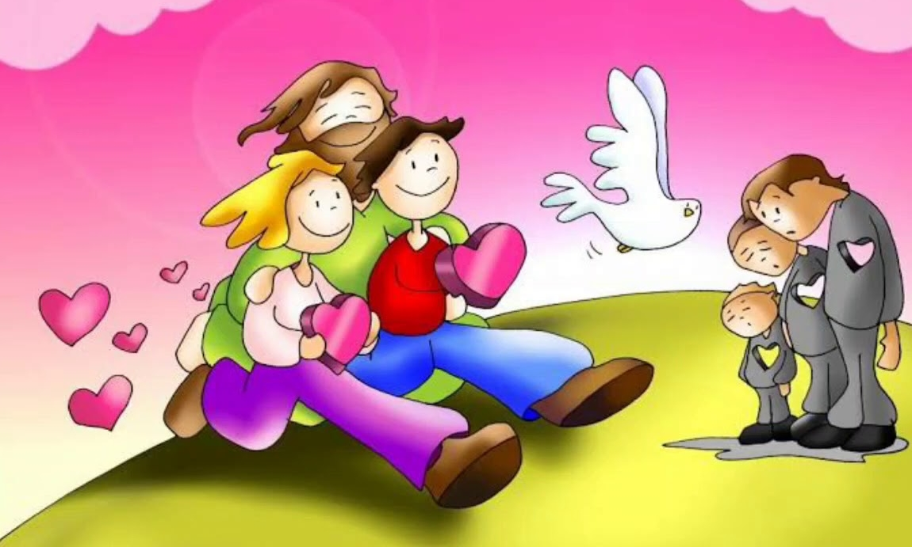
Jesus wants to teach the apostles that it is not always easy to be a follower of Jesus, but He promises to help them and to give them happiness that never ends in the Kingdom of God.
On the other hand, those that refuse to follow Jesus, will be poor, hungry, and sad for all eternity.

Slide 15
ACTIVITY

Slide 16
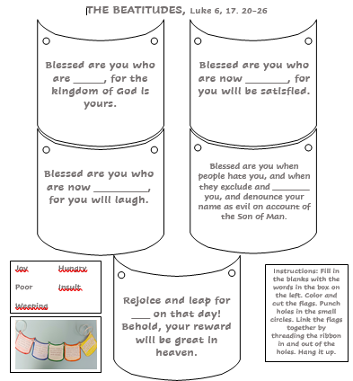
poor
hungry
weeping
insult
Joy Hungry
Poor Insult
Hungry
joy

Slide 17
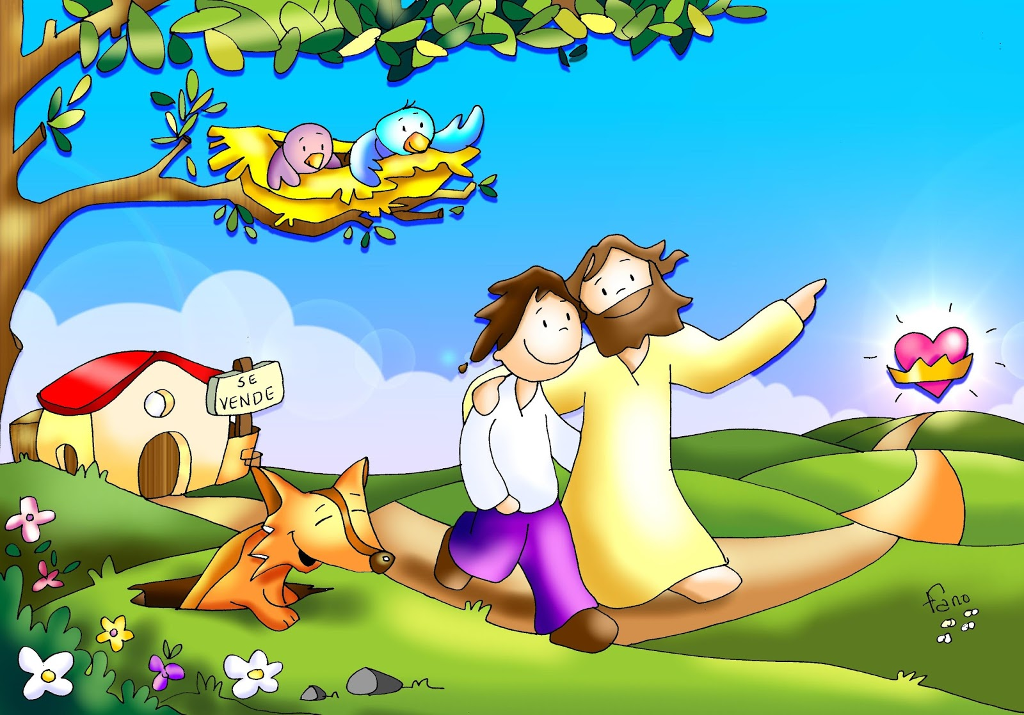
PRAYER
Lord, Jesus, place the desire of Your Kingdom in my heart so I may follow you always, in good and in difficult times. Do not allow that thing of this world separate me from you. Amen

Slide 18
I Have Decided, CJ and Friends, https://youtu.be/G_fZfiuONi0

