Slide 1
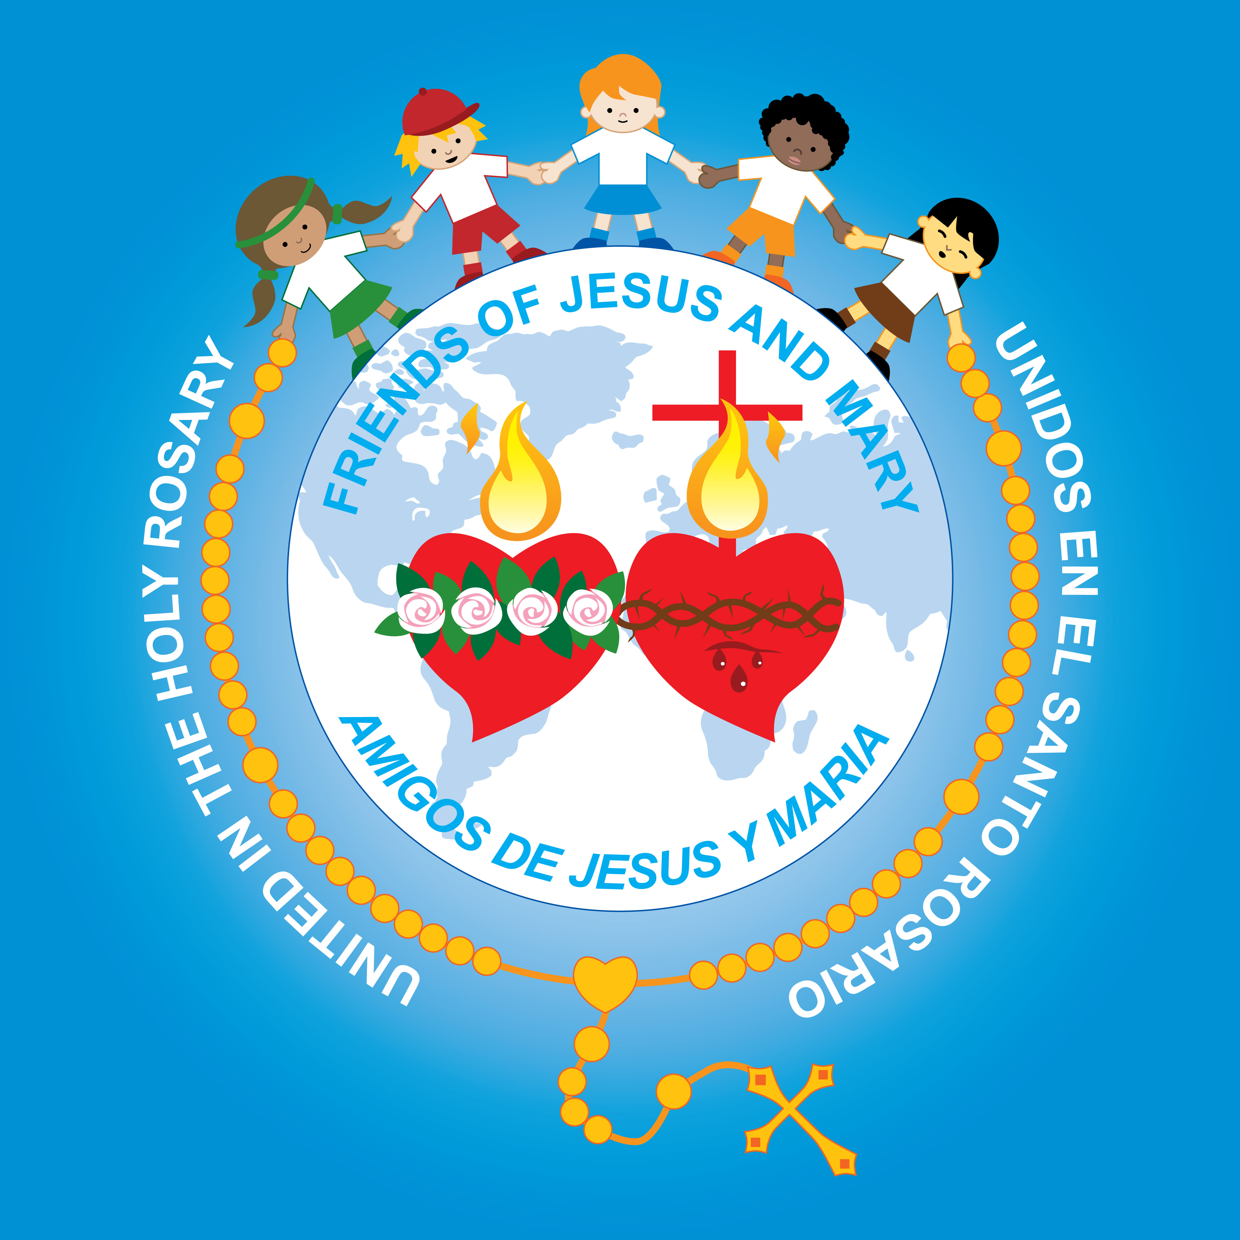
Ministry Friends of Jesus and Mary
Cycle C
VII Sunday of Easter
John 17, 20-26
and the Ascension of Jesus
www.fcpeace.org

Slide 2
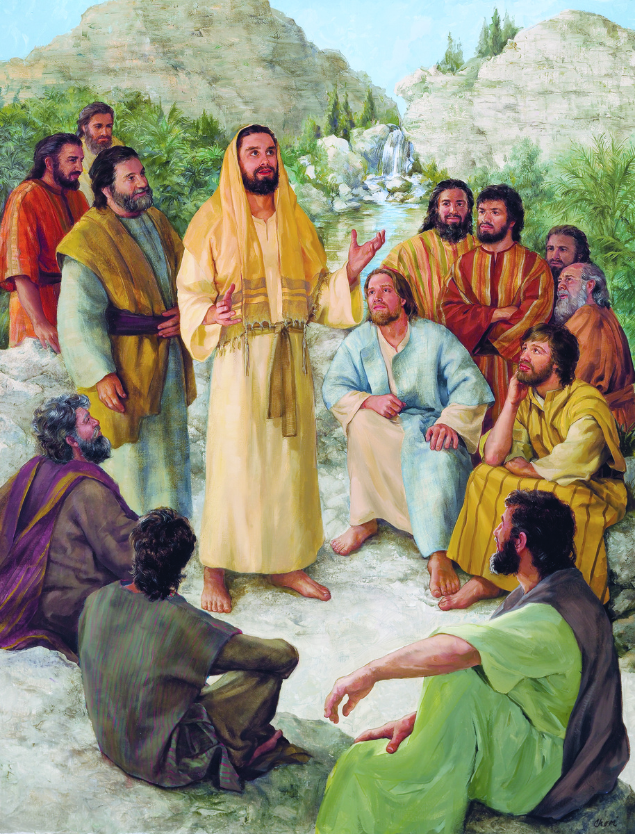
Jesus Prays for the Apostles
John 17,20-26
Lifting up his eyes to heaven, Jesus prayed saying: "Holy Father, I pray not only for them, but also for those who will believe in me through their word, so that they may all be one, as you, Father, are in me and I in you, that they also may be in us, that the world may believe that you sent me.

Slide 3
Jesus Prays for the Apostles
John 17,20-26
And I have given them the glory you gave me, so that they may be one, as we are one, I in them and you in me, that they may be brought to perfection as one, that the world may know that you sent me, and that you loved them even as you loved me.

Slide 4
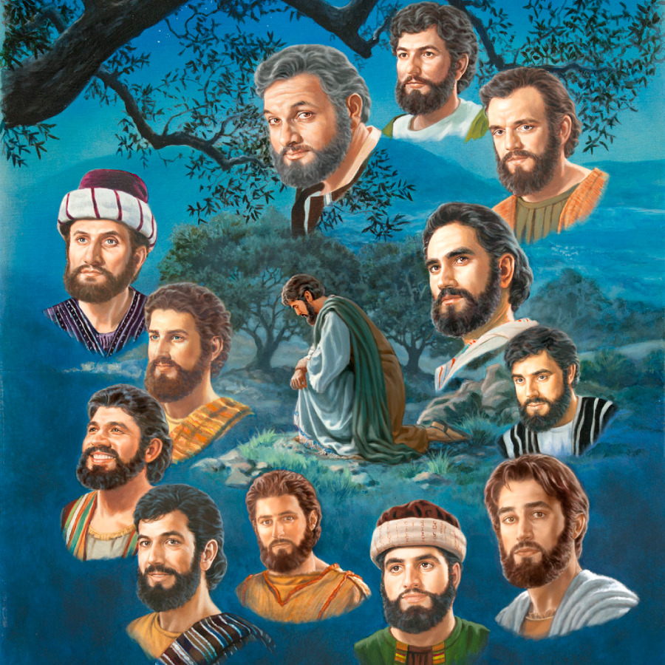
Jesus Prays for the Apostles
John 17,20-26
“Father, they are your gift to me. I wish that where I am, they also may be with me, that they may see my glory that you gave me, because you loved me before the foundation of the world. Righteous Father, the world also does not know you, but I know you, and they know that you sent me. I made known to them your name and I will make it known, that the love with which you loved me may be in them and I in them."
The Gospel of the Lord,
Praise to you Lord Jesus Christ.

Slide 5
The Ascension-Cycle C-Catholic Kids Media- https://youtu.be/VGDWsV3CUfY

Slide 6
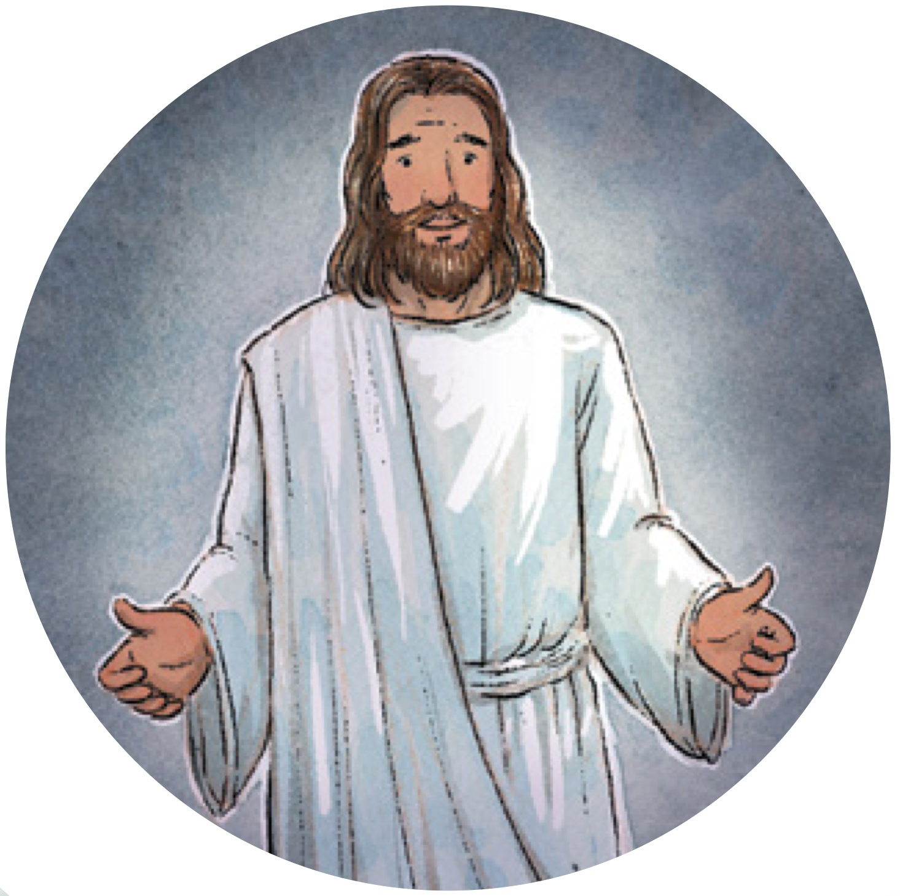
REFLECTION

Slide 7
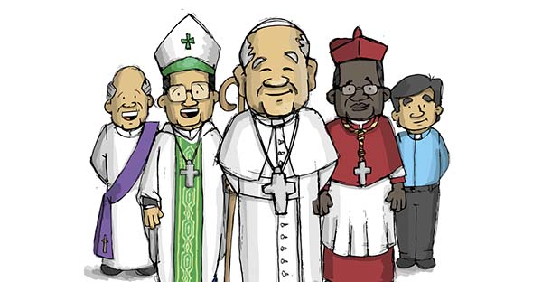
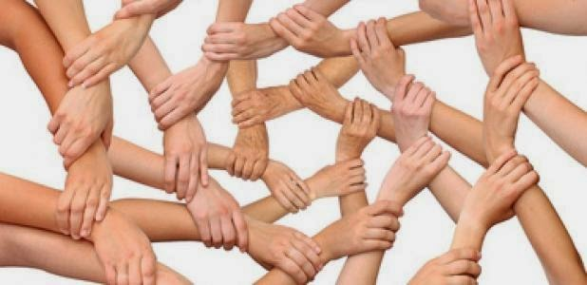
Jesus prays for his apostles who will be pastors of His people. Who continues the work of the apostles?
The Pope, the bishops, and the priests
In prayer, what does Jesus ask of God?
…that the apostles may be in unity with God and with each other

Slide 8
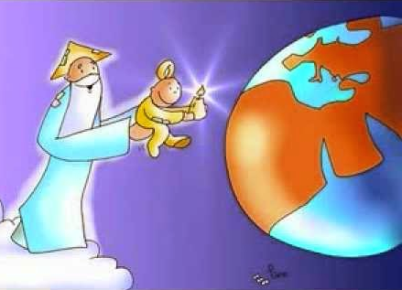
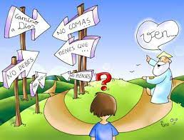
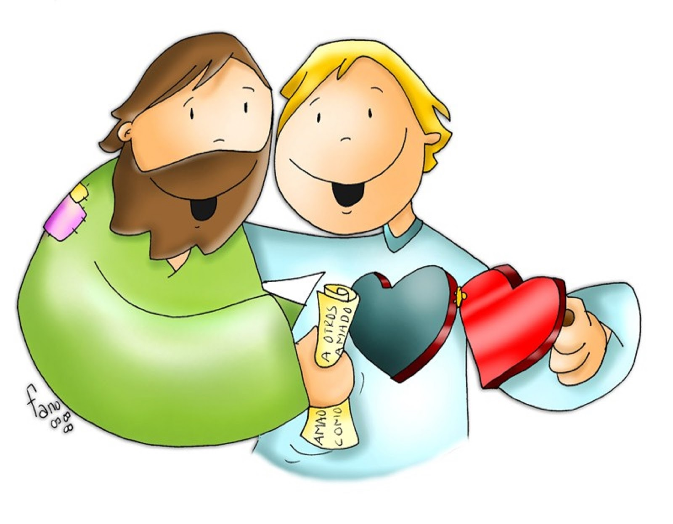
Why does Jesus say that unity is important?
So the world may believe that God sent Him.
When we are in union with God, how do we behave?
obedience,
With Love,
peace,
and joy.

Slide 9
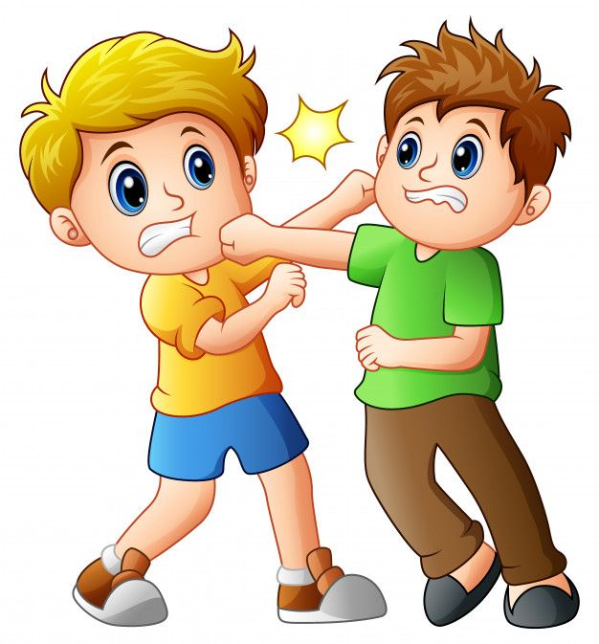
When we are apart from God, how do we behave?
…With fights, anger, and disagreements…

Slide 10
If we are fighting and angry, will people believe that Jesus is in our heart?
share

Slide 11
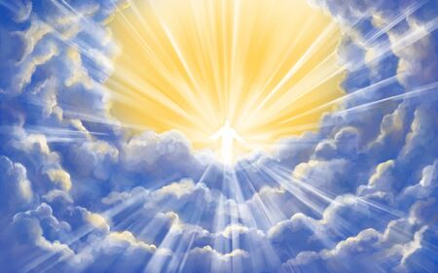
Jesus wants us to be in union with God so we may be with Him in Heaven. Why?
So we may see His Glory in Heaven
Jesus promises that those who know God, His love and He Himself will stay in them. How will He stay in them?
The Holy Spirit enters our heart and gives us peace and love to share with others.

Slide 12
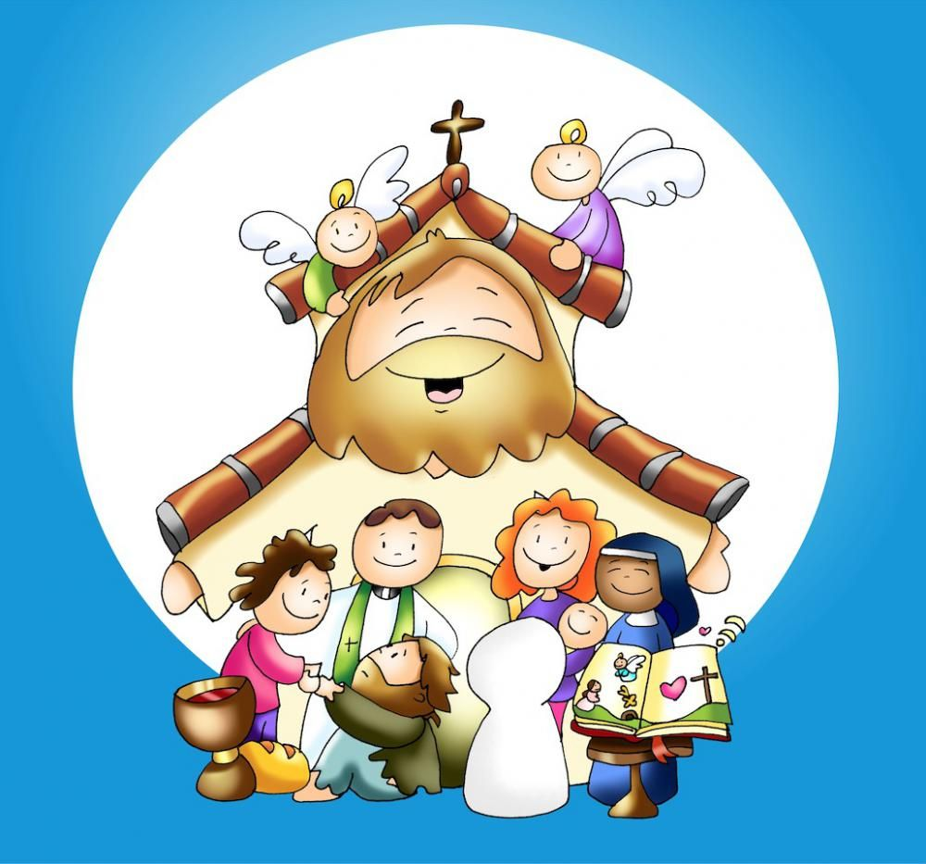
Jesus wants everyone to know and believe in Him; together we can help in His mission.
How can you help Jesus in His mission?
Going to mass; loving and praying for the Church; volunteering in Church by teaching the faith, helping those in needs, assisting in Mass…

Slide 13
activity

Slide 15
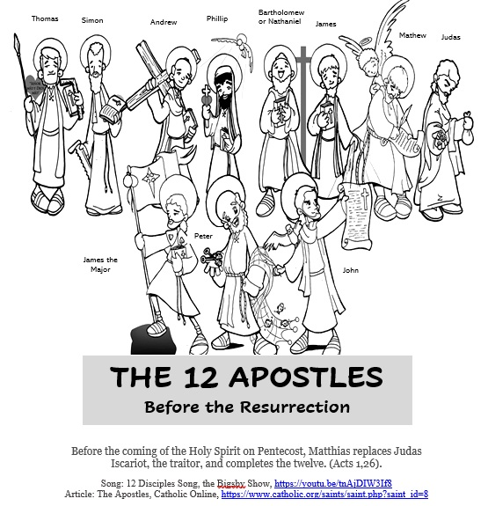
Color and sing the twelve Disciples song.

Slide 16
Song: 12 Disciples Song, the Bigsby Show, https://youtu.be/tnAjDIW3If8

Slide 18
Who is the Priest? Think Priest, https://youtu.be/i-9RoR6IRdg

Slide 19
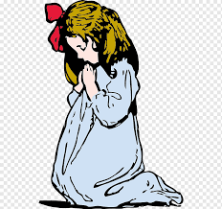
Prayer
Lord, we thank you for Pope Francis, our bishops, and our priests. We pray that they will always be in union with You and with the Holy Church giving testimony of God’s love for His people. Please send us many Holy priests. Help us to also stay in union with you so we may give testimony of your presence in the world.
Amen.

