Slide 1
Friends of Jesus and Mary
Love Your Enemies
Luke 6, 27-38

Slide 2
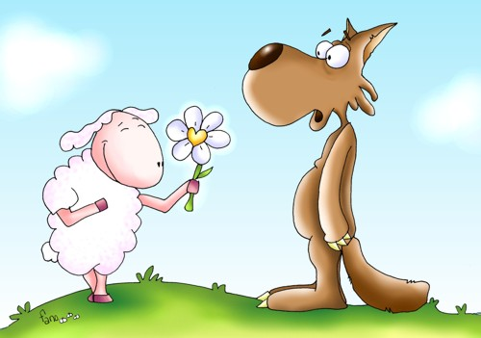
Love your enemies.
Luke 6, 27-38
Jesus said to his disciples: “To you who hear I say, love your enemies, do good to those who hate you, bless those who curse you, pray for those who mistreat you. To the person who strikes you on one cheek, offer the other one as well, and from the person who takes your cloak, do not withhold even your tunic. Give to everyone who asks of you, and from the one who takes what is yours do not demand it back.

Slide 3
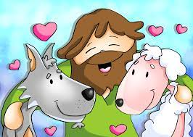
Do to others as you would have them do to you. For if you love those who love you, what credit is that to you? Even sinners love those who love them. And if you do good to those who do good to you, what credit is that to you? Even sinners do the same. If you lend money to those from whom you expect repayment, what credit is that to you? Even sinners lend to sinners, and get back the same amount.

Slide 4
But rather, love your enemies and do good to them, and lend expecting nothing back; then your reward will be great and you will be children of the Most High, for he himself is kind to the ungrateful and the wicked. Be merciful, just as your Father is merciful. “Stop judging and you will not be judged. Stop condemning and you will not be condemned. Forgive and you will be forgiven. Give, and gifts will be given to you; a good measure, packed together, shaken down, and overflowing, will be poured into your lap. For the measure with which you measure will in return be measured out to you.”
The measure of love is to love without measure.
BUILD
O
E
L
V
The Gospel of the Lord, Praise to You Lord Jesus Christ.

Slide 5
REFLECTION

Slide 6
Who do you love most in the world?

Slide 7
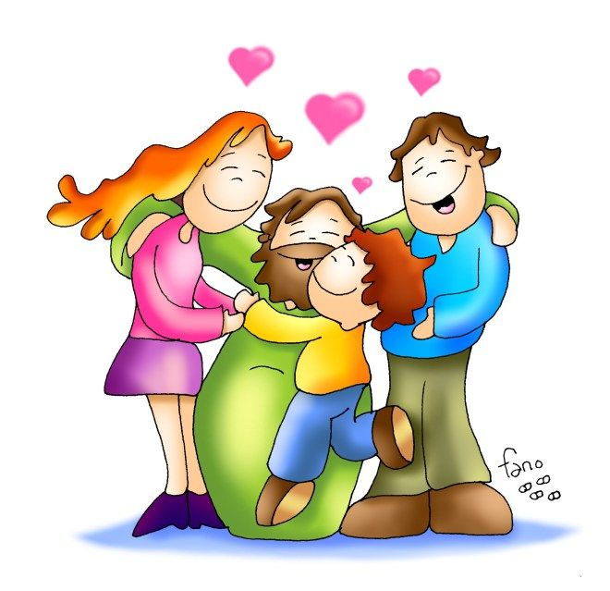
Mother, Father, Brothers, Sisters…

Slide 8
Who do you find most difficult to love and why?

Slide 9
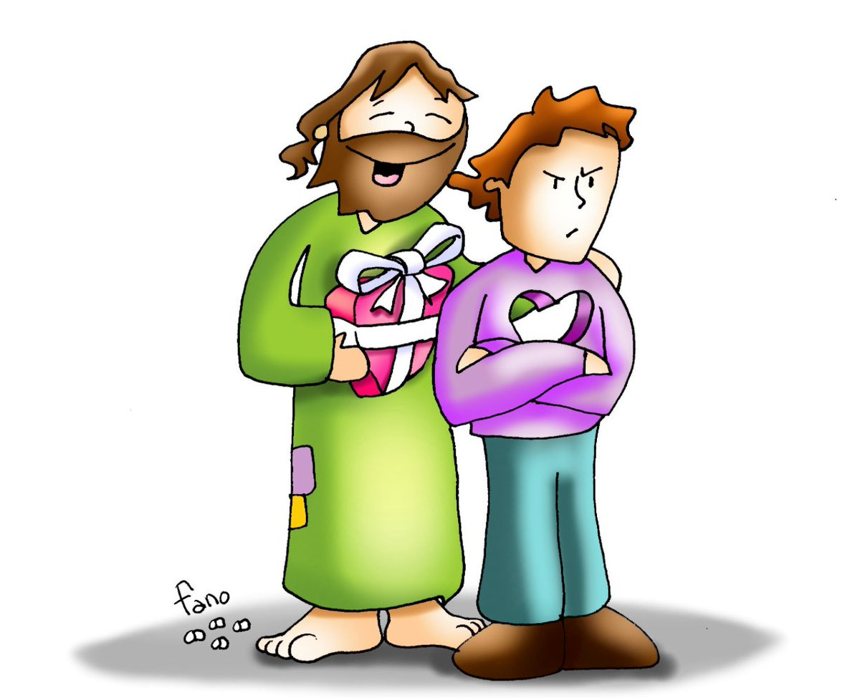

Slide 10
In this Gospel, Jesus wants to teach us to love like our Father in Heaven loves us.
Jesus asks us to love our enemies, and to pray for those who mistreat us.
Is this easy?
Share

Slide 11
What other difficult things does Jesus ask of us?
Do good to those who hate you
Bless those who curse you
To the person who strikes you on one cheek, offer the other one as well
From the person who takes your cloak, do not withhold even your tunic
Give to everyone who asks of you,
From the one who takes what is yours do not demand it back
Lend without expecting anything in return
Do not judge or condemn; Forgive

Slide 12
Did Jesus love His enemies, pray for those who mistreated Him, give without expecting in return…?
Give examples.

Slide 13
Up to what point did Jesus show us how much He loves us?

Slide 14
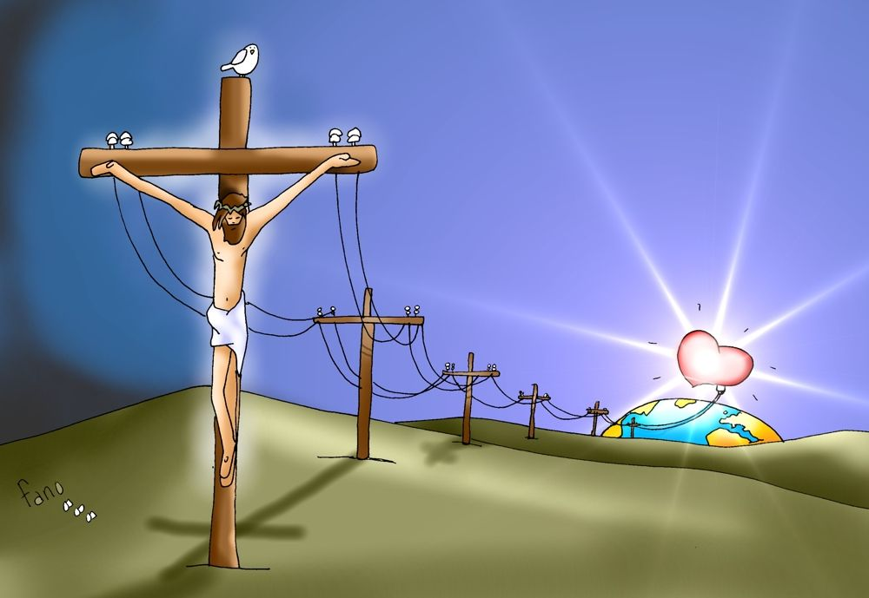
Jesus loved us so much, He even died on the cross to pay for our sins so we may enter Heaven.

Slide 15
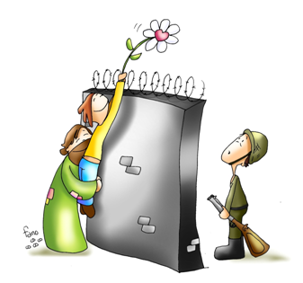
If we want to be another Jesus on earth to make the world a better place, we must try to act as Jesus asks us, as He acted. Then we witness Jesus’ love and possibly make some friends of our enemies. We can then be extraordinary like Jesus.
What can you do to love better?

Slide 16
ACTIVITIES

Slide 17
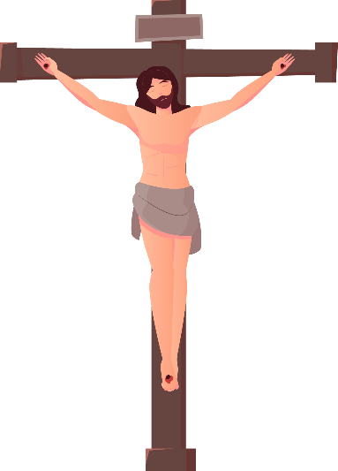
Help the Roman soldier reach Jesus.
Finish
Start

Slide 18
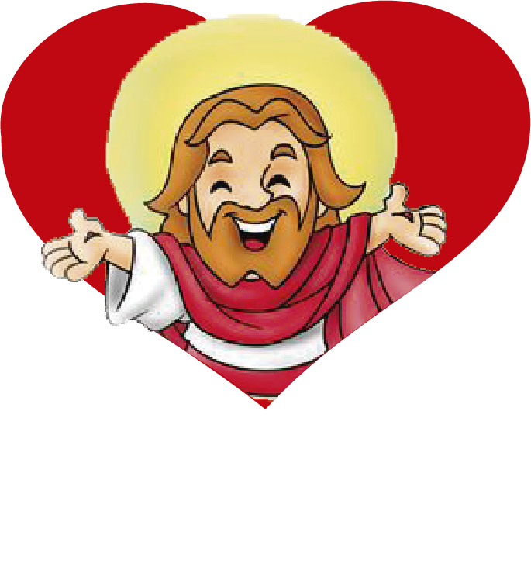
Be children
Love your Enemies
Bless those who curse you.
Do not judge or condemn. FORGIVE
Pray for those who mistreat you.
Do Good to those who hate you.
What does Jesus ask of us so we can be extraordinary and children of the Most High?
Lend expecting nothing back.
Of the Most High

Slide 19
PRAYER
Lord, I want to love as You love. Fill my heart with Your Grace so I may do what appears impossible to me, to love and forgive my enemies. Help me to be extraordinary and be a witness of your great Love.
Amen

Slide 20
Love One Another, Dakota, Pyle, (3-6yrs) https://youtu.be/LYlkcoAfLU4

Slide 21
Give it Away, Lifetree Kids https://youtu.be/ywCiDhbD-Js (7+years)

