Slide 1
Friends of Jesus and Mary
www.fcpeace.org
Solemnity of Pentecost
John 15,26-27; 16,12-15

Slide 2
Solemnity of Pentecost
Gospel: John 15,26-27; 16,12-15
Jesus said to his disciples, “When the Advocate comes whom I will send you from the Father, the Spirit of truth that proceeds from the Father, he will testify to me. And you also testify, because you have been with me from the beginning.
I have much more to tell you, but you cannot bear it now.

Slide 3
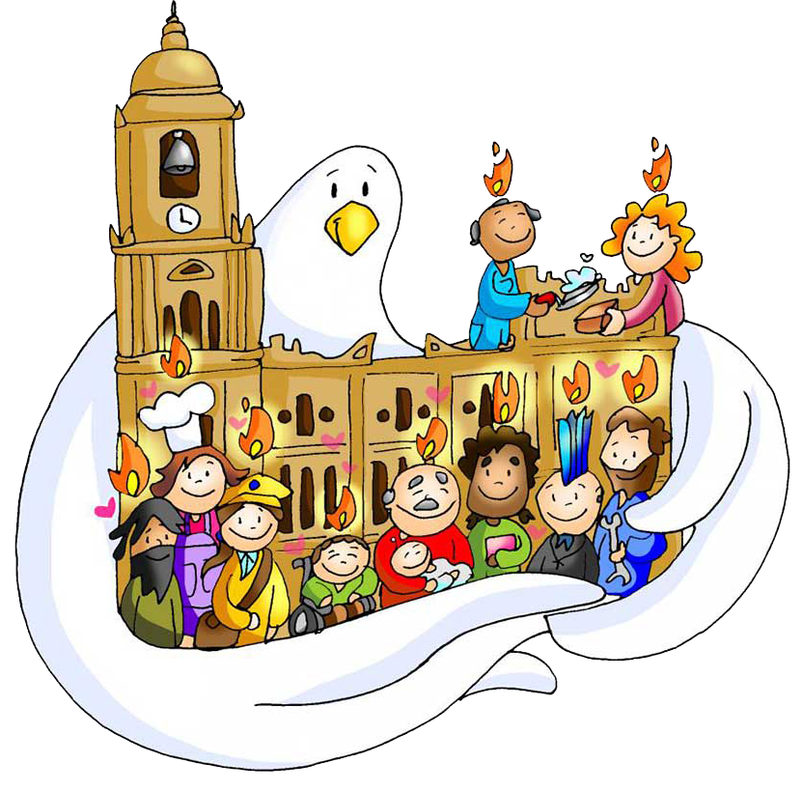
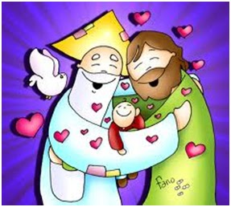
But when he comes, the Spirit of truth, he will guide you to all truth. He will not speak on his own, but he will speak what he hears, and will declare to you the things that are coming.
He will glorify me, because he will take from what is mine and declare it to you. Everything that the Father has is mine; for this reason I told you that he will take from what is mine and declare it to you.”
The Gospel of the Lord, Praise to You Lord Jesus Christ.

Slide 4
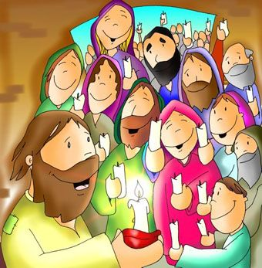
First Reading: Acts 2, 1-11
When the time for Pentecost was fulfilled, they were all in one place together. And suddenly there came from the sky a noise like a strong driving wind, and it filled the entire house in which they were.

Slide 5
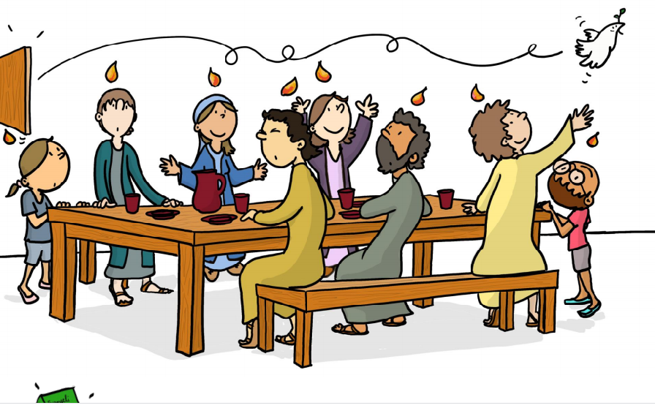
Then there appeared to them tongues as of fire, which parted and came to rest on each one of them. And they were all filled with the Holy Spirit and began to speak in different tongues, as the Spirit enabled them to proclaim.

Slide 6
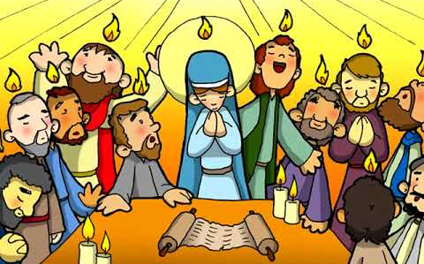
Now there were devout Jews from every nation under heaven staying in Jerusalem. At this sound, they gathered in a large crowd, but they were confused because each one heard them speaking in his own language.

Slide 7
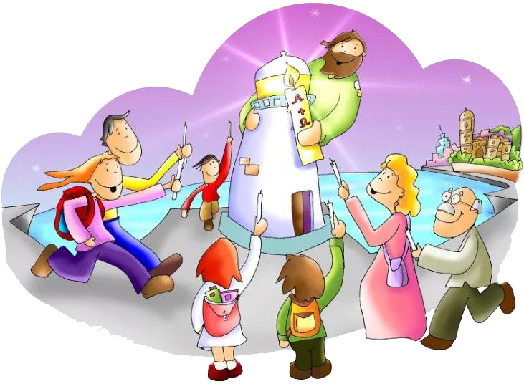
They were astounded, and in amazement they asked, “Are not all these people who are speaking Galileans? Then how does each of us hear them in his native language? We are Parthians, Medes, and Elamites, inhabitants of Mesopotamia, Judea and Cappadocia, Pontus and Asia, Phrygia and Pamphylia, Egypt and the districts of Libya near Cyrene, as well as travelers from Rome, both Jews and converts to Judaism, Cretans and Arabs, yet we hear them speaking in our own tongues of the mighty acts of God.”
The Word of the Lord, Thanks be to God.

Slide 8
REFLECTION

Slide 9
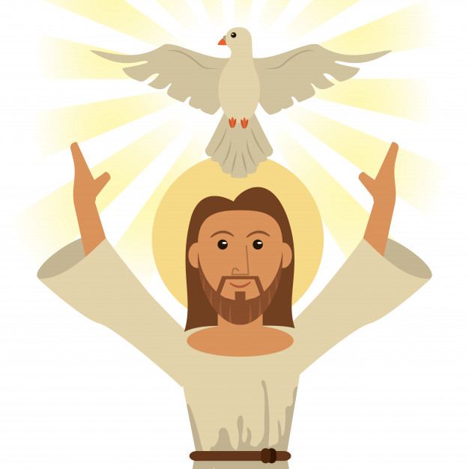
Jesus announces that He will be sending the Holy Spirit.
What other names does He call the Holy Spirit?

Slide 10
The Advocate
and
The Spirit of Truth

Slide 11
What does Jesus say the
Holy Spirit will do when He arrives?

Slide 12
Give testimony to Jesus
Guide the disciples to all truth
Declare the things that are coming
Give glory to Jesus by communicating everything Jesus tells Him

Slide 13
Ten days after Jesus ascends to Heaven, the disciples were gathered in a room, hiding from those persecuting them.
What happened?

Slide 14
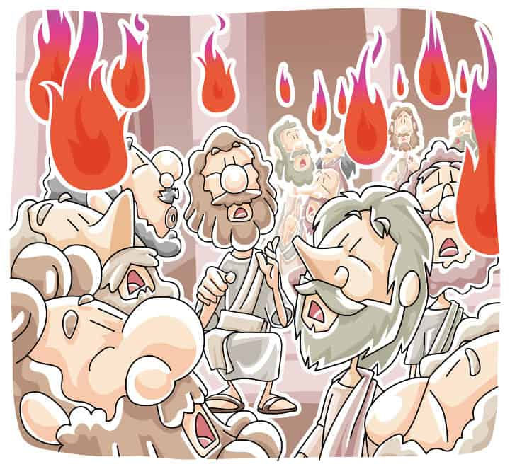
They heard a great noise like a strong wind;
Flames of fire appeared above each of them;
They were filled with the Holy Spirit and spoke in different languages so all in Jerusalem could understand the marvels of God.
Chao
Shalom
Hello
Hola
Bonjour

Slide 15
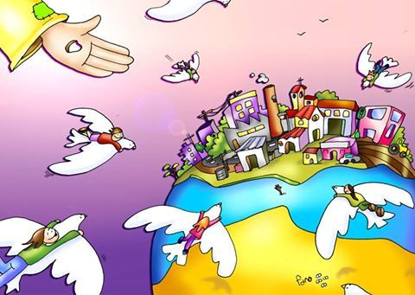
Jesus sends the Holy Spirit that disperses all fear and converts the disciples in proclaimers of the Resurrection of Jesus.
Each one of us receives different gifts and talents, but we are all called to serve God.
What gifts and talents can you put in the service of God?

Slide 16
ACTIVITIES

Slide 17
The Holy Spirit leaves us spiritual gifts in our hearts. Let us pray for these gifts.
Come Holy Spirit
Give me
FEAR OF GOD
so, I may never hurt you with my words or actions.
Come Holy Spirit
Give me
PIETY
so that God may always be first in my life.
Come Holy Spirit
Help me to live with FORTITUDE
and say the truth today.
Come Holy Spirit
Give me
COUNSEL
which I need to recognize right from wrong.
Come Holy Spirit
Give me
WISDOM
which I need to see my family and friends through your eyes.
Come Holy Spirit
Give me
UNDERSTANDING
of the wonderful gift of faith I have.
Come Holy Spirit
Give me
KNOWLEDGE
to better know how to do your will.

Slide 18
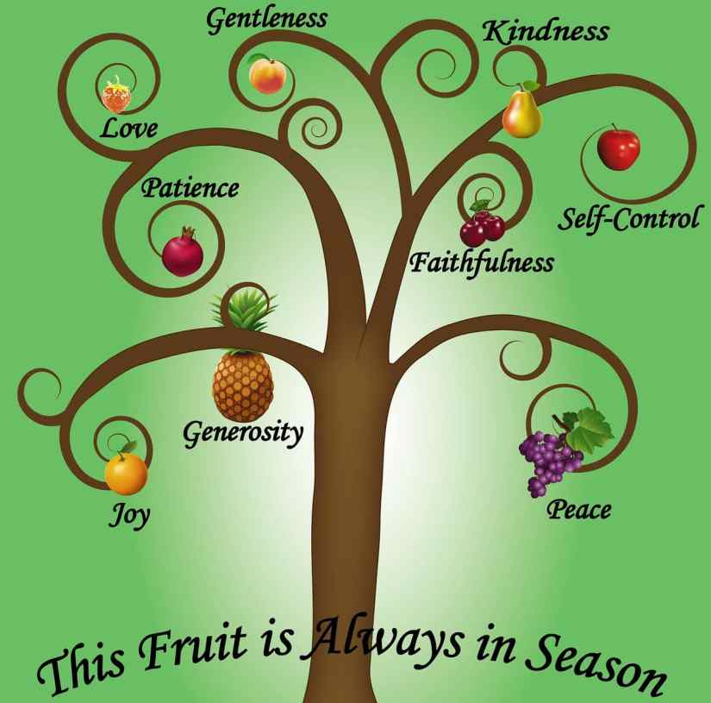
When we have the Holy Spirit in our Heart, we give good fruit; Holy Spirit, give us good fruits.
PRAYER TO THE HOLY SPIRIT
Come, Holy Spirit
Illuminate our hearts and fill them with the fire of your Love. Amen

Slide 19
The symbols of the Holy Spirit help us to know the Holy Spirit better.
WIND
Pushes to action
DOVE
Reflects peace and purity
WATER
Cleans and gives life
FIRE
Purifies, warms and gives light

Slide 20
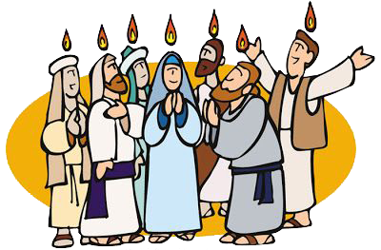
RESURRECTED JESUS SENDS US THE HOLY SPIRIT.
Acts 2, 1-11
THE SYMBOLS OF THE HOLY SPIRIT
_ O _ E
_ I _ E
_ A _ E _
_ _ N _
D
V
F
R
W
T
R
W
I
D

Slide 21
Gift or Fruit of the Holy Spirit?
Draw a gift or a fruit in front of the word.
Love
Peace
Counsel
Piety
Knowledge
Understanding
Fear of God
Wisdom
Kindness
Faithfulness
Patience
Gentleness
Joy
Courage

Slide 22
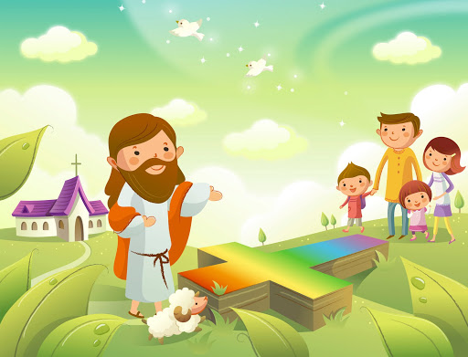
PRAYER
Send your Holy Spirit ,Lord, which brings us peace and courage to face our problems. Give us the fruits of goodness, generosity, joy, peace, and patience, that we can share with our family and our group spreading harmony and the desire to serve others.
Amen.

Slide 23
Holy Spirit for Children, Ayi, (Ctrl Click) https://youtu.be/T4eW2HvizuI

Slide 24
Fruit of the Spirit, Kidspring, (Ctrl Click) https://youtu.be/xWoWDdeD-ns

