Slide 1
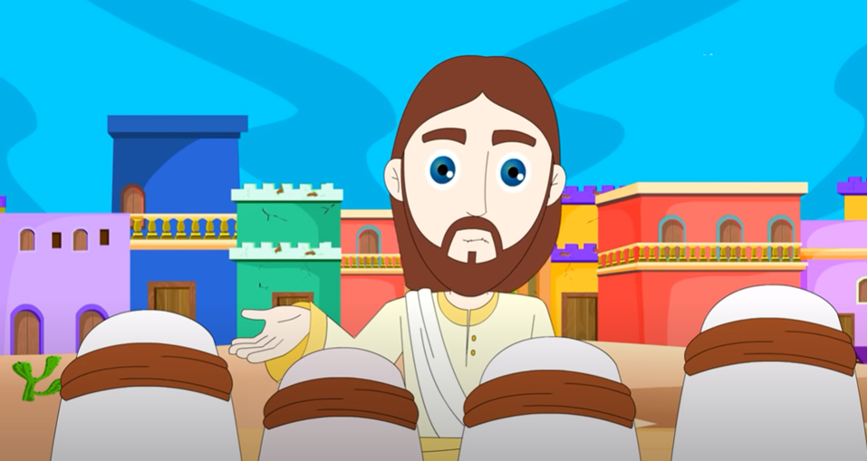
VIII Ordinary Time – Cycle C Can a blind person lead a blind person? (Luke 6, 39-45)
Friends of Jesus and Mary

Slide 2
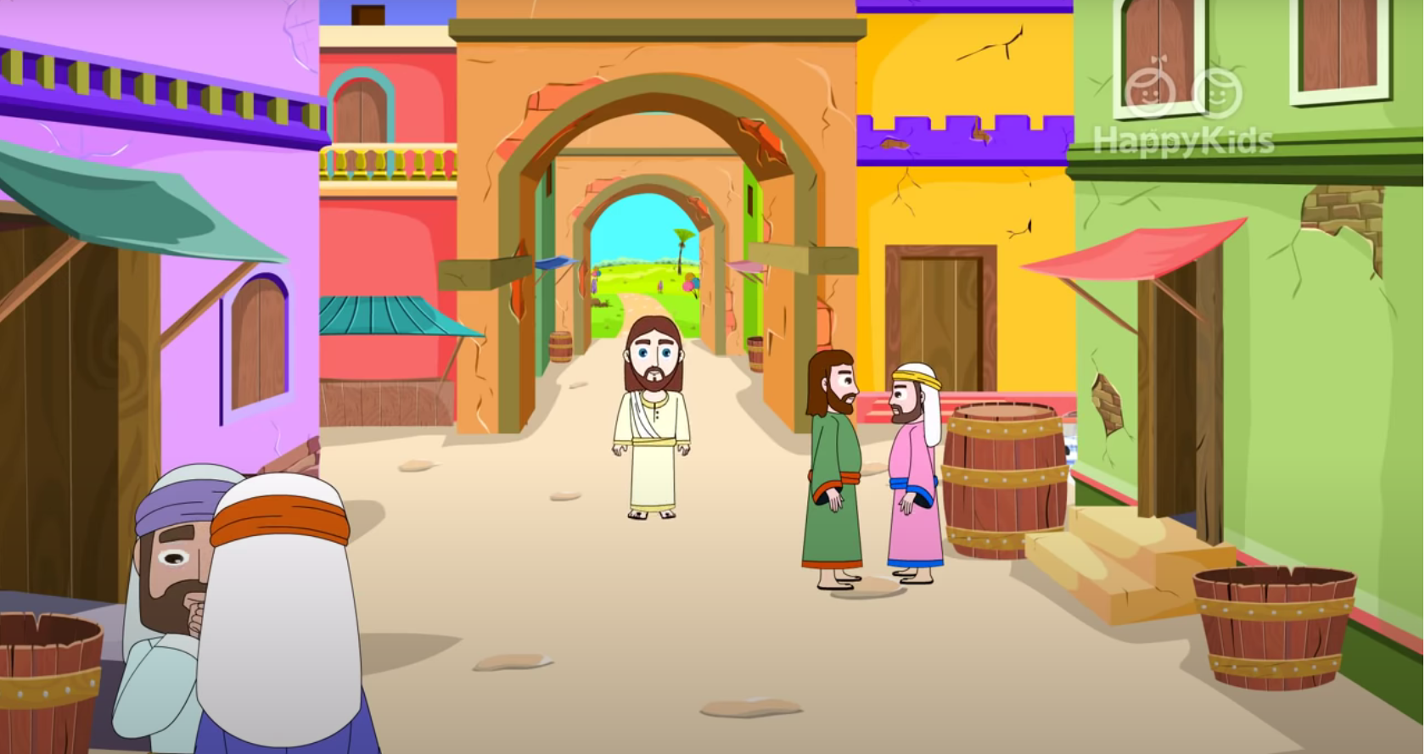
Gospel of Luke 6: 39-45
“Can a blind person lead a blind person?”

Slide 3
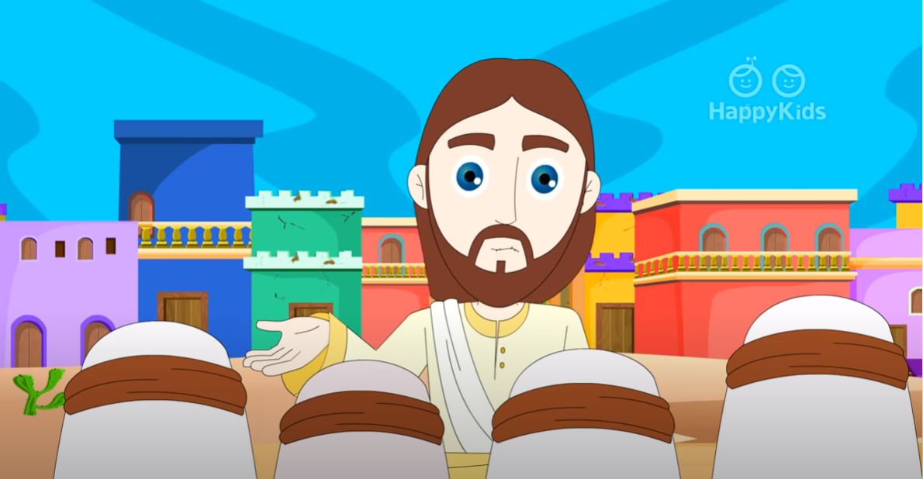
Jesus told his disciples a parable (a story with a teaching)…

Slide 4
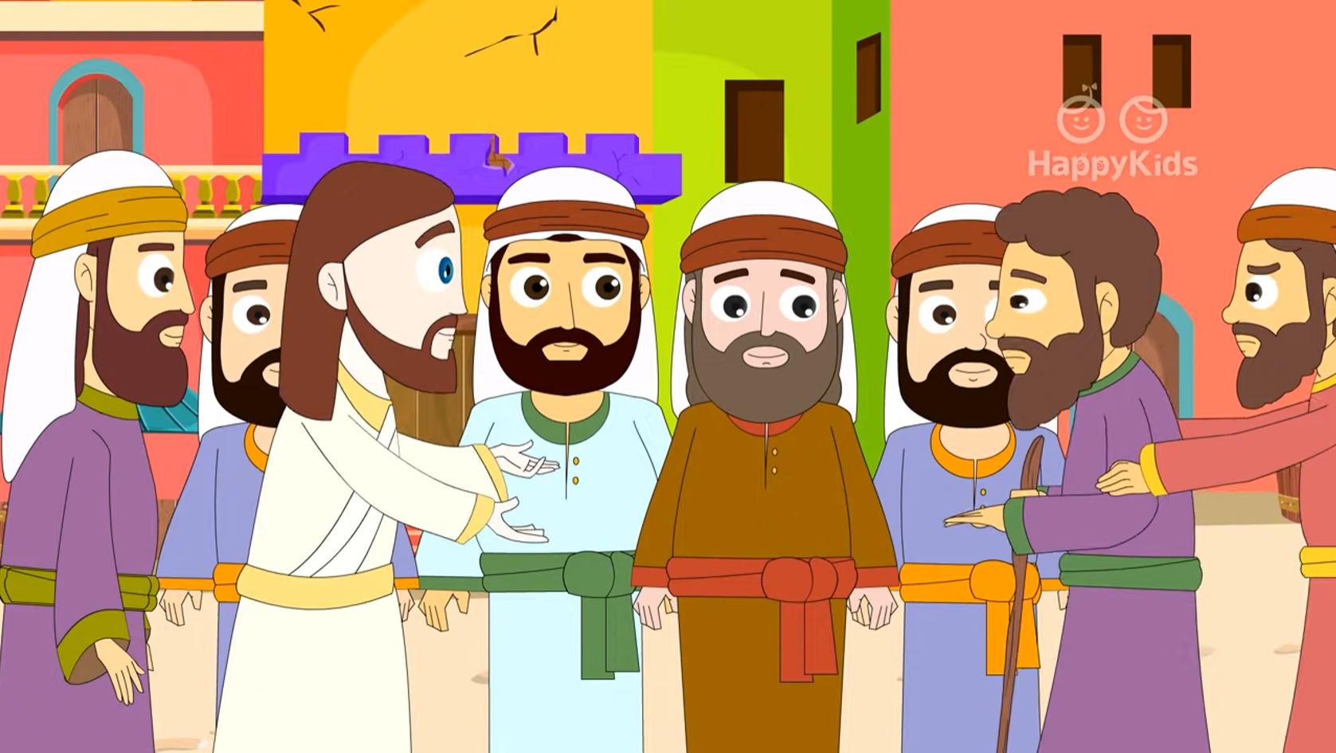
Can a blind person guide a blind person? Will not both fall into a pit?

Slide 5
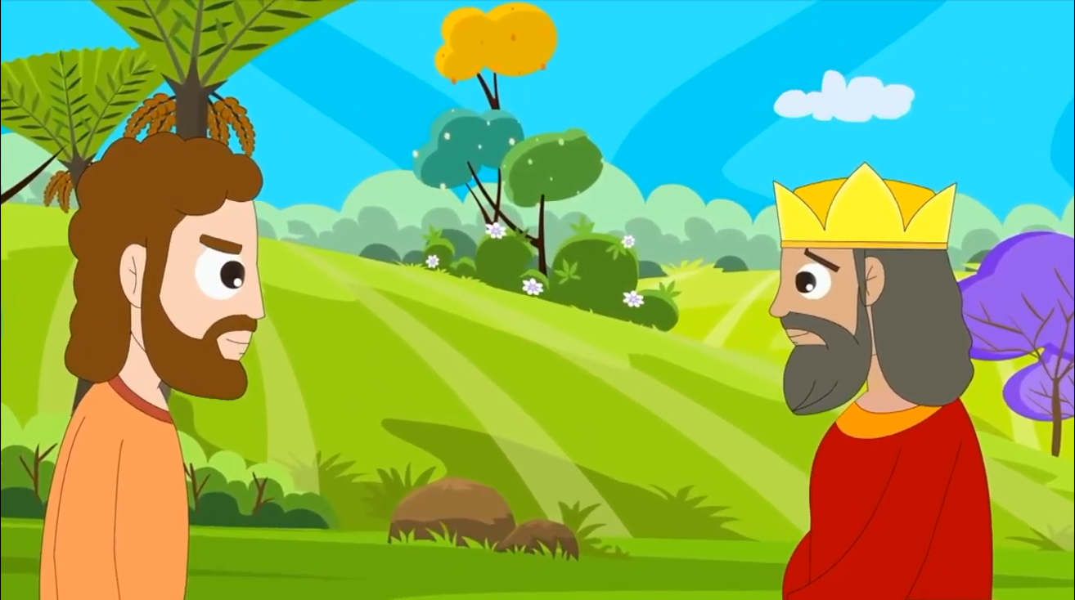
No disciple is superior to the teacher; but when fully trained, every disciple will be like his teacher.

Slide 6
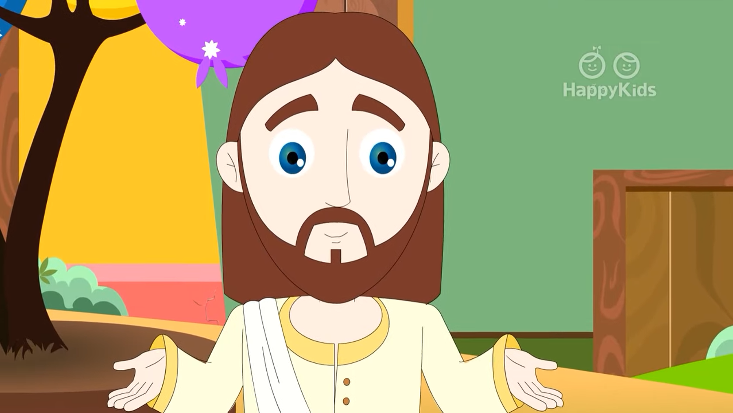
Why do you notice the splinter in your brother's eye, but do not perceive the wooden beam in your own?

Slide 7
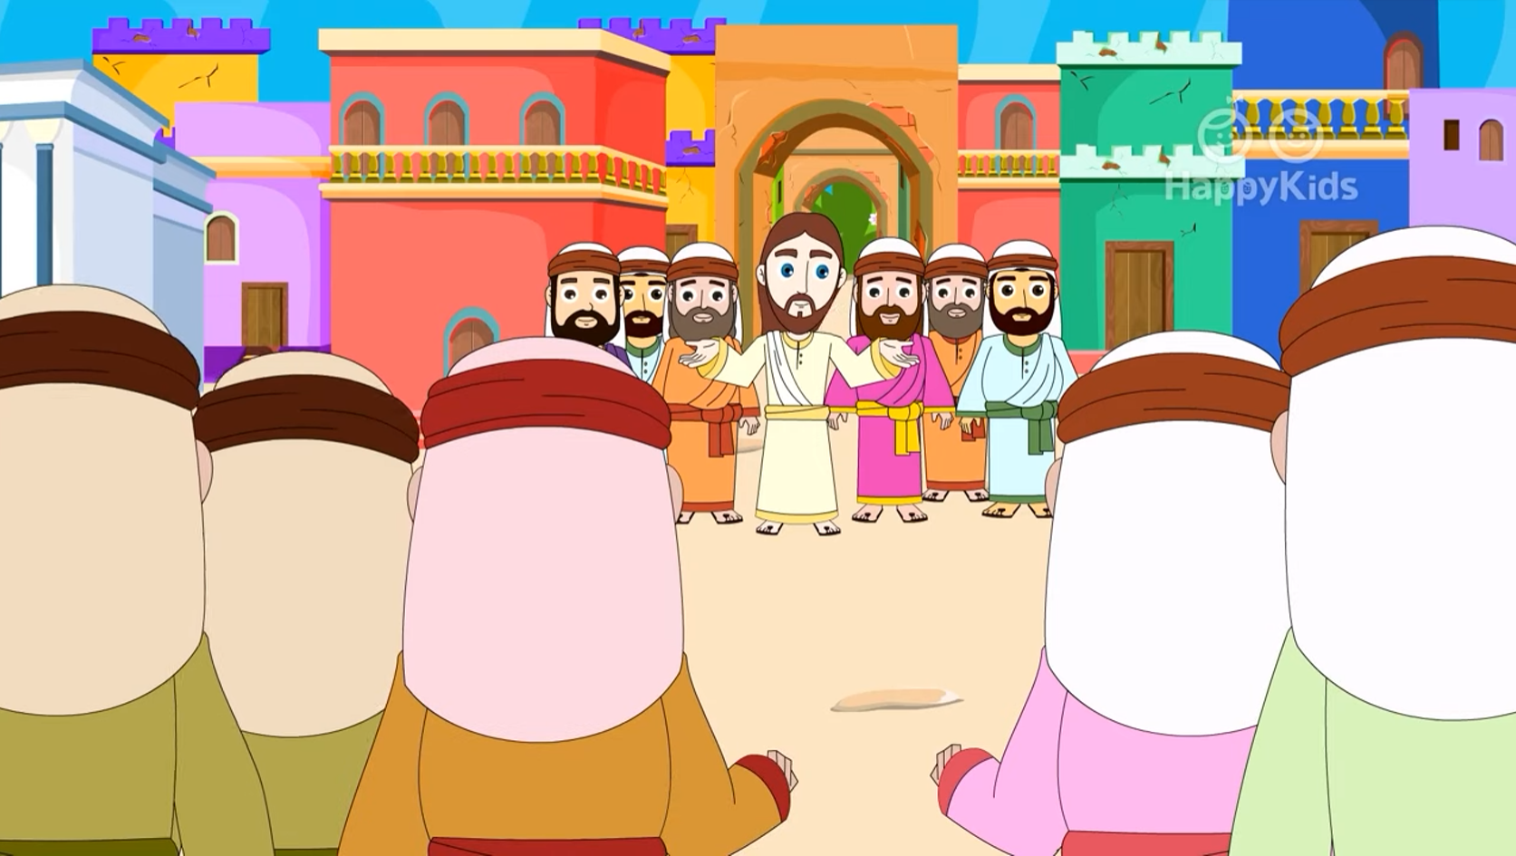
How can you say to your brother, 'Brother, let me remove that splinter in your eye,' when you do not even notice the wooden beam in your own eye?

Slide 8
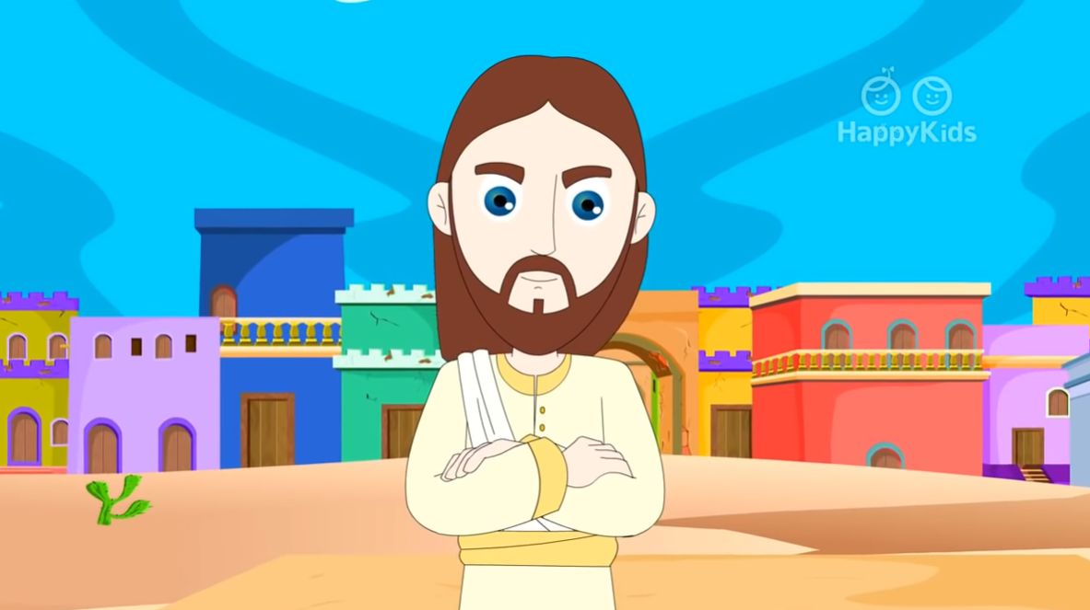
You hypocrite! Remove the wooden beam from your eye first; then you will see clearly to remove the splinter in your brother's eye.

Slide 9
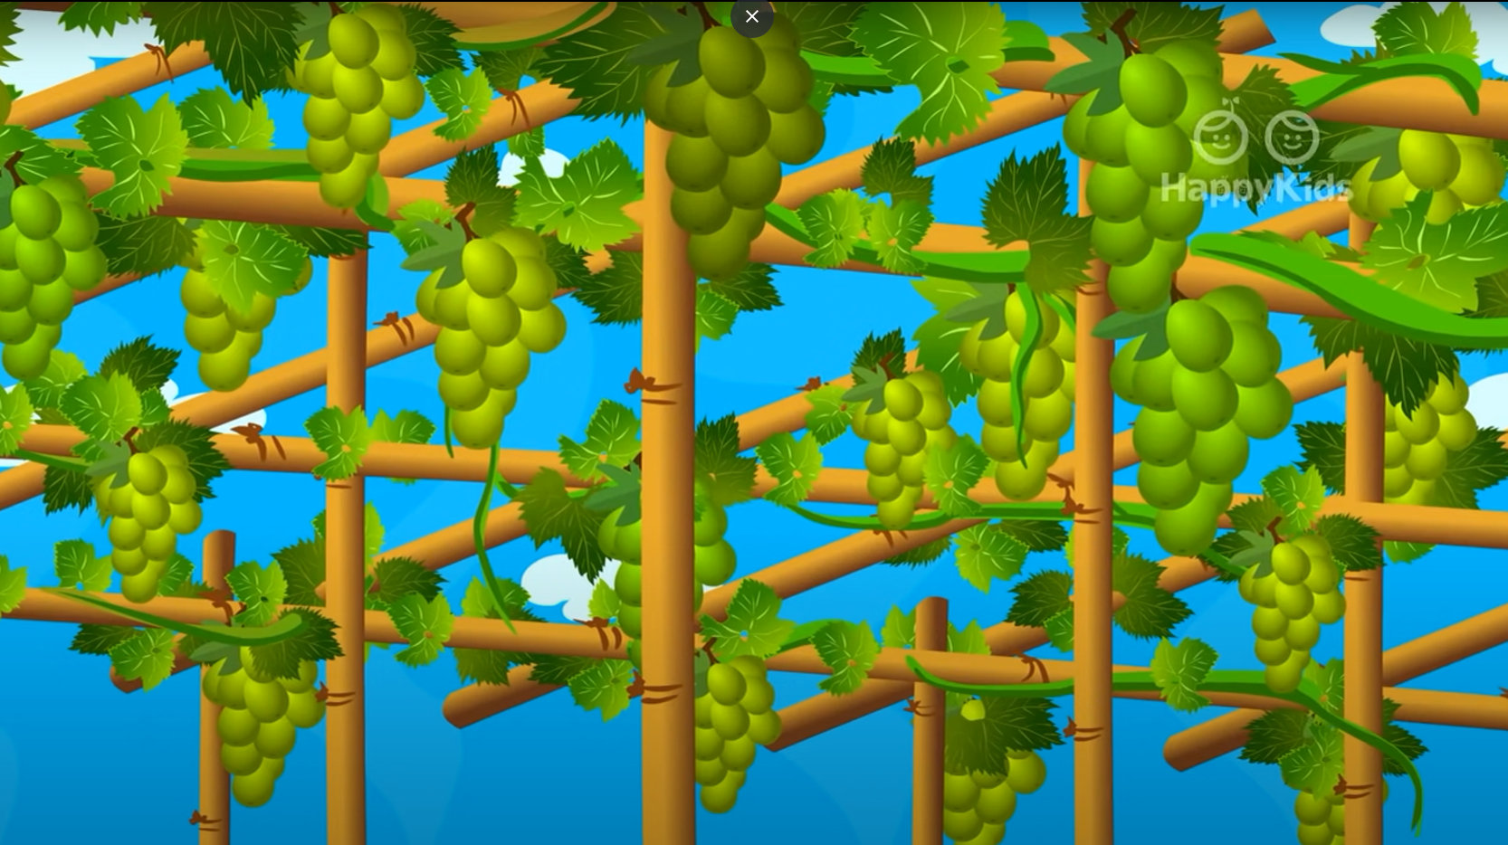
A good tree does not bear rotten fruit, nor does a rotten tree bear good fruit. For every tree is known by its own fruit.

Slide 10
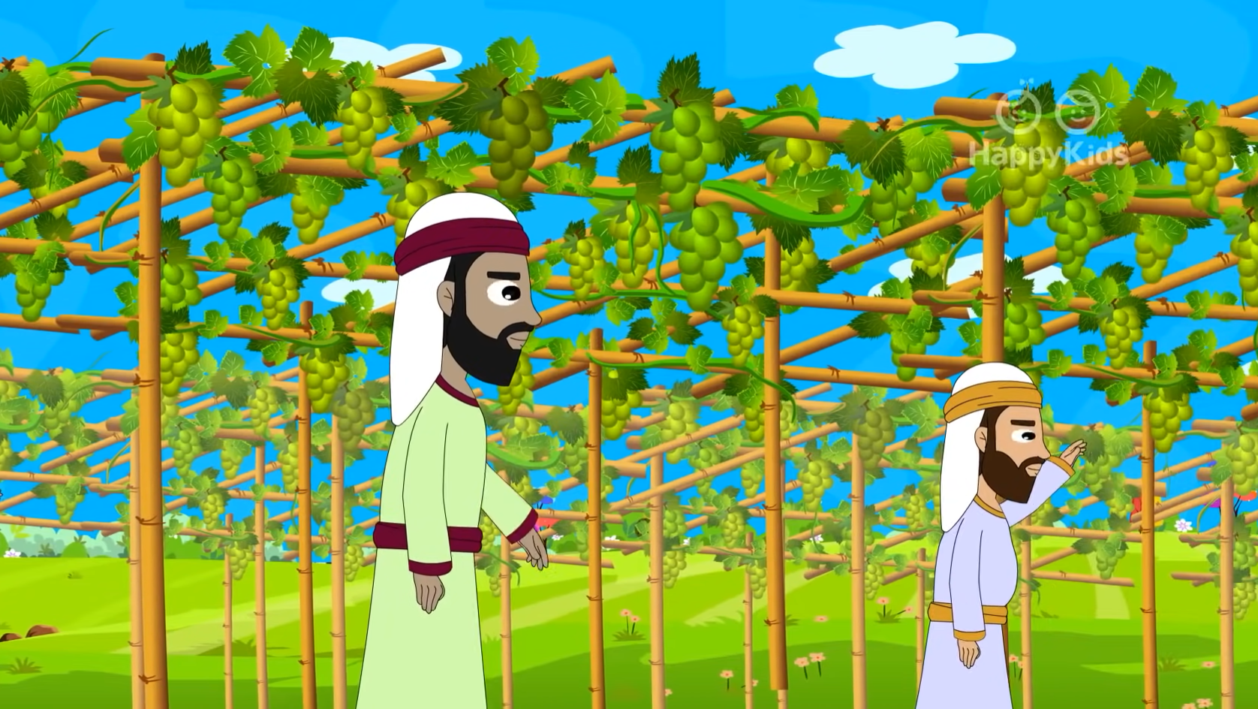
For people do not pick figs from thorn bushes, nor do they gather grapes from brambles.

Slide 11
A good person out of the store of goodness in his heart produces good, but an evil person out of a store of evil produces evil,

Slide 12
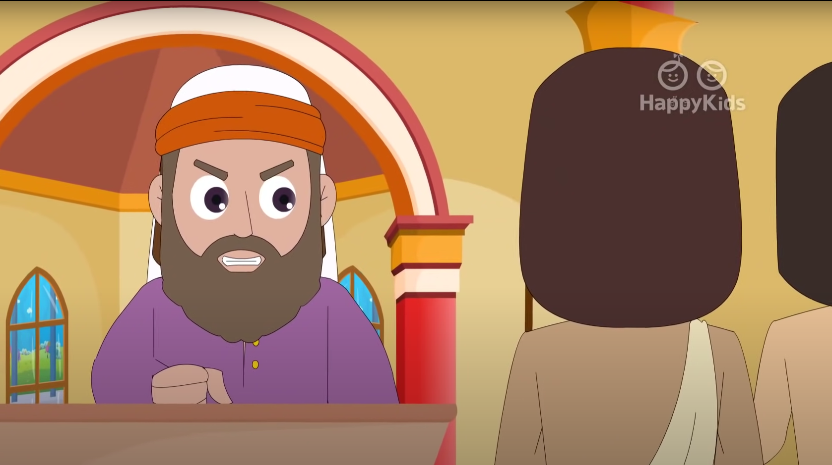
…for from the fullness of the heart the mouth speaks.
The Gospel of the Lord.
Praise to you Lord Jesus Christ.
PALABRA DEL SEÑOR. GLORIA A TI SEÑOR JESUS

Slide 13
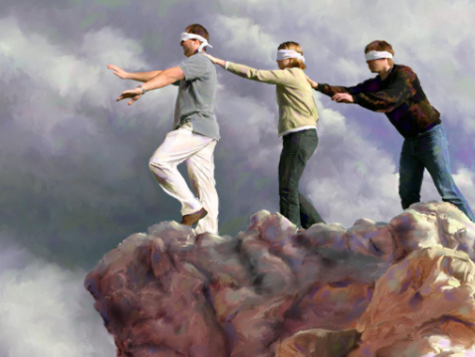
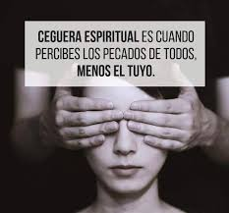
REFLECTION
Do you know what happens if a blind person leads a blind person?
They may fall, or
They may get lost.
SPIRITUAL BLINDNESS IS WHEN A PERSON PERCEIVES THE SINS OF OTHERS, AND NOT THEIR OWN.
Some people are blind of sight, but some are blind in spirit…
How do you think is a person who is blind in spirit?
Share.

Slide 14
REFLECTION
On several occasions, Jesus calls the Pharisees, the leaders of the Jewish religion, “blind guides”. They only cared about appearances, about seeing who complied with the law, and about the money they paid to the Temple. But they DIDN’T see the spirituality in others and they did not love God.
Do you think the Pharisees would be good church leaders?
No, they would not be able to bring souls to God; but would confuse them instead.
Jesus said, “when fully trained, every disciple will be like his teacher…
Who is the real teacher, the true guide?
Jesus.

Slide 15
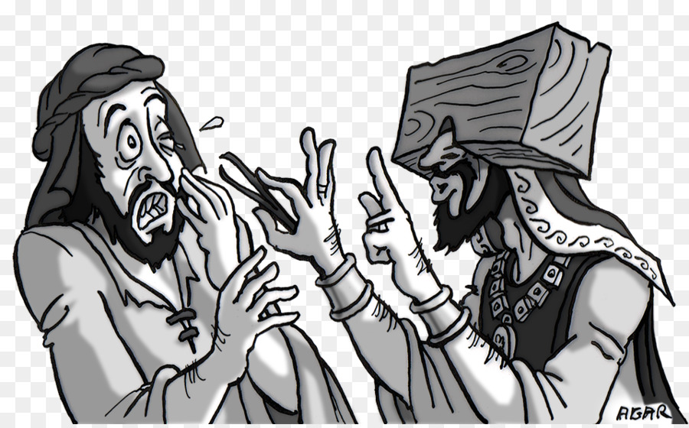
Our goal is to: Be another Jesus on earth. When we understand His teachings and imitate Him, we will be like Jesus (our Teacher).
Jesus refers to the splinter in our brother’s eye and the beam in our own..
The splinter: is something small and easily removed.
The beam: is a rigid, strong board used to support ceilings and buildings.
Jesus asks, Why do you notice the splinter in your brother's eye, but do not perceive the wooden beam in your own??
What does this mean?
Often we only see the small defects in others (the slinter) but we don’t worry about fixing our own large defects (the beam). We judge others? We think we are better than others?

Slide 16
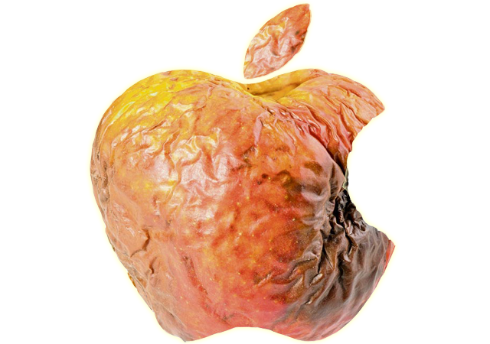
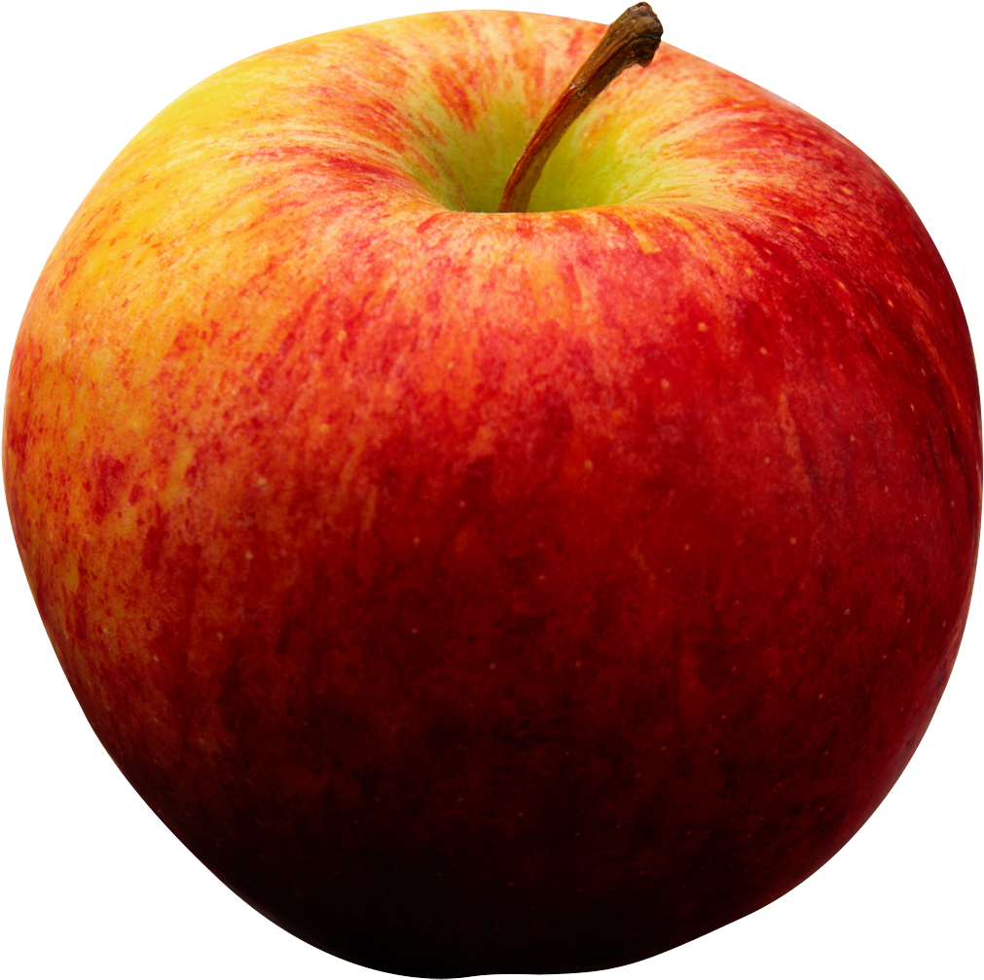
Jesus also says, “A good tree does not bear rotten fruit, nor does a rotten tree bear good fruit.
For every tree is known by its own fruit.
Who does the tree represent?
Jesus compares the tree with a person.
What do the fruits represent?
The fruits are the good words and actions of the person.
Describe the words and actions of a good person? And those of a bad person? How do they compare to the apples below?
.
Good Person
Bad Person

Slide 17
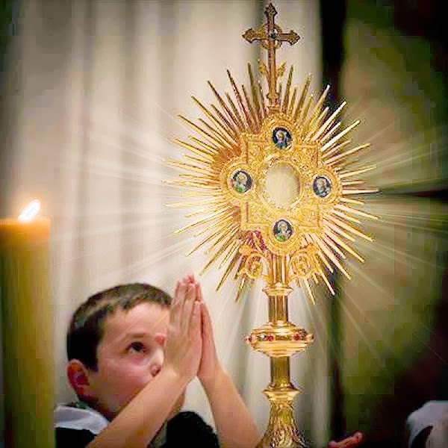
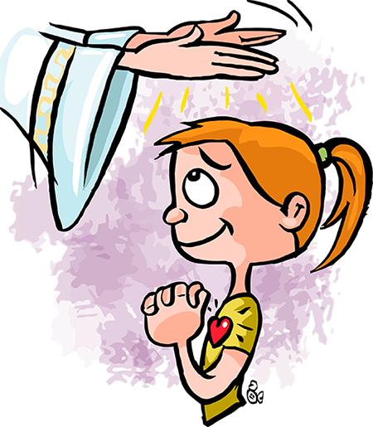
SUMMARY
Jesus invites us to know how to discern between bad and good fruits: between bad people and those that are good for us.
Surround yourself with good people who help you follow the path to Jesus.
Let yourself be guided by Jesus, by His Word, and by those who represent Him. (priests) And prepare yourself to receive the Holy Spirit in the Sacraments.
Do not judge, nor see the defects in others. With humility before God, see your own sins so you may be freed from them, (In the Sacrament of Reconciliation), trying hard to change.

Slide 18
ACTIVITY

Slide 19
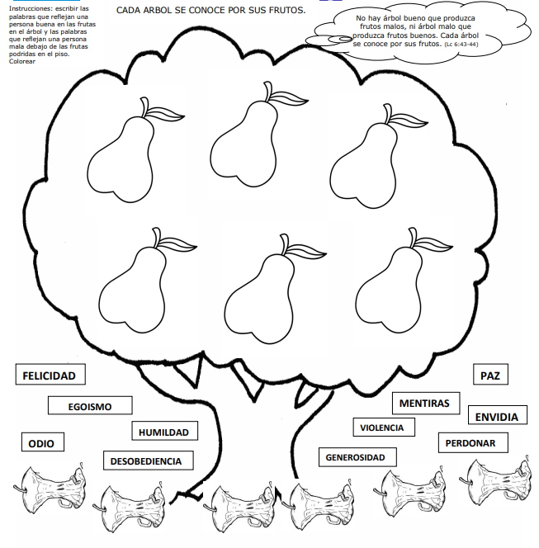
INSTRUCTIONS: Write the words that reflect the qualities of a good person on the fruits on the tree; and those of a bad person, below the rotten fruits on the floor.
Every tree is know by its fruit.
.
1.- Happiness
2.- Selfishness
3.- Hate
4.- Humility
5.- Disobedience
6.- Generosity
7.- Violence
8.- Forgiveness
9.- Lies
10.- Envy
11.- Peace
12.- Love
Humility
Happiness
Love
Generosity
Forgiveness
Peace
Lies
Envy
Selfishness
Hate
Disobedience
Violence

Slide 20
PRAYER
Lord, help me to see others through Your eyes of love. Send Your spirit of wisdom so I may discern between good and evil and always choose goodness. Help me to always be a witness of your love.

Slide 21
Song: Open the Eyes of my Heart Lord, Ft. Paul Baloche: https://youtu.be/r_2xLdgkNKs

