Slide 1

Ministry Friends of Jesus and Mary
Cycle C, XI Sunday in Ordinary Time
John 16, 12-15
www.fcpeace.org

Slide 2
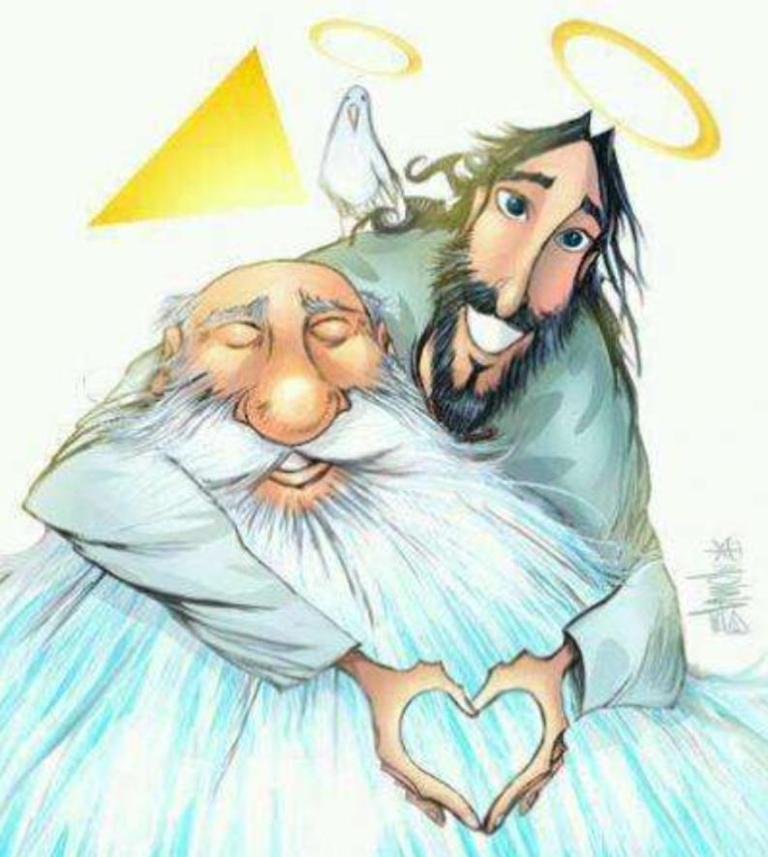
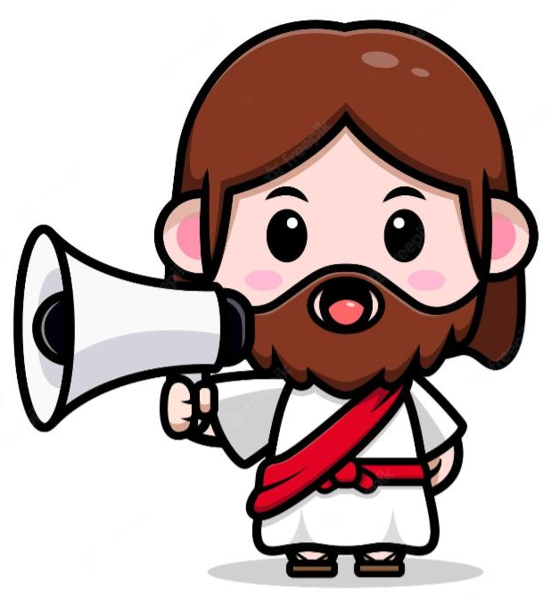
The Holy Trinity
Jesus said to his disciples:
"I have much more to tell you, but you cannot bear it now. .”

Slide 3
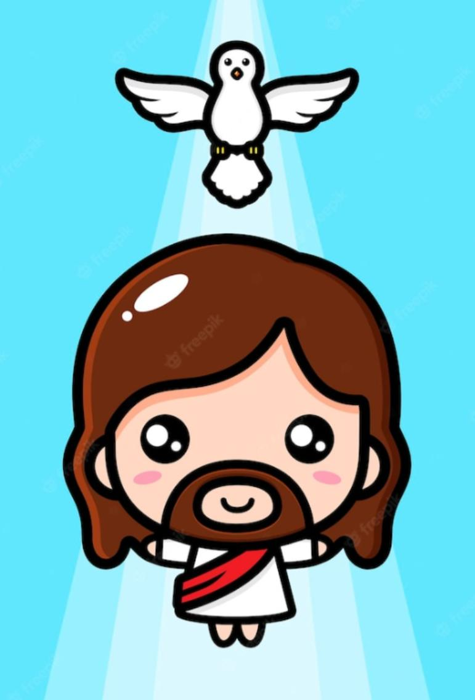
The Holy Trinity
"But when he comes, the Spirit of truth, he will guide you to all truth. He will not speak on his own, but he will speak what he hears, and will declare to you the things that are coming. He will glorify me, because he will take from what is mine and declare it to you.”

Slide 4
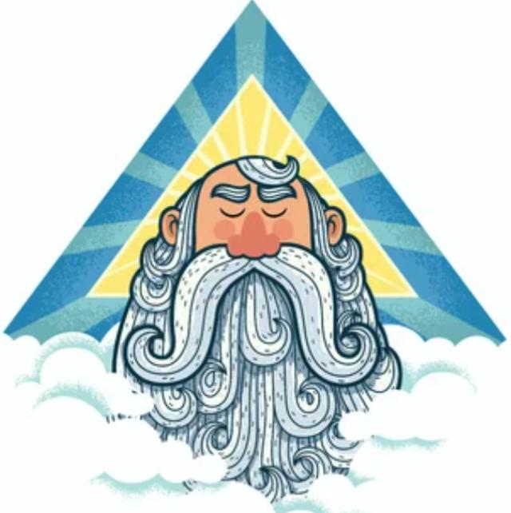
The Holy Trinity
“Everything that the Father has is mine; for this reason, I told you that he will take from what is mine and declare it to you".

Slide 5


Reflection
Jesus says that by ourselves, we cannot understand God. Who does God send to help us understand?
The Spirit of Truth or the Holy Spirit

Slide 6
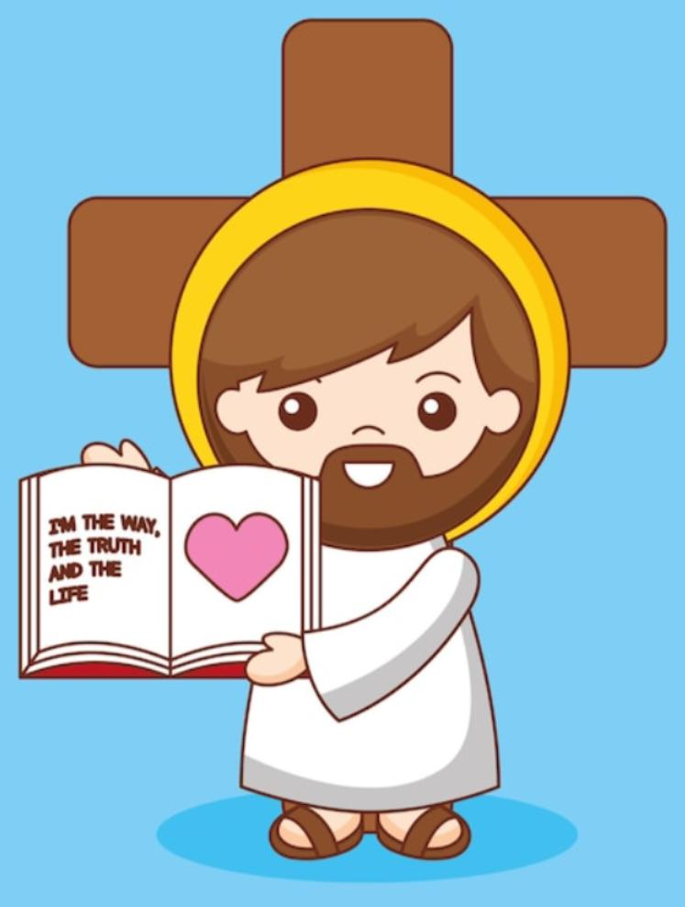
Reflection
How does Jesus say here that the Holy Spirit helps us?
He will guide us to all truth (Jesus) and declare all things that are coming.

Slide 7
Reflection
When we pray, the Holy Spirit leaves inspirations in our heart to guide us. Have you ever felt the Holy Spirit guiding you?
Share.

Slide 8
Reflection
From whom does the Holy Spirit receive the truth and what is to come?
From Jesus
From whom does Jesus receive the Truth?
From God the Father

Slide 9
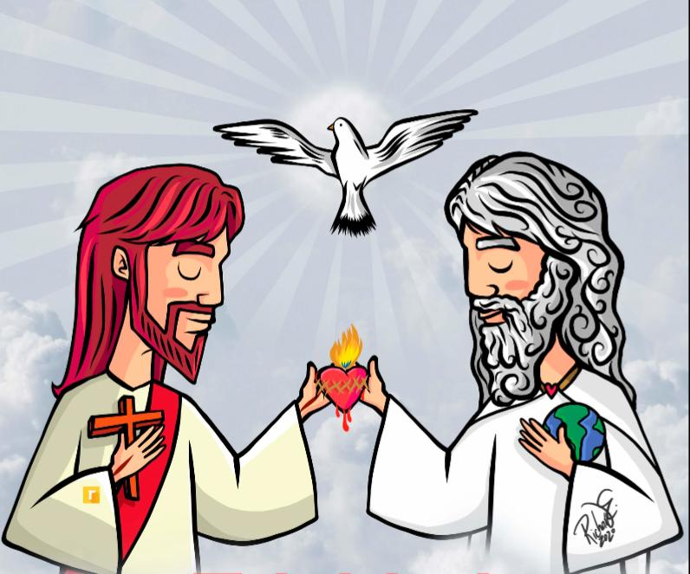
Reflection
The thoughts of God the Father, God the Son, and God the Holy Spirit are the same because they are one God, but three persons.

Slide 10
Reflection
We call our God, the Holy Trinity because “tri” means three.
2
1
3
It is a mystery of our faith that we cannot understand, but we accept it because Jesus taught us this mystery of the Holy Trinity and He is Truth.

Slide 11
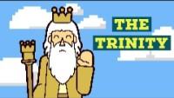
Let’s see a summary.

Slide 12

Let’s sing!
(3-7 years old)

Slide 13

Let’s sing!
(8+ years old)

Slide 14
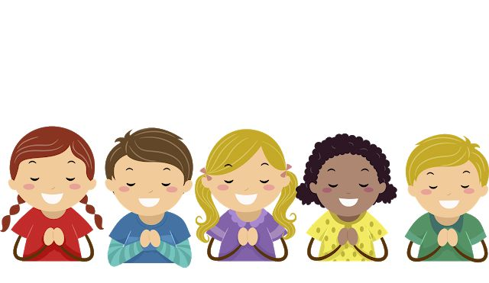
Prayer
In the Name of the Father, and of the Son, and of the Holy Spirit, we are here to praise You, to Thank You, To Bless You, and to Adore You. We are at your service, Lord, Triune God of Love. Amen.

Slide 15
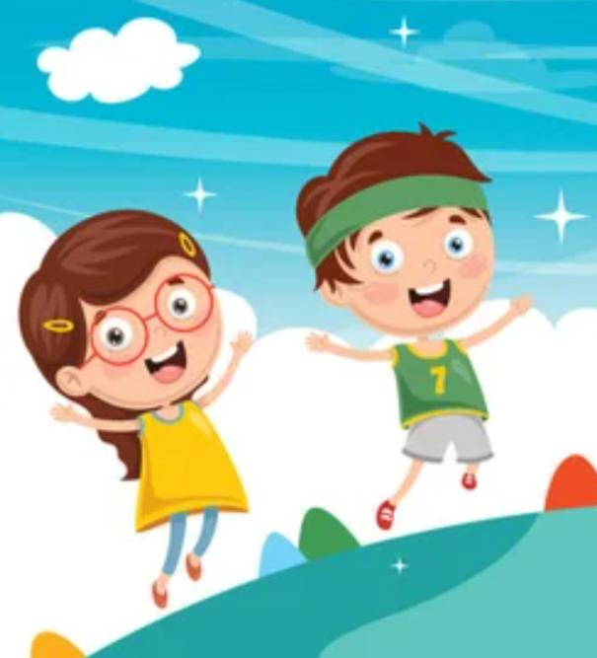
Activity
Let’s play the Memory Game,
Choose 2 cards to find a pair. If you find a pair you get another turn. If you don’t your turn ends. The person with the most pairs wins.

Slide 16
The Holy Trinity
The Holy Trinity
The Holy Trinity
The Holy Trinity
The Holy Trinity
The Holy Trinity
The Holy Trinity
The Holy Trinity
The Holy Trinity
The Holy Trinity
Start again

