Slide 1
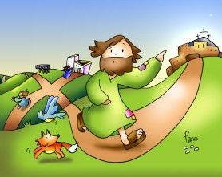
Ministry Friends of Jesus and Mary
Prayer Group for Children
Cycle C- XIII Sunday in Ordinary Time
Gospel of Luke 9: 51-62
God First
www.fcpeace.org

Slide 2
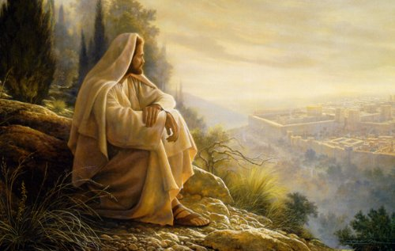
When the days for Jesus' being taken up were fulfilled, he resolutely determined to journey to Jerusalem, and he sent messengers ahead of him.

Slide 3
On the way they entered a Samaritan village to prepare for his reception there, but they would not welcome him because the destination of his journey was Jerusalem.

Slide 4
When the disciples James and John saw this they asked, "Lord, do you want us to call down fire from heaven to consume them?" Jesus turned and rebuked them, and they journeyed to another village.

Slide 5
As they were proceeding on their journey someone said to him, "I will follow you wherever you go." Jesus answered him, "Foxes have dens and birds of the sky have nests, but the Son of Man has nowhere to rest his head."

Slide 6
And to another he said, "Follow me." But he replied, "Lord, let me go first and bury my father." But he answered him, "Let the dead bury their dead. But you, go and proclaim the kingdom of God."

Slide 7
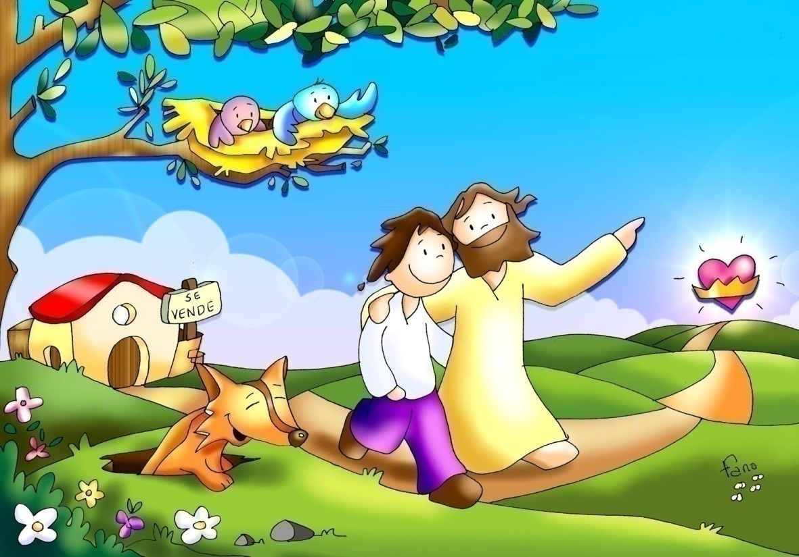
And another said, "I will follow you, Lord, but first let me say farewell to my family at home." To him Jesus said, "No one who sets a hand to the plow and looks to what was left behind is fit for the kingdom of God."
The Gospel of the Lord. Praise to you Lord Jesus Christ.

Slide 8
REFLECTION

Slide 9
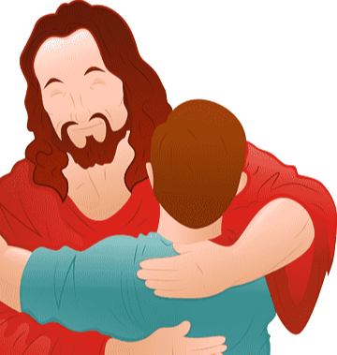
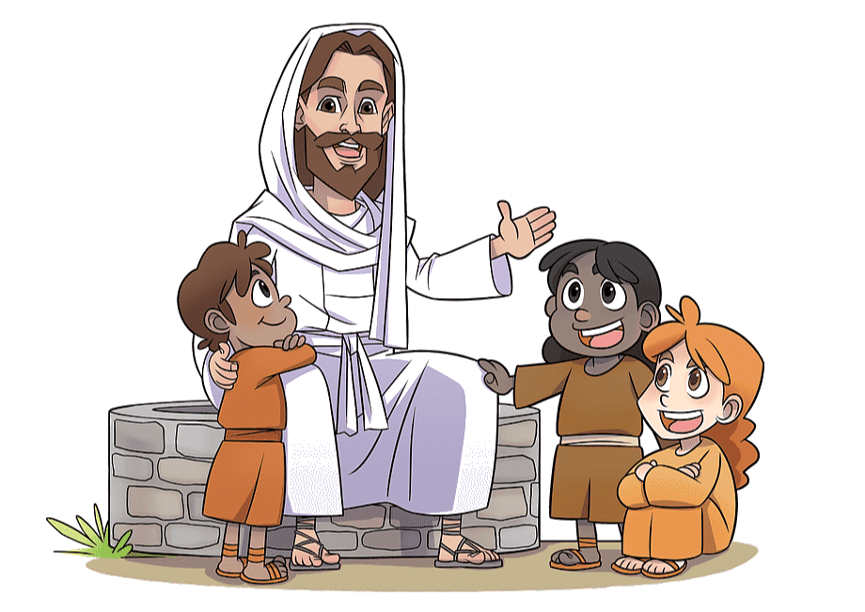
Why did Jesus reprimand James and John?
Jesus had taught them to love and forgive their enemies, not punish them.
Jesus wants to teach them how to be His followers. They will not always be received well.

Slide 10
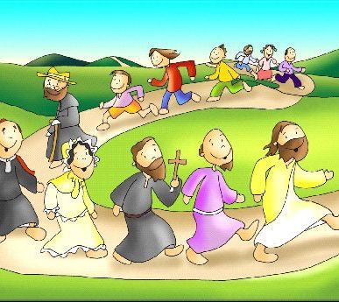
He also told them, “The Son of Man has nowhere to rest his head.”
What is He telling His followers?
They will also, not have a place to rest their heads because they must take His message to the ends of the earth.

Slide 11
Another follower wanted to bury his father first.
What does Jesus tell him?
"Let the dead bury their dead. But you, go and proclaim the kingdom of God." His followers must put God and His mission above everything.
GOD 1st

Slide 12
Another wanted to say goodbye to his family first. .
What does Jesus tell him?
“No one who sets a hand to the plow and looks to what was left behind is fit for the kingdom of God.” Jesus wants His followers to trust Him and to keep their eyes on the mission.

Slide 13
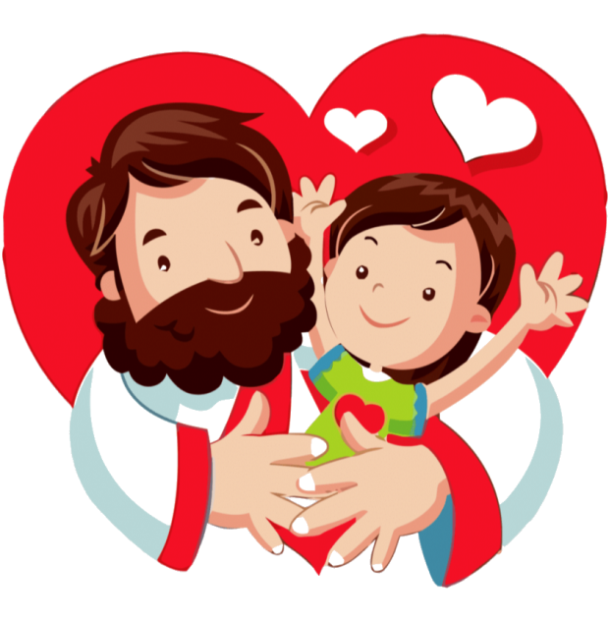
What do His followers need to do?
Put Jesus first before personal comfort, family, and work.

Slide 14
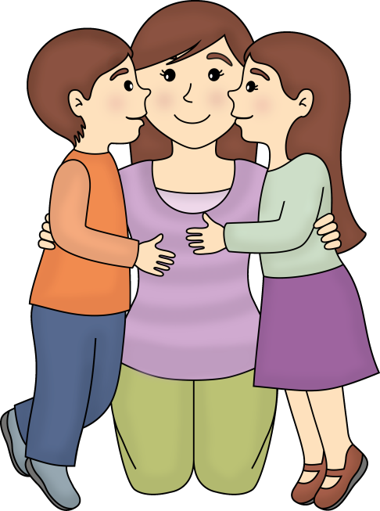
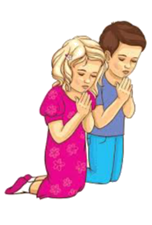
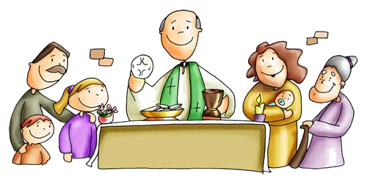
How do we put God first in our life?
Prayer
Obedience
Forgiveness
Mass
Love

Slide 15
ACTIVITIES

Slide 16
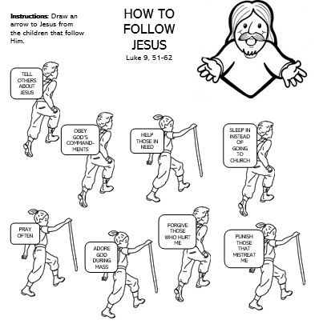
draw an arrow to Jesus from the children that are following Him.

Slide 17
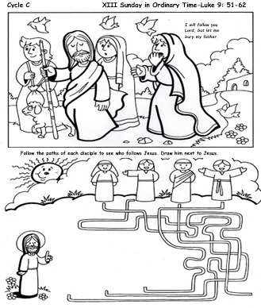
Color and follow the arrows to see who follows Jesus. Draw the follower next to Jesus..

Slide 18
LET’S PLAY JESUS SAYS
Play “Jesus Says” (like Simon Says): The leader gives commands (hands on head, clap…) preceded by “Jesus says” and you must follow. If the command is not preceded by Jesus says, and you follow, you are out of the game. The last person left wins.

Slide 19
PRAYER
Jesus, we want to place You first in our life and follow You. You know what we need most and always provide in Your time. Help us to love You more and to trust You more each day. We want everyone to see Your light shining in us. Amen

Slide 20
I have Decided, Lifetreekids https://youtu.be/sEL0WpeH088

