Slide 1

Friends of Jesus and Mary
Prayer Group for Children
Cycle C XIV Sunday in Ordinary Time
Gospel of Luke10, 1-12. 17-20
“Jesus sends the 72.”

Slide 2

At that time the Lord appointed seventy-two others whom he sent ahead of him in pairs to every town and place he intended to visit. He said to them, "The harvest is abundant, but the laborers are few; so ask the master of the harvest to send out laborers for his harvest.

Slide 3
Go on your way; behold, I am sending you like lambs among wolves. Carry no money bag, no sack, no sandals; and greet no one along the way. Into whatever house you enter, first say, 'Peace to this household.' If a peaceful person lives there, your peace will rest on him; but if not, it will return to you.

Slide 4
Stay in the same house and eat and drink what is offered to you, for the laborer deserves his payment. Do not move about from one house to another. Whatever town you enter, and they welcome you, eat what is set before you, cure the sick in it and say to them, 'The kingdom of God is at hand for you.'"

Slide 5
Whatever town you enter and they do not receive you, go out into the streets and say, 'The dust of your town that clings to our feet, even that we shake off against you.' Yet know this: the kingdom of God is at hand. I tell you, it will be more tolerable for Sodom on that day than for that town."

Slide 6
REFLECTION

Slide 7
Jesus sends the new 72 disciples in groups of two … Why is it better to go in pairs?
…They can help each other; they are safer; people believe two more than one…

Slide 8
Jesus sent them to places He planned on going. …. What does this mean?
We take the message, but Jesus enters the heart!!

Slide 9
What message?
Jesus loves us and opens the gates of Heaven with His death on the cross; He invites us to love Him and follow Him!

Slide 10
Why did He say: “I am sending you like lambs among wolves”?
Some people close their hearts to Jesus’ message; and they reject the messenger; God gives us the choice to accept Him or not.

Slide 11
Jesus asks them to say, “Peace to this household.” Why?
It was a test. If their hearts were open to the message of repentance and love, they would receive them with love and joy and they could stay. If not, they would not receive them and they would have to find another place to stay….

Slide 12
What did Jesus say to do if they were well received? Stay, eat and drink, cure the sick and say, “The kingdom of God is at hand for you”.
…When we receive Jesus into our hearts, He is generous with us! He gives us much peace and happiness to share with others. And He gives us eternal life!!

Slide 13
How can we take this message to the world?
Always act with love, talk to others about Jesus, be an example of living your Catholic faith, pray and do sacrifices for sinners…

Slide 14
ACTIVITY

Slide 15
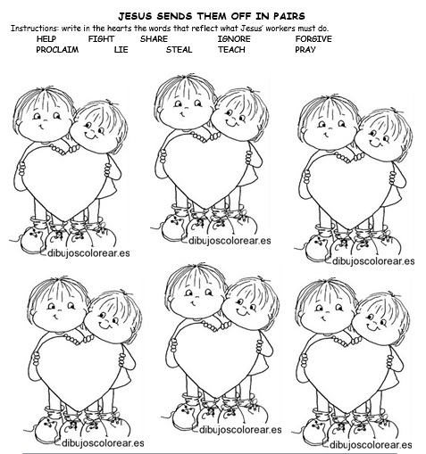
SHARE
HELP
FORGIVE
PROCLAIM
TEACH
PRAY

Slide 16
Instructions: color the name of Jesus, cut, glue to colored construction paper, make holes in the top corners and hang with string in your room to remind you to speak of Jesus to others!!

Slide 17
PRAYER
Jesus, I want to be your messenger. Send your Holy Spirit to my heart so I may take peace and love to all in my family and in my community. Change the hearts that do not want to receive your message. Amen.

Slide 18

SONG: Make me a channel of your peace, CCS version, https://youtu.be/apHvbe-iJ3U

Slide 19

SONG: There’s Just Something About that Name, Maranatha, https://youtu.be/XeL3yngDpMg

