Slide 1
MINISTRY FRIENDS OF JESUS AND MARY www.fcpeace.org
CYCLE C – IXI SUNDAY IN ORDINARY TIME
BE PREPARED

Slide 2
GOSPEL ACCORDING TO LUKE 12, 35-40
Be Prepared.
Jesus said to his disciples: “Gird your loins and light your lamps and be like servants who await their master’s return from a wedding, ready to open immediately when he comes and knocks. Blessed are those servants whom the master finds vigilant on his arrival. Amen, I say to you, he will gird himself, have the servants recline at table, and proceed to wait on them. And should he come in the second or third watch and find them prepared in this way, blessed are those servants. Be sure of this: if the master of the house had known the hour when the thief was coming, he would not have let his house be broken into. You also must be prepared, for at an hour you do not expect, the Son of Man will come.”
The Gospel of the Lord,
PRAISE TO YOU LORD JESUS CHRIST.

Slide 3
REFLECTION

Slide 4
“Gird your loins and light your lamps and be like servants who await their master’s return from a wedding”
BE PREPARED BE PREPARED
BE PREPARED
BE PREPARED BE PREPARED
BE PREPARED
BE PREPARED
BE PREPARED BE PREPARED BE PREPARED
BE PREPARED BE PREPARED
BE PREPARED BE PREPARED

Slide 5
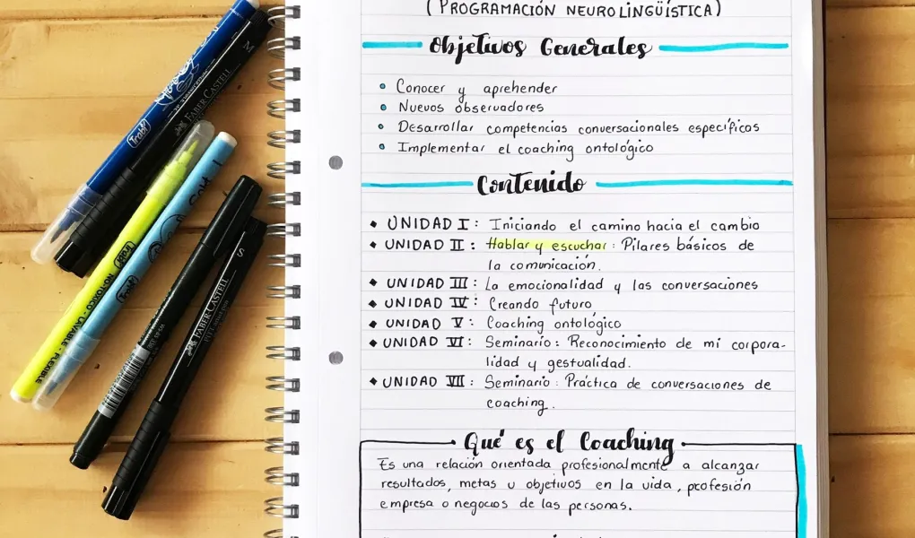
WHEN OUR TEACHER REMINDS US THAT SOON WE WILL HAVE AN EXAM…. WHAT DO WE DO? HOW DO WE PREPARE?
1. WE SHOULD HAVE OUR NOTES…
2. AND OUR BOOKS.
3. WE SHOULD MAKE A STUDY PLAN

Slide 6
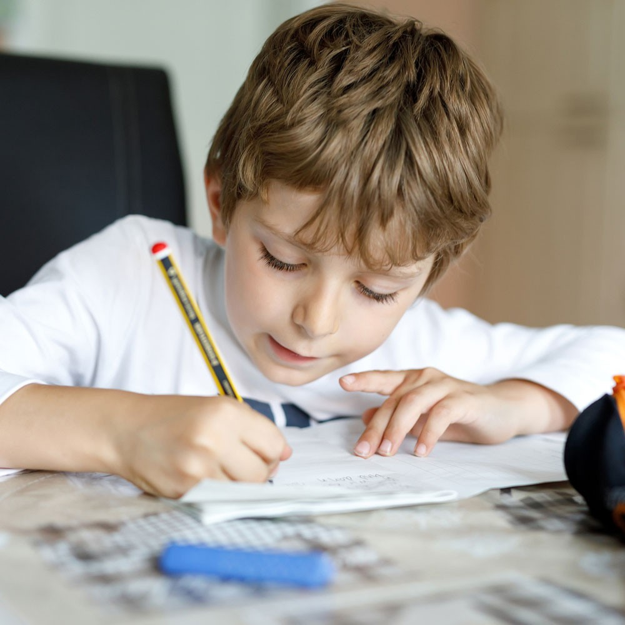
AND OF COURSE…
STUDY
…STUDY
AND … CONTINUE TO STUDY

Slide 7
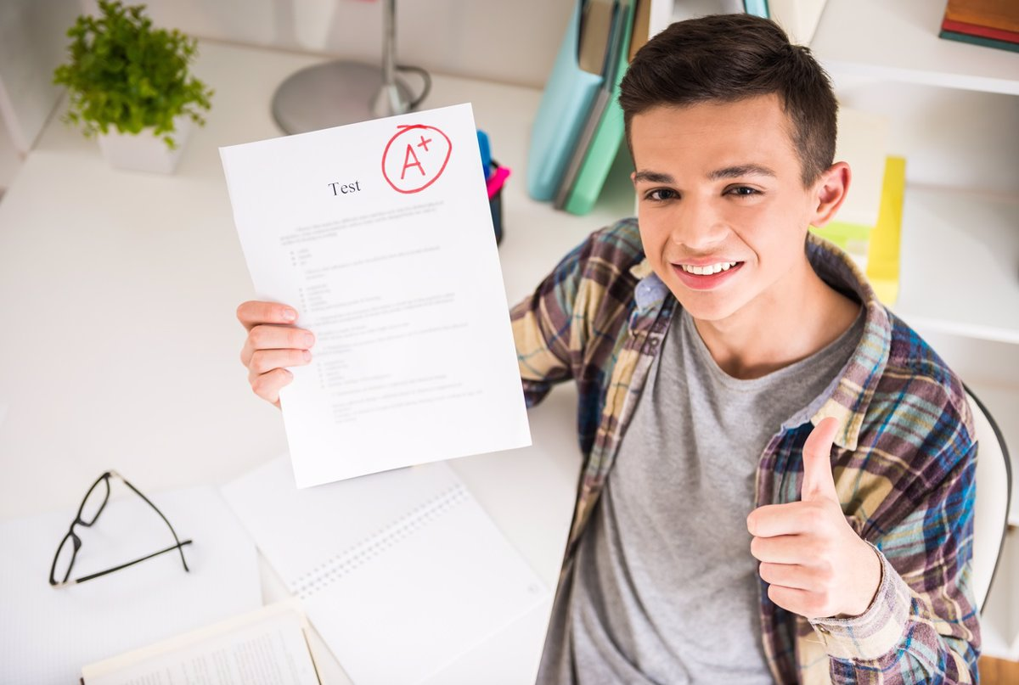
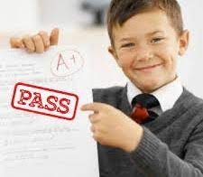
BUT… WHY DO WE STUDY?
OBVIOUSLY TO GET
A GOOD GRADE,
TO PASS THE GRADE,
AND TO BE HAPPY.

Slide 8
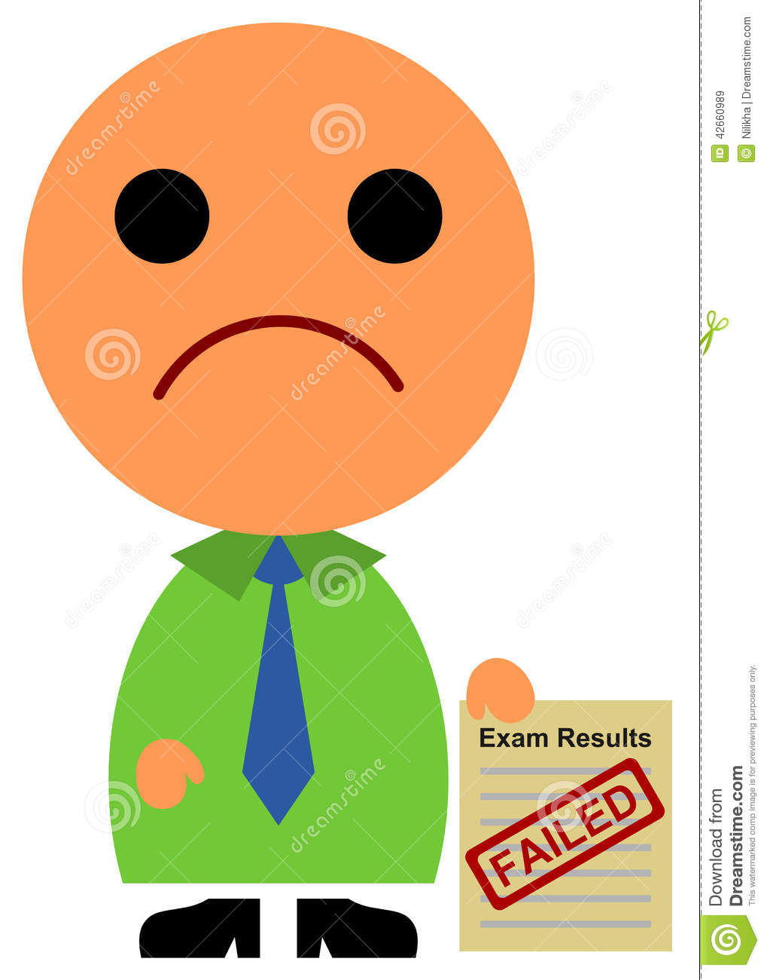
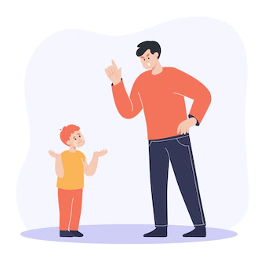
AND WHAT HAPPENS IF WE DON’T STUDY?
WE FLUNK THE TEST.
WE BECOME SAD
AND WORRIED.
AND SO DO OUR PARENTS.

Slide 9
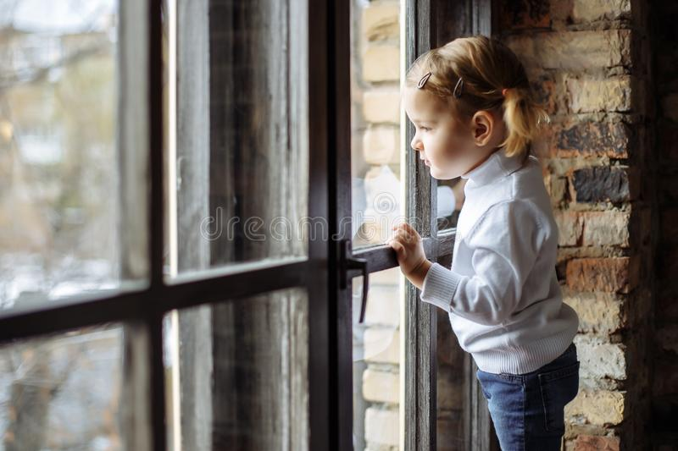
SO JESUS TELLS US:
“BE VIGILANT”

Slide 10
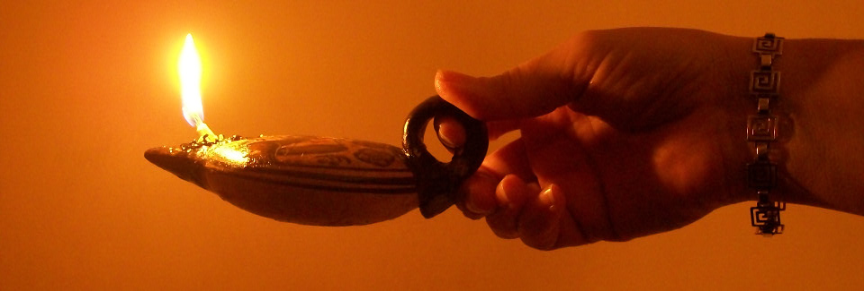
AND LIGHT YOUR LAMPS…

Slide 11
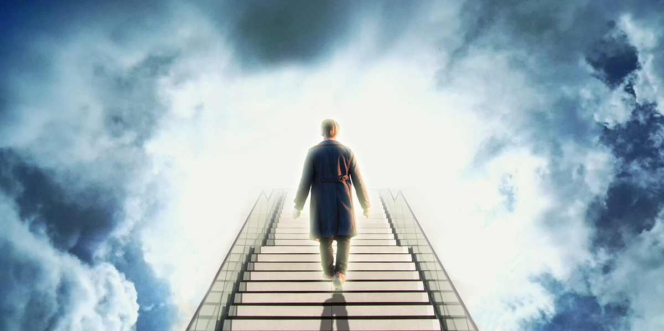
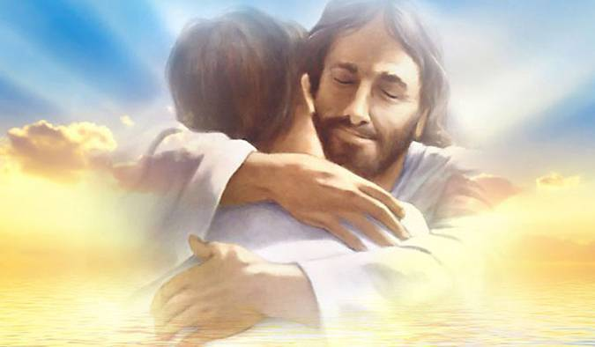
TO BE READY TO
GO TO HEAVEN
AND HUG JESUS

Slide 12
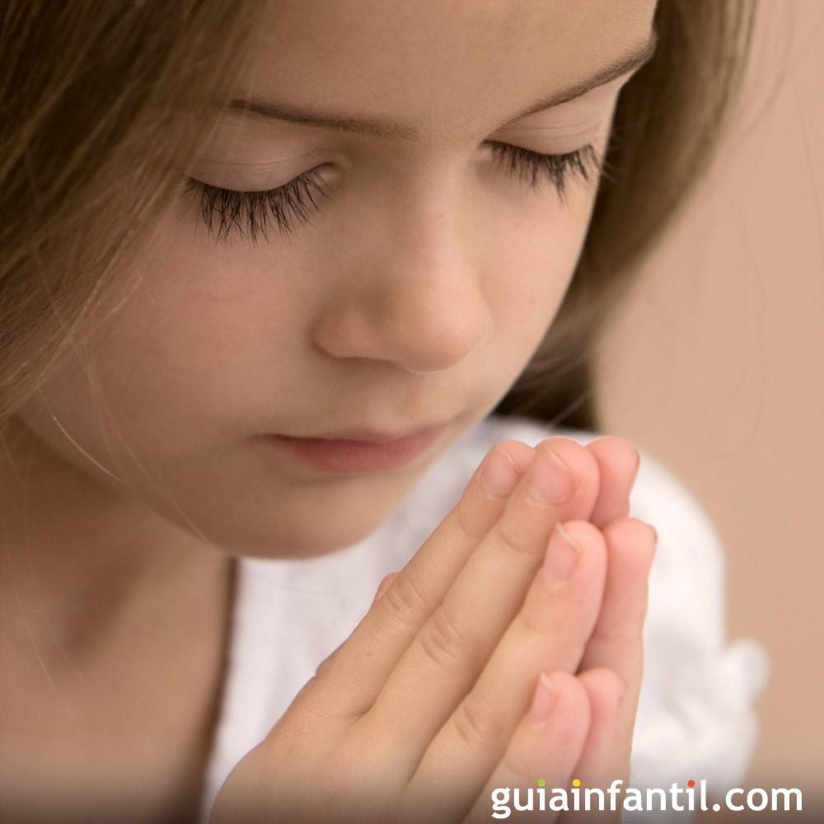
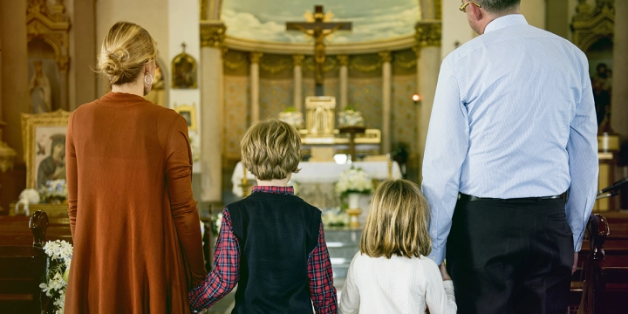
HOW DO WE GET TO HEAVEN?
LOVING GOD BY
PRAYING OFTEN
GOING TO MASS
READING THE BIBLE
THANKING GOD

Slide 13
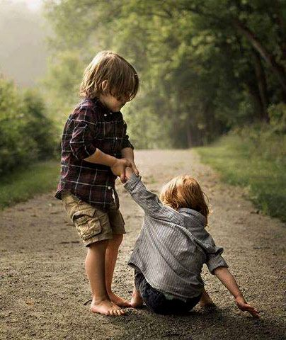
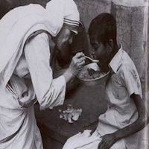
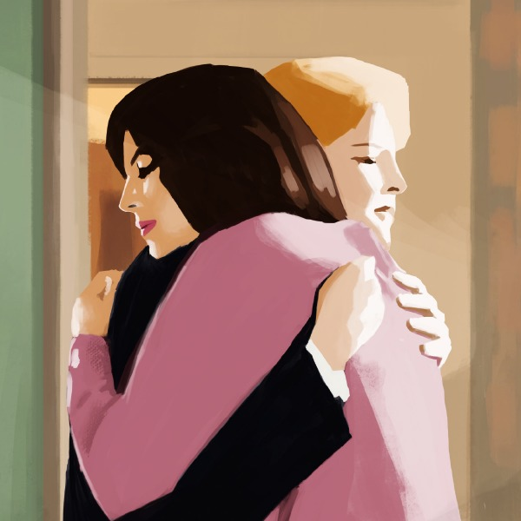
AND LOVING OUR NEIGHBOR
SERVING
HELPING
ASKING FOR
FORGIVENESS
AND FORGIVING
SMILING
ETC…

Slide 14
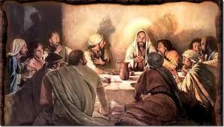
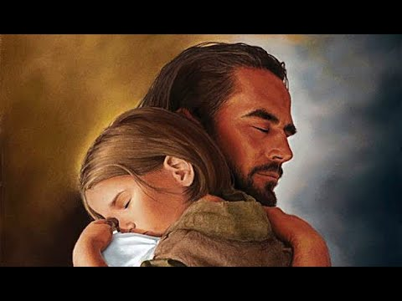
AND HOW WILL GOD RECEIVE US IN HEAVEN?
HE WILL GIRD HIMSELF, HAVE US RECLINE
AT THE TABLE, AND PROCEED TO WAIT ON US
BECAUSE HE LOVES US VERY MUCH
WE ARE THE SERVANTS
AND JESUS IS THE MASTER.

Slide 15
WHAT WOULD YOU DO IF YOU KNEW A THIEF WAS GOING TO ROB YOUR HOUSE?

Slide 16
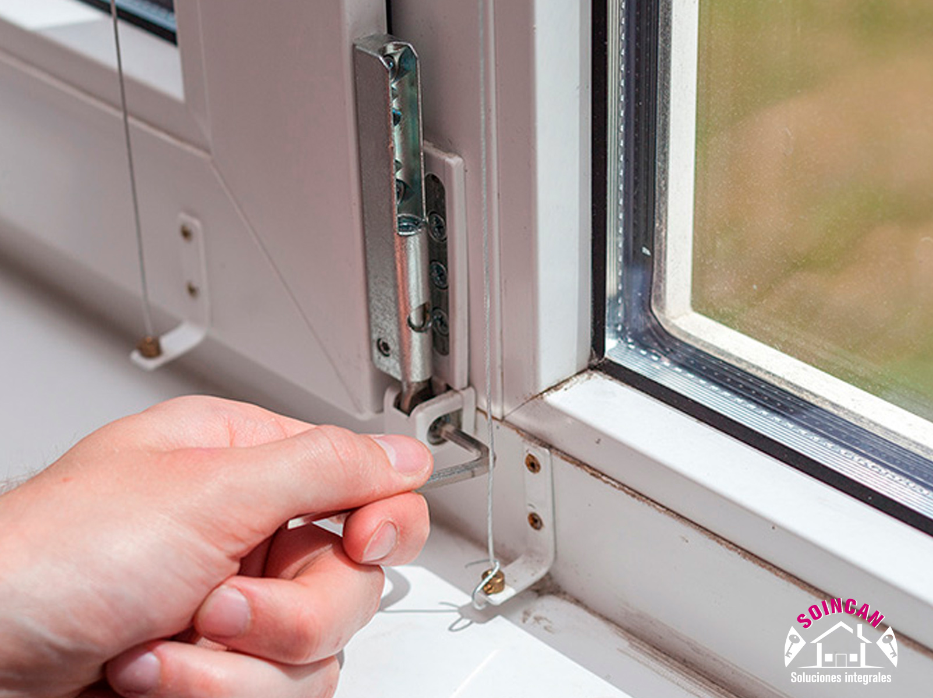

Slide 17
BUT WE DO NOT KNOW WHEN A THIEF IS COMING TO ROB US.
IN THE SAME WAY, NO ONE KNOWS WHEN JESUS WILL CALL US TO HEAVEN, OR WHEN HE WILL RETURN FOR THE SECOND TIME.
WE ONLY KNOW THAT JESUS LOVES US DEEPLY AND WANTS US TO BE PREPARED SO HE CAN SPEND ETERNITY WITH US.

Slide 18
ACTIVITY

Slide 19
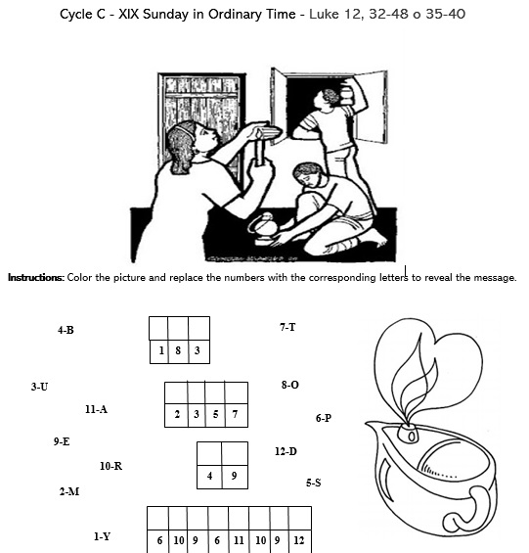
Y
O
U
M
U
S
T
B
E
P
R
E
P
A
R
E
D

Slide 20
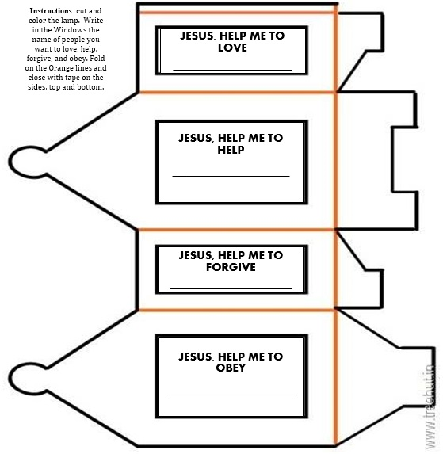

Slide 21
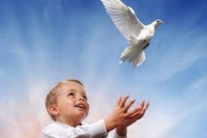
PRAYER
Lord, thank you for loving us so much that with Your painful sacrifice, you opened the gates of Heaven for us. Help us to live each day in Your love so we may always be prepared and so we may be a light leading others to You.
AMEN

Slide 22
This Little Light of Mine, Lifetree Kids, https://youtu.be/ty9bZXN4uWA

