Slide 1
Ministry Friends of Jesus and Mary
XV Sunday in Ordinary Time – Cycle C
The Good Samaritan (Luke 10, 25-37)
www.fcpeace.org

Slide 2
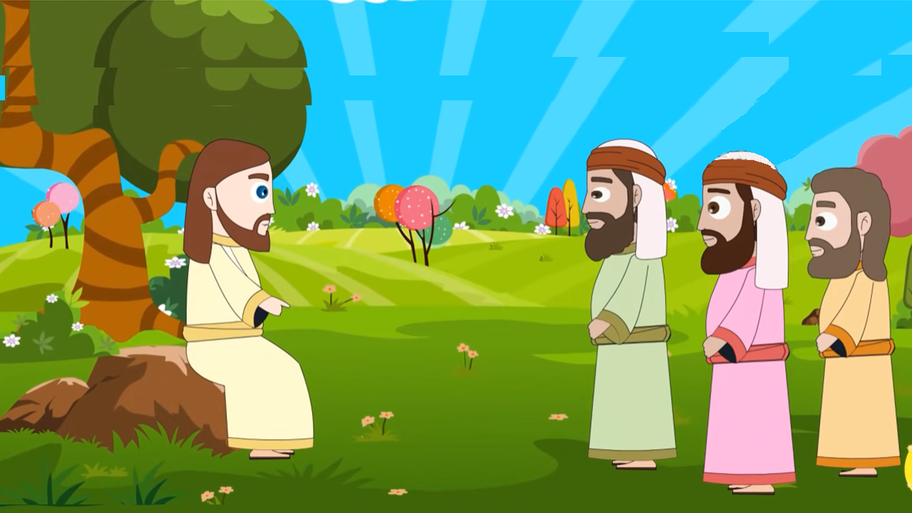
There was a scholar of the law who stood up to test Jesus and said, "Teacher, what must I do to inherit eternal life?"

Slide 3
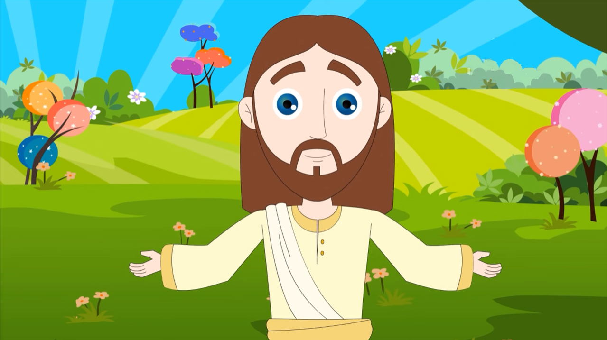
Jesus said to him, "What is written in the law? How do you read it?"

Slide 4
He said in reply, "You shall love the Lord, your God, with all your heart, with all your being, with all your strength, and with all your mind, and your neighbor as yourself."

Slide 5
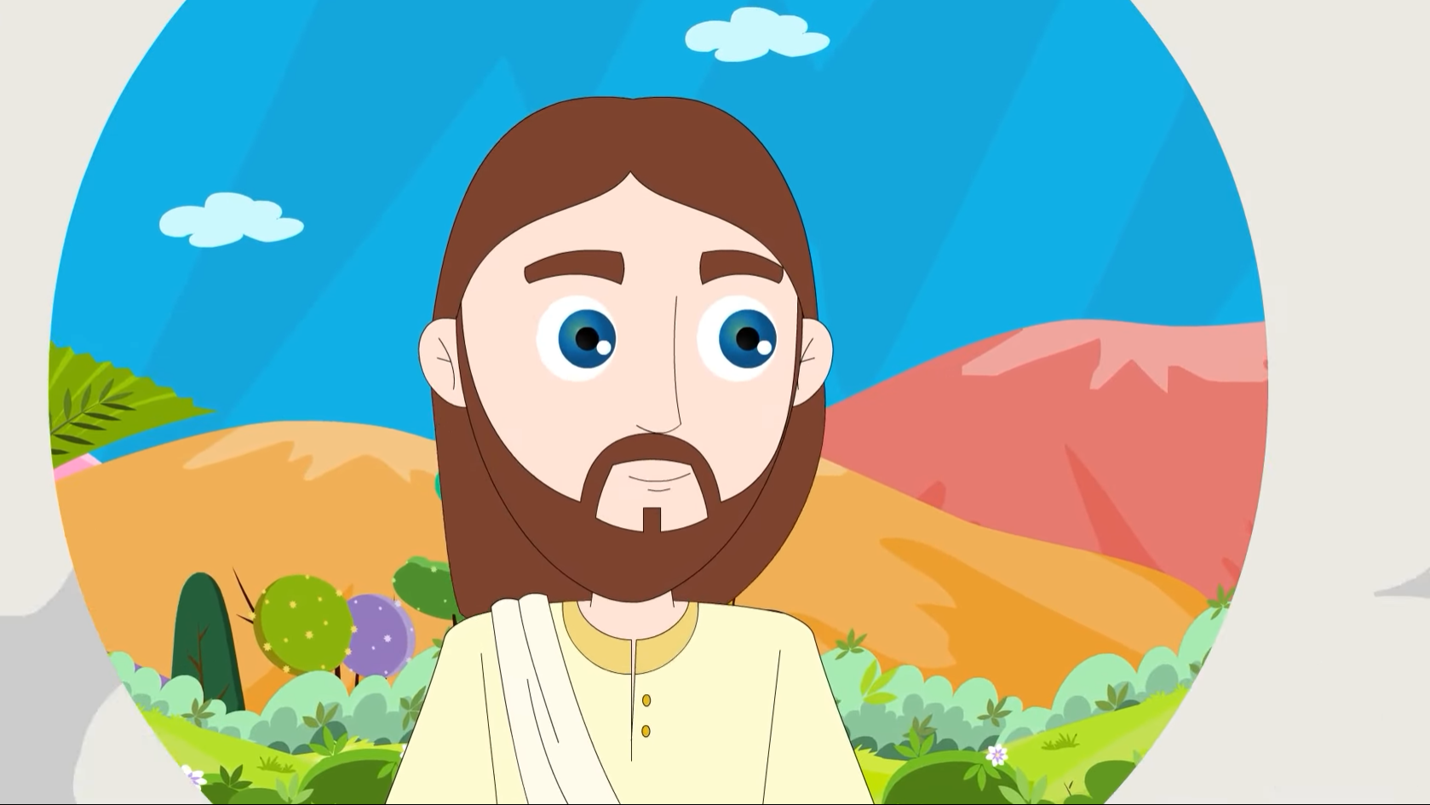
He replied to him, "You have answered correctly; do this and you will live."

Slide 6
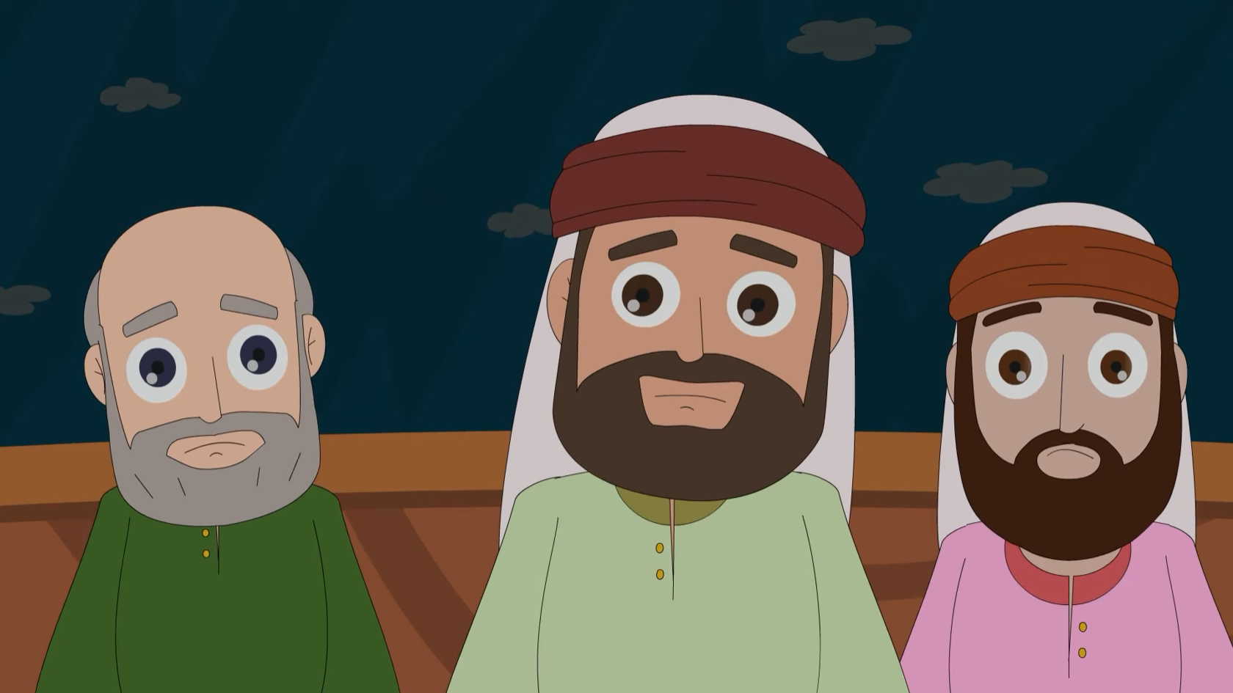
But because he wished to justify himself, he said to Jesus, "And who is my neighbor?"

Slide 7
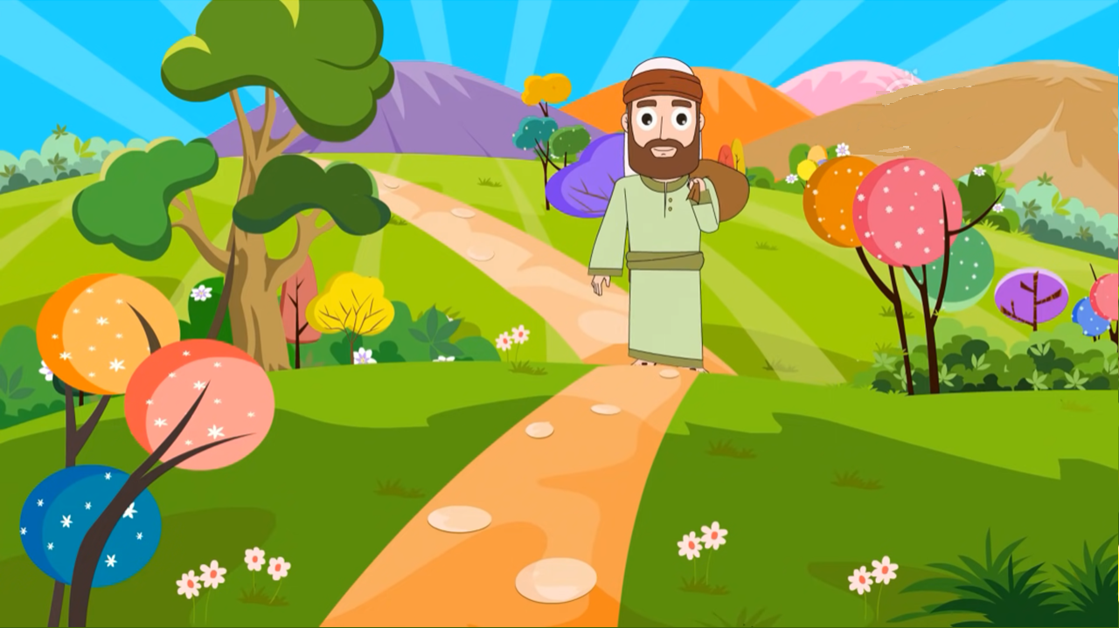
Jesus replied, "A man fell victim to robbers as he went down from Jerusalem to Jericho…

Slide 8
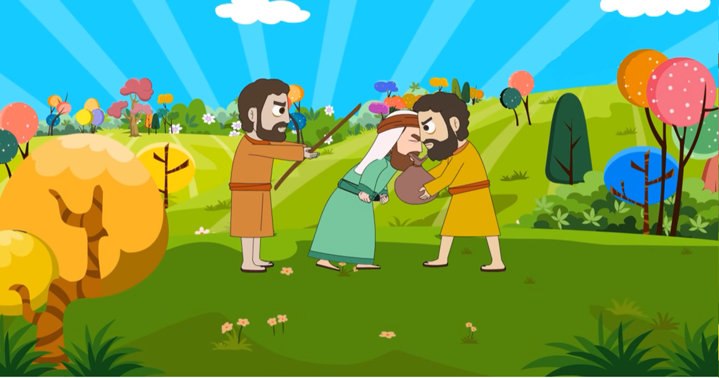
They stripped and beat him and went off leaving him half-dead.

Slide 9
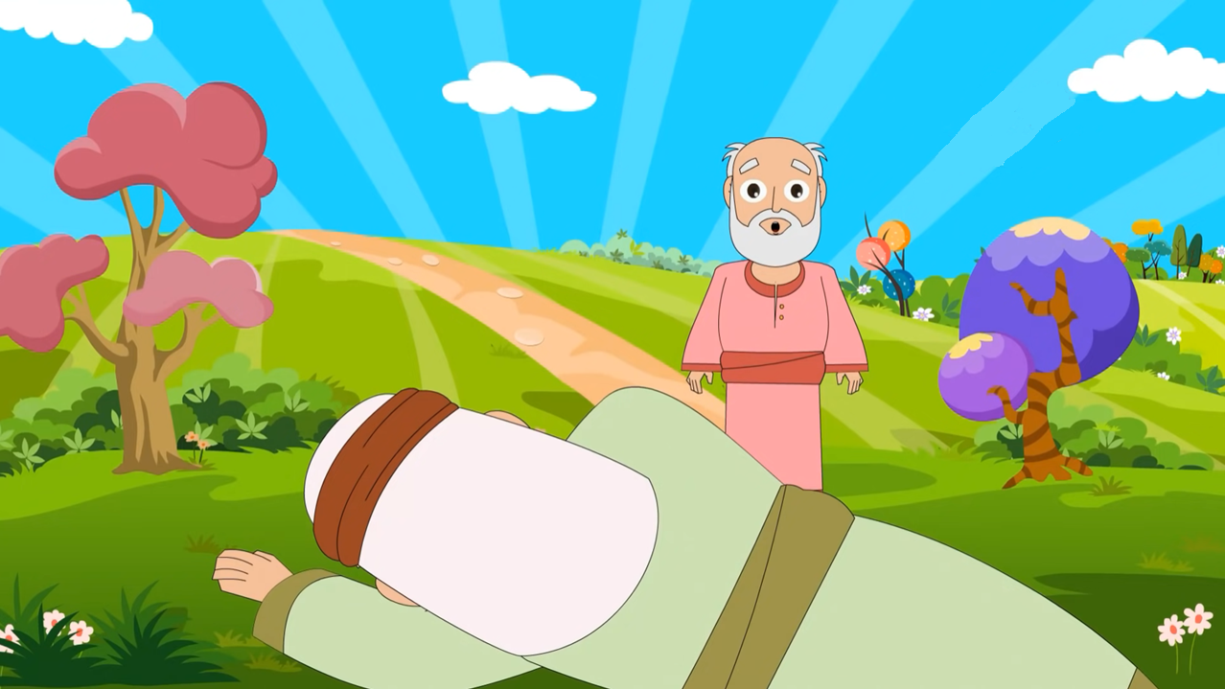
A priest happened to be going down that road, but when he saw him, he passed by on the opposite side.

Slide 10
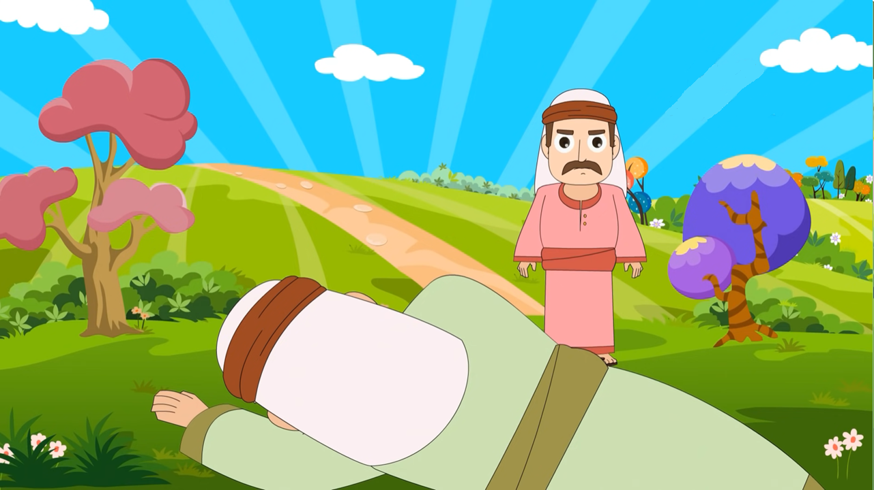
Likewise, a Levite came to the place, and when he saw him, he passed by on the opposite side.

Slide 11
But a Samaritan traveler who came upon him was moved with compassion at the sight. He approached the victim, poured oil and wine over his wounds and bandaged them.

Slide 12
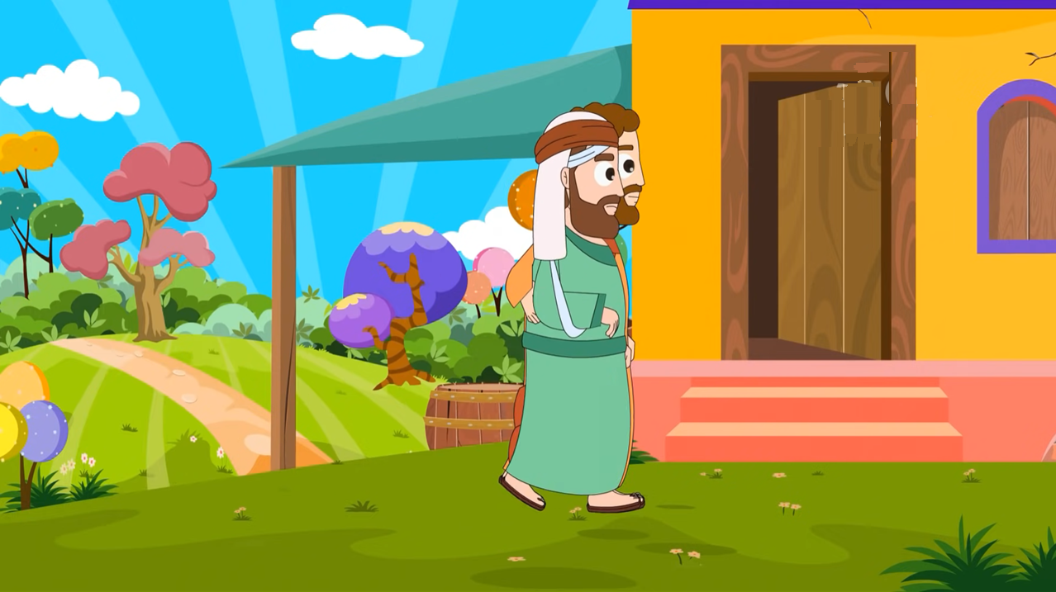
Then he lifted him up on his own animal, took him to an inn, and cared for him. The next day he took out two silver coins and gave them to the innkeeper with the instruction,

Slide 13
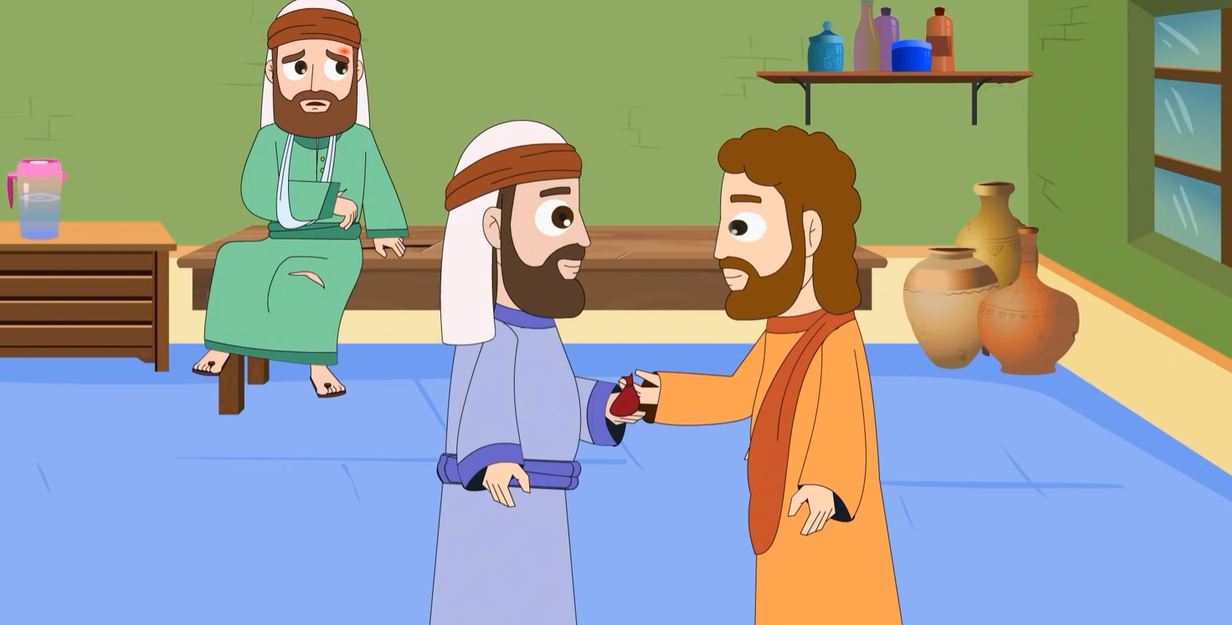
'Take care of him. If you spend more than what I have given you, I shall repay you on my way back.'

Slide 14
Which of these three, in your opinion, was neighbor to the robbers' victim?"

Slide 15
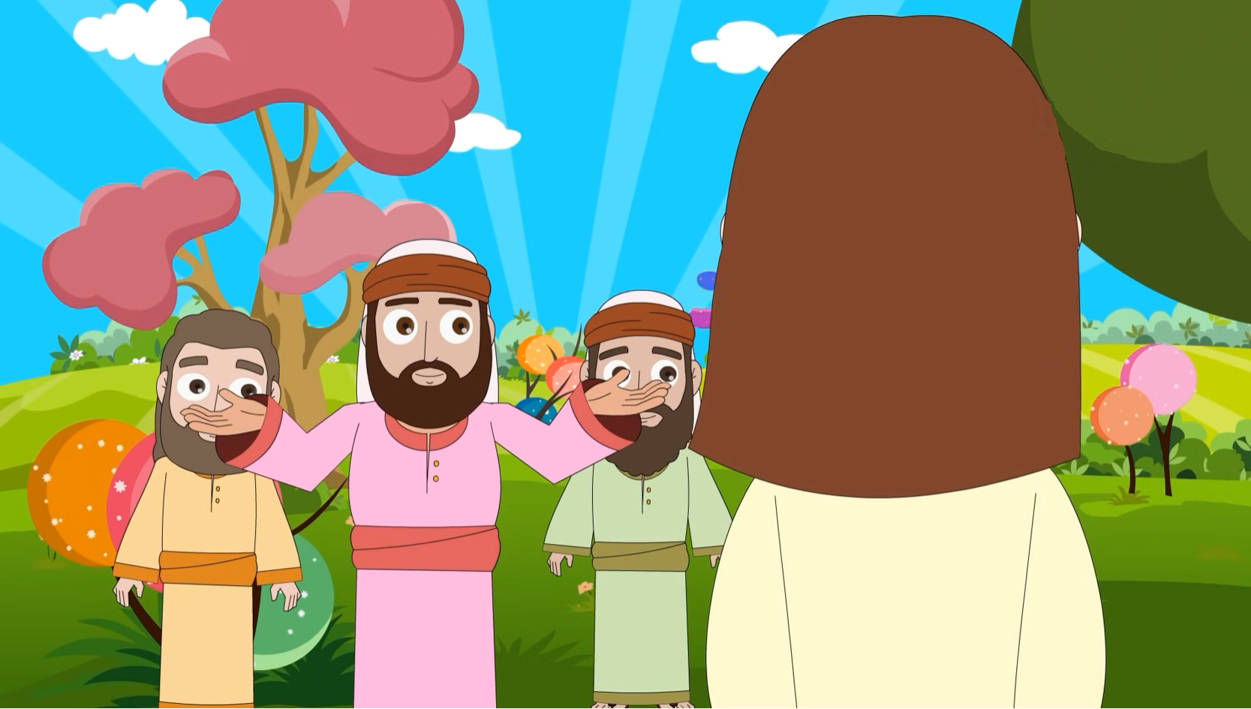
He answered, "The one who treated him with mercy."

Slide 16
Jesus said to him, "Go and do likewise."
The Gospel of the Lord
Praise to you Lord Jesus Christ.

Slide 17
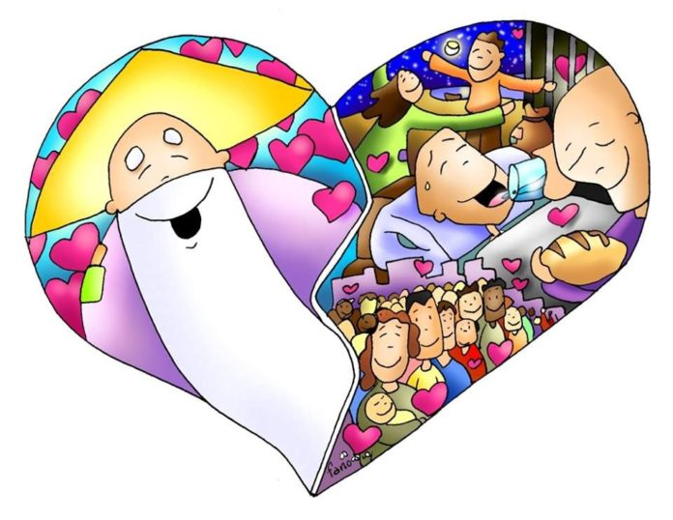
REFLECTION
A scholar of the law asks Jesus, ¿How do you obtain Eternal Life?
What is Eternal Life?
According to the scholar, how do you obtain Eternal Life?
Loving God with all your heart and your neighbor as yourself.

Slide 18
REFLECTION
The scholar of the law also asks Who is my neighbor? What does Jesus do to explain who is his neighbor?
Jesus tells him a parable.
A Parable is a story with a teaching.
A man was robbed and beaten while travelling. 3 men passed by and saw him. Who passed first?
A priest.
What did he do?
He passed by on the opposite side.

Slide 19
REFLECTION
Who passed by next?
A Levite.
What did he do?
He also passed by on the opposite side.
Both the priest and the Levite were Jewish like Jesus and the scholar.
Then a Samaritan passes by. The jews rejected the Samaritans because they adored other gods.
What does the Samaritan do?
He helps the injured man by curing his wounds and taking him to an inn.

Slide 20
REFLECTION
What does Jesus want to teach us?
Anyone who needs help is our neighbor.
Does it matter if they are of a different race, religion, or social group?
No, we are all children of God.
Who do I find difficult to help?
How can I try to help my neighbor this week?

Slide 21
ACTIVITY

Slide 22
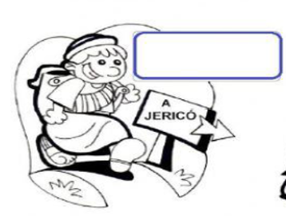
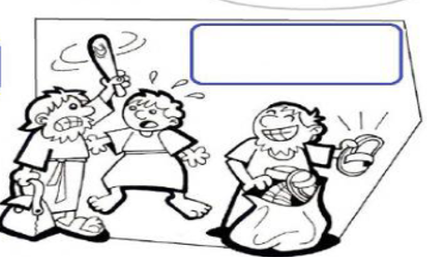
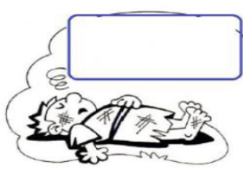
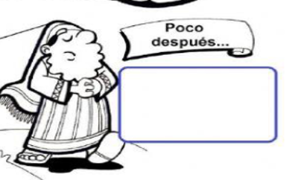
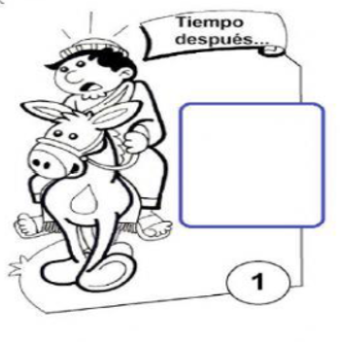
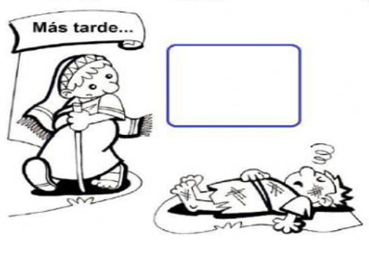
El Buen Samaritano
Selecciona en la columna la frase que va con el dibujo.
1
A man went down from Jerusalem to Jericho.
2
He fell victim to robbers.
But a Samaritan traveler who came upon him was moved with compassion at the sight.
A man went down from Jerusalem to Jericho.
3
They went off leaving him half-dead.
4
A little later
A Levite came to the place, and when he saw him, he passed by on the opposite side.
A priest happened to be going down that road, but when he saw him, he passed by on the opposite side.
Time passed
He fell victim to robbers.
5
Later
But a Samaritan traveler who came upon him was moved with compassion at the sight.
6
They went off leaving him half-dead.
A Levite came to the place, and when he saw him, he passed by on the opposite side.
A priest happened to be going down that road, but when he saw him, he passed by on the opposite side.

Slide 23
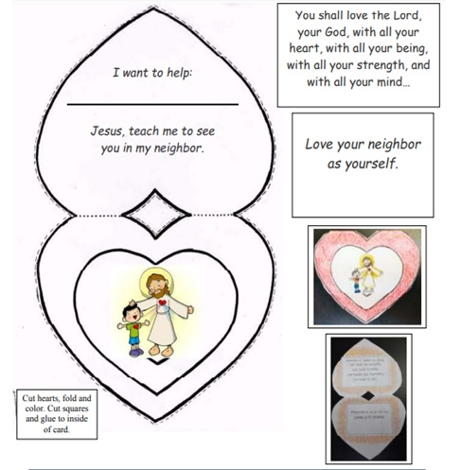

Slide 24
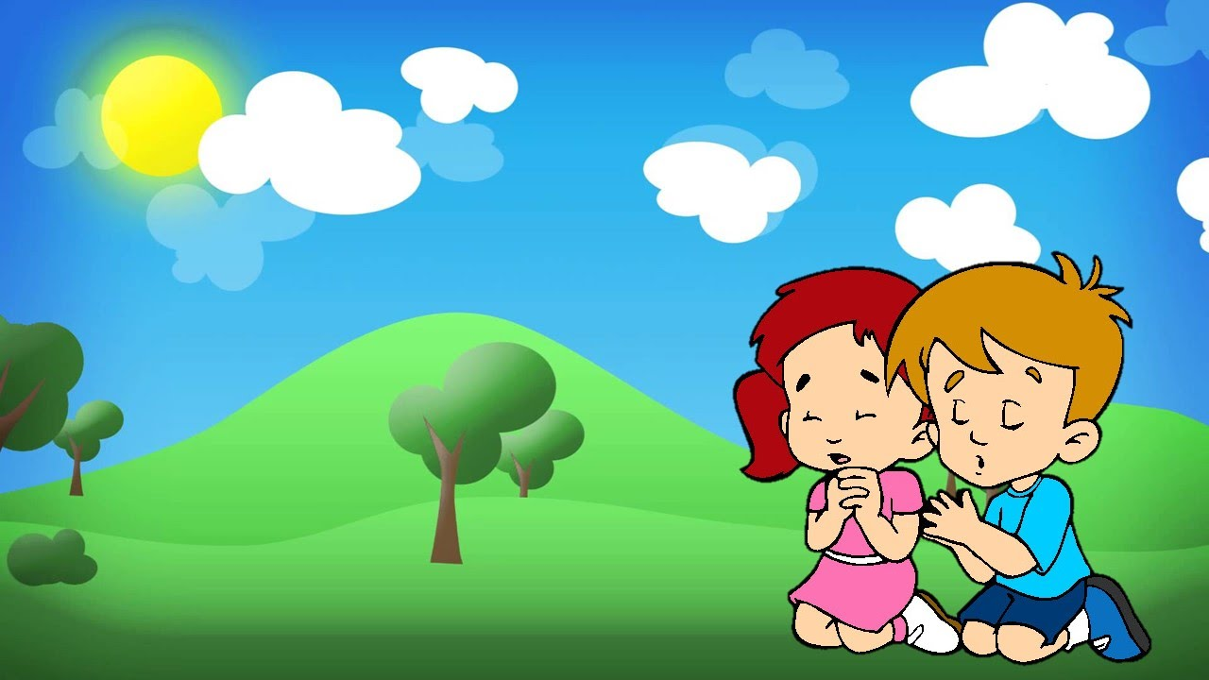
PRAYER

Slide 25
Lord, teach us to be Good Samaritans, welcoming those that are rejected. Give us courage and generosity to do so, even though it requires personal sacrifice.
Amen

Slide 26
Love your Neighbor, Sadock Sebastian https://youtu.be/aLv3V6dzGaU (3-7 years)

Slide 27
The Servant Song, servantofthelion, https://youtu.be/kdmgpMfnjdU (8+ years)

