Slide 1
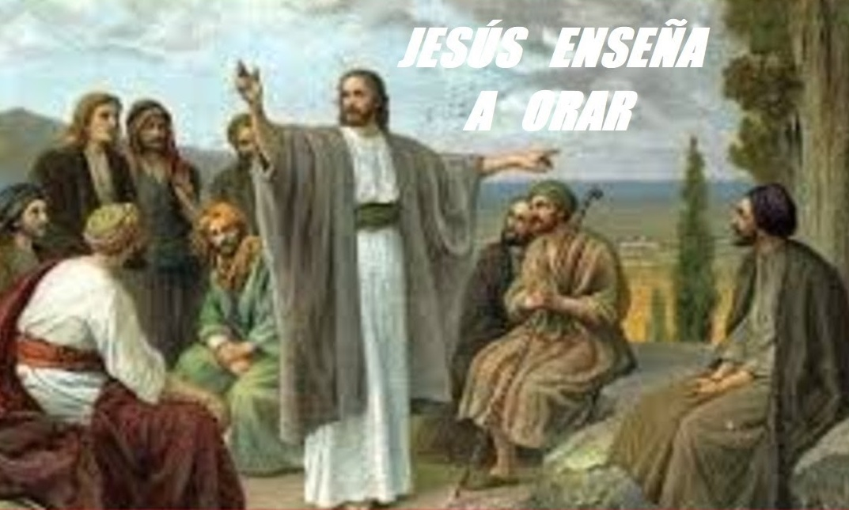
FRIENDS OF JESUS AND MARY
Jesus Teaches to Pray
Prayer Group for Children
Cycle C- XVII Sunday in Ordinary Time
Gospel of Luke 11, 1-13
www.fcpeace.org

Slide 2
LUKE 11,1-13 THE LORD’S PRAYER https://youtu.be/PbY7Z0-ldLE

Slide 3
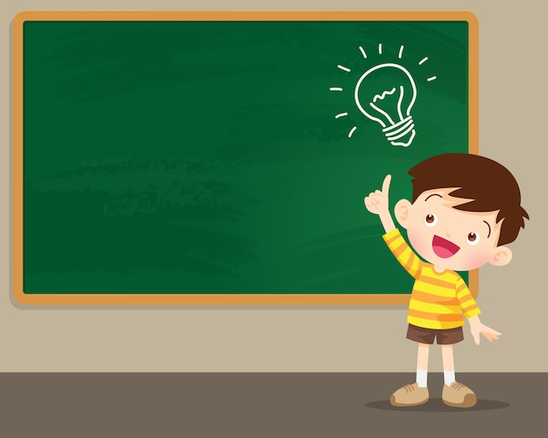
REFLECTION

Slide 4
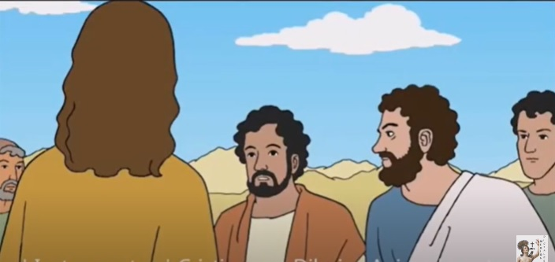
The apostles ask Jesus to teach them to pray.
How does He teach them?
…with the “Our Father”

Slide 5
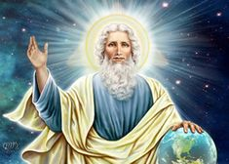
OUR FATHER WHO ARE IN HEAVEN
Jesus teaches us to call God our Father! What a privilege!
Describe your Father in Heaven?

Slide 6
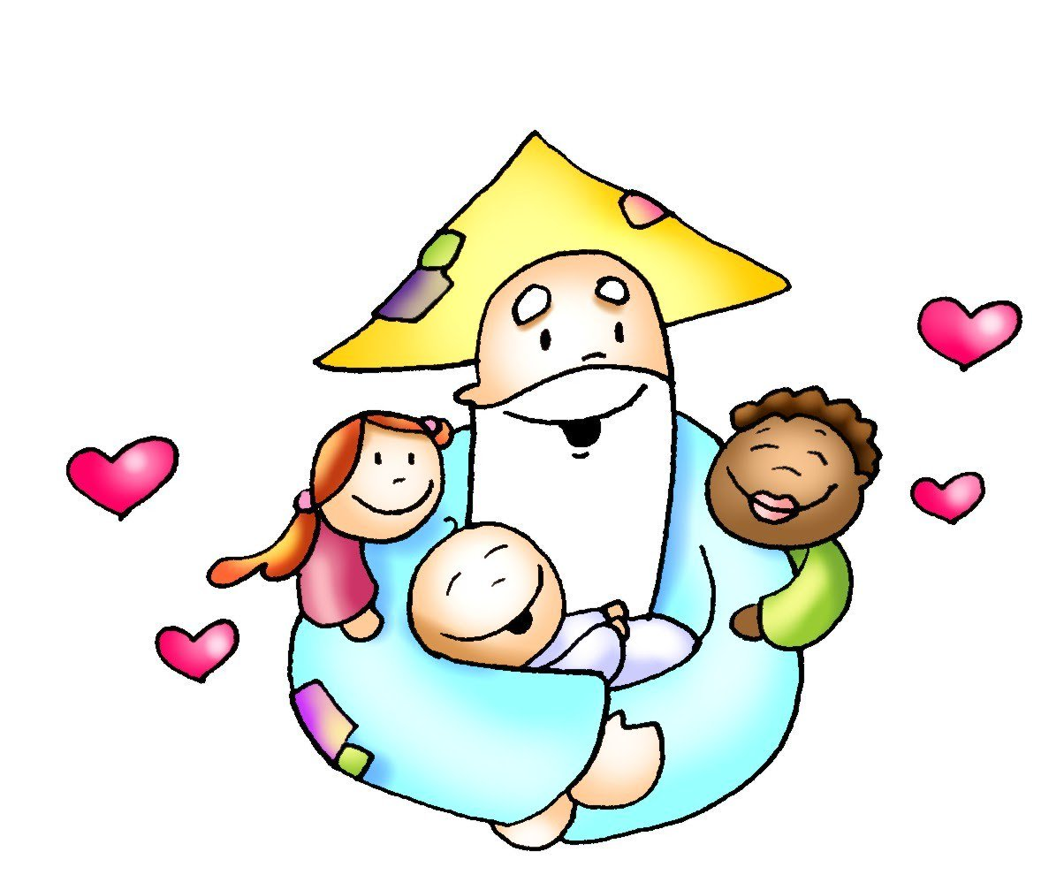
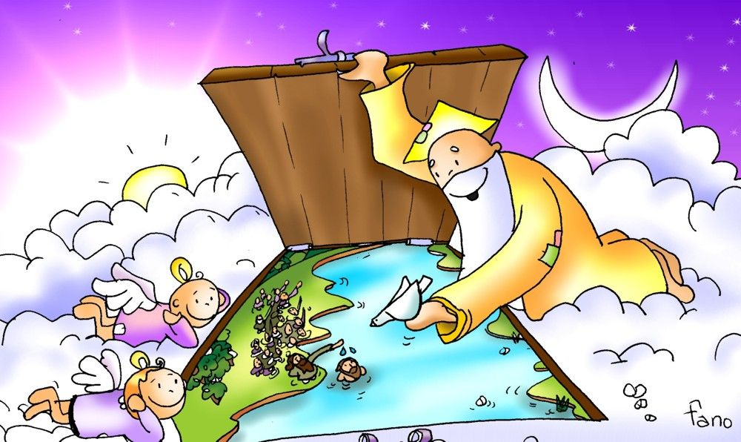
Loving, merciful, good, generous…
…Almighty, strong, eternal… …
He loves us, takes care of us, guides us…

Slide 7
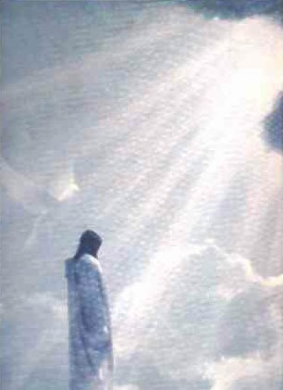
HOLY IS YOUR NAME
How do we keep holy His name?

Slide 8
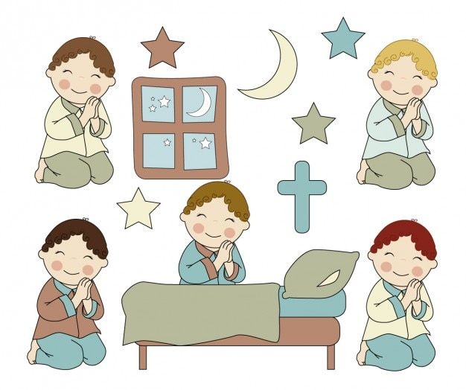
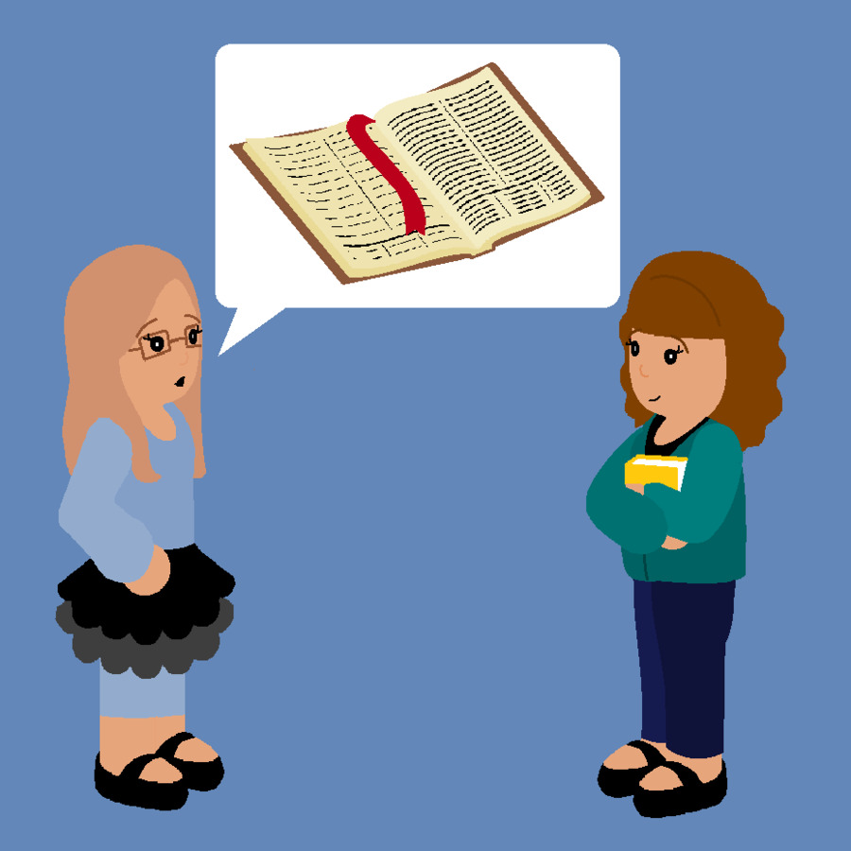
We only use His name with great respect :
When we are praying,
Or speaking well of Him to others.

Slide 9
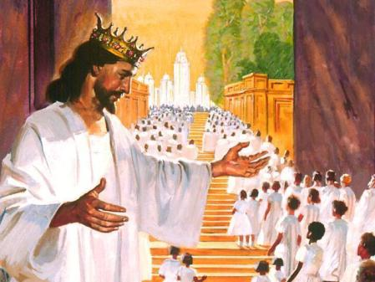
YOUR KINGDOM COME,
YOUR WILL BE DONE,
Describe the Kingdom of God that we want to bring to earth?

Slide 10
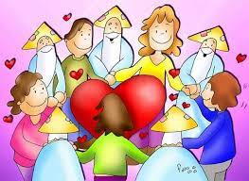
Everyone loves and praises God…
There is peace, joy, and unity.
Everyone does His will.

Slide 11
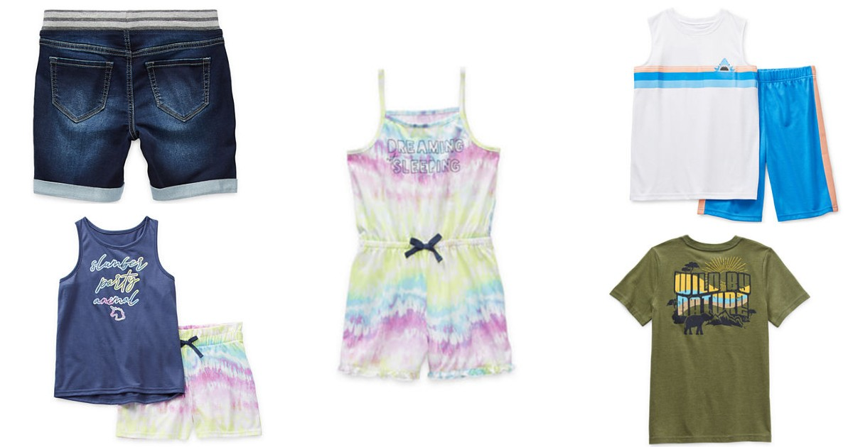
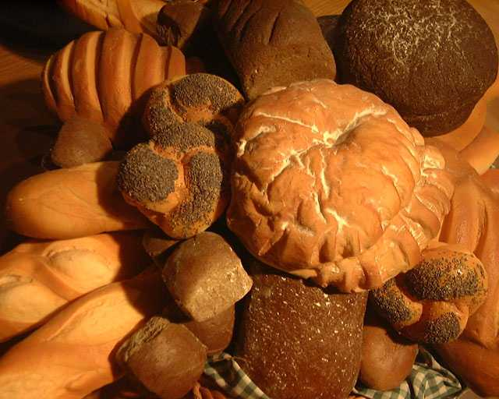
GIVE US THIS DAY OUR DAILY BREAD.
Do we recognize that everything good we have comes from God?
Clothe
Family…
Food

Slide 12
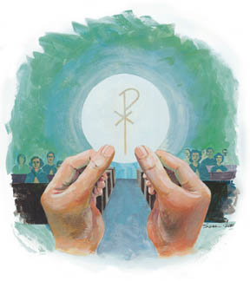
And the Bread of Life…
Jesus present in the Eucharist.

Slide 13
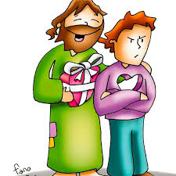
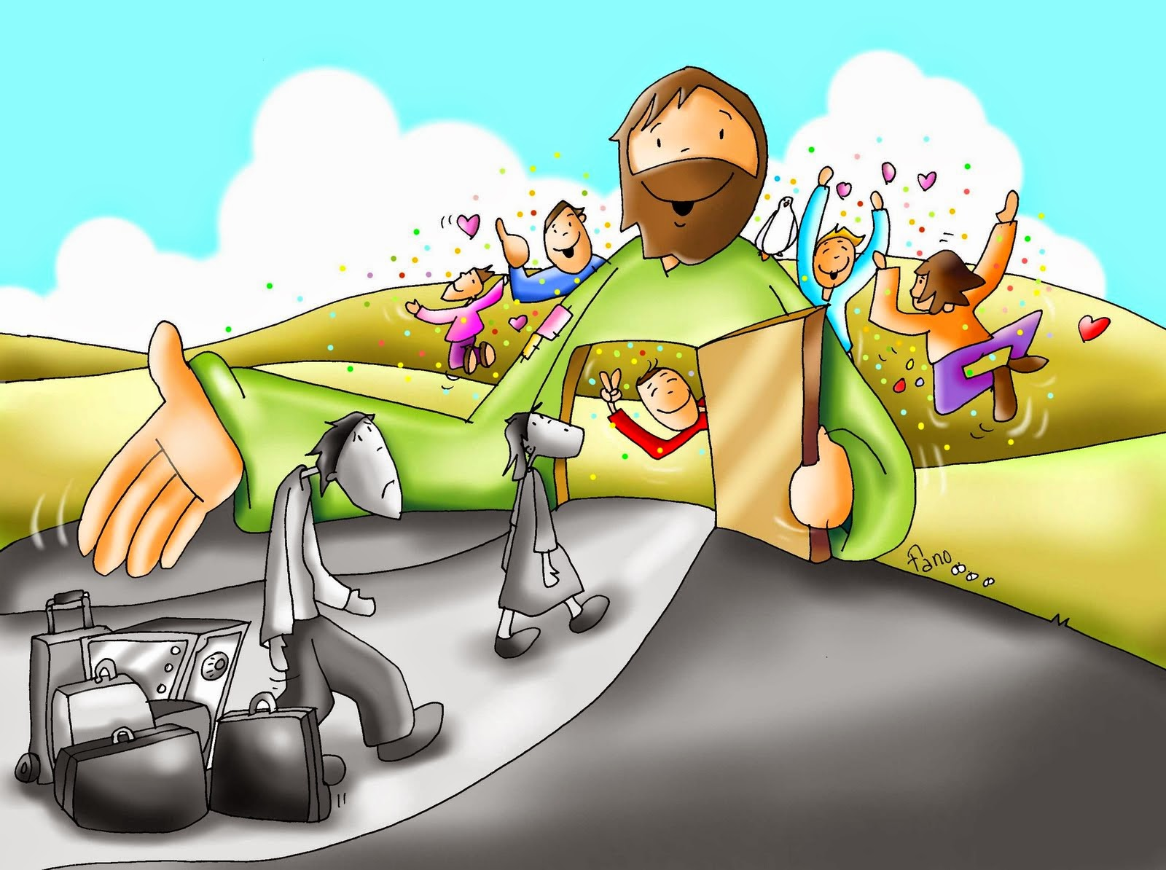
AND FORGIVE US OUR TRESPASSES (SINS),
Without God’s forgiveness, we do not enter Heaven.
Do we ask God for forgiveness for our sins every day?

Slide 14
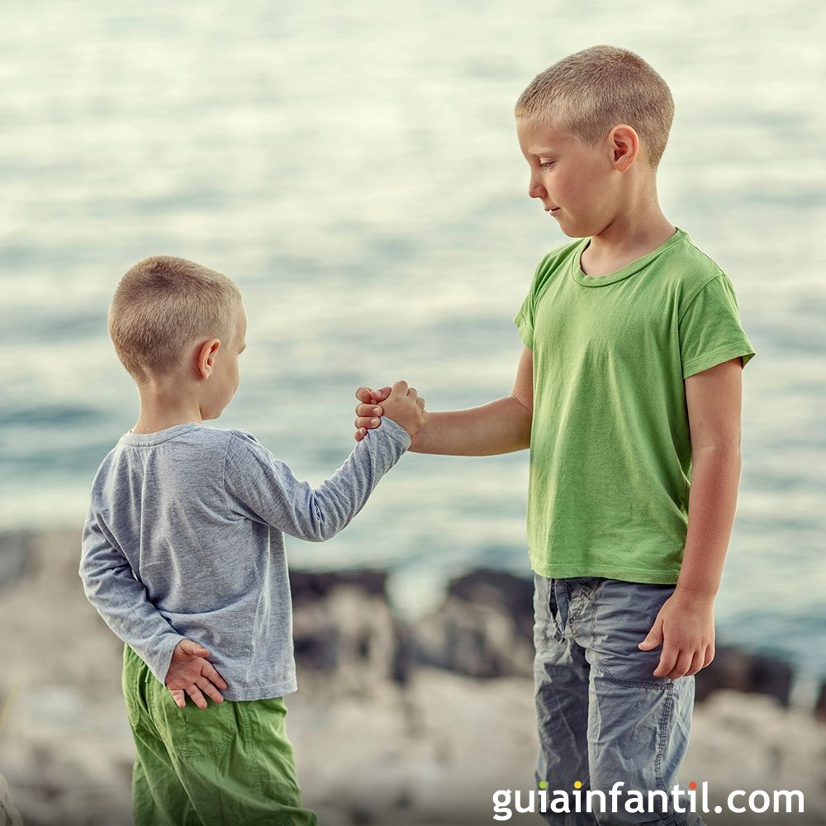
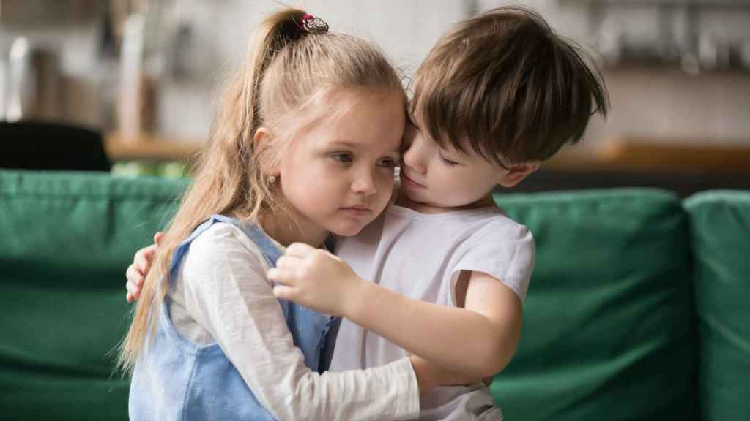
AS WE FORGIVE THOSE WHO TRESPASS (SIN) AGAINST US.
Jesus teaches us that we must forgive others so God may forgive us.
Is there someone you cannot forgive?

Slide 15
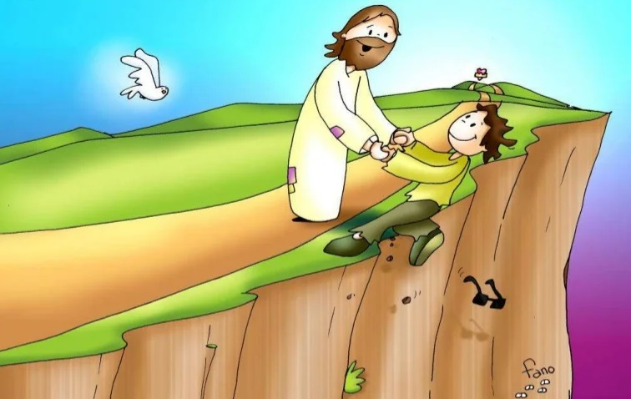
AND LEAD US NOT INTO TEMPTATION,
What is temptation?

Slide 16
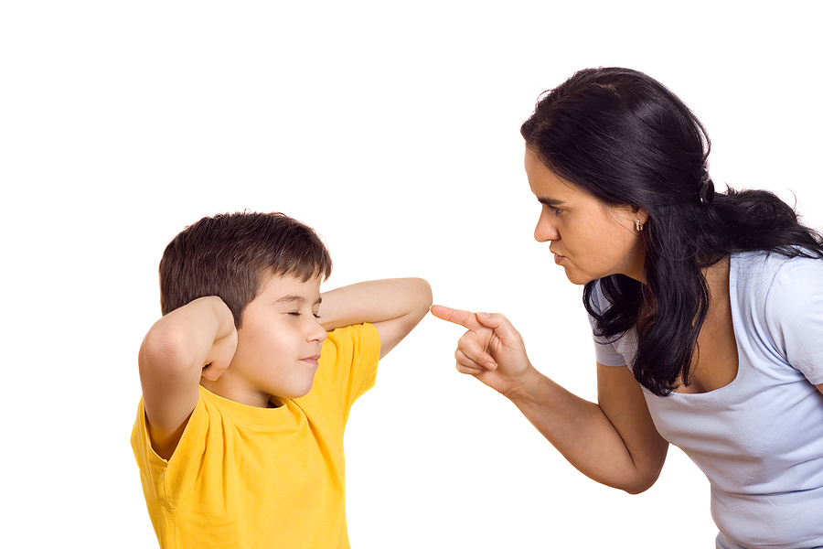
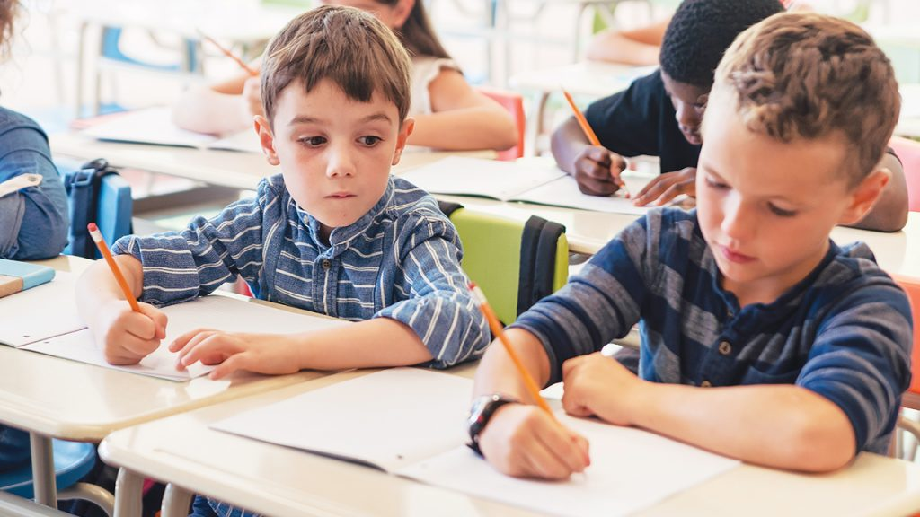
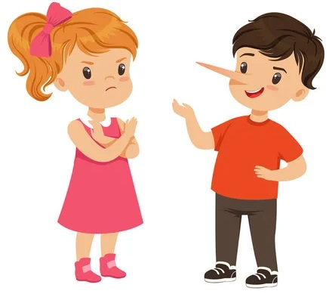
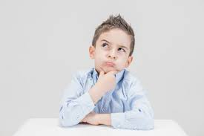
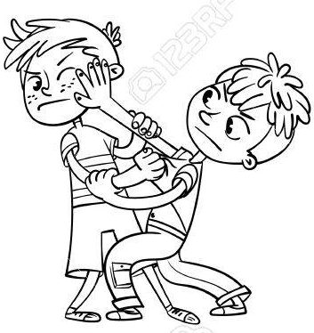
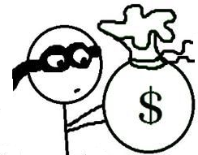
It is when we want to do something we know we should not do.
DISOBEY
COPY
LIE
STEAL
FIGHT
It is only a sin when we say YES to temptation.

Slide 17
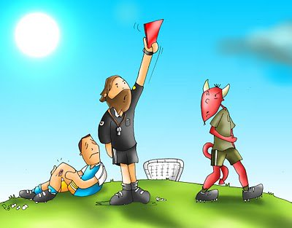
BUT DELIVER US FROM EVIL
We ask God for help because we are weak and
He is ALMIGHTY and can save us.
AMEN

Slide 18
To teach them to pray, Jesus also tells them a parable about a friend who needed 3 loaves of bread.

Slide 19
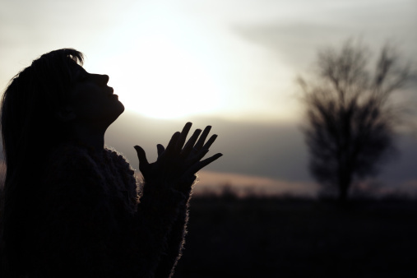
What does Jesus want to teach us in this parable?
Persevere in prayer. A good father always wants to give good things to their children. If it is good for us, with persistent prayer, God will give us what we need.

Slide 20
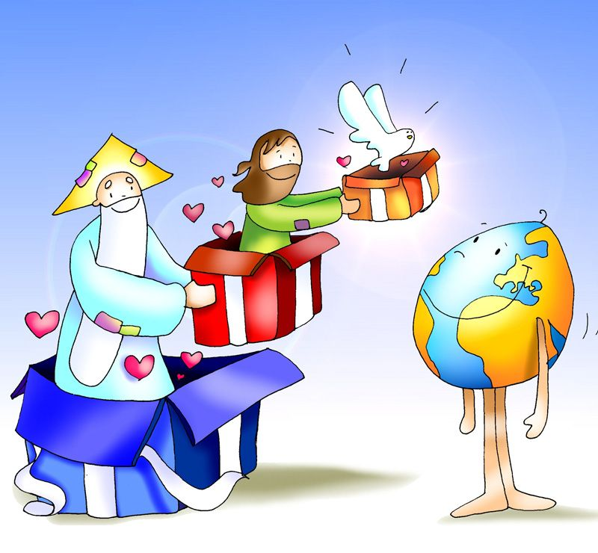
What does God always want to give us?
The Holy Spirit to help us get to Heaven.
Always pray: Come, Holy Spirit, Come.

Slide 21
ACTIVITIES

Slide 22
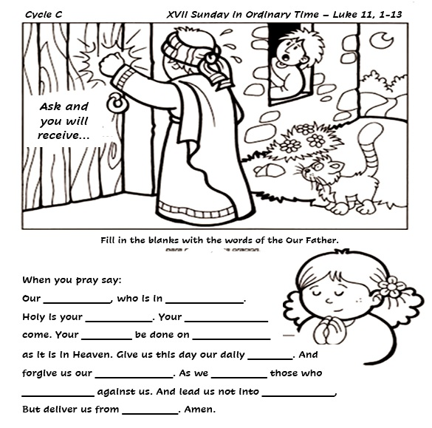
Father
Heaven
name
Kingdom
will
earth
bread
trespasses
forgive
trespass
temptation
evil

Slide 23
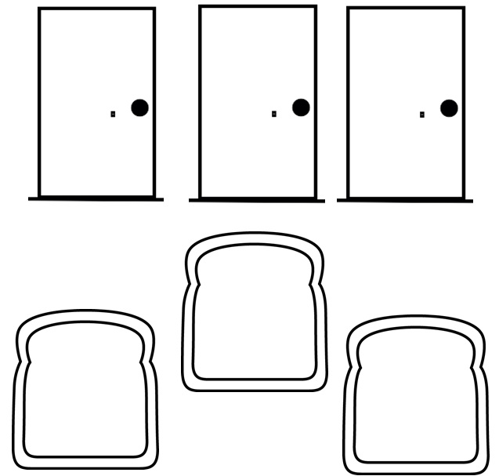
Draw or cut the doors and breads. Write on the doors what you are asking of God. On the breads, write the blessings God has given you. Have each child take their door and bread and place it on the altar saying, “Jesus, I know you always listen.”

Slide 24
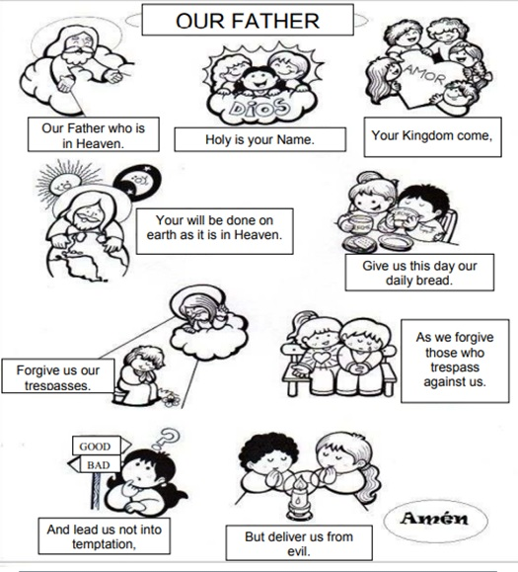
COLOR

Slide 25
PRAYER
Lord, teach me to pray. You are my Father that loves and guides me. Help me to always seek you and to do your Holy will. I know you always listen to me and want the best for me. Send your Holy Spirit in me. Amen.

Slide 26
Song: Our Father, Lord’s Prayer (3-7 years) https://youtu.be/oQUordwB6IQ)

Slide 27
Song: Good, Good Father (8+ years)
https://youtu.be/qlsQrycKKsY

