Slide 1
Ministry Friends of Jesus and Mary
www.fcpeace.org
STORE UP FOR ETERNAL LIFE
Cycle C-XVIII Sunday in Ordinary Time
Luke 12, 13-21

Slide 2
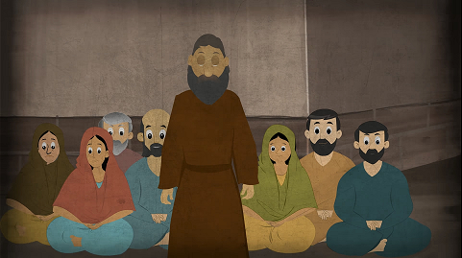
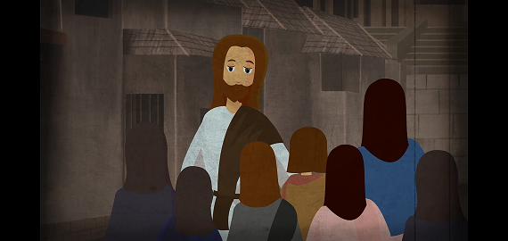
Someone in the crowd said to Jesus, “Teacher, tell my brother to share the inheritance with me.”
He replied to him, “Friend, who appointed me as your judge and arbitrator?”
Then he said to the crowd, “Take care to guard against all greed, for though one may be rich, one’s life does not consist of possessions.”

Slide 3
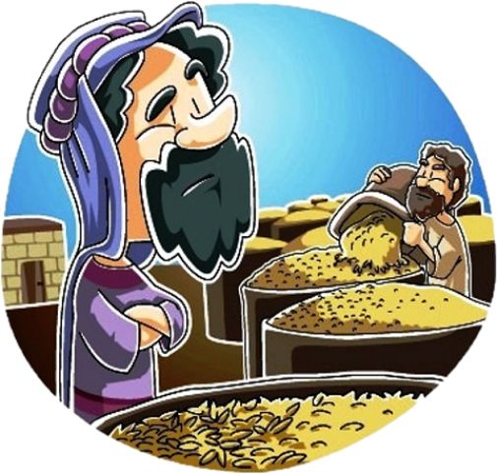
Then he told them a parable. “There was a rich man whose land produced a bountiful harvest. He asked himself, ‘What shall I do, for I do not have space to store my harvest?’

Slide 4
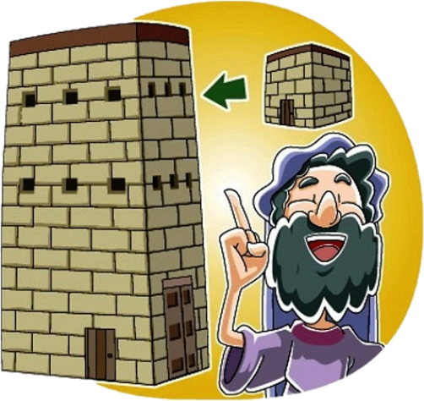
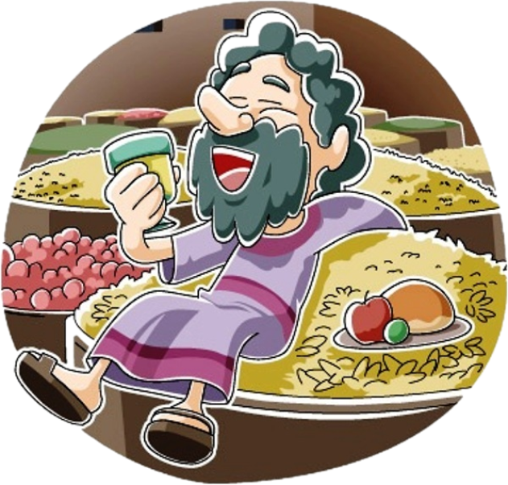
And he said, ‘This is what I shall do: I shall tear down my barns and build larger ones. There I shall store all my grain and other goods and I shall say to myself, “Now as for you, you have so many good things stored up for many years, rest, eat, drink, be merry!”

Slide 5
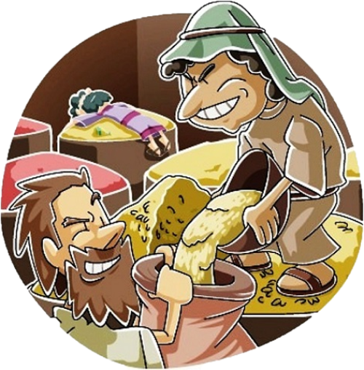
But God said to him, ‘You fool, this night your life will be demanded of you; and the things you have prepared, to whom will they belong?’ Thus will it be for all who store up treasure for themselves but are not rich in what matters to God.”
THE GOSPEL OF THE LORD

Slide 6
REFLECTION

Slide 7
Jesus was in the middle of a crowd. What did a man say to Him?
“Teacher, tell my brother to share the inheritance with me.”
The man is in the presence of a man of God, God Himself, and all he cares about is his inheritance.
What does Jesus answer?
“Who appointed me as your judge and arbitrator?”

Slide 8
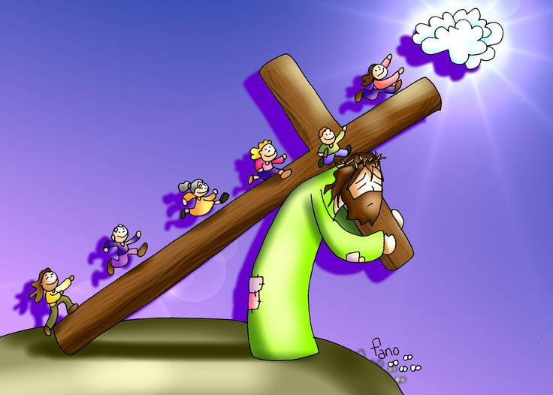
What is Jesus’ mission?
To save souls and to open the gates of Heaven for us with His death on the cross.

Slide 9
¿Do we take our things to Heaven?
NO
What message does Jesus give regarding material goods?
“Take care to guard against all greed, for though one may be rich, one’s life does not consist of possessions.”
Jesus tells them a parable about the rich fool to help them understand what is important.

Slide 10
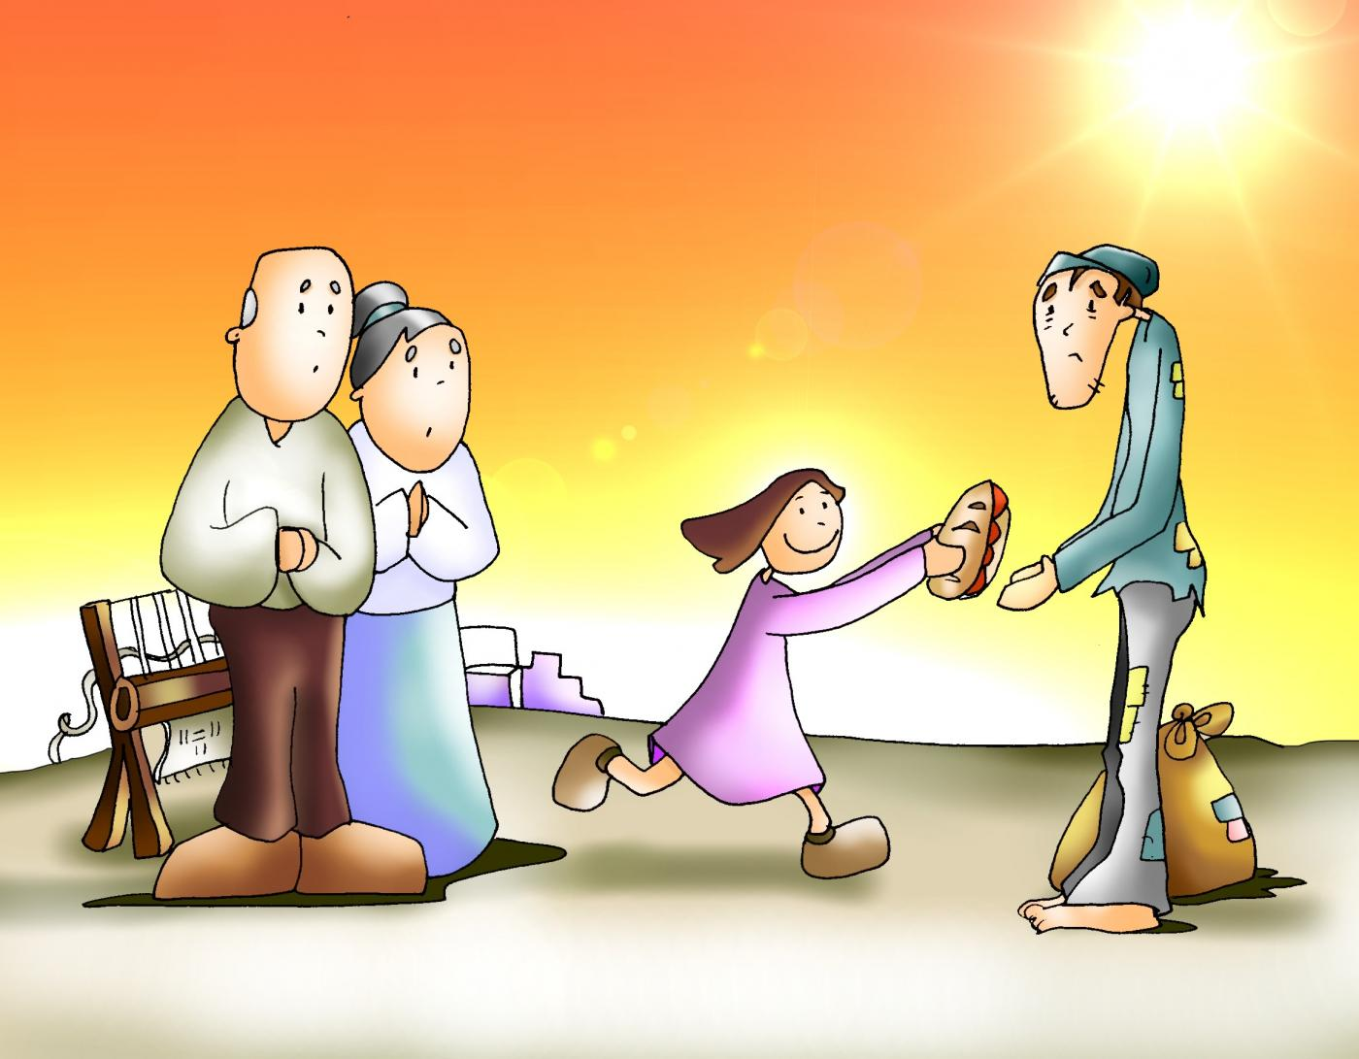
What does Jesus want to teach us with this parable?
The man that only accumulates for himself without thinking of others can lose Eternal Life.
He could have shared his extra wealth with those who had none.
What could he have done differently?

Slide 11
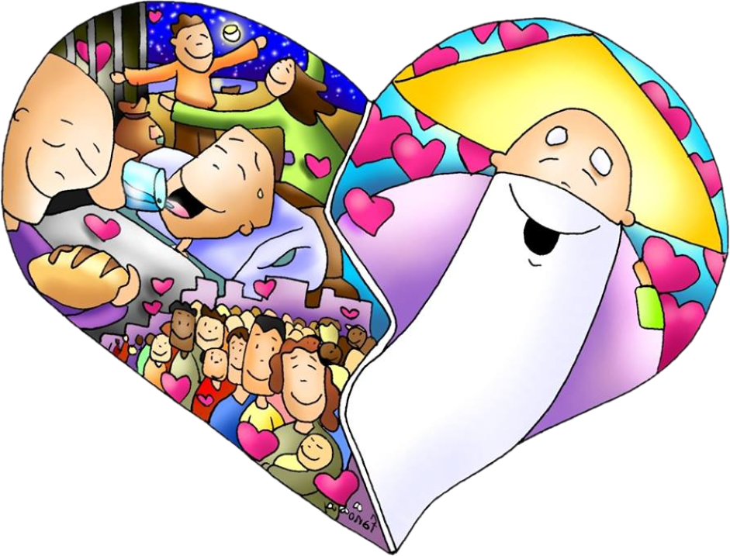
How do we obtain Eternal Life?
Loving God
and
Loving our neighbor.

Slide 12
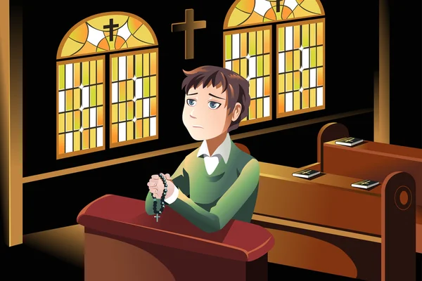
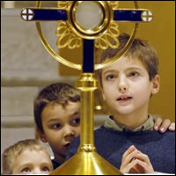
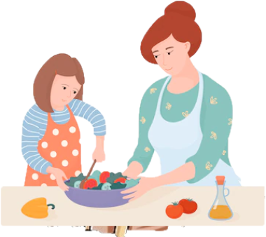
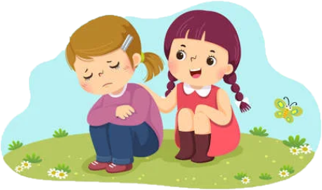
How can we love God?
Spending time with Him in prayer and in Mass,
Reading the Bible,
Adoring Him in the Blessed Sacrament,
Obeying His Commandments.
How can we love our neighbor?
Sharing our time and things, helping and being kind.

Slide 13
ACTIVITIES

Slide 14
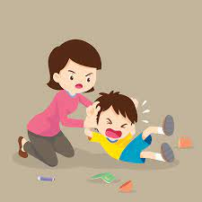
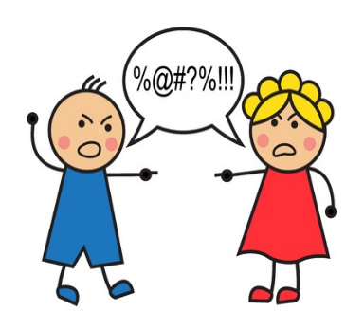
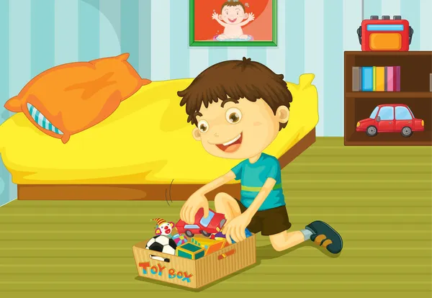
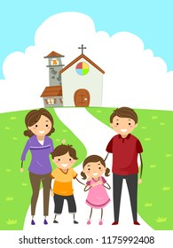
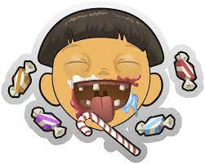
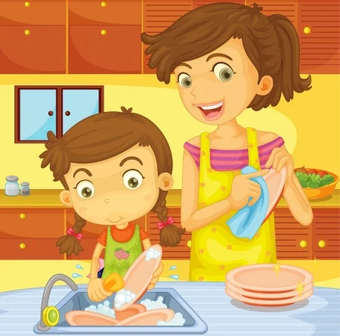
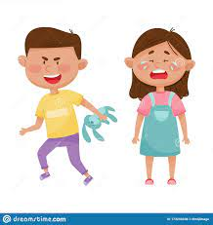
Are these children planting for Eternal Life?
Yes No

Slide 15
Prayer
Lord, thank you for obtaining eternal life for us. Thank you for teaching us how to love and how to be happy. Help us to love You and love each other more every day. Help us to reach eternal life with You. Amen.

Slide 16
Song: Love One Another, Dakota Pyle https://youtu.be/LYlkcoAfLU4 (3-7 years)

Slide 17
Love One Another, Orange Kids Music https://youtu.be/JysQNwalyIQ (8+ years)

