Slide 1
Ministry Friends of Jesus and Mary
Cycle C, XXI Sunday in Ordinary Time
Luke 13, 22-30 The Narrow Door
www.fcpeace.org

Slide 2
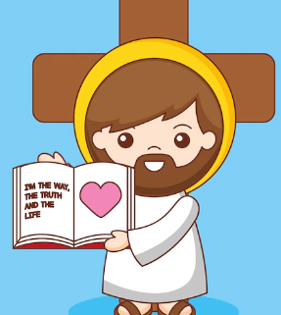
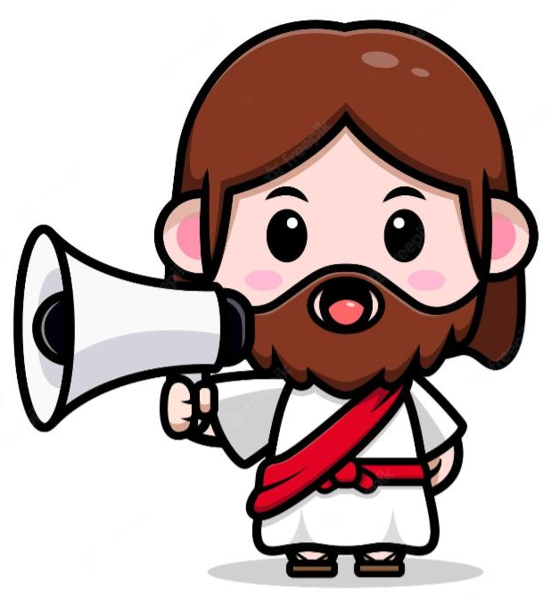
The Narrow Door
Jesus passed through towns and villages, teaching as he went and making his way to Jerusalem. Someone asked him, "Lord, will only a few people be saved?" He answered them,
"Strive to enter through the narrow gate, for many, I tell you, will attempt to enter but will not be strong enough...

Slide 3
The Narrow Door
After the master of the house has arisen and locked the door, then will you stand outside knocking and saying, 'Lord, open the door for us.' He will say to you in reply, 'I do not know where you are from. And you will say, 'We ate and drank in your company and you taught in our streets.' Then he will say to you, 'I do not know where you are from. Depart from me, all you evildoers!'

Slide 4
The Narrow Door
And there will be wailing and grinding of teeth when you see Abraham, Isaac, and Jacob and all the prophets in the kingdom of God and you yourselves cast out. And people will come from the east and the west and from the north and the south and will recline at table in the kingdom of God. For behold, some are last who will be first, and some are first who will be last."
The Gospel of the Lord,
Praise to You Lord Jesus Christ.

Slide 5
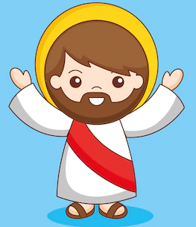
Reflection
To pass on to the next grade you have to meet certain criteria.
What are they?
Share ideas.

Slide 6
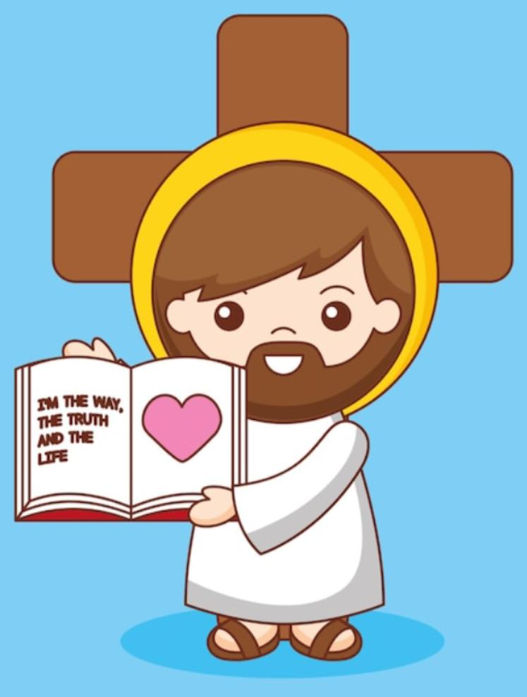
Reflection
Certain behaviors can get you kicked out of school.
What are they?
Share ideas.

Slide 7
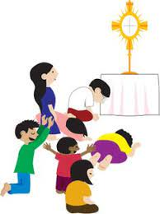
Reflection
Jesus compares salvation to a narrow door where many cannot enter. Jesus says that many will try to enter but He will respond:
‘I don’t know who you are.’
WE MUST KNOW JESUS!
How do we get to know Jesus?

Slide 8
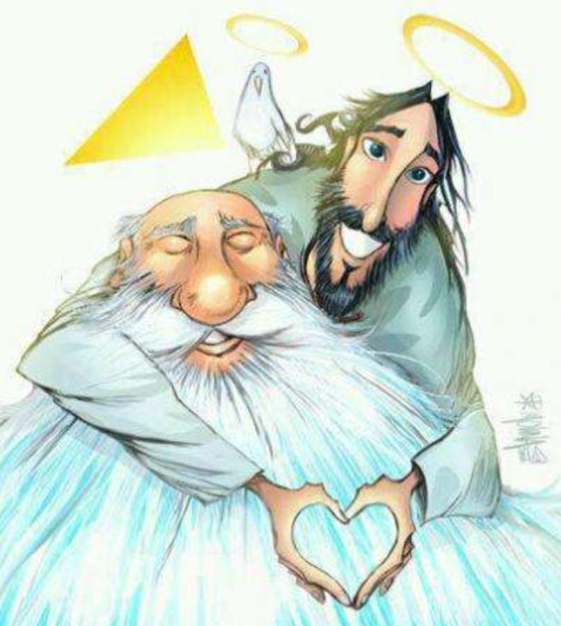
Reflection
Jesus says: ‘Depart from me, all you evildoers!’
If we know and love Jesus, do we want to do evil?
No!
We love Him and want to please Him obeying His commandments of Love.

Slide 9
Reflection
What good things can we do to please Jesus?
Share ideas.

Slide 10
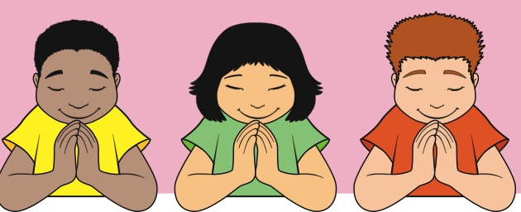
Reflection
Each day we can grow in friendship and love with Jesus and share that love with others, thereby gaining eternal life.
We can also pray for those who do not know Jesus and for those who have separated themselves because of sin so they may return to Jesus and be saved.

Slide 11
Song
SONG: Obey Obey O Obey The Lord https://youtu.be/ivNK3RawfxA (3-7 years)

Slide 12
Song
SONG: I Will Obey, Crossings Kids Worship https://youtu.be/n_skYhGRLVg (8+ years)

Slide 13
Juguemos
Let’s Play!

Slide 14
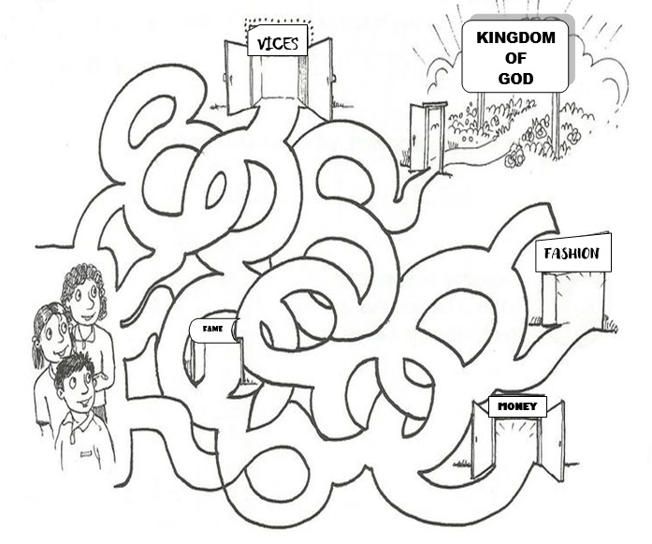
Juguemos
Find the way that leads us to enter through the narrow door to the Kingdom of God.
Let’s Play

Slide 15
Let’s Play
CHOOSE WHICH HELP US ENTER THROUGH THE NARROW DOOR.
Spend a lot of money.
Pray a lot.
Adore Jesus in the Blessed Sacrament.
Lie.
Help my neighbor.
Love God always.
Pray the Rosary.

Slide 16
Let’s pray!
PRAYER
Lord, help me to know you more, to follow you more, to obey you more each day. I want you to be my best friend. Guide me to someday reach the Kingdom of God with you.
Amen.

