Slide 1
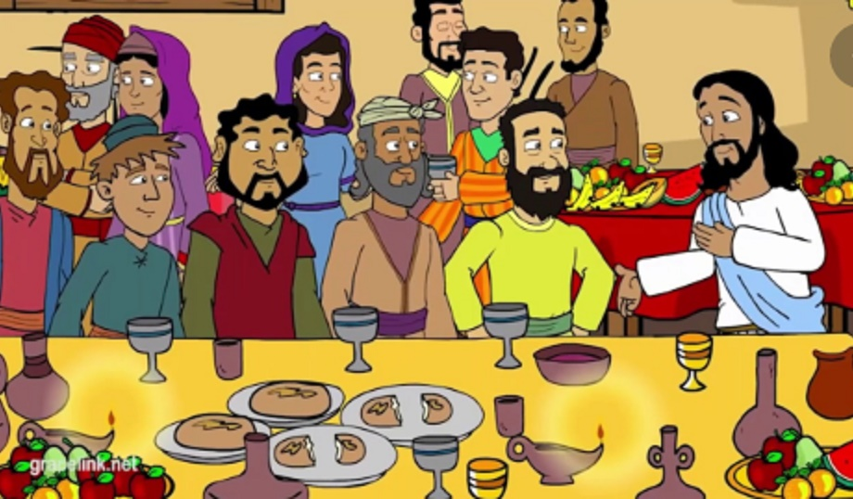
FRIENDS OF JESUS AND MARY
Prayer Group for Children
Cycle C- XXII Sunday in Ordinary Time
Luke 14, 1. 7-14
Take the Lowest Place at the Banquet Table
www.fcpeace.org

Slide 2
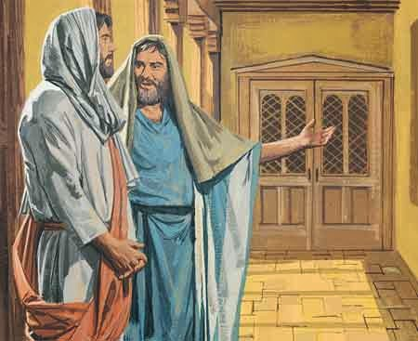
On a sabbath Jesus went to dine at the home of one of the leading Pharisees, and the people there were observing him carefully.

Slide 3
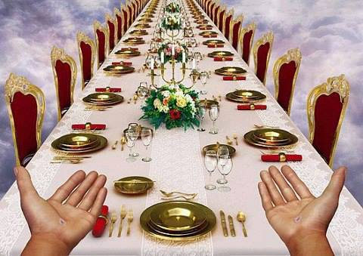
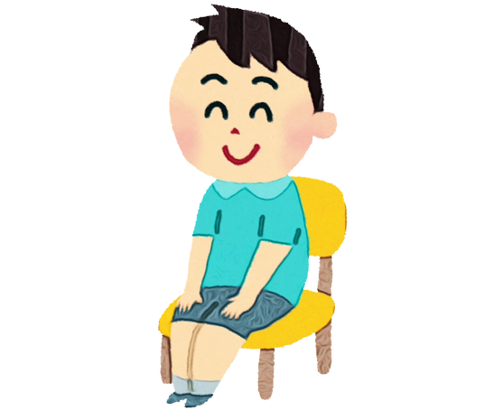
He told a parable to those who had been invited, noticing how they were choosing the places of honor at the table. "When you are invited by someone to a wedding banquet, do not recline at the table in the place of honor. A more distinguished guest than you may have been invited by him, and the host who invited both of you may approach you and say, 'Give your place to this man,' and then you would proceed with embarrassment to take the lowest place.

Slide 4
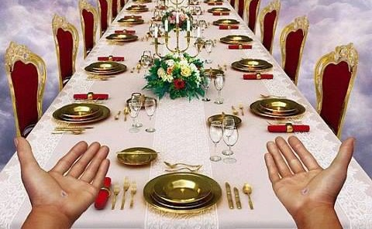
Rather, when you are invited, go and take the lowest place so that when the host comes to you he may say, 'My friend, move up to a higher position. 'Then you will enjoy the esteem of your companions at the table .

Slide 5
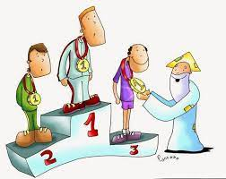
For every one who exalts himself will be humbled, but the one who humbles himself will be exalted.”

Slide 6
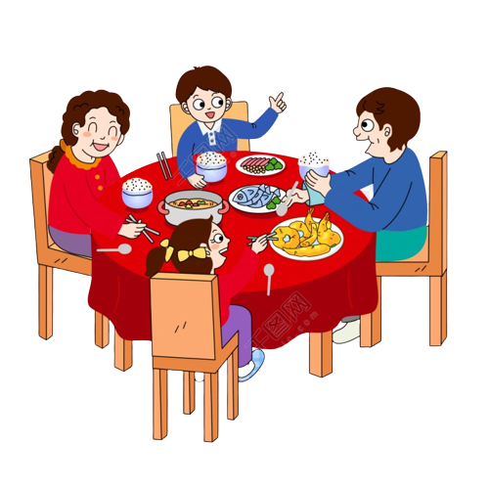
Then he said to the host who invited him, "When you hold a lunch or a dinner, do not invite your friends or your brothers or your relatives or your wealthy neighbors, in case they may invite you back and you have repayment.

Slide 7
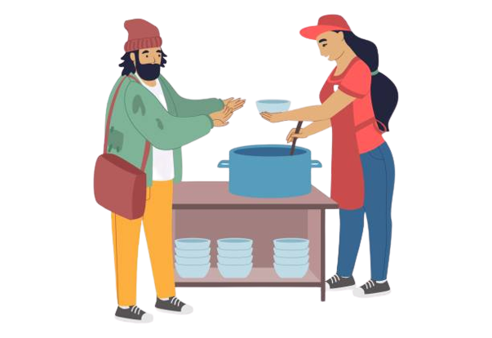
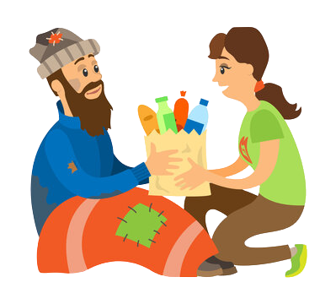
Rather, when you hold a banquet, invite the poor, the crippled, the lame, the blind; blessed indeed will you be because of their inability to repay you. For you will be repaid at the resurrection of the righteous.”
The Gospel of the Lord. Praise to You Lord Jesus Christ.

Slide 8
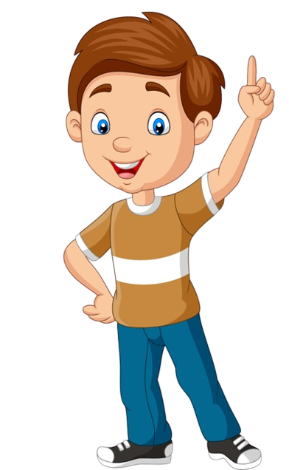
REFLECTION

Slide 9
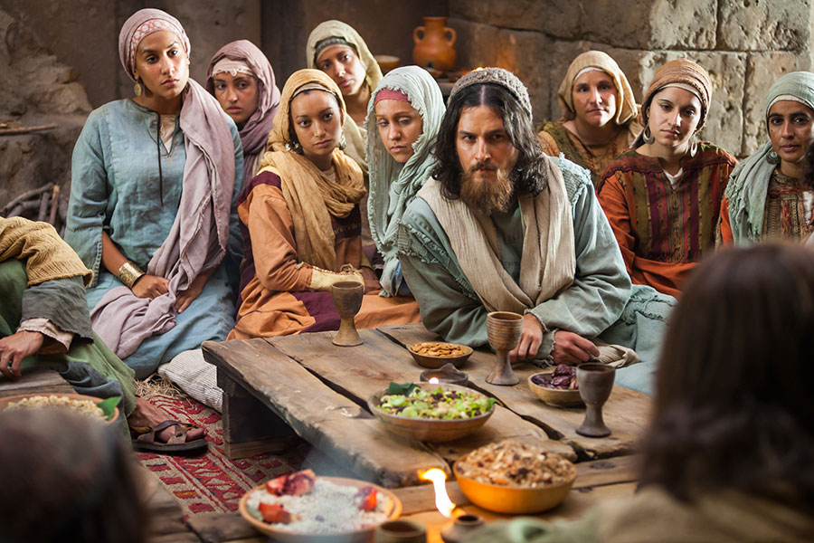
When Jesus went to dine with one of the leading Pharisees, the leaders of the Jewish faith, He saw how many were trying to sit in the places of honor at the table.
Why did they do this?
They wanted to be recognized as more important than the others. recibir bien.

Slide 10
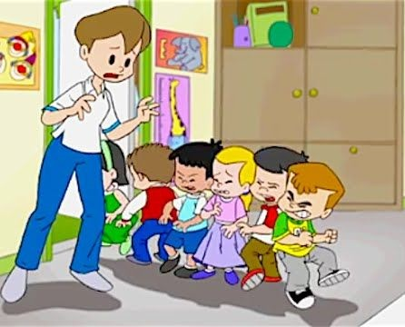
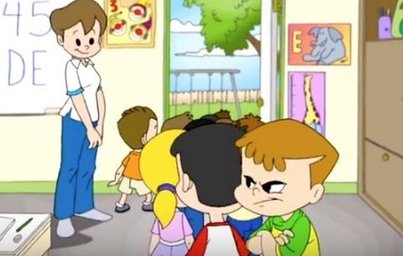
Have you ever tried to be first in line in school or in sports?
Share your thoughts.
Ellos tampoco tendrán casa y cama porque irán por el mundo llevando su mensaje a todos.

Slide 11
Otro seguidor quería enterrar a su padre primero.
Jesus tells them a parable, a story with a teaching, so they can better understand the lesson.
What does Jesus say?
When you are invited to a wedding banquet, do not sit in the first place, instead choose the last place.

Slide 12
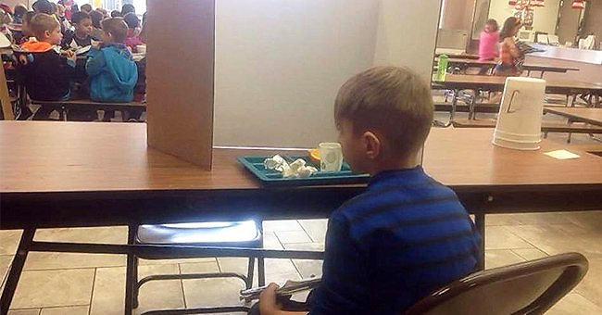
What reason does He give?
If someone more important arrives, they may move you to the last place and you will feel humiliated.
“El que… mira hacia atrás no sirve para el Reino de Dios.” Jesús quiere que confíen en El y que mantengan sus ojos en la misión.

Slide 13
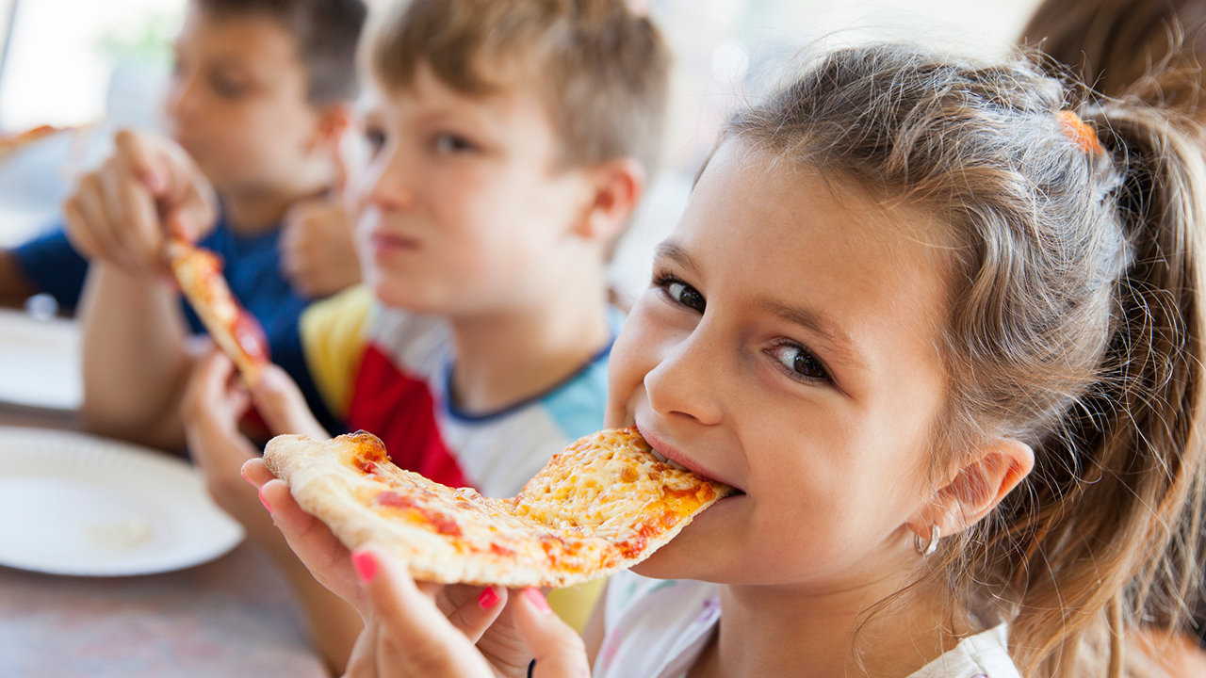
) How would you feel if you sat in the last place and they moved you to the first place?
Happy and grateful.

Slide 14
Jesus wants to teach us the importance of being humble.

Slide 15
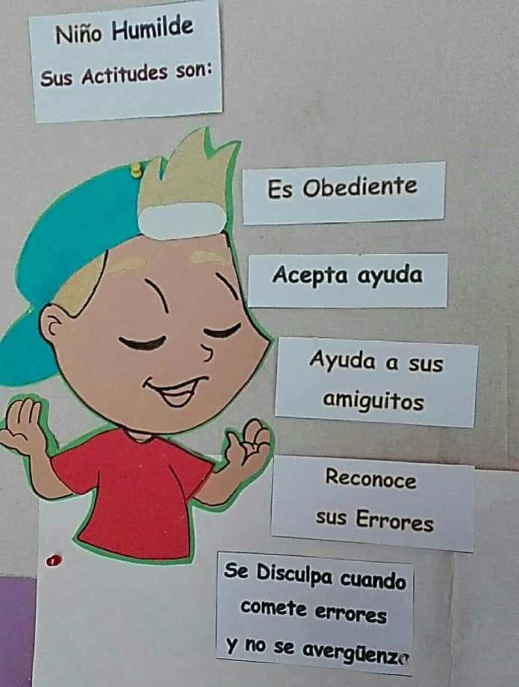
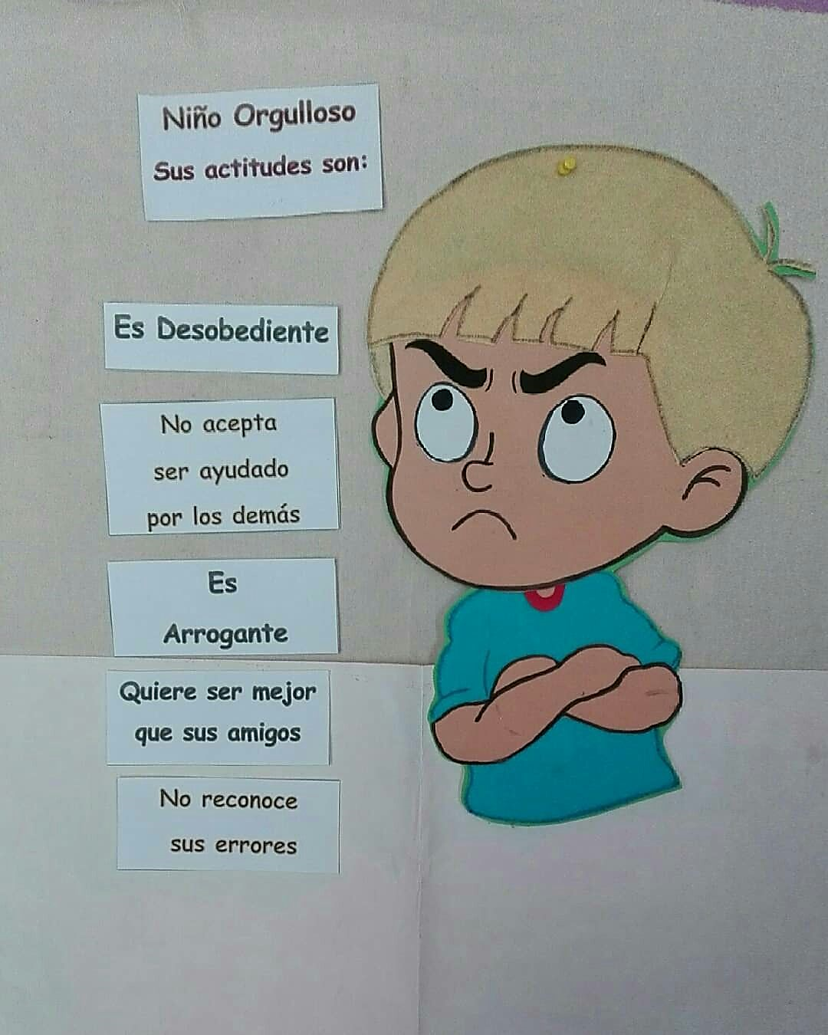
What does it mean to be humble?
oración
obediencia
A humble child…
A proud child is...
Is obedient,
Is disobedient,
Accepts help,
Does not accept help from others,
Helps his/her friends,
Misa
amor
Is arrogant,
Realizes his/her mistakes,
Wants to be better than his/her friends,
Does not recognize his/her mistakes.
Asks forgiveness and is embarrassed when he/she makes mistakes.

Slide 16
A humble person does not consider himself better than others because of personal qualities or possessions; instead, they know all blessings are gifts from God.
Everything is a
oración
obediencia
perdón
Misa
amor
Gift from God!

Slide 17
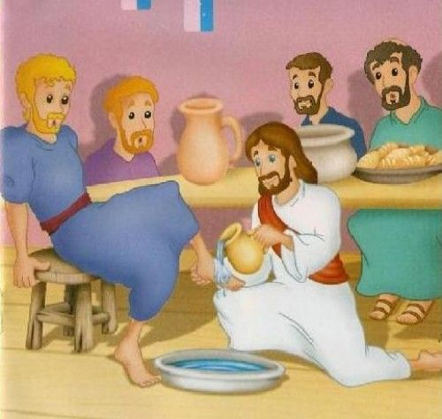
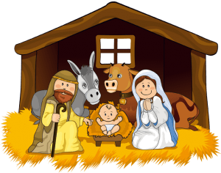
Jesus is God, King of the Universe and He teaches us with His life that we should be humble so we may enter the Kingdom of Heaven.
Can you give examples of Jesus being humble?
oración
obediencia
Jesus Christ
perdón
Misa
King of the Universe…
amor
He wasborn in a poor stable and never had a house,
He washed the feet of his apostles like a slave…

Slide 18
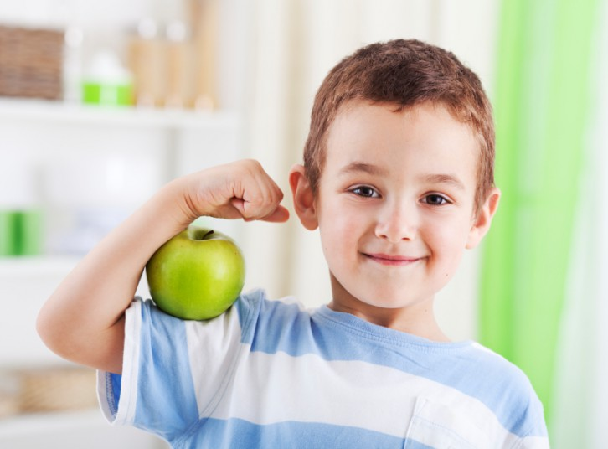
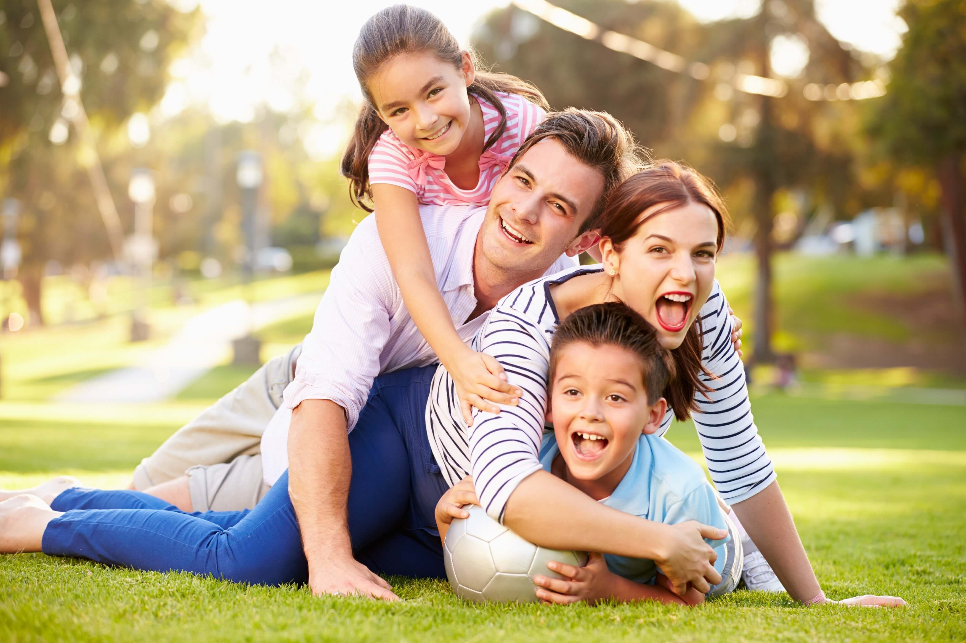
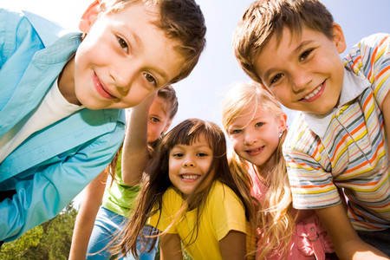
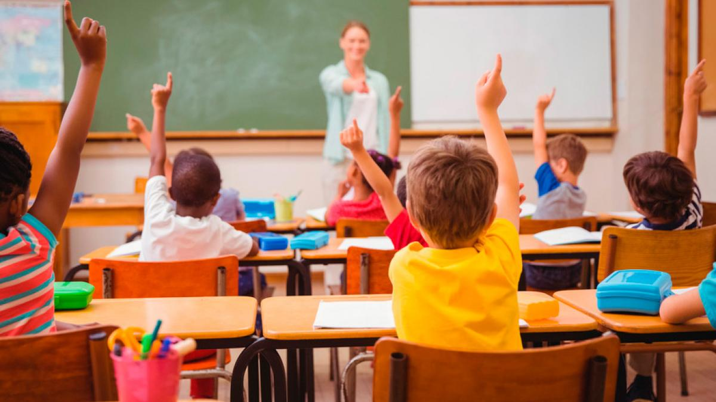
If we know that all our qualities and things are gifts from God and not of our own doing, we are grateful and always thank Him.
Thank you God for the Blessings!
oración
obediencia
perdón
Health
Family
Misa
amor
Friends
School

Slide 19
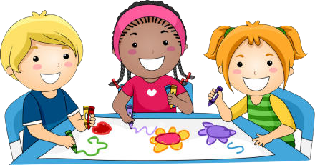
ACTIVITIES

Slide 20
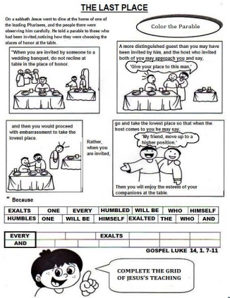
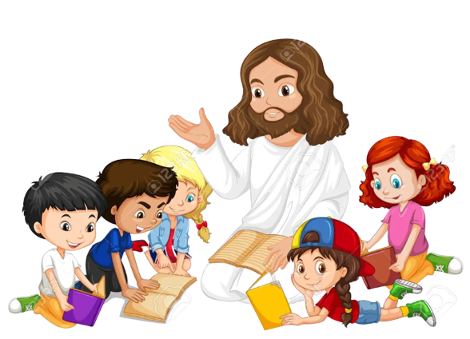
Color the Gospel and complete the table with Jesus’ teaching.
ONE
WHO
HIMSELF
WILL BE
HUMBLED
THE
ONE
WHO
HUMBLES
HIMSELF
WILL BE
EXALTED

Slide 21
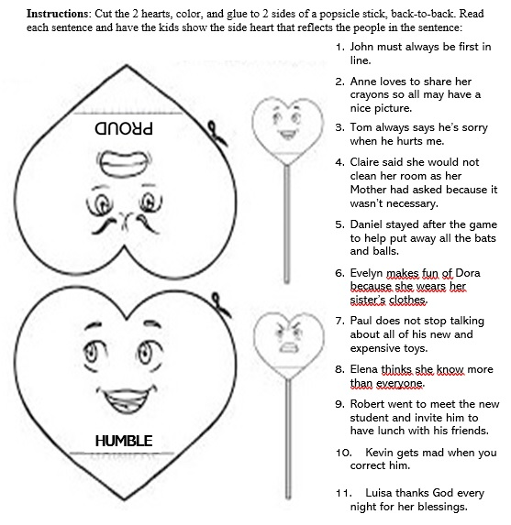
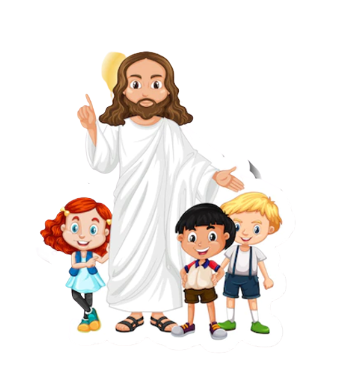

Slide 22
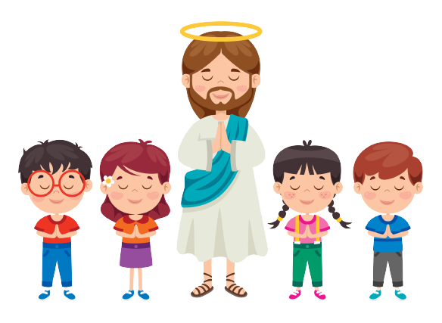
PRAYER
Dear God, help me to always be thankful for all the amazing gifts you give me every day. I know that everything I have comes from you. Help me to be humble like you, giving all for love of others. Amen.

Slide 23
Song: Just be Humble, GoKidzAsia, https://youtu.be/7hdAAANbvl4 (3-7 years)

Slide 24
Song: The Servant Song, servantofthelion, https://youtu.be/kdmgpMfnjdU (8+years)

