Slide 1
Ministry Friends of Jesus and Mary
www.fcpeace.org
XXIV Sunday in Ordinary Time-Cycle C The Lost Sheep (Luke 15, 1-32)

Slide 2
Tax collectors and sinners were all drawing
near to listen to Jesus,

Slide 3
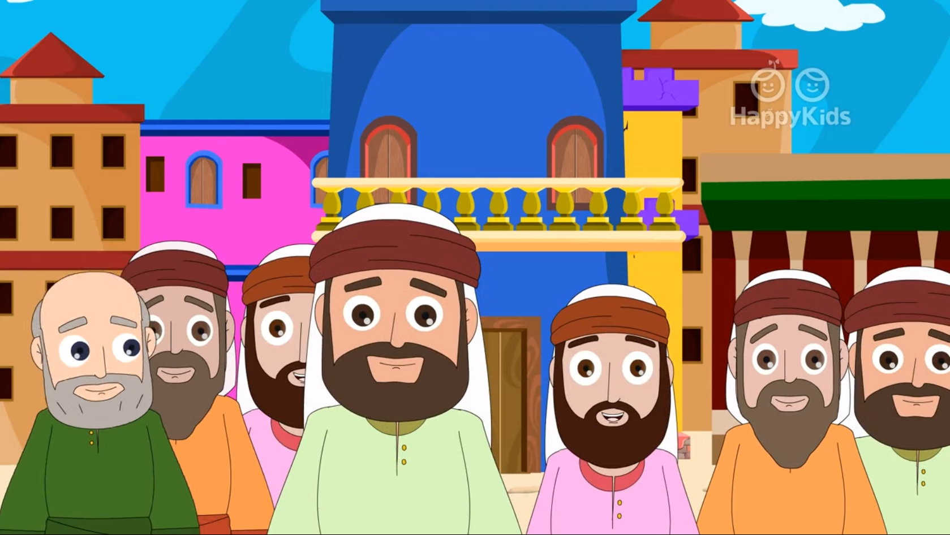
…but the Pharisees and scribes began to complain, saying, “This man welcomes sinners and eats with them.”

Slide 4
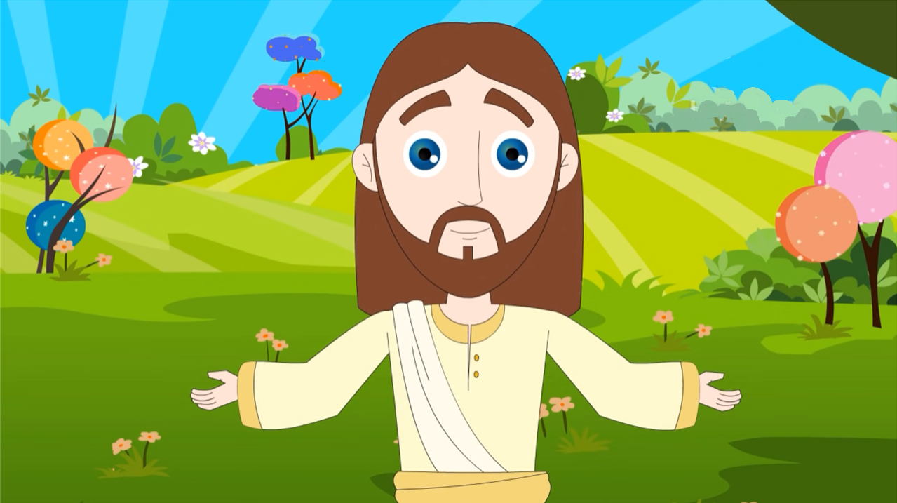
So, to them he addressed this parable. :

Slide 5
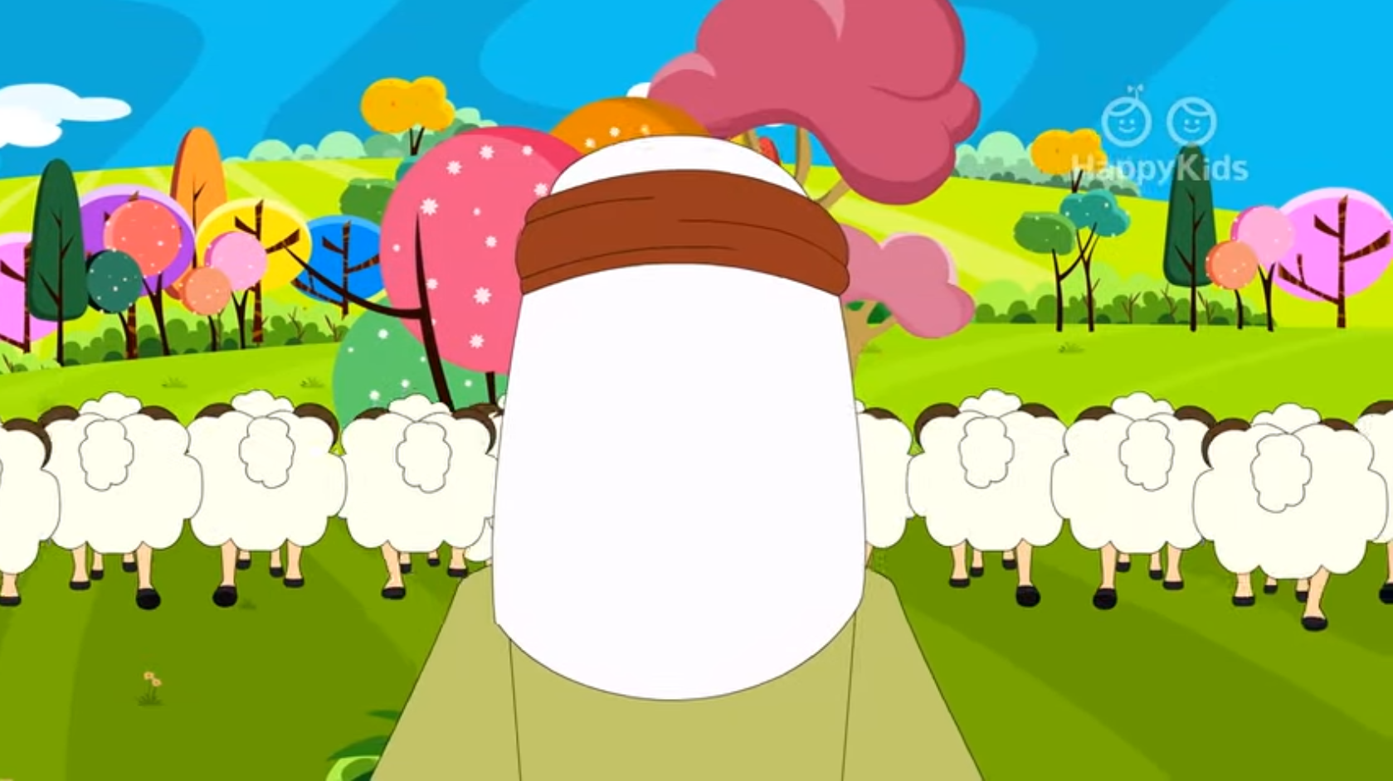
. “What man among you having a hundred sheep and losing one of them would not leave the ninety-nine in the desert...

Slide 6
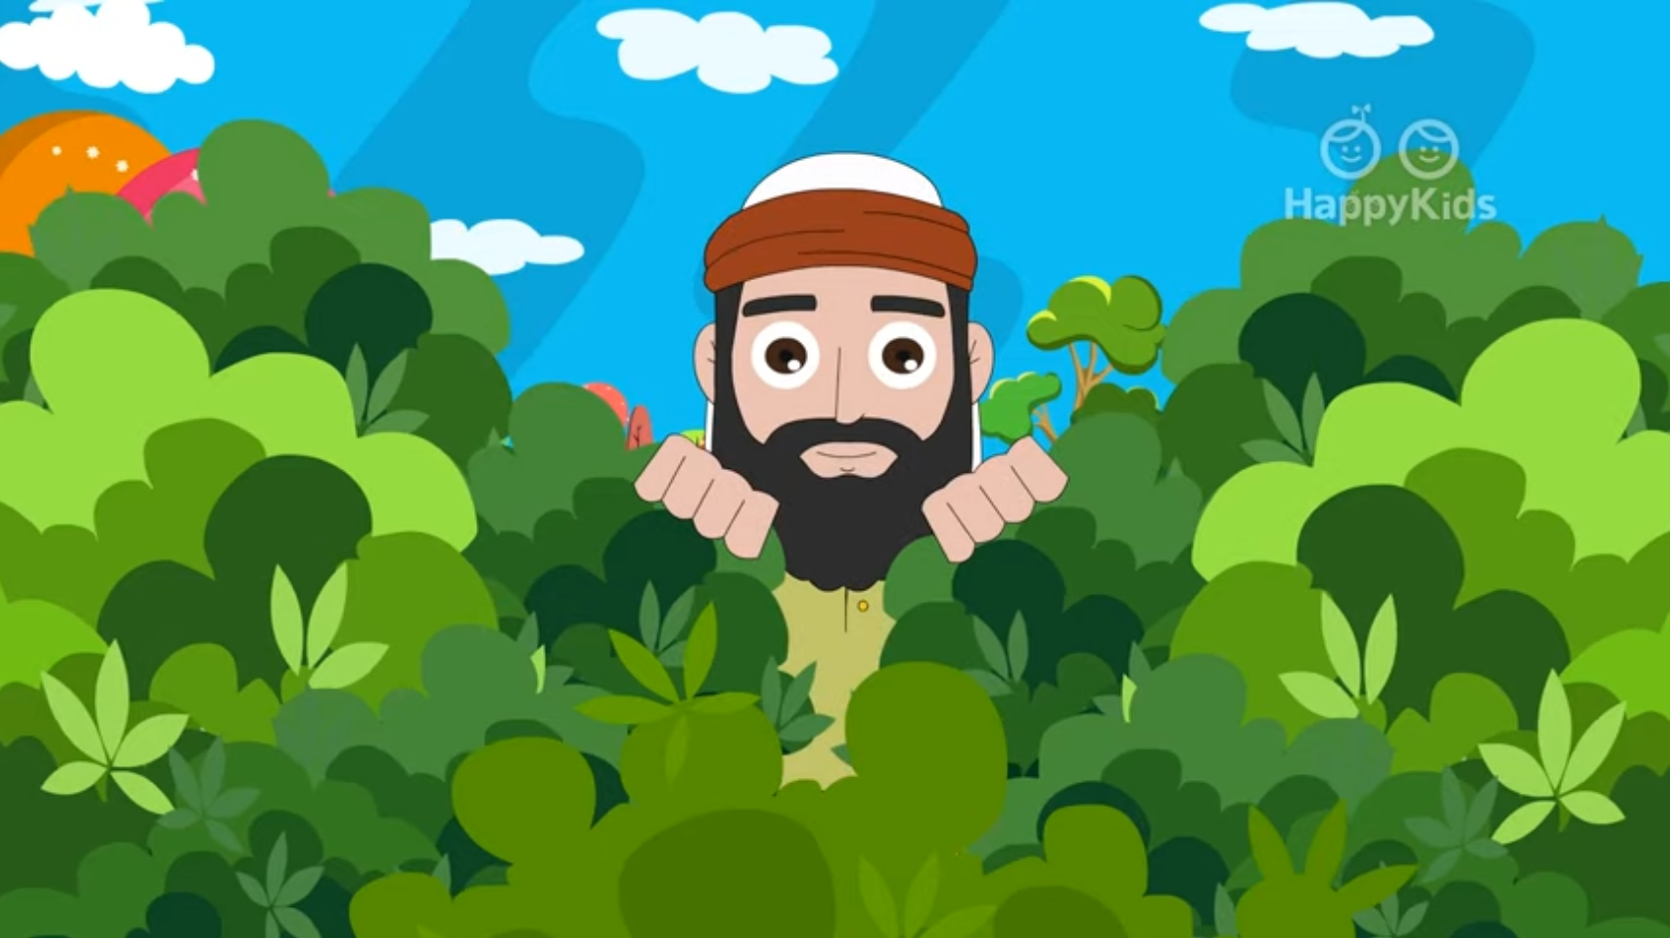
…and go after the lost one until he finds it?

Slide 7
And when he does find it, he sets it on his shoulders with great joy and…

Slide 8
…upon his arrival home, he calls together his friends and neighbors and says to them, ‘Rejoice with me because I have found my lost sheep.’

Slide 9
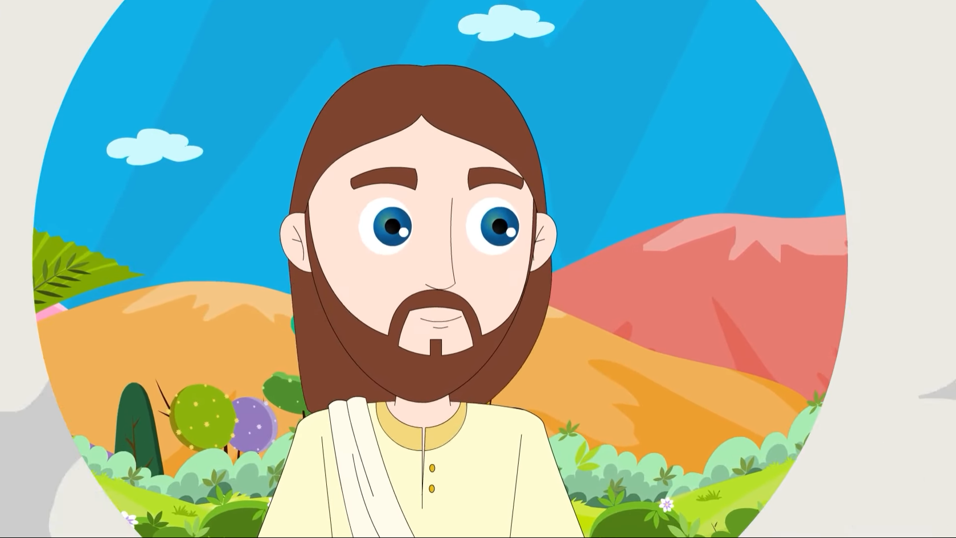
I tell you, in just the same way there will be more joy in heaven over one sinner who repents than over ninety-nine righteous people who have no need of repentance.

Slide 10
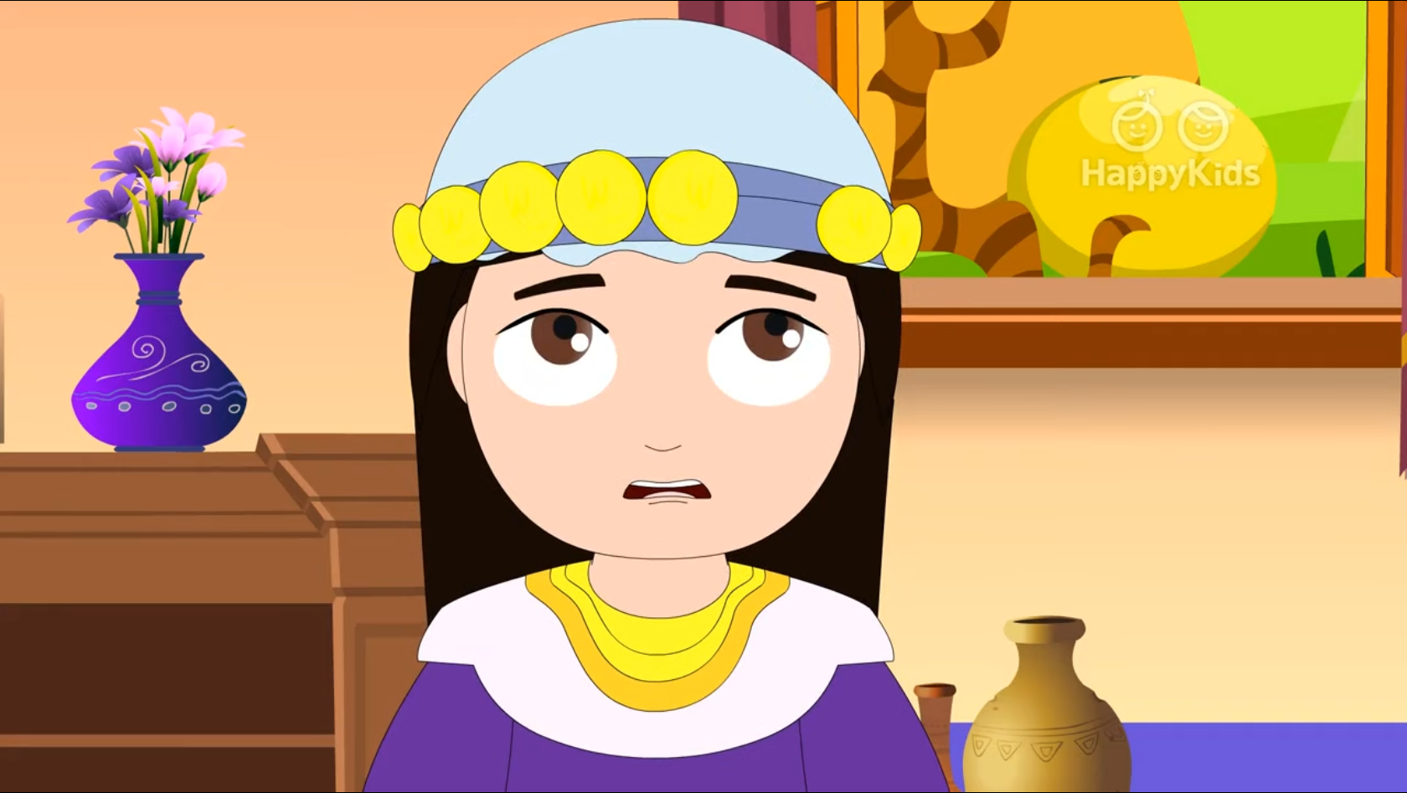
“Or what woman having ten coins and losing one …

Slide 11
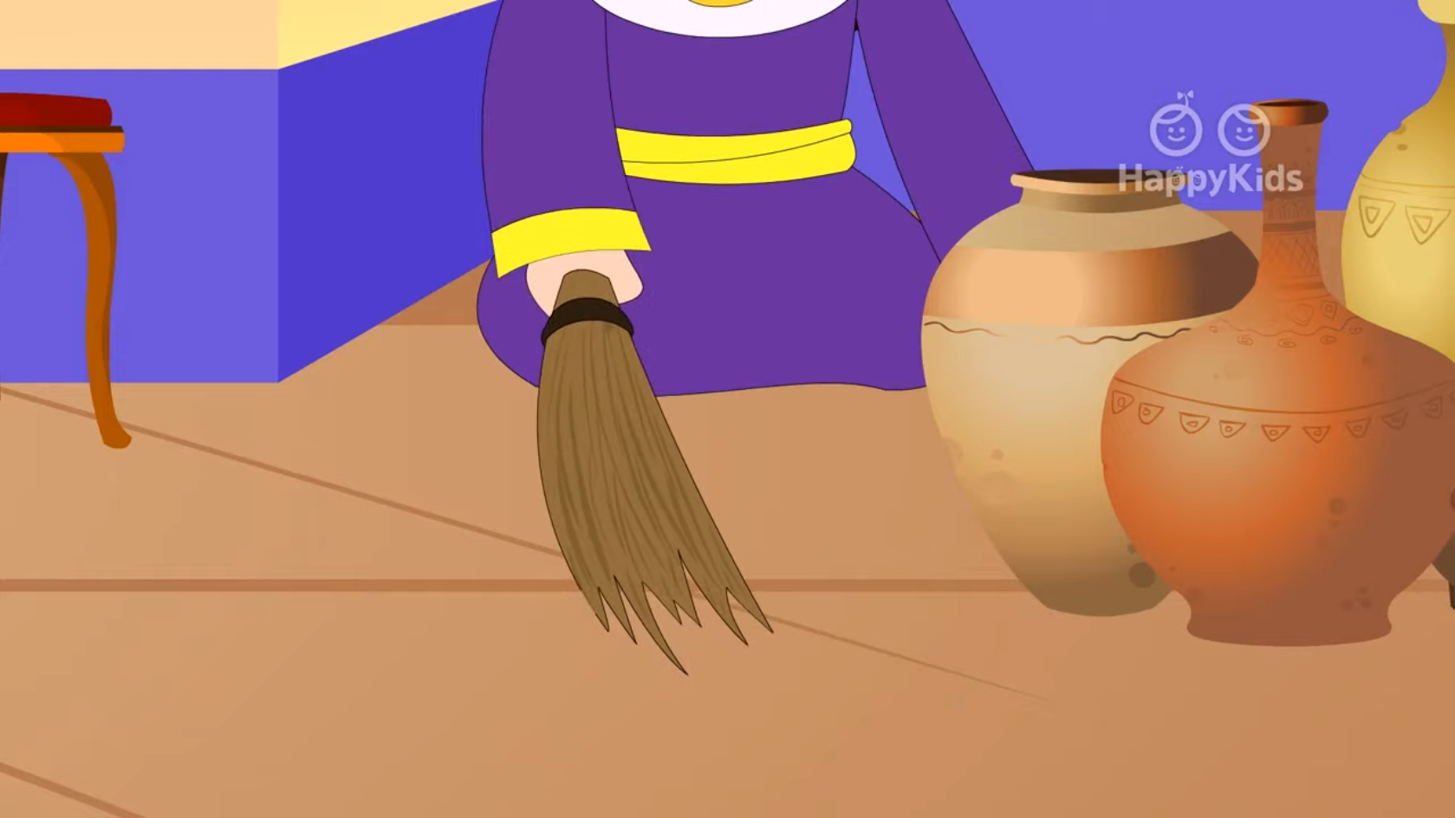
…would not light a lamp and sweep the house, searching carefully until she finds it?

Slide 12
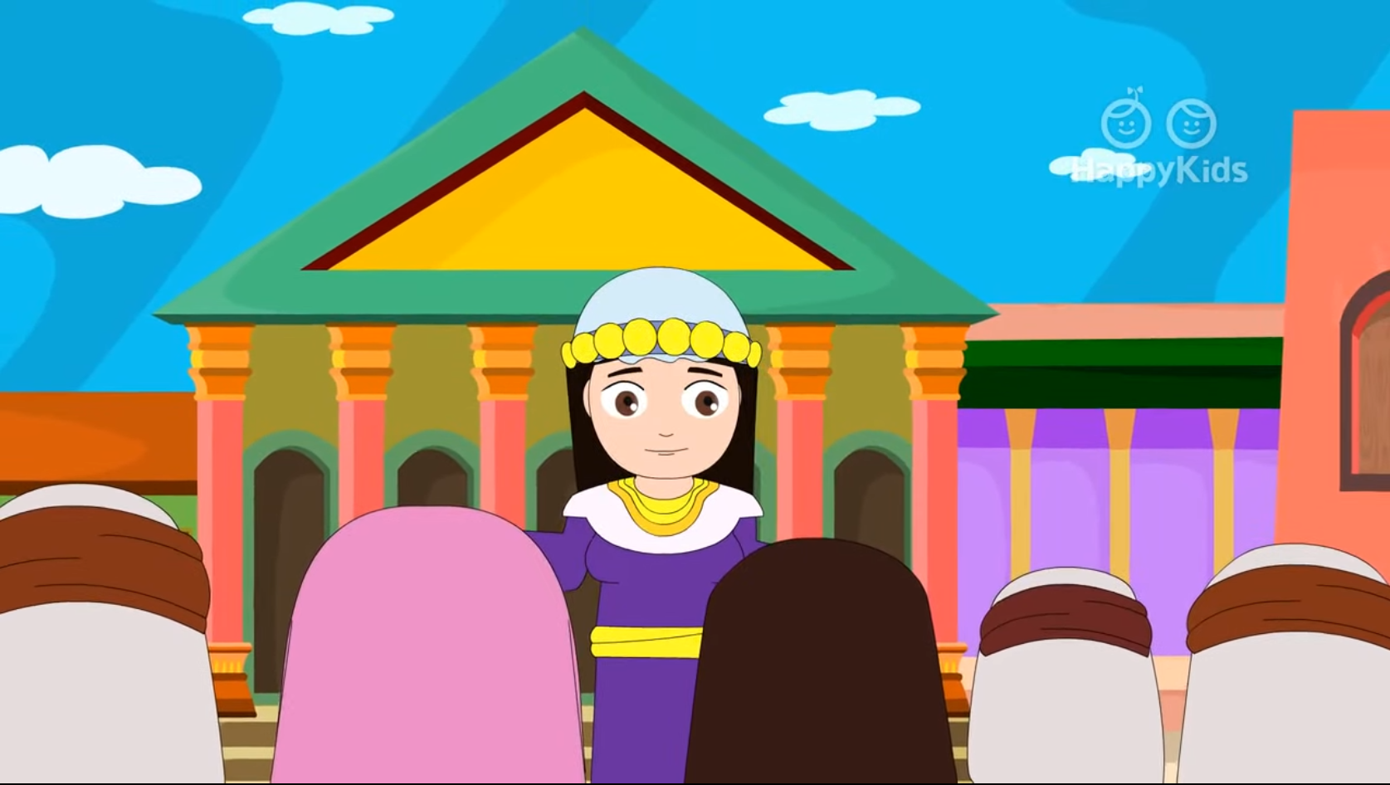
And when she does find it, she calls together her friends and neighbors and says to them, ‘Rejoice with me because I have found the coin that I lost’.’

Slide 13
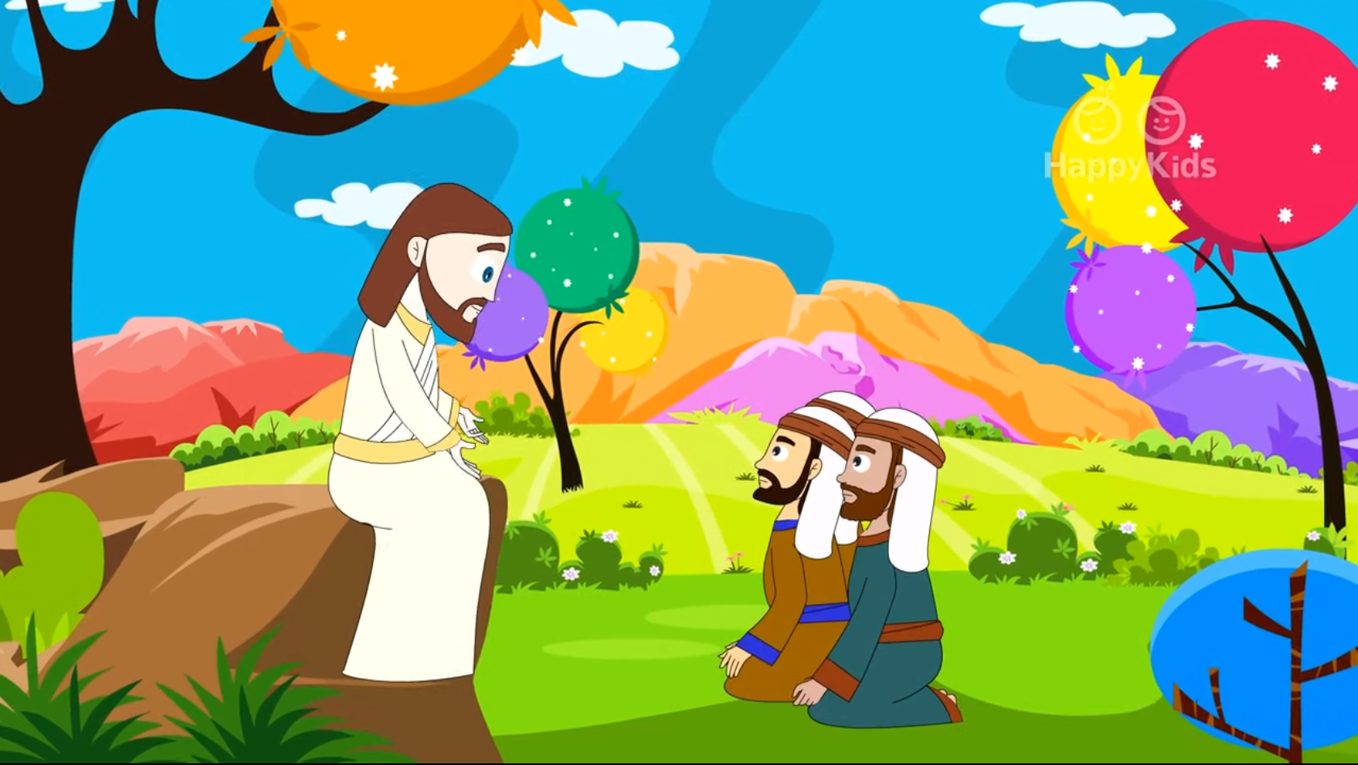
In just the same way, I tell you, there will be rejoicing among the angels of God over one sinner who repents.”
The Gospel of the Lord
Praise to You Lord Jesus Christ

Slide 14
REFLECTION
The Gospel says that the Pharisees and tax collectors approached Jesus to listen. What is a Pharisee?
Leaders of the Jewish faith who were more interested in money and power than in God’s will.
Why are tax collectors considered sinners?
They collected money for the emperor; they often collected more and kept the extra.
Why do the Pharisees object to Jesus talking to the tax collectors and sinners?
They find their actions wrong and so they don’t understand why Jesus doesn’t reject them too.

Slide 15
REFLECTION
Jesus knows what they are thinking and He explains with a parable: a story with a lesson.
Do you remember the first story? What happened to the Shepherd?
He lost his sheep.
How did he feel?
He was worried and sad.
What did the shepherd do?
He left the rest of the flock and went out to find it.

Slide 16
REFLECTION
What did he do when he found the lost sheep?
Full of joy, he carried it over his shoulders and went home to celebrate with family and friends.
Who does the pastor represent?
God, who loves us.
Who does the lost sheep represent?
Us when we disobey God and separate ourselves from Him.

Slide 17
What is the message of the parable?
God loves us very much and when we separate ourselves because of sin, He is saddened and seeks us until He finds us again. All in Heaven celebrate joyfully when a sinner repents and returns to God.
How can we help Jesus in His mission of saving souls?
We can help Jesus by sacrificing and praying for the conversion of sinners.

Slide 18
ACTIVITY

Slide 19
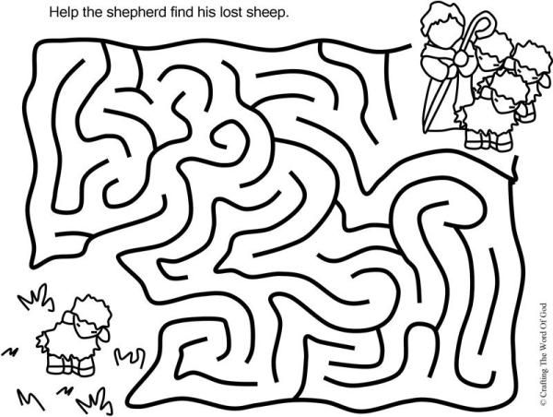

Slide 20
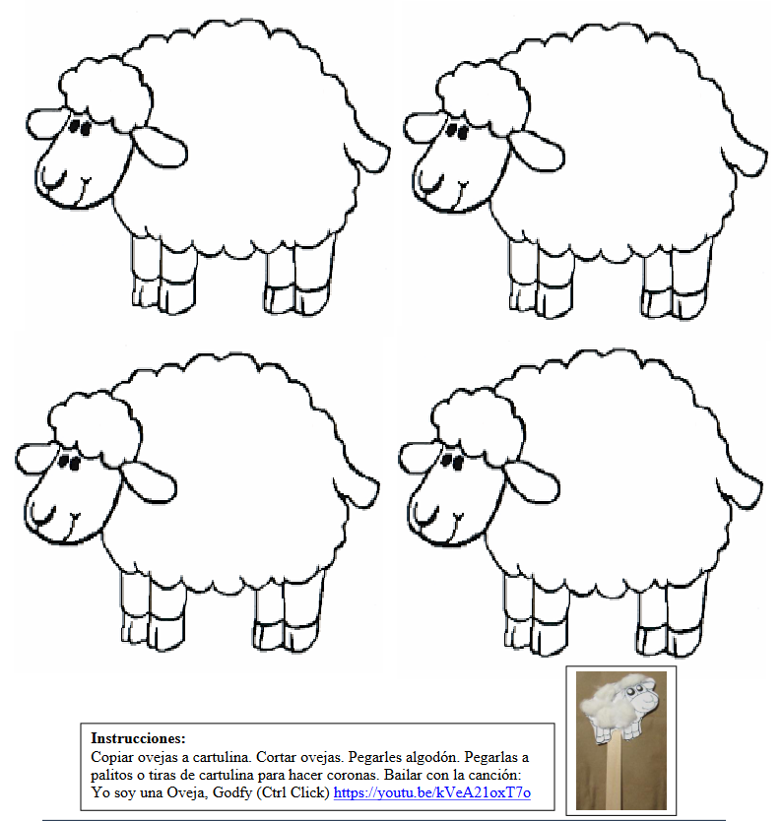
Instructions:
Copy the lamb onto poster paper, cut out, and color. Glue cotton onto the lamb. Glue onto a popsicle stick or strips of cardboard. Dance to the song:
The Lost Sheep, Two by 2, https://youtu.be/iTEhrNeI6Rg
(3-7 years)

Slide 21
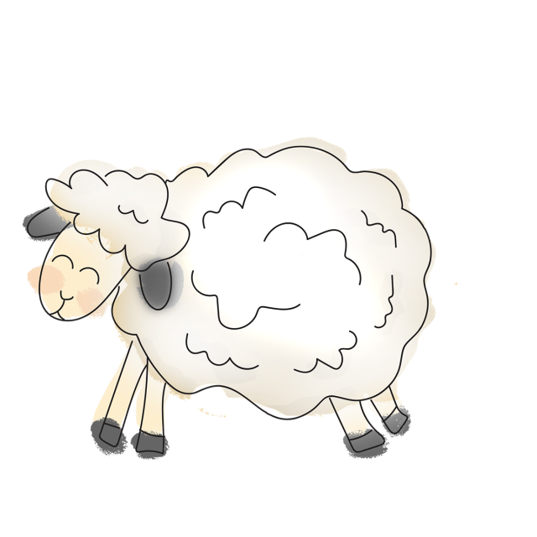
PRAYER
Jesus, thank you for loving me so much. Thank you for seeking me when I leave you. Help me to seek you always and stay by your side. Help me to forgive those who hurt me as you forgive me. Amen.

Slide 22
SONG: The Lost Sheep, Two by 2, https://youtu.be/iTEhrNeI6Rg (3-7 years)

Slide 23
SONG: Hey! Jesus Loves Me, Ill Fight; https://youtu.be/oliRlM6iw3c (8+ years)

