Slide 1
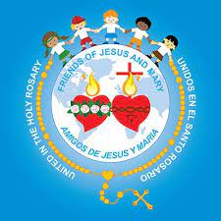
Friends of jesus and mary www.fcpeace.org
CYCLE C - XXIx SUNDAY IN ORDINARY TIME
THE INSISTENT WIDOW
LuKE 18, 1-8

Slide 2
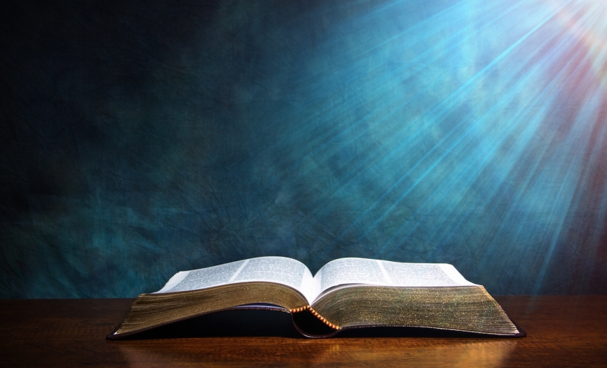
THE GOSPEL ACCORDING TO LUKE 18: 1-8
GLORY TO YOU LORD

Slide 3
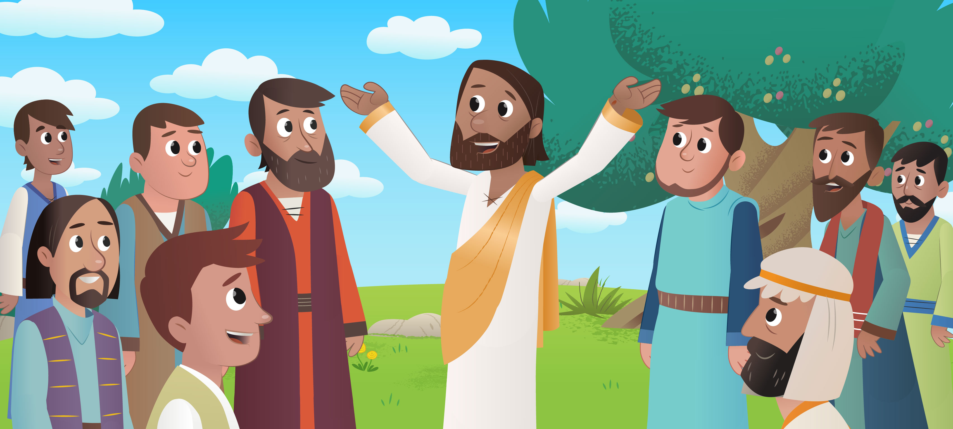
THE INSISTENT WIDOW
Jesus told his disciples a parable about the necessity for them to pray always without becoming weary.

Slide 4
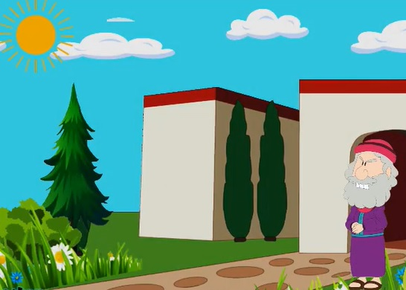
He said, "There was a judge in a certain town who neither feared God nor respected any human being:

Slide 5
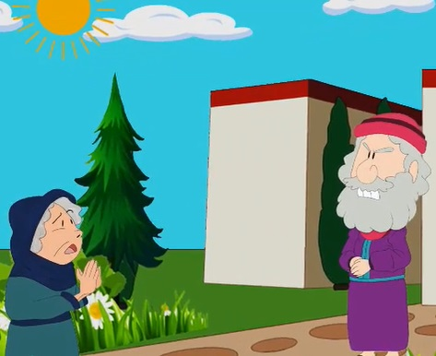
And a widow in that town used to come to him and say, 'Render a just decision for me against my adversary.'

Slide 6
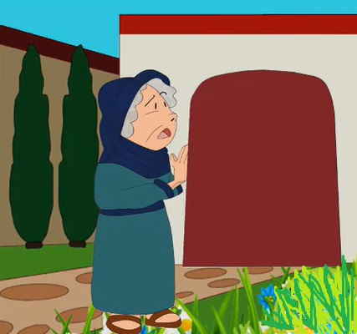
For a long time, the judge was unwilling,

Slide 7
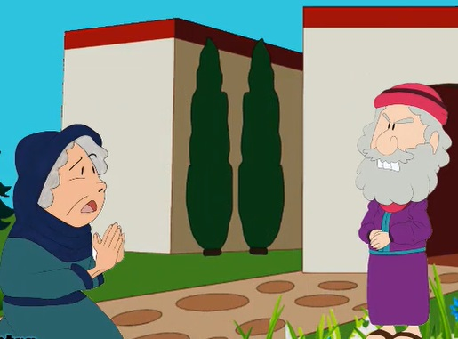
but eventually he thought, 'While it is true that I neither fear God nor respect any human being, because this widow keeps bothering me, I shall deliver a just decision for her lest she finally come and strike me.'

Slide 8
The Lord said, "Pay attention to what the dishonest judge says. Will not God then secure the rights of his chosen ones who call out to him day and night? Will he be slow to answer them?
I tell you; he will see to it that justice is done for them speedily.

Slide 9
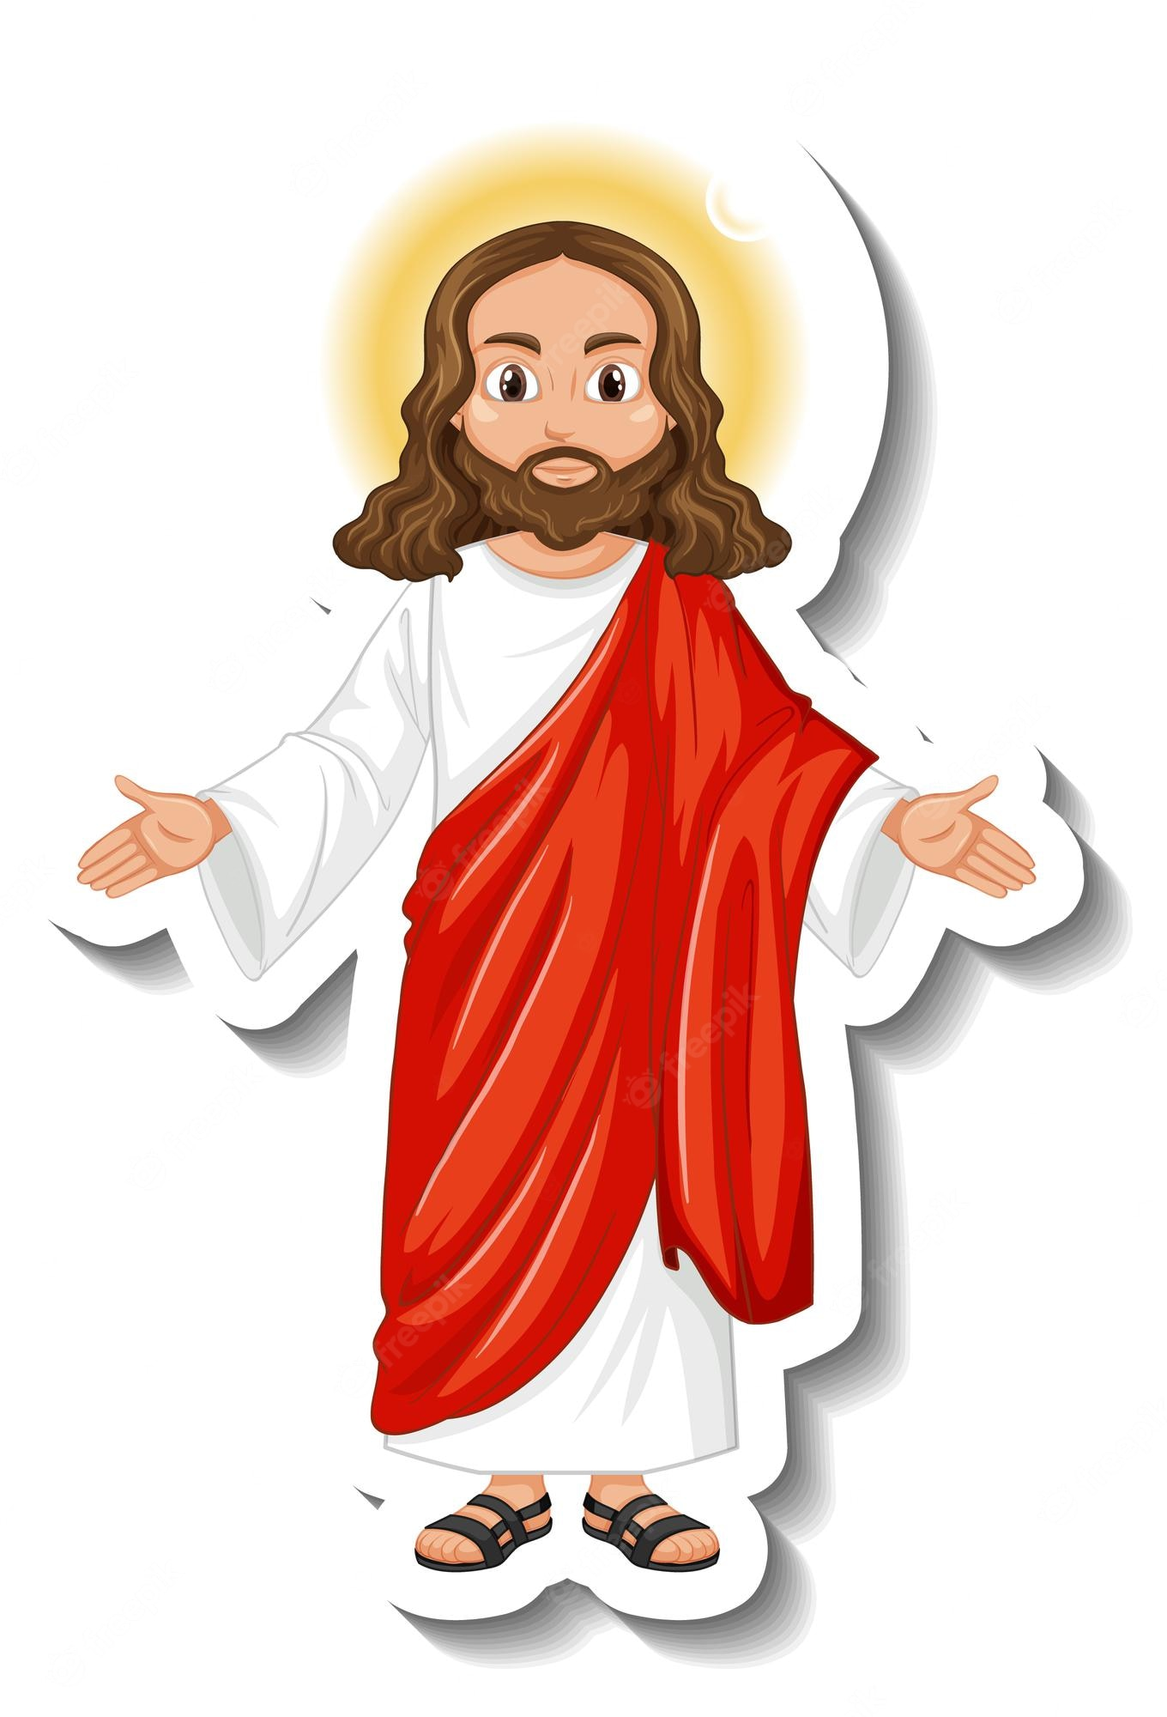
But when the Son of Man comes, will he find faith on earth?

Slide 10
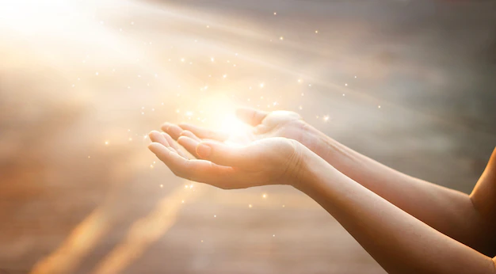
THE GOSPEL OF THE LORD
PRAISE TO YOU LORD JESUS CHRIST

Slide 11
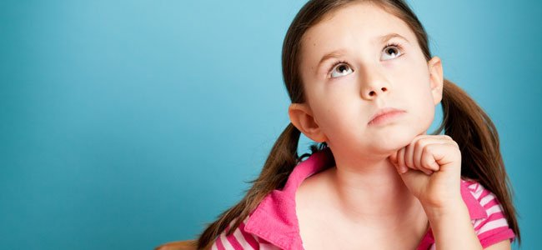
REFLECTION

Slide 12
Jesus teaches us about prayer with a parable (a story with a teaching).
Who does the judge represent in our lives?
GOD

Slide 13
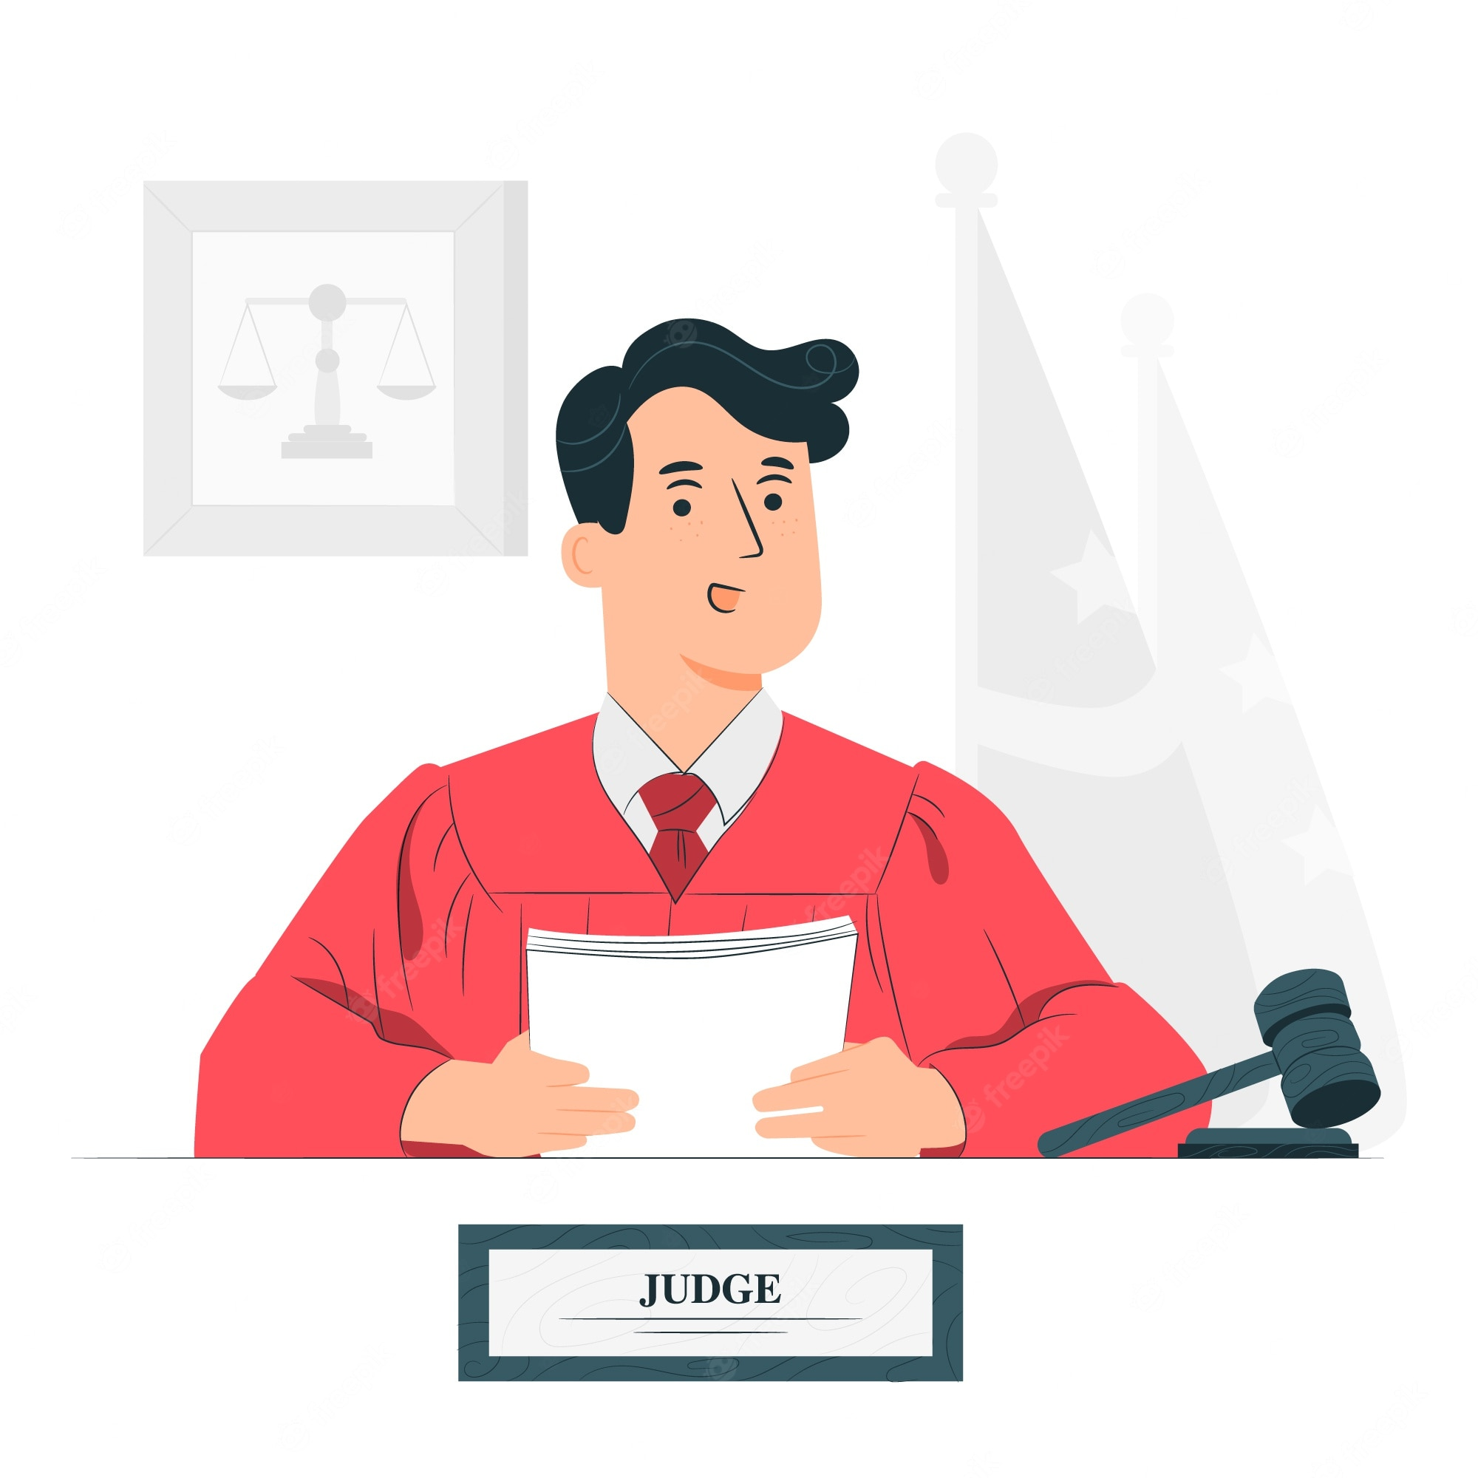
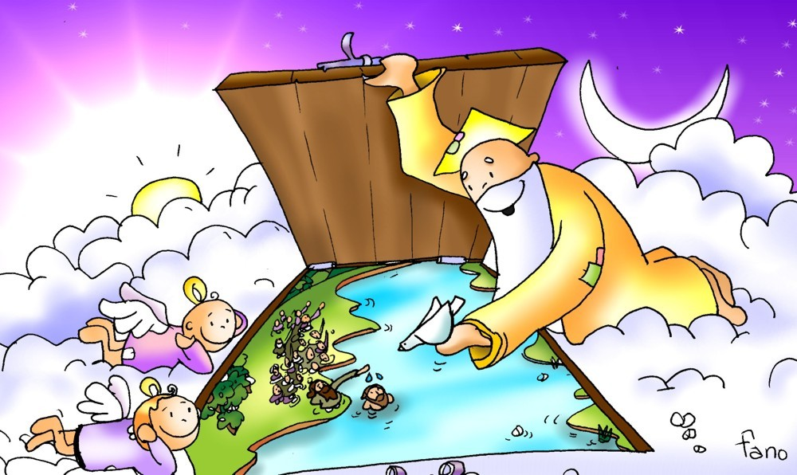
How are God and a judge similar?
Both listen to petitions and decide which ones to grant.

Slide 14
HOW ARE THEY DIFFERENT?
The judge ignored the widow because he had no charity in his heart; God is charity and always listens to us.

Slide 15
Why does the judge finally grant her wish?
He was tired of her pestering him.

Slide 16
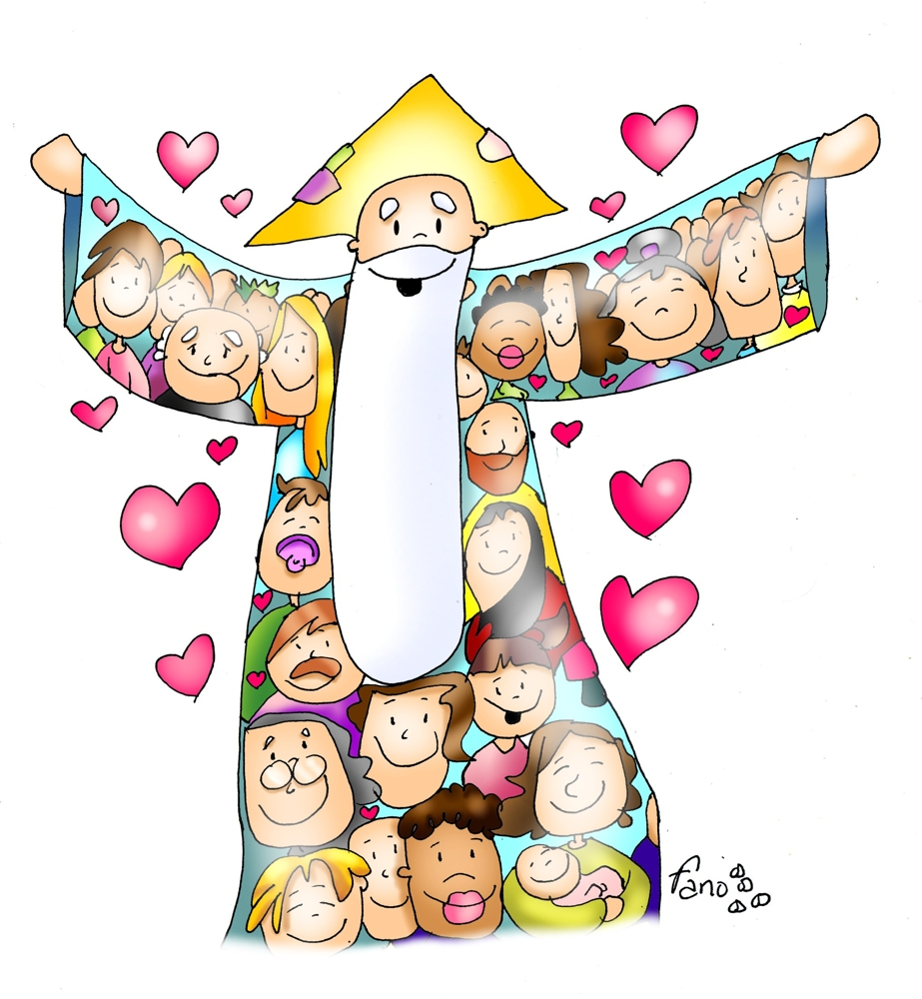
Why does God grant our just requests?
He loves us and wants us to be happy.

Slide 17
What does Jesus want to teach us?
He wants us to be persistent in prayer because God listens to His elect and will do them justice.

Slide 18
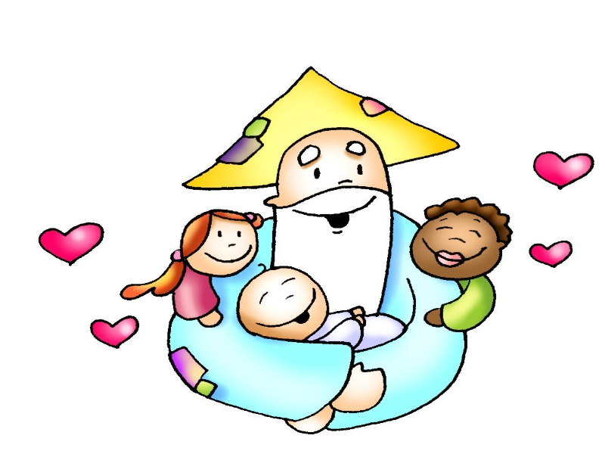
How can we be one of God’s elects?

Slide 19
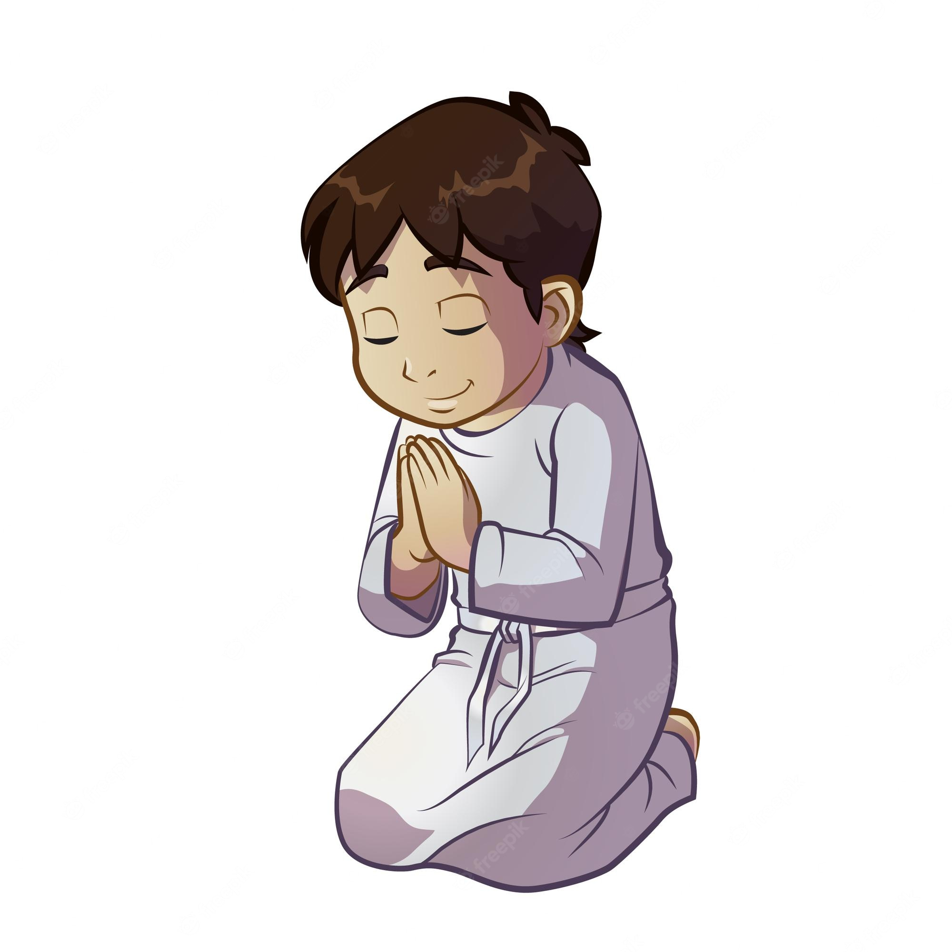
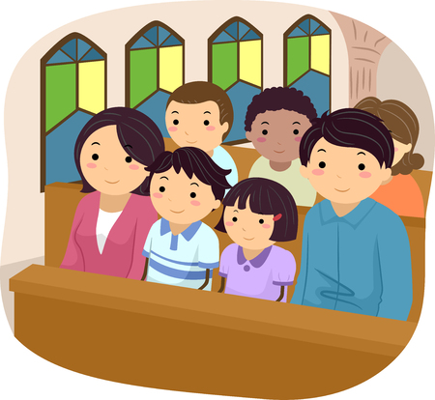
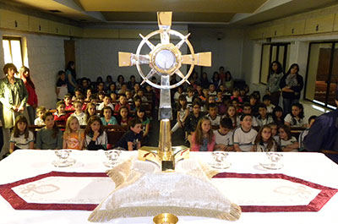
TRY TO GET TO KNOW HIM BETTER BY:
praying,
reading the bible,
going to Mass,
adoring the Blessed Sacrament

Slide 20
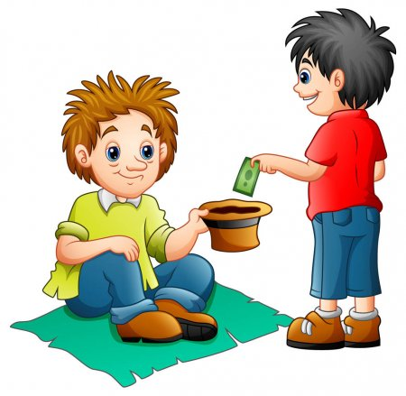
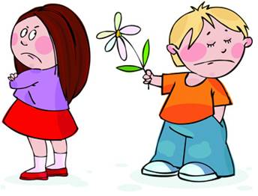
AND OBEYING HIS COMMANDMENTS OF LOVE BY:
helping,
forgiving,
sharing…
with our neighbor.

Slide 21
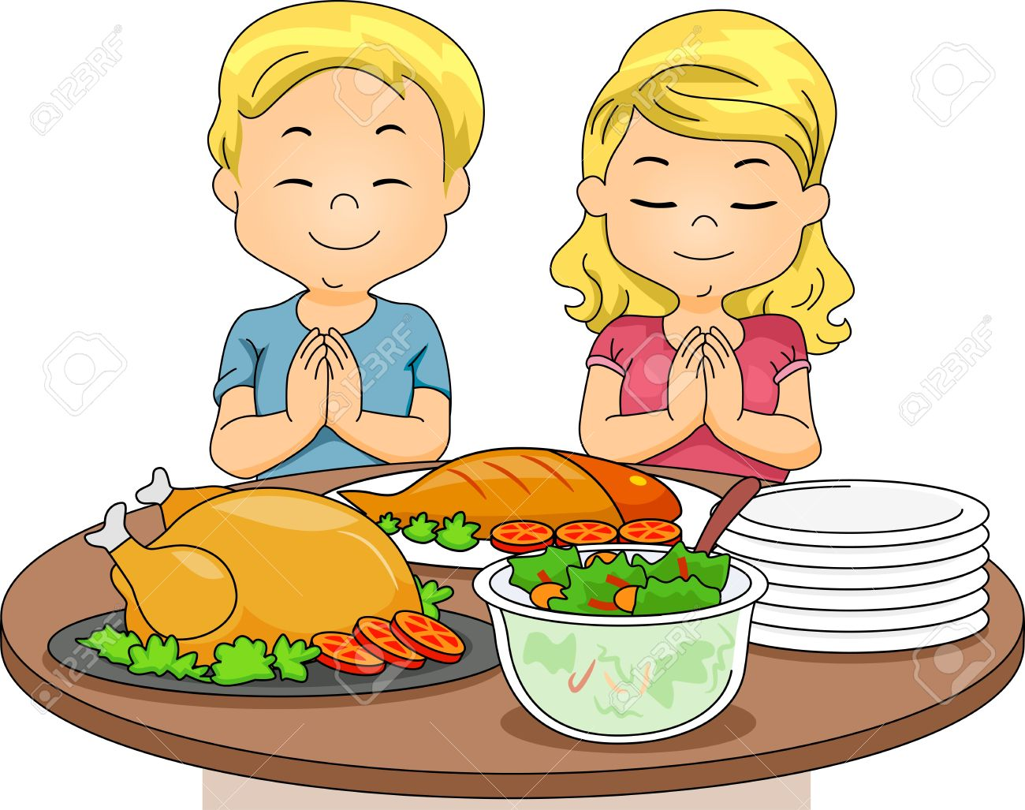
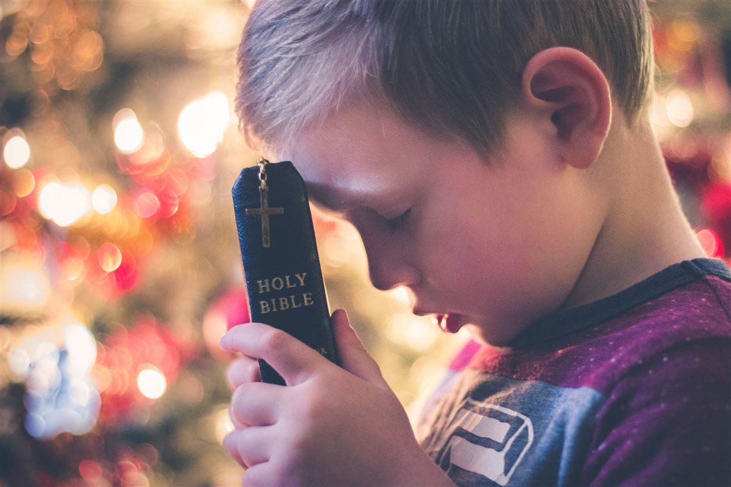
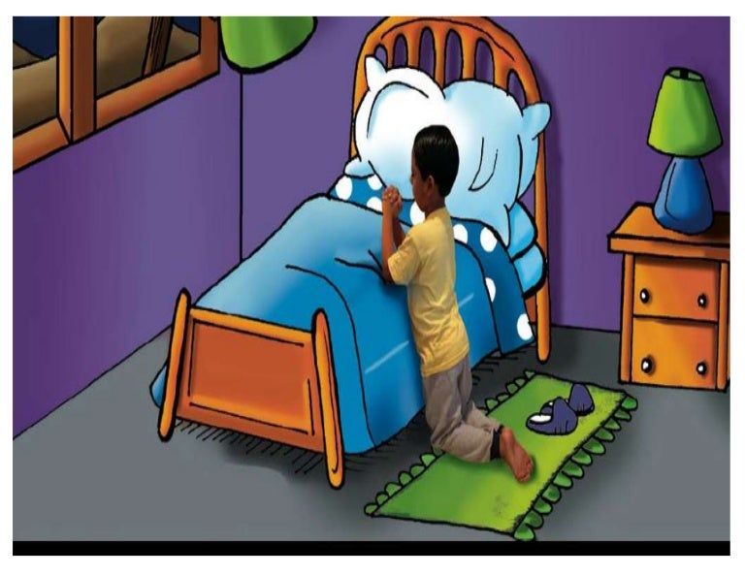
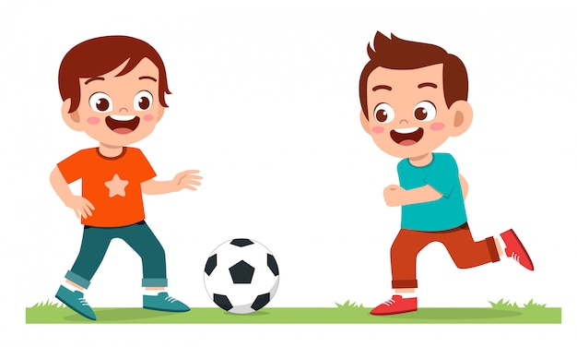
Do you dedicate time to prayer on a daily basis?
What prevents you from praying?

Slide 22
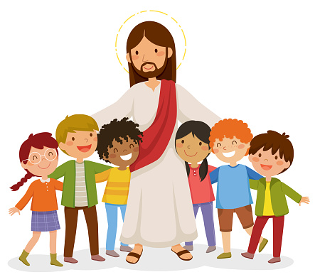
We must remember that God always listens to us and grants everything that is good for our spiritual growth; and being constant in prayer will bring us closer to Him, who is the source of our happiness.

Slide 23
ACTIVITIES

Slide 25
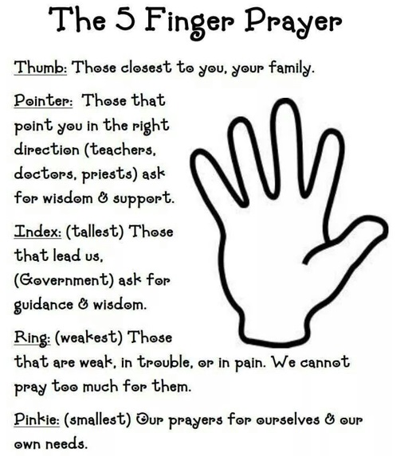

Slide 26
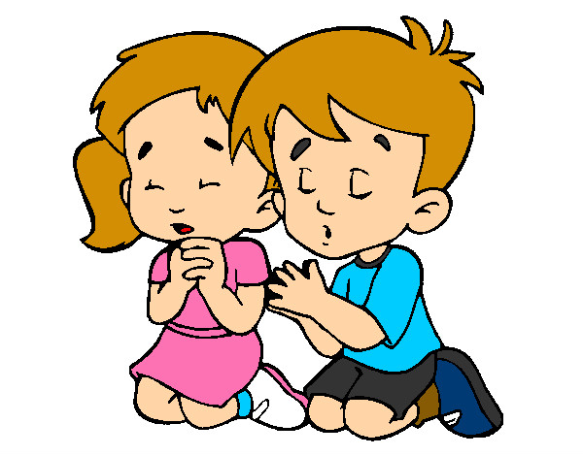
PRAYER
True God, you that are father, son, and the Holy Spirit, I love you with my whole heart. I want to thank you for giving me the gift of love. Thank you for always taking care of me at night, and filling me with blessings in the morning. Thank you for never abandoning me. Help me always be humble and grateful for what I have, help me be a friend of Jesus through my prayers, words, and good example, so that others may learn about you and love you. AMEN
(St. Enrique de Ossó)

Slide 27
Jesus in the morning, Lifekids, (Ctrl Click) https://youtu.be/9F-spTjlGB0 (3-7 yrs.)

Slide 28
GOD ANSWERS PPRAYERS, VBS, https://youtu.be/ABoyVKTPY5c (8+ años)

