Slide 1
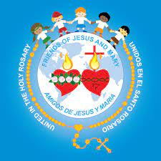
Friends of Jesus and Mary www.fcpeace.org
Prayer Group for Children
XXVI Sunday in Ordinary Time
The Parable of Lazarus and the Rich Man
Luke 16, 19-31

Slide 2
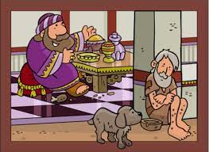
The Parable of Lazarus and the Rich Man
Jesus said to the Pharisees: " There was a rich man who dressed in purple garments and fine linen and dined sumptuously each day. And lying at his door was a poor man named Lazarus, covered with sores, who would gladly have eaten his fill of the scraps that fell from the rich man's table. Dogs even used to come and lick his sores.

Slide 3
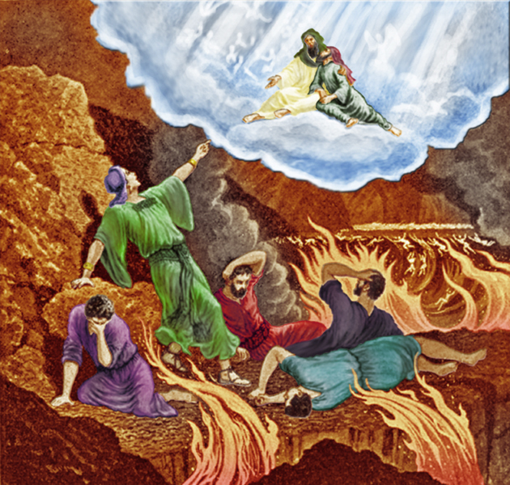
When the poor man died, he was carried away by angels to the bosom of Abraham. The rich man also died and was buried, and from the netherworld, where he was in torment, he raised his eyes and saw Abraham far off and Lazarus at his side. And he cried out, 'Father Abraham, have pity on me. Send Lazarus to dip the tip of his finger in water and cool my tongue, for I am suffering torment in these flames.'

Slide 4
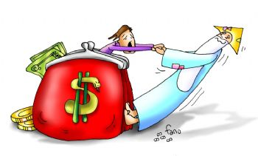
'My child, remember that you received what was good during your lifetime while Lazarus likewise received what was bad; but now he is comforted here, whereas you are tormented.’

Slide 5
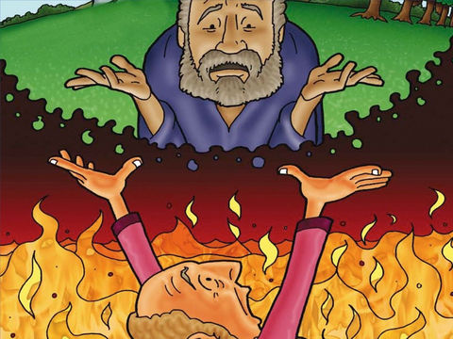
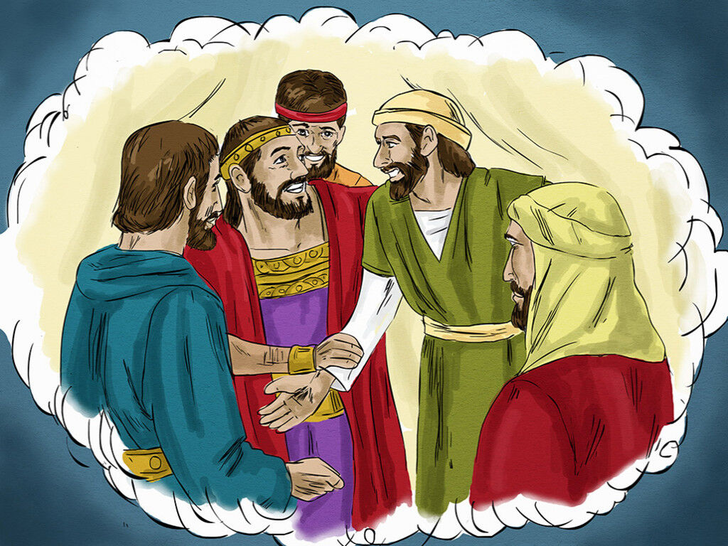
Moreover, between us and you a great chasm is established to prevent anyone from crossing who might wish to go from our side to yours or from your side to ours.'
'Then I beg you, father, send him to my father's house, for I have five brothers, so that he may warn them, lest they too come to this place of torment.'

Slide 6
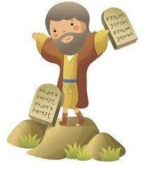
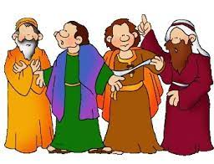
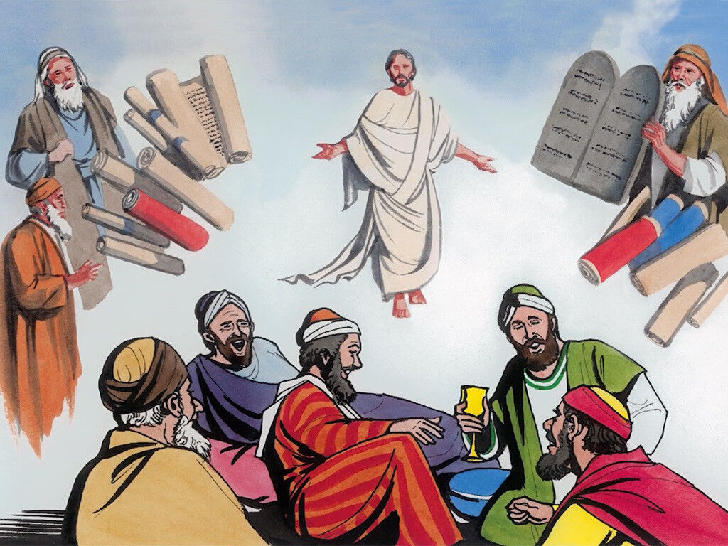
But Abraham replied, 'They have Moses and the prophets. Let them listen to them.'
He said, 'Oh no, father Abraham, but if someone from the dead goes to them, they will repent.’
Then Abraham said, 'If they will not listen to Moses and the prophets, neither will they be persuaded if someone should rise from the dead.'"
The Gospel of the Lord, Praise to You Lord Jesus Christ

Slide 7
Reflection…

Slide 8
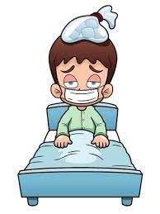
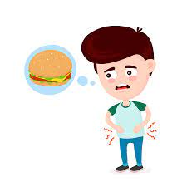
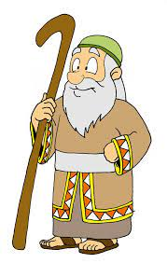
How did the rich man treat Lazarus?
He ignored him even though he was sick and hungry.
After Lazarus died, where did his soul go?
The angels took him to the bosom of Abraham. Jesus had not yet opened the gates of Heaven with His death and resurrection.
After the rich man died, where did his soul go?
He went to the place of suffering.

Slide 9
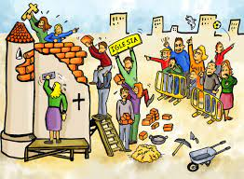
Was it too late for the rich man to change?
CHURCH
Yes. However you live on earth determines where you go after death.

Slide 10
What does the rich man ask for his 5 brothers?
Please send Lazarus to advise them so they don’t end up in the place of torment.
What does Abraham answer?
They have Moses and the prophets; if they don’t listen to them, they will not listen to someone who even resurrected from the dead.
Did the rich man believe in the Word of God?
No, the Word of God teaches us to love and share with those in need.

Slide 11
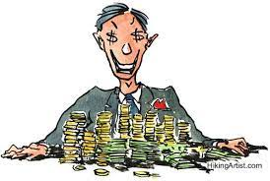
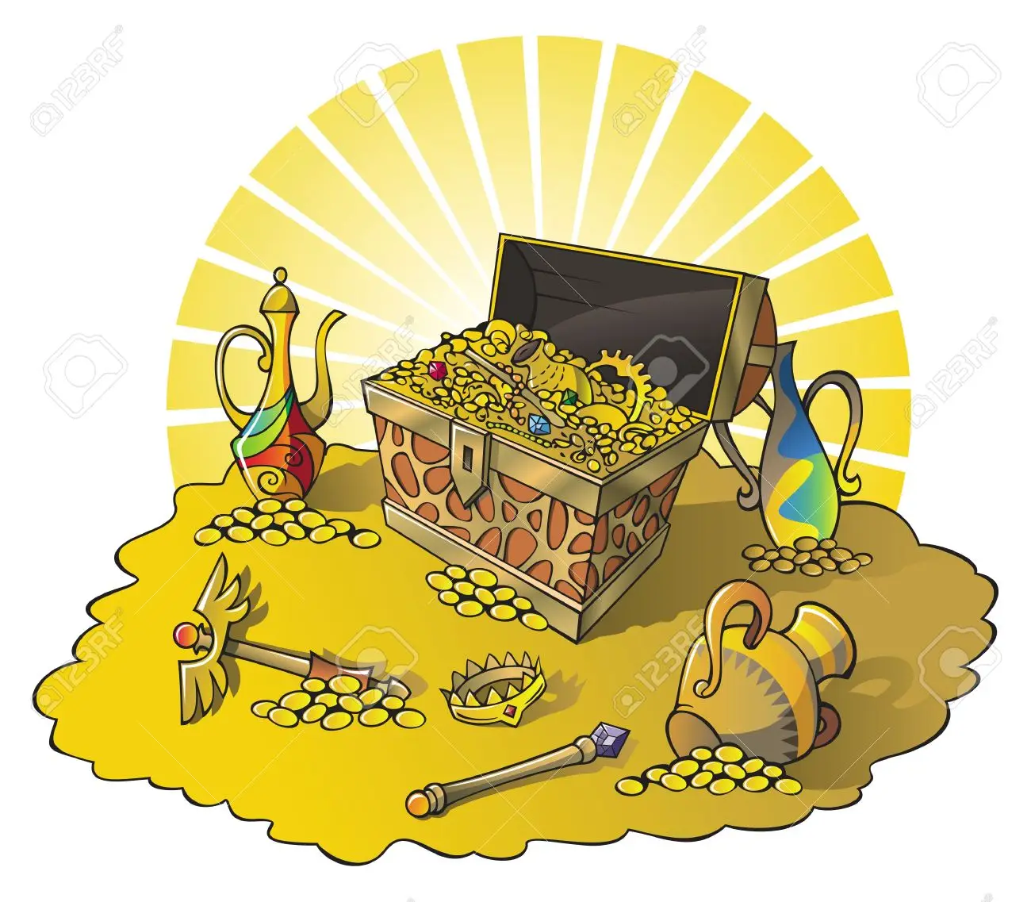
What does Jesus want to teach us with this parable?
Riches can cause us to lose Heaven if we forget to love and listen to God and our neighbor in need.

Slide 12
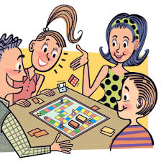
Activity

Slide 13
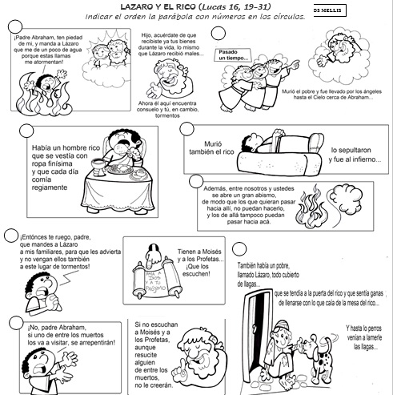
PARABLE OF LAZARUS AND THE RICH MAN
5
3
He cried out, 'Father Abraham, send Lazarus to bring me water, for I am in torment in these flames.'
Much later
Lazarus was carried away by angels to the bosom of Abraham.
Activity
Put the parable in the correct order placing the corresponding number in the circle.
1
4
He saw Abraham far off and Lazarus at his side.
The rich man also died and went to the place of torment.
There was a rich man who dressed and dined luxuriously each day
6
Between us and you is a great chasm which cannot be crossed.
7
I beg you to send him to my father's house, to warn my 5 brothers so they don’t end up here.
They have Moses and the prophets.
2
And lying at his door was a poor man named Lazarus, covered with sores, who would gladly have eaten his fill of the scraps that fell from the rich man's table.
'If they won’t listen to Moses and the prophets, they won’t listen to one who rose from the dead.'
Dogs even used to come and lick his sores.
8
But if someone from the dead goes to them, they will repent.'

Slide 14
Activity
Make a card with a promise to bring something the following week (clothes, food, toys for a person in need) and take to the Church collection for the needy.

Slide 15
Prayer
Jesus, I never want to forget You. Thank you for all the blessings you give me. Fill my heart with Your Love so it will spill over to everyone around me. Help me to share Your love with my neighbor by sharing all my blessings.
Amen

Slide 16
Song: I Love You Jesus, Odessa Paran, https://youtu.be/yux0UF2tbhA

