Slide 1
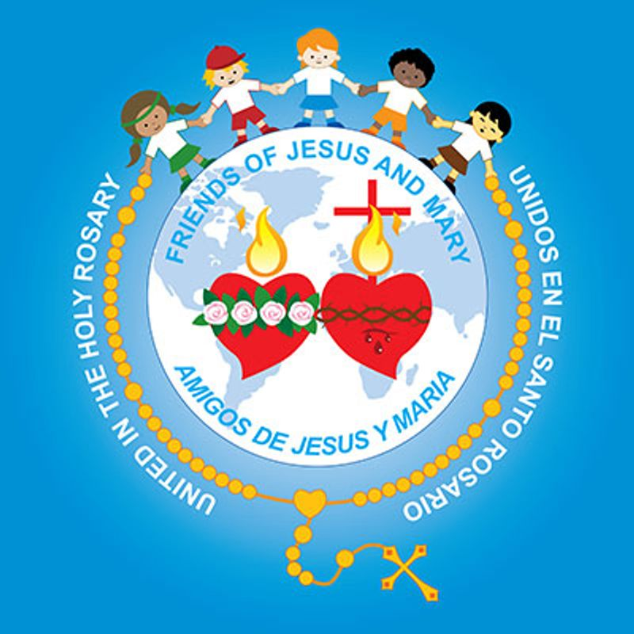
Ministry Friends of Jesus and Mary www.fcpeace.org
Faith the size of a mustard seed.
Ciclo C-XXVII Sunday in Ordinary Time
Luke 17, 5-10

Slide 2
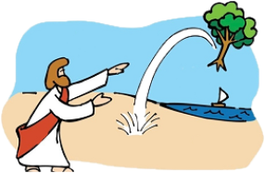
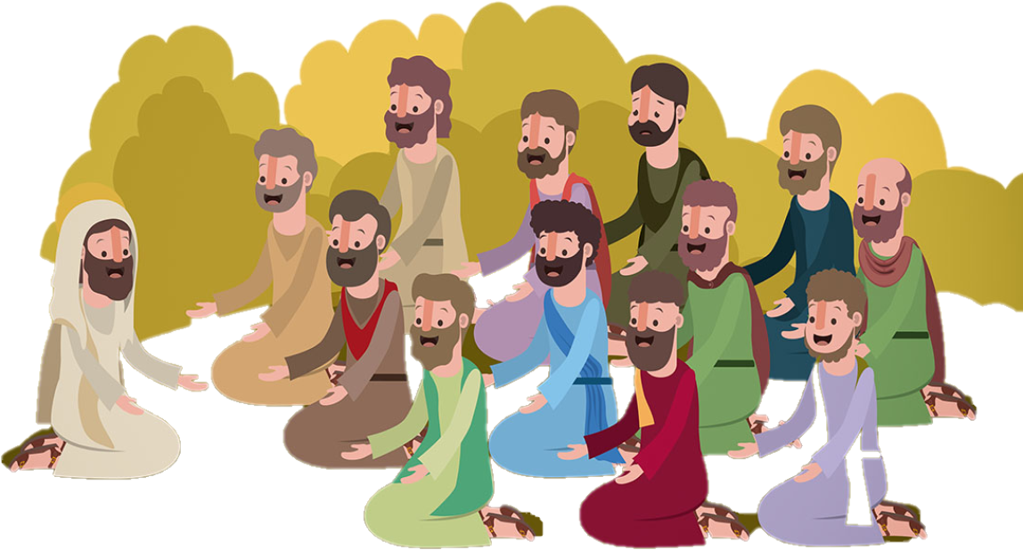
Gospel according to Luke 17, 5-10
The apostles said to the Lord, "Increase our faith." The Lord replied, "If you have faith the size of a mustard seed, you would say to this mulberry tree, 'Be uprooted and planted in the sea,' and it would obey you.
Click inside at the end of the reading.

Slide 3
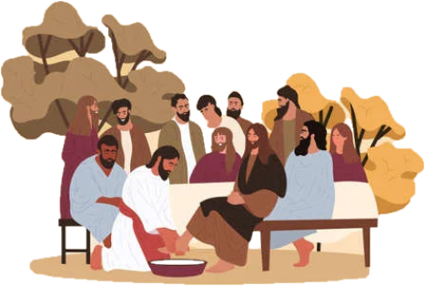
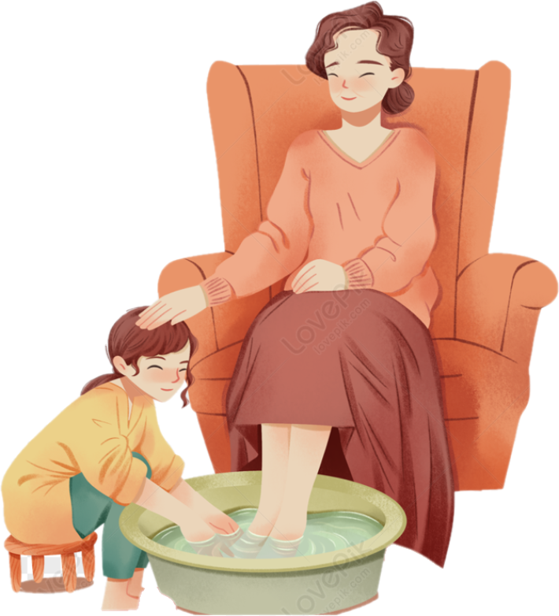
Who among you would say to your servant who has just come in from plowing or tending sheep in the field, 'Come here immediately and take your place at table'? Would he not rather say to him, 'Prepare something for me to eat. Put on your apron and wait on me while I eat and drink. You may eat and drink when I am finished'? Is he grateful to that servant because he did what was commanded? So should it be with you. When you have done all you have been commanded, say, 'We are unprofitable servants; we have done what we were obliged to do.'"

Slide 4
REFLECTION

Slide 5
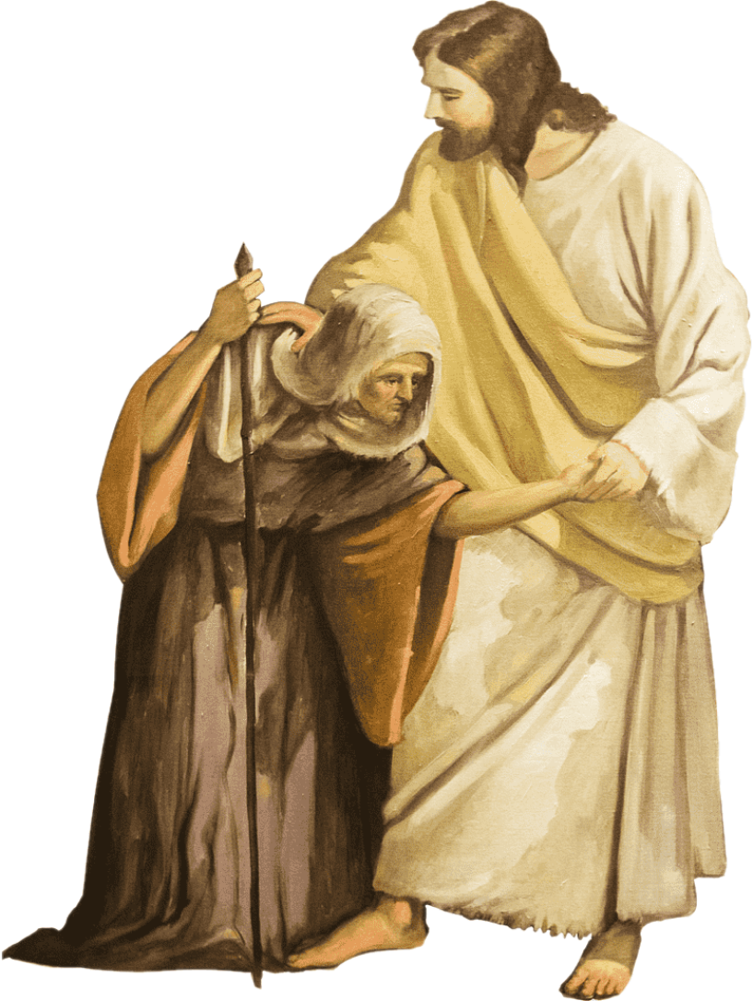
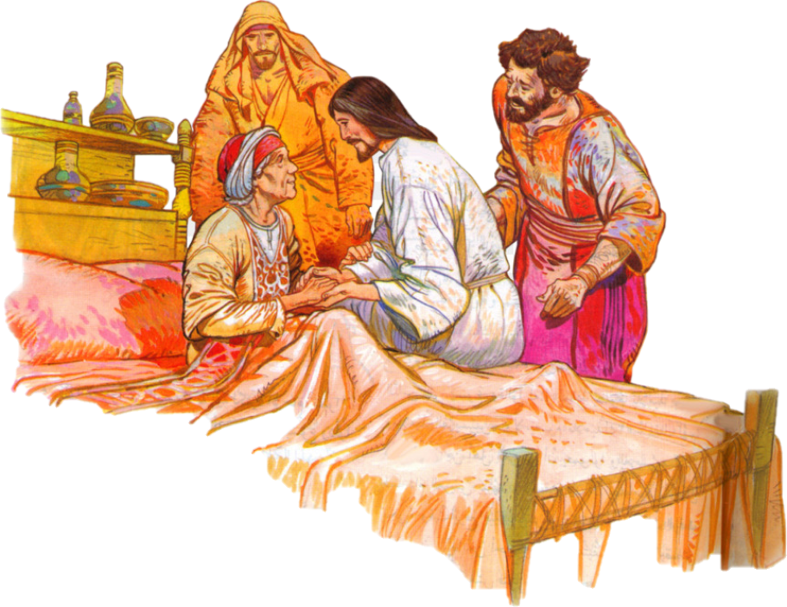
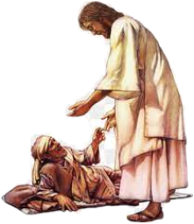
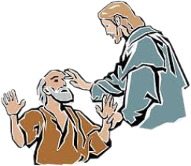
The apostles said to Jesus: “Increase our faith”. What is faith?
Believe and trust in God. We believe He exists, loves us, guides us, and listens to us even though we cannot see Him. Also, He can do anything.
Why did the apostles need more faith?
To carry out their mission to take Jesus’ message of love to the world. Jesus did miracles so all would believe in what He said. Also, the apostles wanted to do miracles so all would believe their message.

Slide 6
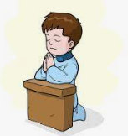
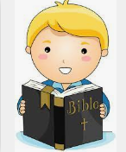
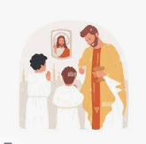
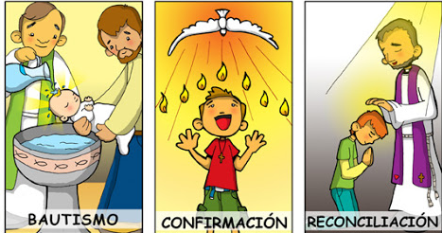
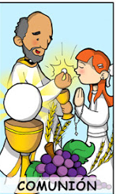
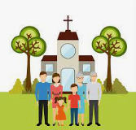
Jesus says that just with a little faith, the size of the tiny mustard seed, we could say to this mulberry tree, 'Be uprooted and planted in the sea,' and it would obey us. Jesus teaches us that faith has power. Where does this power come from?
From God. When we believe and trust in Him, He can do miracles in our lives.
How can we increase our faith?
Praying often, reading the bible, participating in the sacraments, especially Reconciliation and the Eucharist, doing good works, forgiving, following Jesus’ commandments of love.

Slide 7
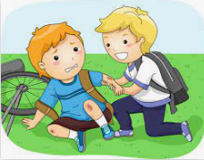
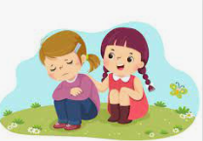
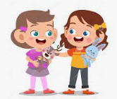
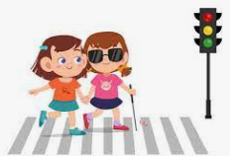
Jesus tells a story of a servant that works in the fields and returns home. Should he expect special treatment for doing his job?
No. He met his responsibility and nothing more.
What does Jesus teach us?
We should be humble servants before God. When we pray, obey the commandments, or do good works, we are meeting our responsibilities as children of God and nothing more. We should not be filled with pride since God is the source of all that is good in us and all the good that we do. We should be grateful to Him.
Let us pray for more faith.

Slide 8
ACTIVITIES

Slide 9
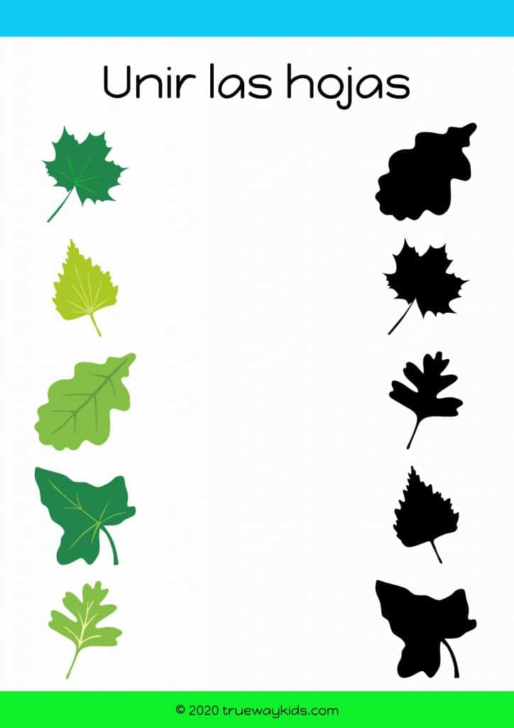
Match the leaf with its shadow and discover that with faith, everything is possible. Examples of Jesus showing the results of faith.
Click twice to see
1
a
The miraculous catch.
Click twice to see
2
e
Peter walked on water.
Click twice to see
3
i
Jesus resurrected the dead.
Click twice to see
4
o
Jesus converted water to wine.
Click twice to see
5
u
Healing the sick. This one was paralyzed.

Slide 10
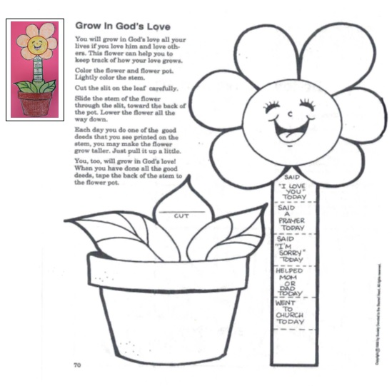

Slide 11
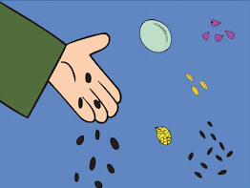
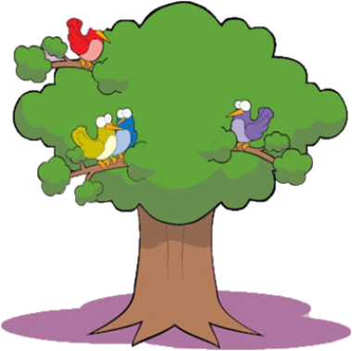
Prayer
Jesus,
Increase my faith so I may believe that You are everything, and You can do anything. Help me to pray more, forgive more, love more. Help me to be a better witness of your love and power. Amen

Slide 12
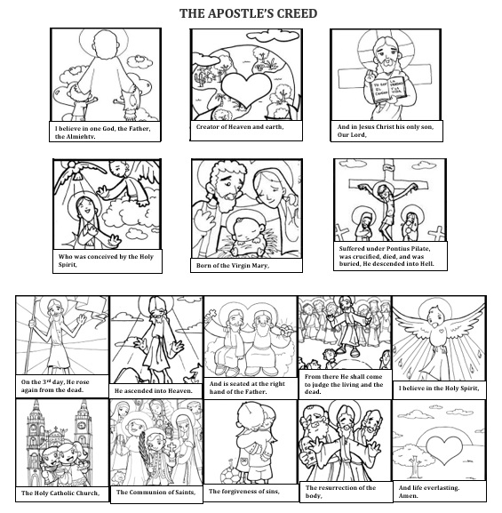

Slide 13
Fly, Lifetree Kids, (Ctrl Click) https://youtu.be/eWFAezIAvhs

