Slide 1
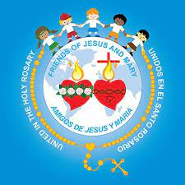
FRIENDS OF JESUS AND MARY www.fcpeace.org CYCLE C - XXVIII SUNDAY IN ORDDINARY TIME the grateful leper

Slide 2
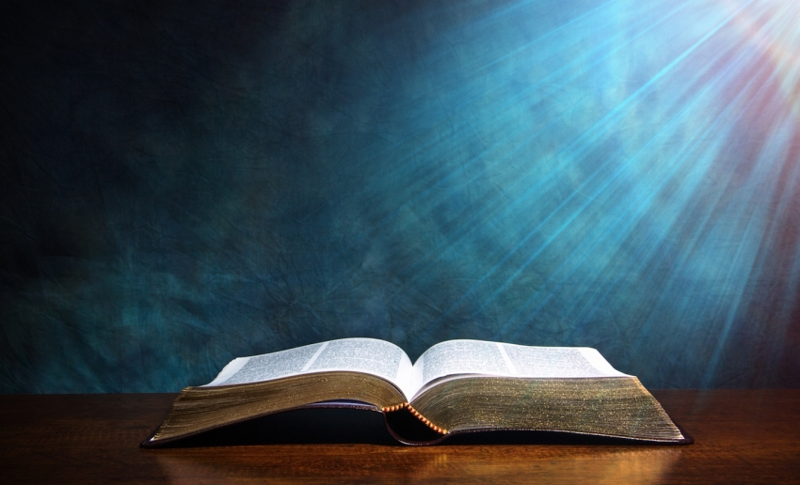
THE GOSPEL ACCORDING TO LUKE 17, 11-19
Glory to you lord jesus christ

Slide 3
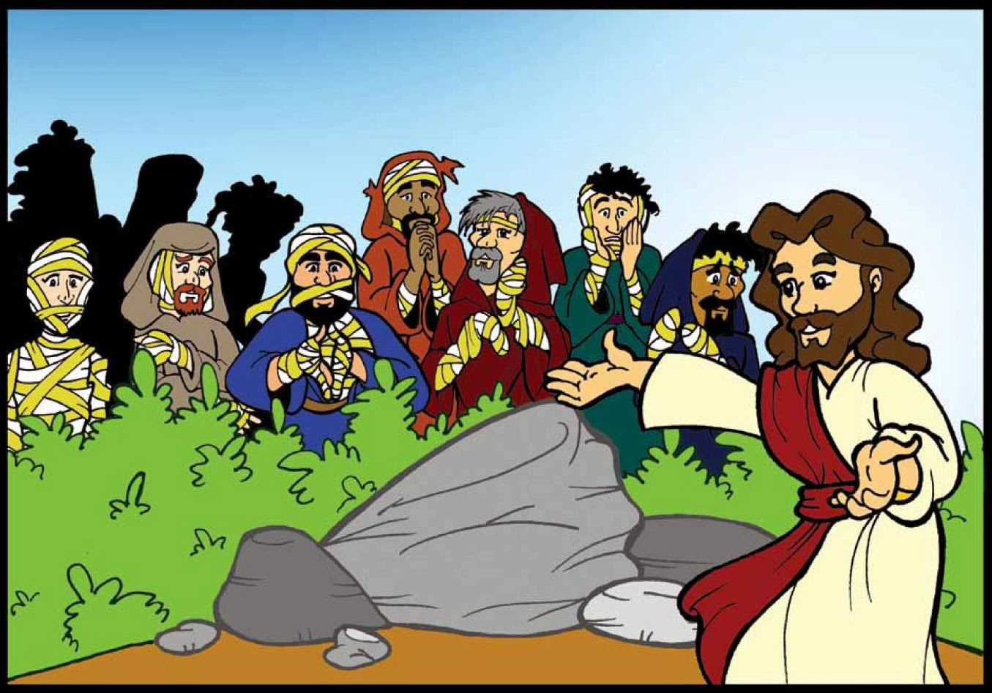
The grateful leper
As Jesus continued his journey to Jerusalem, he traveled through Samaria and Galilee.
As he was entering a village, ten lepers met him. They stood at a distance from him and raised their voices, saying, "Jesus, Master! Have pity on us!"

Slide 4
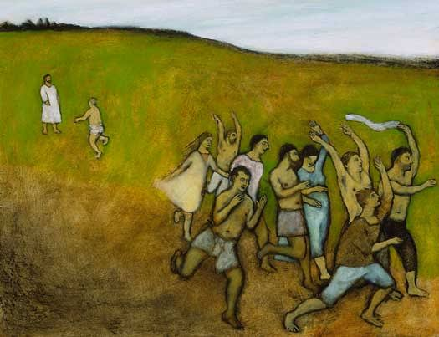
And when he saw them, he said, "Go show yourselves to the priests."
As they were going they were HEALED.
And one of them, realizing he had been healed, returned, glorifying God in a loud voice; and he fell at the feet of Jesus and thanked him. He was a Samaritan.

Slide 5
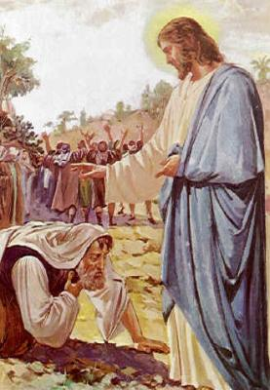
Jesus said in reply, "Ten were HEALED, were they not? Where are the other nine?
Has none but this foreigner returned to give thanks to God?" Then he said to him, "Stand up and go; your faith has saved you."

Slide 6
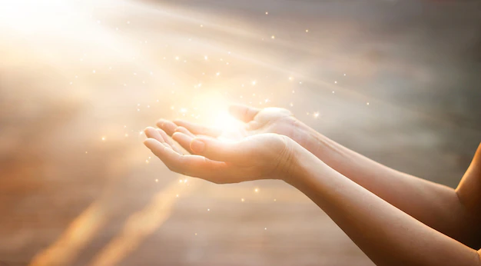
The gospel of the lord
Praise to you lord jesus christ

Slide 7
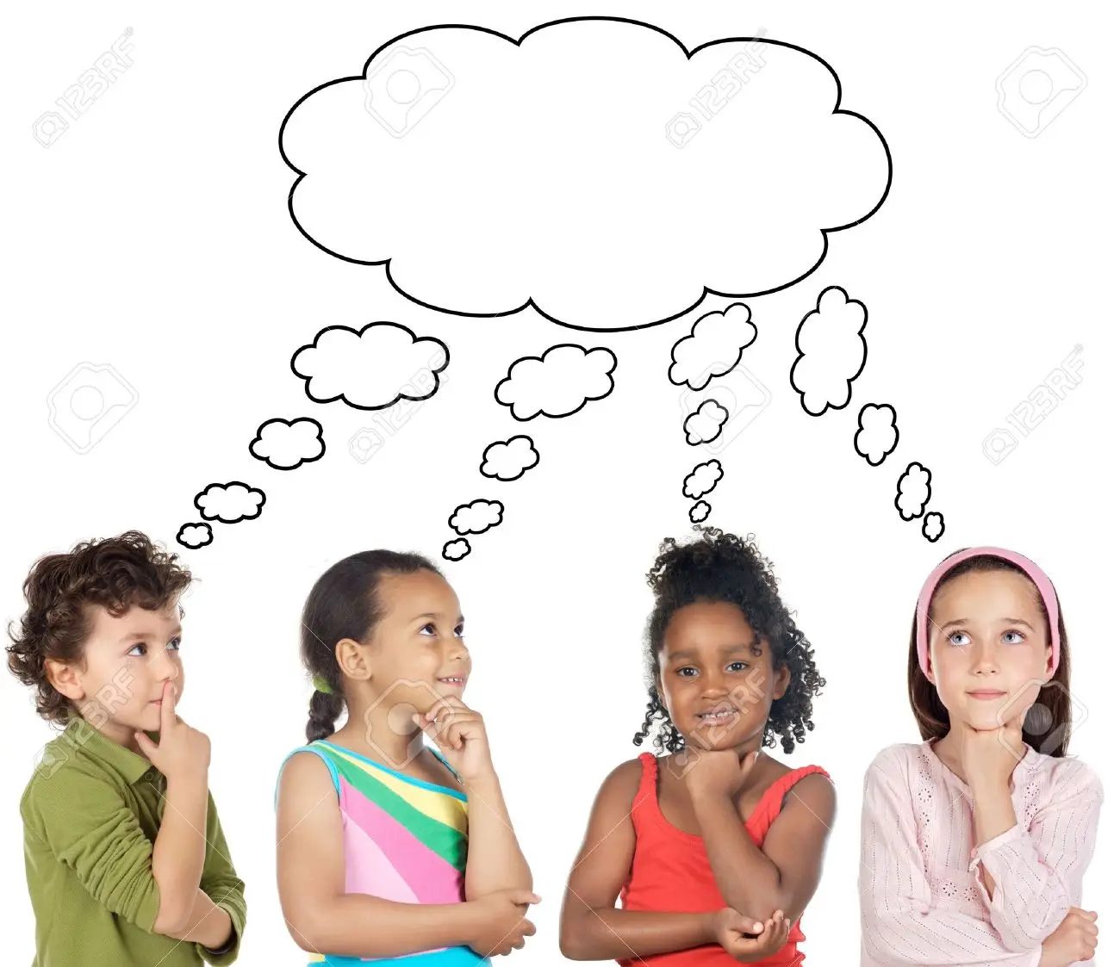
REFLECTION

Slide 8
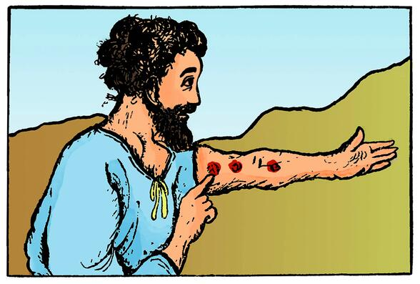
TEN LEPERS ASKED JESUS TO HEAL THEM.
What is a leper?
A person with leprosy, a contagious disease that attacks the skin and the extremities.

Slide 9
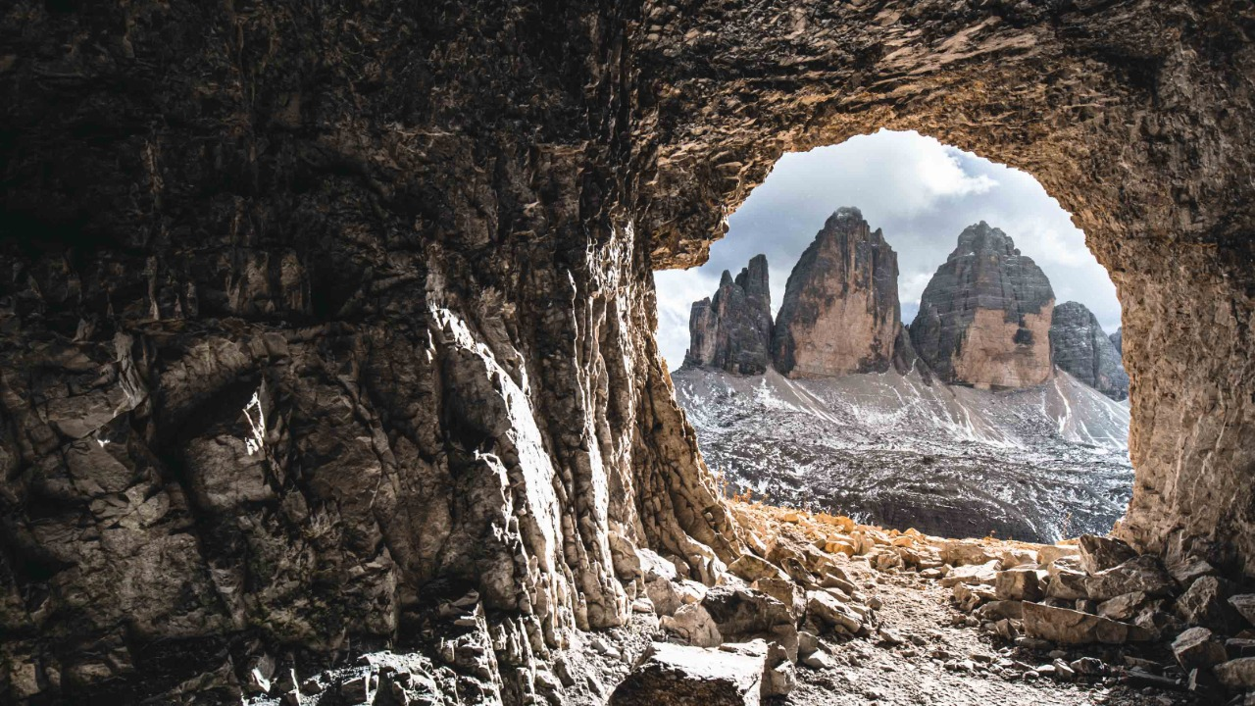
How did lepers live?
Isolated so as not to spread the disease.

Slide 10
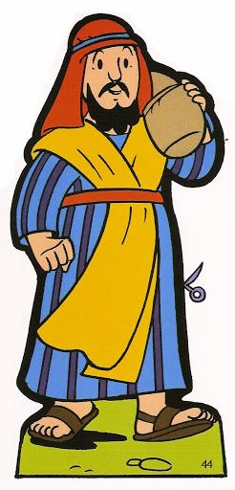
Jesus sends them to the priests. They knew that even the priests did not want to see them, but with faith, they go and are healed on the way. But only the Samaritan came back to thank Jesus for such great a gift.
What is a Samaritan?
Someone from another religion; enemies of the jews.

Slide 11
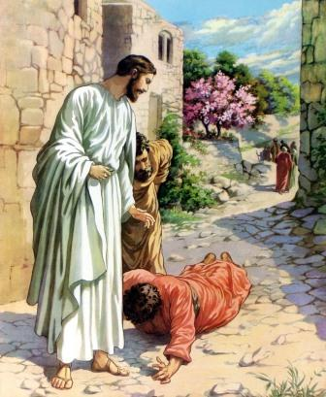
Why is it important that he returned?
He was not of the Jewish faith, the chosen people of God, yet he realizes Jesus’ power and love cured him.
Jesus tells the samaritan that his faith saved him.
Jesus’ love and mercy is for everyone.

Slide 12
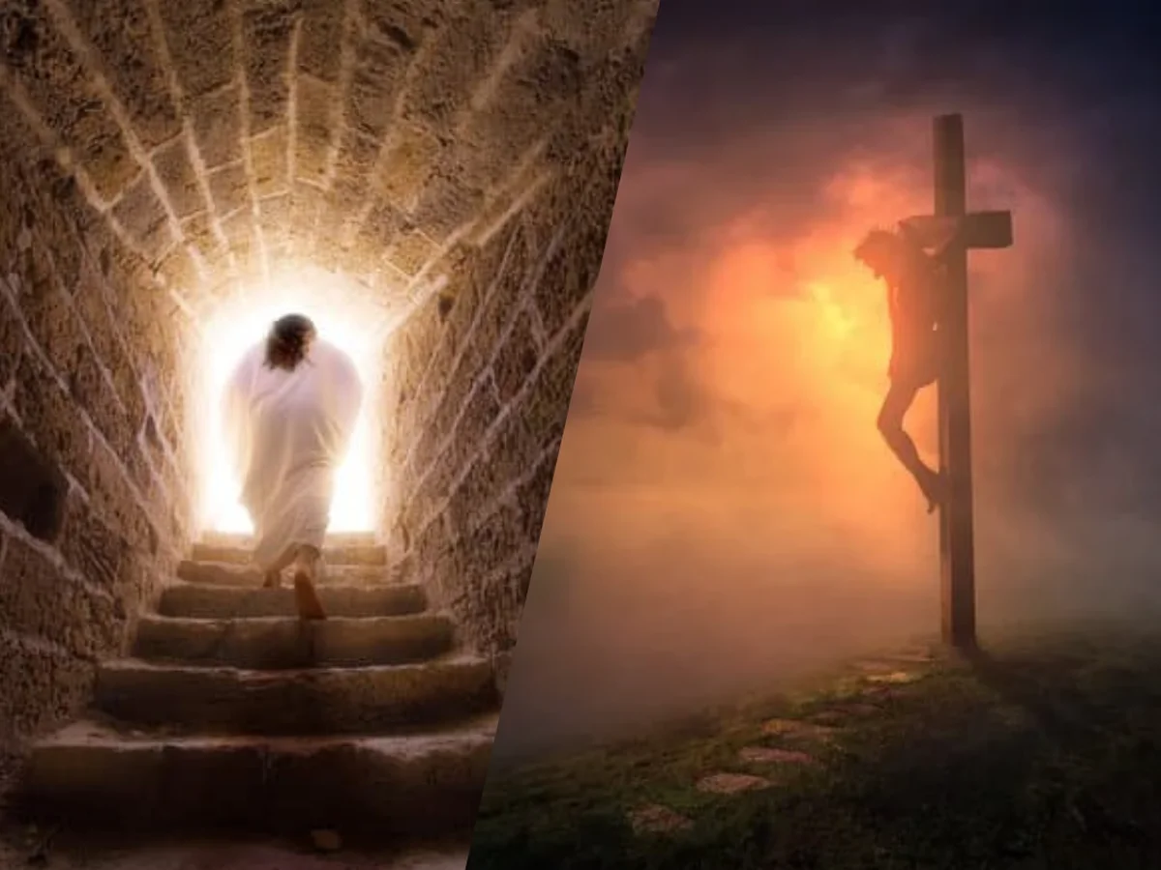
What can we thank god for every day?
Jesus has given us his love, mercy, and forgiveness.
just like leprosy separates the sick person from the community, sin separates the sinner from god and their faith family.
But the forgiveness that Jesus obtained for us on the cross, restores that separation from God and the faith community.

Slide 13
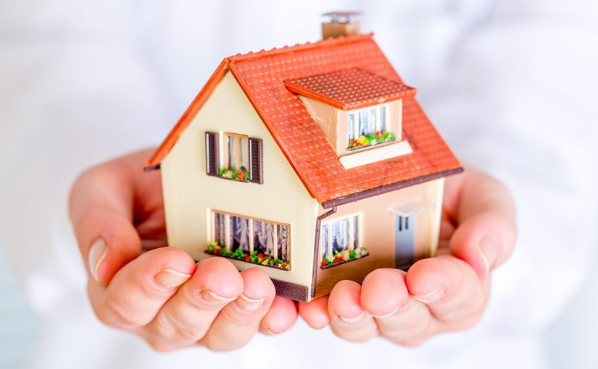
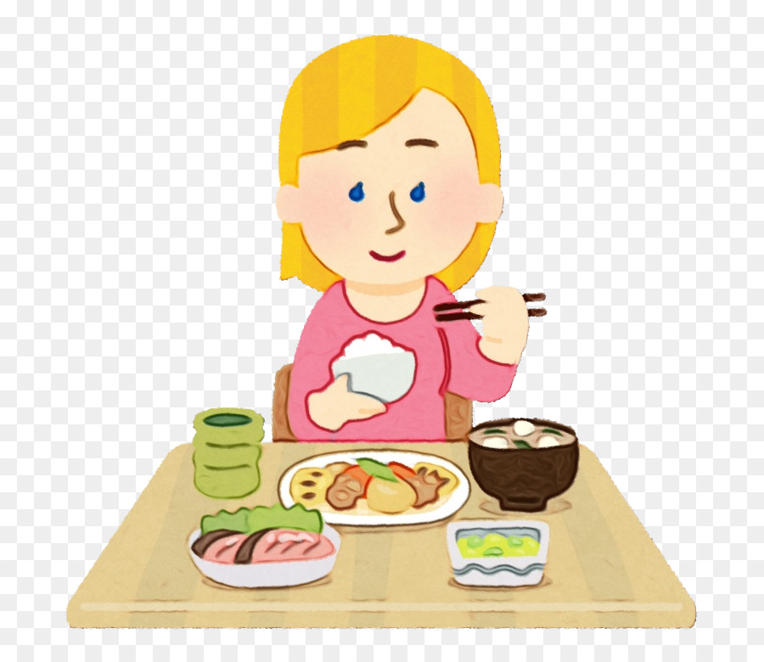
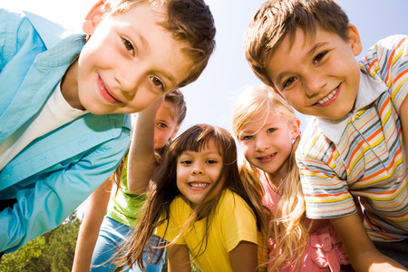
what can you thank god for every day?

Slide 14
ACTIVITY

Slide 15
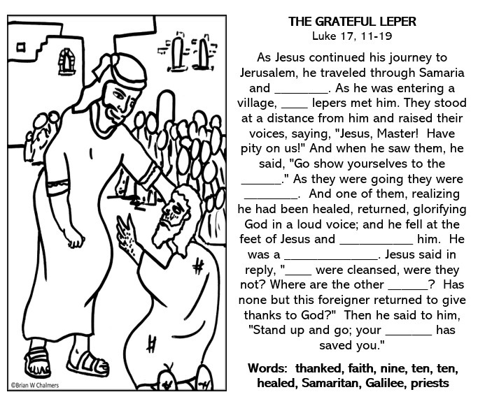
Galilee
ten
priests
healed
thanked
Samaritan
ten
nine
faith

Slide 16
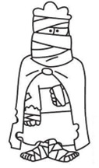
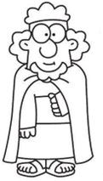
COLOR, CUT, AND GLUE THE SICK AND THE HEALED LEPER IN THE CORRESPONDING SPACE.

Slide 18
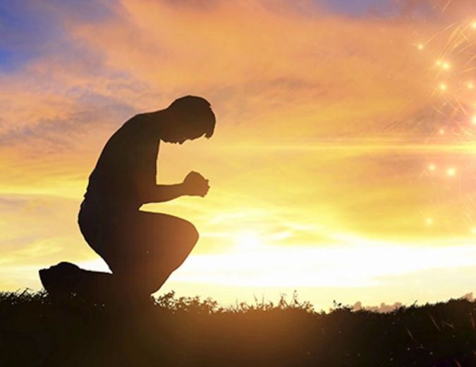
prayer
Lord, I thank you for the great love you have for me; for dying on the cross to be with me in Heaven; for the gift of faith that gives me peace and joy in my heart. Grant me humility so I may always know that all that I have and am is a gift from you.
Amen

Slide 19
SONG: Thankful, Shawna Belt Edwards, https://youtu.be/XTHDKxOL9cg

