Slide 1
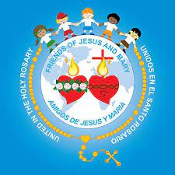
FRIENDS OF JESUS AND MARY www.fcpeace.org
CYCLE C - XXx SUNDAY IN ORDINARY TIME
THE REPENTANT TAX COLLECTOR
LuKE 18, 9-14

Slide 2
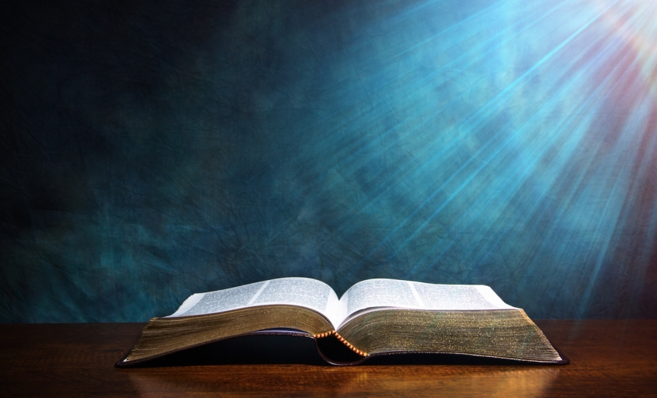
GOSPEL ACCORDING TO LUKE 18, 9-14
GLORY TO YOU LORD

Slide 3
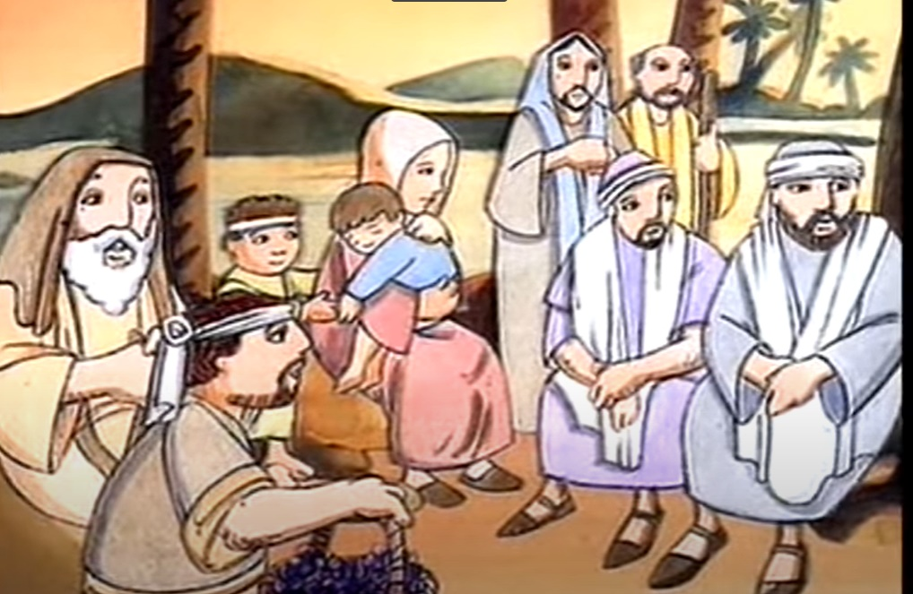
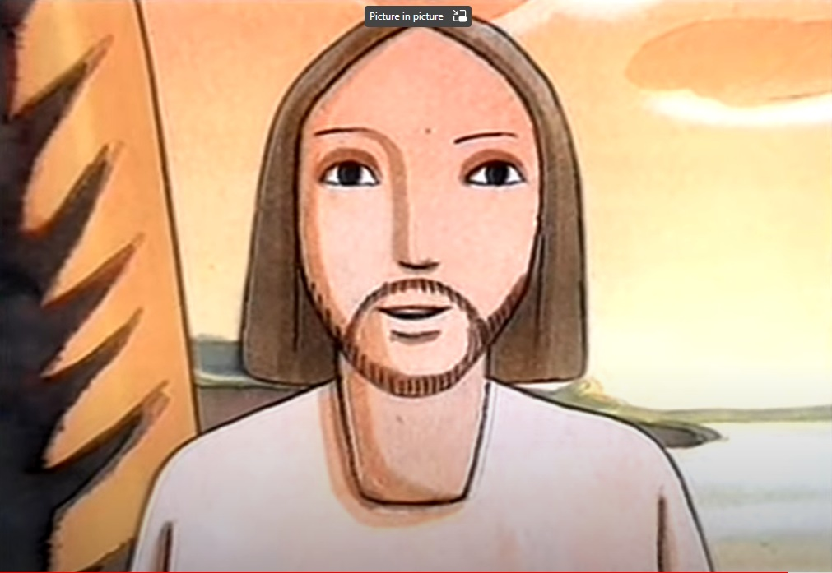
THE REPENTANT TAX COLLECTOR
Jesus addressed this parable to those who were convinced of their own righteousness and despised everyone else.

Slide 4
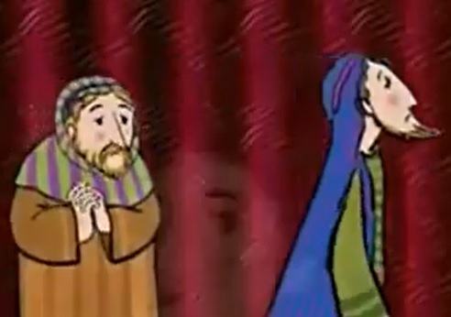
Two people went up to the temple area to pray; one was a Pharisee and the other was a tax collector.

Slide 5
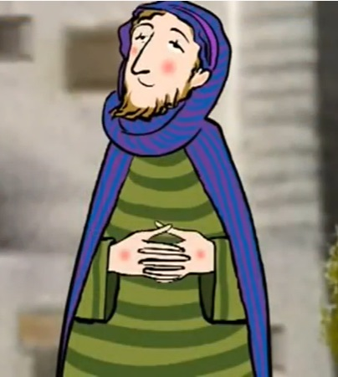
The Pharisee took up his position and spoke this prayer to himself,

Slide 6
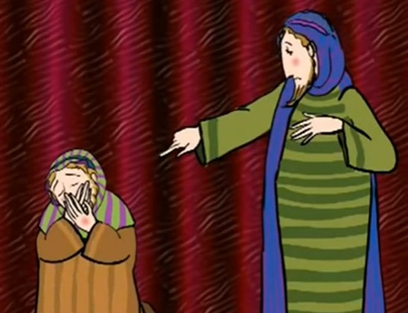
O God, I thank you that I am not like the rest of humanity --greedy, dishonest, adulterous -- or even like this tax collector.

Slide 7
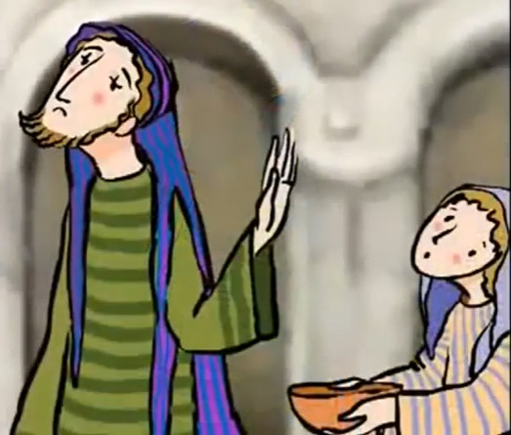
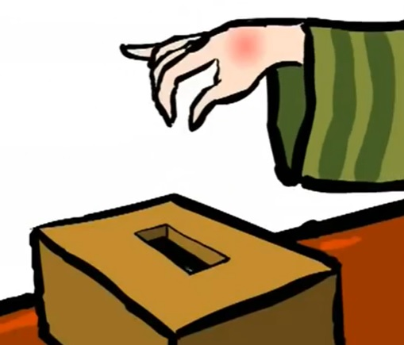
I fast twice a week, and I pay tithes on my whole income.

Slide 8
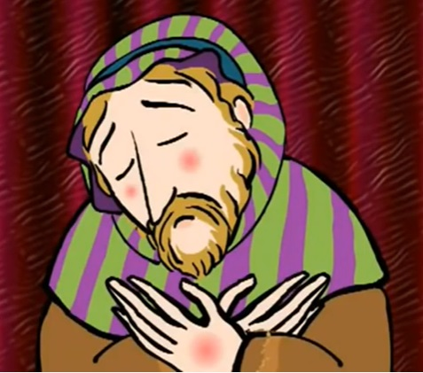
But the tax collector stood off at a distance and would not even raise his eyes to heaven but beat his breast and prayed,

Slide 9
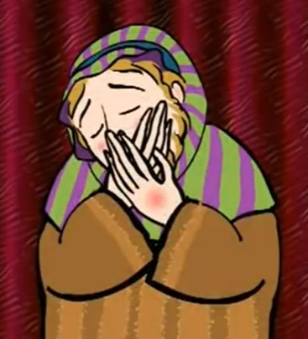
O God, be merciful to me a sinner.

Slide 10
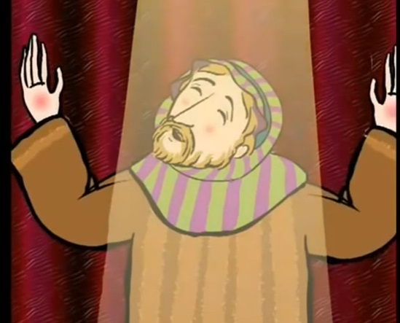
I tell you, the latter went home justified, not the former; for whoever exalts himself will be humbled, and the one who humbles himself will be exalted."

Slide 11
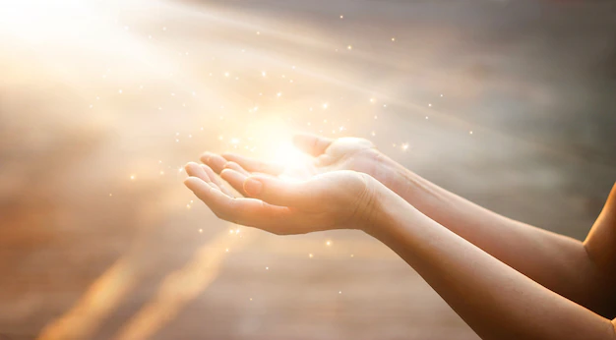
THE GOSPEL OF THE LORD
PRAISE TO YOU LORD JESUS CHRIST

Slide 12
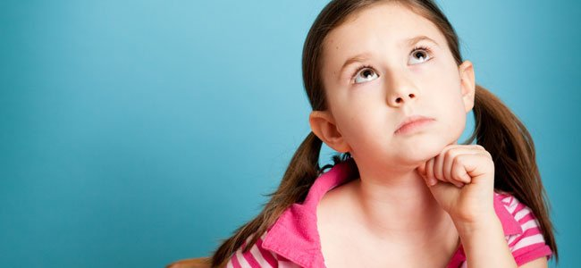
REFLECTION

Slide 13
Jesus teaches us with a parable (a story with a teaching).
Who were the Pharisees?
They were the leaders of the Jewish people who were experts in the law of Moses; they thought they were better than others.

Slide 14
Who were the tax collectors?
They collected taxes for the Romans and often collected extra for themselves; they were hated by the Jewish people.

Slide 15
How did the Pharisee pray?
He thanked God that he was better than others.
HOW DID THE TAX COLLECTOR PRAY?
HE HUMBLY ASKED FORGIVENESS FOR HIS SINS.

Slide 16
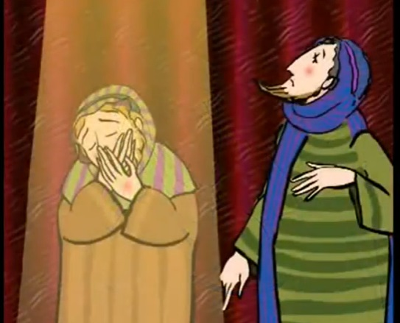
Which of the two do you think pleased God the most and why?
The tax collector pleased God because he was humble; he knew he was a sinner and needed God’s forgiveness.

Slide 17
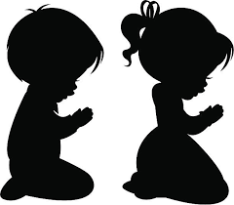
When we pray do we turn to God asking for forgiveness knowing that we need HIM?

Slide 18
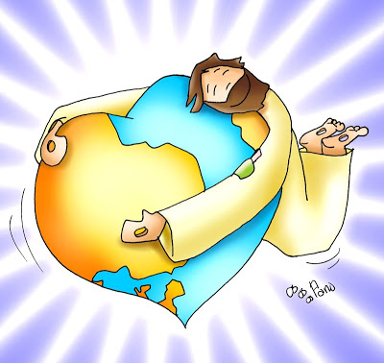
God is love and always loves us perfectly.

Slide 19
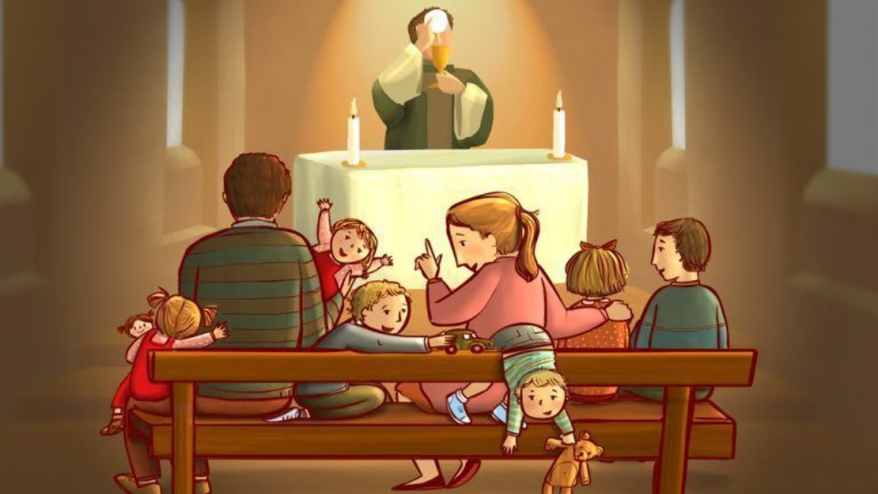
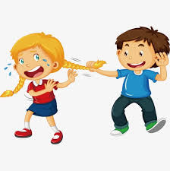
But we do not always love God AS WE SHOULD,
nor do we always love our neighbor as we should.

Slide 20
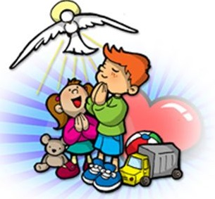
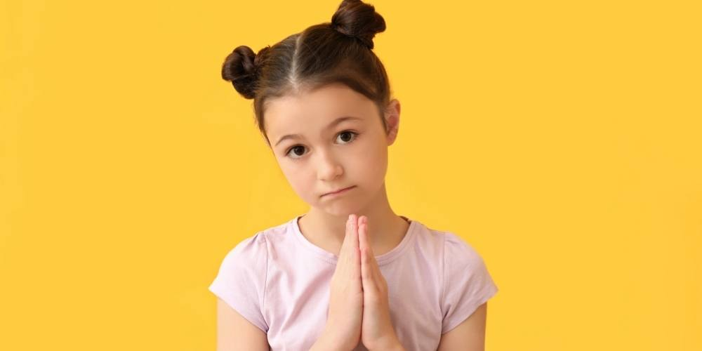
Let’s ask the Holy Spirit to help us see how we can love better.
Let’s ask forgiveness for our lack of love.

Slide 21
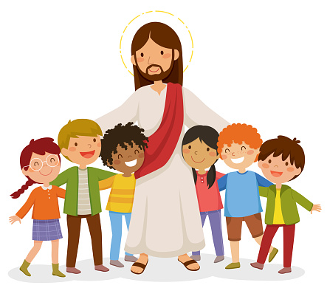
In this way, God will see us as His friend.

Slide 22
ACTIVITIES

Slide 23
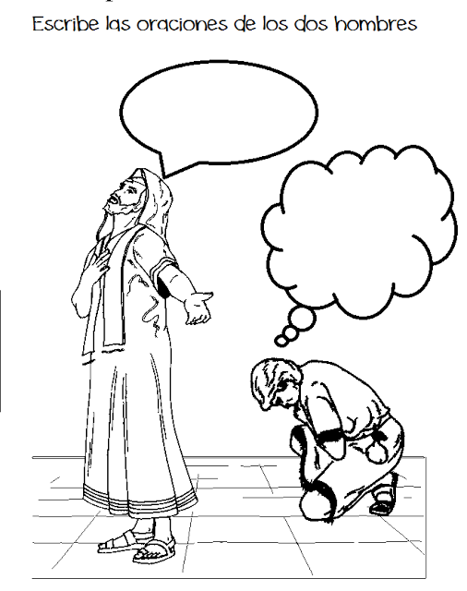
Write the prayers of the two men.
'O God, I thank you that I am not like the rest of humanity .
'O God, be merciful to me a sinner..

Slide 24
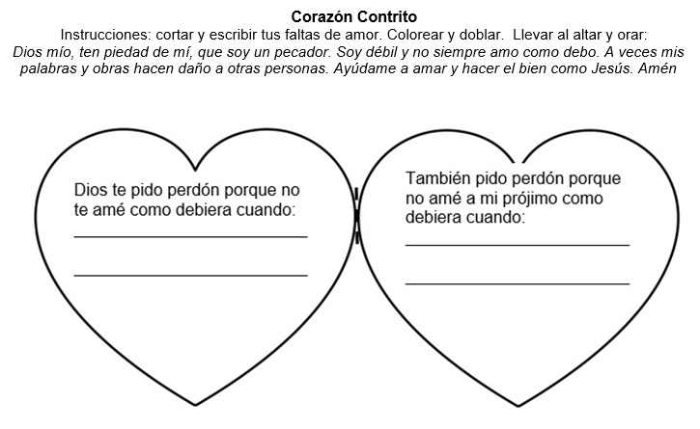
A Contrite Heart
Instructions: cut and write a time you lacked in love to God and to your neighbor. Color and fold. Take to the altar and pray: My God, have mercy on me a poor sinner. I am weak and do not always do what I should. Sometimes my words and deeds hurt other people. Help me to love and do good as Jesus did. Amen
God, I ask forgiveness for not loving you as I should when I:
I also ask forgiveness because I did not love my neighbor as I should when I:

Slide 25
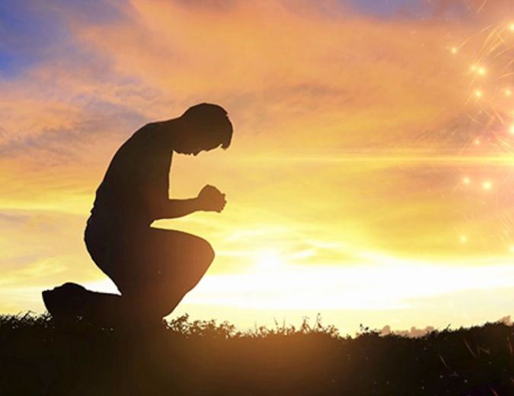
prayer
My God, have mercy on me a poor sinner. I am weak and do not always do what I should. Sometimes my words and deeds hurt other people. Help me to love and do good as Jesus did.
Amen

Slide 26
You forgive me, Lifetree kids, https://youtu.be/LO-2fm7IKcU

