Slide 1
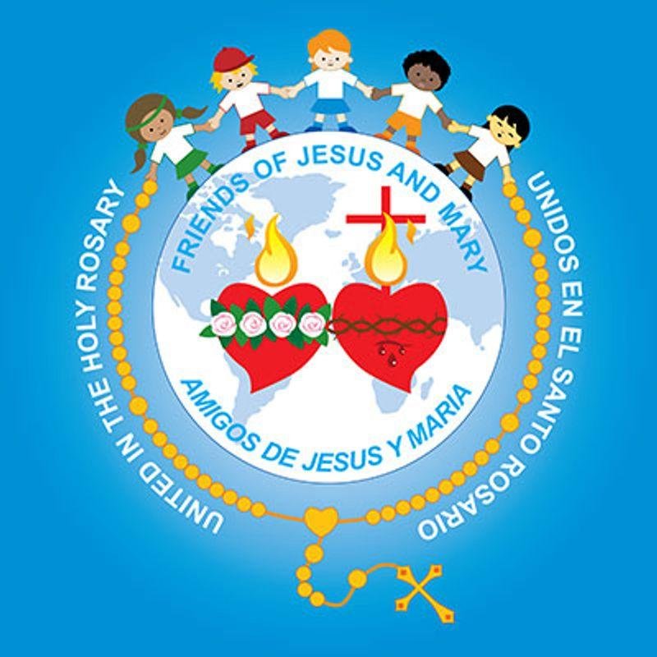
MINISTRY FRIENDS OF JESUS AND MARY
Cycle C, XXXI Sunday in Ordinary Time
Luke 19, 1-10
www.fcpeace.org

Slide 2
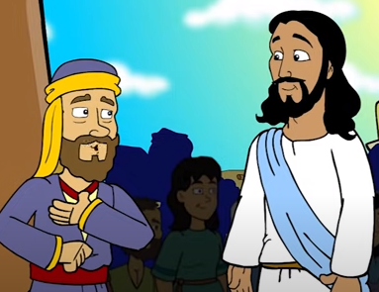
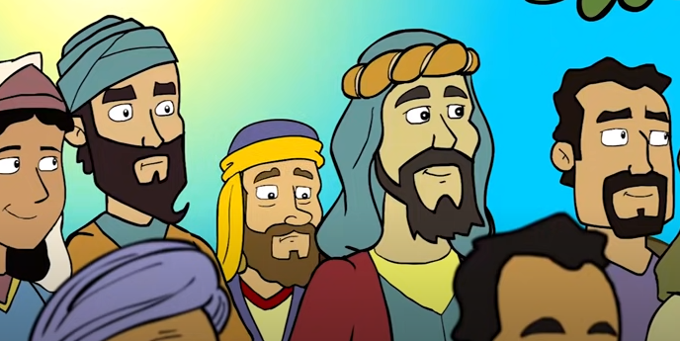
Zacchaeus seeks Jesus.
At that time, Jesus came to Jericho and intended to pass through the town. Now a man there named Zacchaeus, who was a chief tax collector and also a wealthy man, was seeking to see who Jesus was; but he could not see him because of the crowd, for he was short in stature.

Slide 3
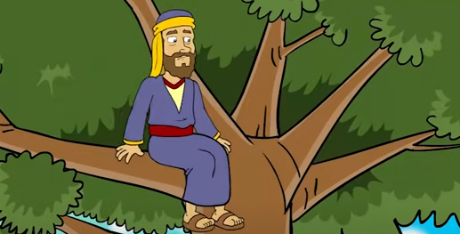
Zacchaeus seeks Jesus.
So he ran ahead and climbed a sycamore tree in order to see Jesus, who was about to pass that way. When he reached the place, Jesus looked up and said, "Zacchaeus, come down quickly, for today I must stay at your house." And he came down quickly and received him with joy.

Slide 4
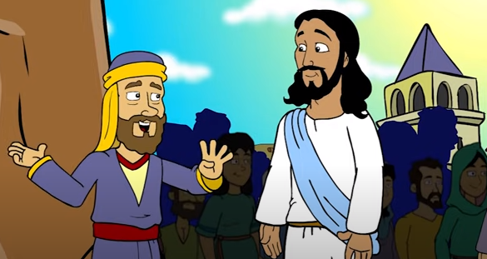
Zacchaeus seeks Jesus.
When they all saw this, they began to grumble, saying, "He has gone to stay at the house of a sinner." But Zacchaeus stood there and said to the Lord, "Behold, half of my possessions, Lord, I shall give to the poor, and if I have extorted anything from anyone, I shall repay it four times over."

Slide 5
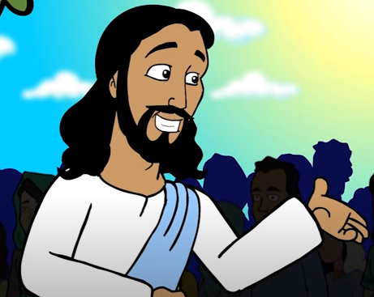
Zacchaeus seeks Jesus.
And Jesus said to him, "Today salvation has come to this house because this man too is a descendant of Abraham. For the Son of Man has come to seek and to save what was lost."
The Gospel of the Lord, Praise to you Lord Jesus Christ.

Slide 6
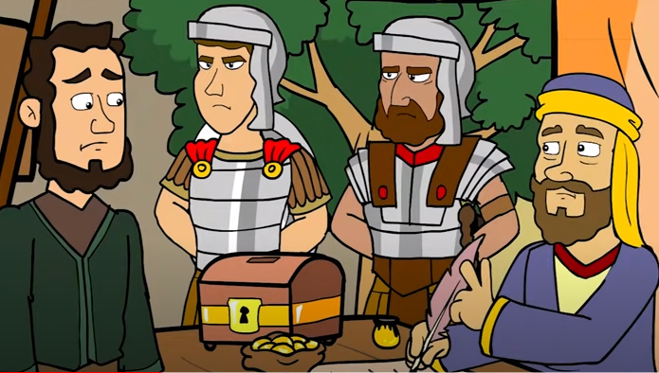
Reflection
Zacchaeus was Jewish and chief of the tax collectors. Why was he hated by his people?
They collected taxes for the Romans, often overcharging to keep some for themselves and so were hated. Zacchaeus was seen as a traitor for helping the Romans at the expense of his people.

Slide 7
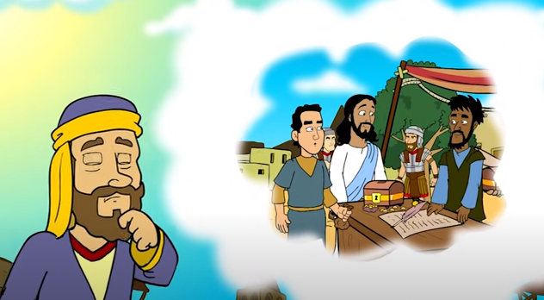
Reflection
Why did Zacchaeus try to see Jesus?
He had heard about His miracles and that He was a man of God. His heart felt His call. He needed to fill the emptiness that his stolen riches left him.

Slide 8
Reflection
Why did he climb the tree?
He was short in stature and could not see Jesus walk by. His small size also symbolizes his social status because of his sins. He had to work harder to see Jesus than others.

Slide 9
Reflection
How did Zacchaeus feel when Jesus called out to him?
Happy and grateful.
What did he promise Jesus?
To give half of his riches to the poor and to pay back 4 times the amount he had stolen to people.

Slide 10
Reflection
When he opened his heart to Jesus, he was filled with Jesus’ love, repented of his sins, and was filled with love for others, wanting to make up for the damage he had done them. HE WAS SAVED!
How did the others react when they saw Jesus go to his house?
They complained that Jesus visited the home of sinners.

Slide 11
Reflection
What distances us from Jesus? Share.
How can we seek Him? Share.

Slide 12
Let’s Sing!
Jesus Saves, Answer VBS, https://youtu.be/pilKEi9Ekho

Slide 13
Let’s Play!
Write what the people said in the Gospel of Luke 19,1-10: the story of Zacchaeus.

Slide 14
Let’s Play!
At that time, Jesus came to Jericho and intended to pass through the town. Now a man there named Zacchaeus, who was a chief tax collector and also a wealthy man, was seeking to see who Jesus was; but he could not see him because of the crowd, for he was short in stature. So he ran ahead and climbed a sycamore tree in order to see Jesus, who was about to pass that way. When he reached the place, Jesus looked up and said,

Slide 15
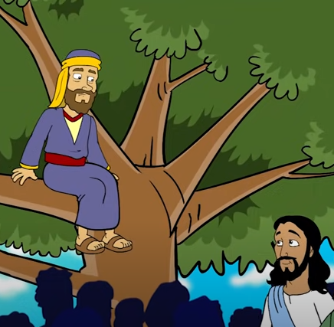
Let’s Play!
What did Jesus say?
Zacchaeus, come down quickly, for today I must stay at your house.

Slide 16
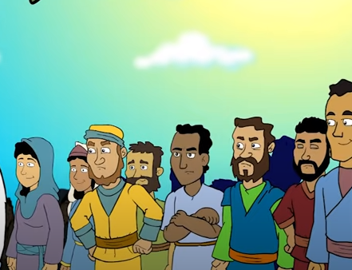
Let’s Play!
And he came down quickly and received him with joy. When they all saw this, they began to grumble, saying, (What did they grumble?)
He has gone to stay at the house of a sinner.

Slide 17
Let’s Play!
But Zacchaeus stood there and said to the Lord:
(What did he say?)
Behold, half of my possessions, Lord, I shall give to the poor, and if I have extorted anything from anyone, I shall repay it four times over.

Slide 18
Let’s Play!
And Jesus said to him, (What did Jesus say?)
Today salvation has come to this house because this man too is a descendant of Abraham. For the Son of Man has come to seek and to save what was lost.

Slide 19
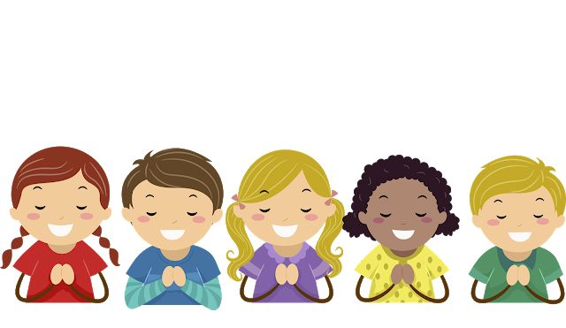
Prayer Jesus, forgive me for separating myself from you. I promise to change and to avoid things that cause me to sin. Help me to pray more, forgive more, and love more. I pray for the conversion of sinners. Amen.

