Slide 1
MINISTRY FRIENDS OF
JESUS AND MARY
Prayer Group for Children
Cycle C- XXXII Sunday in Ordinary Time
Luke 20, 27-38
Jesus Affirms the Resurrection of the Dead
www.fcpeace.org

Slide 2
Some Sadducees, those who deny that there is a resurrection, Jesus said to them, "The children of this age marry and remarry; but those who are deemed worthy to attain to the coming age and to the resurrection of the dead neither marry nor are given in marriage. They can no longer die, for they are like angels; and they are the children of God because they are the ones who will rise.

Slide 3
That the dead will rise even Moses made known in the passage about the bush, when he called out 'Lord, ' the God of Abraham, the God of Isaac, and the God of Jacob; and he is not God of the dead, but of the living, for to him all are alive."

Slide 4
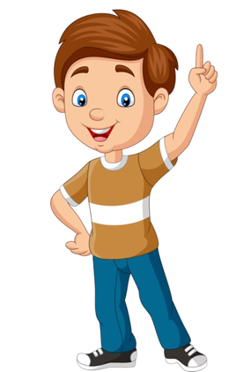
REFLECTION

Slide 5
Who were the Sadducees?
A Jewish religious sect that existed during the time of Jesus; they did not believe in the resurrection of the dead.

Slide 6
What does the resurrection of the dead mean?
The Church teaches us that just like Jesus resurrected from the dead, at the end of time, we will resurrect with Jesus, with our same body, but transfigured into our glorious or heavenly body .”

Slide 7
How does Jesus describe resurrected people?
They will not get married nor will they die, because they will be like angels and children of God.
What are angels?
They are spirits that love and serve God with their whole being.

Slide 8
When we get to Heaven, we will be surrounded with so much love from God that we will only want to serve Him forever.
How can we love and serve God better while still on earth?...

Slide 9
Peace
Justice
Imitating our living God, Jesus, by sharing, loving, and forgiving, bringing His peace, love, and life to others.
Life
Notes:
COMPARTIR , HABLAR A LOS DEMAS DE LA PAZ, JUSTICIA, DEFENDER LA VIDA, CONECTARME CONTIGO A TRAVES DE TU PALABRA

Slide 10
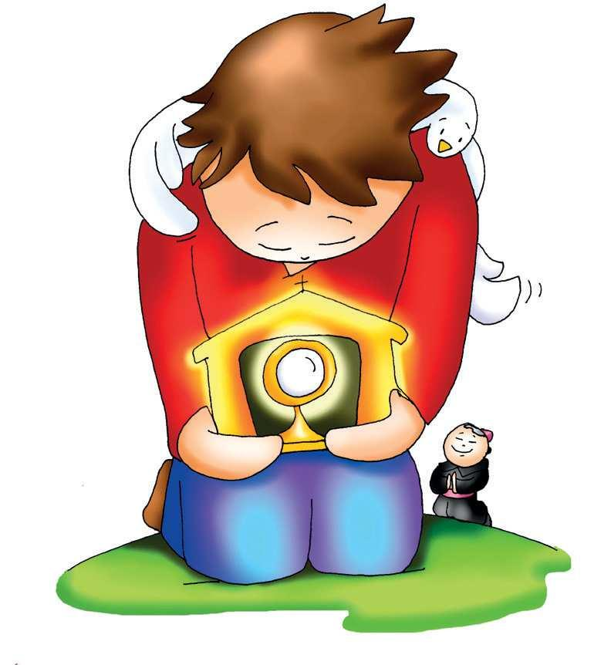
PRAYER
God of Love, thank you for loving me so much that you sacrificed Your beloved Son so I may be with you in Heaven. Help me to love, to forgive, and to serve you better so I may please You and bring to this world more peace and joy. Amen.

Slide 11
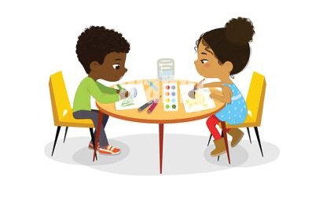
ACTIVITIES

Slide 12
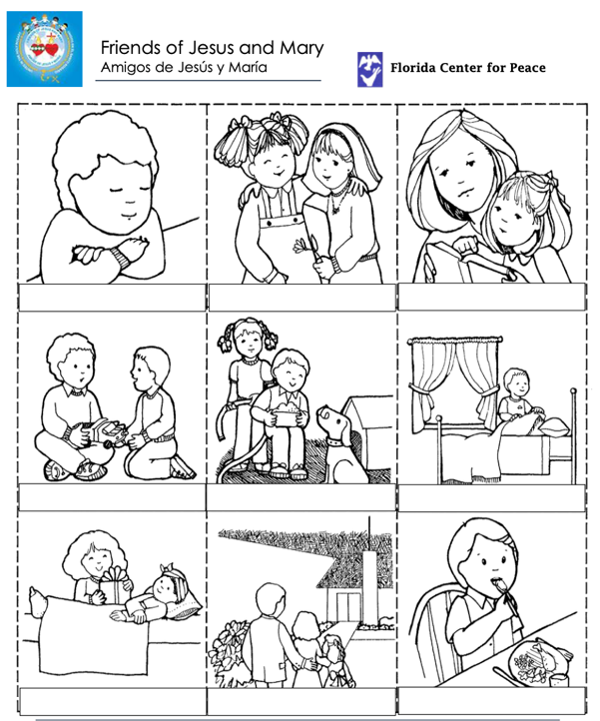
Write or discuss how each is loving and serving God. Color.

Slide 13
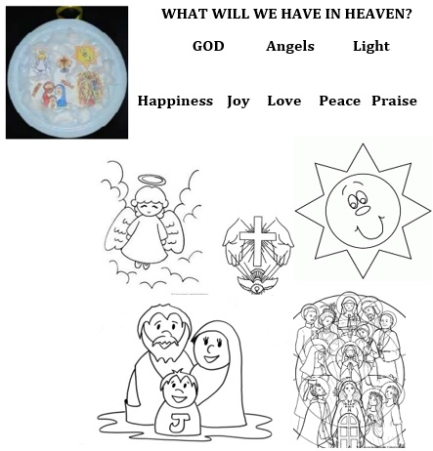
Make a Heaven craft
Cut the words and the drawings. Color the drawings and glue onto a light blue or white paper plate. Glue pieces of cotton around the drawings representing clouds. Behind the plate, glue the words and add your own: saints, the Holy Family... Hang with a ribbon.

Slide 14
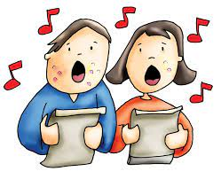
Heaven is Real, Brentwood Benson, https://youtu.be/csbRqyuZwnE , 3-7 yrs.

Slide 15
Yancy Shine and Serve, https://youtu.be/gVE8ZNHhd_A , 8+ yrs.

