Slide 1
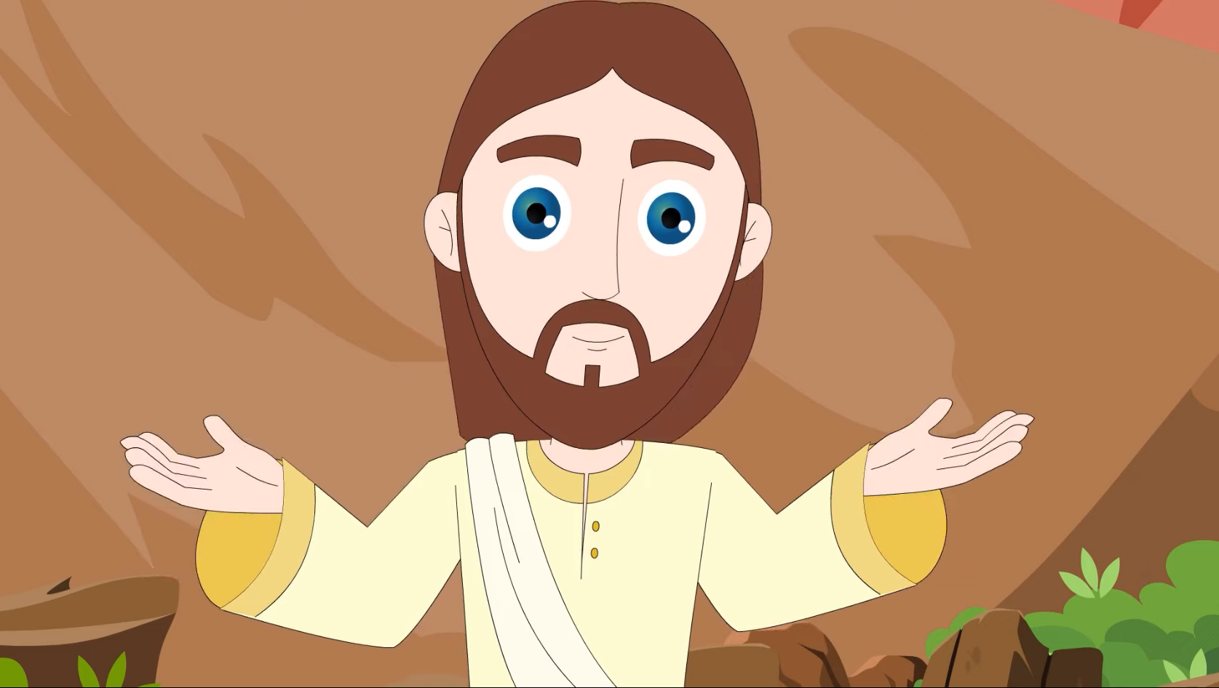
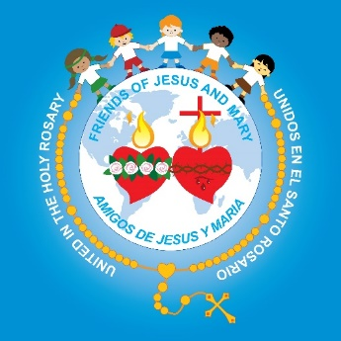
MINISTRY FRIENDS OF JESUS AND MARY
www.fcpeace.org
XXXIII Sunday in Ordinary Time – Cycle C
Persevere in Faith
(Luke 21, 5-19)

Slide 2
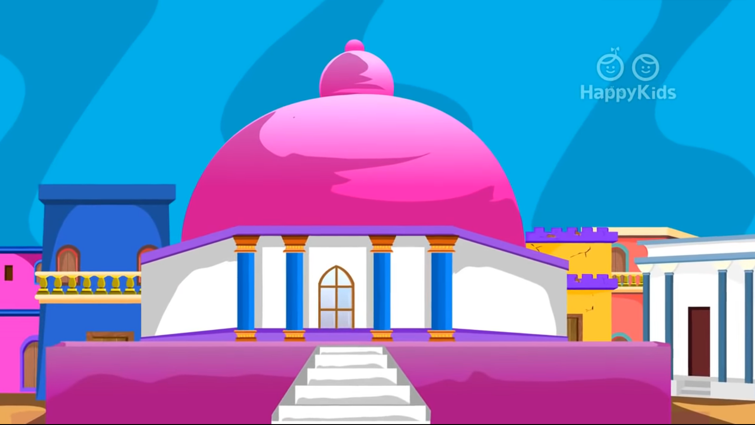
While some people were speaking about how the temple was adorned with costly stones and votive offerings, Jesus said,

Slide 3
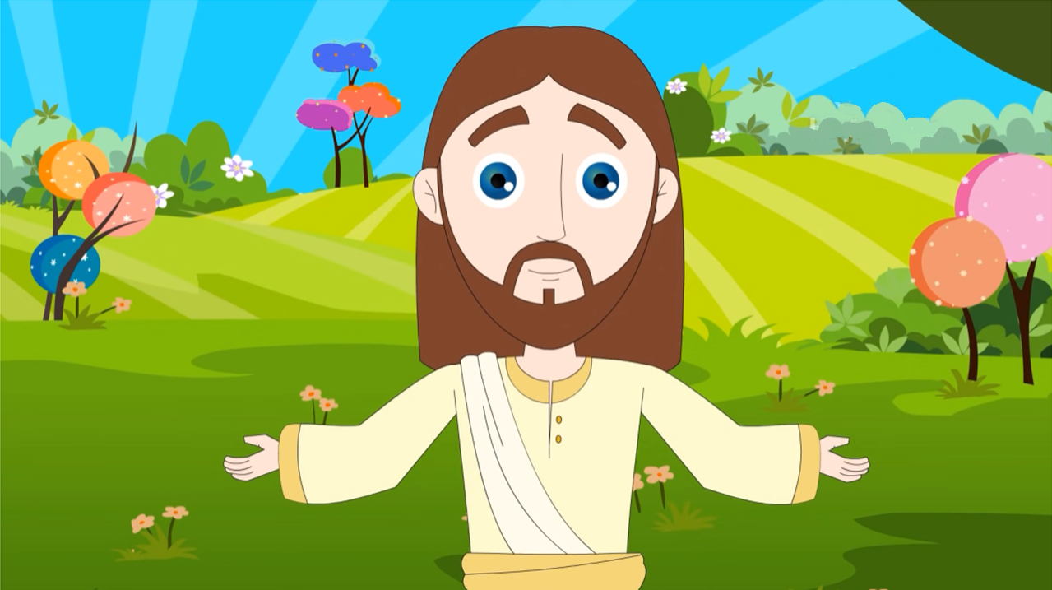
All that you see here, the days will come when there will not be left a stone upon another stone that will not be thrown down."

Slide 4
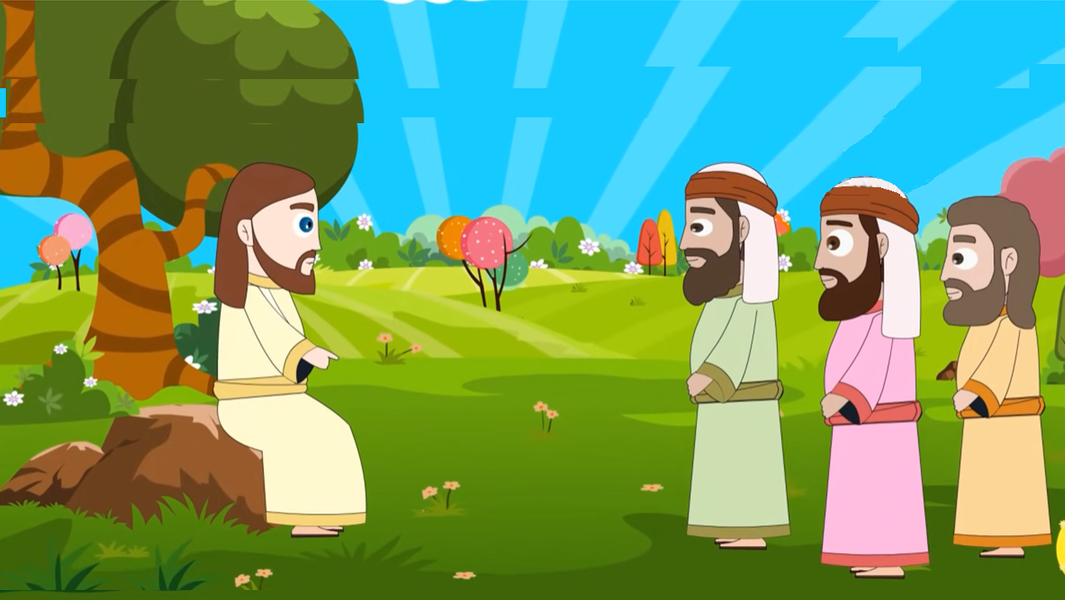
Then they asked him, "Teacher, when will this happen? And what sign will there be when all these things are about to happen?"?"

Slide 5
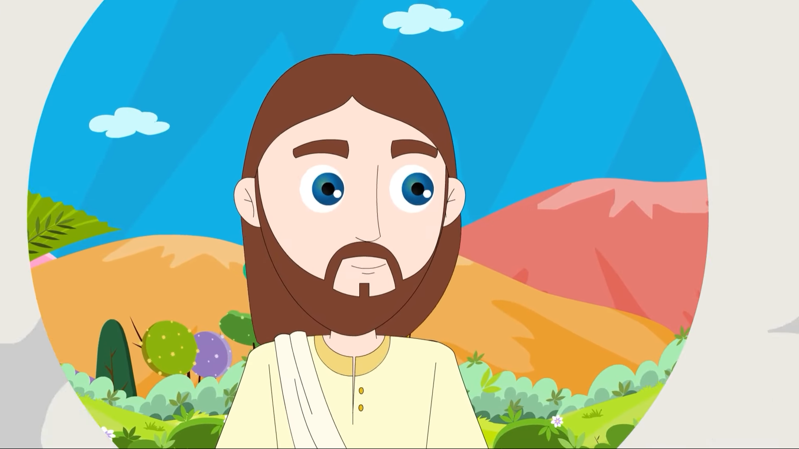
He answered, "See that you not be deceived, for many will come in my name, saying, 'I am he,' and 'The time has come.'

Slide 6
Do not follow them! When you hear of wars and insurrections, do not be terrified;

Slide 7
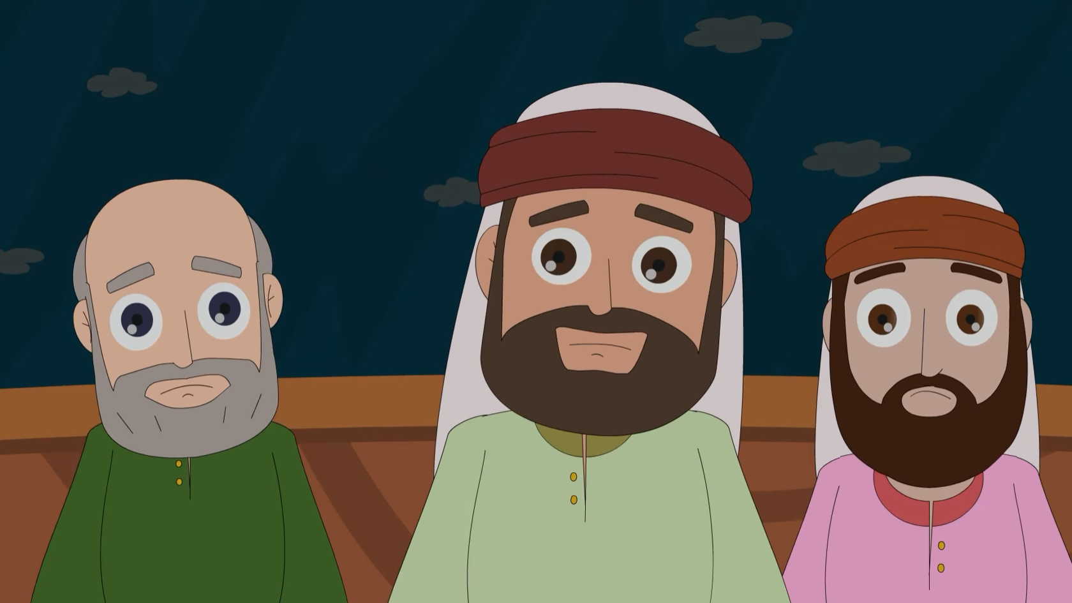
for such things must happen first, but it will not immediately be the end." Then he said to them, "Nation will rise against nation,

Slide 8
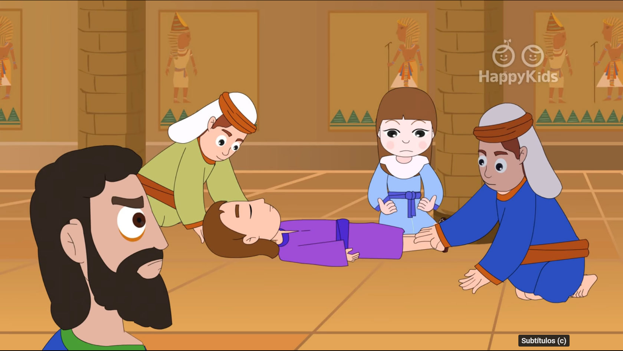
…and kingdom against kingdom. There will be powerful earthquakes, famines, and plagues from place to place; and awesome sights and mighty signs will come from the sky.

Slide 9
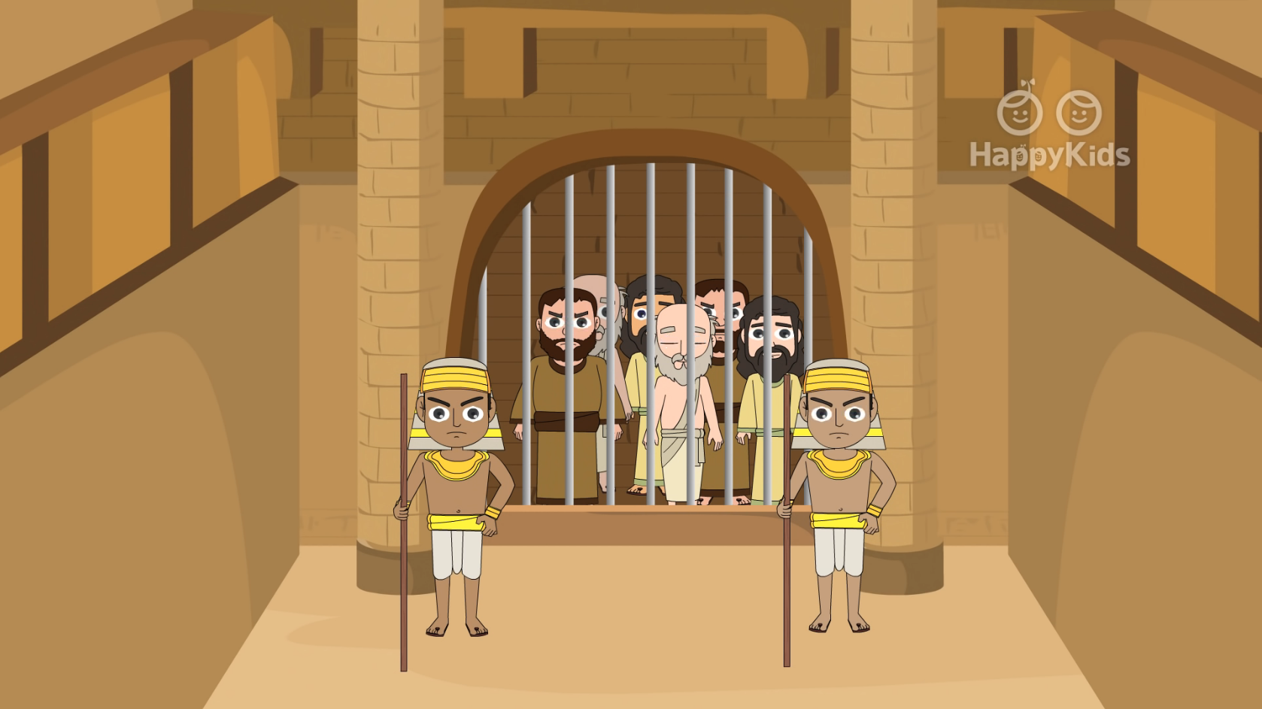
Before all this happens, however, they will seize and persecute you, they will hand you over to the synagogues and to prisons, and they will have you led before kings and governors because of my name.

Slide 10
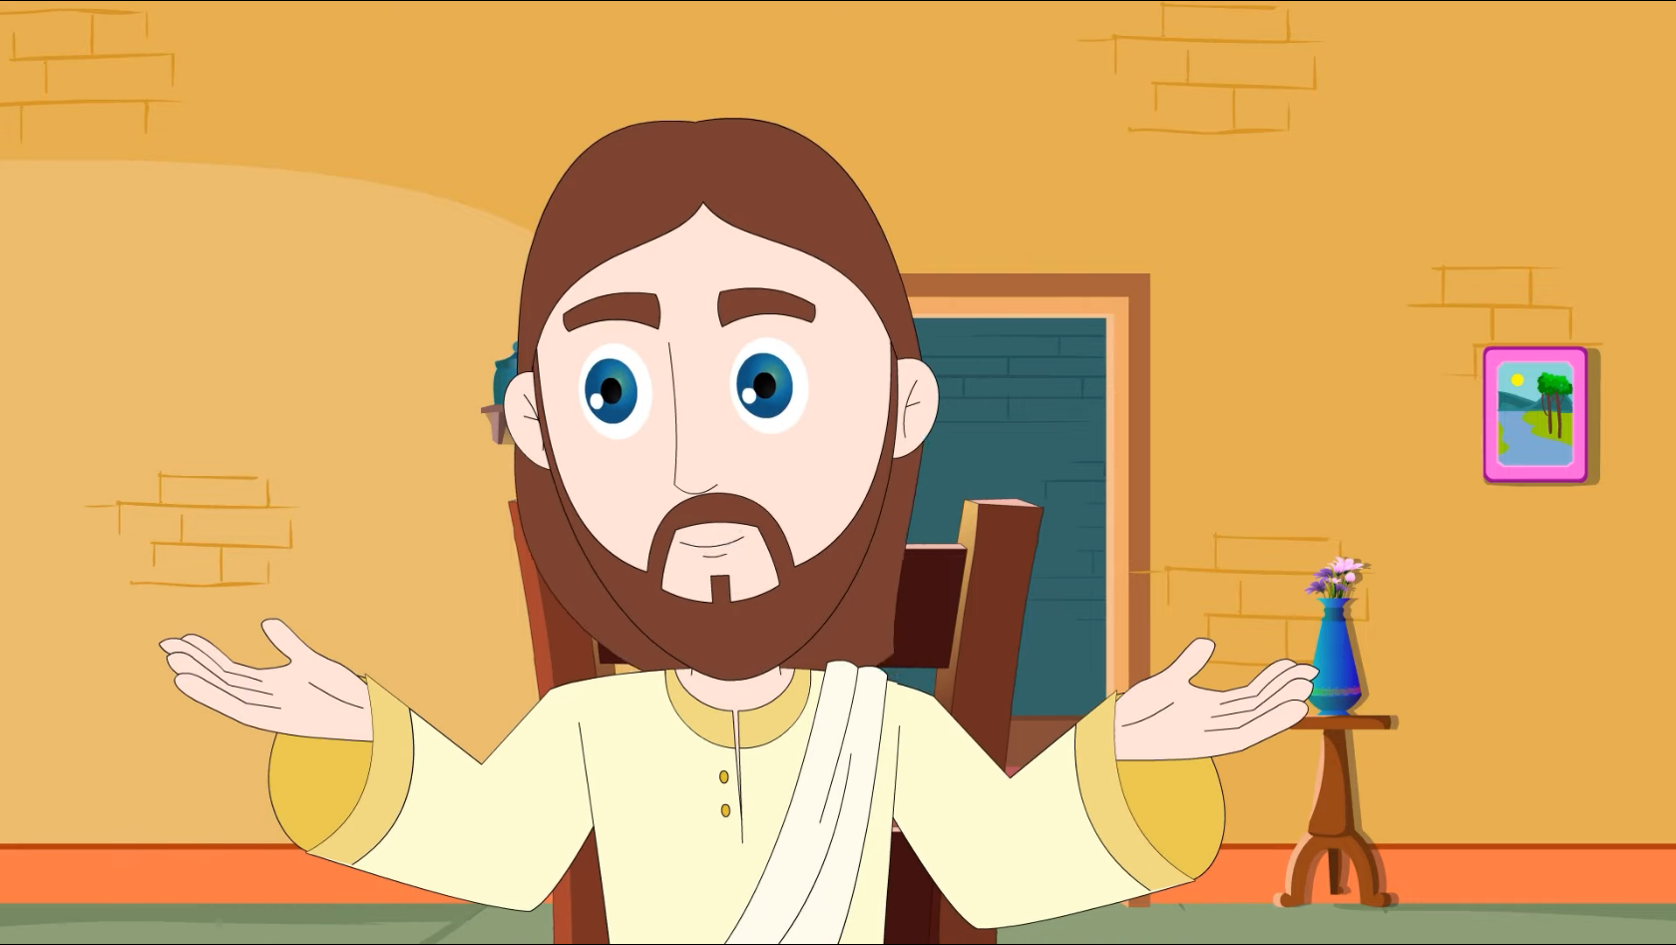
It will lead to your giving testimony. Remember, you are not to prepare your defense beforehand,

Slide 11
…for I myself shall give you wisdom in speaking that all your adversaries will be powerless to resist or refute.

Slide 12
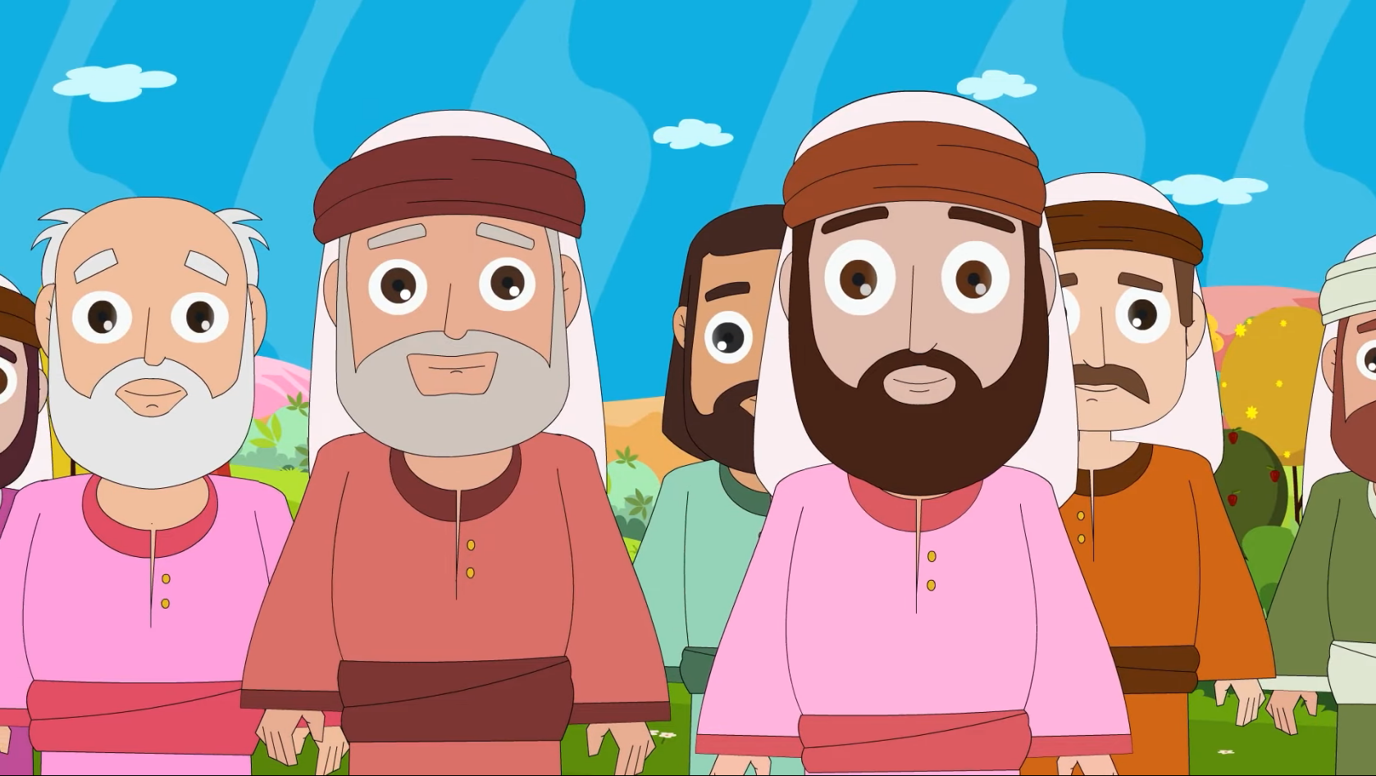
You will even be handed over by parents, brothers, relatives, and friends, and they will put some of you to death.

Slide 13
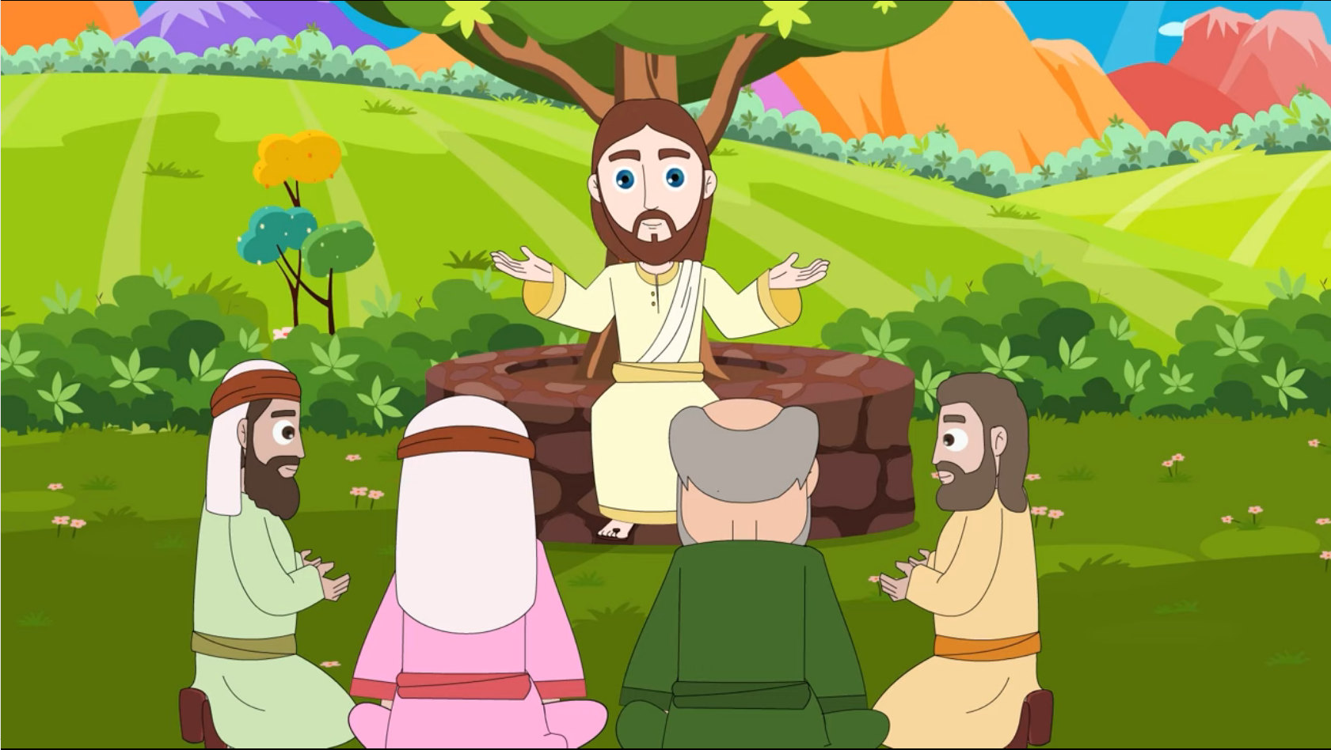
You will be hated by all because of my name, but not a hair on your head will be destroyed. By your perseverance you will secure your lives."
The Gospel of the Lord,
Praise to you Lord Jesus Christ.

Slide 14
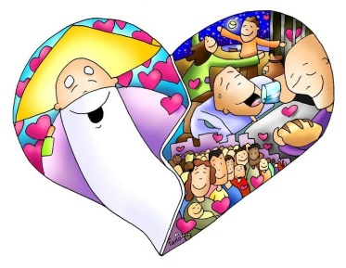
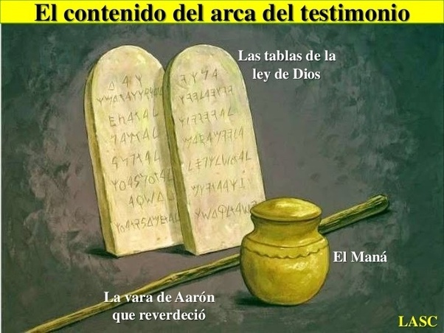
REFLECTION
What is the Temple?
The temple was the place where all Jews worshipped God.
Where was it?
It was in Jerusalem.
Who went to the Temple?
Jews of all places and social classes.
What important thing was in the Temple?
The Ark of the Covenant where God spoke to His people from between the angels.
What did it contain?
The 10 commandments (God’s Old Covenant with His people), the manna from the desert, and Aaron’s staff.
How often did the Jews go to the Temple?
Once a year to celebrate Passover.

Slide 15
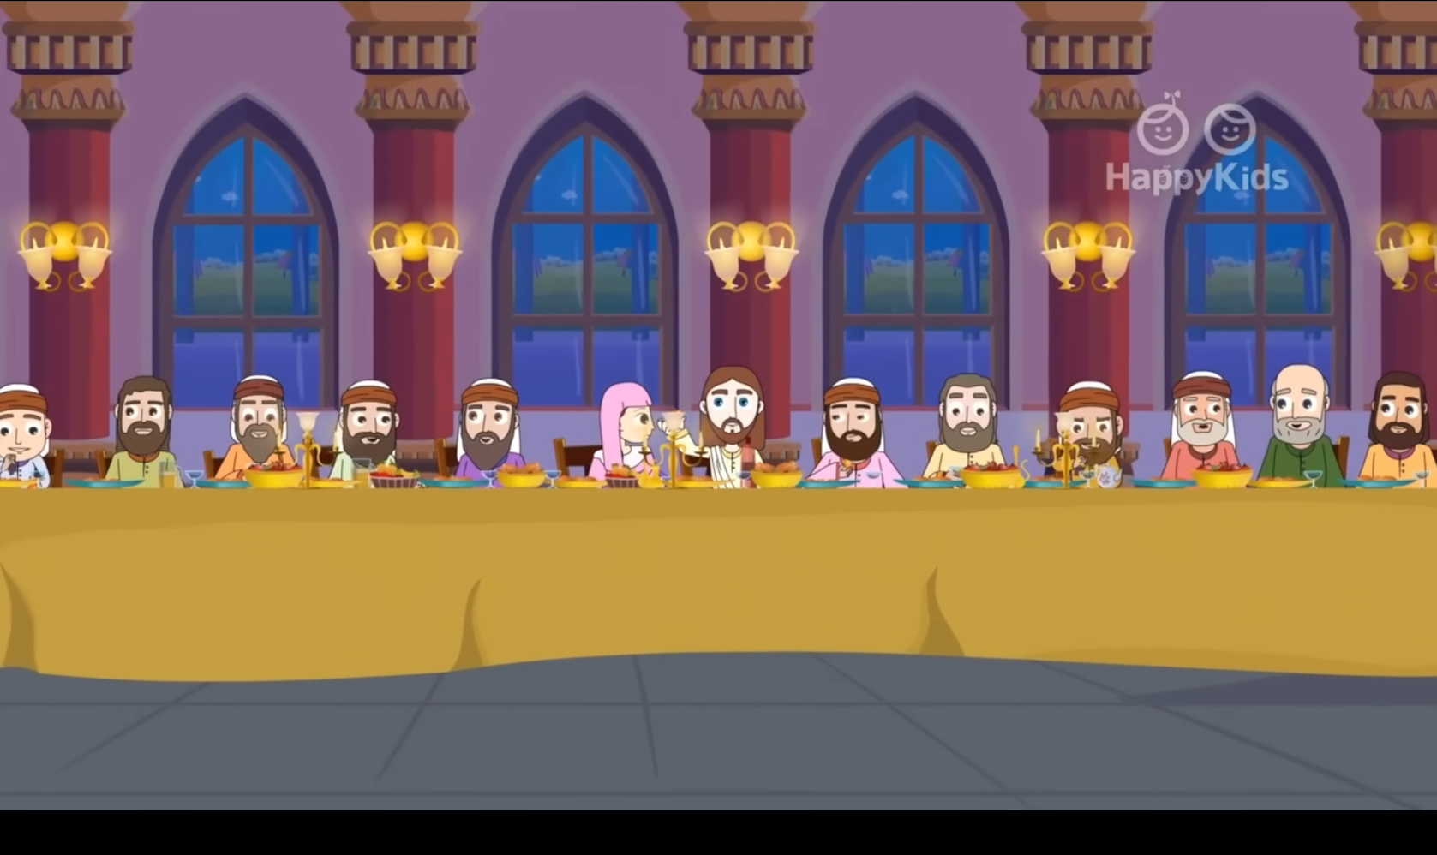
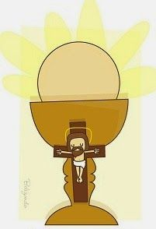
REFLECTION
What did Jesus mean when He said, “there will not be left a stone upon another stone”?
The temple would be destroyed and the Ark of the Covenant, God’s presence, would be lost.
Where is Jesus present today?
At the Last Supper, Jesus creates a New Covenant with all people who believe He is their God and Savior.
What did He give us that day?
That day, Jesus gave us the EUCARIST to physically stay with us always. He also stays spiritually in our heart.

Slide 16
REFLECTION
What does Jesus tell us about the future?
Jesus says there will be difficult times and the world will hate His followers.
Should we be scared?
NO!!! He promises to be with us and protect us if we remain firm in our faith in Him.
This invites us to never lose faith and trust in Jesus and not to depend on exterior things. Jesus is God, Almighty, that loves us with His whole life.

Slide 17
ACTIVITY

Slide 18
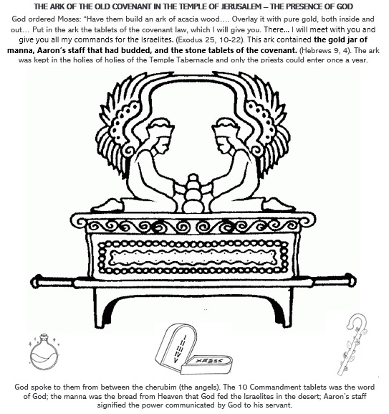
Color the Ark of the Old Covenant and its content.

Slide 19
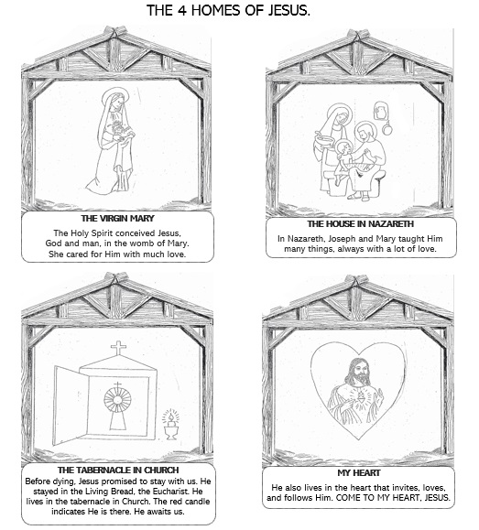
THE 4 HOMES OF JESUS,
GOD’S PRESENCE ON EARTH
Instructions:
Fold and cut a construction paper in half the long way (4.25”x5.5”). Fold in half, then fold in half again. Form a cube by taping the ends together from the inside. Fold the remaining paper in half twice, then cut a rectangle. Fold the rectangle in half and tape on the inside to opposite sides of the cube to make the roof.
Cut and color the 4 houses with the writing below each. Glue one to each side of the cube. On the roof, glue the sign, “The 4 homes of Jesus.”
You can also make a mobile or a book with the 4 homes.

Slide 20
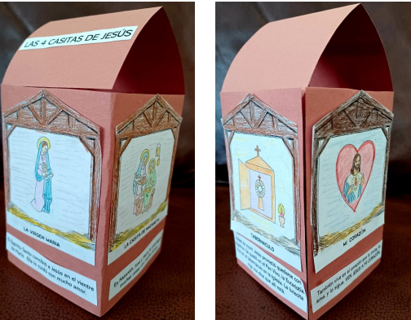

Slide 21
PRAYER FOR CHILDREN

Slide 22
Prayer
Jesus, my God,
Enter my heart and help me to remain firm in my faith, trusting that you are always with me. Thank you for staying with me in the Eucharist to help me get to Heaven. Thank you for loving me. I love you.
Amen

Slide 23
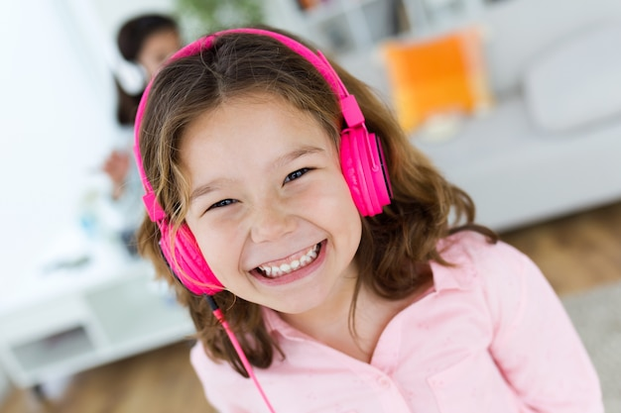
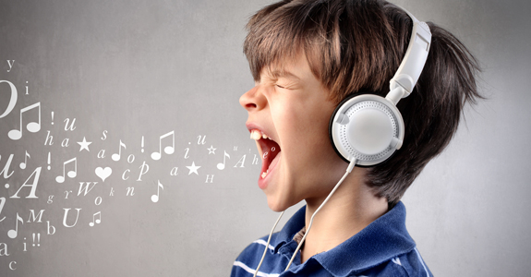
SONGS

Slide 24
By Faith, Ayi the Cow, https://youtu.be/YDu8ZH0_ktE (3-7 years)

Slide 25
Faith, Lifetree Kids, https://youtu.be/vTCQ81-7MnA (8+ years)

