Slide 1
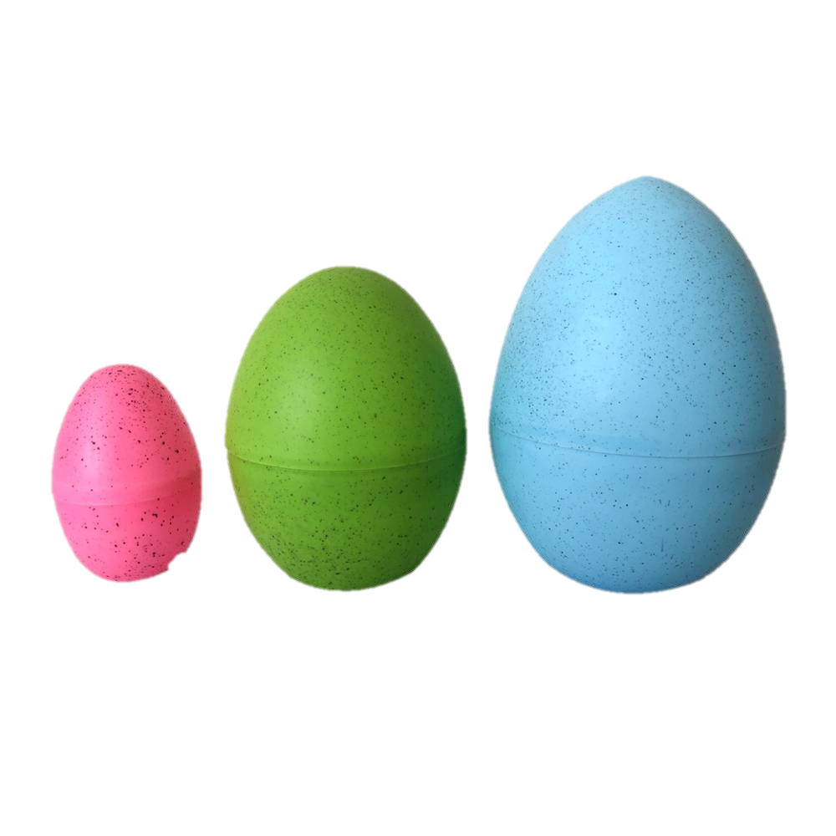
PASCHAL TRIDUUM

Slide 2
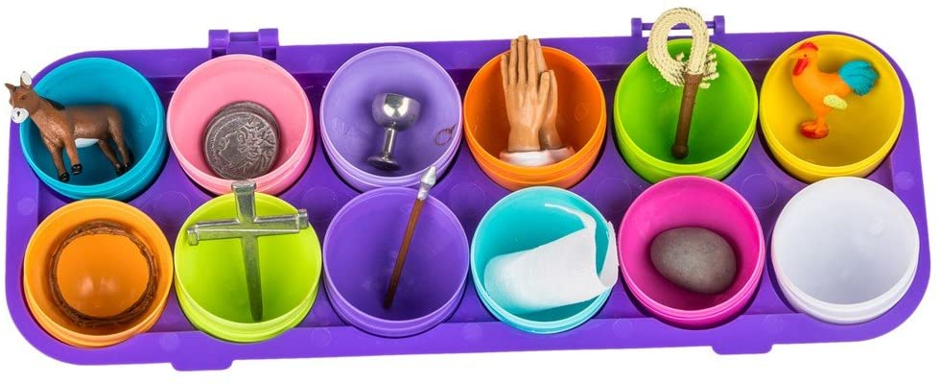
PASCHAL TRIDUUM

Slide 3
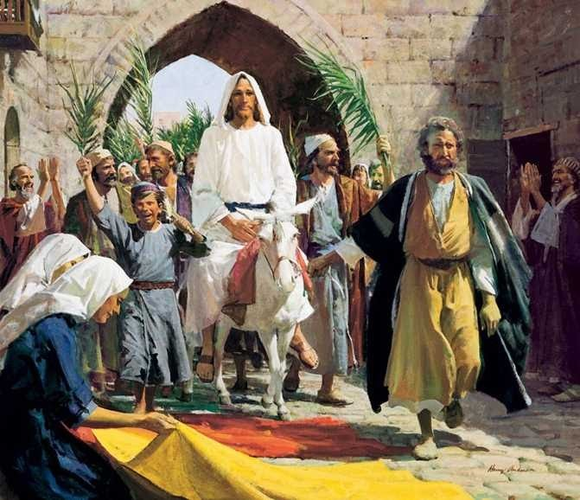
PALM SUNDAY
JESUS ENTERS TRIUMPHANTLY INTO JERUSALEM.

Slide 4
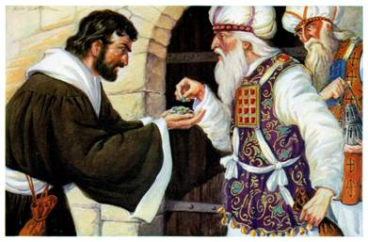
JUDAS’ BETRAYAL
HE SELLS JESUS FOR 30 SILVER PIECES.

Slide 5
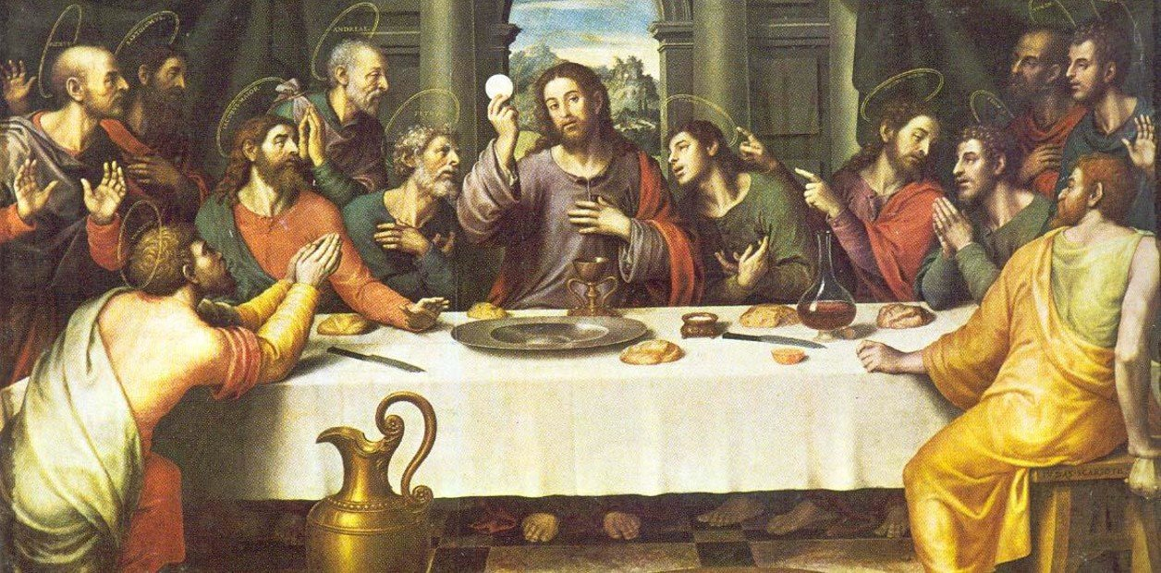
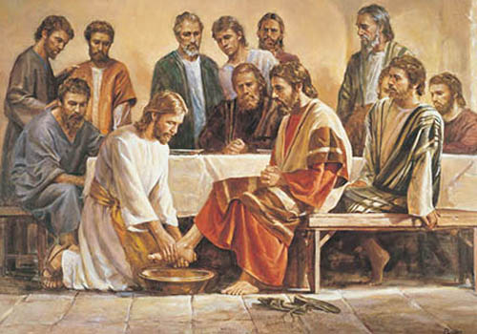
THE LAST SUPPER
JESUS INSTITUTES THE EUCHARIST AND THE PRIESTHOOD AND TEACHES US TO SERVE.

Slide 6
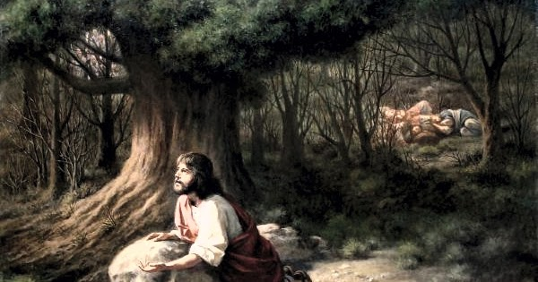
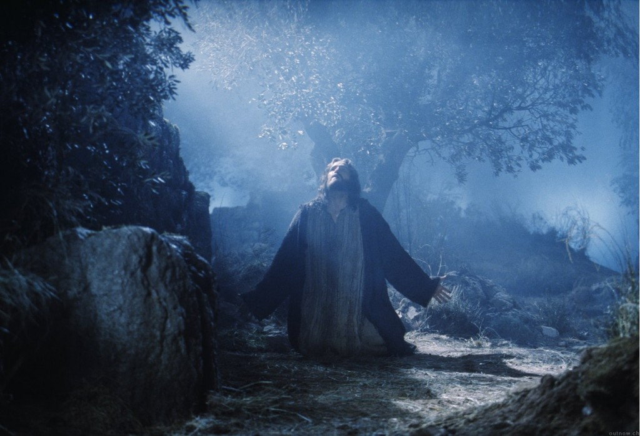
JESUS’ PRAYS IN AGONY IN THE GARDEN OF GETHSEMANE.

Slide 7
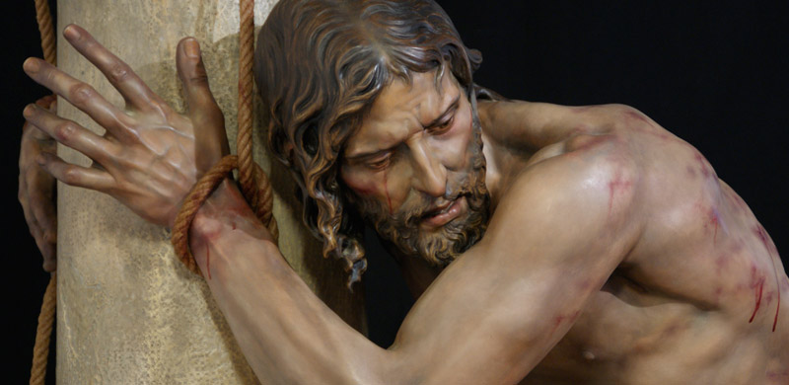
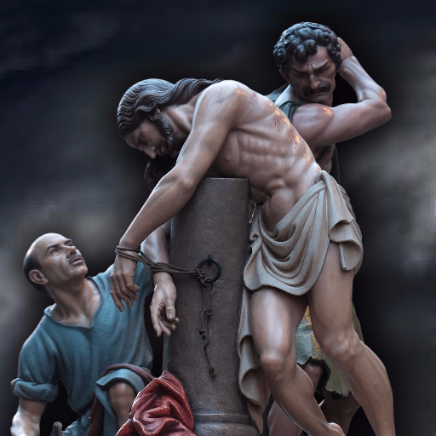
PONTIUS PILATE SENDS JESUS TO BE SCOURGED AT THE PILLAR.

Slide 8
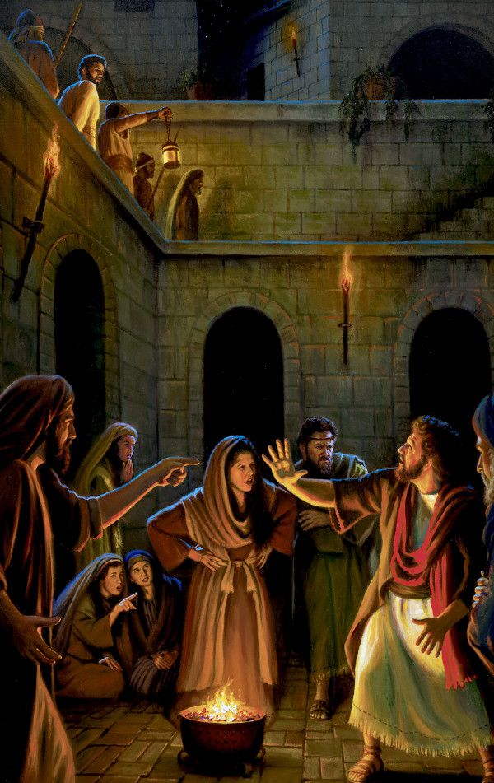
THE ROOSTER CROWS 3 TIMES AFTER PETER DENIES KNOWING JESUS 3 TIMES.

Slide 9
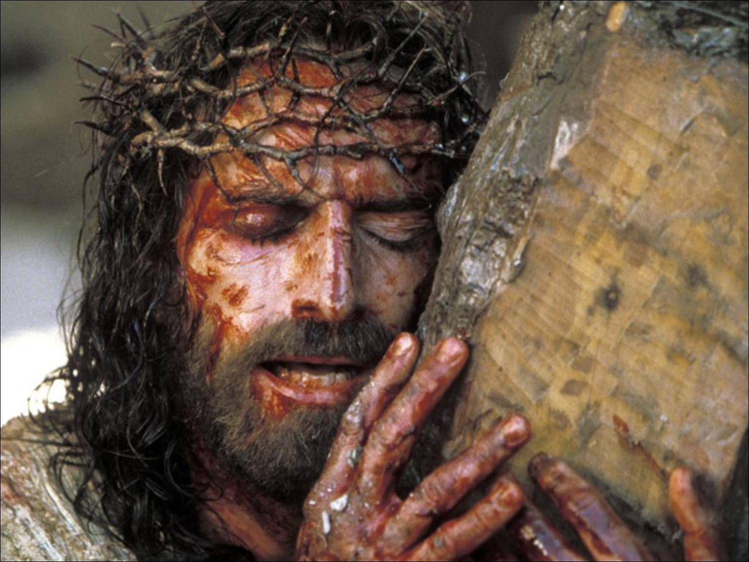
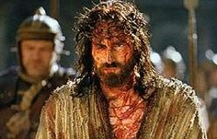
THE SOLDIERS CROWN JESUS WITH THORNS.

Slide 10
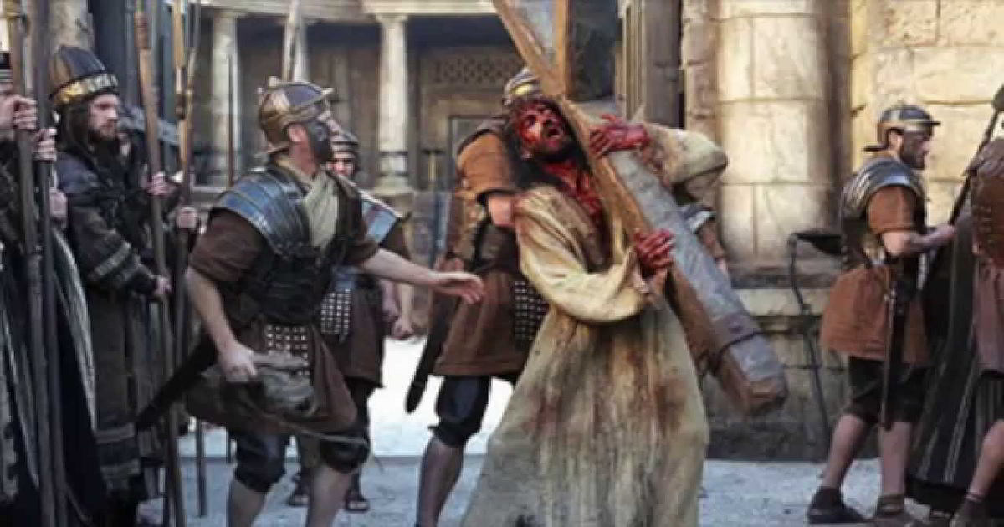
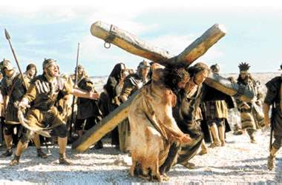
JESUS CARRIES HIS CROSS TO CALVARY.

Slide 11
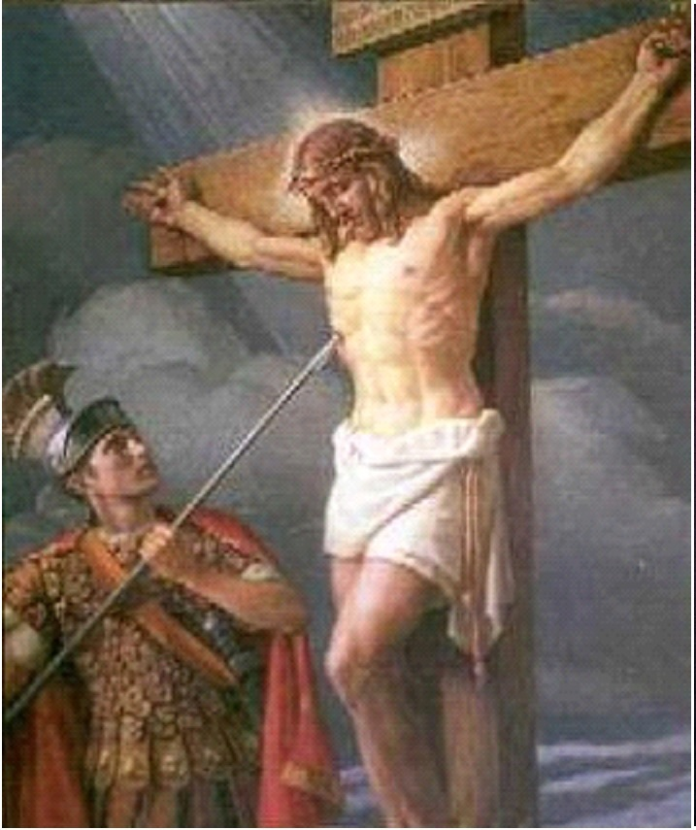
A SOLDIER PIERCED A LANCE THROUGH JESUS’ HEART.

Slide 12
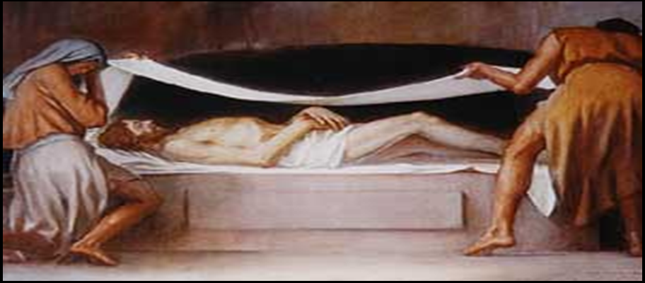
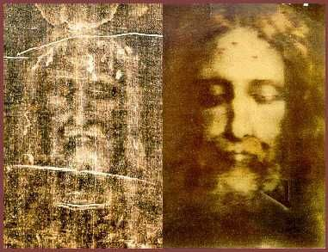
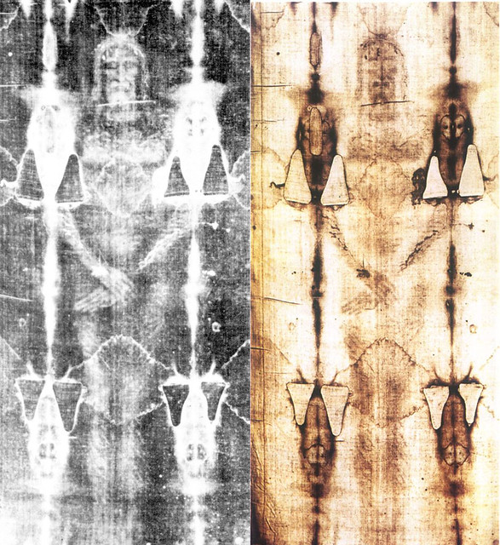
THEY WRAPPED JESUS’ BODY WITH LINENS.

Slide 13
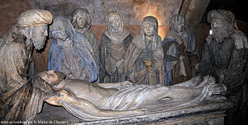
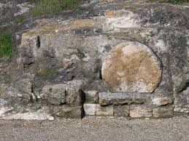
THEY LAID JESUS’ BODY IN A TOMB AND CLOSED IT WITH A LARGE STONE.

Slide 14
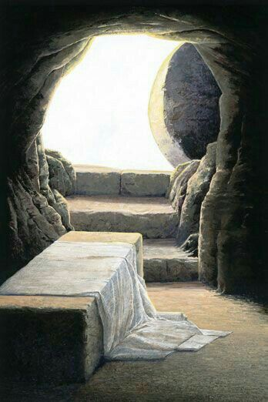
THE TOMB IS EMPTY!

Slide 15
