Slide 1
The Holy Rosary– Glorious Mysteries

Slide 2
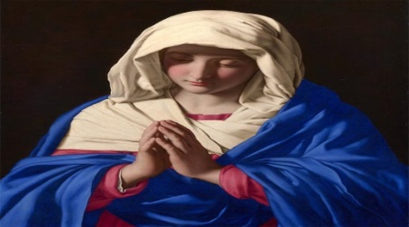
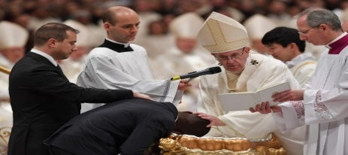
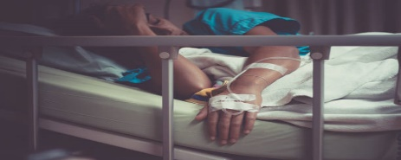
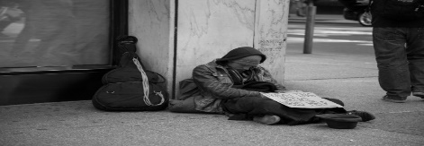
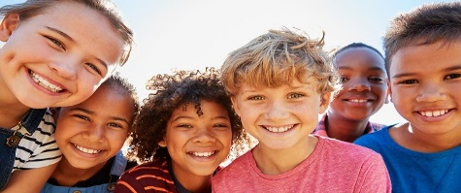
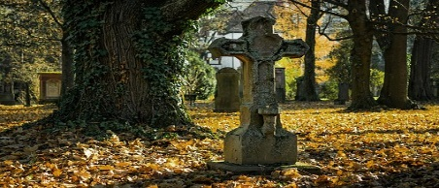
INTENTIONS
For the intentions of Our Blessed Mother.
For our Holy Catholic Church, our Holy Father Pope Francis, Pope Emeritus Benedict XVI, the Bishops and all the clergy, the consecrated religious; and for all the members of the Church
For an increase in vocations to the priesthood and the religious life
For our country’s leaders, that they may promote life, peace, and justice for all
For the elderly, the sick, the dying, the suffering, and those caring for them
For the end to the Corona Virus pandemic
For the homeless, the poor, the unemployed and all those struggling financially
For all the children and youth, especially the abandoned, abused, neglected and at-risk unborn
For all the youth, that they follow in the light of Christ
For physical or emotional healing for our family and friends and all those that have asked for prayer
For our deceased parishioners, family, and friends and for those mourning their loss
For the souls in Purgatory and for those who do not know of the love of Christ. Amen.

Slide 3
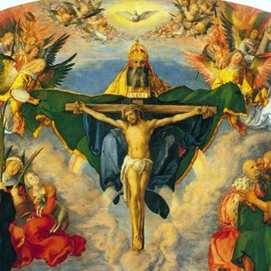
In the name of the Father and of the Son and of the Holy Spirit. Amen.

Slide 4
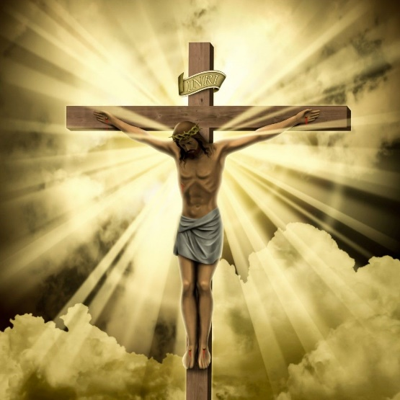
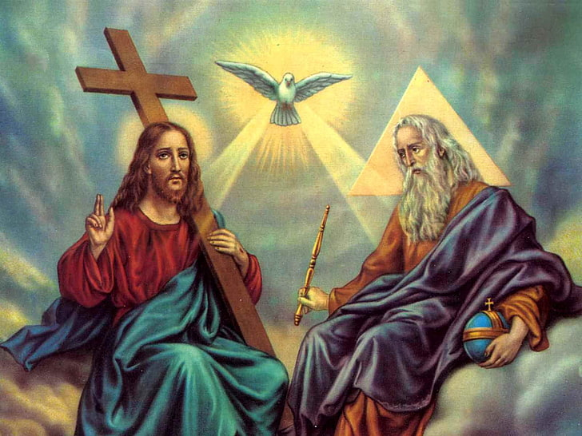
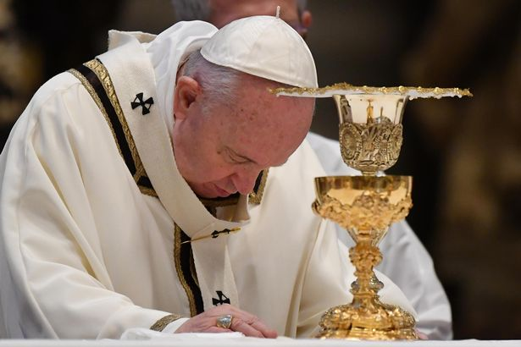
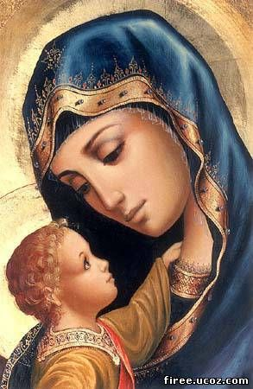
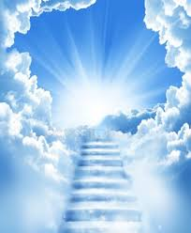
Apostle’s Creed
I believe in One God, the Father the Almighty,
Creator of Heaven and earth; and in Jesus Christ, His only Son Our Lord, Who was conceived by the Holy Spirit,
born of the Virgin Mary, suffered under Pontius Pilate,
was crucified, died, and was buried. He descended into Hell;
On the third day He rose again from the dead; He ascended into Heaven, and is seated
at the right hand of God, the Father almighty;
from thence He shall come to judge
the living and the dead and His Kingdom will have no end. I believe in the Holy Spirit, the holy Catholic Church,
the communion of saints, the forgiveness of sins,
the resurrection of the body and life everlasting.
Amen

Slide 5
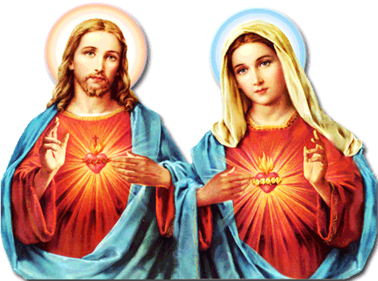
FAITH
HOPE
LOVE

Slide 6
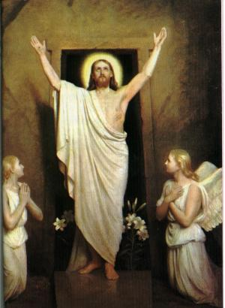
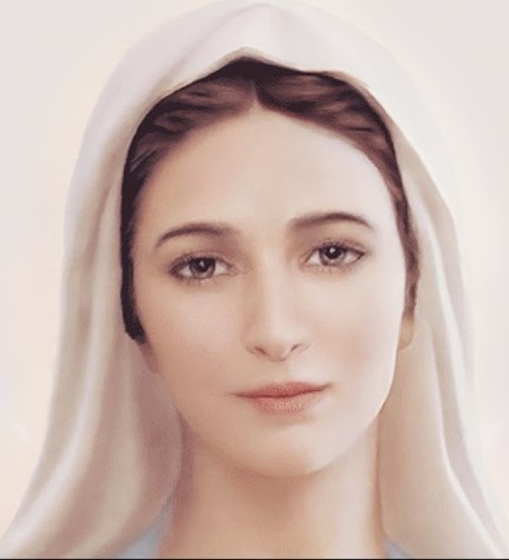
The 1st Glorious Mystery
THE RESURRECTION

Slide 7
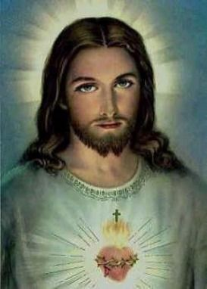
Oh my Jesus. Forgive us our sins Save us from the fire of Hell. Lead all souls to Heaven, especially those in most need of thy Mercy. Amen.

Slide 8
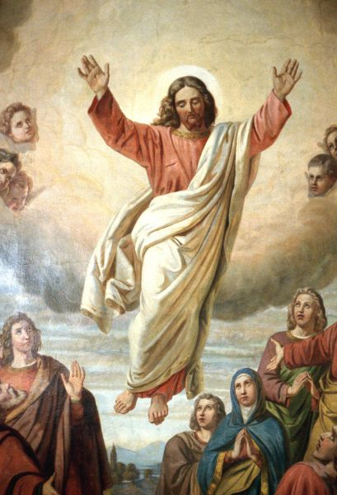
The 2nd Glorious Mystery
THE ASCENSION INTO HEAVEN

Slide 9
Oh my Jesus. Forgive us our sins Save us from the fire of Hell. Lead all souls to Heaven, especially those in most need of thy Mercy. Amen.

Slide 10
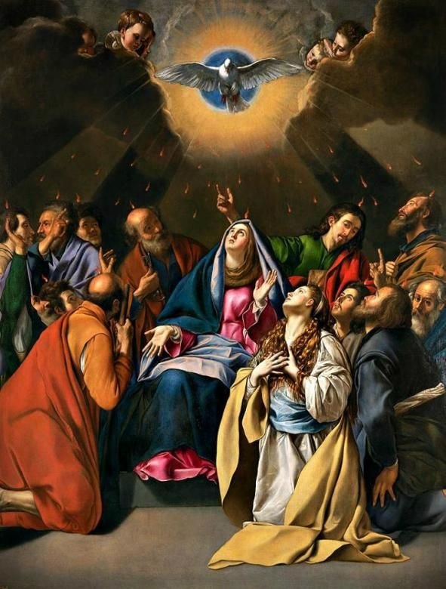
The 3rd Glorious Mystery
THE DESCENT OF
THE HOLY SPIRIT

Slide 11
Oh my Jesus. Forgive us our sins Save us from the fire of Hell. Lead all souls to Heaven, especially those in most need of thy Mercy. Amen.

Slide 12
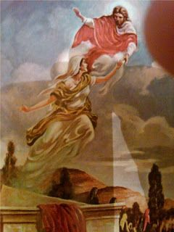
The 4th Glorious Mystery
THE ASSUMPTION OF MARY INTO HEAVEN

Slide 13
Oh my Jesus. Forgive us our sins Save us from the fire of Hell. Lead all souls to Heaven, especially those in most need of thy Mercy. Amen.

Slide 14
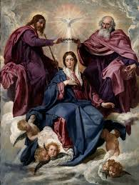
The 5th Luminous Mystery
MARY CROWNED
QUEEN OF THE UNIVERSE

Slide 15
Oh my Jesus. Forgive us our sins Save us from the fire of Hell. Lead all souls to Heaven, especially those in most need of thy Mercy. Amen.

Slide 16
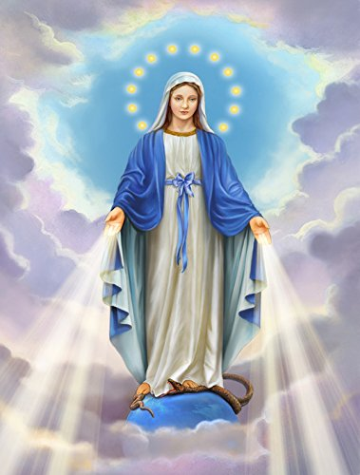
Hail, Holy Queen, Mother of Mercy, our life, our sweetness and our hope! To thee do we cry, poor banished children of Eve. To thee do we send up our sighs, mourning and weeping in this valley of tears! Turn, then, most gracious Advocate, thine eyes of mercy toward us, and after this, our exile, show unto us the blessed fruit of thy womb, Jesus. O clement, O loving, O sweet Virgin Mary. V. Pray for us, O holy Mother of God. R. That we may be made worthy of the promises of Christ. Amen Salve Regina, joelocampo119 https://youtu.be/tf3p6XrX_wE

Slide 17
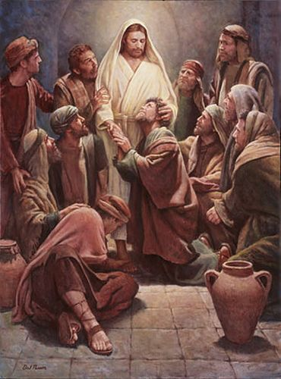
Let us Pray. O God, whose only-begotten Son, by His life, death and resurrection, has purchased for us the rewards of eternal life, grant, we beseech Thee, that while meditating on these mysteries of the most holy Rosary of the Blessed Virgin Mary, we may imitate what they contain, and obtain what they promise, through the same Christ our Lord. Amen.

Slide 18
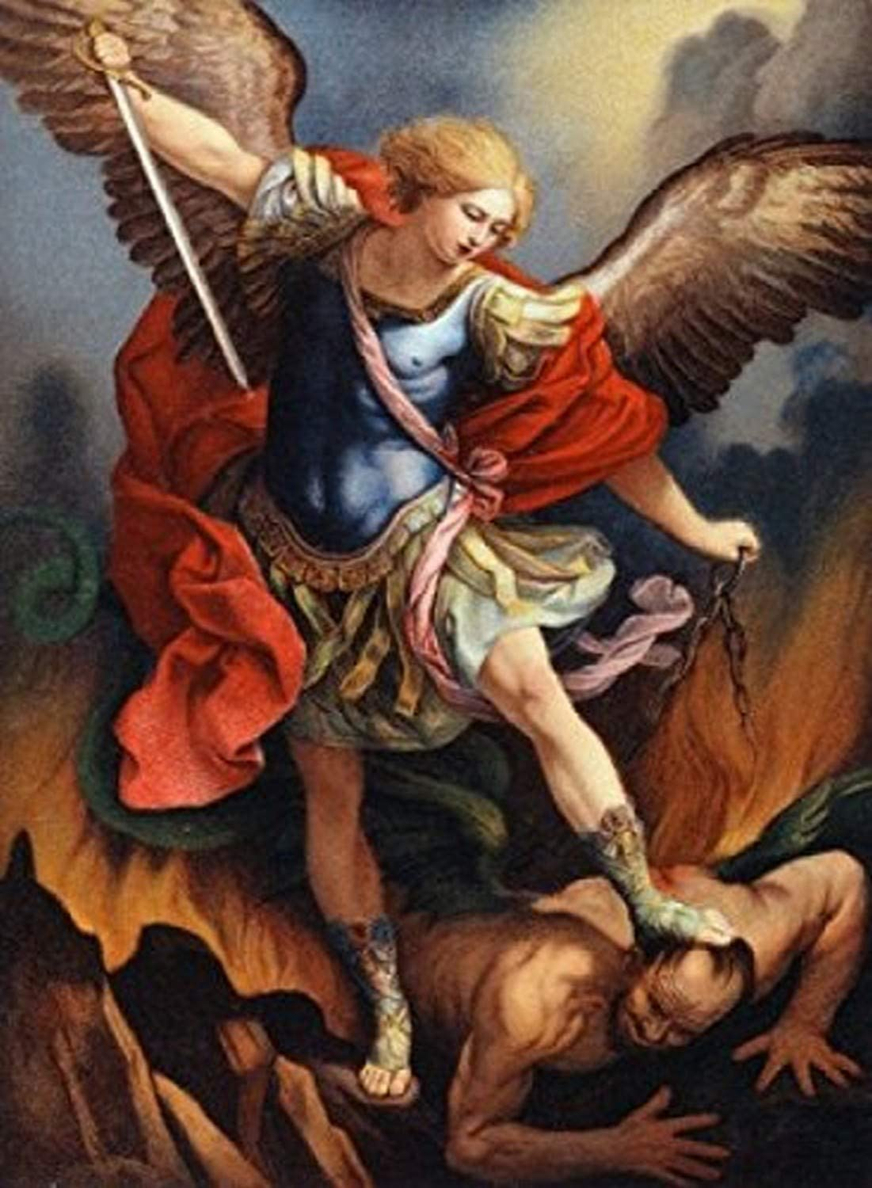
St. Michael the Archangel, defend us in battle. Be our protection against the wickedness and snares of the Devil. May God rebuke him, we humbly pray, and do thou, O Prince of the heavenly hosts, by the power of God, thrust into hell Satan, and all the evil spirits, who prowl about the world seeking the ruin of souls. Amen

Slide 19
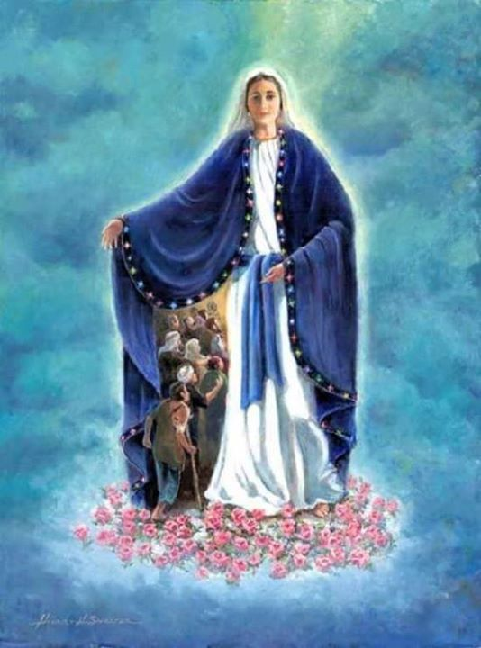
The Memorare Remember, O most gracious Virgin Mary, that never was it known that anyone who fled to your protection, implored your help, or sought your intercession was left unaided. Inspired by this confidence, I fly unto you, O Virgin of virgins, my mother; to you do I come, before you I stand, sinful and sorrowful. O Mother of the Word Incarnate, despise not my petitions, but in thy mercy hear and answer me. Amen

Slide 20
In the name of the Father and of the Son and of the Holy Spirit. Amen.

