Slide 1
The Holy Rosary– Joyful Mysteries

Slide 2
We thank you Lord for:

Slide 3
We Praise You. Lord you are:

Slide 4
Lord, we are sorry for:

Slide 5
Lord, we ask you for:

Slide 6
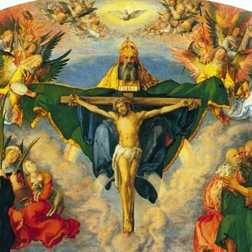
In the name of the Father, and of the Son, and of the Holy Spirit.
Amen

Slide 7
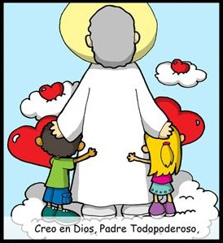
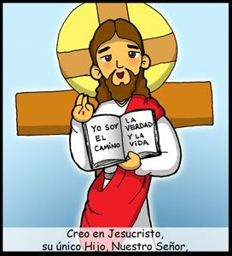
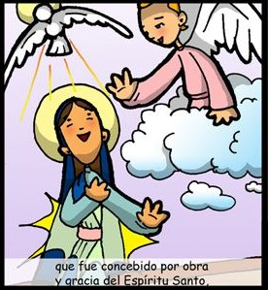
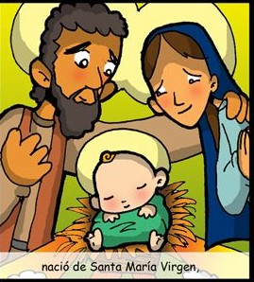
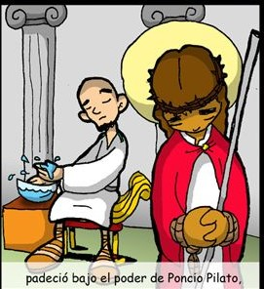
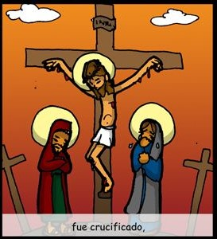
THE
CREED
I believe in one God, the Father Almighty,
Creator of Heaven and Earth,
and in Jesus Christ,
His only Son, Our Lord,
who was conceived
by the Holy Spirit,
born of the Virgin Mary,
suffered under Pontius Pilate,
Was crucified,

Slide 8
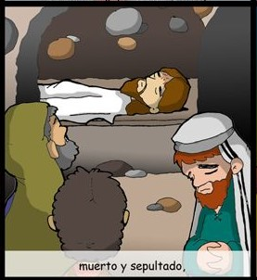
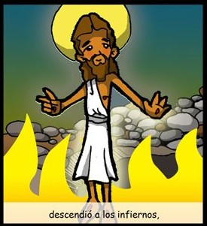
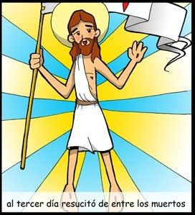
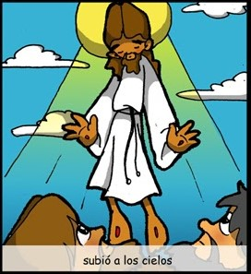
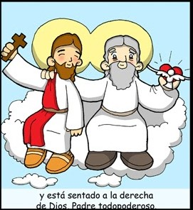
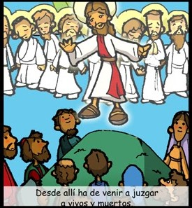
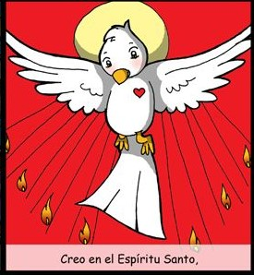
died and was buried.
He descended into Hell,
On the 3rd day He rose from the dead,
ascended into Heaven,
And is seated at the
right hand of the Father.
From thence He shall come
to judge the living and the dead.
I believe in the Holy Spirit,
the Holy Catholic Church,

Slide 9
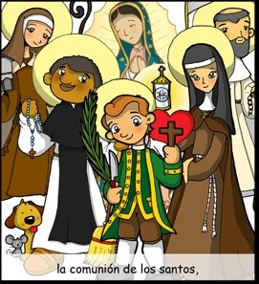
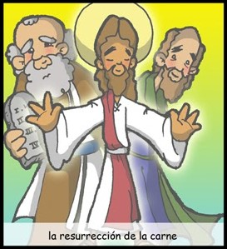
the communion of Saints,
The forgiveness of sins,
the resurrection of the body,
and life everlasting.
AMEN

Slide 10
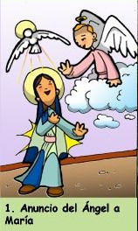
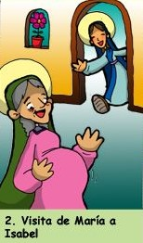
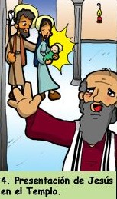
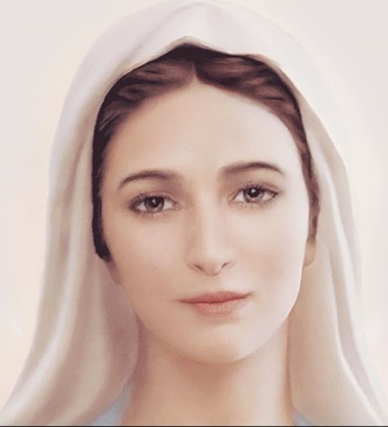
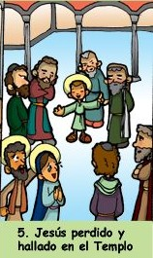
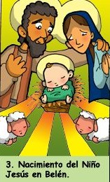
The Annunciation
2. The Visitation
4. The Presentation at the Temple
3. The Nativity
5. Jesus Lost and Found in Temple

Slide 11
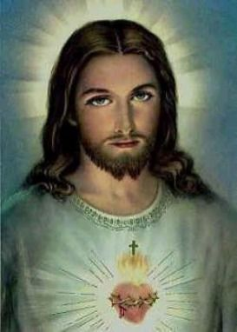
Oh My Jesus, Forgive us our sins. Save us from the fires of Hell. Lead all souls to Heaven, especially those in most need of your mercy. Amen.

Slide 12
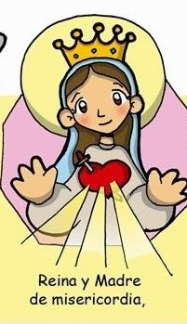
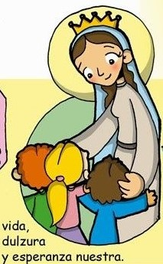
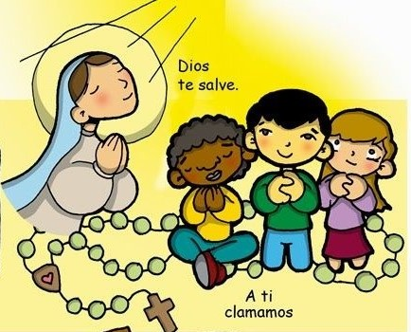
Hail
Holy Queen,
Mother of Mercy,
our life,
To thee do
we cry.
our sweetness and our hope,
Poor banished children of Eve.
to thee do we send up our sighs,
Mourning and weeping,
In this valley of tears.
Turn then most gracious advocate

Slide 13
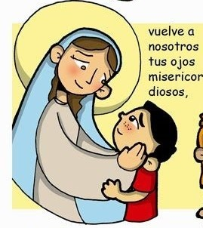
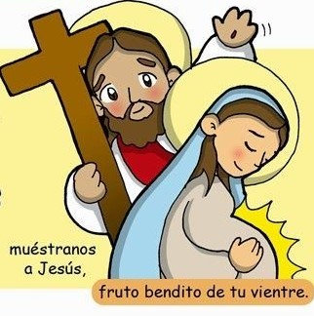
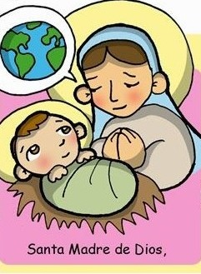
Thine eyes of mercy towards us.
oh clement,
oh loving
oh sweet
Virgin
Mary
And after this our exile,
Show
unto
us,
the blessed fruit of thy womb, Jesus.
Pray for
us
That we may be made worthy
Of the promises of Christ
Oh Holy Mother of God,
Amen

Slide 14
In the name of the Father, and of the Son, and of the Holy Spirit.
Amen

