Slide 1
The Holy Rosary-Joyful Mysteries
PRAYER CODES:
Our Father
Hail Mary
Glory Be
To start slide show select “Slide Show” in menu at the top of the screen. Then select “From Beginning” on the far top, left of the screen.
To proceed through the slide show, click on mouse consecutively.
To return to former slide or action, select “Backspace”.

Slide 2
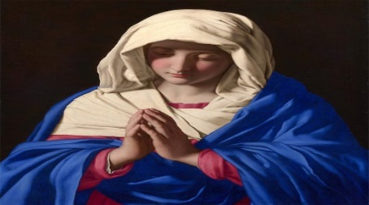
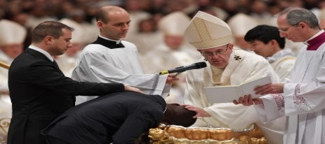
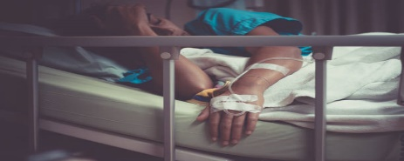
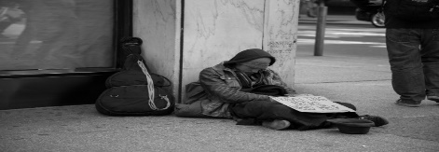
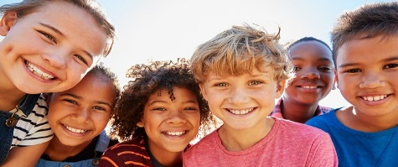
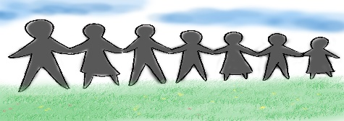
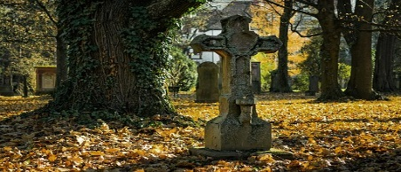
INTENTIONS
For the intentions of Our Blessed Mother,
For our Holy Catholic Church,
For our country’s leaders, that they may promote life, peace, and justice for all,
For the elderly, and the sick, and those caring for them,
For the end to the Corona Virus pandemic,
For the homeless, the poor, and all those struggling financially,
For all the children and youth, especially the abandoned, abused, and at-risk unborn,
For healing for our family and friends and all those that have asked for prayer,
For the souls in Purgatory and for those who do not know of the love of Christ. Amen.

Slide 3
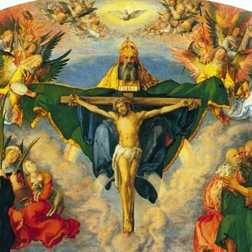
In the name of the Father and of the Son and of the Holy Spirit. Amen.

Slide 4
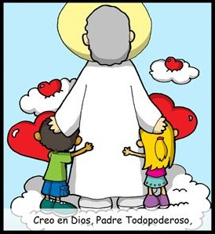
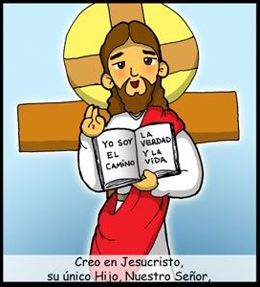
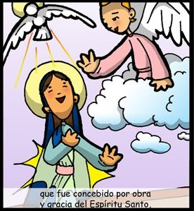
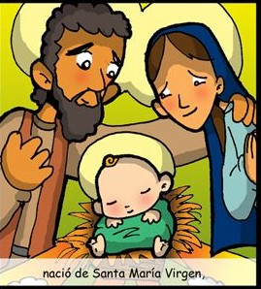
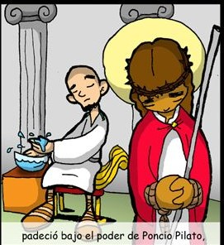
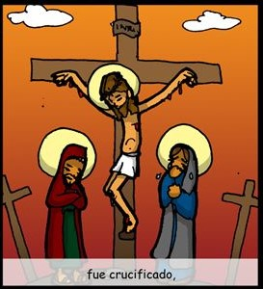
THE
CREED
I believe in one God,
the Father Almighty,
and in Jesus Christ,
His only Son, Our Lord,
Creator of Heaven and Earth,
who was conceived
by the Holy Spirit,
born of the Virgin Mary,
suffered under Pontius Pilate,
Was crucified,

Slide 5
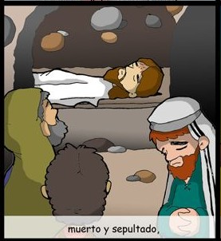
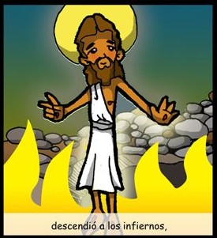
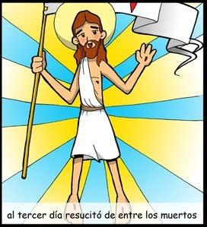
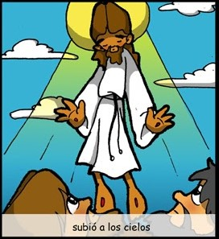
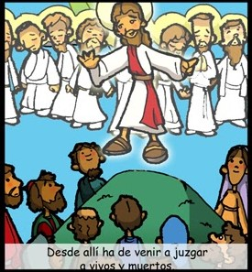
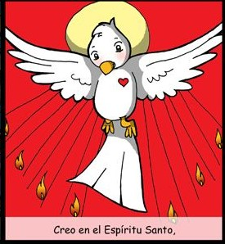
On the 3rd day He rose
from the dead,
died and was buried.
He descended into Hell,
ascended into Heaven,
And is seated at the
right hand of the Father.
From thence He shall come
to judge the living and the dead.
I believe in the Holy Spirit,
the Holy Catholic Church,

Slide 6
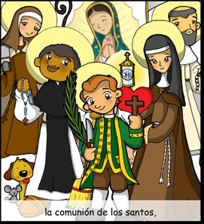
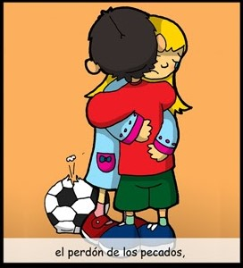
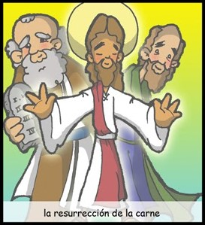
the communion of Saints,
The forgiveness of sins,
the resurrection of the body,
and life everlasting.
AMEN
(I Believe)

Slide 7
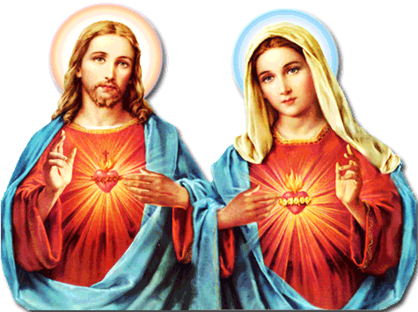
Our Father, who are in heaven, holy is your name. Your Kingdom come.
Your will be done, on earth as it is in Heaven. Give us this day our daily bread. And forgive us our trespasses, as we forgive those who trespass against us. And lead us not into temptation, but deliver us from evil. Amen.
For Pope Francis
and his intentions
Hail Mary, full of grace, the Lord is with you: blessed are you among women, and blessed is the fruit of your womb, Jesus. Holy Mary, Mother of God,
pray for us sinners, now and at the hour of our death. Amen.
For more Faith in Jesus Christ
Glory be to the Father, and to the Son, and to the Holy Spirit, as it was
in the beginning, is now, and ever shall be, world without end. Amen
For more Hope in Jesus’ promises
For more Love of
God and neighbor

Slide 8
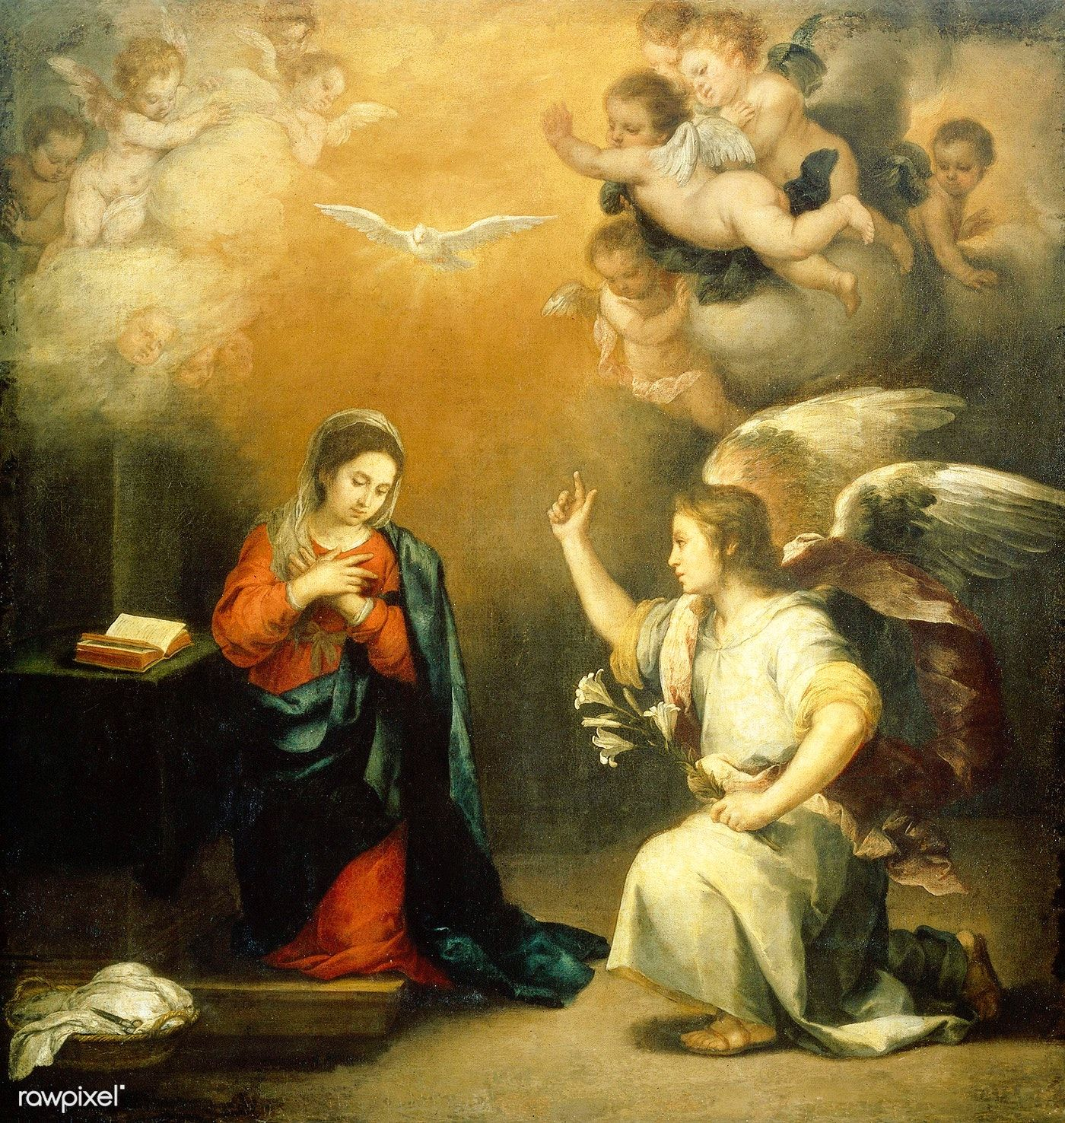
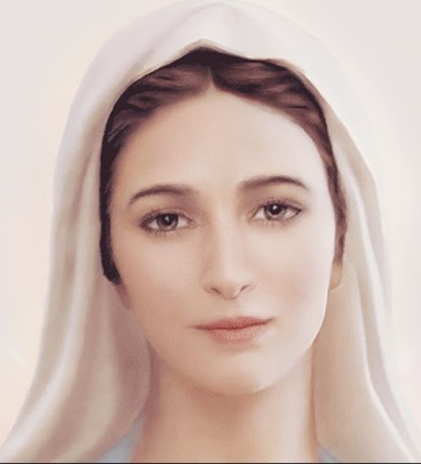
1st Joyful Mystery
The Annunciation
And when the angel had come to her, he said, “Hail, full of grace, the Lord is with you.” (Luke 1:28)
Fruit of the Mystery: Humility

Slide 9
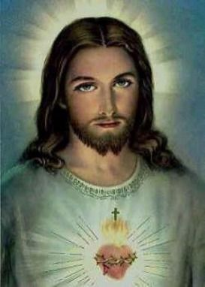
Oh my Jesus, Forgive us our sins. Save us from the fires of Hell. Lead all souls to Heaven, especially those in most need of your Mercy. Amen.

Slide 10
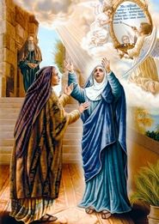
2nd Joyful Mystery
The Visitation
Elizabeth, filled with the Holy Spirit, cried in a loud voice and said, “Most blessed are you among women, and blessed is the fruit of your womb!” (Luke 1:41-42)
Fruit of the Mystery: Love of Neighbor

Slide 11
Oh my Jesus, Forgive us our sins. Save us from the fires of Hell. Lead all souls to Heaven, especially those in most need of your Mercy. Amen.

Slide 12
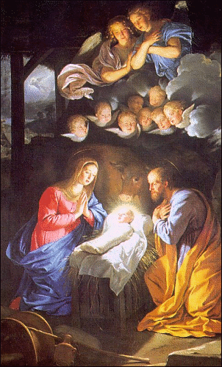
3rd Joyful Mystery
The Nativity
She gave birth to her first-born Son. She wrapped Him in swaddling clothes and laid Him in a manger, because there was no room for them in the inn. (Luke 2:7)
Fruit of the Mystery: Poverty of Spirit

Slide 13
Oh my Jesus, Forgive us our sins. Save us from the fires of Hell. Lead all souls to Heaven, especially those in most need of your Mercy. Amen.

Slide 14
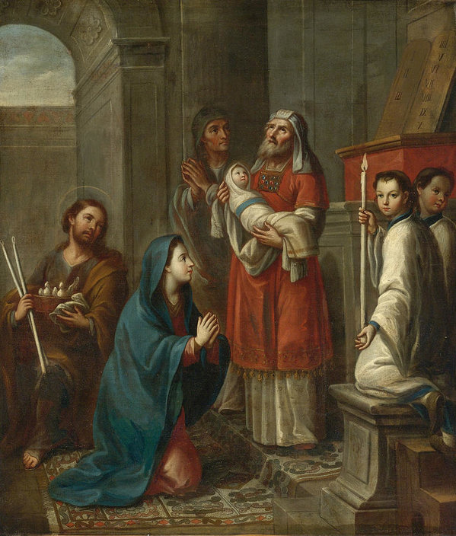
4th Joyful Mystery
The Presentation in the Temple
When the days were completed for their purification according to the law of Moses, they took Him up to Jerusalem to present Him to the Lord, just as it is written in the law of the Lord, “every male that opens the womb shall be consecrated to the Lord.” (Lk 2:22-23)
Fruit of the Mystery: Obedience

Slide 15
Oh my Jesus, Forgive us our sins. Save us from the fires of Hell. Lead all souls to Heaven, especially those in most need of your Mercy. Amen.

Slide 16
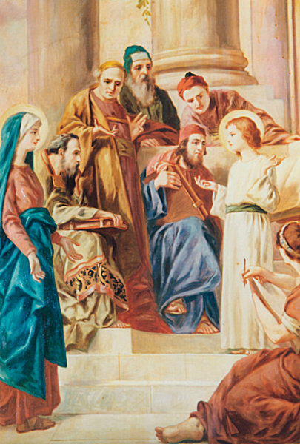
5th Joyful Mystery
Jesus Lost and Found in the Temple
After three days they found Him in the temple, sitting in the midst of the teachers, listening to them and asking them questions (Luke 2:46)
Fruit of the Mystery: Joy in Finding Jesus

Slide 17
Oh my Jesus, Forgive us our sins. Save us from the fires of Hell. Lead all souls to Heaven, especially those in most need of your Mercy. Amen.

Slide 18
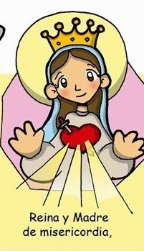
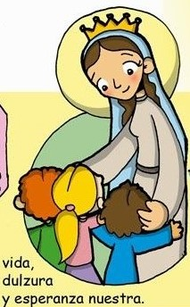
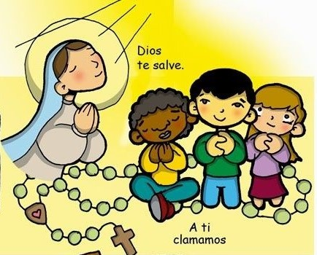
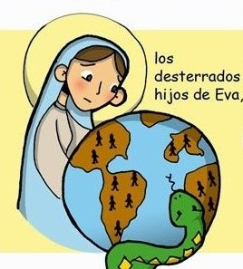
Hail Holy Queen
Hail Holy Queen
Mother of Mercy
our
Life our
sweetness
To thee do we cry
and our hope.
Poor banished children of Eve
To thee do we
send up our sighs
mourning and weeping
Turn then most gracious advocate
in this valley of tears.

Slide 19
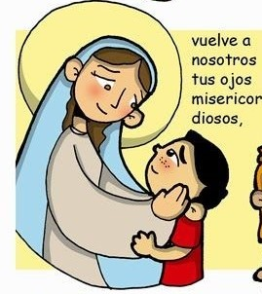
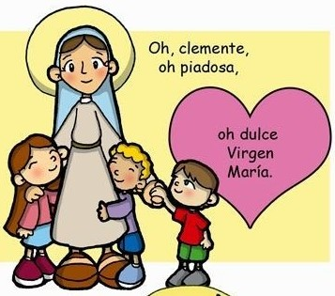
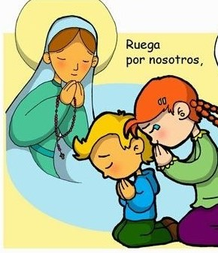
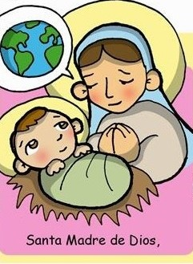
Thine eyes of mercy toward us
Oh clement, Oh loving
Oh sweet Virgin
Mary
And after this our exile
Show
unto us
The blessed fruit
of thy womb, Jesus
Pray for
us
That we may be made worthy
Of the promises of Christ,
Oh Holy Mother of God
Amen

Slide 20
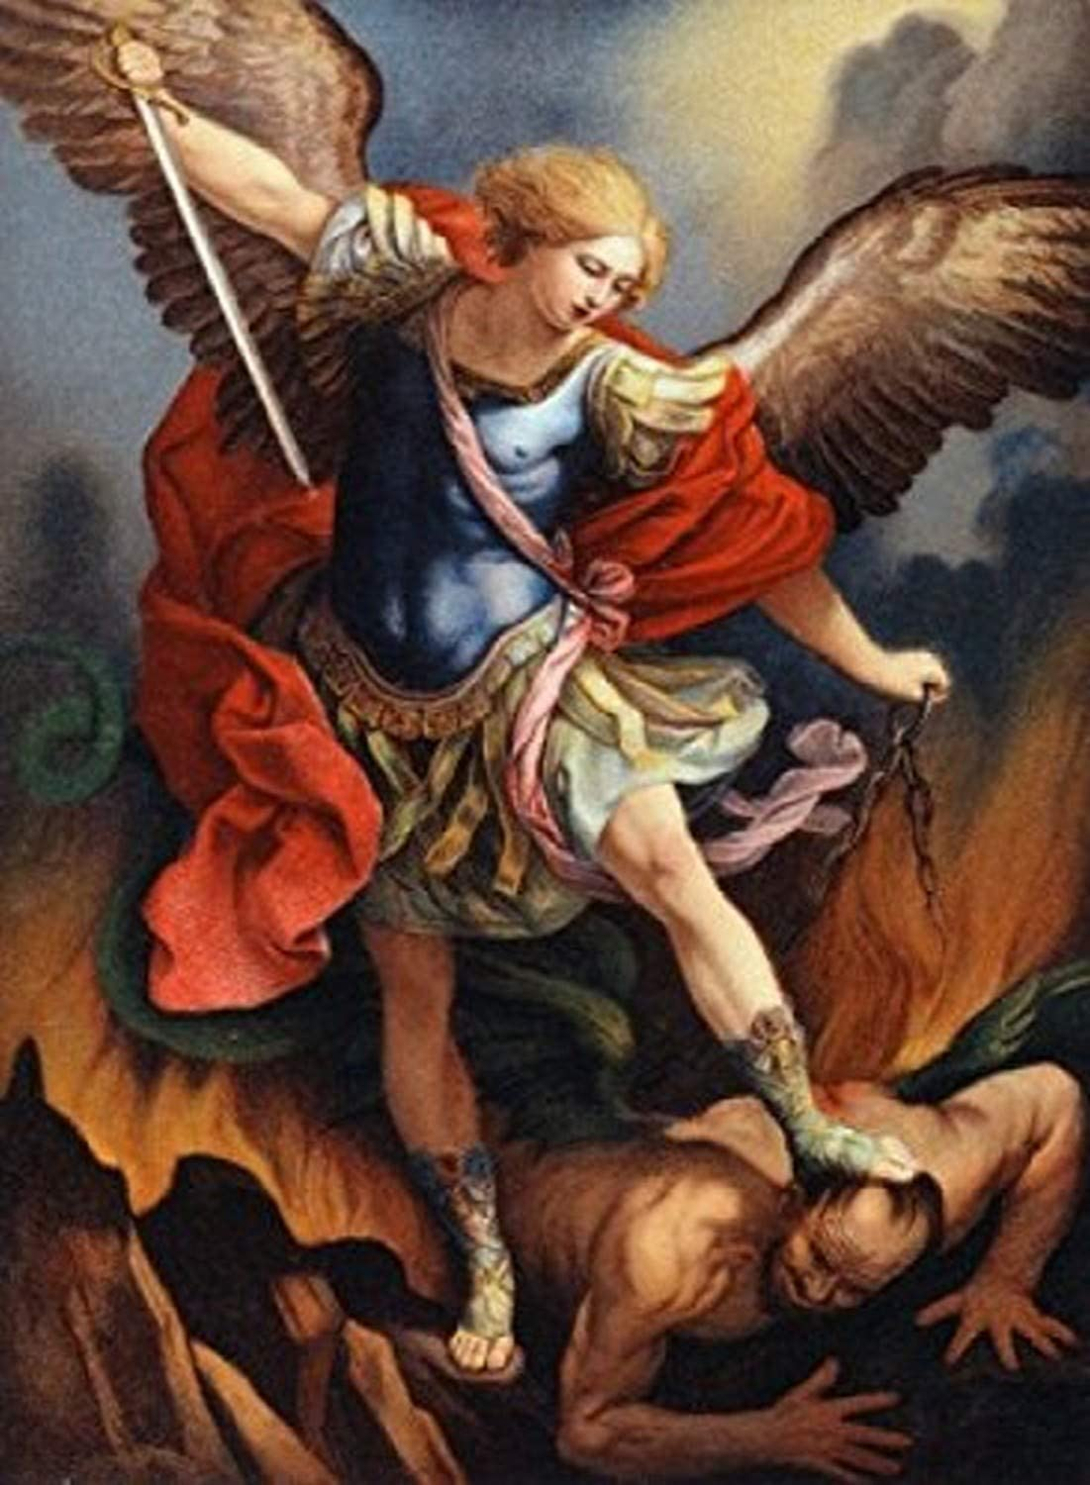
St. Michael the Archangel, defend us in battle. Be our protection against the wickedness and snares of the Devil. May God rebuke him, we humbly pray, and do thou, O Prince of the heavenly hosts, by the power of God, thrust into hell Satan, and all the evil spirits, who prowl about the world seeking the ruin of souls. Amen

Slide 21
In the name of the Father and of the Son and of the Holy Spirit. Amen.

Slide 22
Nicole
Rafael
Austin
Daniel
Katherine
Alejandro
Alessandro
Logan
Rafael
Gabriela
Isabella

Slide 23
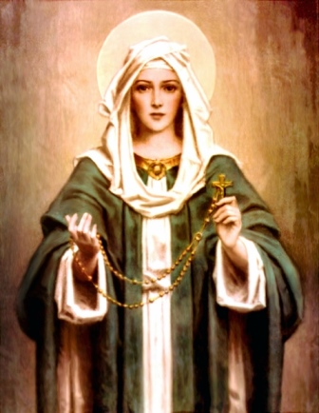
Why Pray the Rosary?
1 - The Rosary is the spiritual sword that conquers evil.
2 - The Rosary teaches the life of Jesus and brings peace.
3 - The Rosary teaches virtue which is necessary to grow in holiness.
4 - The Rosary is an expression of our love for Jesus and Mary.
5 – The Church gives plenary and partial indulgences for praying the Rosary.
6 - Fifteen promises of the Virgin Mary for those who pray the Rosary.

