Slide 1
The Holy Rosary-Luminous Mysteries

Slide 2
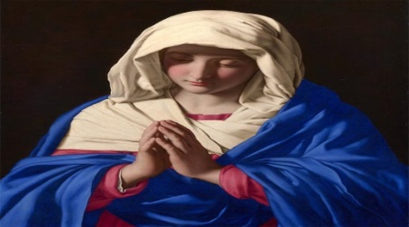
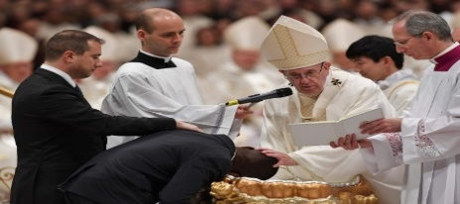
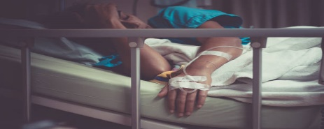
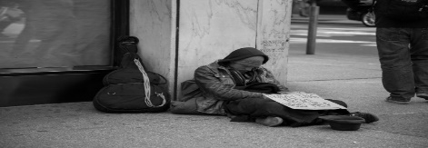
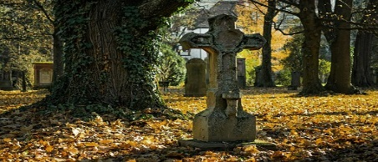
INTENTIONS
For the intentions of Our Blessed Mother,
For our Holy Catholic Church, for Pope Francis, our priests and religious.
For our country’s leaders, that they may promote life, peace, and justice for all,
For the elderly, and the sick, and those caring for them,
For the end to the Corona Virus pandemic,
For the homeless, the poor, and all those struggling financially,
For all the children and youth, especially the abandoned, abused, and at-risk unborn,
For healing for our family and friends and all those that have asked for prayer,
For the souls in Purgatory and for those who do not know of the love of Christ. Amen.

Slide 3
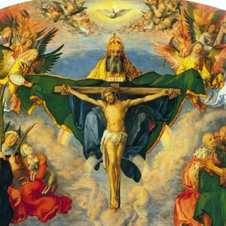
In the name of the Father and of the Son and of the Holy Spirit. Amen.

Slide 4
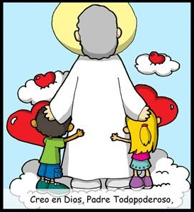
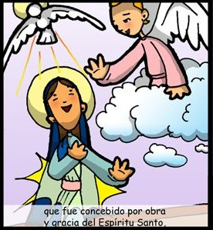
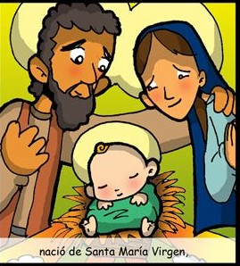
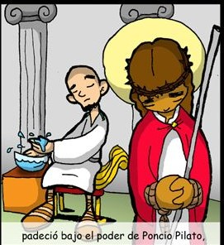
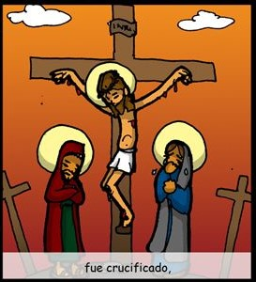
THE
CREED
I believe in one God, the Father Almighty,
Creator of Heaven and Earth,
and in Jesus Christ,
His only Son, Our Lord,
who was conceived
by the Holy Spirit,
born of the Virgin Mary,
suffered under Pontius Pilate,
Was crucified,

Slide 5
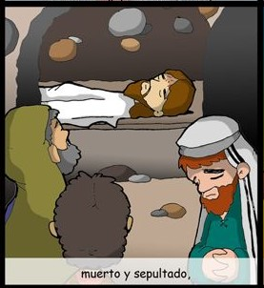
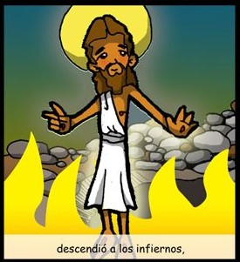
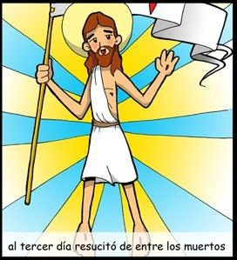
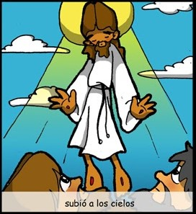
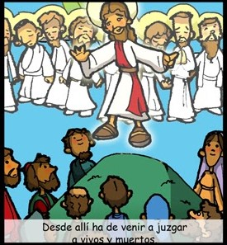
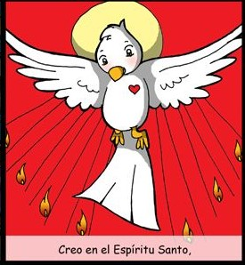
died and was buried.
He descended into Hell,
On the 3rd day He rose from the dead,
ascended into Heaven,
And is seated at the
right hand of the Father.
From thence He shall come
to judge the living and the dead.
I believe in the Holy Spirit,
the Holy Catholic Church,

Slide 6
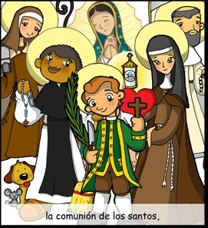
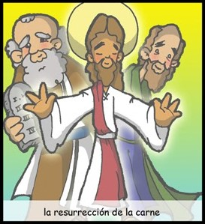
the communion of Saints,
The forgiveness of sins,
the resurrection of the body,
and life everlasting.
AMEN

Slide 7
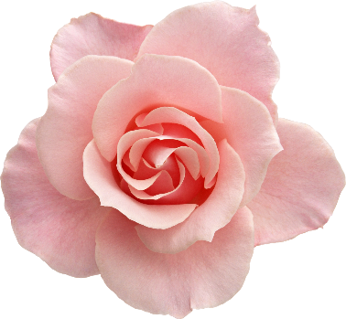
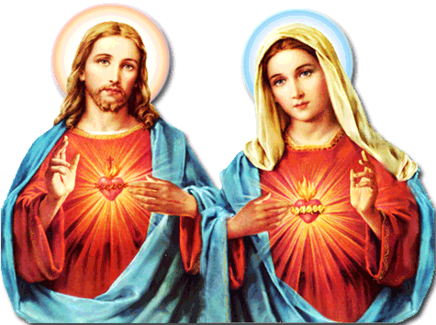
Our Father, who are in heaven, holy is your name. Your Kingdom come.
Your will be done, on earth as it is in Heaven. Give us this day our daily bread. And forgive us our trespasses, as we forgive those who trespass against us. And lead us not into temptation, but deliver us from evil. Amen.
For Pope Francis
Hail Mary, full of grace, the Lord is with you: blessed are you among women, and blessed is the fruit of your womb, Jesus. Holy Mary, Mother of God,
pray for us sinners, now and at the hour of our death. Amen.
For Faith
Glory be to the Father, and to the Son, and to the Holy Spirit, as it was
in the beginning, is now, and ever shall be, world without end. Amen
For Hope
For Love

Slide 8
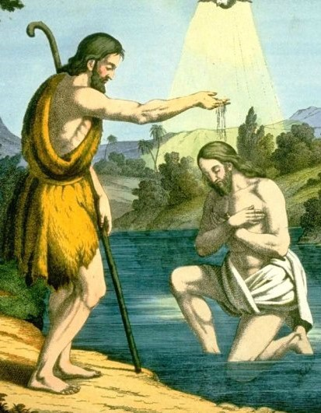
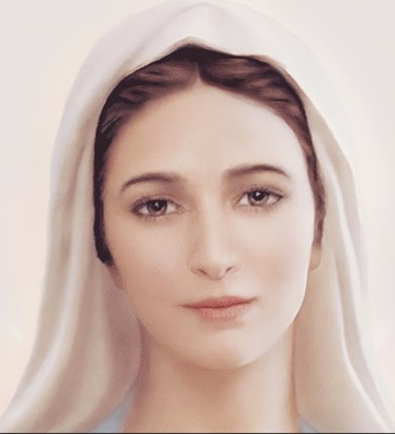
1st Luminous Mystery
The Baptism of Jesus
After Jesus was baptized,…the heavens were opened, and he saw the Spirit of God descending like a dove and coming upon Him. And a voice from heaven said, “This is My beloved Son, with whom I am well pleased.” (Mt 3: 16-17)
Fruit of the Mystery: Openness to the Holy Spirit

Slide 9
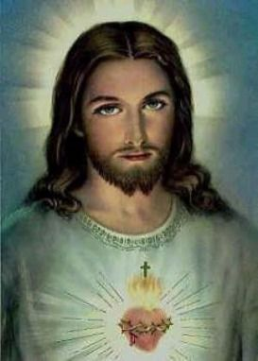
Oh my Jesus, Forgive us our sins. Save us from the fires of Hell. Lead all souls to Heaven, especially those in most need of your Mercy. Amen.

Slide 10
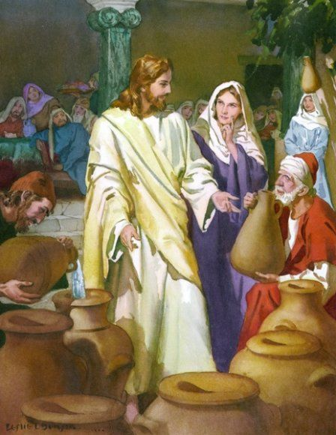
2nd Luminous Mystery
The Wedding at Canaan
His mother said to the servers, “Do whatever He tells you.”…Jesus told them, “Fill the jars with water.” So they filled them to the brim. (Jn 2:5-7)
Fruit of the Mystery: To Jesus through Mary

Slide 11
Oh my Jesus, Forgive us our sins. Save us from the fires of Hell. Lead all souls to Heaven, especially those in most need of your Mercy. Amen.

Slide 12
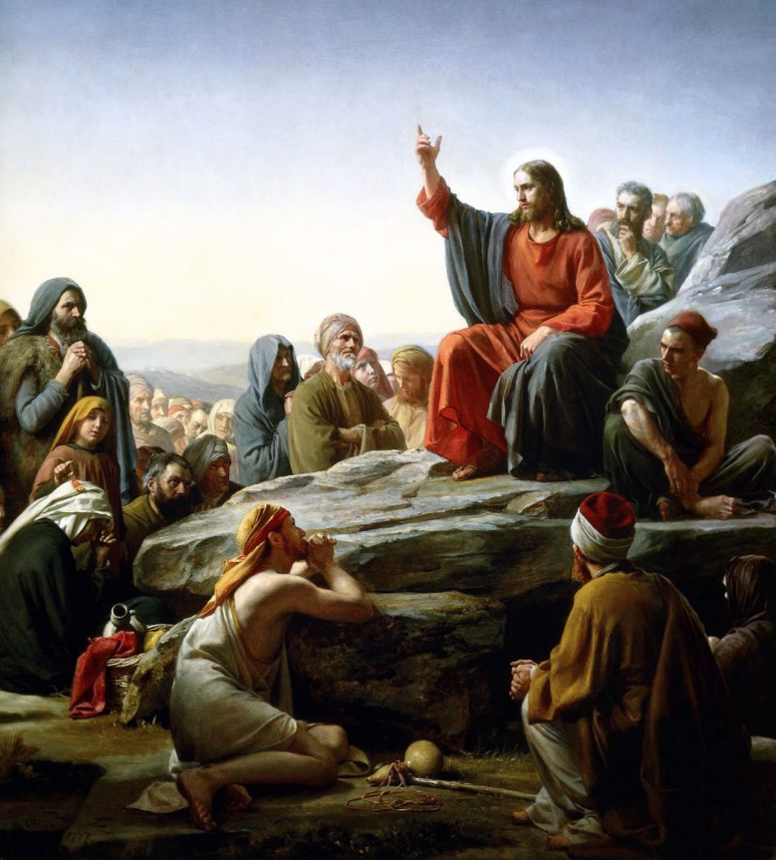
3rd Luminous Mystery
Jesus Proclaims the Kingdom of God
“As you go, make this proclamation: ‘The kingdom of heaven is at hand.’ Cure the sick, raise the dead, cleanse lepers, drive out demons. Without cost you have received; without cost you are to give.”
Fruit of the Mystery: Repentance and Trust in God.

Slide 13
Oh my Jesus, Forgive us our sins. Save us from the fires of Hell. Lead all souls to Heaven, especially those in most need of your Mercy. Amen.

Slide 14
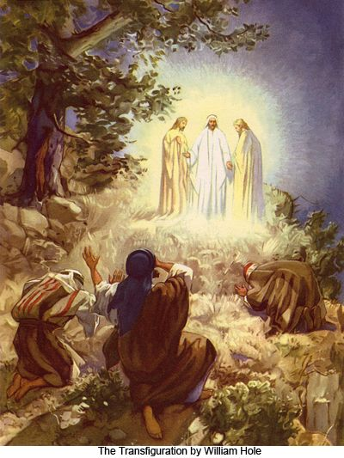
4th Luminous Mystery
THE TRANSFIGURATION
While He was praying His face changed in appearance and His clothing became dazzling white. Then from the cloud came a voice that said, “This is My chosen Son; listen to Him.” (Lk 9:29, 35)
Fruit of the Mystery: Desire for Holiness

Slide 15
Oh my Jesus, Forgive us our sins. Save us from the fires of Hell. Lead all souls to Heaven, especially those in most need of your Mercy. Amen.

Slide 16
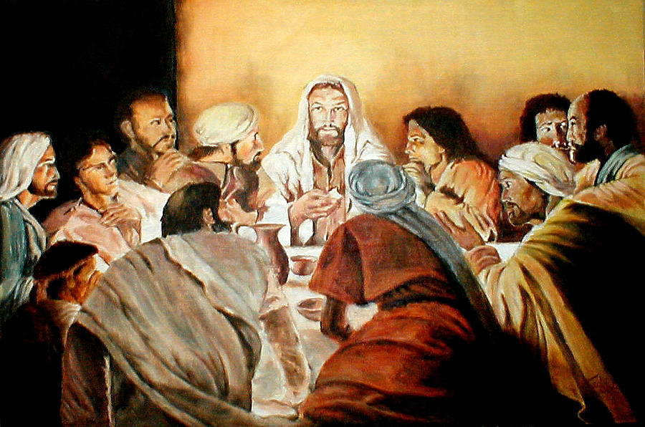
5th Luminous Mystery
The Institution of the Eucharist
Then He took the bread, said the blessing, broke it, and gave it to them, saying, “This is My body, which will be given for you…” And likewise the cup after they had eaten, saying, “This cup is the new covenant in My blood.” (Lk 22: 19-20)
Fruit of the Mystery: Adoration

Slide 17
Oh my Jesus, Forgive us our sins. Save us from the fires of Hell. Lead all souls to Heaven, especially those in most need of your Mercy. Amen.

Slide 18
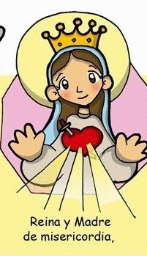
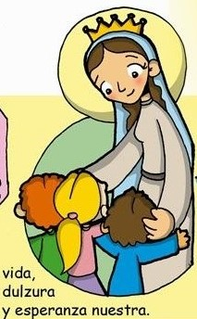
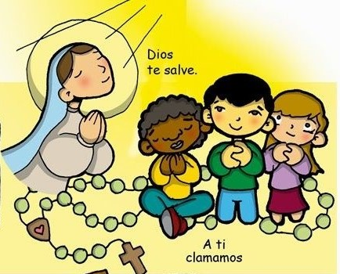
Hail Holy Queen
Hail Holy Queen
Mother of Mercy
our
Life our
sweetness
To thee do we cry
and our hope.
Poor banished children of Eve
To thee do we
send up our sighs
mourning and weeping
Turn then most gracious advocate
in this valley of tears.

Slide 19
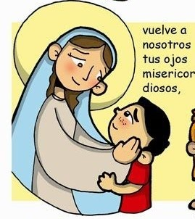
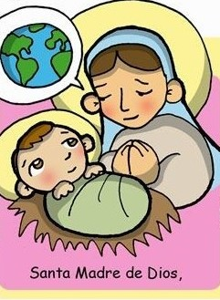
Thine eyes of mercy toward us
Oh clement, Oh loving
Oh sweet Virgin
Mary
And after this our exile
Show
unto us
The blessed fruit
of thy womb, Jesus
Pray for
us
That we may be made worthy
Of the promises of Christ,
Oh Holy Mother of God
Amen

Slide 20
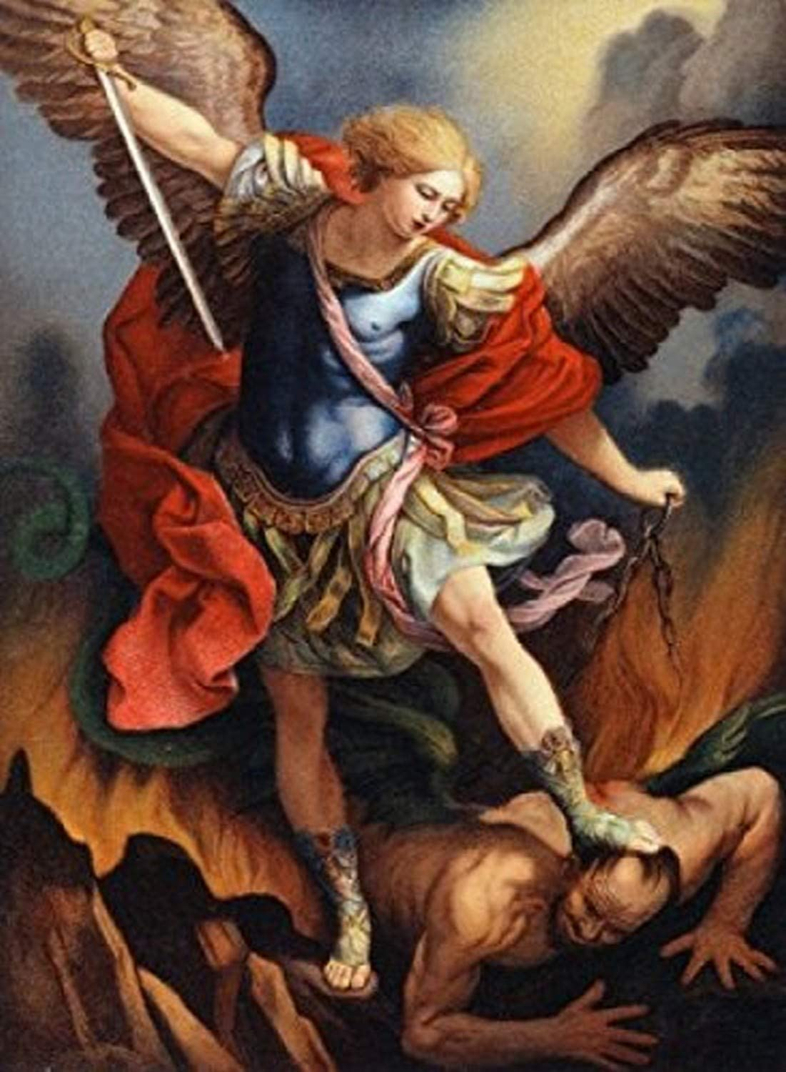
St. Michael the Archangel, defend us in battle. Be our protection against the wickedness and snares of the Devil. May God rebuke him, we humbly pray, and do thou, O Prince of the heavenly hosts, by the power of God, thrust into hell Satan, and all the evil spirits, who prowl about the world seeking the ruin of souls. Amen

Slide 21
In the name of the Father and of the Son and of the Holy Spirit. Amen.

Slide 22
Nicole
Rafael
Austin
Daniel
Katherine
Alejandro
Alessandro
Logan
Rafael
Gabriela
Isabella

Slide 23
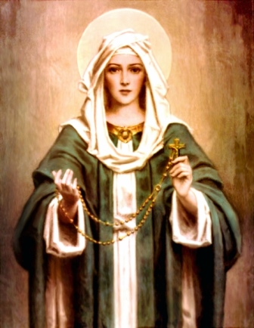
Why Pray the Rosary?
1 - The Rosary is the spiritual sword that conquers evil.
2 - The Rosary teaches the life of Jesus and brings peace.
3 - The Rosary teaches virtue which is necessary to grow in holiness.
4 - The Rosary is an expression of our love for Jesus and Mary.
5 – The Church gives plenary and partial indulgences for praying the Rosary.
6 - Fifteen promises of the Virgin Mary for those who pray the Rosary.

