Slide 1
The Holy Rosary– Glorious Mysteries

Slide 2
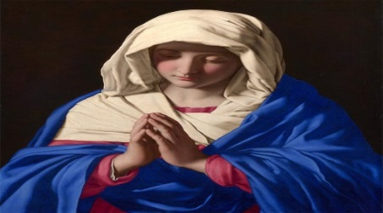
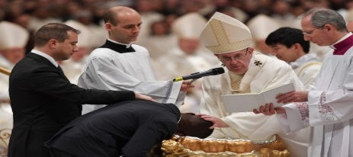
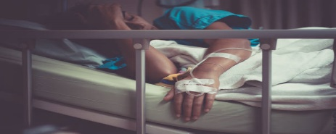
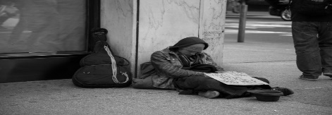
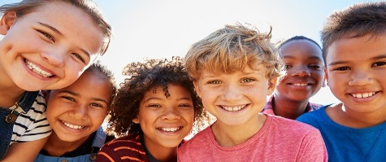
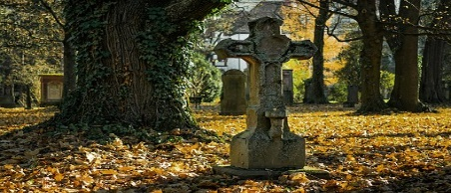
INTENTIONS
For the intentions of Our Blessed Mother,
For our Holy Catholic Church, for Pope Francis, our priests and religious.
For our country’s leaders, that they may promote life, peace, and justice for all,
For the elderly, and the sick, and those caring for them,
For the end to the Corona Virus pandemic,
For the homeless, the poor, and all those struggling financially,
For all the children and youth, especially the abandoned, abused, and at-risk unborn,
For healing for our family and friends and all those that have asked for prayer,
For the souls in Purgatory and for those who do not know of the love of Christ. Amen.

Slide 3
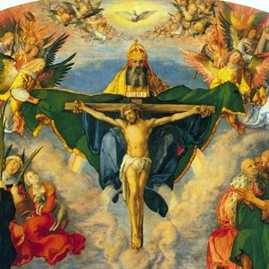
In the name of the Father and of the Son and of the Holy Spirit. Amen.

Slide 4
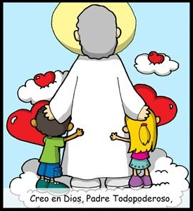
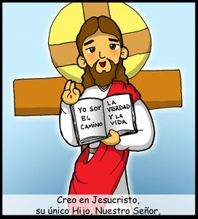
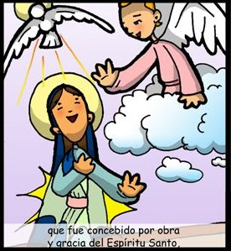
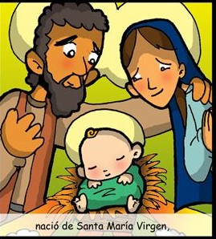
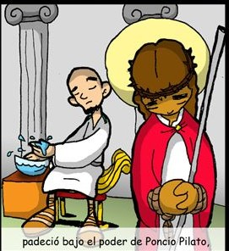
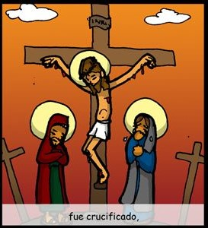
THE
CREED
I believe in one God, the Father Almighty,
Creator of Heaven and Earth,
and in Jesus Christ,
His only Son, Our Lord,
who was conceived
by the Holy Spirit,
born of the Virgin Mary,
suffered under Pontius Pilate,
Was crucified,

Slide 5
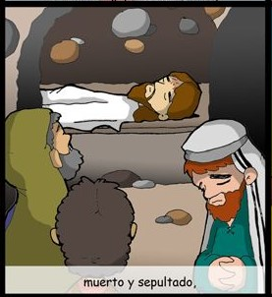
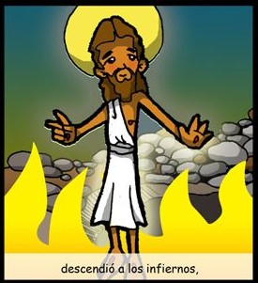
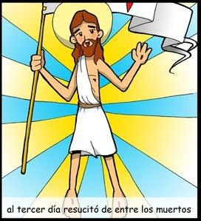
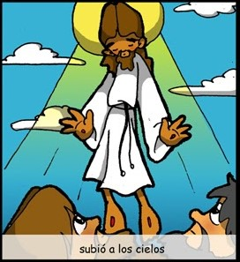
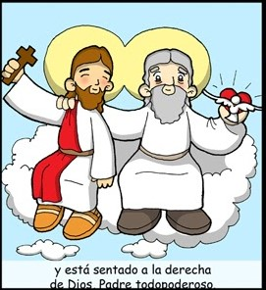
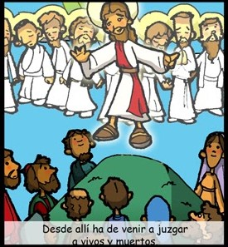
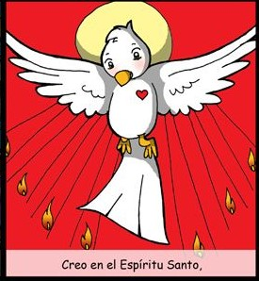
died and was buried.
He descended into Hell,
On the 3rd day He rose from the dead,
ascended into Heaven,
And is seated at the
right hand of the Father.
From thence He shall come
to judge the living and the dead.
I believe in the Holy Spirit,
the Holy Catholic Church,

Slide 6
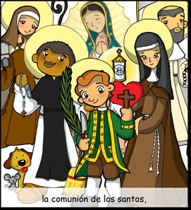
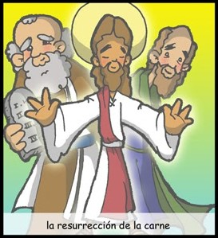
the communion of Saints,
The forgiveness of sins,
the resurrection of the body,
and life everlasting.
AMEN

Slide 7
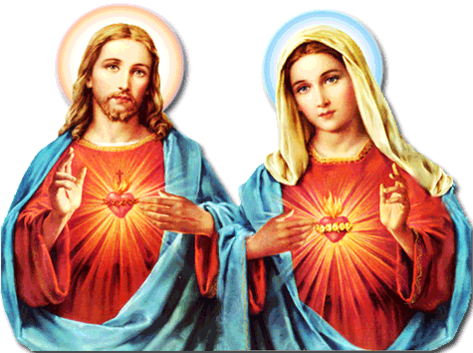
Our Father, who are in heaven, holy is your name. Your Kingdom come.
Your will be done, on earth as it is in Heaven. Give us this day our daily bread. And forgive us our trespasses, as we forgive those who trespass against us. And lead us not into temptation, but deliver us from evil. Amen.
For Pope Francis
Hail Mary, full of grace, the Lord is with you: blessed are you among women, and blessed is the fruit of your womb, Jesus. Holy Mary, Mother of God,
pray for us sinners, now and at the hour of our death. Amen.
For Faith
Glory be to the Father, and to the Son, and to the Holy Spirit, as it was
in the beginning, is now, and ever shall be, world without end. Amen
For Hope
For Love

Slide 8
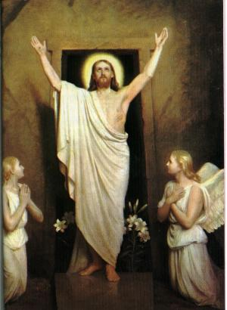
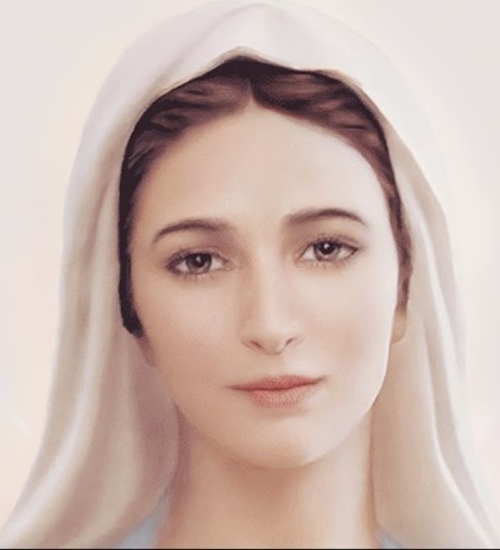
1st Glorious Mystery
The Resurrection

Slide 9
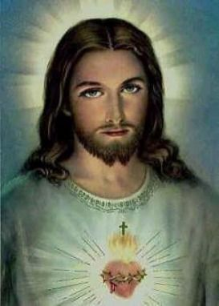
Oh my Jesus, Forgive us our sins. Save us from the fires of Hell. Lead all souls to Heaven, especially those in most need of your Mercy. Amen.

Slide 10
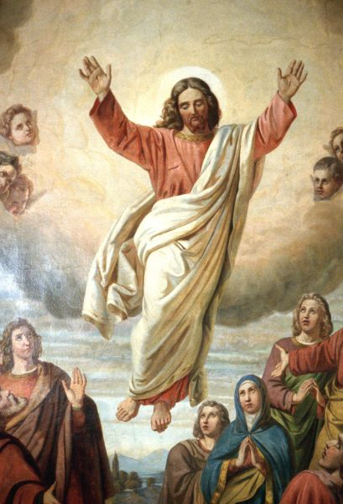
2nd Glorious Mystery
The Ascension of Jesus

Slide 11
Oh my Jesus, Forgive us our sins. Save us from the fires of Hell. Lead all souls to Heaven, especially those in most need of your Mercy. Amen.

Slide 12
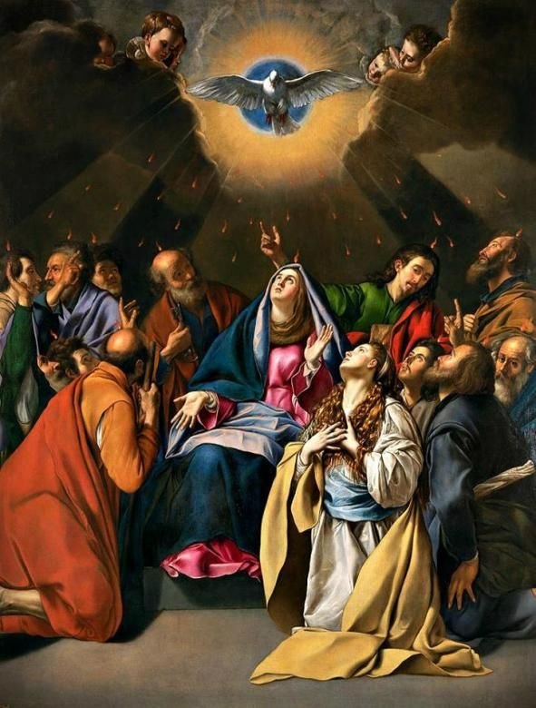
3rd Glorious Mystery
The Coming of
The Holy Spirit

Slide 13
Oh my Jesus, Forgive us our sins. Save us from the fires of Hell. Lead all souls to Heaven, especially those in most need of your Mercy. Amen.

Slide 14
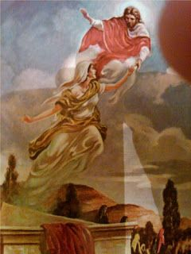
4th Glorious Mystery
The Asumption of Mary
Into Heaven

Slide 15
Oh my Jesus, Forgive us our sins. Save us from the fires of Hell. Lead all souls to Heaven, especially those in most need of your Mercy. Amen.

Slide 16
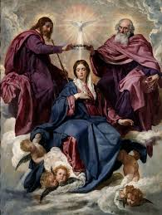
5th Glorious Mystery
The Coronation of Mary
Queen of the Universe

Slide 17
Oh my Jesus, Forgive us our sins. Save us from the fires of Hell. Lead all souls to Heaven, especially those in most need of your Mercy. Amen.

Slide 18
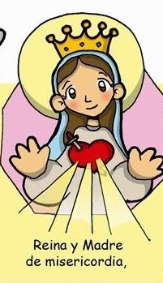
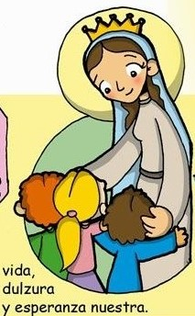
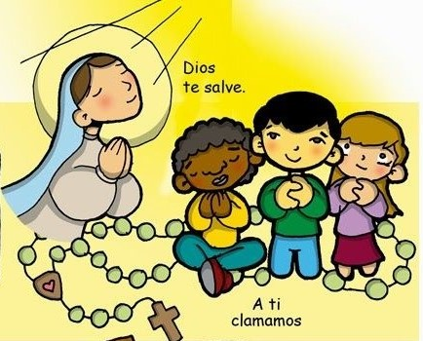
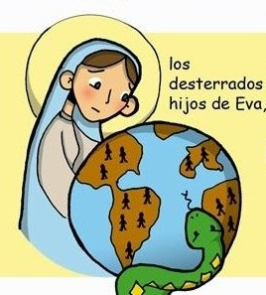
Hail Holy Queen
Hail Holy Queen
Mother of Mercy
our
Life our
sweetness
To thee do we cry
and our hope.
Poor banished children of Eve
To thee do we
send up our sighs
mourning and weeping
Turn then most gracious advocate
in this valley of tears.

Slide 19
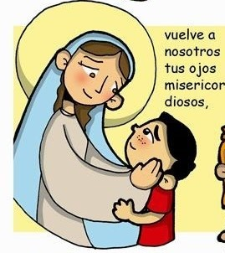
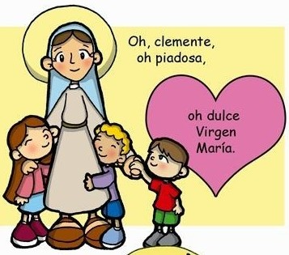
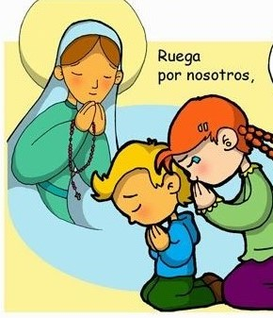
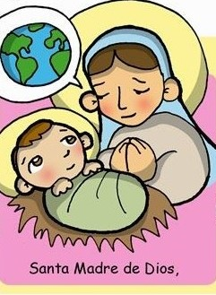
Thine eyes of mercy toward us
Oh clement, Oh loving
Oh sweet Virgin
Mary
And after this our exile
Show
unto us
The blessed fruit
of thy womb, Jesus
Pray for
us
That we may be made worthy
Of the promises of Christ,
Oh Holy Mother of God
Amen

Slide 20
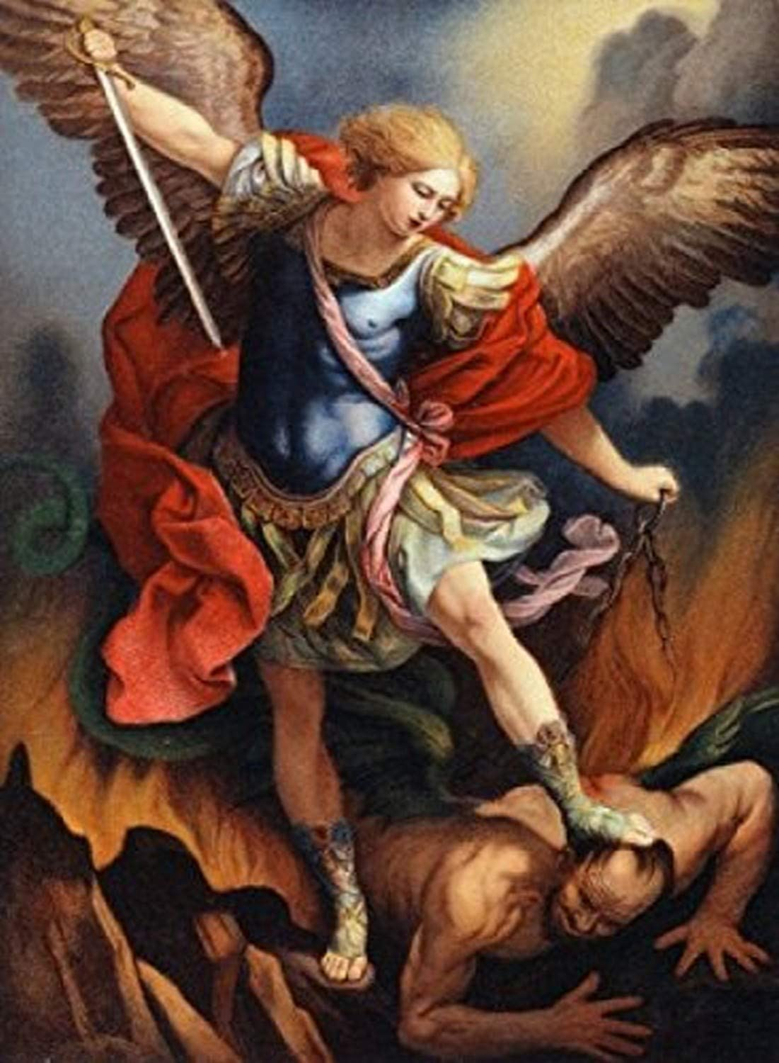
St. Michael the Archangel, defend us in battle. Be our protection against the wickedness and snares of the Devil. May God rebuke him, we humbly pray, and do thou, O Prince of the heavenly hosts, by the power of God, thrust into hell Satan, and all the evil spirits, who prowl about the world seeking the ruin of souls. Amen

Slide 21
In the name of the Father and of the Son and of the Holy Spirit. Amen.

