Slide 1
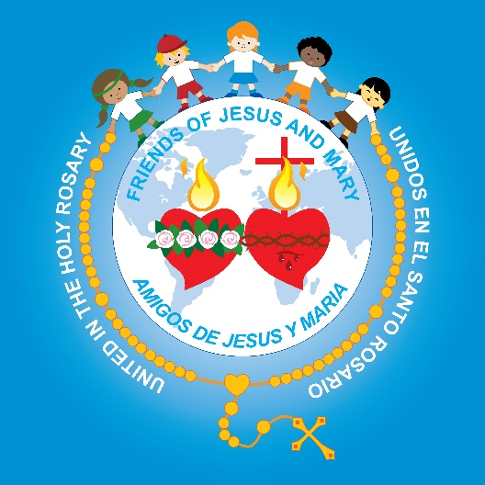
Friends of Jesus and Mary
The Sacrament of Reconciliation

Slide 2
Jesus gives the Apostles the power to forgive sins. (John 20: 19-23) https://youtu.be/b2szkCm0ulY
On the evening of that first day of the week, when the doors were locked, where the disciples were, for fear of the Jews, Jesus came and stood in their midst and said to them, “Peace be with you.”
When he had said this, he showed them his hands and his side. The disciples rejoiced when they saw the Lord.
[Jesus] said to them again, “Peace be with you. As the Father has sent me, so I send you.”
And when he had said this, he breathed on them and said to them, “Receive the holy Spirit. Whose sins you forgive are forgiven them, and whose sins you retain are retained.”
THE GOSPEL OF THE LORD. PRAISE TO YOU LORD JESUS CHRIST.

Slide 3
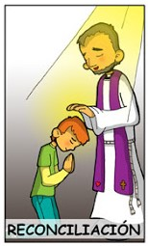
Reconciliation is a Healing Sacrament https://youtu.be/dgEhqvydsK0
Reconciliation

Slide 4
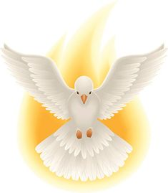
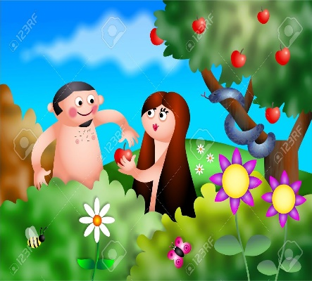
Original Sin is the sin of Adam and Eve. In the Sacrament of Baptism, God erases the stain of Original Sin, and fills us with the Holy Spirit.

Slide 5
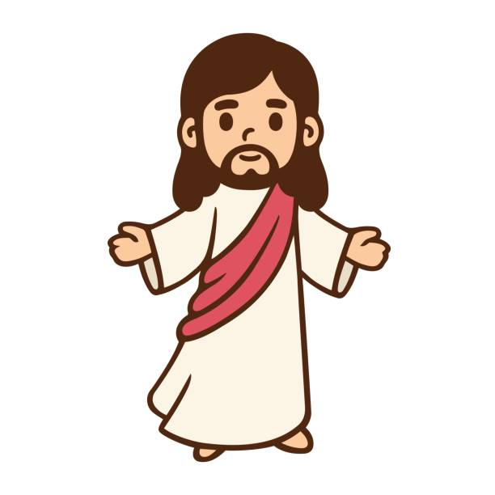
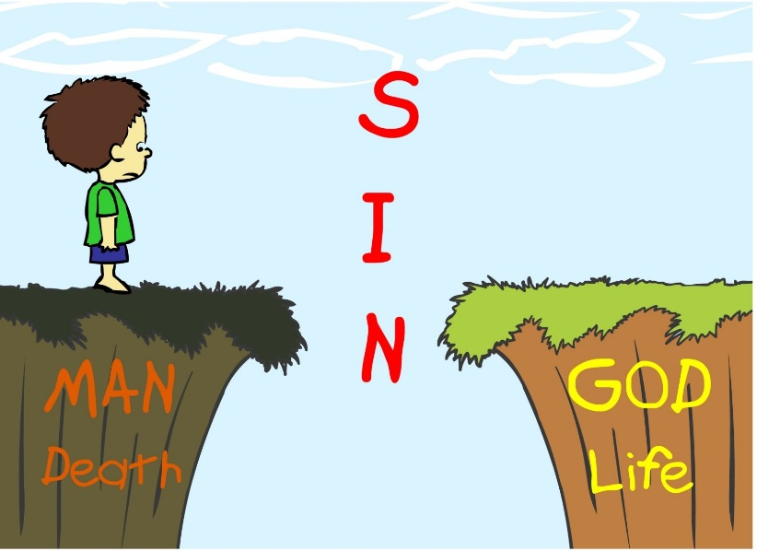
Personal Sin is the sin we choose to commit.
There are 2 kinds of Personal Sin.
When we totally reject God, we commit a Mortal Sin. We put ourselves at risk of facing God’s judgement after death.
Venial Sins are less serious, but they still hurt our relationship with God and others.

Slide 6
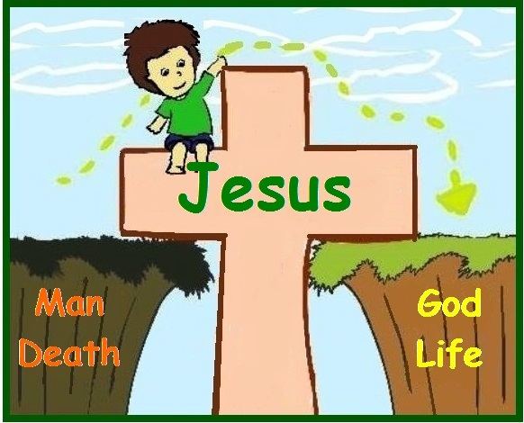
Because of Jesus’ sacrifice for us, our sins are forgiven in the Sacrament of Reconciliation.

Slide 7
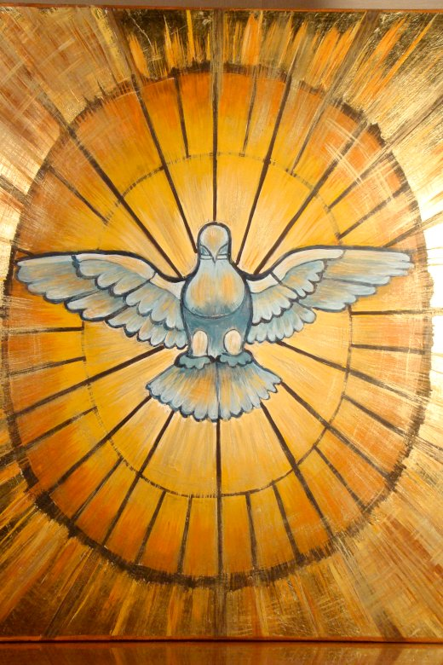
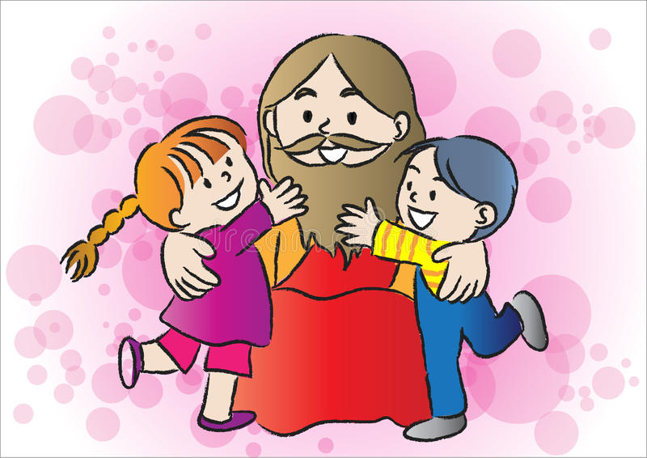
God, in his grace, wants all his children to live with him in heaven.
Guided by the Holy Spirit, we confess our sins in the Sacrament of Reconciliation.
When we sin, the Holy Spirit leads us back to God.

Slide 8
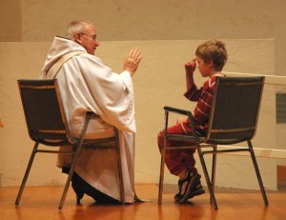
The priest gives us a penance to make up for hurting God with our sin, and God gives us the gift of His forgiveness.
Then we know we are at peace with God, and so at peace with ourselves and others.

Slide 9
7 Steps of the Sacrament of Reconciliation https://youtu.be/gy0xSo1JnWs

Slide 11
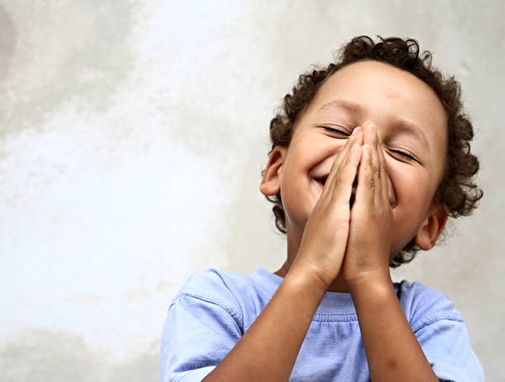
Prayer Thank you Jesus for all you did so my sins would be forgiven. Help me to be obedient and loving like you. Amen.

Slide 12
The Power Shuffle, Lifetree Kids, https://youtu.be/JNEAtmq6oTE

