Slide 1
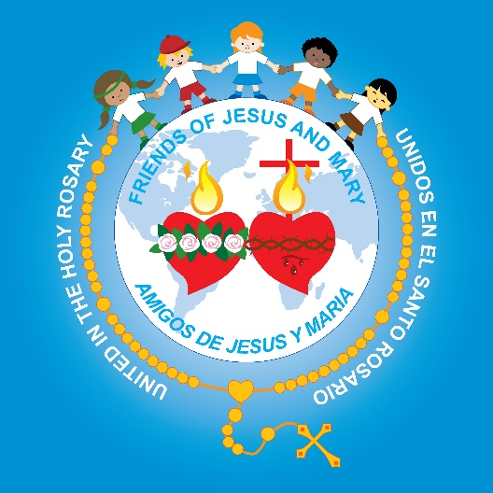
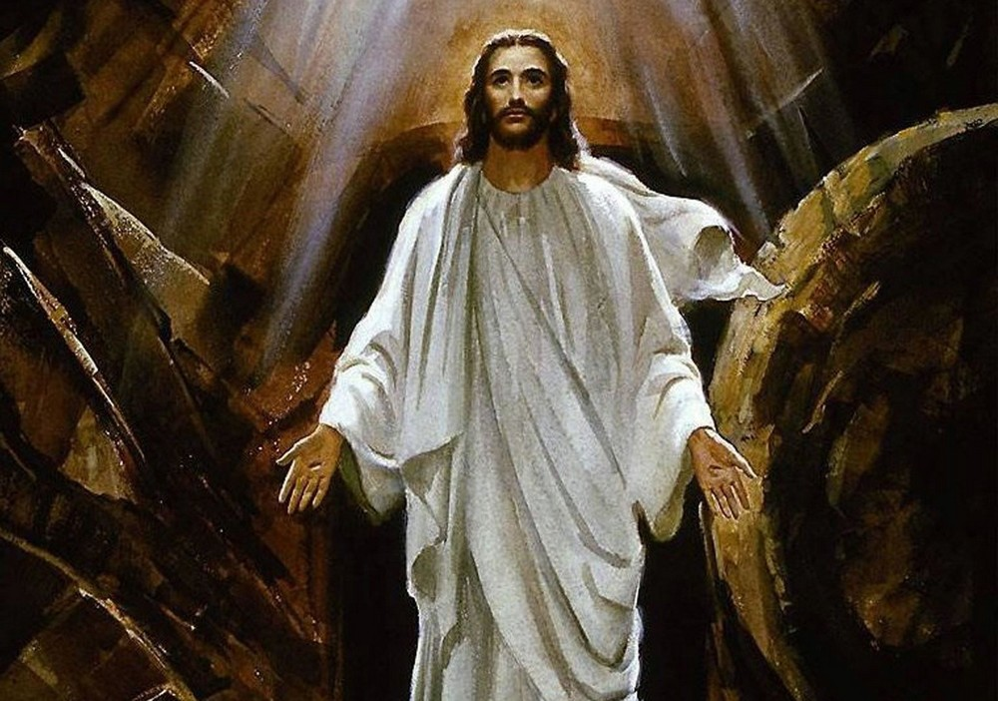
Friends of Jesus and Mary
The Eucharist - Jesus’ Real Presence in Mass

Slide 2
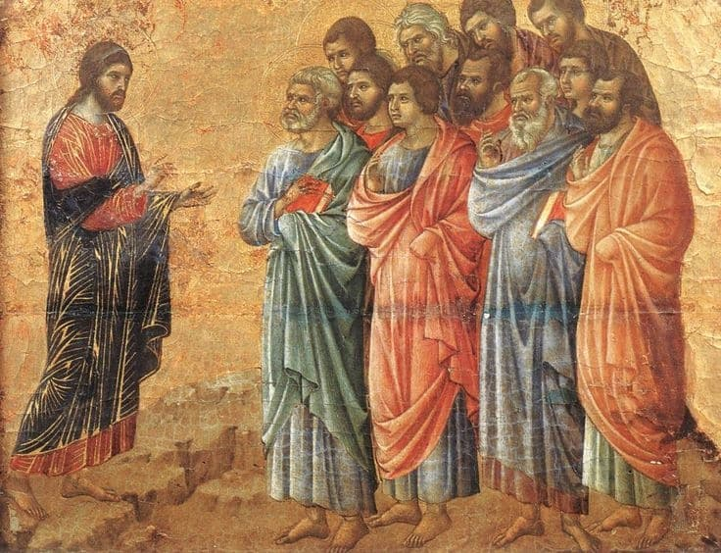
Before ascending into Heaven, Jesus told the apostles He would be with them always until the end of time.

Slide 3
He is hidden in our heart.
Where is Jesus?

Slide 4
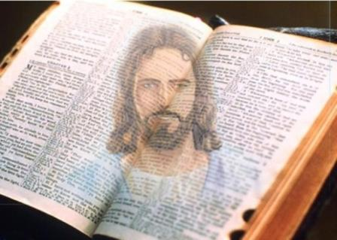
He is present in Holy Scripture.

Slide 5
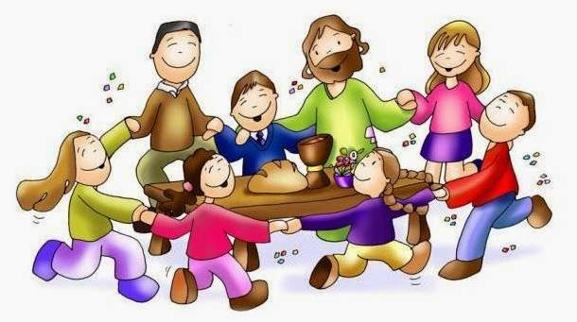
He is present in the community. He promised that where two or more are gathered in His name, He is present.”

Slide 6
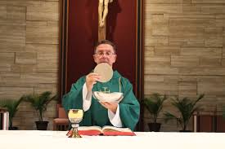
He acts through the Priest.

Slide 7
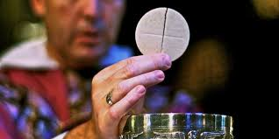
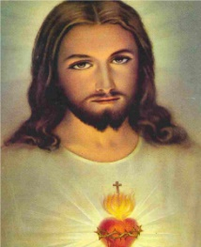
He is hidden in the bread and wine we eat during mass, the Eucharist.
It is a miracle!

Slide 8
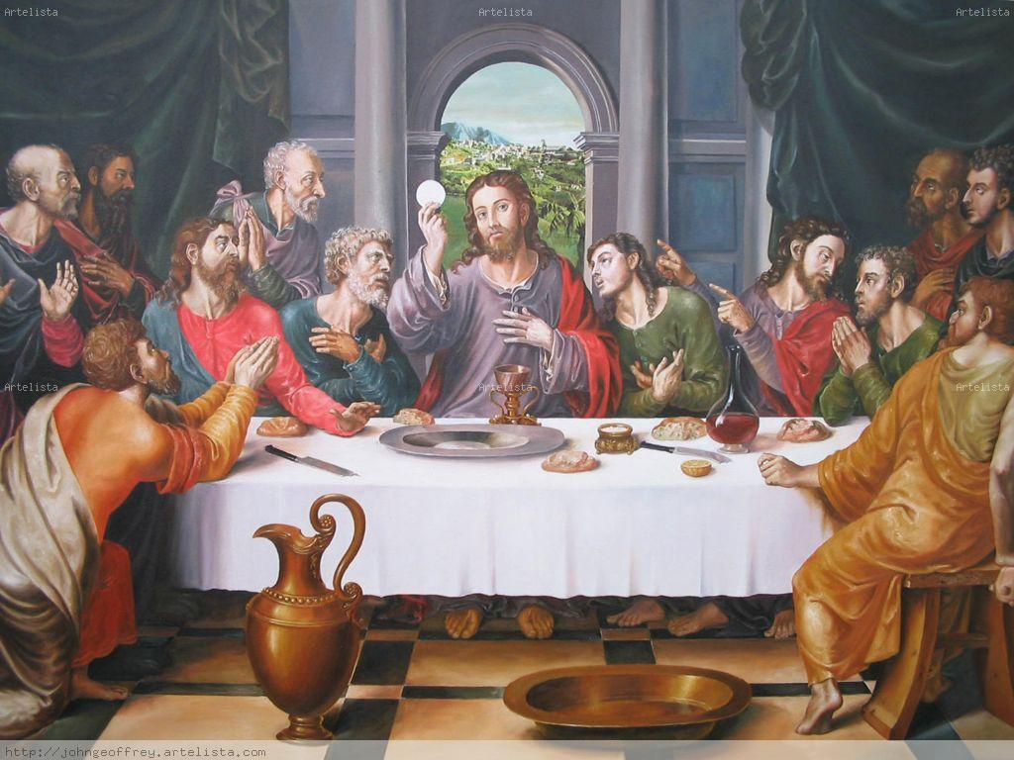
How is He present?
In the last supper, Jesus broke the bread, blessed it, and gave it to his disciples saying,
“Take this bread and eat it. This IS my body which will be given up for you.”
Then He took the wine and blessed it saying,
“Take this wine and drink it, this IS my blood that will be shed for you for the forgiveness of sin.
“Do this in memory of me.”

Slide 9
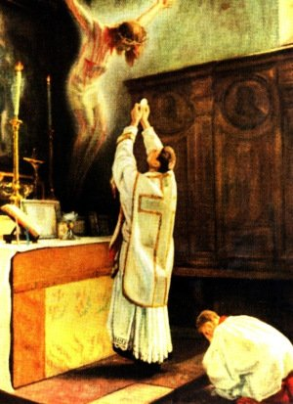
During the mass, the priest repeats these words over the bread and wine.
This is the moment of the
CONSECRATION,
When God changes the bread and wine to the body and blood of Jesus.
Often a bell is rung to announce
this important moment.
IT IS A MIRACLE!

Slide 10
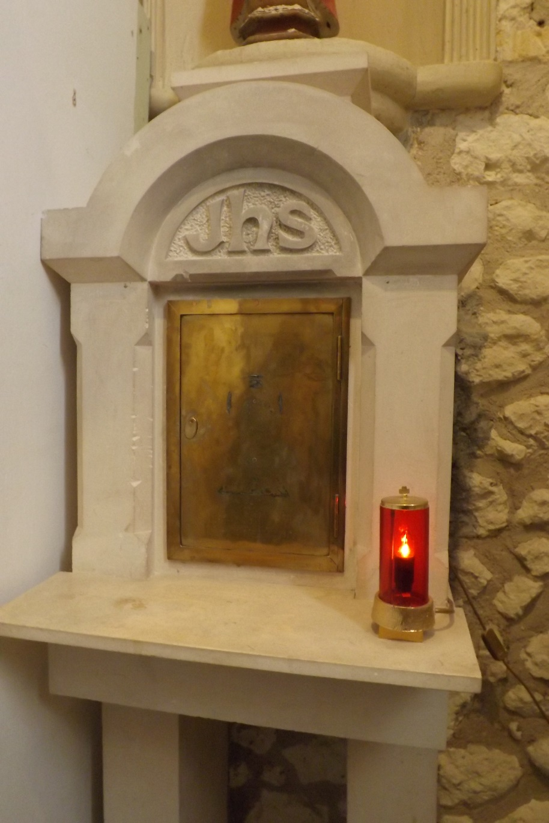
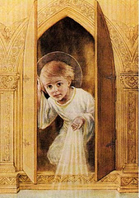
In the Church, Jesus in the Eucharist stays in the Taberncle.
The red light lit near the Tabernacle indicates Jesus is present there.
Jesus is there!
He waits for
us to visit.

Slide 11
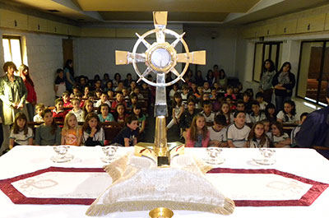
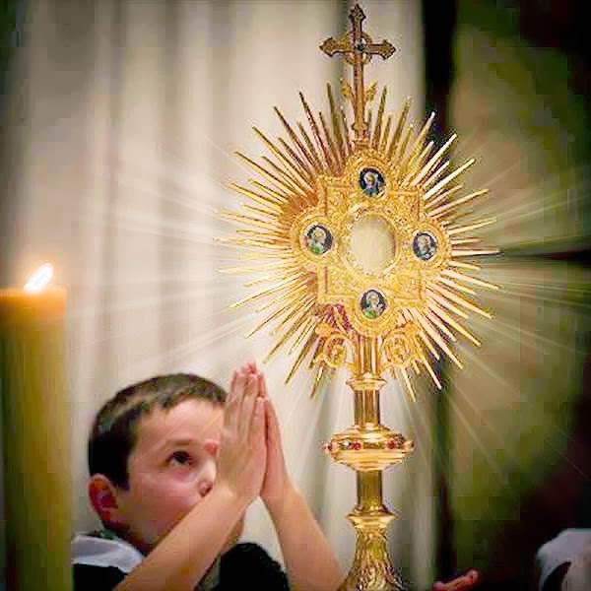
When we want to adore Jesus in a group, the priest puts Jesus in a Monstrance so he can bring Him close to the people.
We adore Jesus in the Blessed Sacrament.

Slide 12
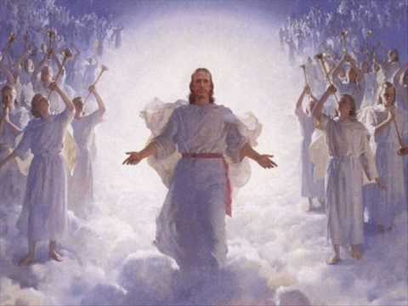
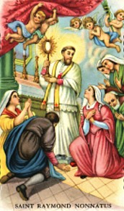
Wherever Jesus is, the angels and saints are also there adoring and praising their God and King.
And in the Eucharist
In Heaven…

Slide 13
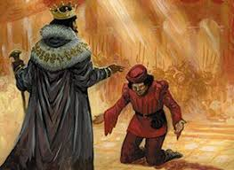
How do we behave before a King?
We bow and treat them with much respect.

Slide 14
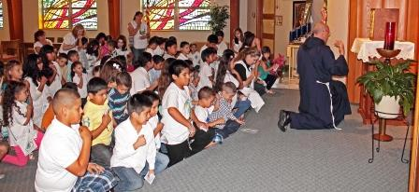
How do we behave before our King?
We kneel silently and respectfully.

Slide 15
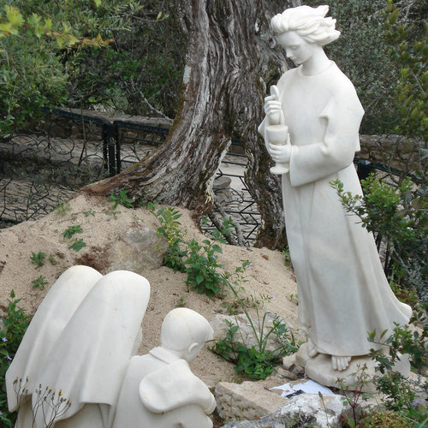
The angel of Peace in Fatima, Portugal asked the three children to pray often before Jesus in the Eucharist the following:
My God
I believe
I adore
I trust
And I love you.
I beg pardon for those who Do not believe
Do not adore
Do not Trust
And do not love you.(3X)

Slide 16
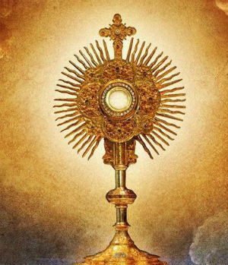
Let’s pray this prayer before Jesus in the Eucharist often.

