Slide 1
Friends of Jesus and Mary
The Holy Mass
The greatest miracle on earth
Based pm the movie “The Greatest Miracle”
From Dos Corazones Movies

Slide 2
What is a Miracle?
noun
a surprising and welcome event that is not explicable by natural or scientific laws and is therefore considered to be the work of a divine agency.
a highly improbable or extraordinary event, development, or accomplishment that brings very welcome consequences
an amazing product or achievement, or an outstanding example of something.

Slide 3

What happens in the movie?
One ordinary morning in an unnamed contemporary city, three people, all strangers to each other, go about their own lives. The story alternates among them, shows each encountering hardship of one kind or another. Monica is a widow anxiously doing all she can to support her young son, Diego, who is frustrated that she does not spend more time with him. Don Chema, a bus driver, learns that he has a gravely ill child, after which he tells everyone on the bus to leave before he breaks down in tears. Doña Cata, a weary old lady, misses her dead husband. Each is at a difficult crossroads and feels alone. But they are not as alone as they think. Thanks to the intervention of their guardian angels, they find themselves on their way to the same Mass at a beautiful local parish.

Slide 4
What happens in the movie?
At Mass, the angels encourage the three characters, instructing them on such things as preparing oneself for Mass, the existence of Purgatory, and how to pray.
Though each is a faithful Mass attendee, their eyes need to be opened to the graces available to them and to the great universal battle that gives ultimate meaning to their struggles.

Slide 5


Sharing your opinion

Slide 6
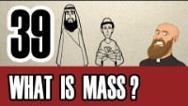
What is Mass?
The Eucharistic liturgy (the Mass) is the height of Christian prayer, and so essential to Christian life that the Church requires all the faithful to attend Mass every Sunday, as well as on holy days of obligation.

Slide 7
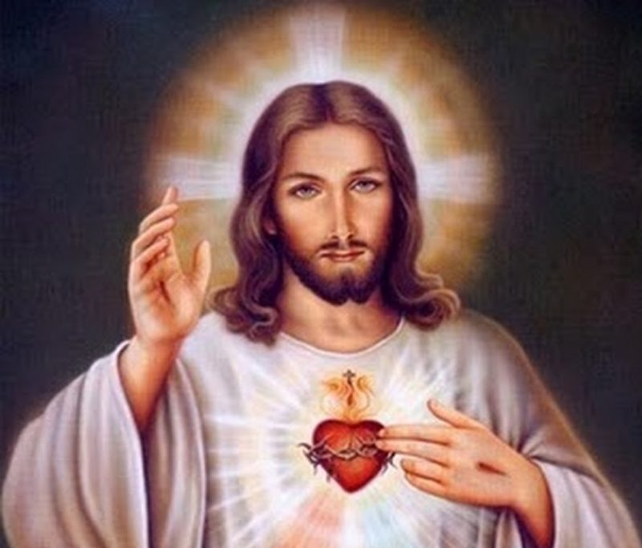
¿Are you ready to receive Him?
How to prepare to receive Jesus

Slide 8
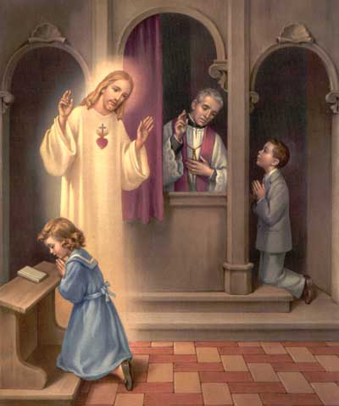
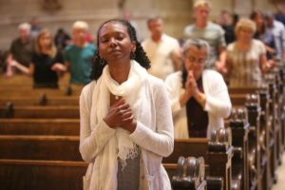
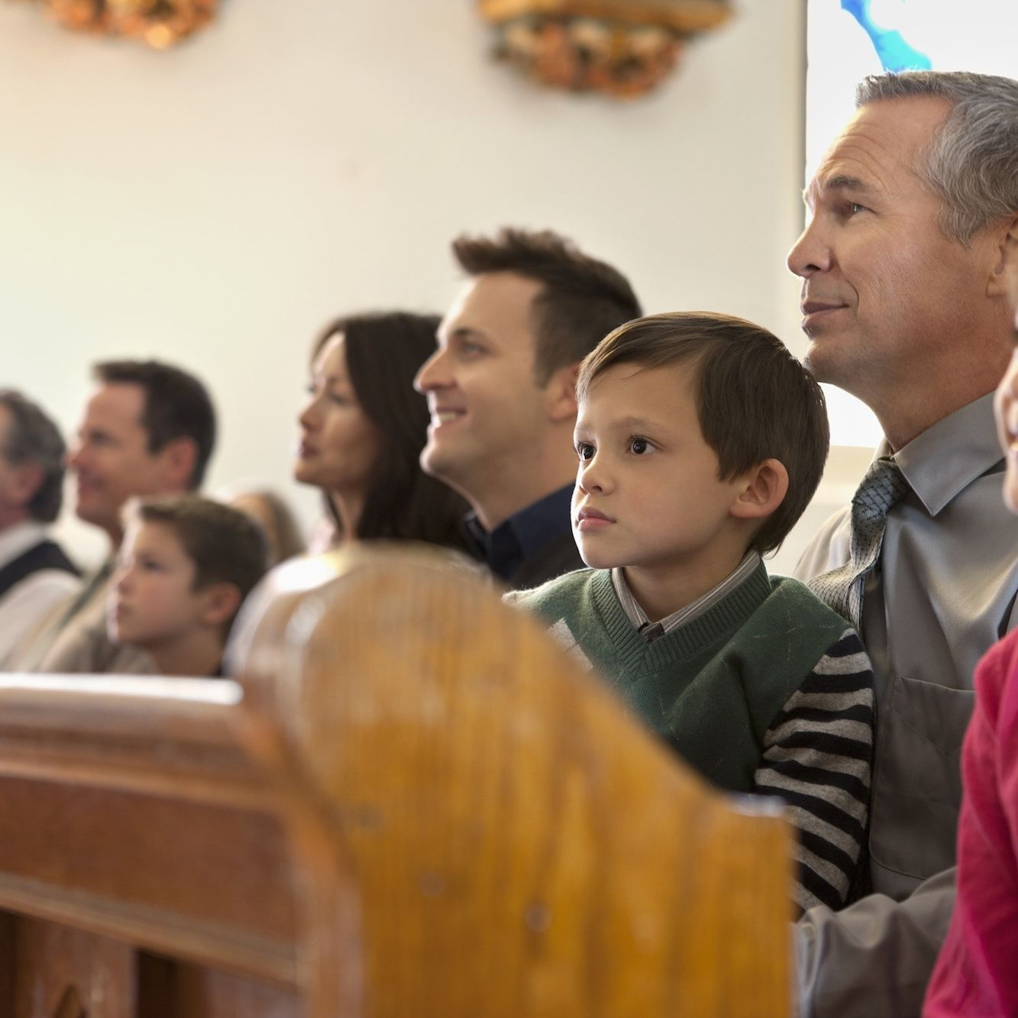
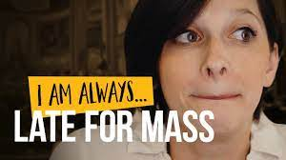
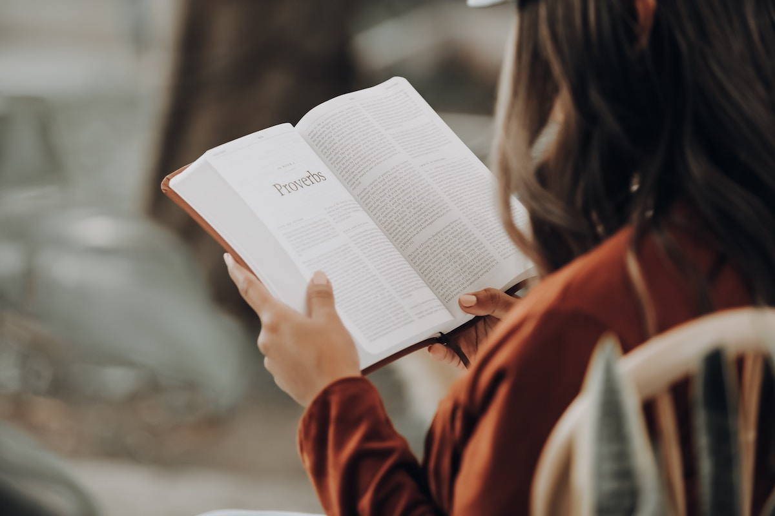
How to properly prepare for Mass
Go to confession often
Pray (sing)
Pay attention
Be prepared
Don’t be late

Slide 9
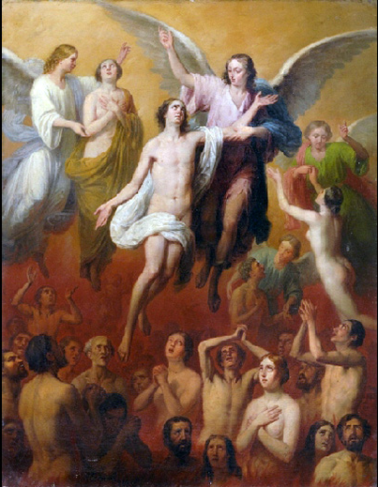
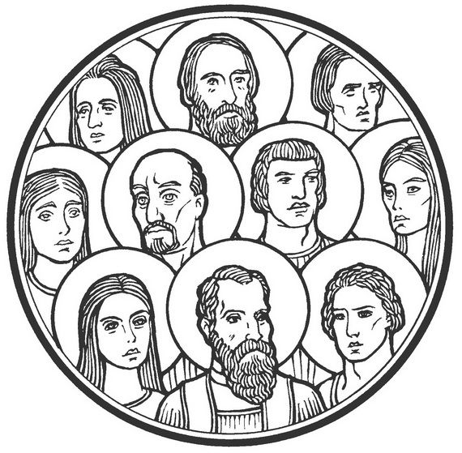
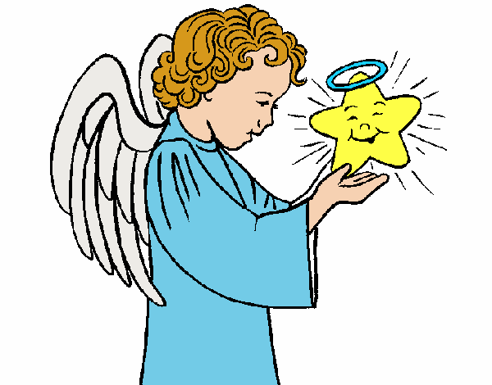
Are you alone in Mass?
No, besides other people like my family and the priest, angels, saints and souls in purgatory go to mass

Slide 10
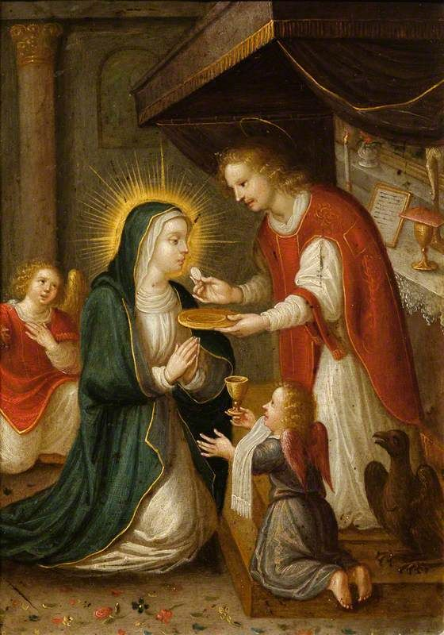
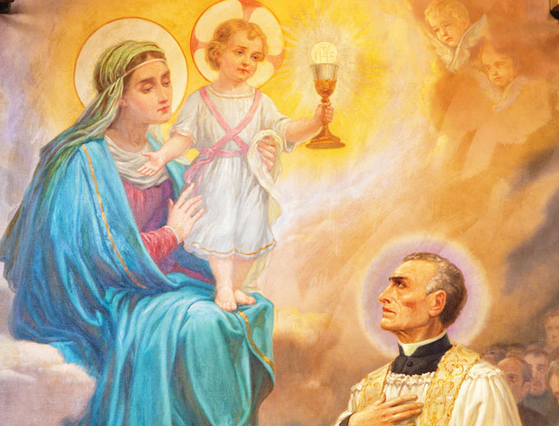
Are you alone in Mass?
Additionally, our Mother the Virgin Mary comes to mass too.

Slide 11
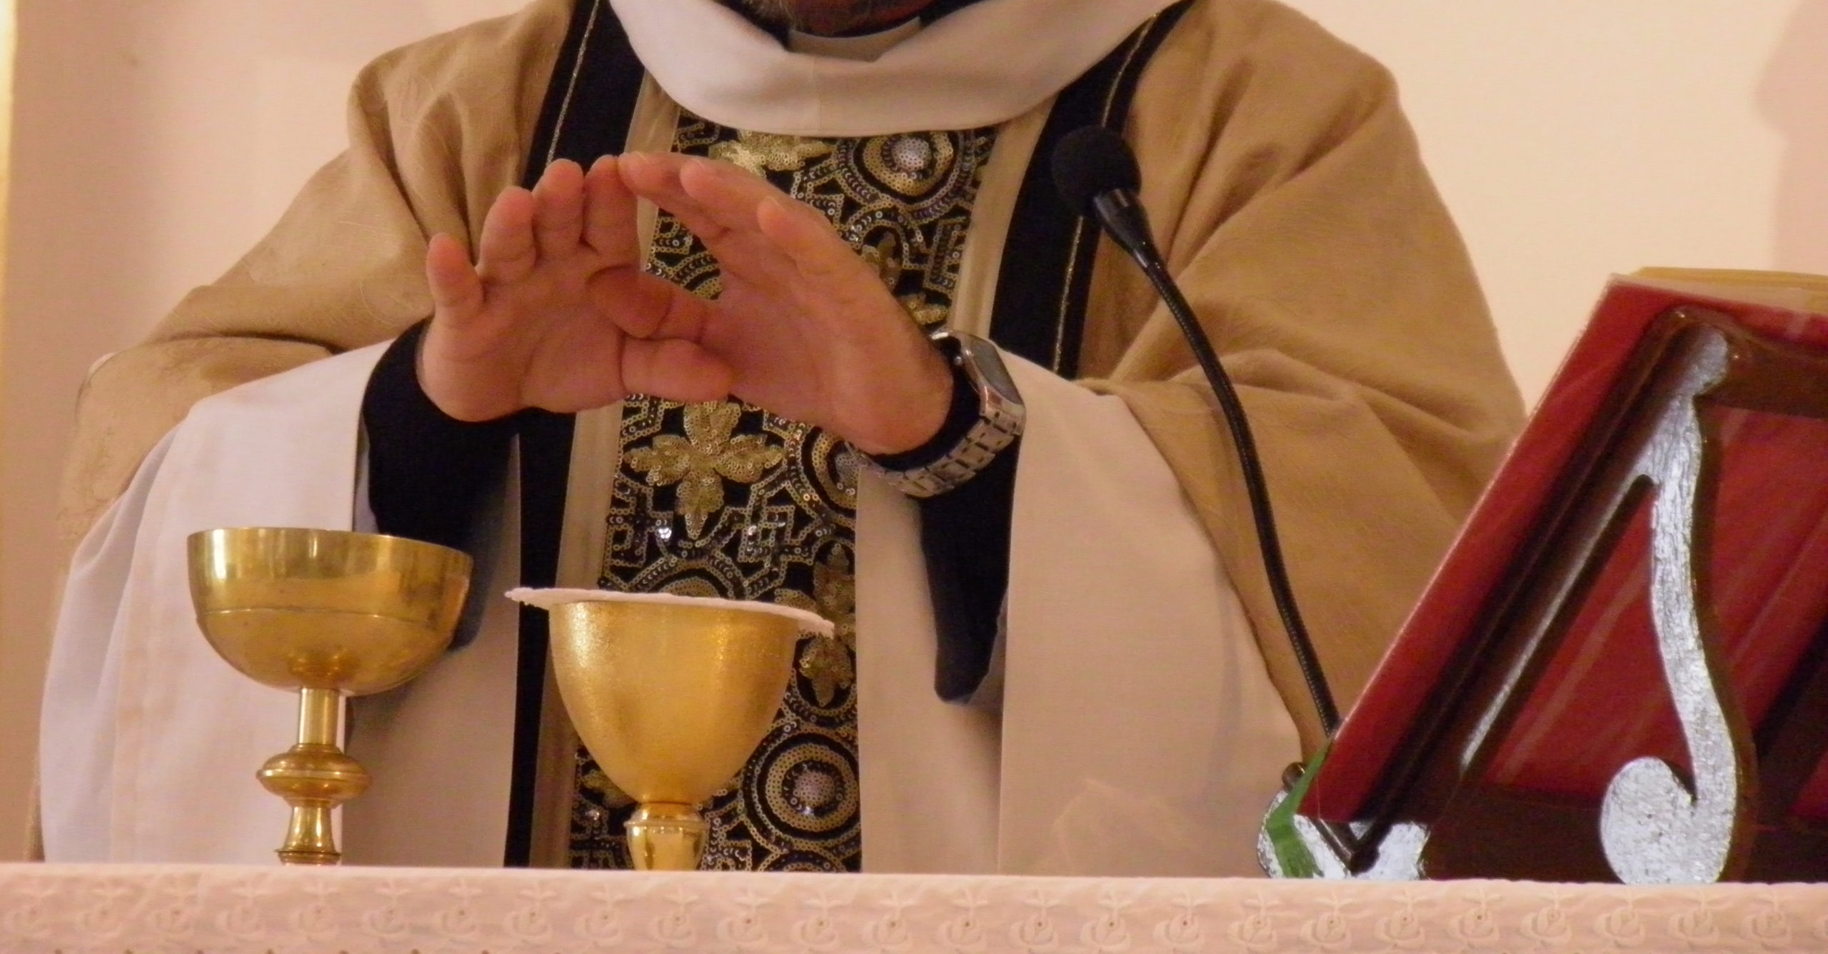
What happens in Mass
The holy spirit comes down from heaven and changes the bread and the wine in the body and blood of Jesus

Slide 12
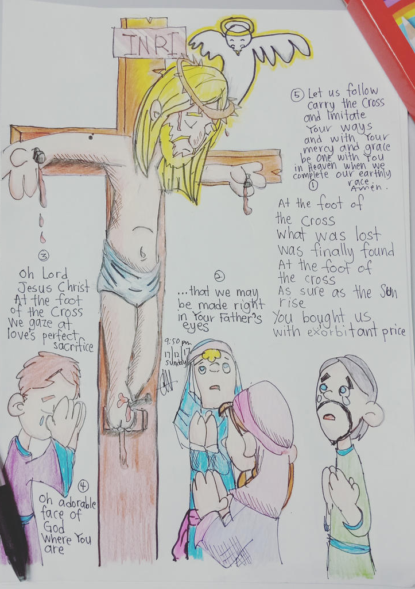
What happens in Mass
We stand at the foot of the cross, reliving the sacrifice of Jesus. It is not a new sacrifice it’s the same one that happened thousands of years ago.

Slide 13
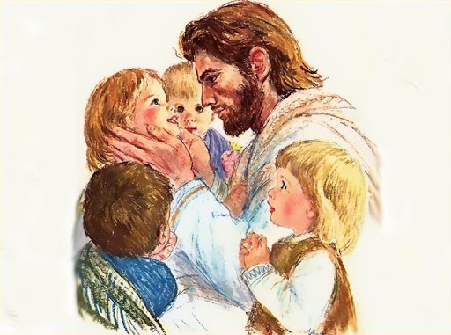
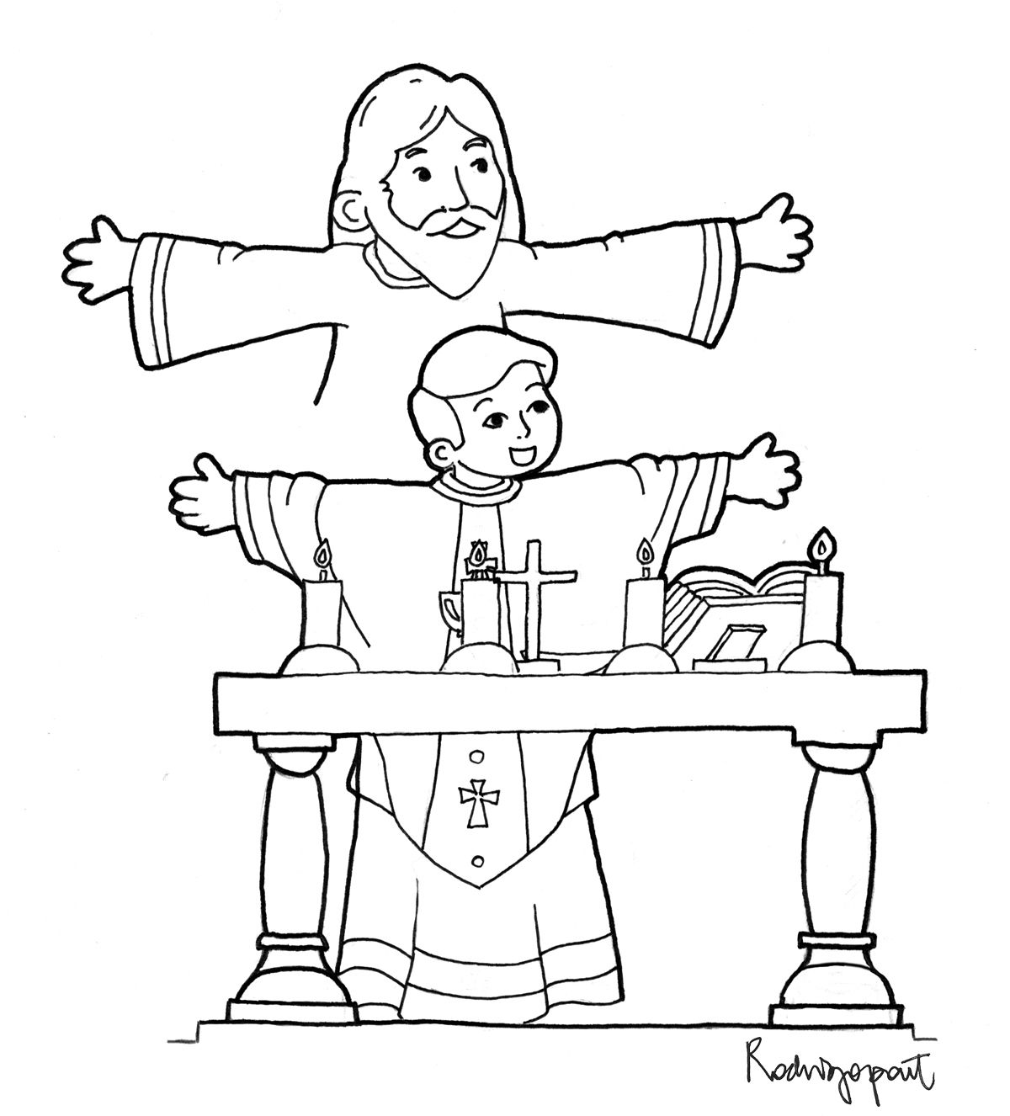
Why does God come down from heaven at mass?
Jesus wants to be with you forever, because He loves you

Slide 14
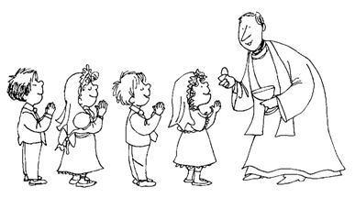
How long does Jesus stay with me after I receive him in communion?
As long as you acknowledge and appreciate His presence in you. Make your heart His home.

Slide 15
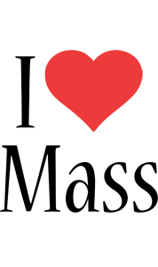
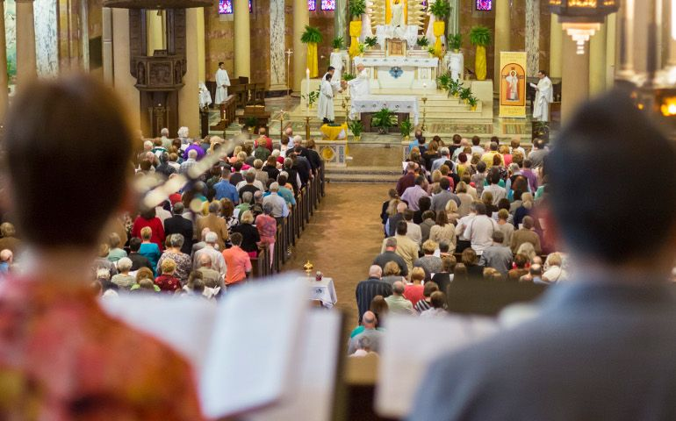

What would Jesus want us to do now that we understand mass?
Give thanks
Teach everyone what the mass is

Slide 16
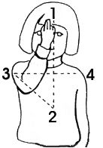
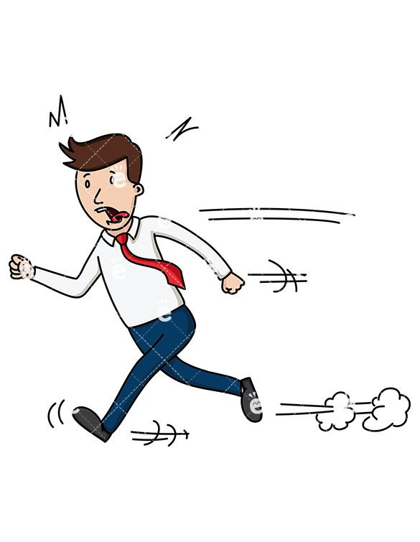
Don’t Forget at the end of mass
Do the sign of the cross with respect
Don’t rush when leaving church, remember who is with you.

Slide 17
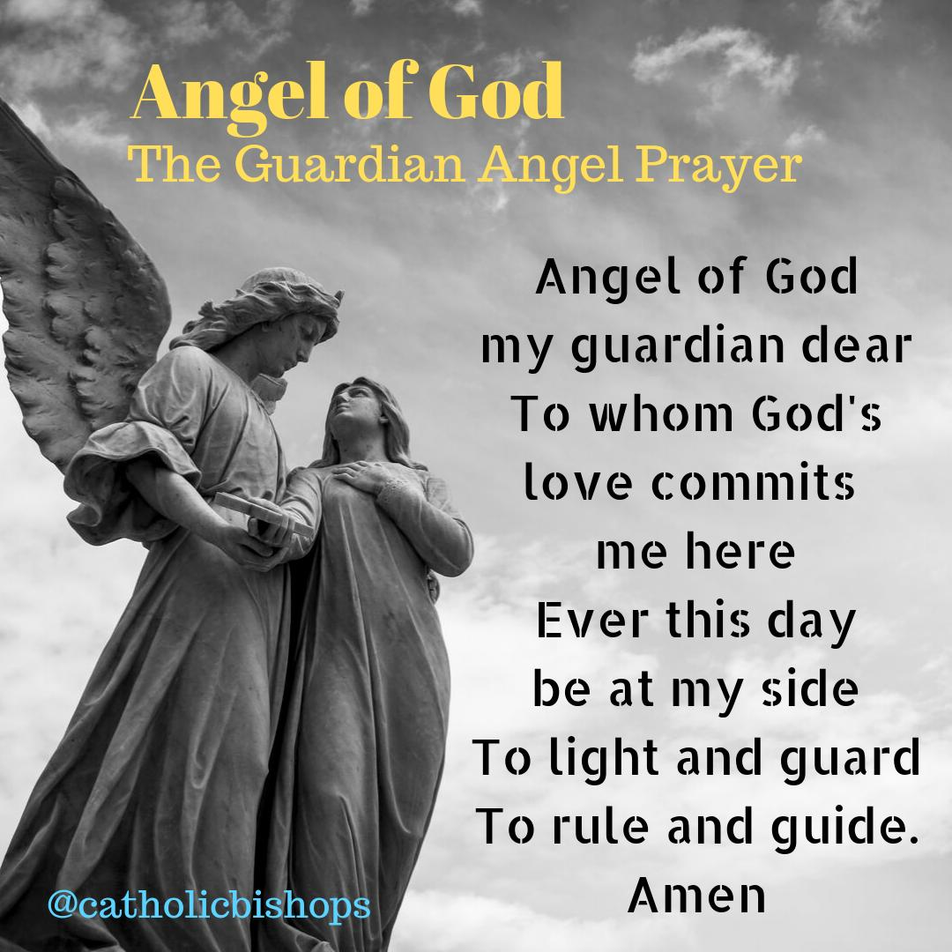
Write a small prayer to your Guardian Angel related to what he does for you in mass

Slide 18
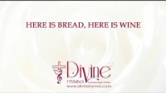

Slide 19
Friends of Jesus and Mary
Cycle B – IV Sunday of Easter
Acts 4:8-12; Psalm 117: 1. 8-9. 21-23. 26. 28cd. 29; 1 John 3: 1-2; John 10:11-18
Jesus is the Good Shepherd
I am the good shepherd, who is willing to die for the sheep. When the hired man, who is not a shepherd and does not own the sheep, sees a wolf coming, he leaves the sheep and runs away; so, the wolf snatches the sheep and scatters them. The hired man runs away because he is only a hired man and does not care about the sheep. I am the good shepherd. As the Father knows me and I know the Father, in the same way I know my sheep and they know me. And I am willing to die for them. There are other sheep which belong to me that are not in this sheep pen. I must bring them, too; they will listen to my voice, and they will become one flock with one shepherd. The Father loves me because I am willing to give up my life, in order that I may receive it back again. No one takes my life away from me. I give it up of my own free will, I have the right to give it up, and I have the right to take it back. This is what my Father has commanded me to do.

