Slide 1
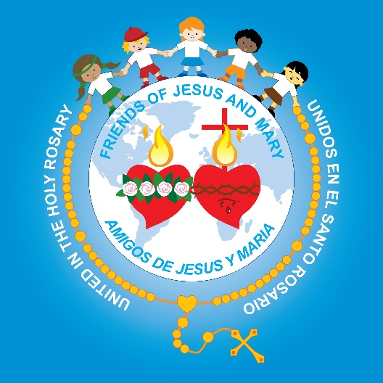
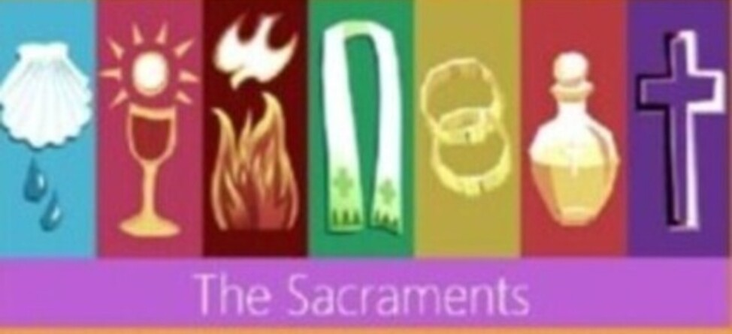
Friends of Jesus and Mary
THE 7 SACRAMENTS

Slide 2
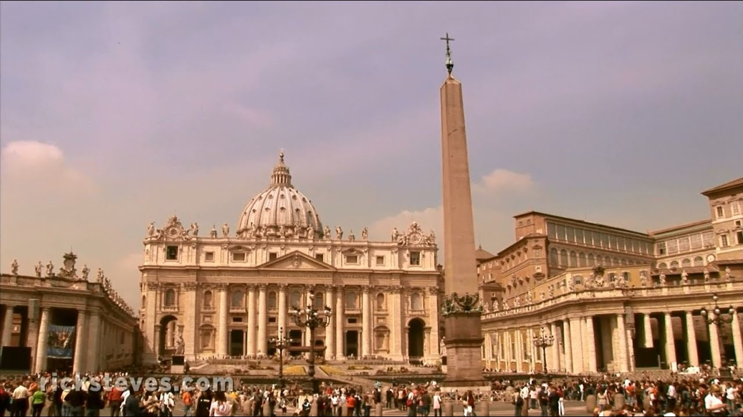
God gives us the great gift of the Catholic Church to help us be happy on earth and in Heaven.
St. Peter’s Basilica in the Vatican City, Rome Italy

Slide 3
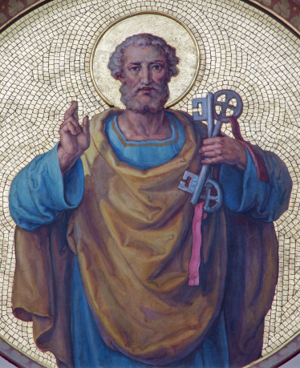
Jesus started the Catholic Church when He chose Peter to be the first Pope or leader of the Church.

Slide 4
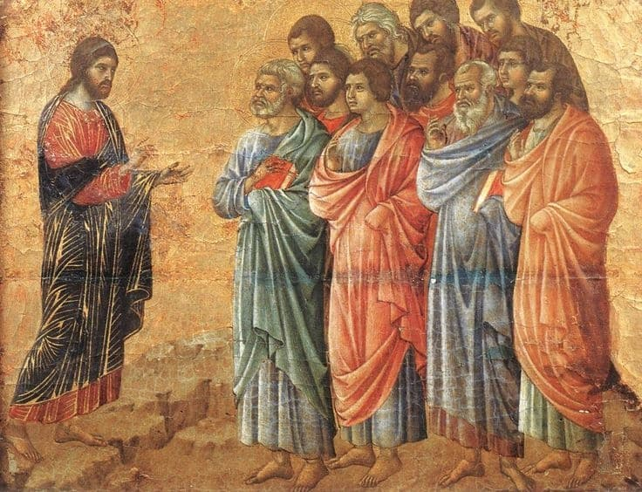
After Resurrecting, Jesus meets with the apostles and gives them the mission to baptize all the nations in the name of the Father and of the Son and of the Holy Spirit. Our bishops and priests are the successors of the apostles.
Jesus wants everyone to know of God’s love and to be a part of His family.

Slide 5
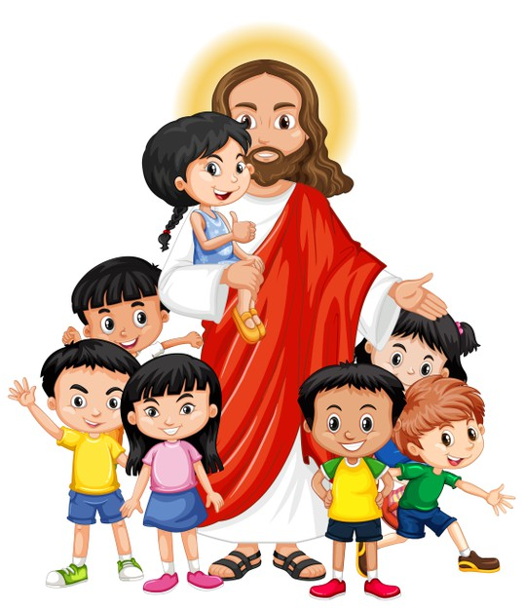
The Church gives us 7 Sacraments so we may be closer to God.
A Sacrament is an outward sign of God acting inside of us.
In the Sacraments, God becomes present and acts in our life.
He gives us His Grace,
His life within us.

Slide 6
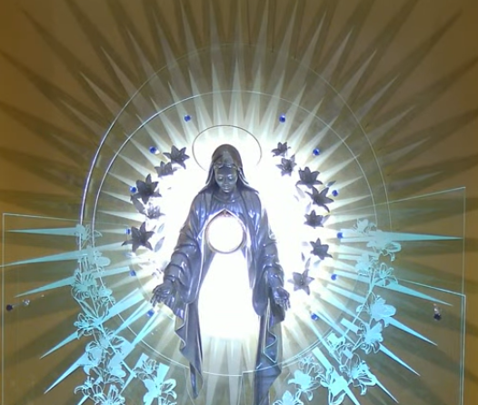
Through the Sacraments, we receive God’s life within us.
Mary was
full of Grace,
God’s life, because she was sinless.
The better the condition of our heart, the more Grace we receive.
Adoration Chapel in Polska, Poland

Slide 7
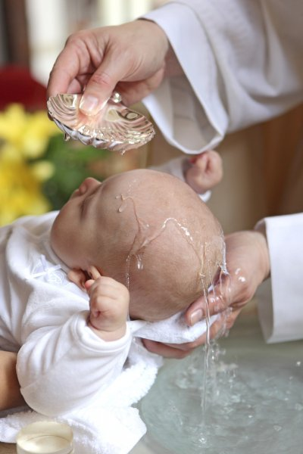
The Sacraments use symbols to represent the actions of God which we cannot see.

Slide 8
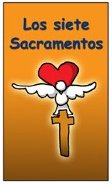
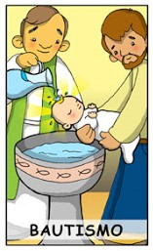
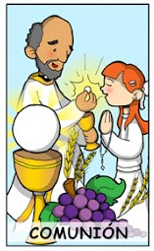
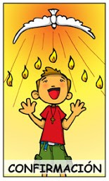
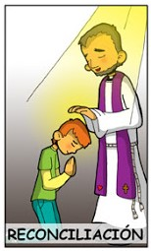
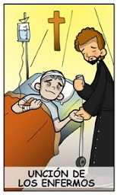
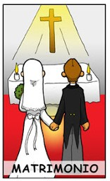
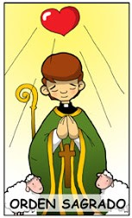
The Sacraments are divided into 3 types:
The Seven
Sacraments
INITIATION SACRAMENTS
(Beginning)
HEALING SACRAMENTS
Annointing of
the Sick
Baptism
Communion
Confirmation
Reconciliation
VOCATION SACRAMENTS
(Profession)
Matrimony

Slide 9
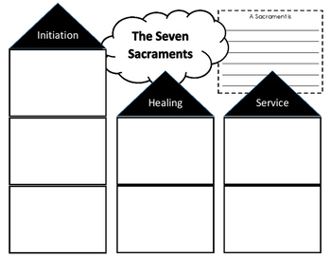
Draw the symbol in the red square and label the Sacrament.

Slide 10
1st Sacrament of Initiation BAPTISM
The Baptism of Jesus
https://youtu.be/oGMCA_aUY4c
What happens to us when we receive the Sacrament of Baptism?

Slide 11
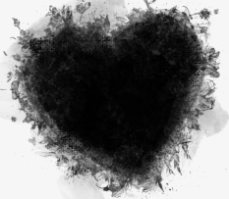
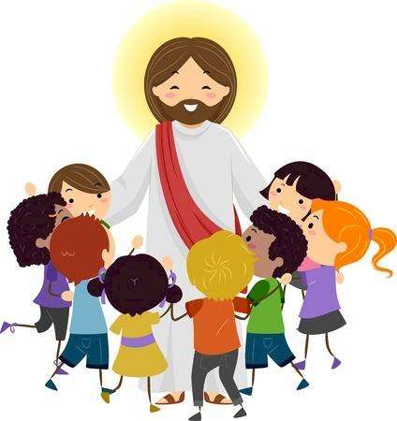
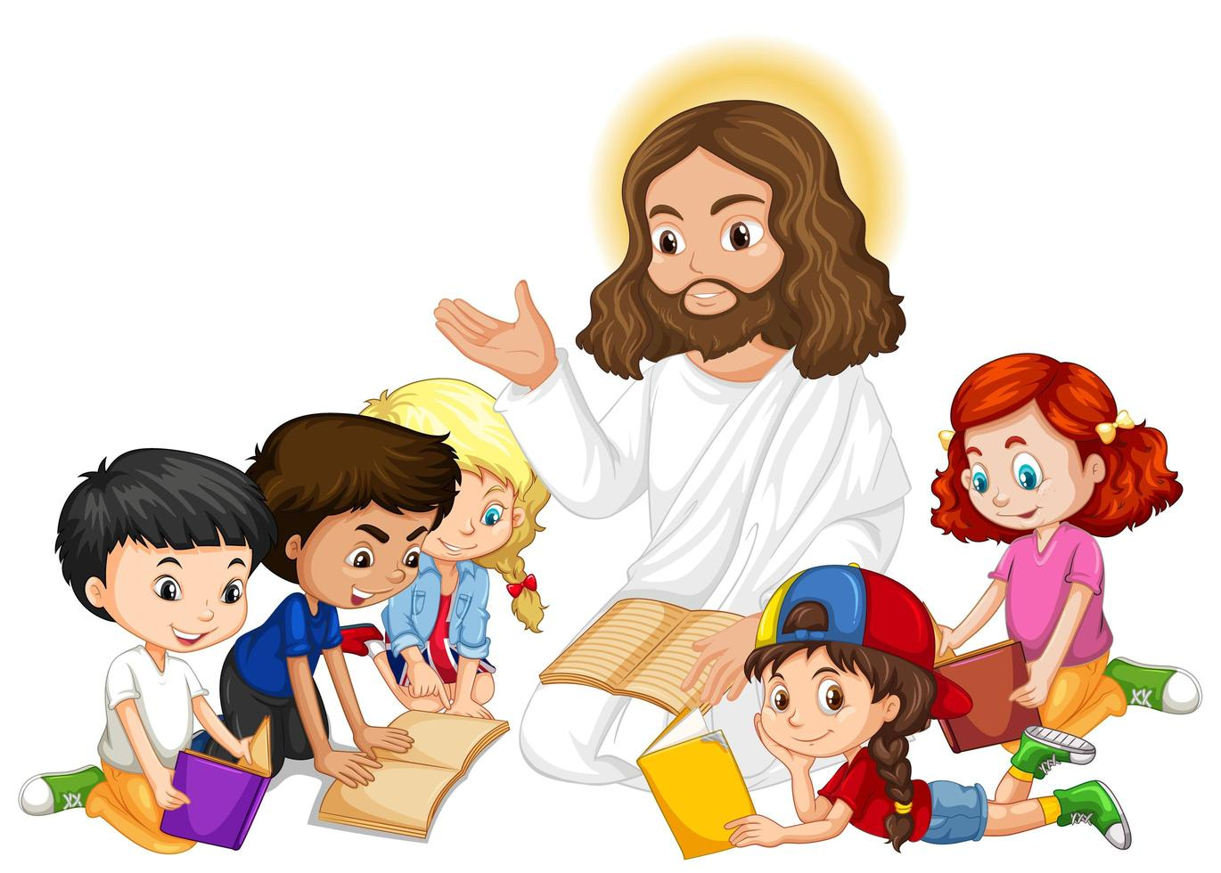
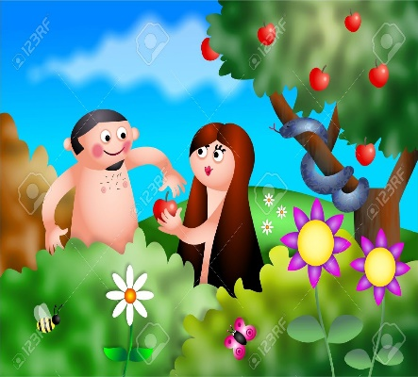
God erases the stain of Original Sin, the sin of Adam and Eve, and we receive the Holy Spirit, God himself, in our heart.
We enter into God’s family, the Church.
And we share in the mission of Jesus to help bring God’s Kingdom to the world.

Slide 12
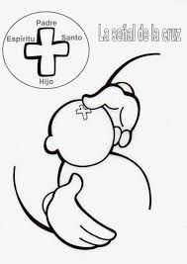
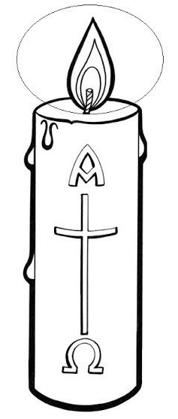
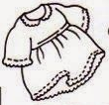
What are the symbols of Baptism and what do they represent?
The sign of the cross symbolizes we belong to Jesus.
The oil symbolizes we receive the Holy Spirit.
The water symbolizes we are purified from sin and receive new life in Jesus.
The white garments symbolize we are cleansed and “dressed of Jesus”.
The candle symbolizes the light of Jesus which shines in us.

Slide 13
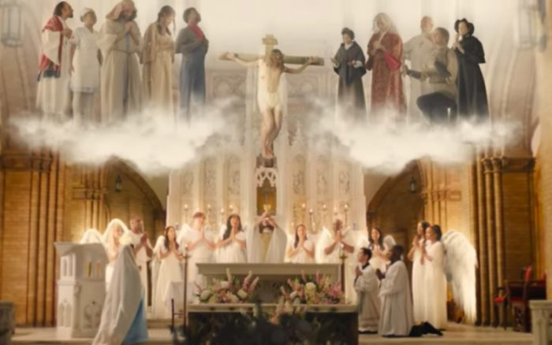
2nd Sacrament of Initiation COMMUNION
The Last Supper
https://youtu.be/y-SrXeZcVhU
(Stop at 2:10 minutes)
What happens in the Sacrament
of Communion?

Slide 14
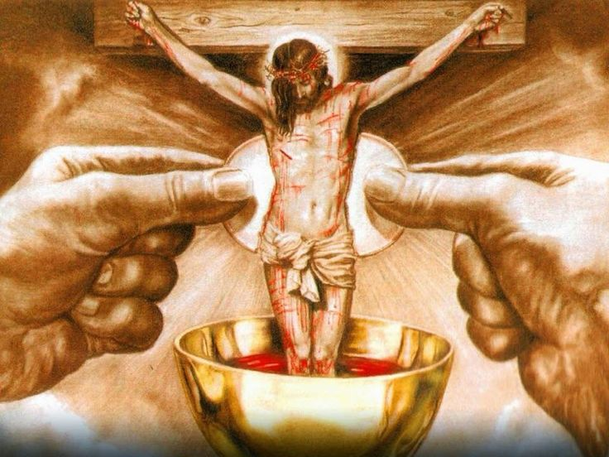
In the Sacrament of Communion or the Eucharist, the bread and wine, by the power of the Holy Spirit, become the body and blood of Christ at the moment of Consecration.
The moment of Consecration is when the priest repeats the words of Jesus at the Last Supper. We ring a bell to mark this important event.

Slide 15
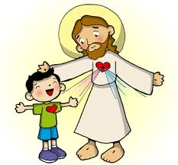
When we receive the Eucharist, we become one with Jesus.
He strengthens our spirit and helps us to be more like Him.

Slide 16
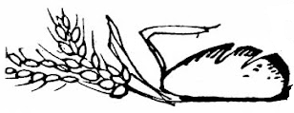
What are the symbols of Communion and what do they represent?
Jesus used a cup or a CHALICE as the vessel for his Blood at the Last Supper.
Grapes are used to make wine.
A HOST, a round piece of unleavened bread, consecrated during Mass becoming the body of Christ. In Latin, it means a sacrificial lamb. Jesus is “the lamb of God who takes away the sins of the world”.
Wheat is the main ingredient for bread and Jesus is the Bread of Life who feeds our spirit.
Jesus used wine at the Last Supper which becomes His BLOOD, shed for many for the forgiveness of sins.

Slide 17
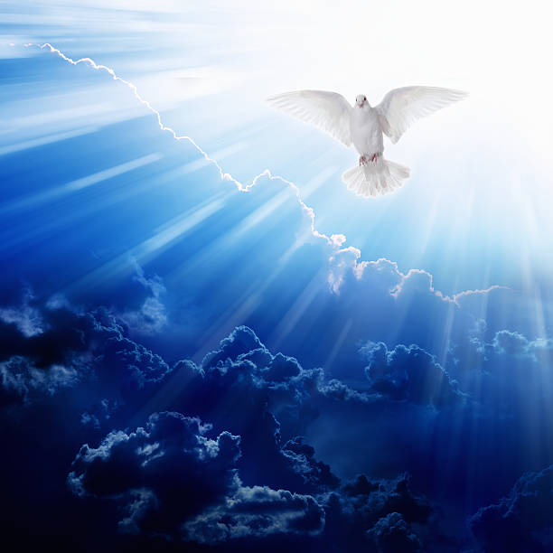
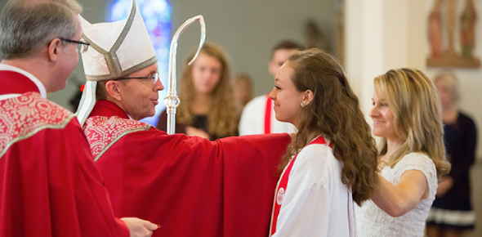
3rd Sacrament of Initiation CONFIRMATION
Pentecost
https://youtu.be/4cJtafGUVno
What happens to us when we receive the Sacrament of Confirmation?

Slide 18
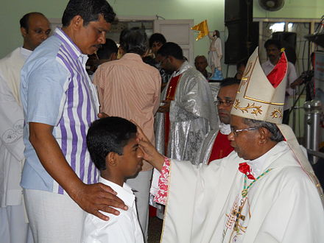
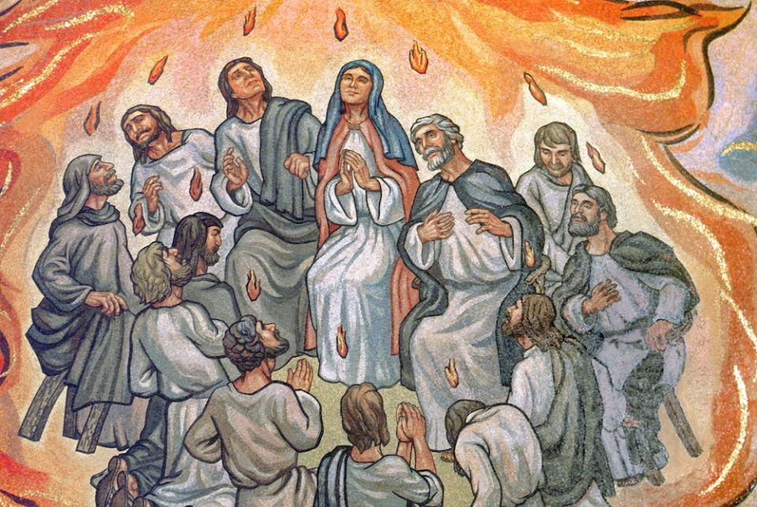
This sacrament is called Confirmation because you now confirm the faith you were given in Baptism.
During Confirmation, God the Holy Spirit comes upon the person, accompanied by God the Father and God the Son, just as he did at Pentecost.
The focus is on the Holy Spirit, who confirmed the apostles on Pentecost (Acts 2:1–4) and gave them courage to practice their faith.
You accept responsibility for living your faith with God’s help.

Slide 19
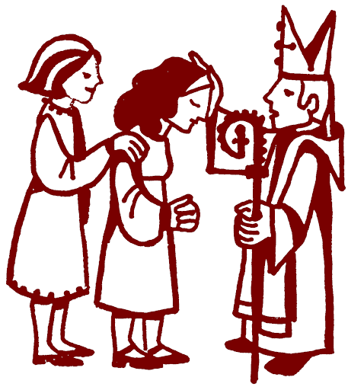
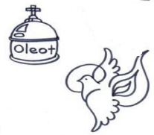
The Chrism is scented oil blessed by the Bishop. The oil symbolizes we receive the Holy Spirit.
What are the symbols of Confirmation and what do they represent?
The Bishop’s laying on of hands symbolizes the gifts of the Holy Spirit, which strengthens us to do what God the Father asks of us.

Slide 21
Together the 3 Sacraments of Initiation:
Baptism
Communion
Confirmation
…complete our initiation into the Church.

Slide 22
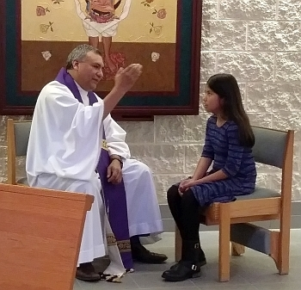
1st Sacrament of Healing RECONCILIATION
Jesus appears to His disciples
(John 20: 19-23)
https://youtu.be/sd236l2fpxw
What happens to us when we receive the Sacrament of Healing?

Slide 23
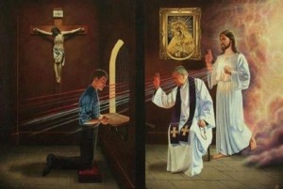
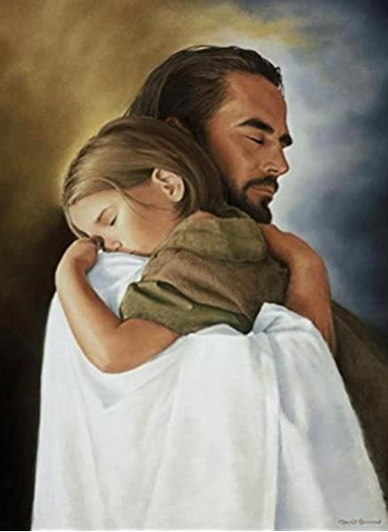
In the Sacrament of Reconciliation, we confess our sins with a sorry heart to a priest. He forgives us in Jesus’ name.
The grace we have lost is given back to us.
Jesus comforts us and strengthens us on our journey.
We are reconciled with God, with the Church, and with the people we have hurt.

Slide 24
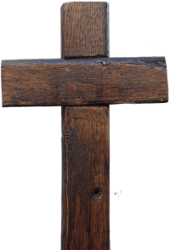
What are the symbols of Reconciliation and what do they represent?
The sign of the cross is given by the priest as he recites the final words of the Prayer of Absolution. Jesus forgives us through the priest.
“I absolve you in the name of the Father, and of the Son, and of the Holy Spirit. Amen
The raised hand is done by the priest in the Prayer of Absolution (forgiveness) in removing the persons sins.

Slide 25
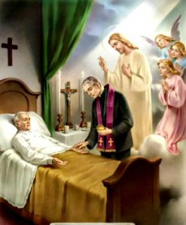
2nd Sacrament of Healing Anointing of the Sick
What happens to us when we receive the Sacrament of Annointing
of the Sick?

Slide 26
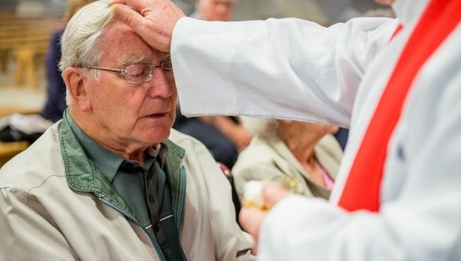
In the Sacrament of the Anointing of the Sick, God protects the spirit from the sufferings of the body, mind, and emotions.

Slide 27
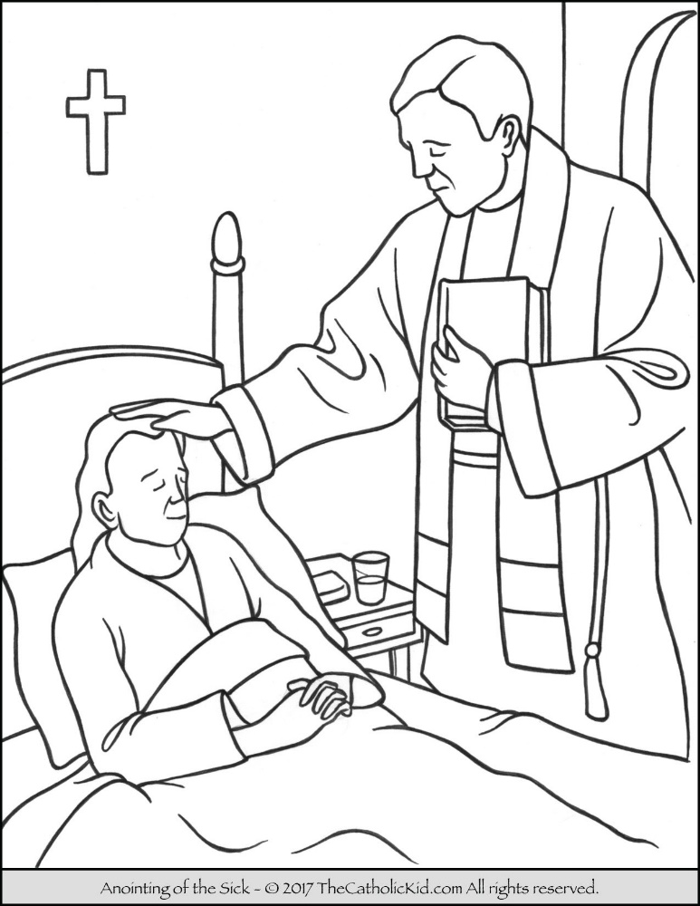
What are the symbols of Anointing of the Sick and what do they represent?
The laying on of hands symbolizes the power of God entering the sick person.
The priest lays his hands on the sick person's head.
Then he anoints the sick person with the oil on the forehead and palms of the hands and prays.
The oil signifies that an interior action has taken place.

Slide 28
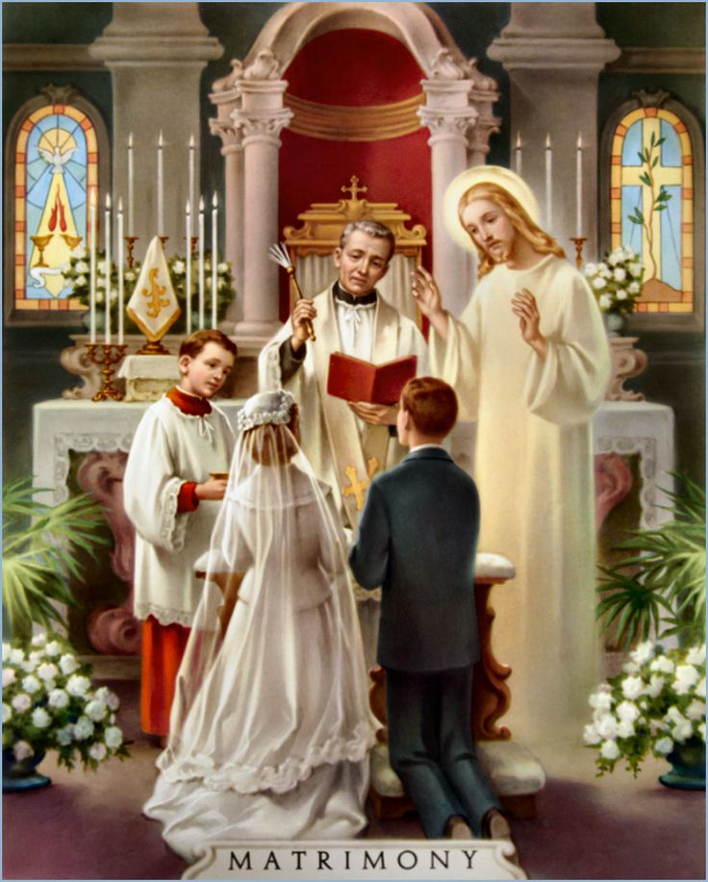
1st Sacrament of Vocation Matrimony or Marriage
The Wedding at Cana,
https://youtu.be/ZYLUTdB9l1g
What happens to us when we receive the Sacrament of Matrimony?

Slide 29
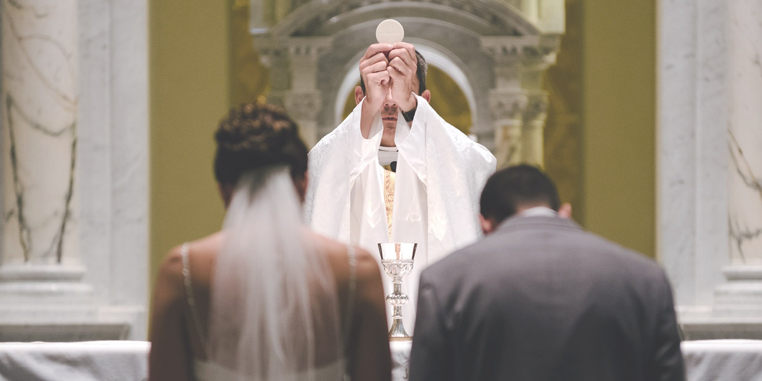
In the Sacrament of Matrimony, a man and a woman become husband and wife through a sacred covenant with God and each other.
By marrying in the Church, the couple invites God’s blessing and help in their relationship.

Slide 30
What are the symbols of Matrimony and what do they represent?
The wedding rings symbolize the covenant between the couple and their love for one another.
A Covenant is an agreement between two parties which requires something from each and brings them into a family relationship. A Marriage parallels the covenant between God and His people.

Slide 31
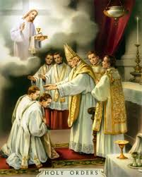
2nd Sacrament of Vocation Holy Orders
What happens when someone receives the Sacrament of Holy Orders?

Slide 32
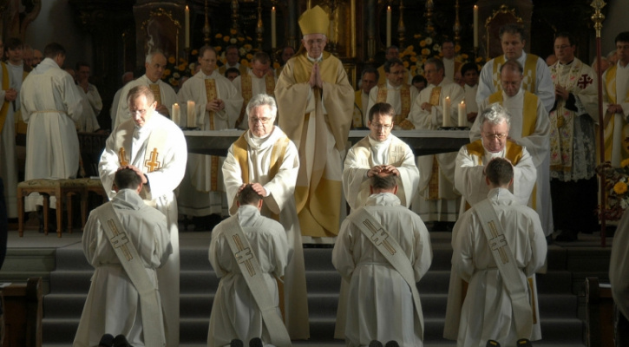
Bishops and priests when ordained, receive a permanent spiritual mark, called a character, signifying that they represent Jesus’ presence in the Church.
As successors of the apostles, they have the important mission of spreading the Gospel, (the good news about Jesus).

Slide 33
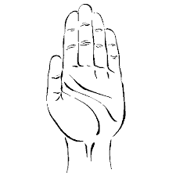
What are the symbols of Holy Orders and what do they represent?
The stole signifies a sign of ministry.
The oil signifies that the one anointed has been called by God to a special service.
The laying-on-of- hands signifies that the Church authorizes the anointed to perform this service.

Slide 34
Activity

Slide 35
The Seven
Sacraments
Draw an arrow to the box where the Sacrament belongs.
INITIATION SACRAMENTS
(Beginning)
HEALING SACRAMENTS
VOCATION SACRAMENTS
(Profession)
Anointing of
the Sick
Matrimony
Baptism
Reconciliation
Communion
Confirmation

Slide 36
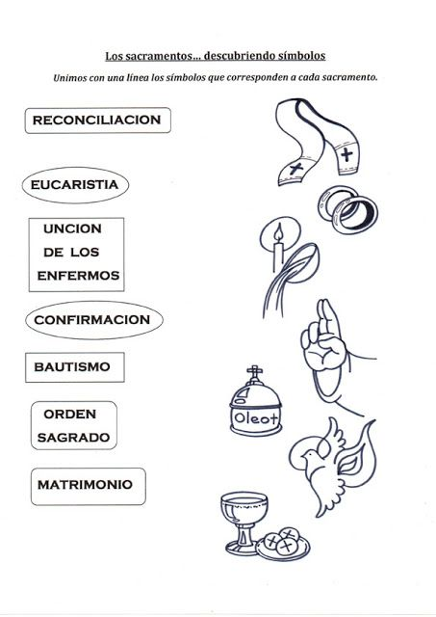
THE SACRAMENTS Match the symbols with the sacrament.
RECONCILIATION
EEUCHARIST
ANNOINTING OF THE SICK
CONFIRMATION
BAPTISM
HOLY
ORDERS
MATRIMONY

Slide 37
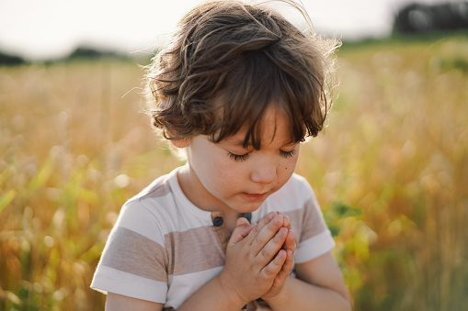
Prayer Lord Jesus, you came to make us a part of your family. You freed us from sin and death. Help us to take your message of love to everyone. Amen. Song He is the light, Lifetree Kids https://youtu.be/fzoOmdZxrx8

Slide 38
Life of Blessed Carlo Acutis, https://youtu.be/yC_oZIY_f5w

