Slide 1
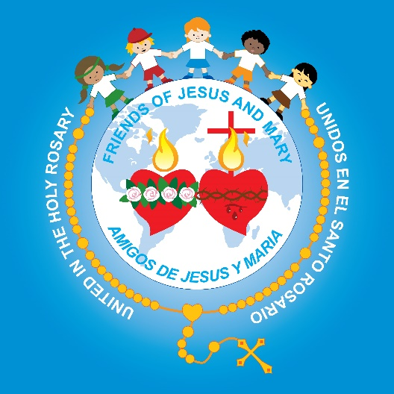
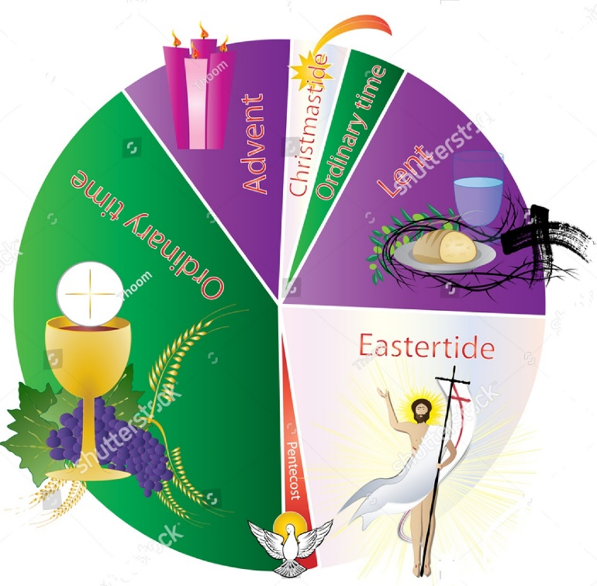
Ministry Friends of Jesus and Mary
Prayer Group for Children
The Liturgical Year
www.fcpeace.org

Slide 2
THE LITURGICAL YEAR THE CHURCH CELEBRATES THE WHOLE YEAR FOR JESUS.
Jesus is born!
Jesus teaches us!
Jesus is coming!
Jesus will die and resurrect!
Jesus teaches us!
Jesus dies!
Jesus Resurrects!
Jesus sends the Holy Spirit!

Slide 3
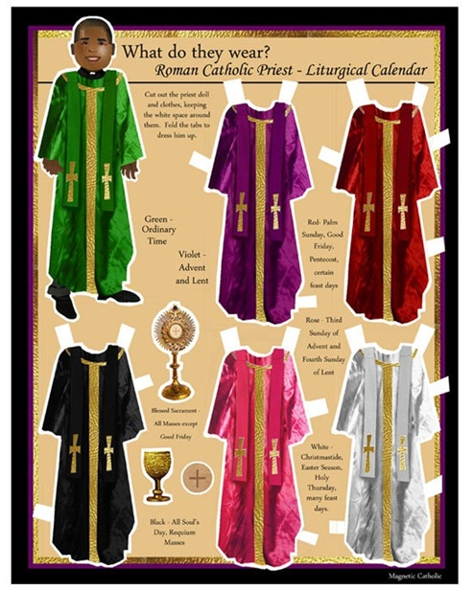
Liturgical colors used in Mass The priest wears a CHASUBLE with the colors of the liturgical season.
Purple – Used in Advent and Lent – It means penance and preparation.
Pink – Used the 3rd week of Advent and 2 weeks before Easter – It means anticipation.
White/Gold – Used in Christmas, Easter, feasts of the Virgin Mary and saints not martyred – It means joy and purity.
Green – Used in Ordinary Time – It means growth and hope.
Red – Used on Passion or Palm Sunday, Good Friday, and feast days of the apostles & martyrs. It means sacrifice.
Black – May be worn on All Souls Day, funeral masses and Good Friday. Not commonly used.

Slide 4
There are 3 cycles: A, B and C throughout 3 years. Each cycle has its own sequence of readings from the Old Testament and the New Testament. The 3 cycles cover all Salvation History.
THE SCRIPTURES READ IN MASS DURING THE LITURGICAL YEAR

Slide 5
In Cycle «A», The main gospel read is St. Matthew. In Cycle «B», The main gospel read is St. Mark. In Cycle «C», The main gospel read is St. Luke. The Gospel of St. John is used on special occasions such as Holy Week, and for important feast days of the Church.
THE SCRIPTURES READ IN MASS DURING THE LITURGICAL YEAR

Slide 6
Remember that the Liturgical Year starts with the 1st week of ADVENT and ends with the Solemnity of Christ the King. The Liturgical year usually begins at the end of November or the beginning of December. It is not the same as the Calendar Year.
The Liturgical Year

