Slide 1
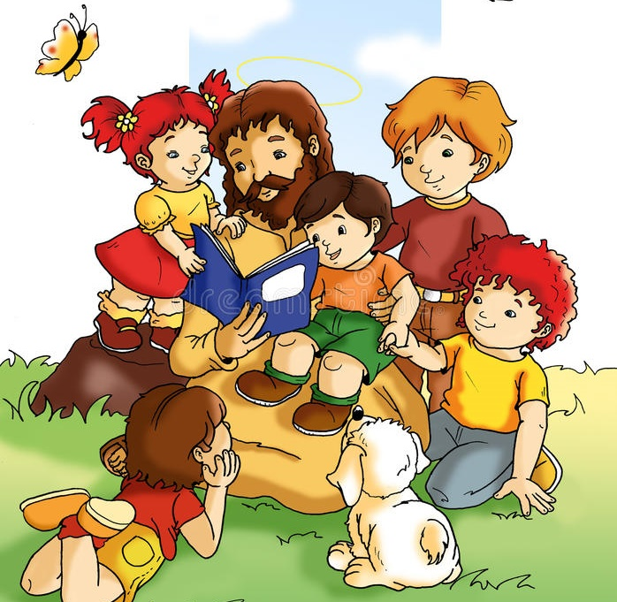
Ministry Friends of Jesus and Mary
XVIII Sunday in Ordinary Time
Cycle B – Mark 10: 17-27
“The Rich Man Speaks with Jesus.”
www.fcpeace.org

Slide 2
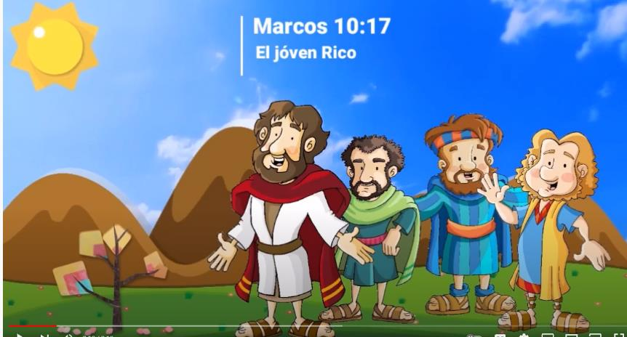
A rich man speaks to Jesus.
As Jesus was setting out on a journey,

Slide 3
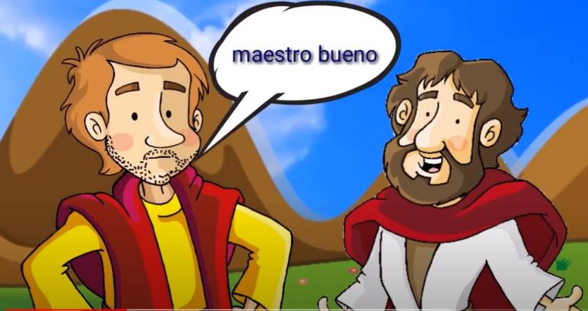
…a man ran up, knelt down before him, and asked him,
Good Teacher
Good teacher
What must I do to inherit eternal life?

Slide 4
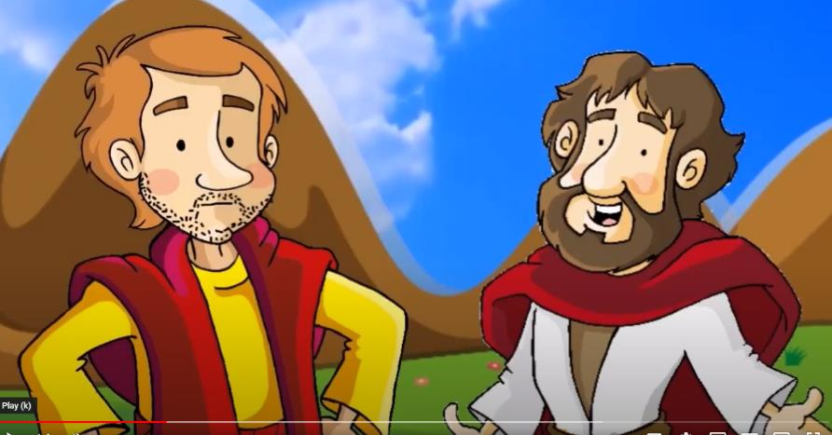
Jesus answered him,
Why do you call me good? No one is good but God alone.

Slide 5
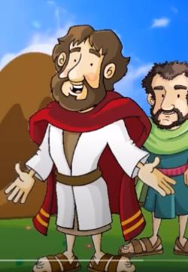
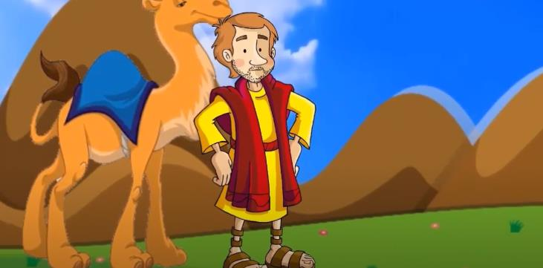
You know the commandments:
You shall not kill;
You shall not commit adultery;
You shall not steal;
You shall not bear false witness;
You shall not defraud;
Honor your father and your mother."
He replied and said to him, "Teacher, all of these I have observed from my youth."

Slide 6
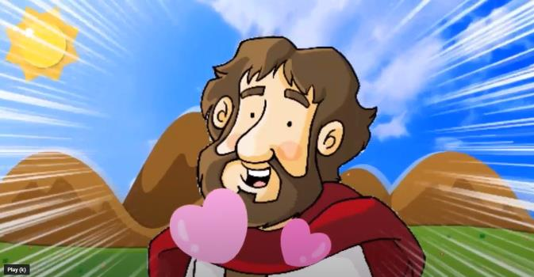
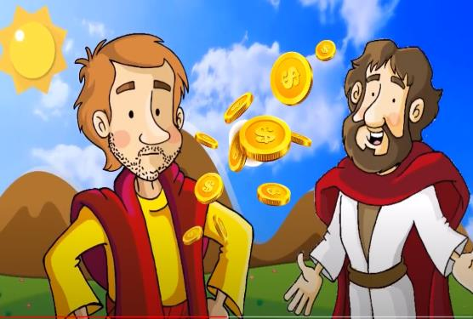
Jesus, looking at him, loved him and said to him,
You are lacking in one thing. Go, sell what you have, and give to the poor and you will have treasure in heaven; then come, follow me.

Slide 7
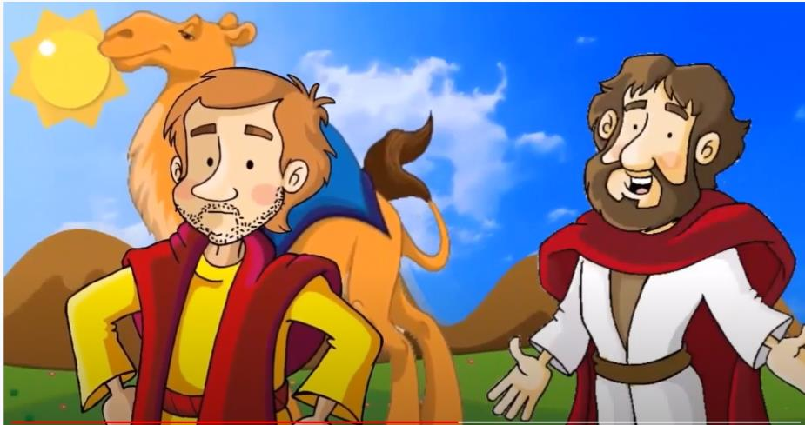
At that statement his face fell, and he went away sad, for he had many possessions.

Slide 8
Jesus looked around and said to his disciples,
How hard it is for those who have wealth to enter the kingdom of God!

Slide 9
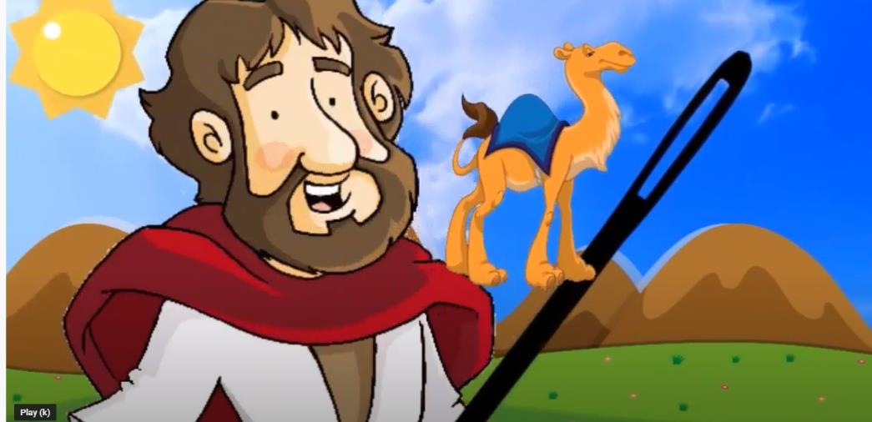
The disciples were amazed at his words. So Jesus again said to them in reply,
"Children, how hard it is to enter the kingdom of God! It is easier for a camel to pass through the eye of a needle than for one who is rich to enter the kingdom of God. "

Slide 10
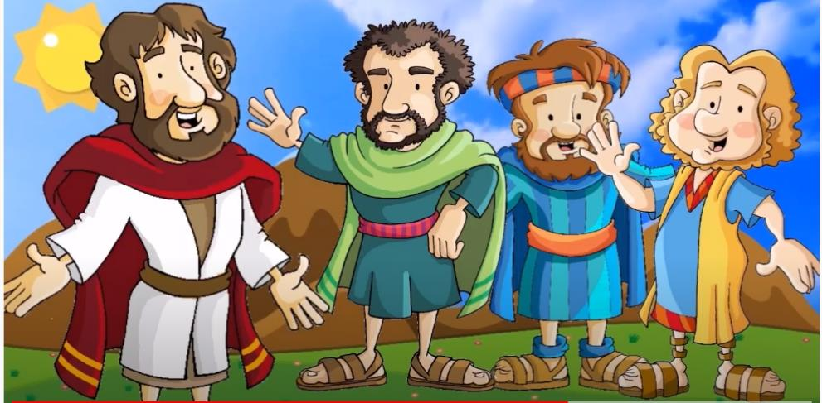
They were exceedingly astonished and said among themselves, "Then who can be saved?" Jesus looked at them and said,
The Gospel of the Lord,
Praise to you, Lord Jesus Christ.
"For human beings it is impossible, but not for God.
All things are possible for God."

Slide 11
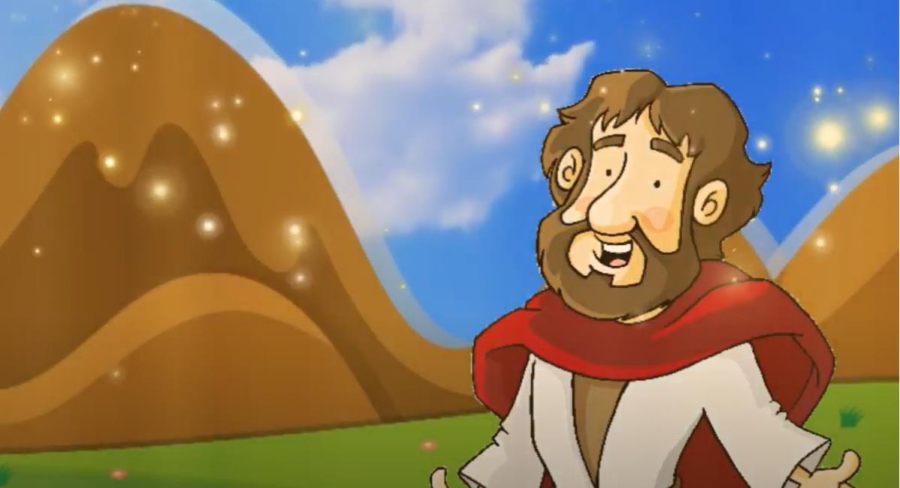
REFLECTION

Slide 12
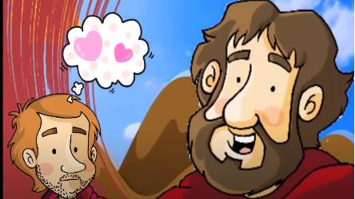
A man kneels before Jesus and asks Him an important question. What did he ask?
Good teacher, what must I do to inherit eternal life?
Good Teacher
What does Jesus answer?
First, He tests him asking, “Why do you call me good? No one is good but God alone.”
Did the man know that Jesus was God?
No, he called Him teacher.

Slide 13
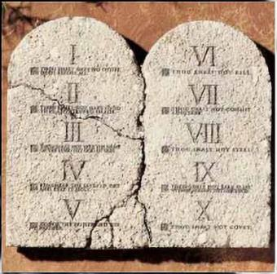
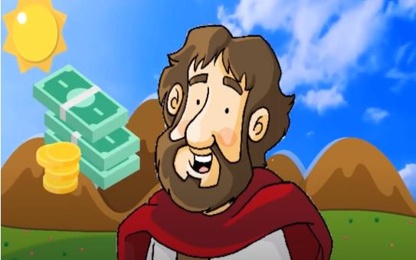
Then Jesus tells him to follow the commandments.
What does the man say?
He had followed them since he was young.
Then Jesus asks him for more.
What was that?
Go, sell what you have, and give to the poor and you will have treasure in heaven; then come, follow me.

Slide 14
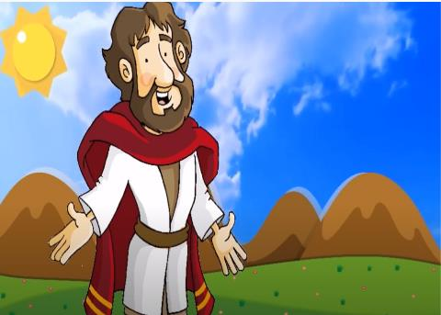
What did the man do?
He went away sad, for he had many possessions he didn’t want to sell.
Jesus said that it is difficult for a rich man to get to Heaven; however, all is possible with God.
With God’s help,
we can trust God.

Slide 15
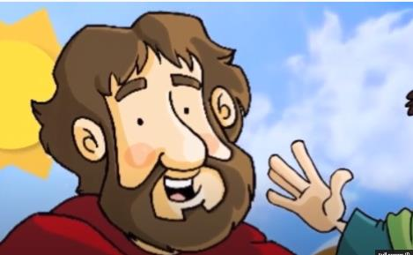
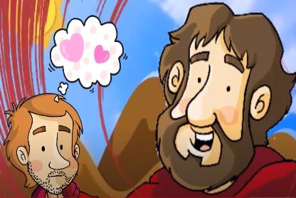
Jesus does not want us to trust in riches. Why?
Wealth does not give us true happiness nor eternal life.
What gives us true happiness and eternal life?
Only God fills our heart with true happiness. He asks us to trust completely in His love for us so we may share eternal happiness with Him.

Slide 16
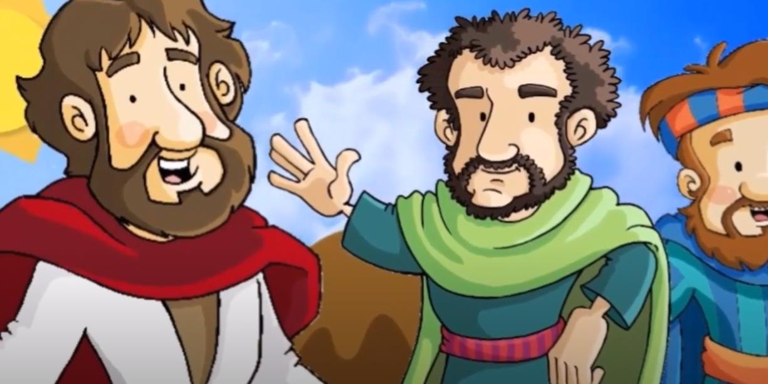
ACTIVITIES

Slide 17
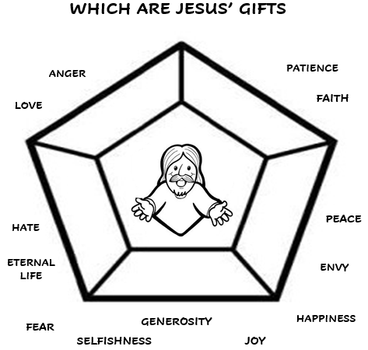
FAITH
PATIENCE
LOVE
PEACE
ETERNAL
LIFE
JOY
HAPPINESS
GENEROSITY

Slide 18
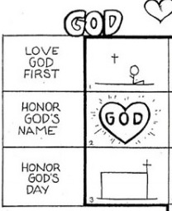
The 10 Commandments-Part 1
Love God
Fold a piece of paper in half (top and bottom). Draw a large heart on the top half and another on the bottom half. Write the first 3 commandments and draw their symbols.

Slide 19
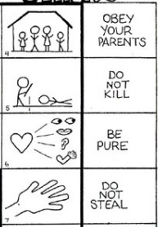
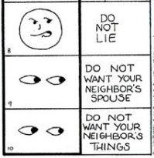
The 10 Commandments-Part 2
Love Others
Write the last 7 commandments and draw their symbols.
Game: organize 2 teams. Draw a symbol on the board and each team takes turns guessing which commandment it represents. The team with most points wins.

Slide 20
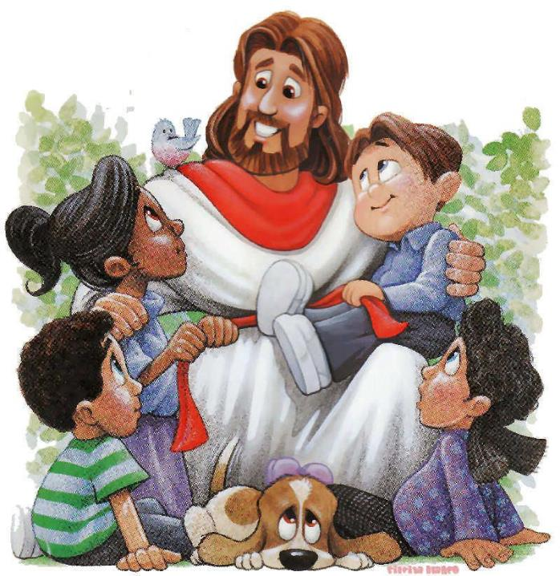
PRAYER
Lord, help me to trust completely in you. Teach me to share what I have and am. Help me to understand that generosity opens my heart to your love and many gifts. Amen.

Slide 21
Songs: I’ve got the joy, joy… Apple Crisol https://youtu.be/LylgwOEI7AY (2-7 yrs.)

Slide 22
Songs: I’ve got joy, Parent Cue https://youtu.be/6OMHBK1qSTs (8+ yrs.)

