Slide 1
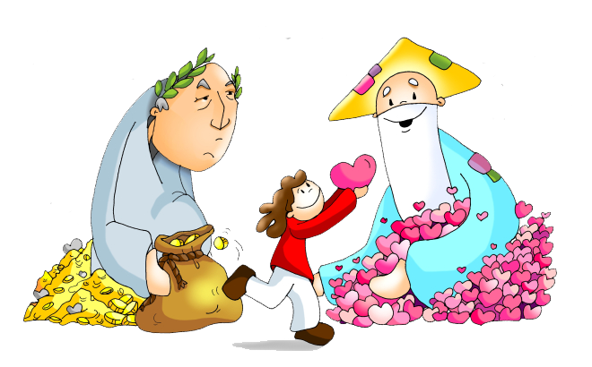
Friends of Jesus and Mary www.fcpeace.org
Cycle C - XXV Sunday in Ordinary Time
You Cannot Serve God and Money
Luke 16, 10-13

Slide 2
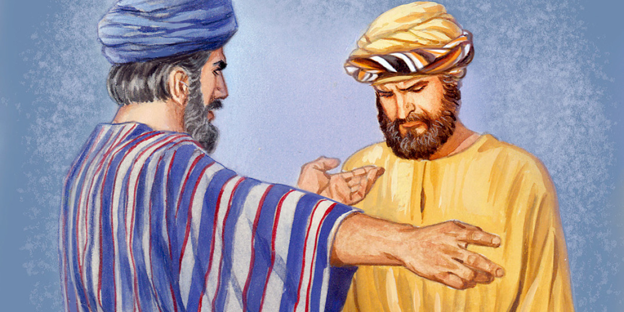
You Cannot Serve God and Money
Luke 16, 10-13
Jesus said to his disciples, "A rich man had a steward who was reported to him for squandering his property. He summoned him and said, 'What is this I hear about you? Prepare a full account of your stewardship, because you can no longer be my steward.'

Slide 3
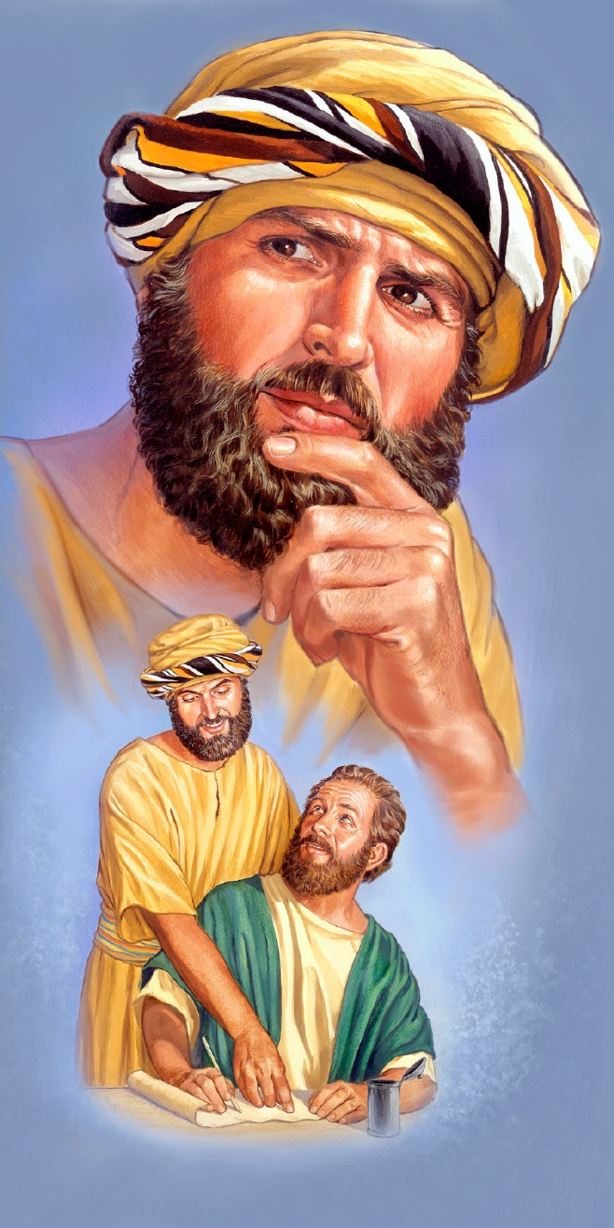
The steward said to himself, 'What shall I do, now that my master is taking the position of steward away from me? I am not strong enough to dig and I am ashamed to beg. I know what I shall do so that, when I am removed from the stewardship, they may welcome me into their homes.'

Slide 4


He called in his master's debtors one by one. To the first he said, 'How much do you owe my master?' He replied, 'One hundred measures of olive oil.' He said to him, 'Here is your promissory note. Sit down and quickly write one for fifty.'

Slide 5
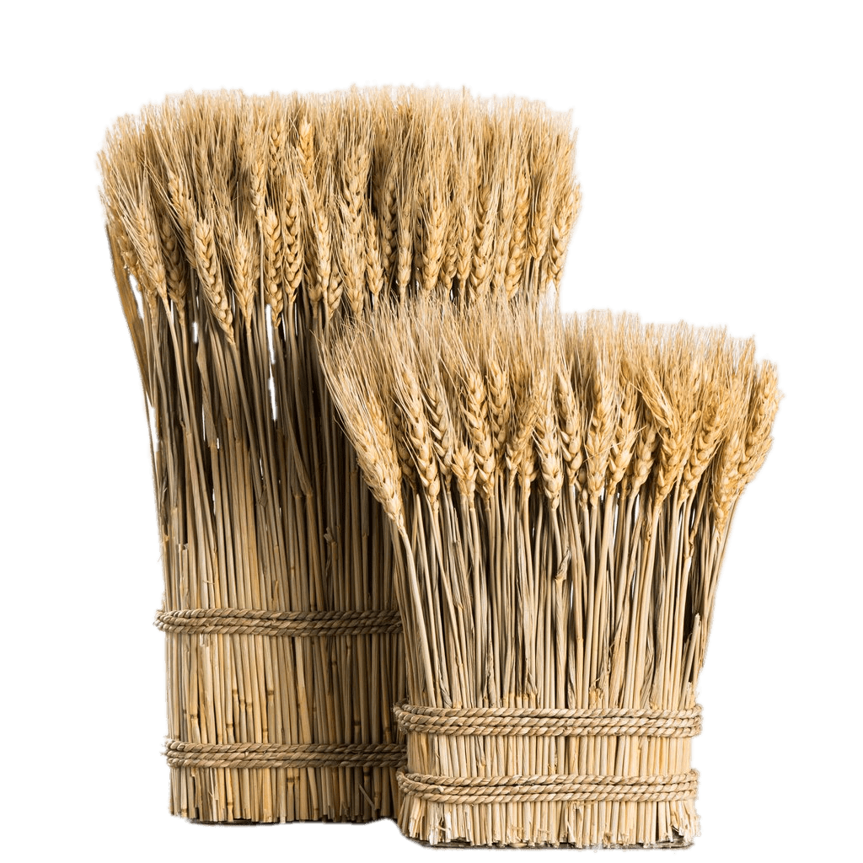
Then to another the steward said,
'And you, how much do you owe?'
He replied, 'One hundred kors of wheat.'
The steward said to him, 'Here is your promissory note; write one for eighty.’
And the master commended that dishonest steward for acting prudently.
"For the children of this world are more prudent in dealing with their own generation than are the children of light.

Slide 6
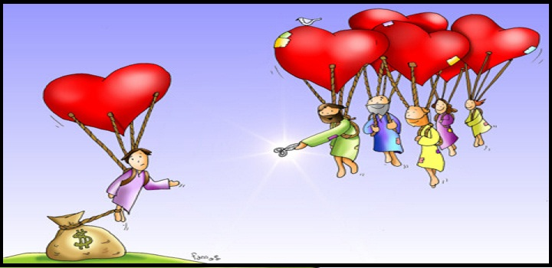
I tell you, make friends for yourselves with dishonest wealth, so that when it fails, you will be welcomed into eternal dwellings. The person who is trustworthy in very small matters is also trustworthy in great ones; and the person who is dishonest in very small matters is also dishonest in great ones.

Slide 7
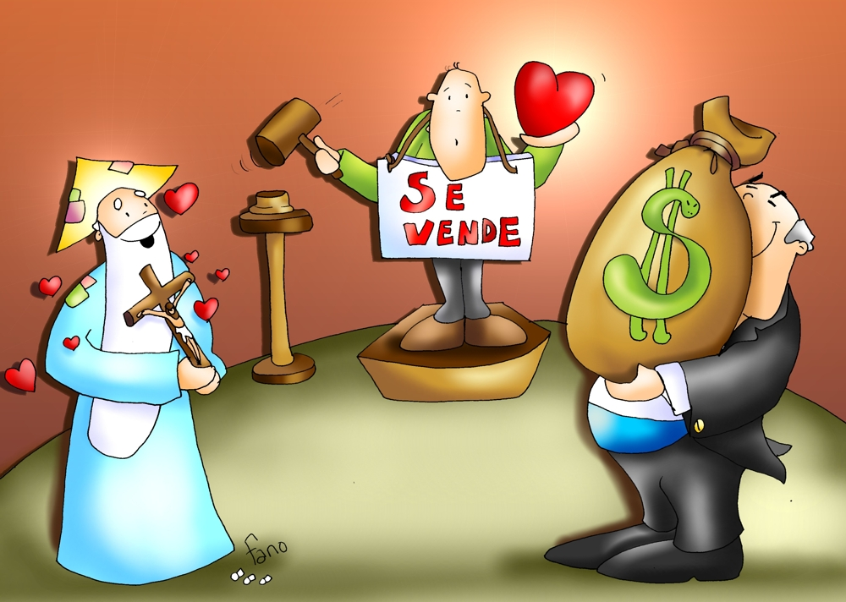
If, therefore, you are not trustworthy with dishonest wealth, who will trust you with true wealth? If you are not trustworthy with what belongs to another, who will give you what is yours? No servant can serve two masters.
He will either hate one and love the other, or be devoted to one and despise the other. You cannot serve both God and mammon.”
For Sale
The Gospel of the Lord, Praise to You Lord Jesus Christ.

Slide 8
REFLECTION

Slide 9

Jesus tells a parable about someone who uses money to make friends.
What did he do?
Share

Slide 10
Jesus said: “The person who is trustworthy in very small matters is also trustworthy in great ones.”
What responsibilities do you have in your home or in school?

Slide 11

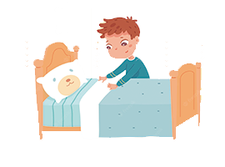

Make your bed, brush your teeth, do your homework…

Slide 12
If you fulfill these responsibilities,
what happens?

Slide 13
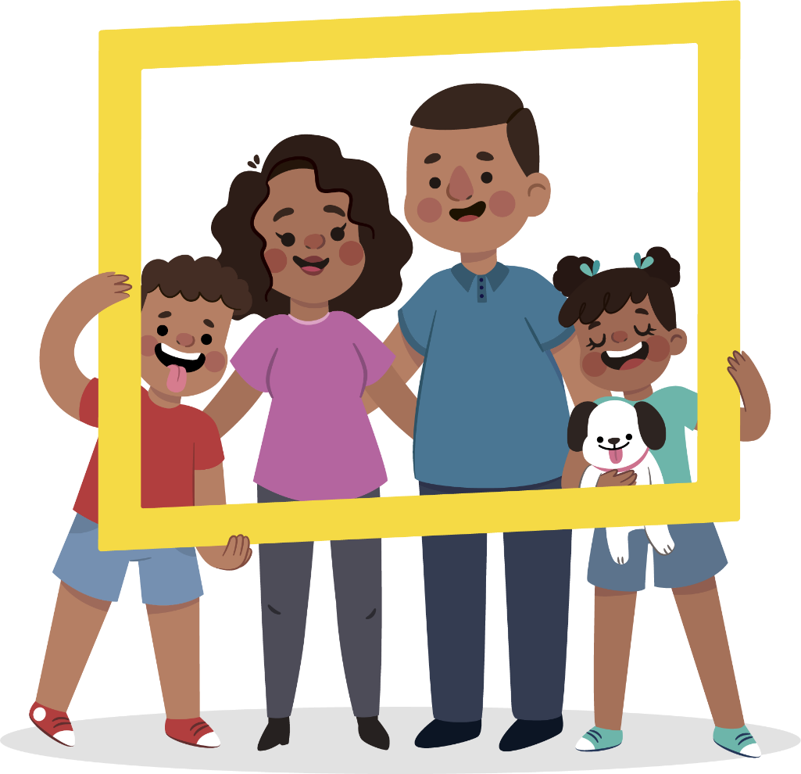
Parents and teachers are happy and may give you more responsibilities.

Slide 14
What happens if you don’t do them?

Slide 15

Parents become sad and angry and will not trust you with more.

Slide 16
Jesus says that if, someone is not trustworthy with dishonest wealth, they cannot be trusted with true wealth.
What is the true wealth God wants to give us?

Slide 17

His Holy Spirit with all His gifts and fruits, for us to share with others and the Church, thus giving glory to God.

Slide 18
Jesus says: make friends for yourselves with dishonest wealth, so that when it fails, you will be welcomed into eternal dwellings.
What did He mean?

Slide 19
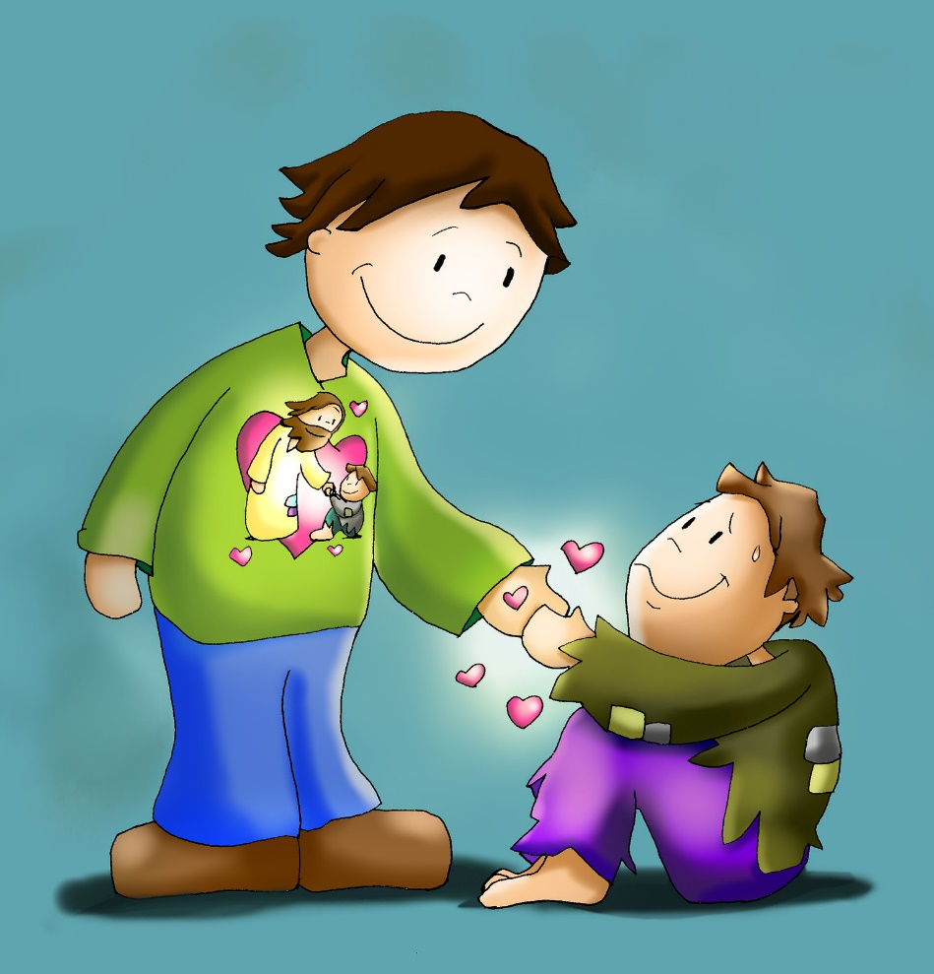
Helping the needy, the Church, the family with money, action, or prayers will gain us friends in Heaven.

Slide 20
If we don’t love God and we love money instead, what happens?

Slide 21
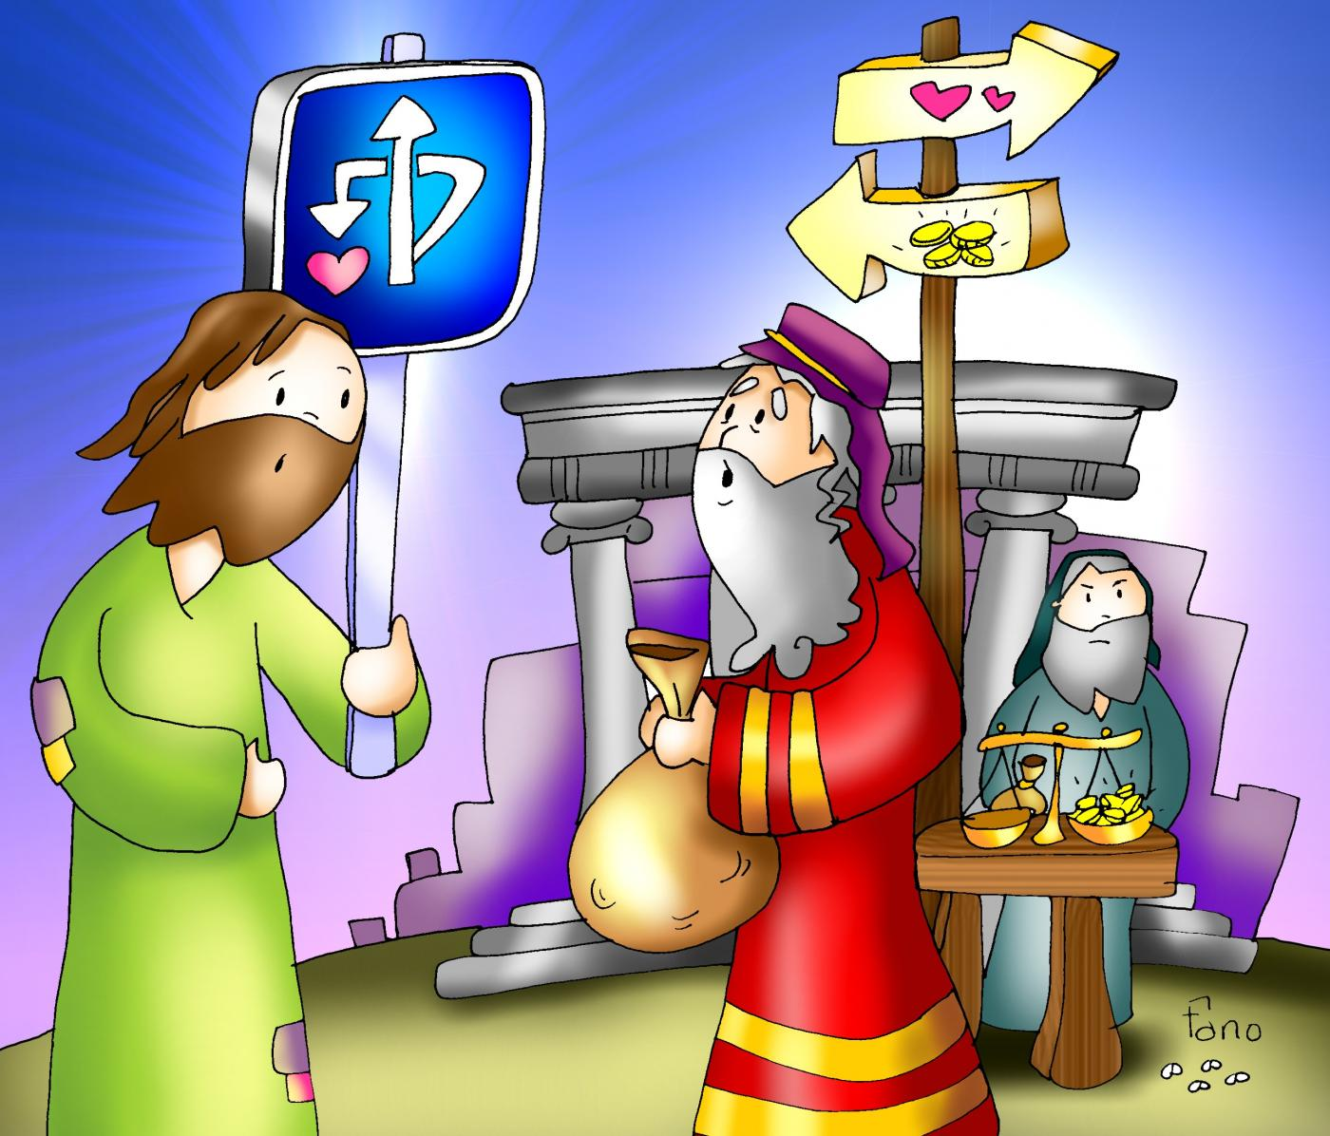
We become selfish and full of avarice and we may do anything to get richer: steal, lie…

Slide 22
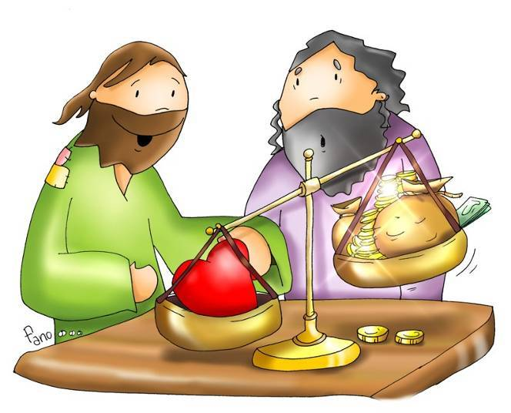
Does money help us get to Heaven? Does the Holy Spirit help us get to Heaven?

Slide 23
ACTIVITIES

Slide 24
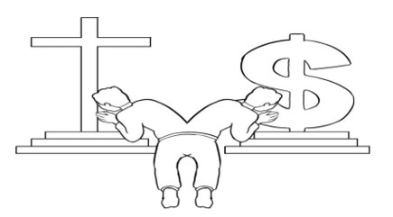
Color

Slide 25
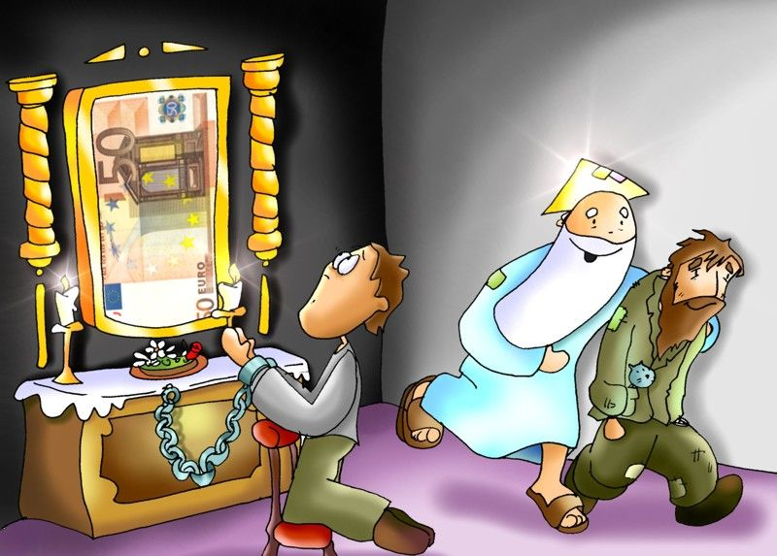
You Cannot Serve God and Mammon (Money)
Luke 16, 10-13
Jesus said to his disciples:
"The person who is trustworthy in very _______ matters
is also trustworthy in ______ ones;
and the person who is __________ in very small matters
is also dishonest in great ones.
If, therefore, you are not trustworthy with dishonest wealth,
who will trust you with ______ wealth?
If you are not trustworthy with what belongs to another,
who will give you what is yours?
No servant can ______ two masters.
He will either ______ one and love the other,
or be devoted to one and despise the other.
You cannot serve both _____ and mammon."
small
great
dishonest
true
serve
hate
God

Slide 26
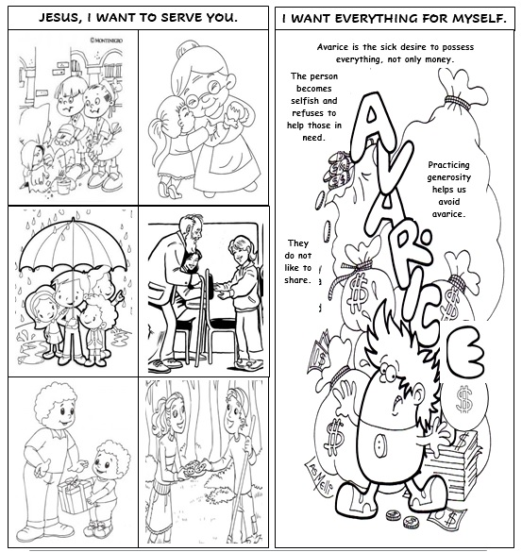
Cut, color, and glue the pictures of persons serving others to one side of ½ a construction paper. Cut, color, and glue the description of avarice on the other side.

Slide 27
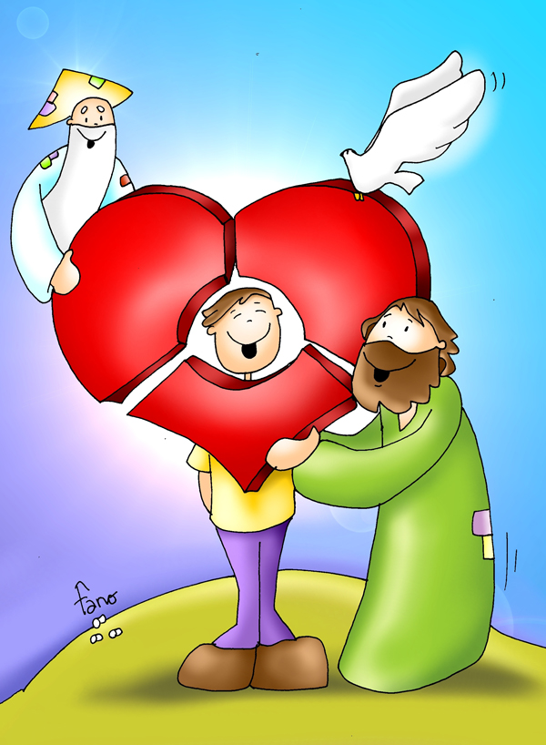
PRAYER
My God, send your Holy Spirit into my heart and fill it with love. Help me to see the needs of my neighbor and give me the generosity to share my gifts. Thank you for your love and forgiveness.
Amen

Slide 28

This Little Light of Mine, Listener Kids, https://youtu.be/cKkbIZtqhyQ (3-7 years)

Slide 29

Generosity, Jerome Collins, https://youtu.be/nF3yJg45NZY (8+ yrs.)

