Slide 1
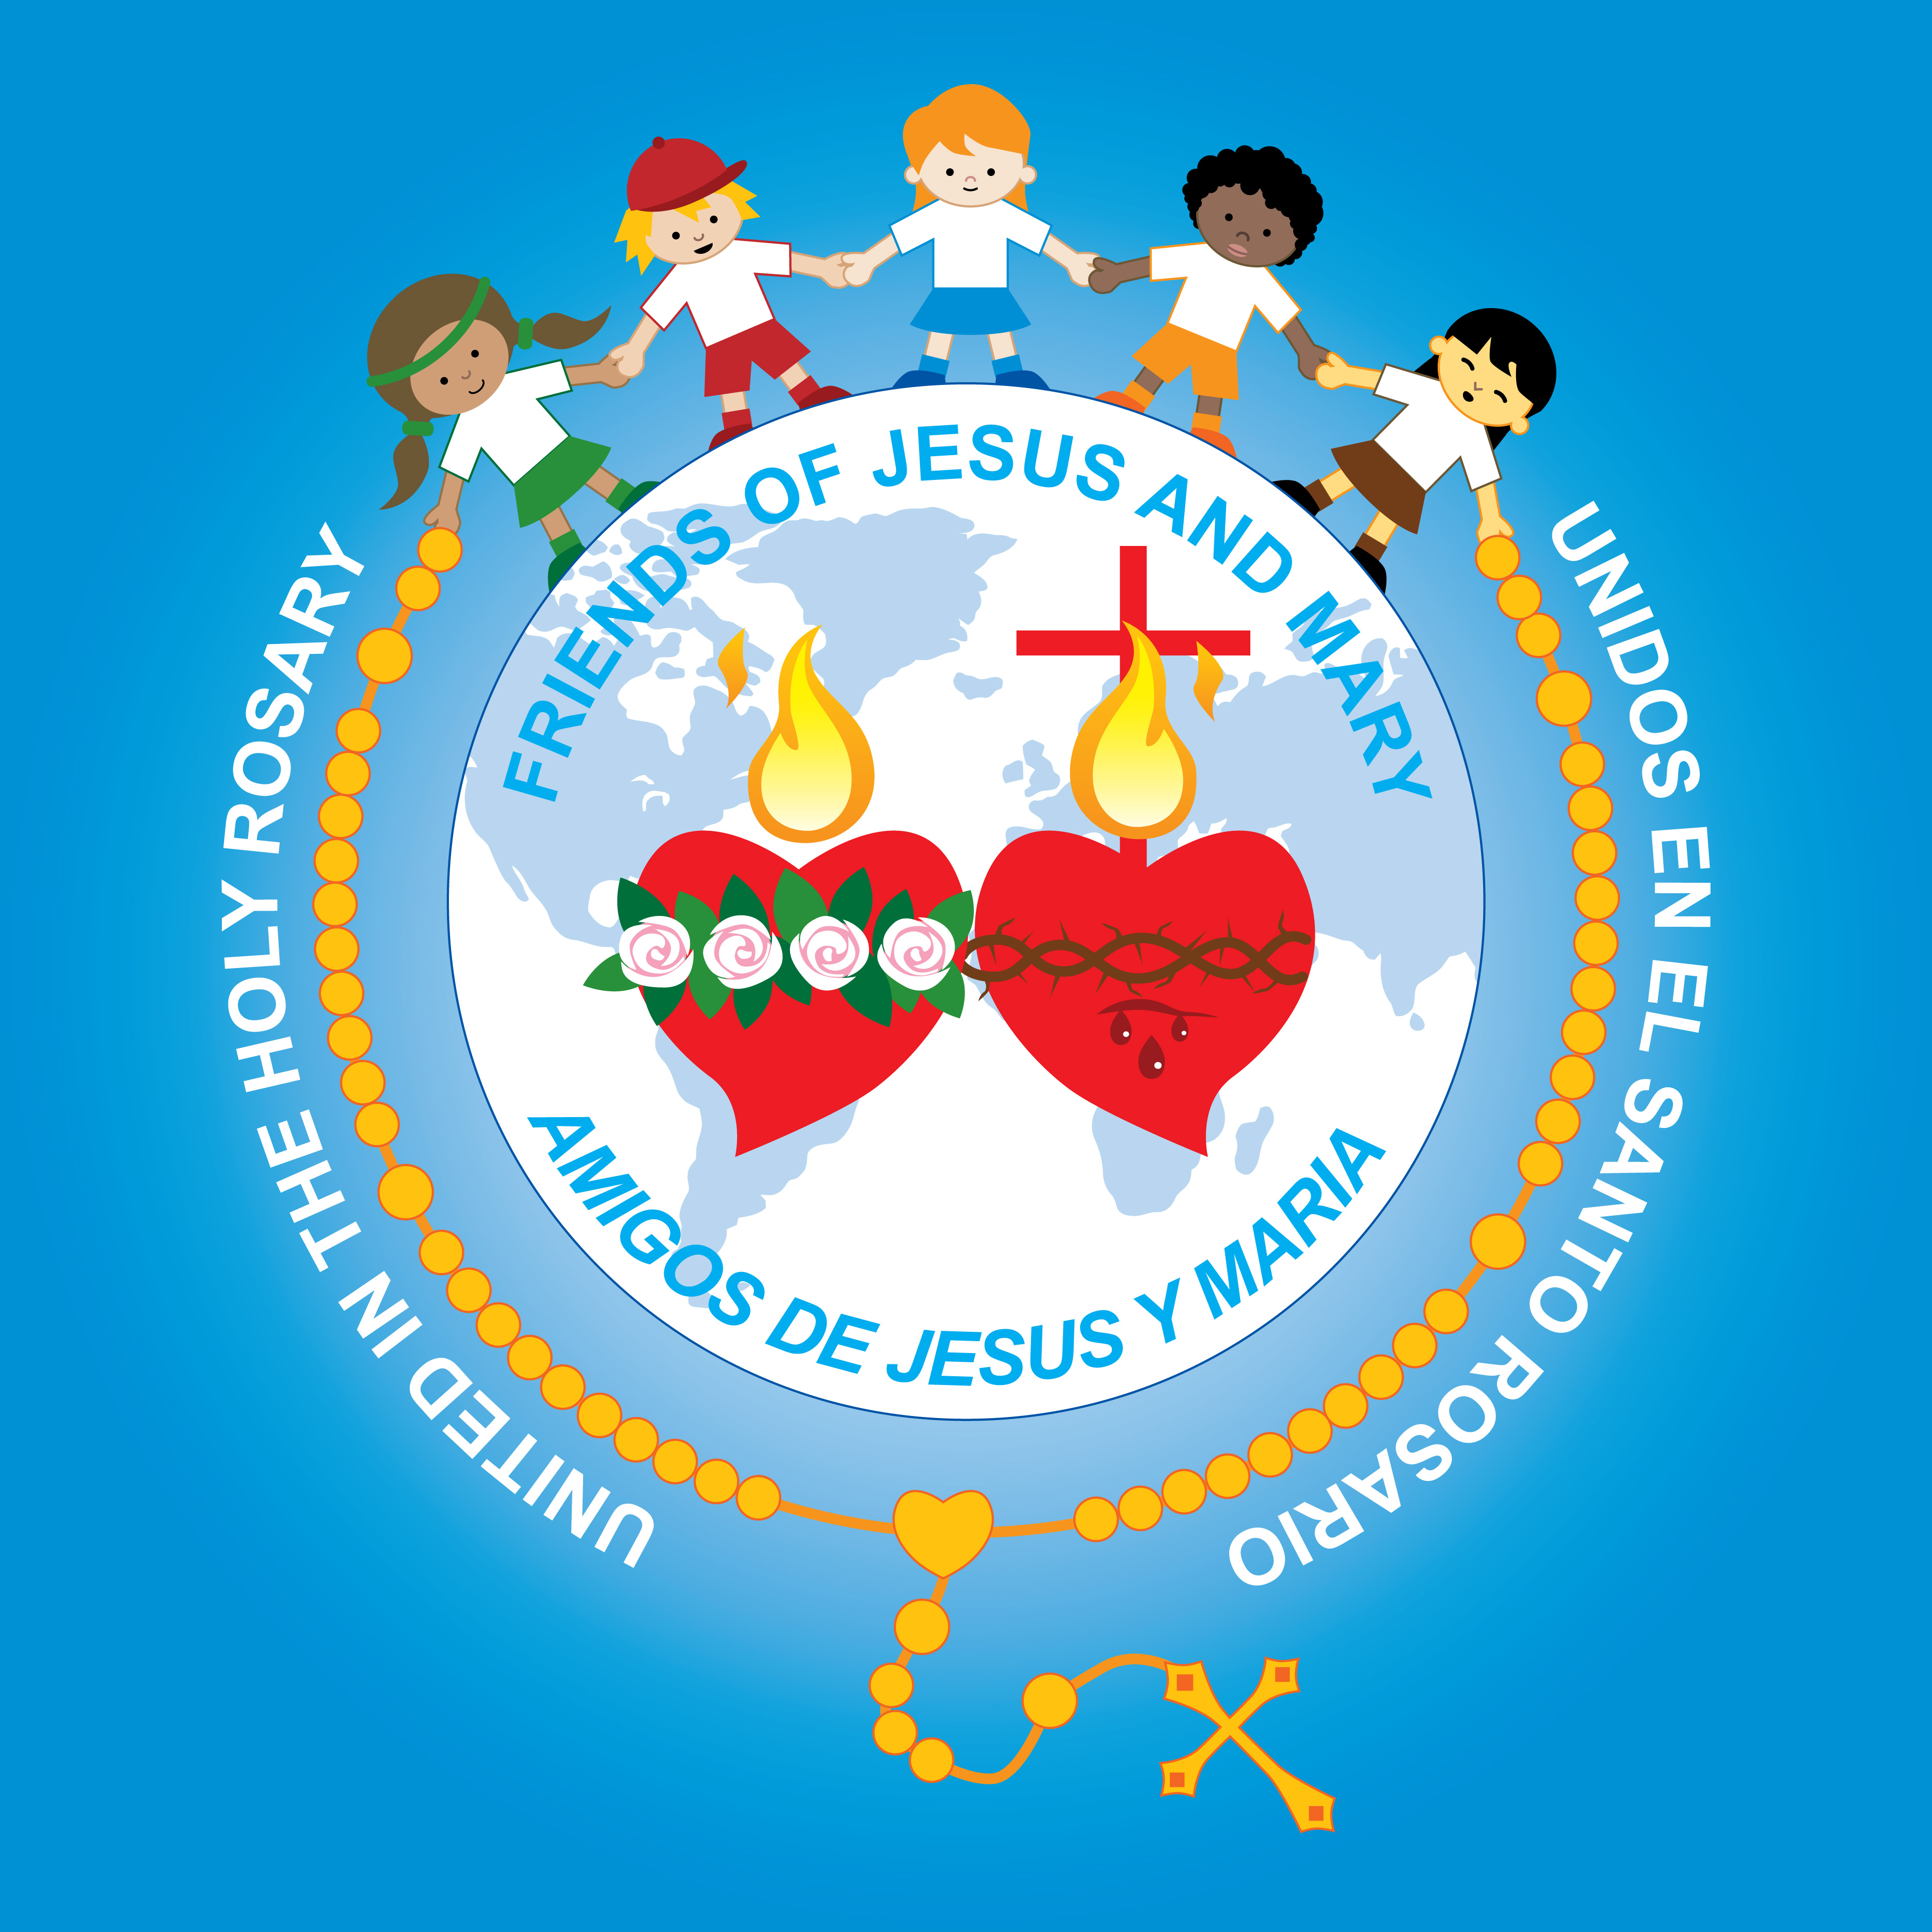
Ministry Friends of Jesus and Mary
Cycle C - IV Sunday in Ordinary Time
Luke 2, 22-32
The Presentation of Jesus in the Temple
www.fcpeace.org

Slide 2
The Presentation in the Temple- Luke 2, 22-32

Slide 3
Reflection

Slide 4
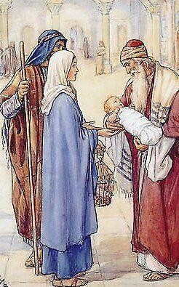
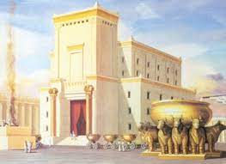
Why did Joseph and Mary go to the temple in Jerusalem?
To present Jesus and consecrate Him to God and to offer up two turtle doves as required by the law of Moses.
The law asked that all first-born sons be consecrated to God. (Ex. 13,1-2) The law also required that a mother who gave birth to a son be purified during 40 days then offer a pair of turtle doves to God as a sacrifice for sin. (Lev. 12, 1-8)

Slide 5
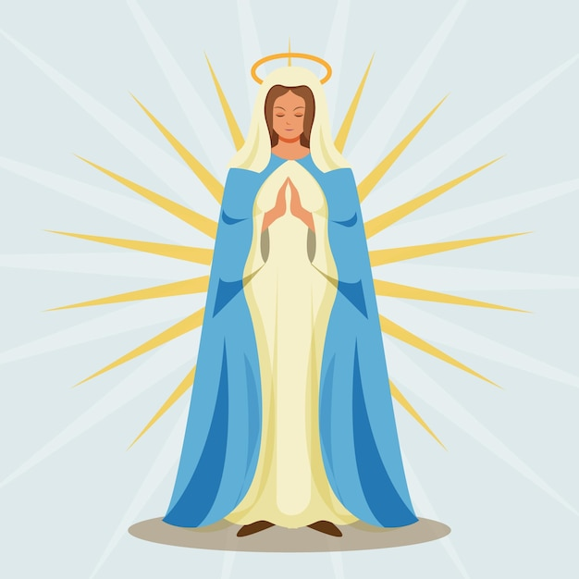
Did the Virgin Mary have any sins?
No, Mary was born without original sin and she never sinned; but she was always obedient to the law of God.

Slide 6
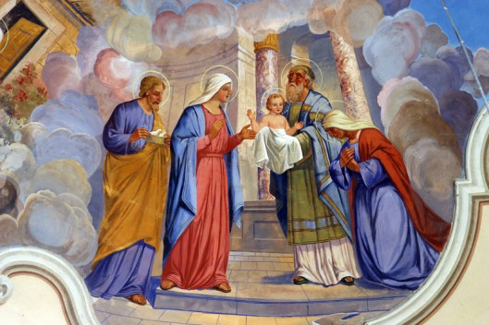
What happened in the temple?
Simeon, a just man, filled with the Holy Spirit and who awaited the coming of the Messiah, recognized Jesus as the Savior of the world with the help of the Holy Spirit. He held Jesus and blessed God.

Slide 7
What does Simeon say about Jesus?
He is God’s salvation;
a light for revelation to the Gentiles;
the Glory of Israel.

Slide 8
From what does Jesus save us?
SIN
Man
Death
GOD
LIFE
Man
Death
GOD
LIFE
…From sin that separates us from God, thus reuniting us with Him.

Slide 9
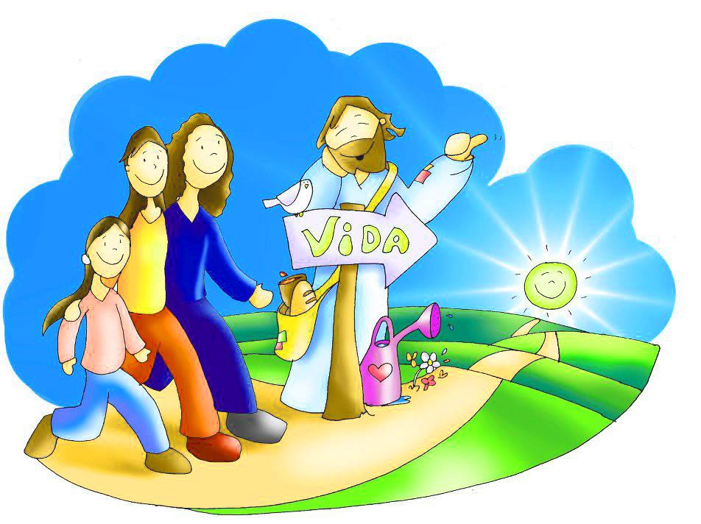
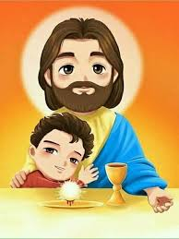
How is Jesus a light?
With His words and His life, Jesus lights the path to eternity showing us how to love God and our neighbor.
His presence in the Eucharist unites us to God and fills us with the Holy Spirit and the warmth of His love.

Slide 10
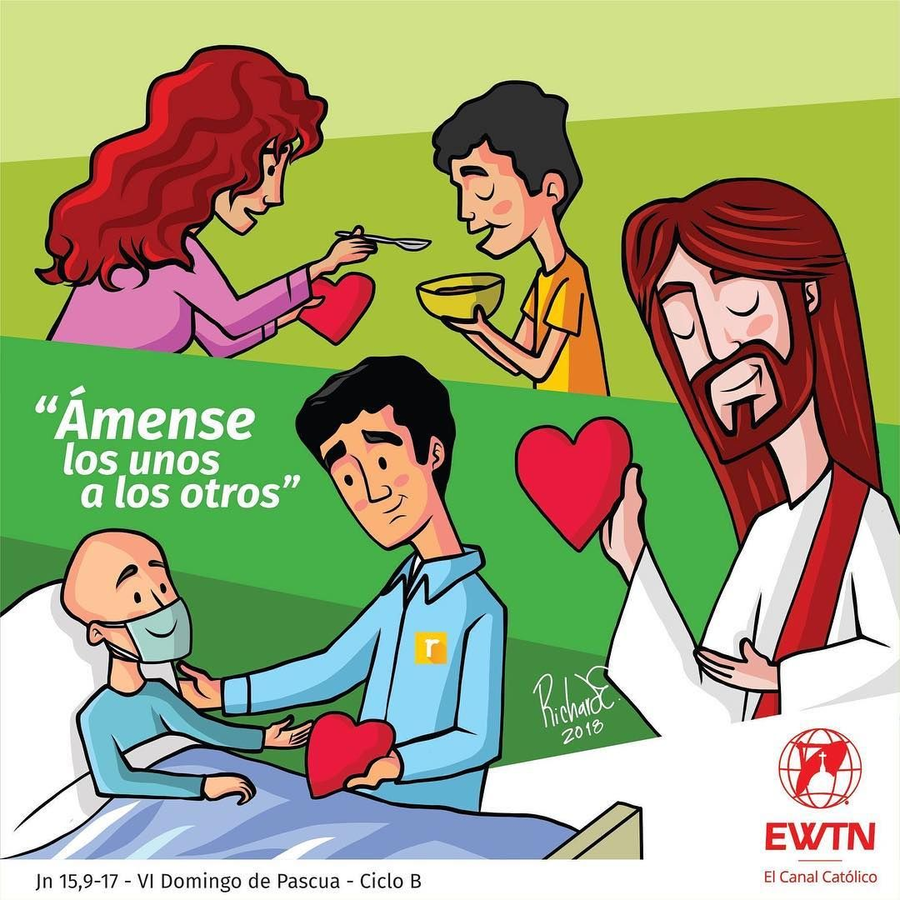
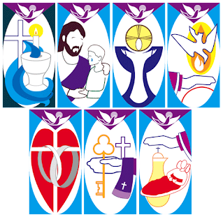
How can we take that light to everyone in our life?
A HUMBLE CHILD IS…
OBEDIENT
LOVE ONE ANOTHER
ACCEPTS HELP
HELPS OTHERS
SEES HIS ERRORS
FORGIVES
Love and serve others.
Participate in the Sacraments.
Be humble and obedient.

Slide 11
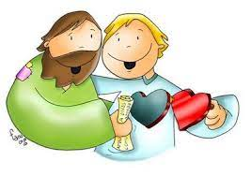
Obey His Commandments.
Love God,
Listen to Him in prayer and in the bible,

Slide 12
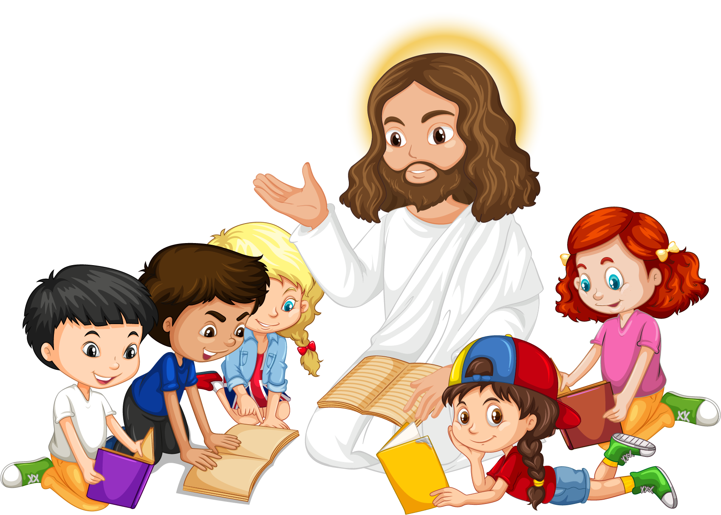
Activity

Slide 13
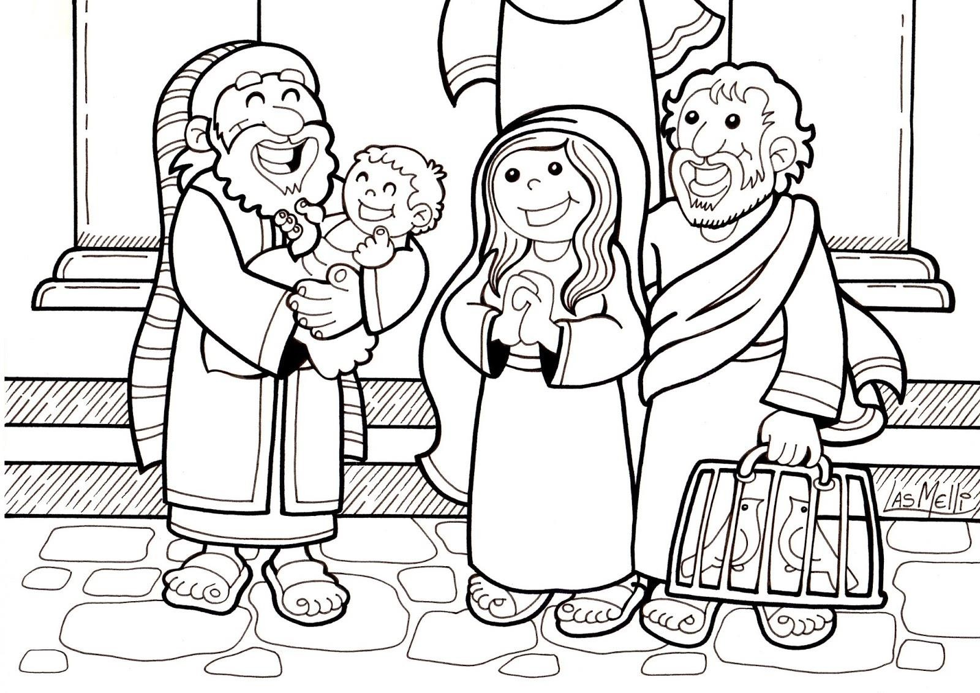
La Presentación de Jesús en el Templo
COLOR

Slide 14
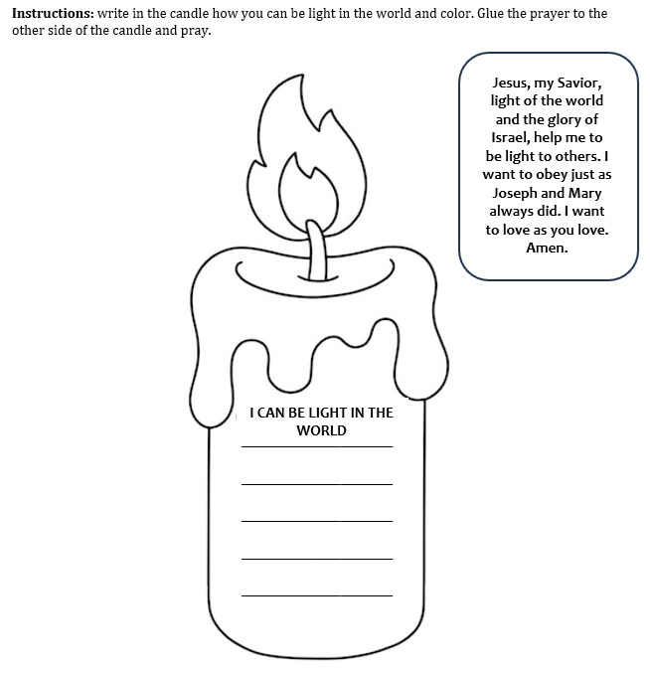
COLOR

Slide 15
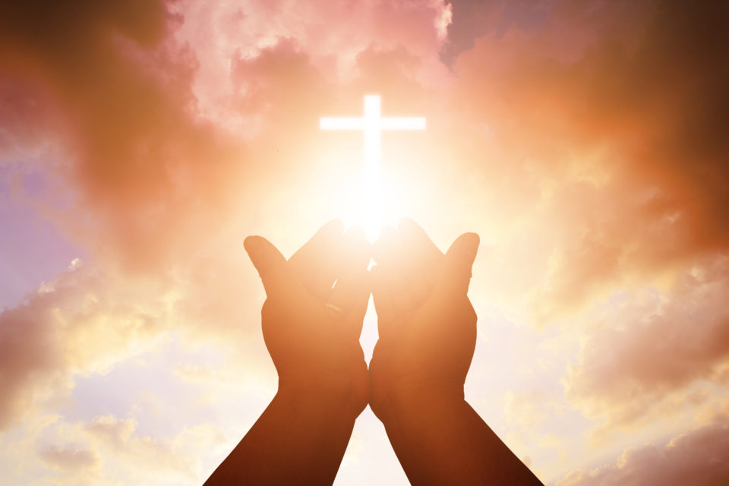
Prayer
Prayer
Jesus, my Savior, light of the world and the glory of Israel, help me to be light to others. I want to obey just as Joseph and Mary always did. I want to love as you love. Amen.

Slide 16
Song: This Little Light of Mine, https://youtu.be/cKkbIZtqhyQ?si=c1o8TaZxiPw7kCTO

