Slide 1
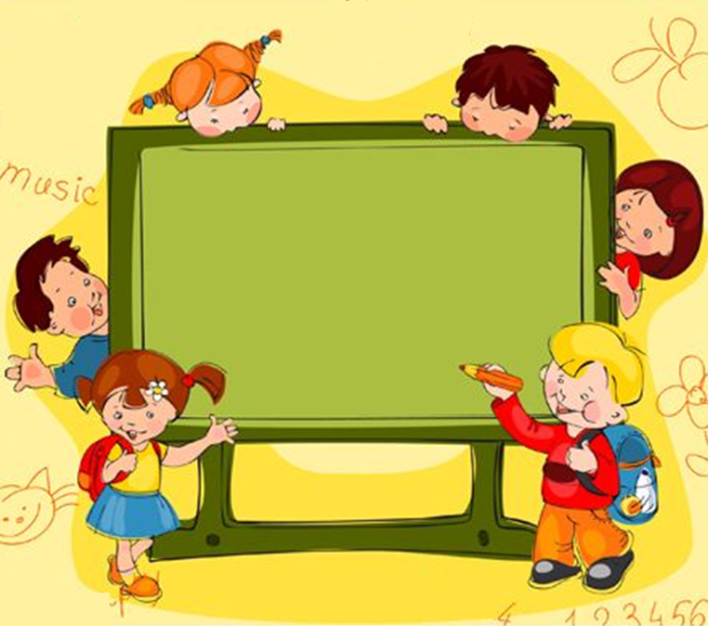
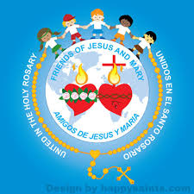
Friends of Jesus and Mary
Cycle C-XXIV Sunday of Orinary Time
Jesus must be lifted up
John 3, 13-17
www.fcpeace.org

Slide 2

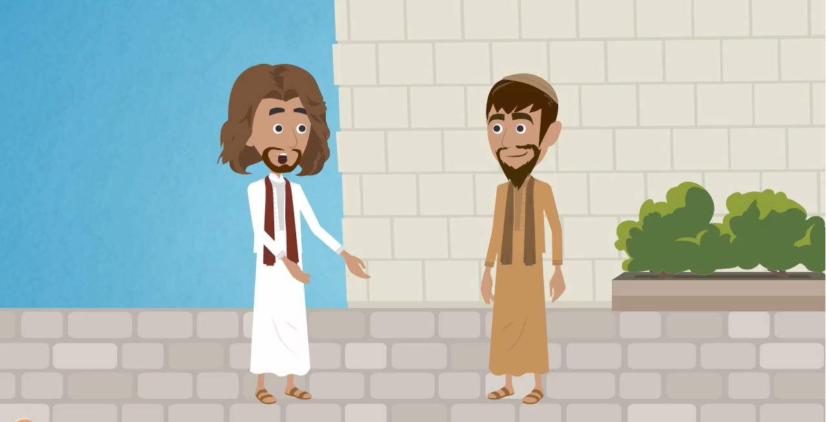
John 3, 13-17
Jesus said to Nicodemus:

Slide 3
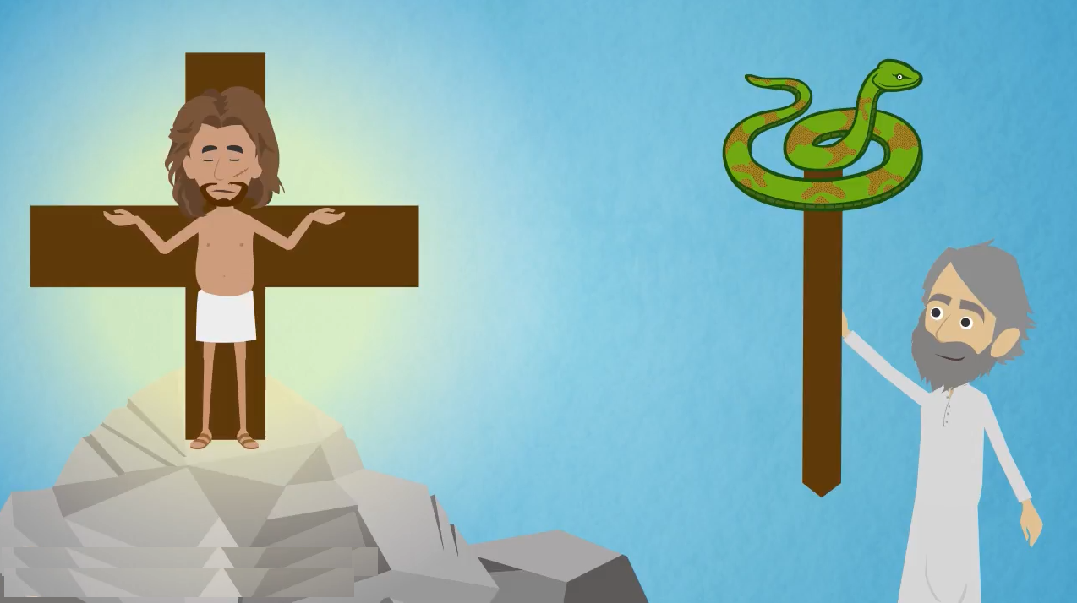
“Just as Moses lifted up the serpent in the desert, so must the Son of Man be lifted up, so that everyone who believes in him may have eternal life.”

Slide 4
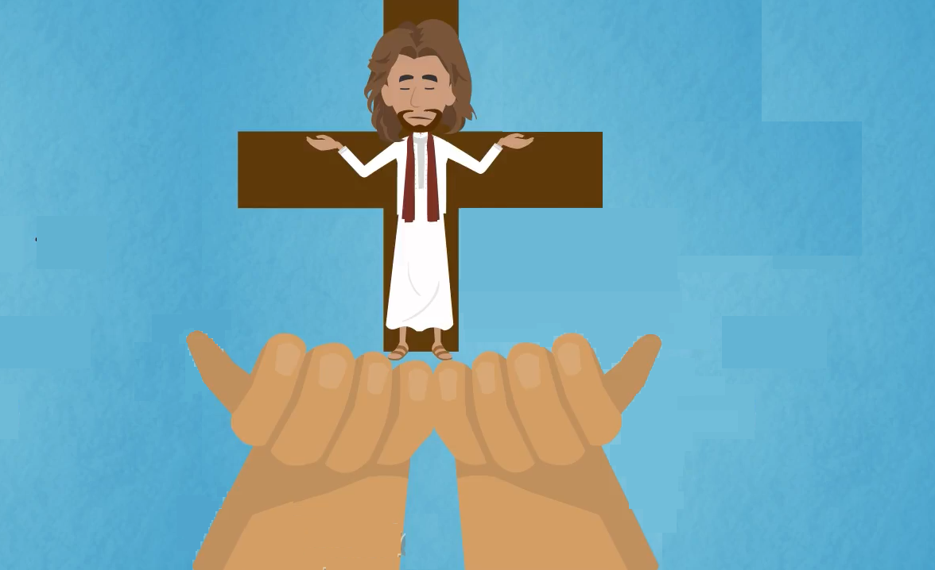
For God so loved the world that he gave his only Son, so that everyone who believes in him might not perish but might have eternal life.

Slide 5
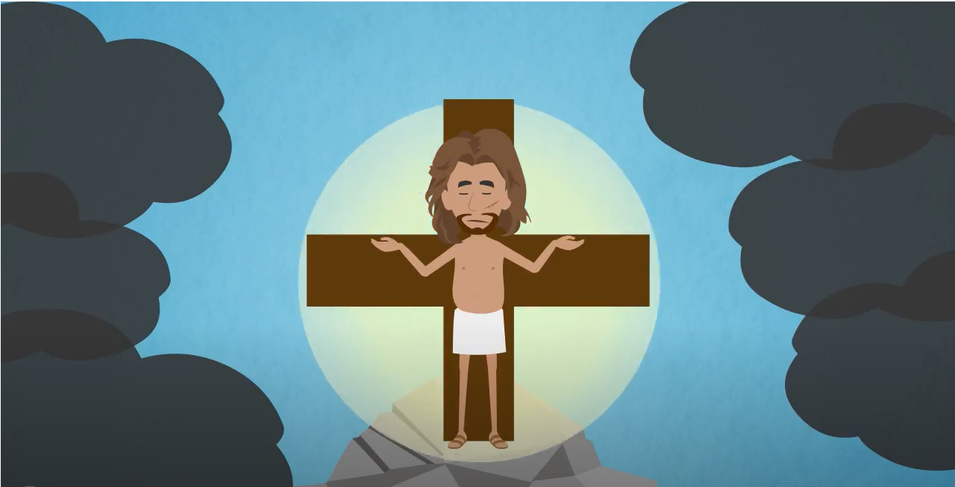
For God did not send his Son into the world to condemn the world, but that the world might be saved through him.

Slide 6
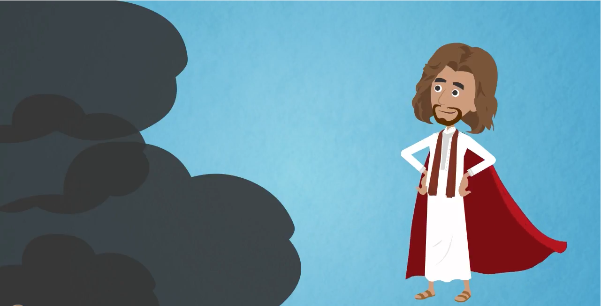
Whoever believes in him will not be condemned, but whoever does not believe has already been condemned, because he has not believed in the name of the only Son of God.
CONDEMNATION
Salvación
Condenación
SALVATION

Slide 7
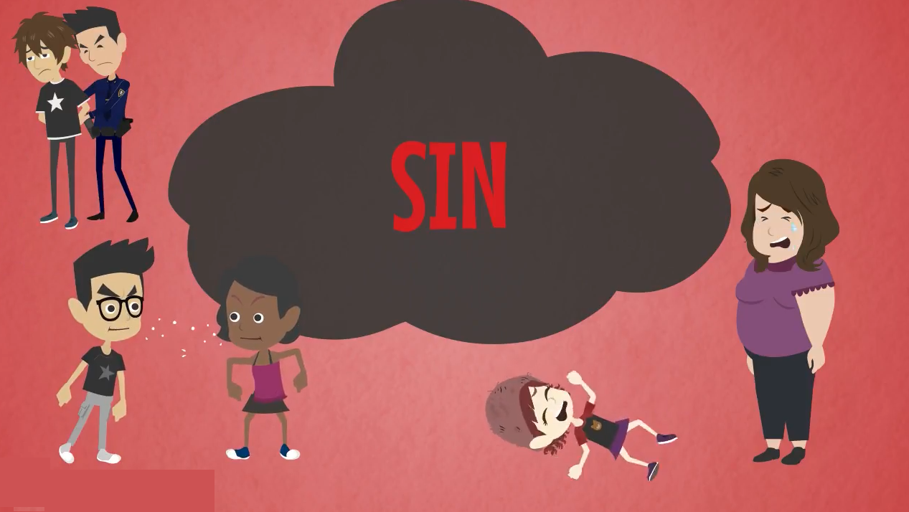
And this is the verdict, that the light came into the world, but people preferred darkness to light, because their works were evil.
SIN

Slide 8
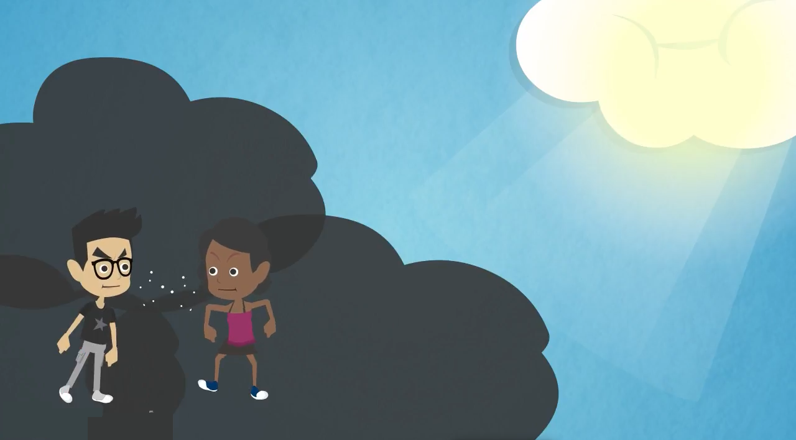
For everyone who does wicked things hates the light and does not come toward the light, so that his works might not be exposed.
FIGHTS
INSULTS

Slide 9
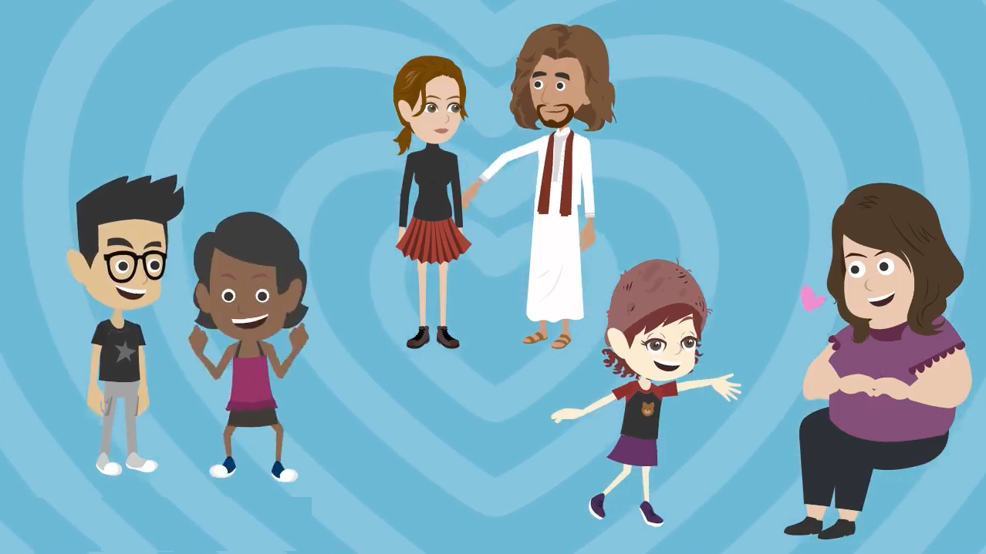
“But whoever lives the truth comes to the light, so that his works may be clearly seen as done in God”.
THE GOSPEL OF THE LORD. PRAISE TO YOU LORD JESUS CHRIST.

Slide 10
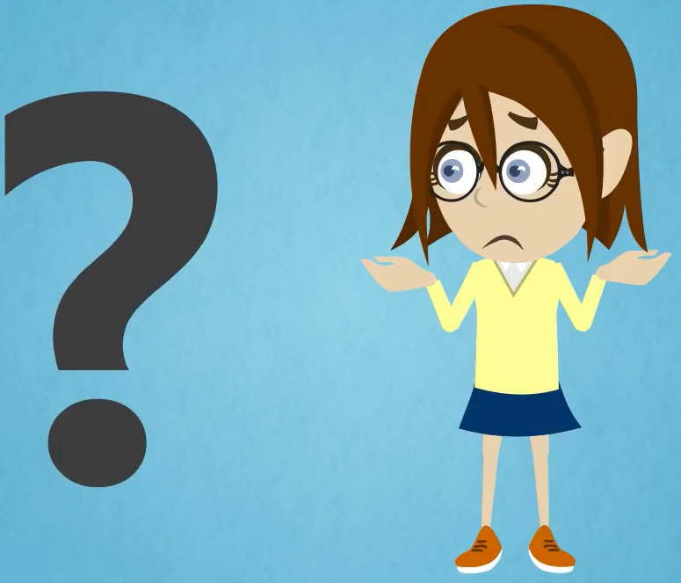
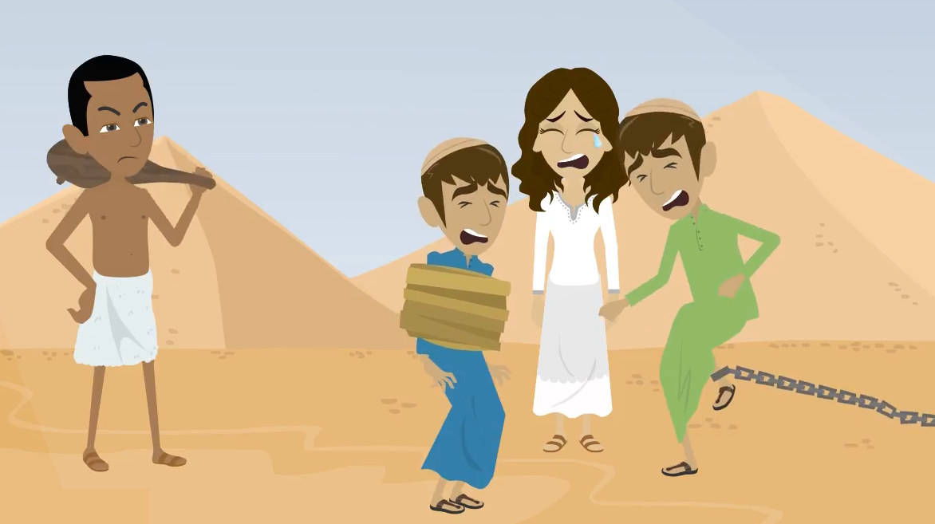
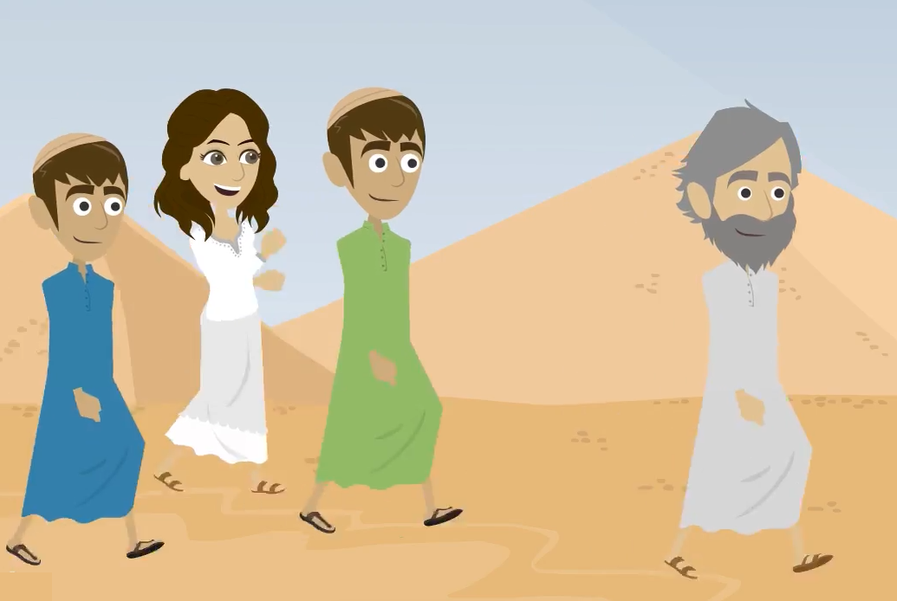
Why does Jesus speak of Moses and the serpent lifted up in the desert?
https://youtu.be/HRQkbADC8hI
The Hebrews lived as slaves in Egypt. God listened to their cries and sent Moses to free them.
Moses guided them to freedom and they were very happy. But to get to the Promised Land, they had to cross a large desert.

Slide 11
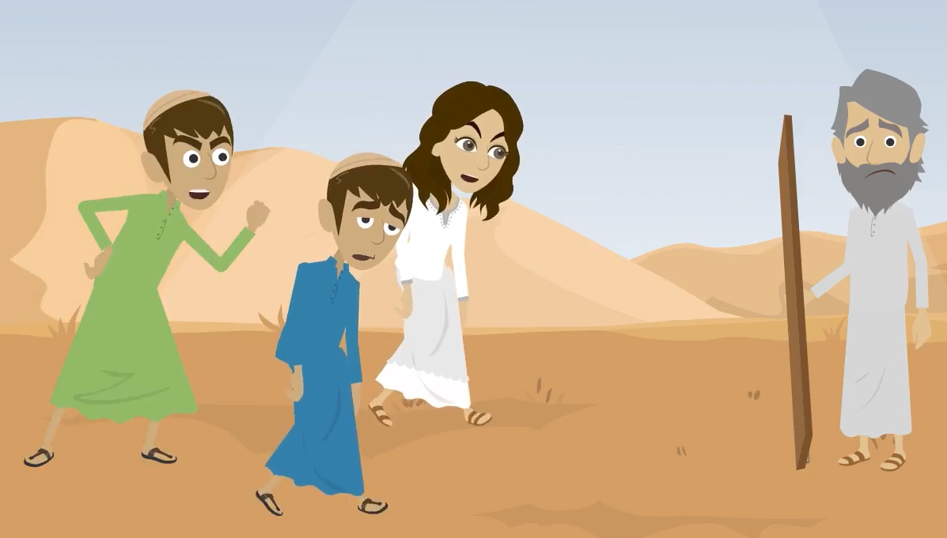
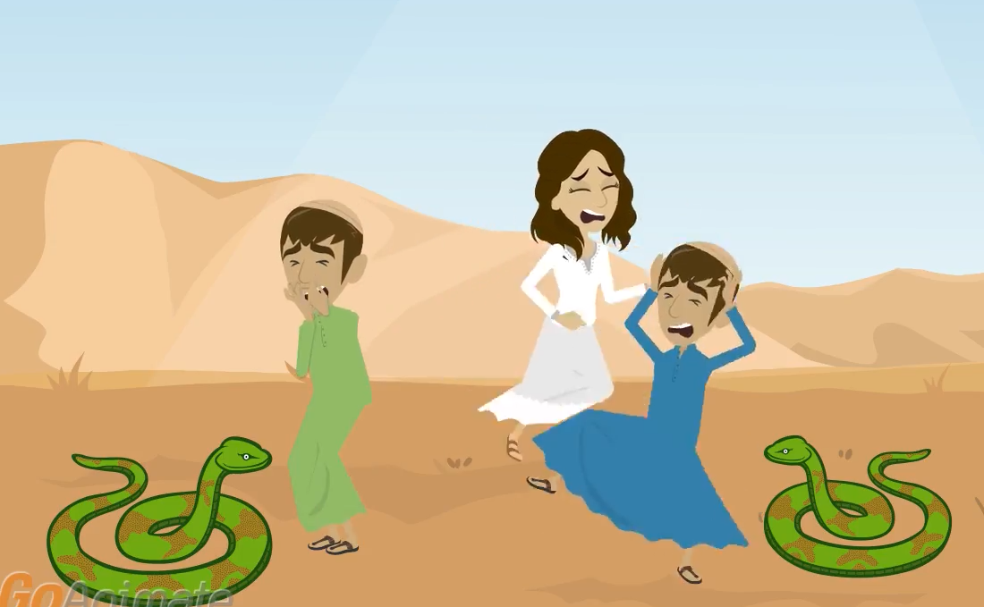
On the way the Hebrew people lost their patience and started to complain to God and to Moses. They were tired of living in the desert.
This sinful attitude angered God so he sent poisonous serpents that bit many causing them to die.

Slide 12
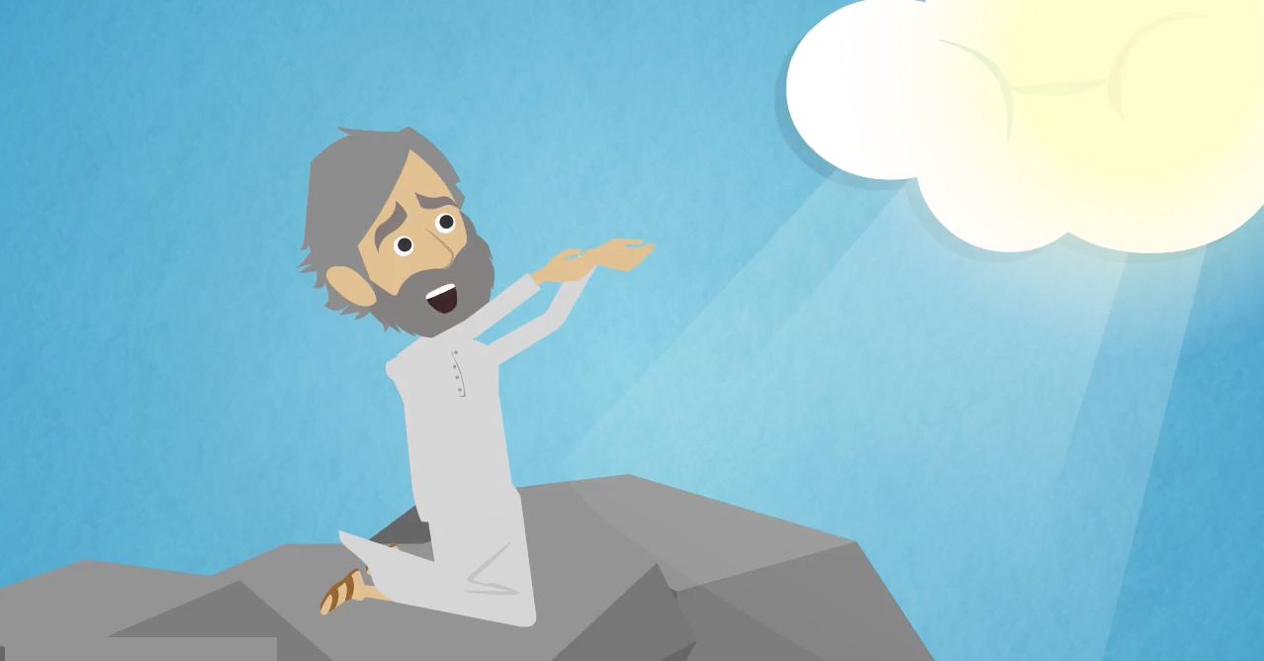
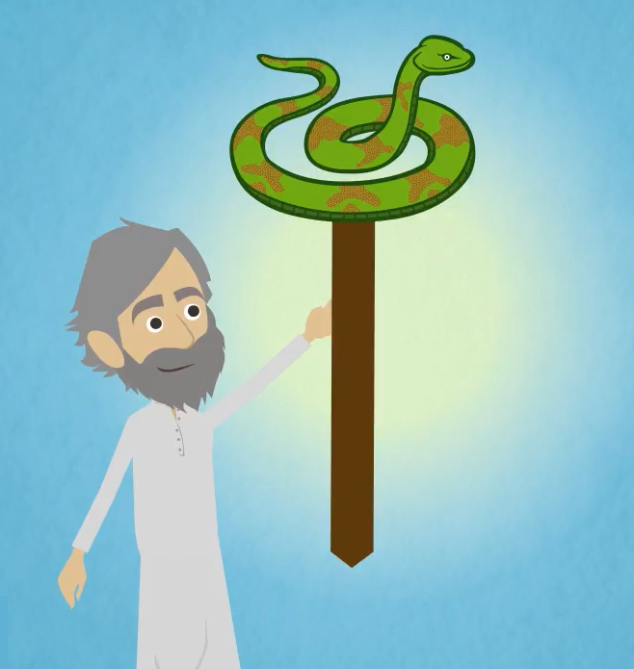
Moses prayed to God to take the serpents away. God heard him and told him to make a serpent on a pole; everyone who was bit will live when they look upon it.
So Moses made a bronze serpent, placed it on a pole and those who looked upon it were saved.

Slide 13
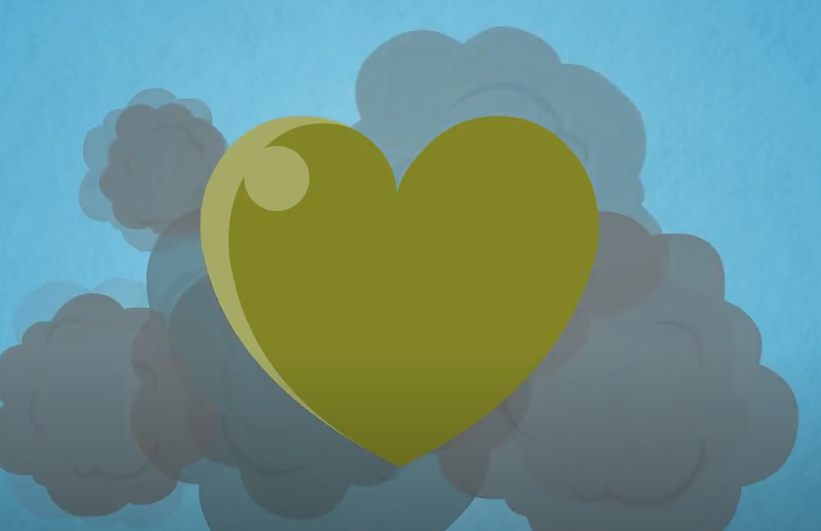
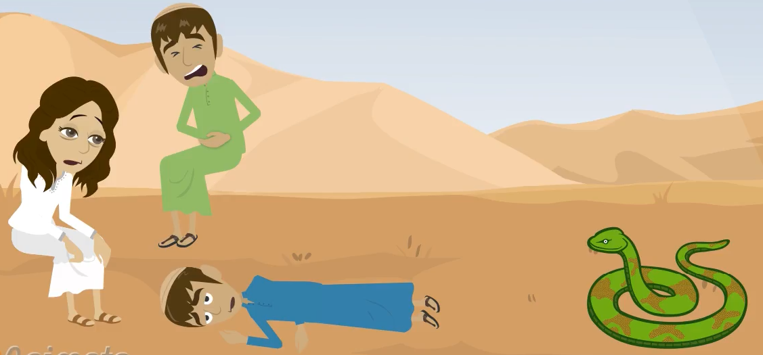
REFLECTION
What happens when we behave as we want and not as God wants us to behave?
SIN
We do the same that the people in the desert did:
We fight, we disrespect our parents, we become lazy, we steal, we disobey, etc.
How do you think our hearts become?
Our hearts sicken and are filled with wounds of sin like the people who were bit by the serpents in the desert.

Slide 14
REFLECTION
WHO CAME TO SAVE US FROM SIN AND EVIL?
JESUS
Who sent us Jesus?
God so loved the world that He sent us His beloved Son.

Slide 15
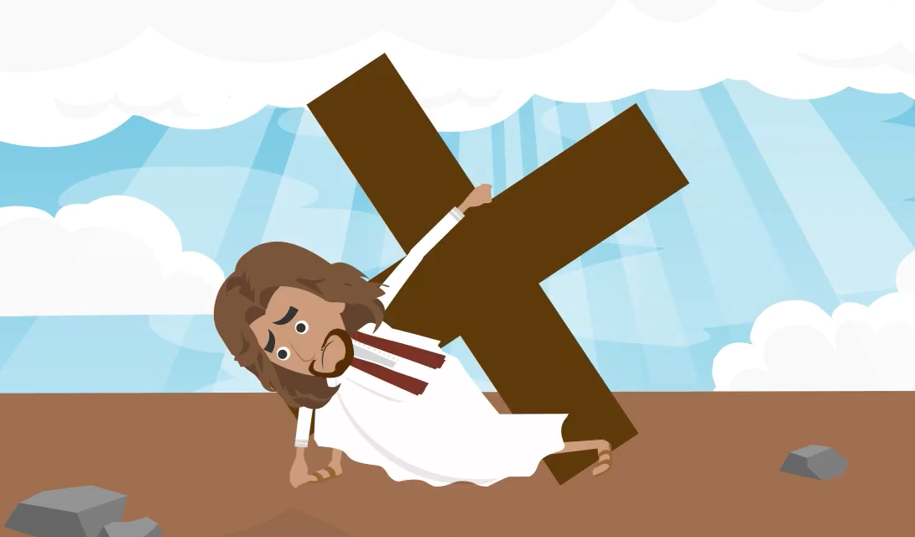
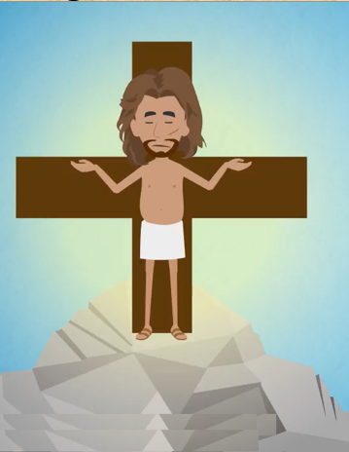
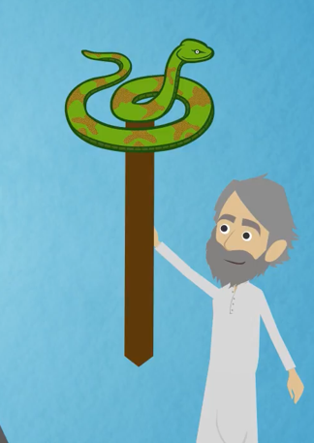
How did Jesus
save us?
JESUS carried our sins and died on the cross for us so we would not have to live separated from God.
Do you see a similarity between the two?
Jesus is the cure for our sins. Thanks to His sacrifice on the cross, we can reach Heaven.
The bronze serpent cured the people bit by the poisonous snakes in the desert so they can reach the promised land.

Slide 16

REFLECTION
Always remember the LOVE that Jesus has for You.
And allow others to feel that Love . How?
Praying to Jesus, and always thanking Him for being your Savior.
Being kind to others.
Avoiding sin (complaining, disobeying, etc) which so saddens Jesus.
Thank you JESUS for dying for me and saving me. I LOVE YOU JESUS.

Slide 17
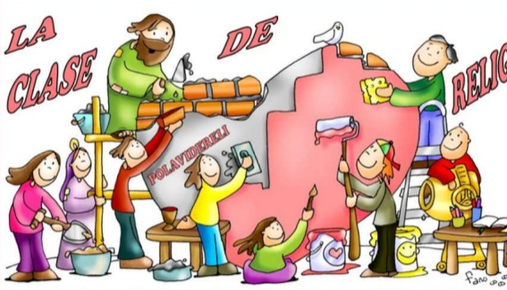
ACTIVITY

Slide 18
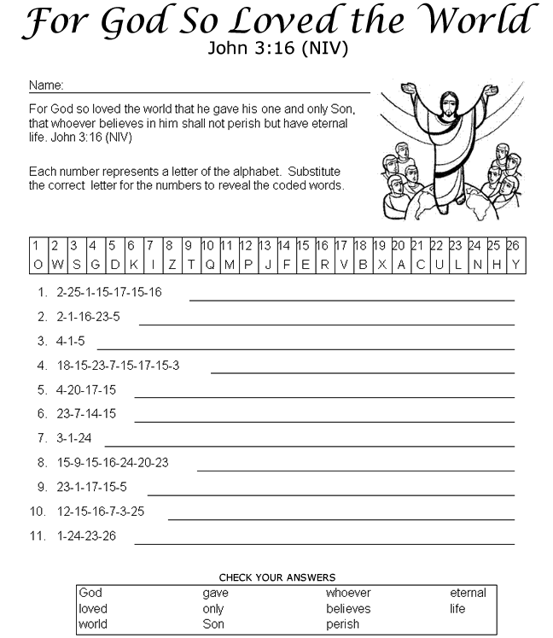
W
H
O
E
V
E
R
W
0
R
L
D
G
O
D
B
E
L
I
E
V
S
E
G
A
V
E
I
L
F
E
N
O
S
A
E
N
L
T
E
R
L
O
V
E
S
P
E
I
H
R
S
O
N
L
Y

Slide 19
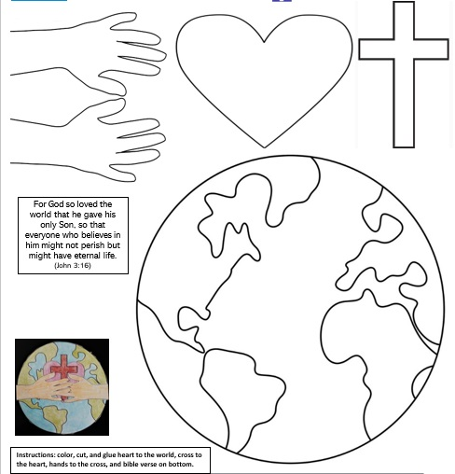

Slide 20
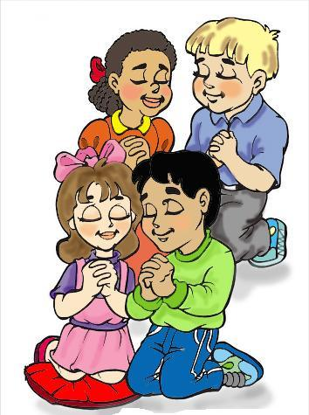
PRAYER
Jesus,
Lord, enter into my heart. Your presence heals me. Give me your love, your light, your strength to face my difficulties. Jesus I trust in you. Amen

Slide 21
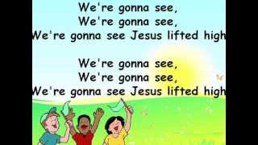
Song: I want to see Jesus lifted high, KWSCM https://youtu.be/FfpJ1SY4uJU

