Slide 1
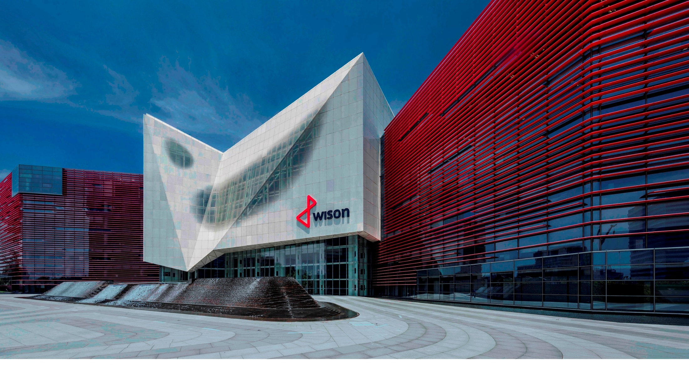
Wison Generation 2e FLNG
WisonNewEnergies - Ran Pu
October 2025

Slide 2
From One Generation to the Next
Wison’s Product Strategy
Wison Generation 2 FLNG (2024)
Wison Generation 2 e-FLNG (2025)
Conclusion

Slide 3
Wison’s Product Strategy for the FLNG
Wison has pioneered FLNG development since the first FLNG (Tango)was built and commissioned in 2015.
Wison has a core program of FLNG Development for a standardized FLNG.
  Main features and interfaces are pre-defined, and overall arrangement follows an inherently safe design.
  An ever-expanding catalogue of FLNG solutions and building blocks
  Standardized building blocks used customized to Client needs, within the design envelope.
  Wison Generation 1 FLNG has been created - two FLNGs are being built based on this core program.
Wison Generation 2 FLNG is the next evolution of the core program.
  The objective is to achieve CO2 emissions below 0.2 tCO2e/tLNG.
Notes:
Wison has pioneered FLNG development since the first FLNG (Tango)was built and commissioned in 2015.

Slide 4
Wison Generation 2 FLNG - 2024
- Emission Reductions

Slide 5


Emission Target
Wison Generation 2 FLNG already offers a step change in emissions – using proven and robust technology
Significant further reductions are possible using innovative technology solutions, once further developed and fully qualified
2030
A next FLNG Generation with
CO₂ emissions < 0.1 t/t
Generation | Target Emissions tCO₂e/tLNG
Generation 1 | < 0.3 t/t
Generation 2 | < 0.2 t/t
A next Generation To be rolled-out before 2030 | < 0.1 t/t
Low Carbon Generation
2024
Generation 2 FLNG with
CO₂ emissions < 0.2 t/t
2022
Generation 1 FLNG with
CO₂ emissions < 0.3 t/t
2nd Generation
1st Generation

Slide 6
Low carbon solutions investigated
Notes:
MWW

Slide 7
Wison Generation 1 and 2 FLNG compared
Different combinations of drivers for power generation and compressors were compared
Difference in CO2 emission
  Excluding Feed Gas CO2
  Includes only the different combinations of Refrigeration and Power Generation emitters
Driver Options (Power + Compression) | Generation 1 (2.4 Mtpa) | Generation 2 (3.6 Mtpa)
Refrigerant Compressor Drivers | 2 x LM6000PF+ (with WHR) | 2 x LM9000 (with CCGT)
Inlet Air Chilling | None | On MR Comp GT Drive
NGL Recovery Booster Compression | LM2500 | E-drive
Power Generation Drivers | Solar Titan 130 (with WHR) | DF Engines plus STG
CO₂ Emissions (t/hr) | Generation 1 2.4 MTPA | Generation 2 3.6 MTPA
CO₂ from Feed Gas | Excluded | Excluded
Other Fuel Gas Users (incinerator, Flare) | - | -
Refrigeration | 46.3 | 59.4
Booster Compressor | 14.7 | -
Power Generation | 17.3 | 16.7
Total CO₂ | 48.3 | 76.1
LNG Production (t/hr) | 302.5 | 453.3
t CO₂ / t LNG | 0.259 | 0.168

Slide 8
Wison Generation 2 FLNG - highlights
Significant reduction in emissions intensity of around 35%, with proven technologies
Main reduction from
  Selection of high efficiency GTs coupled with IAC (inlet air chilling)
  Selection of CCGT with the addition of a 16 MW STG for power recovery
  Selection of high-efficiency DF engines (located within the hull machinery space)

Slide 9
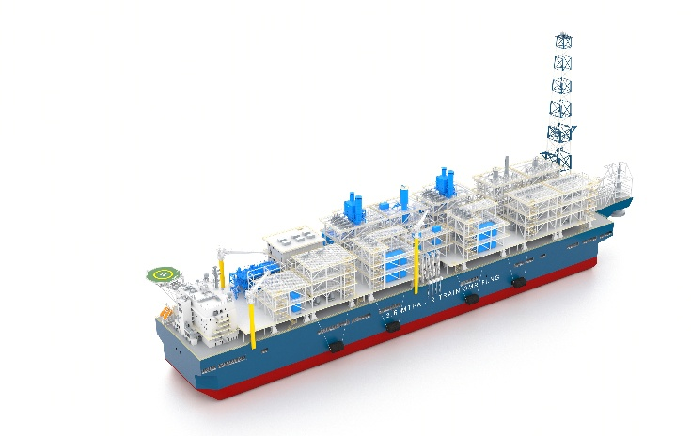
Wison Generation 2 FLNG – GT driven MR Compressors
For more stringent allowable environments standards, several combinations of drivers for power generation and compressors were compared.
Examples of equipment configuration changes that improve the carbon intensity to <0.2 tCO2e/tLNG:
In terms of TRL, all the equipment selected for Generation 2 is mature and suitable for use with tolerable levels of risk.
Driver Options (Power + Compression) | Generation 1 (2.4 Mtpa) | Generation 2 (3.6 Mtpa)
Refrigerant Compressor Drivers | 2 x LM6000PF+ (with WHR) | 2 x LM9000 (with CCGT)
IAC | None | On MR Compressor and GT Drive
NGL Recovery Booster Compression | LM2500 | Motor Drive
Power Generation Drivers | Solar Titan 130 (with WHR) | DF Engines plus STG
In terms of TRL, all the equipment selected for Generation 2 is mature and suitable for use with tolerable levels of risk

Slide 10
Wison Generation 2 e-FLNG - 2025
- Large electrical driven MR Compressors

Slide 11
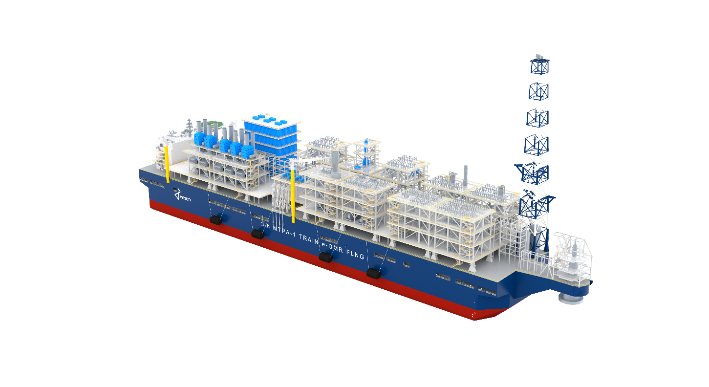
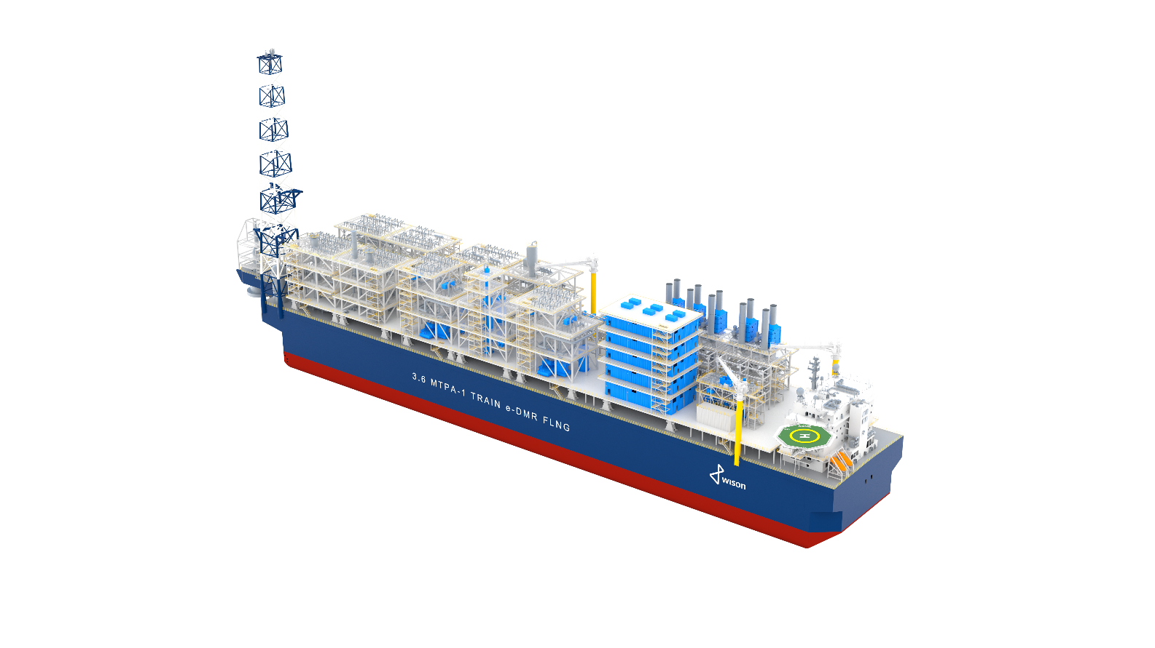
Wison Generation 2 eFLNG – with CCGT and e-Drive for MR Compressors
The Generation 2 e-FLNG
Notes:
G2 e-FLNG portside and starboard

Slide 12
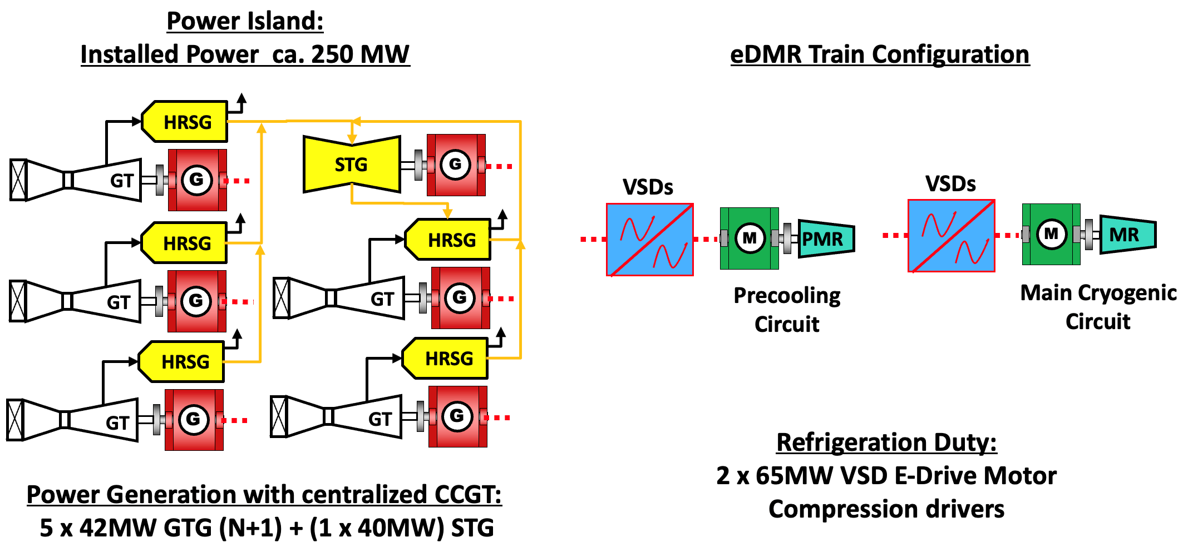
E-FLNG Power & Heat Supply Architecture
Refrigeration Duty:
2x 70MW VFD motor compressor drivers

Slide 13
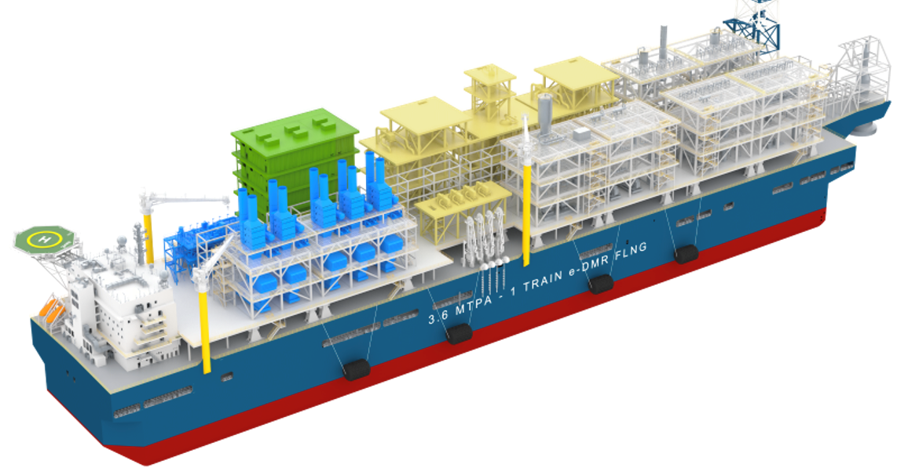
Wison Generation 2 eFLNG – with CCGT and e-Drive for
MR Compressors
2x70MW E-drive and motor
210MW electrical system
E-DMR Modules
5 level E-house
w/ 140MW VFD
40MW STG & Treatment Plant
210 MW
Power Island
350m x 64m

Slide 14
Generation 2 e-FLNG - System reliability is key
 | Design of | Practice | Key
1 | Power system | Accumulation of many littles | - System voltage selection - Power management
2 | Motor selection | Marinisation of onshore model | - Large capacity - High speed
3 | VFD selection | Design freeze | - Topology selection - Redundancy
4 | Skid | Mechanical simulation of the motor Compressor skid vibration analysis | - Maximum deflection - Skid design
Notes:
Not shown, but included:
Is limiter
Step down Transformers are included
Option 2 Drive Train smaller motor

Slide 15


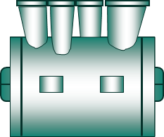


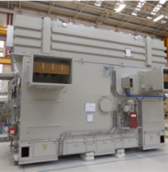
The e-drive and MR compressors
Variable frequency drive
Transformer
#1 for each motor
70MW motor
PMRC
Frequency converter
#1 each motor
Potential harmonic filters #1 each motor
1 train
70MW motor
Motor
2 poles - Synchronous motor 70 MW
MRC
Copyright 2025 Baker Hughes Company, all rights reserved

Slide 16
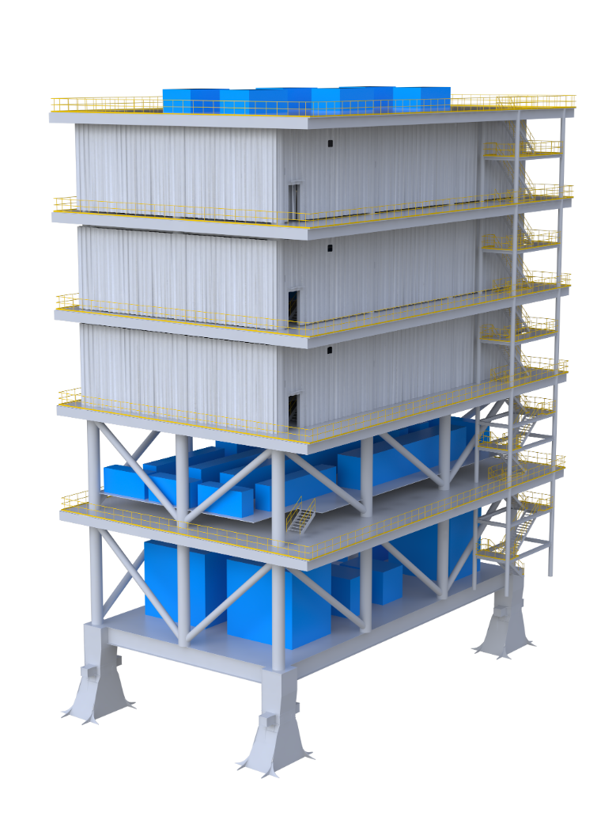

The E-house of Generation 2 e-FLNG
Level 2:
HV switchboards
HV VFD
Level 1:
VFD transformers
HV transformers

Slide 17
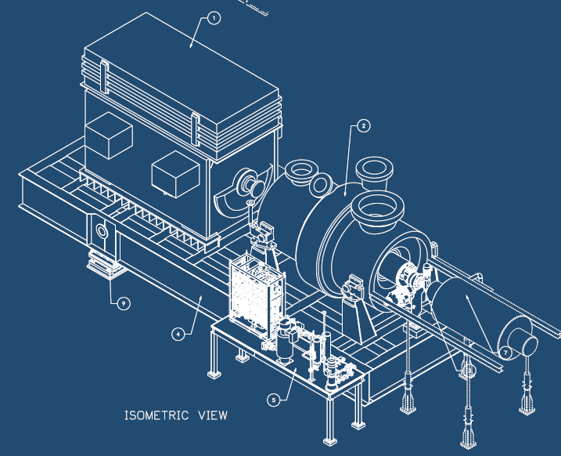
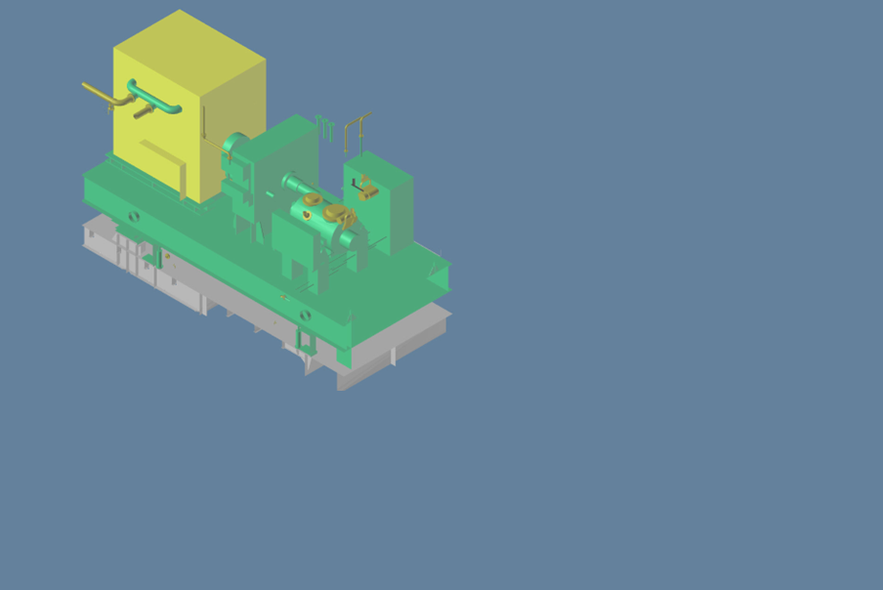
The 70MW synchronous motor - marinisation
70MW motor already in onshore operation, but the offshore reference goes up to 30-40MW
2 pole, direct drive
8m long, 5m tall, and 120T weight, additional complexity:
  Deflection on the base plate
  Mechanical handling
Redundancy and sparing
Yellow=20MW motor, 4m length
White=70MW motor, 8m length
  Why 2 pole is preferred?
  Could avoid having gear box
  A higher design envelope to maximise the technology potential
Copyright 2025 Baker Hughes Company, all rights reserved

Slide 18
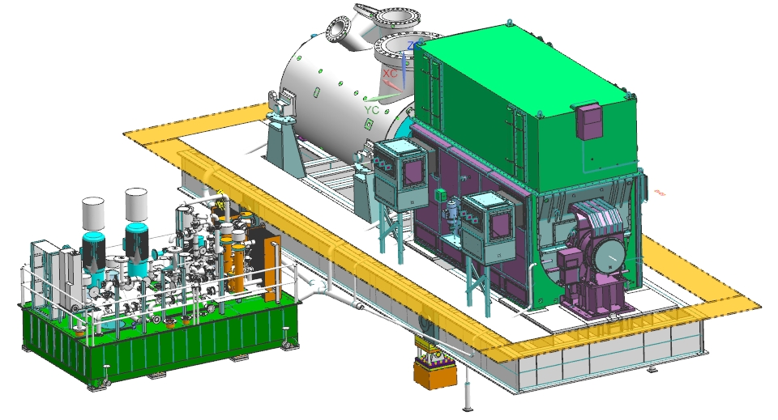
The motor-compressor skid for Generation 2 e-FLNG
Inclinations
Mechanical handling
  70MW motor weighs up to 120T
  Rotor weighs 20+T
Vibration performance of the package
Heavy weights, stiff skids
  The skid has to cope with much higher deflection than onshore
  3 points with gimbal support
Copyright 2025 Baker Hughes Company, all rights reserved
Feasibility proven by skid design with proposed compressor and motor

Slide 19
The studies carried out towards TRL3 (Ready for FEED)
Component | Study | TRL before | TRL after
Compressor | Compressor selection | 7 | 7
 | Compressor mechanical configuration
 | Compressor rotor-dynamic analysis
Motor and VFD | Electric motor & VFD selection | 7 | 7
 | Motor-compressor GA (preliminary)
 | Availability & reliability assessment
Skid | Baseplate selection/design | 2 | 3
 | Pitch and roll analysis (Lube oil, Axial thrust etc.)
 | Torsional analysis for complete train
 | Dynamic simulation @ start-up, and ramp 70-105%
 | Determine max tolerable deflection for motor
 | Final baseplate report (static & dynamic analysis)
 | Final motor-compressor GA & report
Integration | Electrical system design | n/a | n/a
 | Typical layout on FLNG, mechanical handling plan
TRL7=system proven; TRL3=Ready for FEED; TRL2=concept (Wison adaption of API 17N TRL)

Slide 20
Conclusion Generation 2 e-FLNG

Slide 21
Conclusions
Two Generation 1 FLNGs (with less than 0.3 tCO2e/tLNG emission) are currently in execution.
Wison expands the Generation 2 FLNG catalogue, aiming at reducing emission to less than 0.2 tCO2e/tLNG with the addition of an all-electric e-FLNG using a Shell DMR liquefaction system targeting 3.6 mtpa capacity with motor driven mixed refrigerant compressors (MRC).
  These new technologies are introduced following a strict technology qualification process, to achieve TRL 3 level (Ready for FEED), with no significant increase in project risk.
This solution offers some of the building blocks for the Generation 3 FLNG with renewable power import aiming to achieve emissions below 0.1 t CO2e/t LNG
Notes:
Same as the previous 3 colour roadmap
E-FLNG new technologies are following TRL evaluation process

Slide 22
Thank you
Wison New Energies Co., Ltd
  633 Zhongke Road, Zhangjiang, Pudong, Shanghai,
  201210, P.R. China
  Tel: +86-21-2030 6000
  www.wison-energies.com

