Slide 1


Petroleum & Energy Conference 2025
On the Board Agenda
Pieter Steyn - 9 October 2025
KPMG Papua New Guinea

Slide 2
On the Board Agenda: Challenges and Strategies

Slide 3

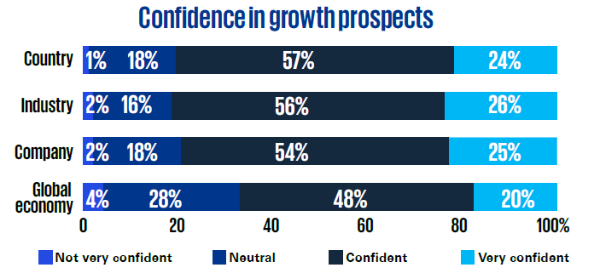
1
Geopolitical, economic shifts and global disruption
“Country-First” Models
Grey -listing
New tax bill
National Petroleum Authority
Business
Resilience

Slide 4

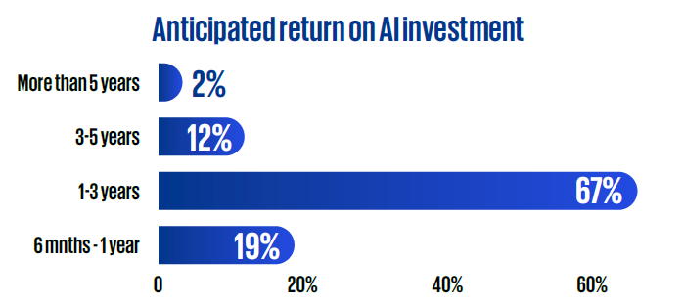
2
Understanding the AI strategy and deployment of technology
3
Data governance and security frameworks
Data Governance Framework
Risk Management Framework
Business
Resilience

Slide 5


Environmental and social issues
4
1. Legislated?
2. Stakeholders
ESG
3. Voluntary
4. Cost/Benefit

Slide 6

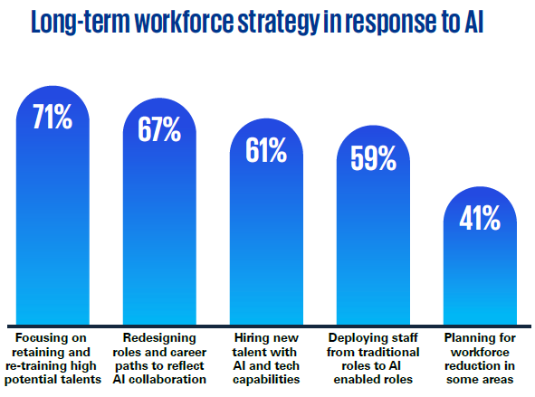
5
CEO succession and talent development
Board composition and succession
6
Succession planning
Skills needed

Slide 7

7
Tone and culture, managements efforts to build trust
8
Risk oversight and allocation to committees
Shaping Corporate Culture
Zero-tolerance / whistleblower
Misinformation… reputation

Slide 8
1
Geopolitical and economic shifts and global disruption
2
Understanding the AI strategy and deployment of technology
Data governance and security frameworks
3
4
Environmental and social issues
5
CEO succession and talent development
6
Tone and culture, managements efforts to build trust
7
Risk oversight and allocation to committees
8
Board composition and succession

Slide 9
Thankyou

