Slide 1
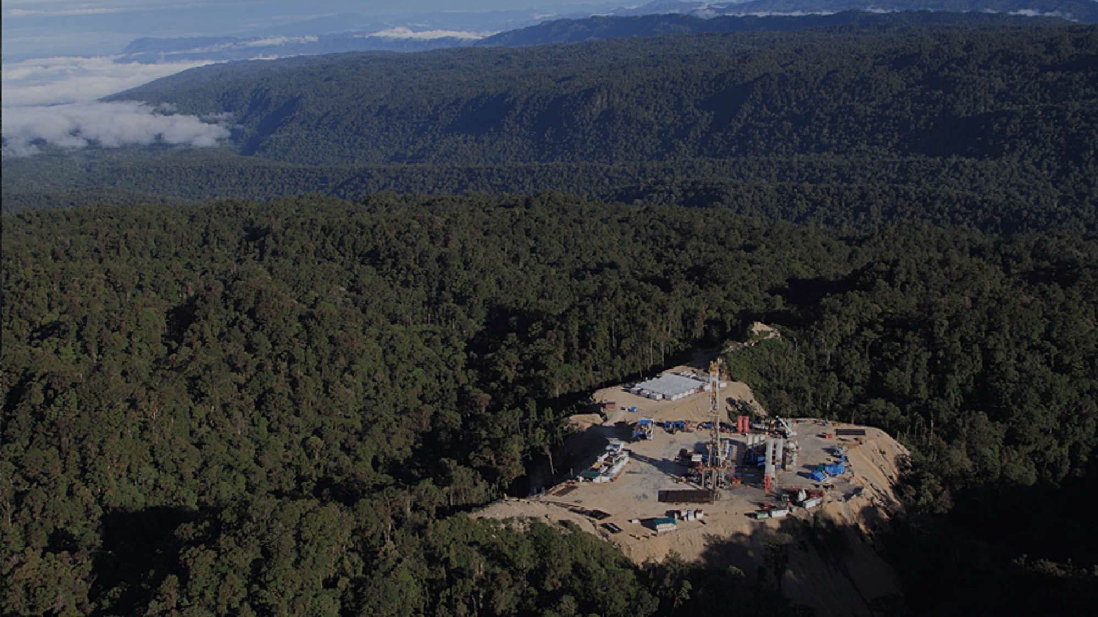

the trusted provider of energy services
Minimising Project Delivery Risk
TSXV : HOH
2025 PNG Petroleum & Energy Conference

Slide 2
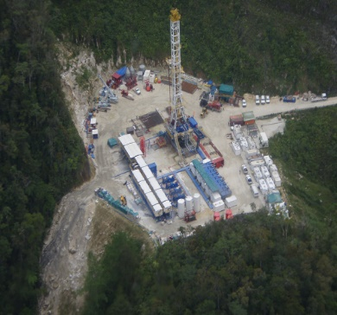
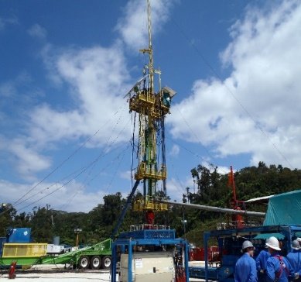
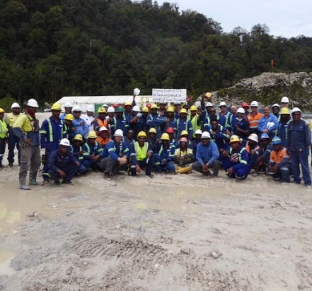
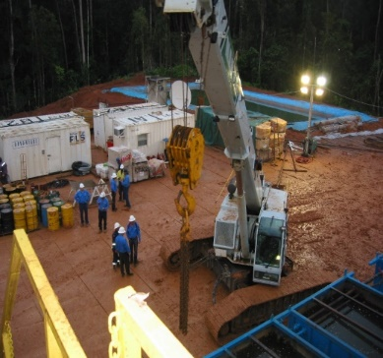
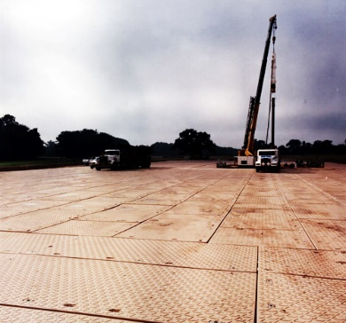
High Arctic
Remote Operations Specialist
Specialist in PNG drilling operations and logistics
18 Years continuous operations in PNG
Drilling, remote equipment rentals & fire safety
Provision of manpower, personnel and training & development
Global pace setter in quality outcomes
World-leading safety performance - zero TRIF for nine years
Listed on the Toronto Venture Stock Exchange TSXV:HOH
2
Notes:
Thankyou. I’m MM, Chief Exec of High Arctic. I might be a little off-topic at first consideration, however we thought we would share with you something we have learned during our 18 years in Papua New Guinea, which we think, helps our customers to realise their objectives of effectively unlocking PNG resources.
In the world today with incredible access to information through the internet and social media, people can know a lot about everything, but you still cannot understand the nuances of anything without experience.
We believe that successfully unlocking the enormous resource potential of PNG is not just about technology & infrastructure, its about a modern approach to local involvement and supply chain management.
This, we believe has become our expertise and it has enabled us to deliver some world leading performance in one of the worlds most challenging places.

Slide 3
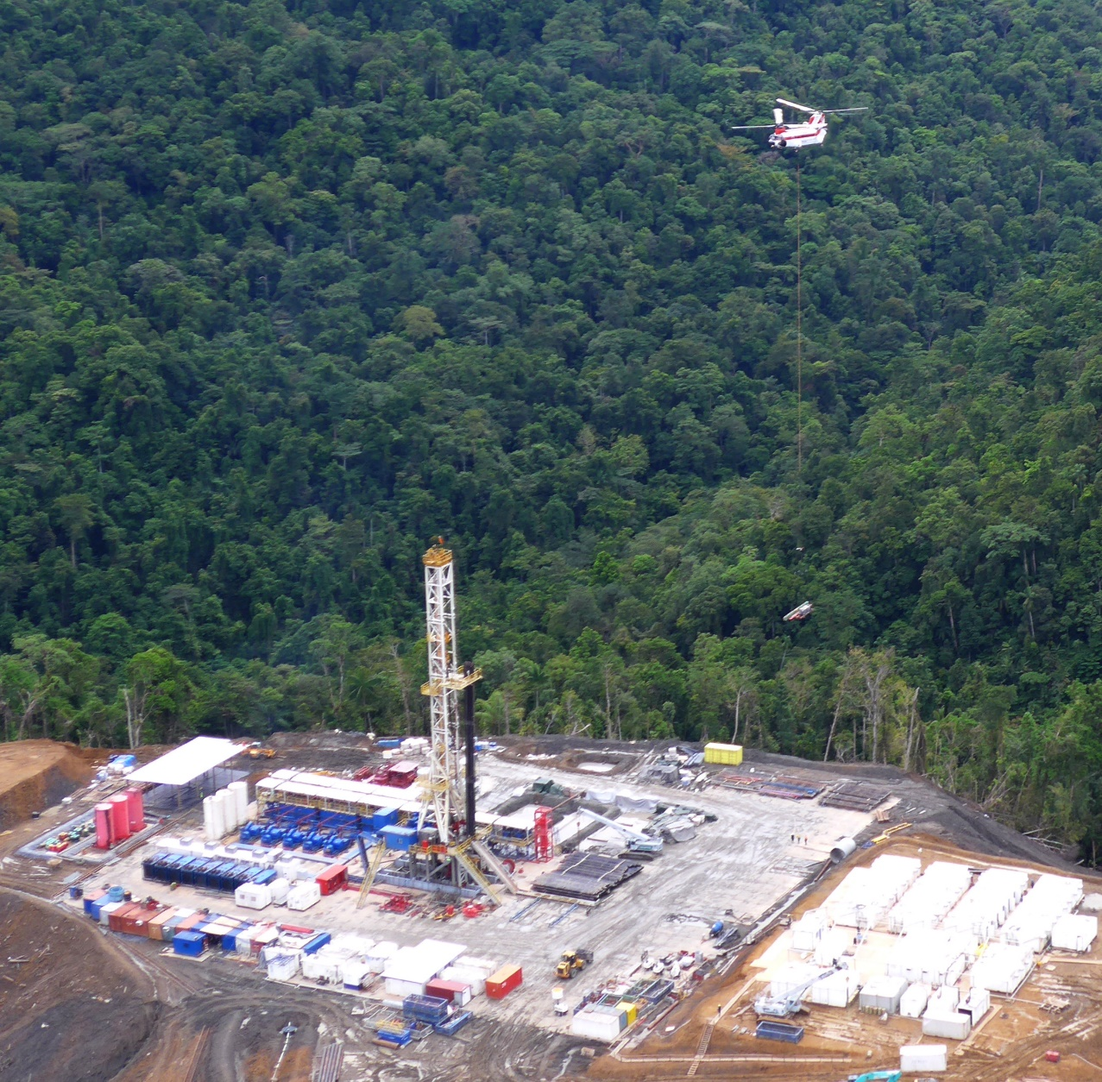
High Arctic’s World Class DRILLING Operation
High Arctic Rigs
Rig 115 and Rig 116
Tier – 1, 1500 HP, 750,000 lbs hookload
Highly versatile – road, light helicopter, heavy helicopter
Ideal exploration and appraisal workhorses
Rig 102 - 340,000 lbs midsize hydraulic workover unit
Customer Rigs
Rig 103
Tier – 1, 1500 HP, 750,000 lbs hookload
Road and heavy helicopter only
Proven efficient appraisal and development rigs
“Leapfrog” rig designs substantially improve time between completion of drilling activity and start of the next well.
3
Notes:
Most people would identify us as the pre-eminent PNG focused oil and gas drilling contractor.
Our can-do attitude saw us secure a contract to oversee the commissioning , delivery and operation of purpose built brand new rigs in 2008. Unique at the time for their state-of-the-art AC electric drives, PLC controls and offshore style cyber-chair drilling cabins.
In 2014 we sourced more versatile rigs to meet a growing demand for remote exploration drilling in PNG. The result was the procurement, upgrade and delivery of rigs 115 & 116. Crucially, they shared the same AC electric drive and cyber chair drilling technology that has been fundamental to drilling success in PNG. But they have the flexibility to break-down to lighter transport loads – providing access to use a wider range of available helicopters and other transport methods – de-risking remote access and egress challenges.
At the same time, recognizing our obligations to create employment opportunities in the local communities, all rigs retain a significant amount of meaningful crew work, with automation targeting reliability and efficiency improvement over worker displacement.
Innovations, like the leapfrog designs have been fundamental to improving customer well cost reduction and reducing non-productive time. The leapfrog concept has a second center section comprising the rig structure and some of the power system, along with a subset of camp and office buildings that can be assembled before the drilling crew is released from drilling on the current well.
At the beginning of 2015 there were 7 working rigs in PNG with High Arctic operating 2 of them. Between 2016 and 2022 the only drilling rigs that operated in PNG were High Arctic. But it is fair to say that activity today for exploration and appraisal drilling, well workover and well abandonment is at the lowest levels seen since we first arrived.
This low activity is troubling for the nascent dedicated PNG services industry, as we contemplate a substantive upswing for major projects in the coming years.

Slide 4
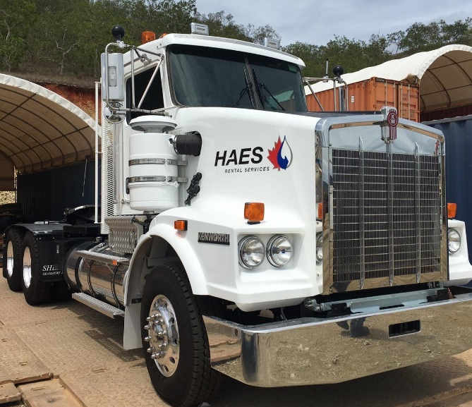
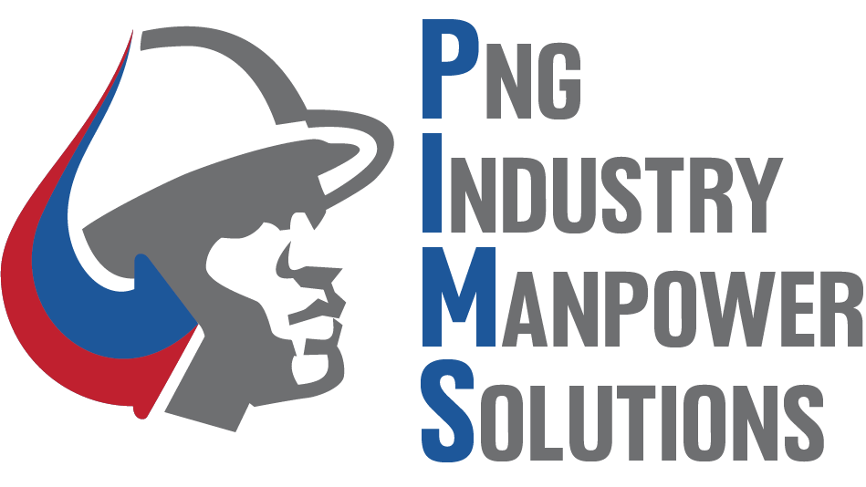
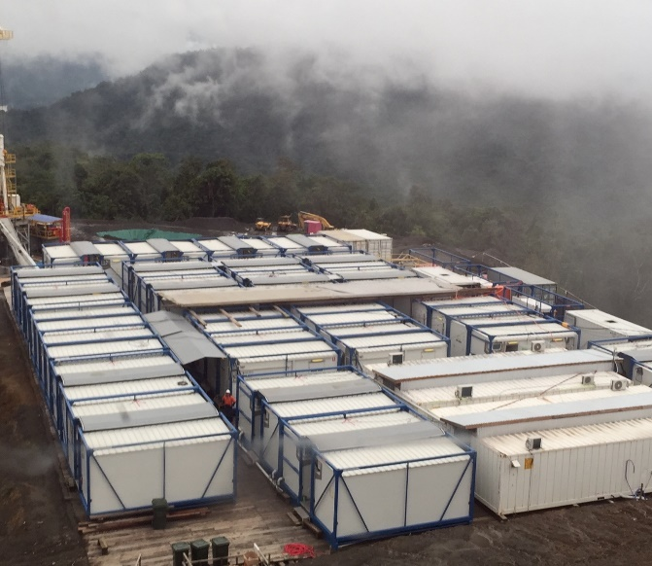
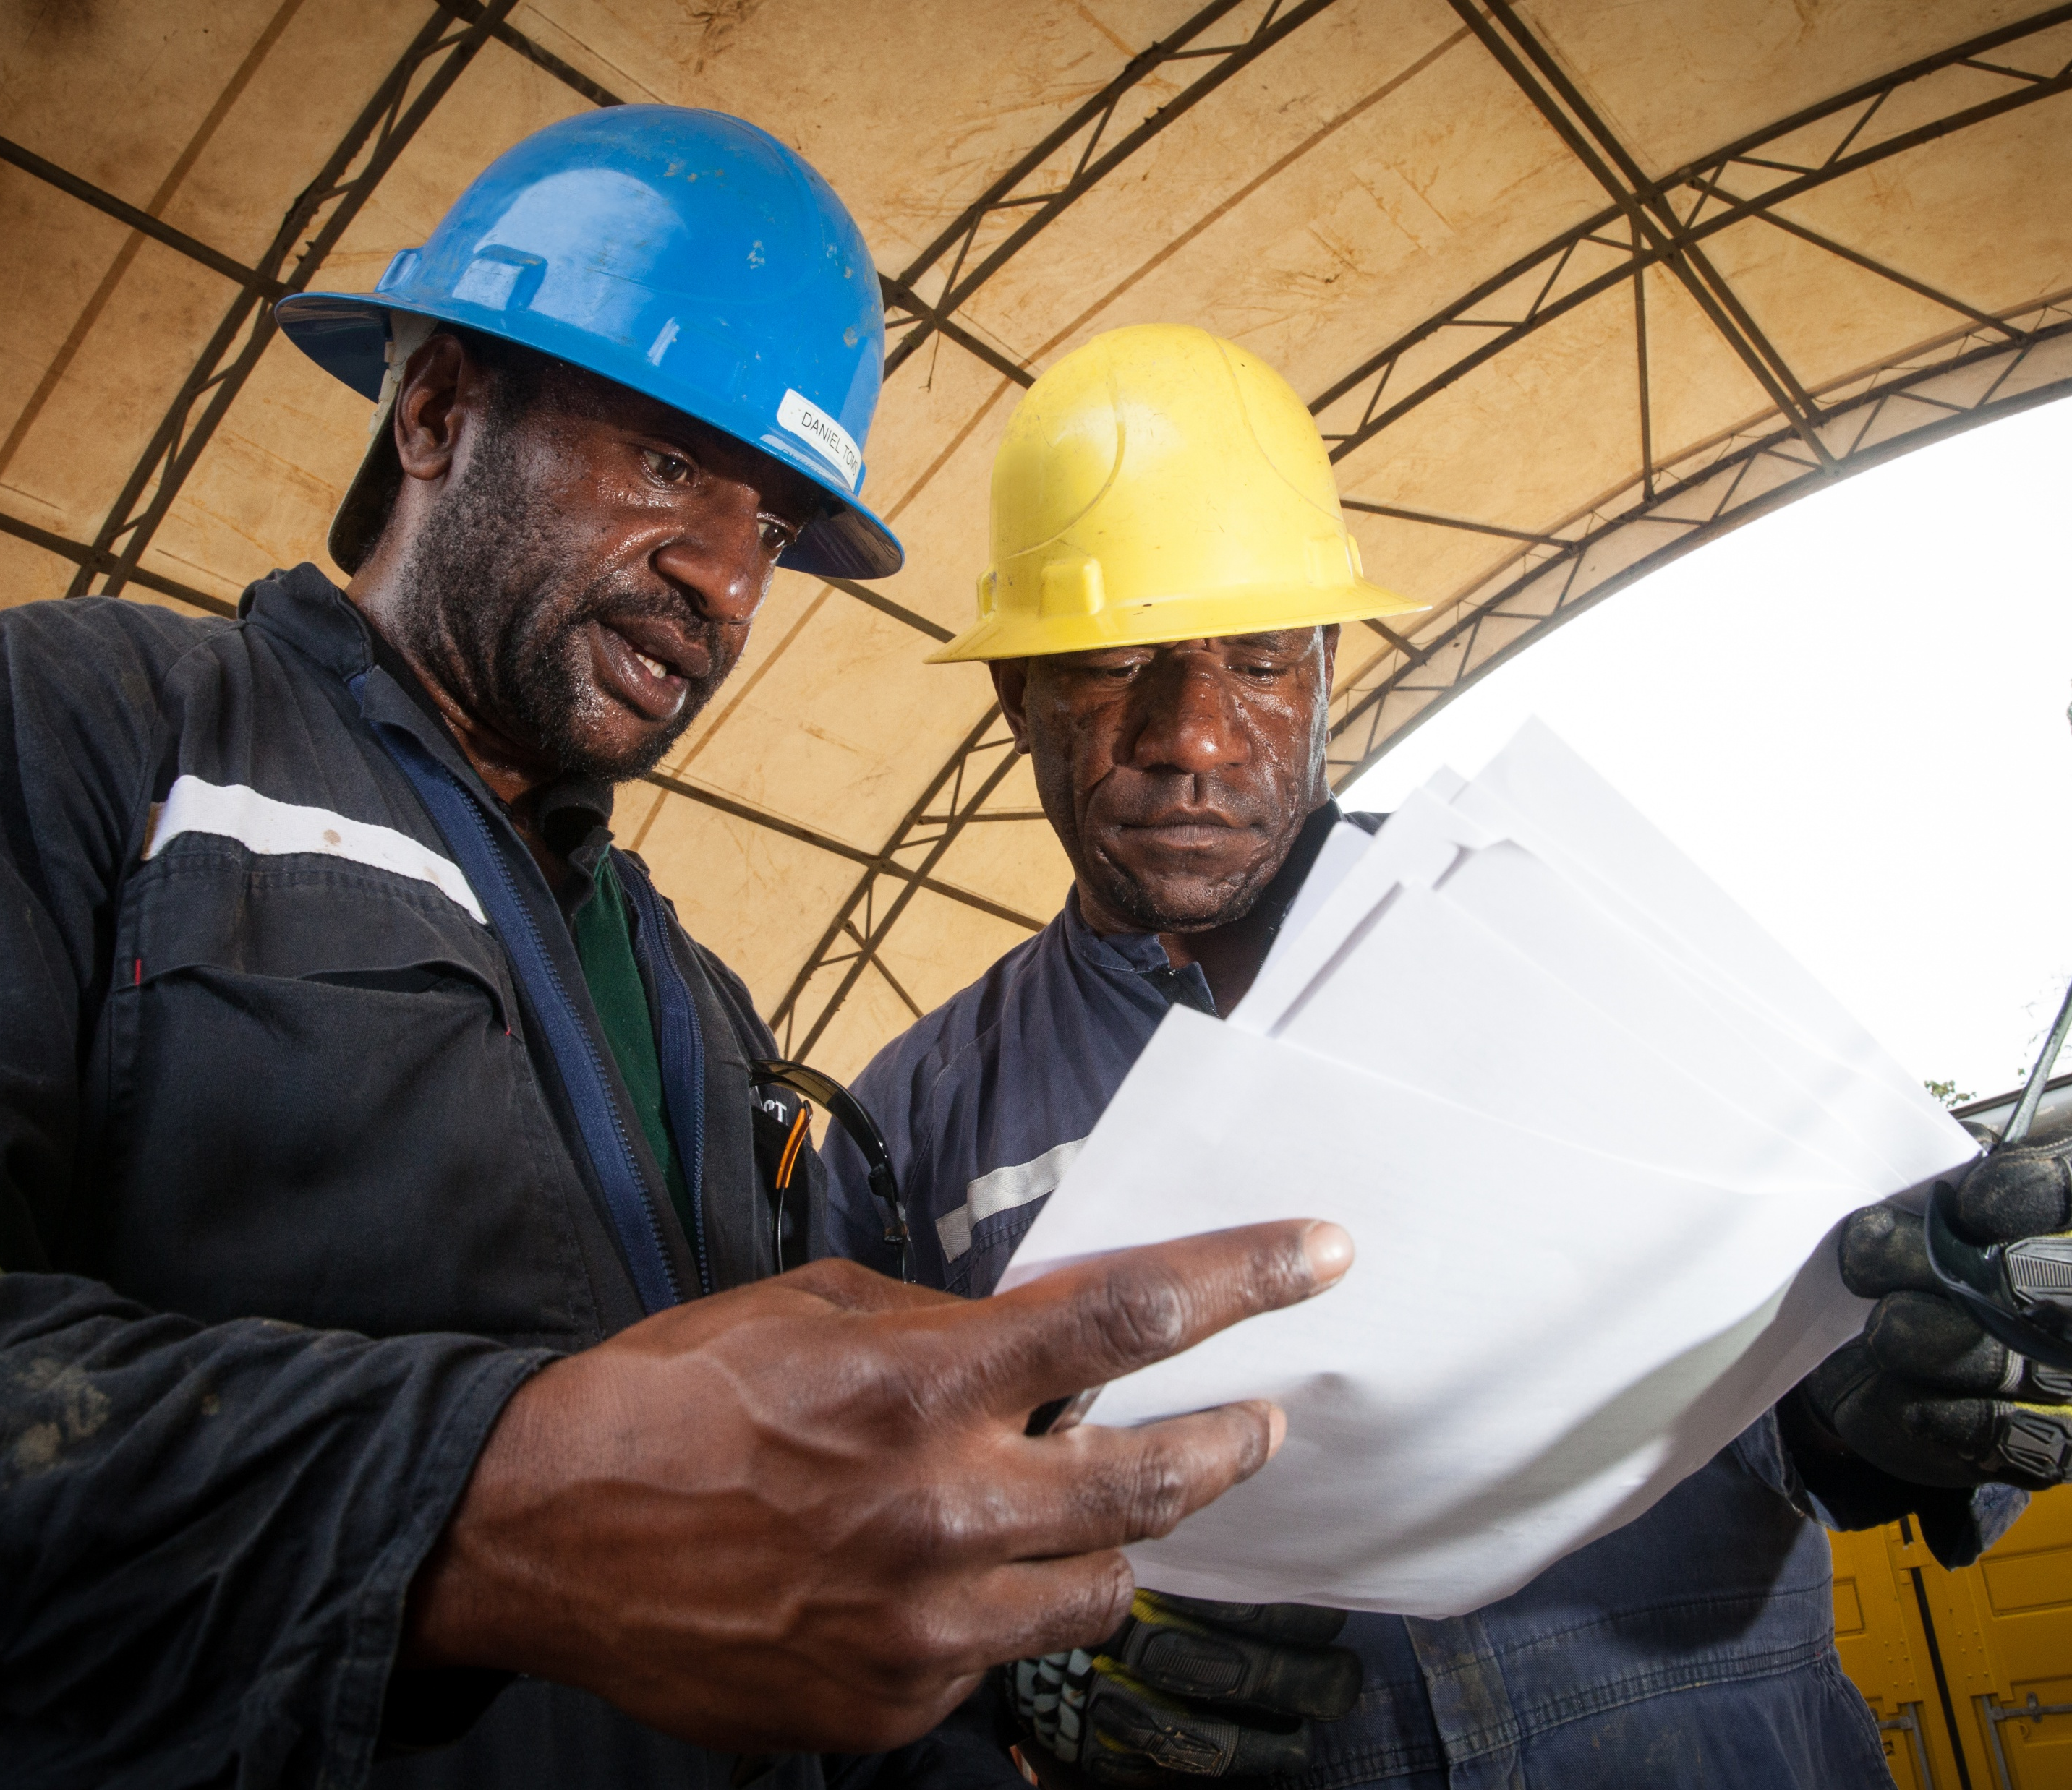
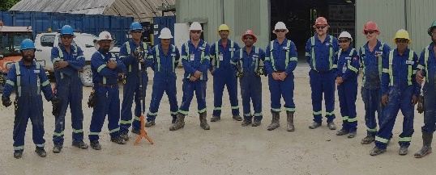
PNG MORE THAN DRILLING
Rentals Cranes, trucks, forklifts and other material handling equipment River pumps, generators, lighting towers and assorted oilfield equipment Worksite Matting Inventory of 4,000 rental mats | Manpower Solutions Labor hire, skilled and unskilled personnel Training & development Competency assessment | Camps Own and manage two 103 bed Heli-portable camps Operate and manage two 93 bed + two 34 bed Heli- portable camps Smaller “Pioneer” – first deployment camps | Fire Services ¹ Fire monitoring & deluge systems Installations and refurbishment Inspections and testing Compliance management
New service line commenced in Q3 2025
4
Notes:
Our business in PNG is not just about drilling services, we are a solutions focussed business. We identify needs and prepare ourselves to be a supplier of solutions.
In 2009 we imported the first High Density Poly Ethylene rugged work-site mats to PNG. They were an instant success, eliminating lost time due to bogged vehicles, immobilised material handling plant and stuck people too! The Oil and Gas industry adopted uptake in PNG to the point were we had over 10,000 mats under rental at the peak of activity.
The mats are a great and simple example of the solutions focused attitude that has seen High Arctic succeed in a place were others have not. We have assembled a large array of rental equipment modified or designed to deploy efficiently under a heli-copter or via other limited transport methods available.
In 2023, we added the provision of certified safety training, competency verification and equipment licencing services. We have long provided these in-house, but in the covid shutdown we found these services in demand from our customers and their other contractors. So too we found demand for the skills of our people away from our core service offerings.
We have been building the capacity of PNG Industry Manpower Solutions (or PIMS as we call it), to provide skilled & semi-skilled labour, trades qualified personnel and professionals in PNG. We have aligned our training programs to the Australian Training Framework and obtained licences for delivery in PNG. And we currently have dozens of people deployed with various customers conducting an array of technical activity. I am excited about the role we will be playing in preparing PNG citizens to be job ready for the major increase in site based workers that are going to be needed for the advancement of major projects anticipated through the tail end of this decade and beyond.
Earlier this year we made a strategic decision to add fire safety services to our service offerings. The decision was driven by the identification of a growing need for fire detection and deluge installation and maintenance and a serious deficiency of quality service providers. We commenced services in August and have a growing pipeline of projects in oil and gas as well as mining facilities, vehicles and commercial buildings.

Slide 5
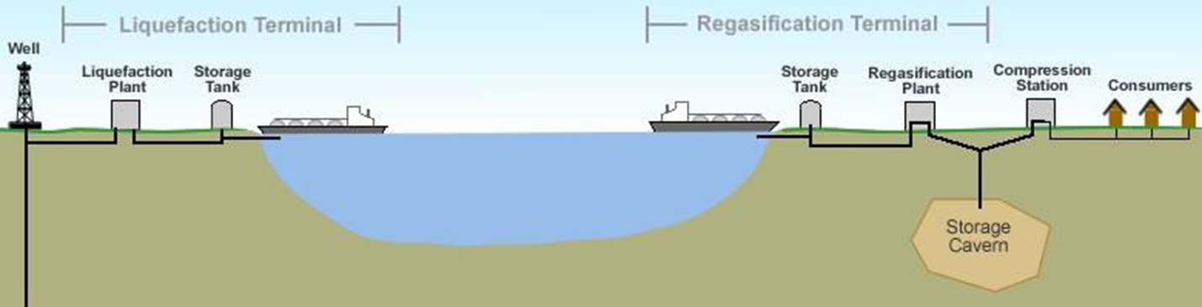
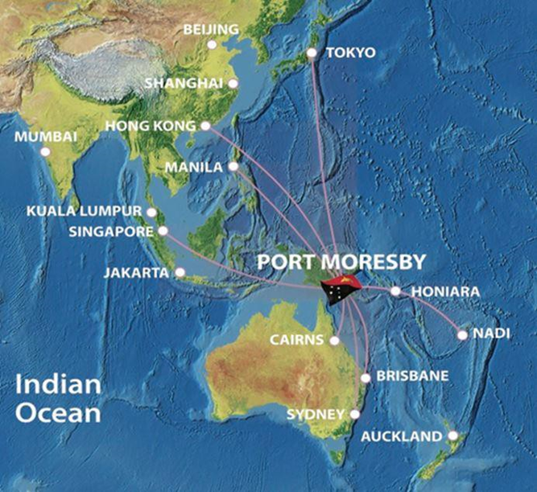
Project Development is Complex
PNG has excelled in the past.
And it is ideally positioned.
5
Notes:
We have heard many encouraging and interesting facts presented here this morning. We understand that the global demand for resources and energy is expected to be strong for decades to come, and that current producing projects cannot meet expected demand.
We also aware that global under-investment in recent years is expected to result in a supply gap and that there is an ideal window for bringing new supply to market.
Nowhere illustrates this point better than PNG. In the 5 years from 2014 to 2019 nearly a hundred oil and gas wells were drilled here. However, in the last 5 years there have only been 12.
Now there are many reasons for this, including the impact of Covid-19 restrictions. But it highlights one of the challenges – how to successfully ramp that activity level back up so that we can collectively work safely, efficiently and effectively deliver the next wave of major projects on time and within budget, for the benefit and betterment of the people of PNG.

Slide 6
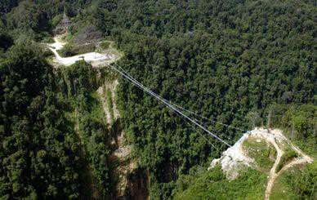
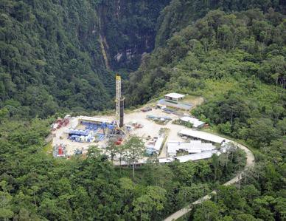
Just getting there is half the battle
PNG onshore wells are more comparable to deep marine operations than most land drilling around the world.
It's far more about logistics in PNG
Rig costs are under 10% of well AFE in PNG verses over 30% in typical North American operations where supply chain is a standardized manufacturing style process. (PNG mob/demob and support logistics much higher)
6
Notes:
The nature of the technical work required to assess and transform a prospect into a resource is always complicated and challenging. Nowhere is that more apparent, than here in Papua New Guinea.
In PNG, getting to the location is one of many substantive challenges.
Drillers and engineers all know how a loss of well-control can lead to a well blow-out and cause costs to blow a wells budget very quickly.
In PNG, the loss of ‘project control’ can do the same thing, and it is a lot easier to happen.
The jungle environment can be murder on the reliability of otherwise high quality materials.
And there is a lack of local support infrastructure that most places, take for granted.
The want of a seemingly small and insignificant spare part can bring a multi-million dollar worksite to a halt and result in extended periods of expensive lost progress.
Some of you may be recalling specific projects that come to mind, and which lead to some participants pulling out of PNG altogether.

Slide 7
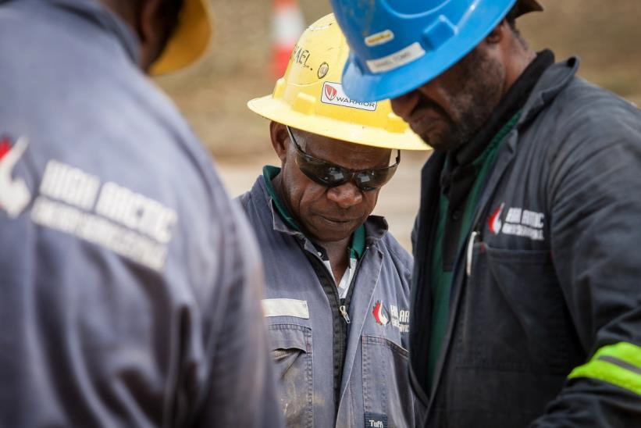
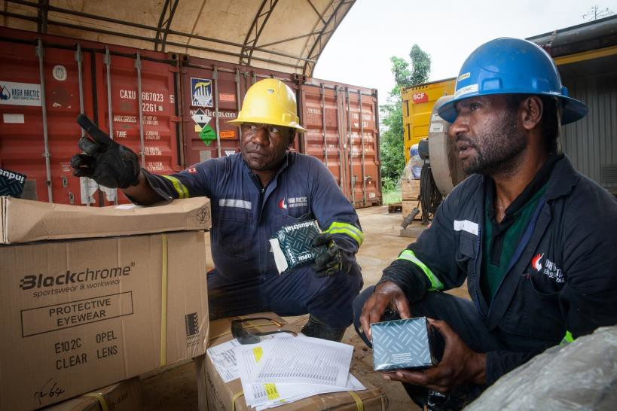
High Arctic - Leading edge and nimble
Quality Centric Approach:
Using quality to achieve pace setter safety record
Made long term commitment to a local and reliable workforce
Kept essential services throughout the pandemic restrictions
New technologies and services to reduce loads and increase flexibility of transport
Deep and long experience means we know the nuances of PNG logistics
Errors in remote operations are magnified proving the axiom ‘for the lack of a nail the kingdom can be lost’ - we have saved more than one kingdom
7
Notes:
High Arctic learned to meet the challenges presented in PNG by taking a modern entrepreneurial approach to two areas:
Focus on quality to achieve safety as an outcome.
Setting aspirational goals for the advancement of PNG citizen employees to align our mutual success.
Competent personnel, following proven processes, using bespoke equipment and materials, from a large inventory kept locally.
Our view was, if it’s done right the first time, it is safe and reliable every time. This attitude has given us a worlds best safety record with our over 80% PNG citizen workforce, and a reputation for successful project control in PNG.
We have leaned into the PNG “Wantok” culture, by not only engaging with the local community to provide jobs while we are in their lands; but also identifying key individuals that we make a permanent part of our crew.
A core part of that assessment is how they engage in safe work programs and look out for and genuinely care for the safety of the people they work with, who are for the most part, from other places.

Slide 8
Imagine a relationship - not just a contract
Automotive Industry realized that they must move:
FROM: The classical “adversarial” lowest price arrangement.
TO: Value added supplier network using continuous improvement model.
FROM: Practices which create expensive nonvalue-added work.
TO: The elimination of wasteful and time-consuming practices and processes.
FROM: One-way “command and control” communication.
TO: Two-way participative communication.
FROM: A Just Too Late Basis / Missed It Completely scenario.
TO: A Just In Time / JTP basis via good robust up-front analysis / planning.
FROM: Reactive “Seats of the pants” judgement process.
TO: Systematic problem definition, analysis and solution procedures.
8
Notes:
Many decades ago the automobile industry learned a supply chain model that endures today.
High Arctic takes the same approach with our customers – we seek alignment and long term relationships.
Our commitment to PNG as a market, means we don’t need to maximise a single job or contract
For just one example, we were able to keep frontline operational workers in the field during the tightest covid travel restrictions, keeping our customers essential operations running, but at the same time we lost money. If it was just about a contract to us, financial logic said to shutdown, stranding our clients and our citizen workforce.

Slide 9
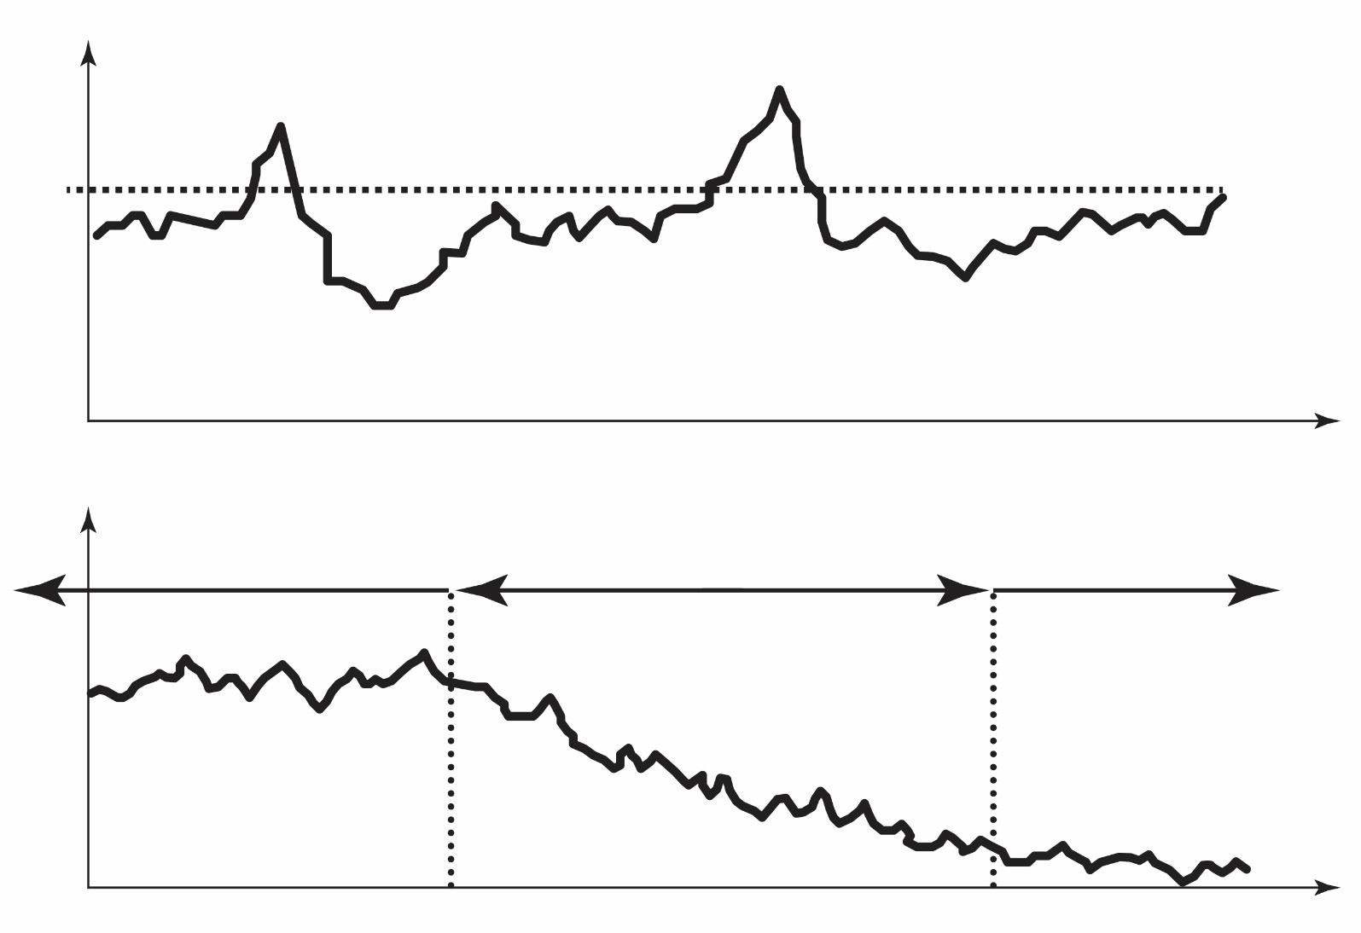
Relationships drive down cost
Management Attention
Threshold of Pain
Purchased Costs
Procurement Model
WASTE
Time
New Zone of
Continuous Improvement
Planning
Improvement
Purchased Costs
Supply Chain Model
WASTE
Time
9
Notes:
Procurement: it is the act of finding, buying goods, services or works from an external source, often by tendering or competitive bidding process …… a purely transactional deal by deal approach.
At its core, supply chain management is the act of overseeing and managing a supply chain to ensure it is operating as efficiently as possible.
That means, ensuring all suppliers are aligned in improving quality and focusing on reducing costs.
It means knowing that your success depends upon the success of the other party.
It is the Wantok system in place through the supply chain.
In a world increasingly concerned about ESG this modern supply chain management approach also improves control over governance and management of desired environment and social outcomes as well.

Slide 10
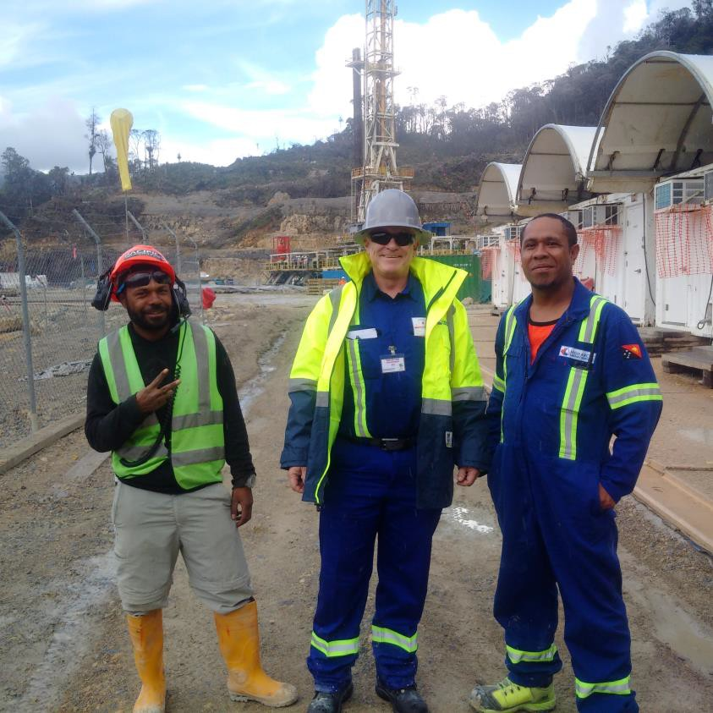
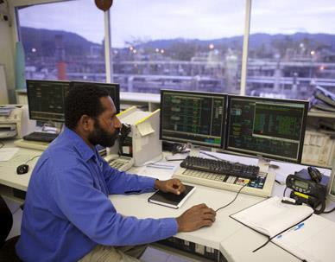
Local involvement
10
Notes:
A problem of traditional procurement models is that short term contracts do not allow for investment in long term training and the development of management opportunities for locals.
No matter where we’ve done oil and gas development around the world, when the people of an area see value being made under their feet, they rightfully expect to be involved.
We’ve never seen success where locals are not respectfully included. A long term approach helps us meet our clients local benefits goals.
A long term approach reduces security risks through the engagement and development of employees from nearby communities.

Slide 11
Quality Results
11
Notes:
The proof is in the pudding as they say.
In 2015 we changed our model to focus on quality, and the development of our local workforce, and as a result we changed safety to an outcome.
Our results are world leading in a very challenging place. Over 9 years and 4 million hours of recordable incident free work to date.
We have achieved employee buy-in to our way of work and lifted literacy along the way, resulting in advancement of personnel.
And we have often prevented loss of project control, saving our clients enormous time and money along the way.

Slide 12
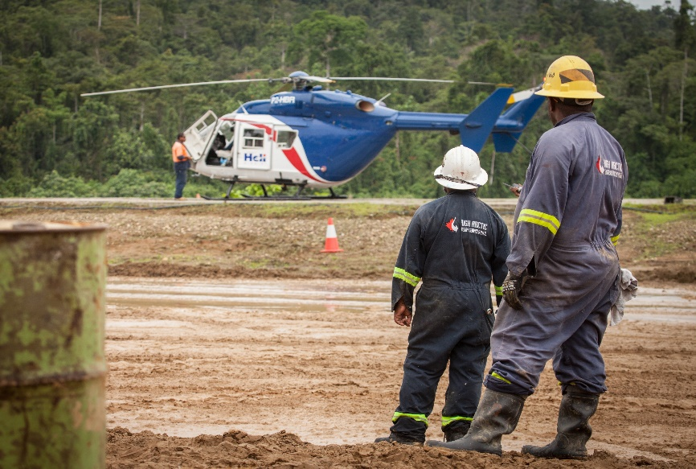
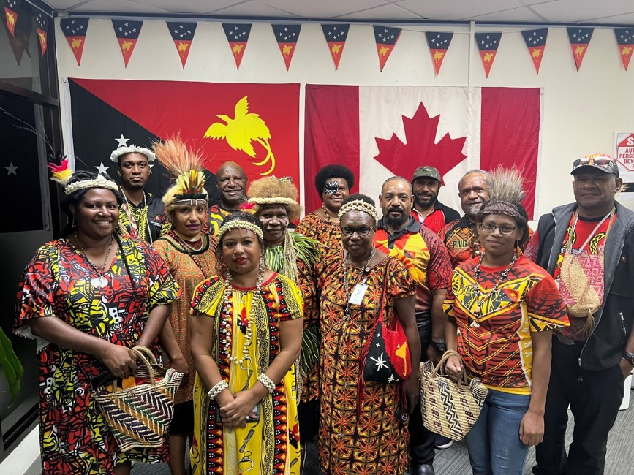
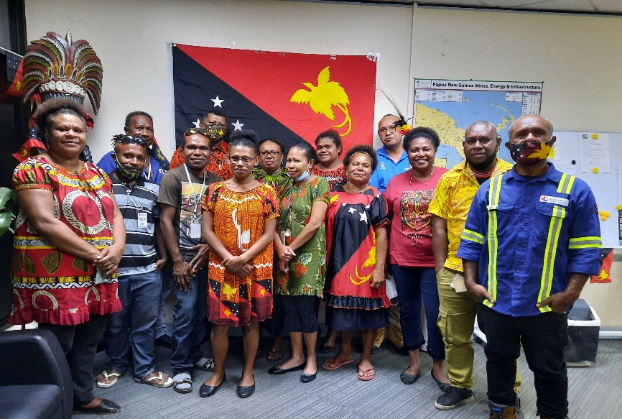
Conclusion – A recipe for Success
Its important - A lot of people depend on a successful supply chain from the well head in PNG to the burner tip in Japan
Future energy investment and access requires efficiency and investor returns while maintaining ESG standards
Success in the PNG market is dependent first and foremost on logistics efficiency and local involvement
nuances need experience and flexibility to prevent train wrecks
We are committed to PNG and it’s people.
We want to collaborate and solve problems for our clients
Create long term trusted and effective supply chain relationships
A continuous improvement model needs a team that continuously improves – who is on your team?
12
Notes:
We are committed long term to PNG and its citizens and we kept our clients working through the covid crisis with a trained local workforce and at a loss to us.
Few service companies have made the long-term commitment to the social development of PNG citizens and maintaining ESG standards. We have.
We think this is key to successfully unlocking PNG resources.
We want to collaborate and solve problems for our clients, to create long term trusted and effective supply chain relationships.
We think our results are speaking for themselves, and we hope to be a key supply chain partner in unlocking PNG resources for a long time into the future.

Slide 13
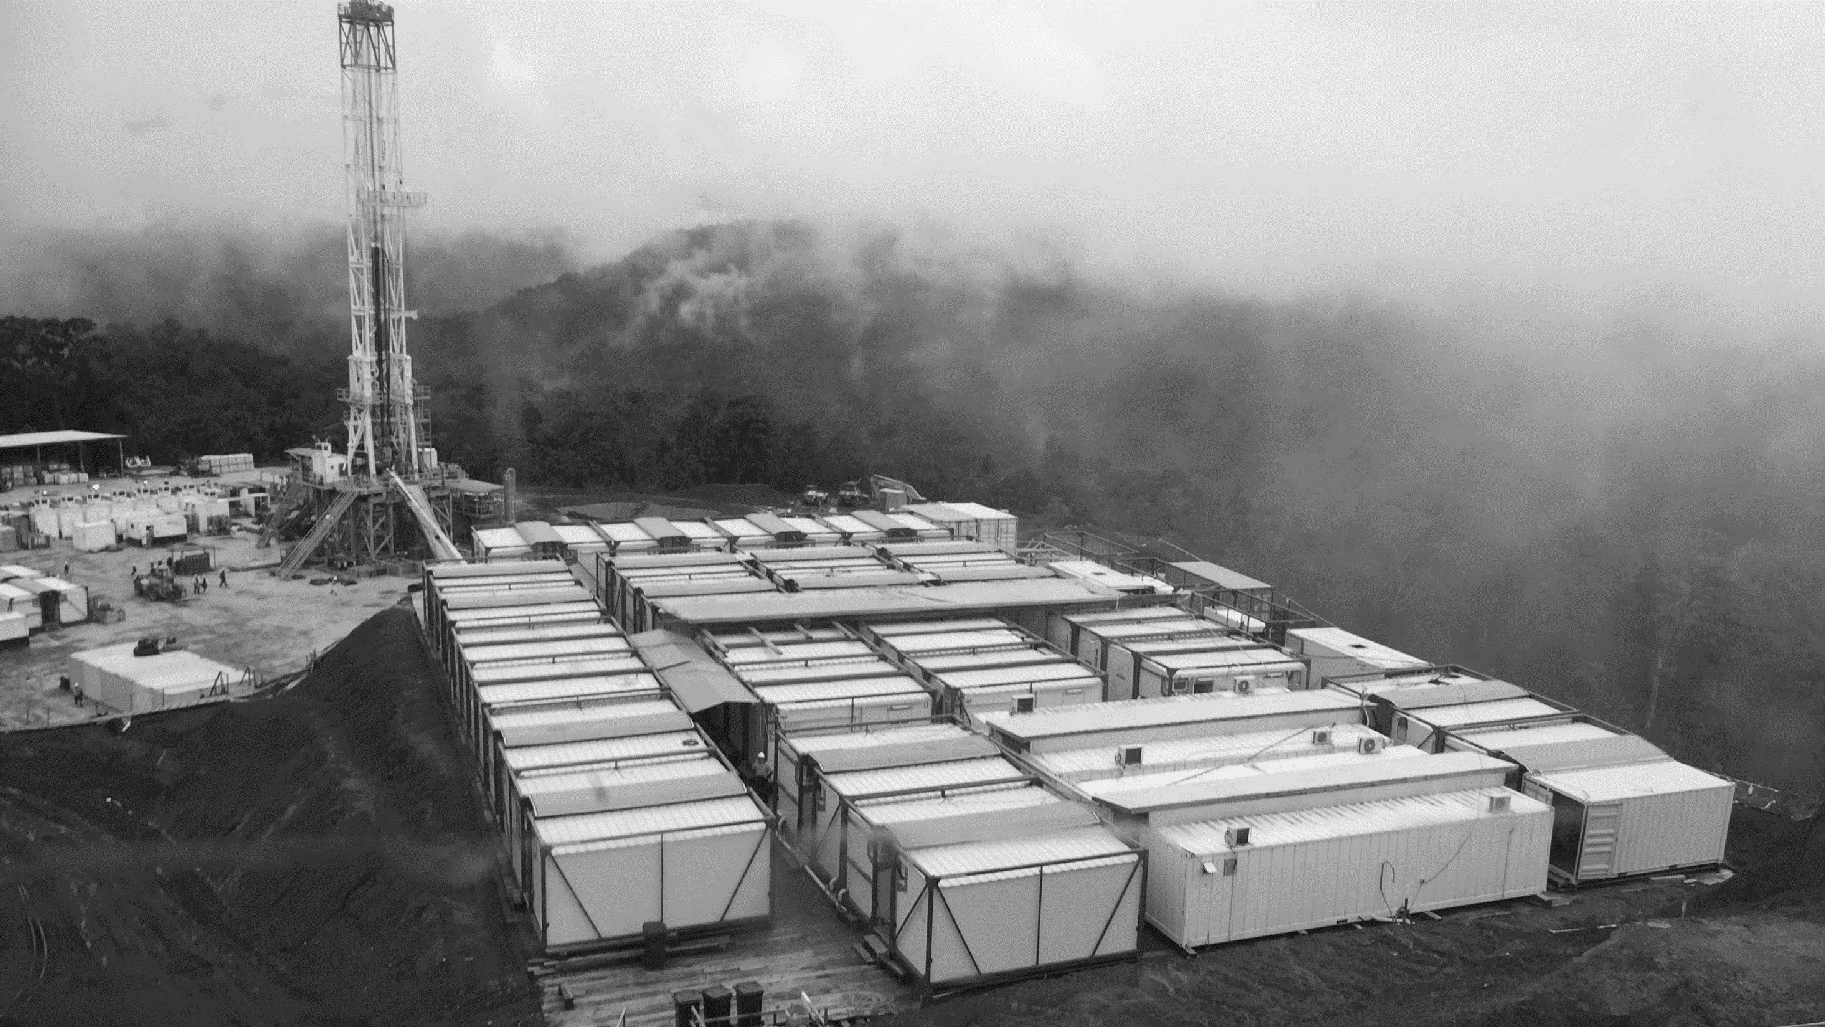
CONTACT US www.higharctic.com info@higharctic.com
Thankyou for listening
TSXV : HOH +1.587.320.1301 +61.7.3911.1385 +675.307.2025
13
Notes:
Thankyou and I am happy to take any questions.

