Slide 1

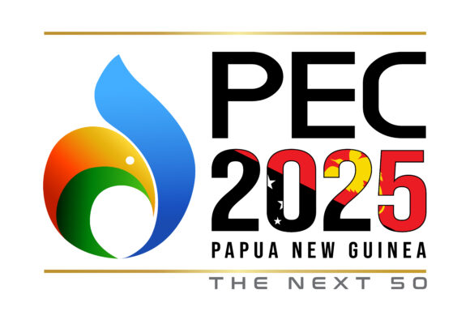
2025 PNG PETROLEUM & ENERGY CONFERENCE
NATIONAL PETROLEUM AUTHORITY
8 & 9 OCTOBER 2025
Session 3: Explorations
Operations, Is There a Future?
Presenter: David Manau
Secretary & A/Managing Director
Notes:
Speaker Notes: “Good afternoon, ladies and gentlemen. It’s an honour to speak on a topic that sits at the heart of PNG’s energy future. Exploration is not just a technical process—it’s a strategic choice. It’s about how we position our country, attract investment, and unlock long-term value for our people. Today, I’ll walk us through PNG’s current exploration footprint, the challenges we’ve faced, and the opportunities that lie ahead. The question is not whether exploration has a future—but how we shape that future together.”

Slide 2
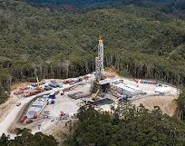
PNG’s Strategic Energy Position
PNG holds ~25 trillion cubic feet (Tcf) of identified gas reserves—among the largest in the region.
Oil production began in 1991 but is now declining; national focus has shifted to LNG.
PNG is a rising LNG exporter to Asia-Pacific markets, with growing demand.
Kumul Petroleum Holdings Ltd (KPHL) holds State equity in all future developments.
State Endorsement of the National Petroleum Authority (NPA): Tasked with promoting exploration and de-risking prospects in partnership with licence owners and industry partners.

Slide 3
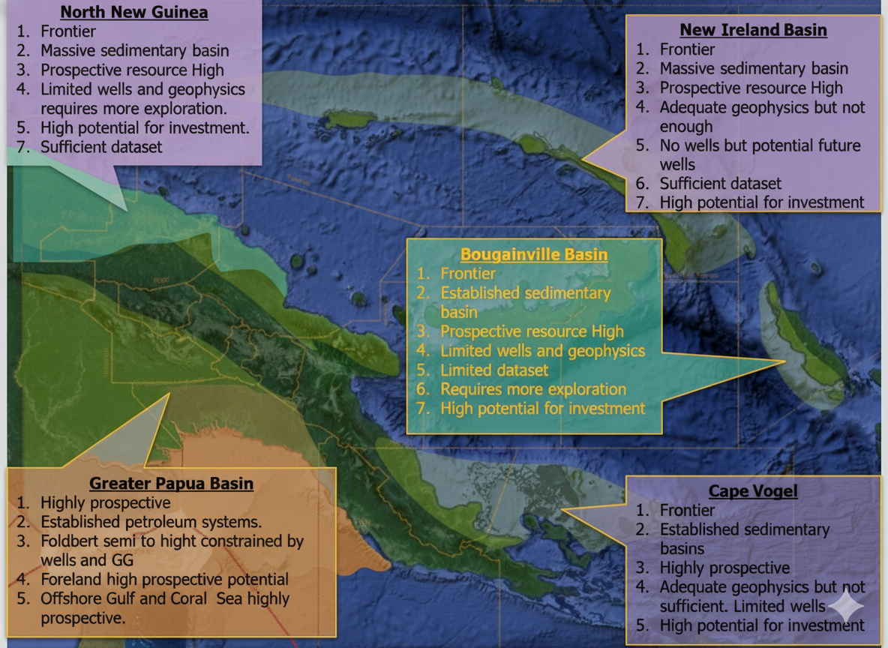
Development Footprint: PNG’s Petroleum Basins
PNG has five petroleum basins: Papuan, North New Guinea, Cape Vogel, Bougainville, and New Ireland.
Only the Papuan Basin is currently producing oil and gas.
The Papuan Basin contributes ~17% of PNG’s GDP—highlighting its economic significance.
Other basins are underexplored and require geoscientific data and policy incentives to attract investment.
Unlocking even one additional basin could dramatically increase national revenue and landowner benefits.

Slide 4
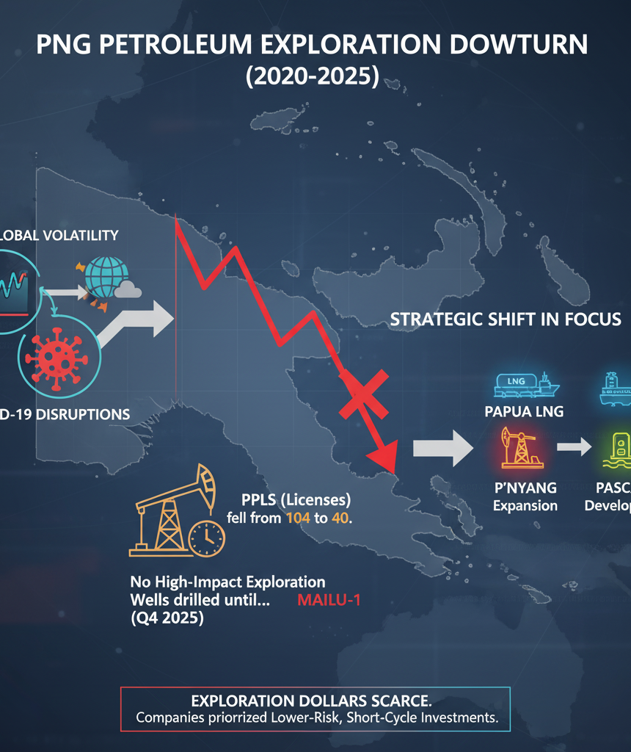
Exploration Activity (2020 – 2025)
Exploration activity declined sharply due to global volatility and COVID-19 disruptions.
Petroleum Prospecting Licenses (PPLs) dropped from 104 to 40.
No high-impact exploration wells were drilled until Mailu-1, scheduled for Q4 2025.
Focus shifted to LNG development projects: Papua LNG, P’nyang, Pasca A.
Exploration dollars were scarce, and companies prioritized lower-risk, short-cycle investments.

Slide 5
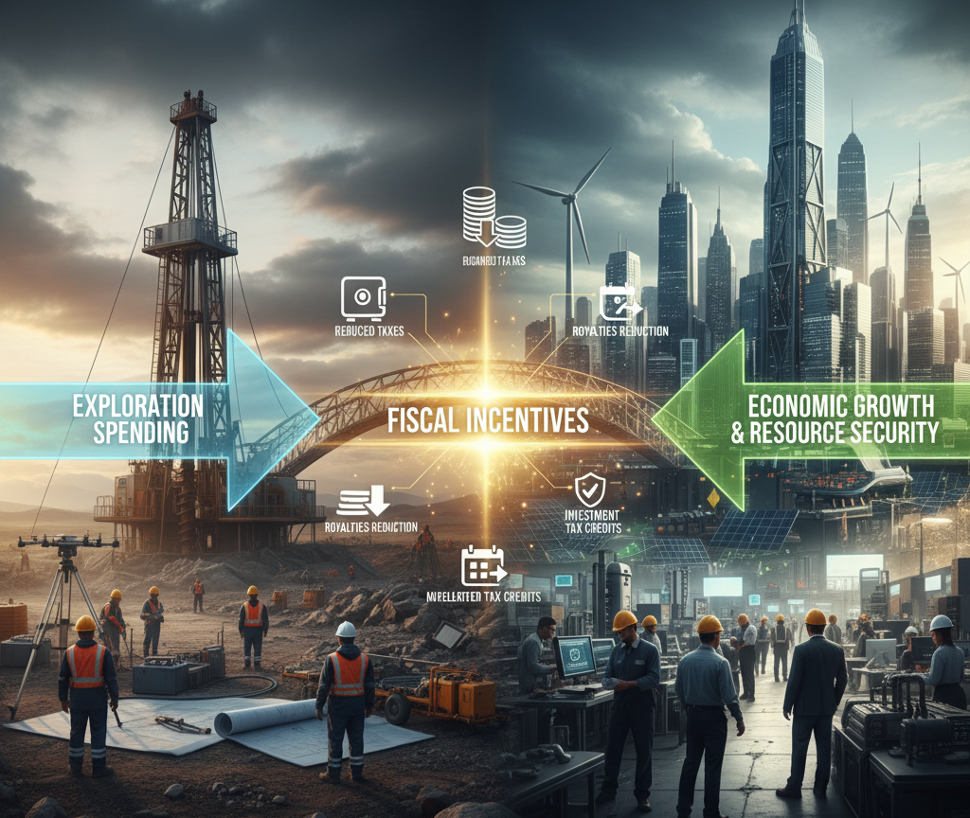
Exploration Spending & Fiscal Incentives
Despite low drilling, companies invested in seismic surveys, G&G studies, and licensing.
PNG’s Income Tax Act (s155N) allowed amortization of exploration expenditure—leading to K10 billion in forgone revenue.
This fiscal incentive kept exploration capital flowing during the downturn.
Zero-rating of exports also supported upstream investment.
These tools demonstrate PNG’s commitment to exploration-friendly policy.

Slide 6
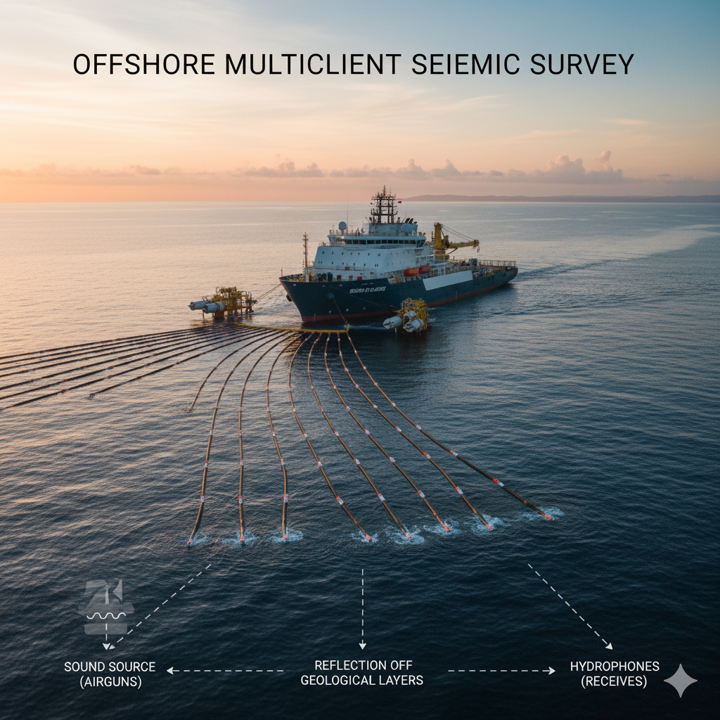
Offshore Multi-Client Seismic Surveys
Painimaut 2D (2020): A comprehensive 2D seismic survey acquired in the deepwater Gulf of Papua to map regional geology.
Nanamarope 3D (2023): A high-resolution 3D seismic survey acquired to define specific drill targets.
Vendor-Funded & Non-Exclusive: These multi-client surveys, initiated by seismic vendors, signal speculative but increasing industry confidence in the region.
Catalyst for Investment: By spreading data costs, multi-client surveys effectively de-risk exploration, drawing a wider range of bidders for future license block allocations.
PNG's Next Exploration Hotspot: The Offshore Gulf of Papua is rapidly gaining recognition as PNG's most promising new exploration frontier.

Slide 7
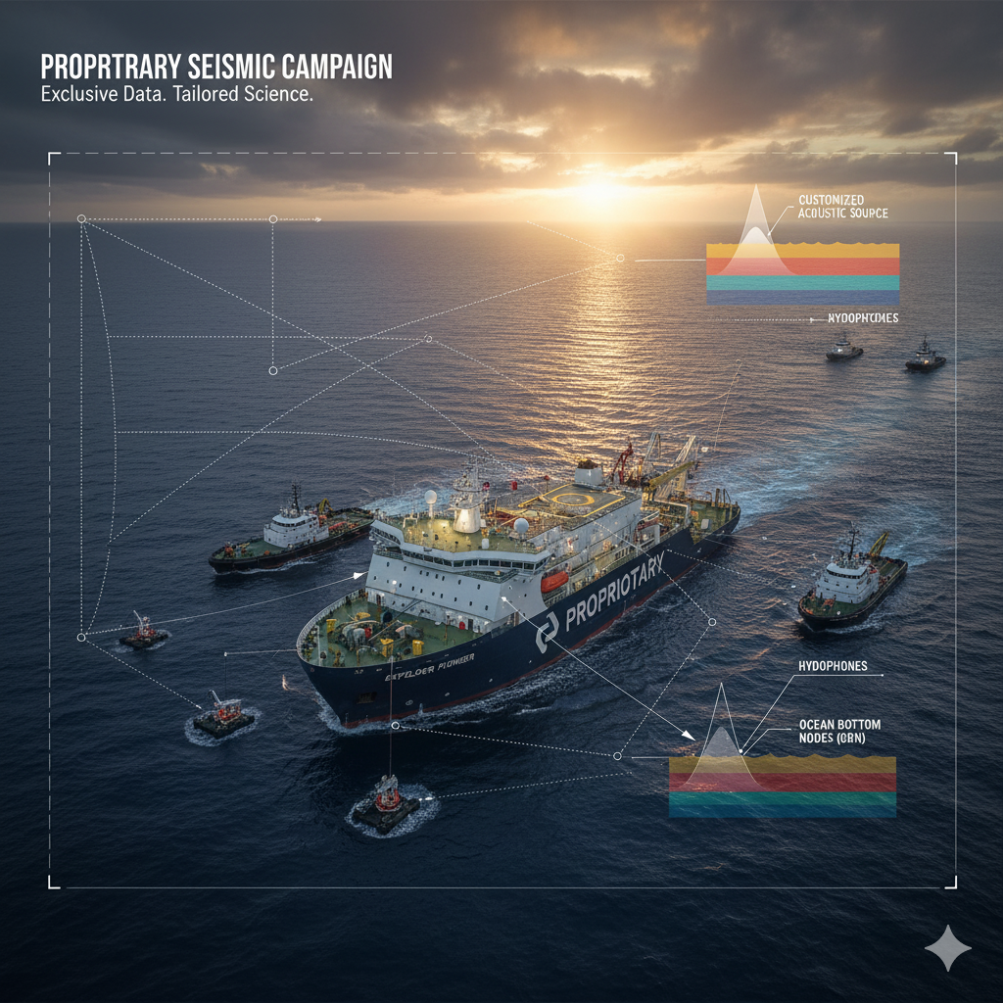
Proprietary Seismic Campaigns
KPHL Enters Upstream Exploration: Kumul Petroleum Holdings Limited (KPHL) completed its inaugural seismic campaign in the Kimu and Barikewa Petroleum Retention Licenses (PRLs).
AIE Optimizes P'nyang: AIE utilized Vibroseis technology for an infill exploration survey near the P'nyang field, aiming to refine existing reserve estimates.
The Nature of Proprietary Seismic: Such surveys are 100% funded by the operator, often target geologically complex reservoir systems, and necessitate extensive manual clearing of survey lines alongside robust community engagement.
Sustained National Exploration: These activities highlight PNG's ongoing national commitment to resource exploration, persisting even through adverse global economic and market pressures.

Slide 8
Deepwater Wildcat – Game Changer
MAILU-1
Mailu-1 targets a giant liquids prospect in Tertiary carbonate play.
Requires advanced deepwater drilling: DP3 drillship, MPD system, 2,100m water depth.
Estimated cost: $50–$80 million USD.
Petronas farmed into PL 576, acquiring 50%—validating the prospect’s potential.
Scheduled to spud in Q1 2026; could open a new offshore hydrocarbon province.
WILDEBEEST (onshore Gulf)
Operator: Originally operated by TotalEnergies (now TotalEnergies EP PNG Corporation, a subsidiary of TotalEnergies SE).
Location: Situated onshore Gulf Province, an area that is considered one of PNG's next high-impact exploration frontiers.
Wildebeest considered a wildcat prospect, Such wells are high-risk, high-reward.
High-Impact Potential: The prospect has been identified as having the potential for very large gas discoveries.

Slide 9
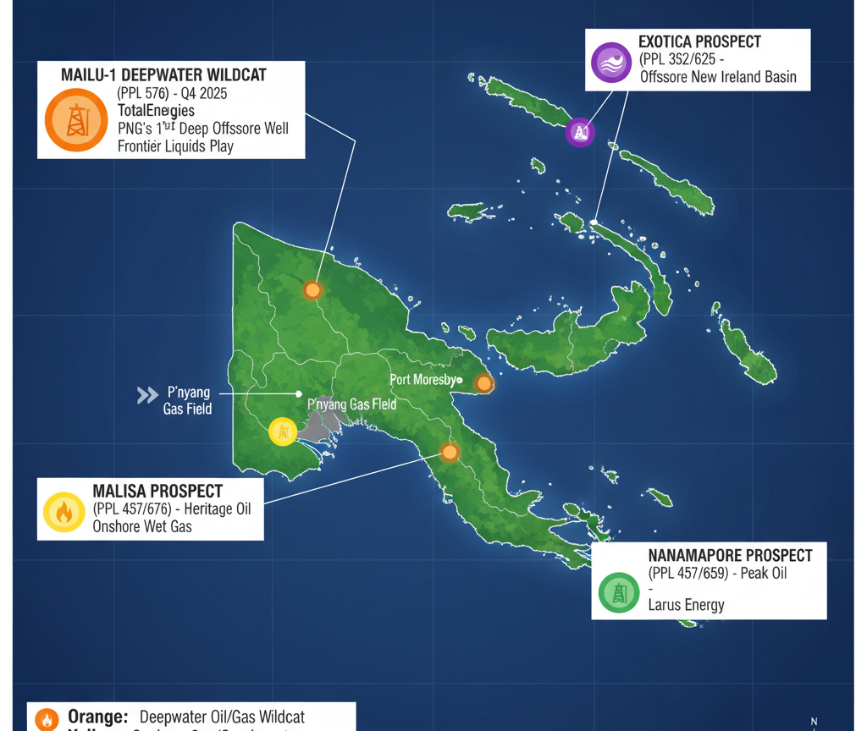
PNG Exploration Initiatives
PPL437 & PPL676 (Malisa Prospect): Operated by Heritage Oil, this prospect is located near P'nyang and is identified as a drill-ready prospect with approximately 2 Tcf potential, focused on wet gas.
Exotica Gas Prospect (PPL 352 and PPL 625): Located in the New Ireland Basin, licenses held by Peak Oil.
Nanamapore Prospect (PPLs 579 and 659): Located in Central Province, Papuan Basin, and is a Larus Energy prospect.

Slide 10
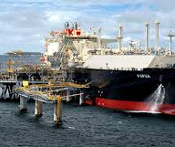
Leveraging Infrastructure & Brownfield Strategy
Near-field exploration near existing pipelines and LNG plants reduces cost and risk.
Brownfield areas offer faster time-to-market for new discoveries.
Angore Pipeline Tie-in Project is a model for efficient development.
Existing infrastructure can support marginal fields and domestic supply.
Strategic use of infrastructure enhances investor confidence.

Slide 11
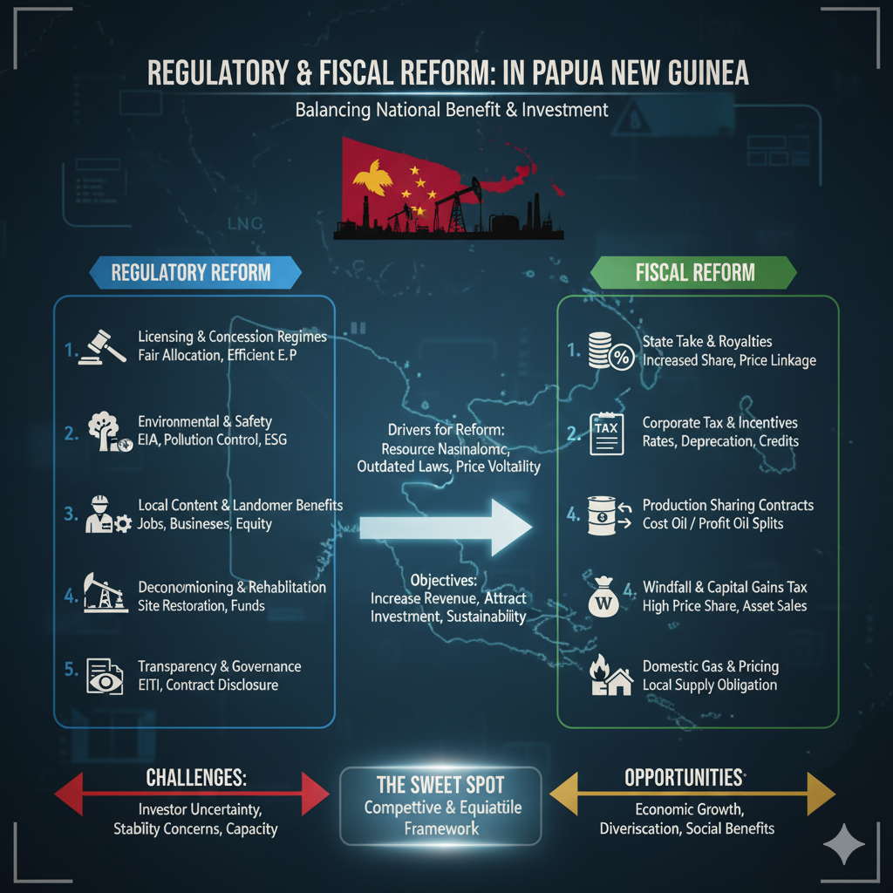
Regulatory & Fiscal Reform
PNG is transitioning from a concessional regime to a Production Sharing Regime (PSR) by 2026.
PSR offers a different risk/reward balance—more attractive for frontier exploration.
NPA is preparing bid rounds and facilitating MCSS permits.
Data-driven governance improves transparency and investor engagement.
Reforms must align with geological potential and market realities.

Slide 12
Way Forward: Centers on three pillars
1. Fiscal and Regulatory Reform
PNG is shifting to a Production Sharing Regime (PSR) by 2026, replacing the current concessional model for explorations. The National Petroleum Authority (NPA) will launch a new exploration licensing bid round in Q1 2026.
2. Aggregate marginal fields for LNG tie-in and domestic supply.
3.Reviving Exploration & Reducing Risk: support high-risk exploration projects.Multi-client seismic surveys (MCSS) will continue in frontier areas like the Offshore Gulf of Papua and to other basins, to reduce geological uncertainty.
4. Operational Efficiency and Domestic Impact
PNG is prioritizing a brownfield strategy—using existing LNG infrastructure to lower costs and speed up development. Projects like the Angore Pipeline Tie-in and AgogoTie-in project show how futture new discoveries can be efficiently integrated.

