Slide 1



Driving Logistics into Energy- Pioneering PNG’s Domestic Gas Revolution
PNG Petroleum & Energy Conference (PEC) 2025
Stanley Hotel, 8-9 October 2025
Mr Rupa Mulina
TWL Group External Affairs Manager

Slide 2
The Foundation
Founded: 2009 in Papua New Guinea (PNG) as a landowner-led enterprise.
Vision: "To develop an integrated, sustainable transportation and logistics business beyond the life of oil and gas in PNG.“
Scale:
10,000+ shareholders across 4 provinces, 9 ethnic groups, and 28 landowner companies.
700+ employees, PGK 150M+ net assets, PGK 100M+ average annual turnover.

Slide 3
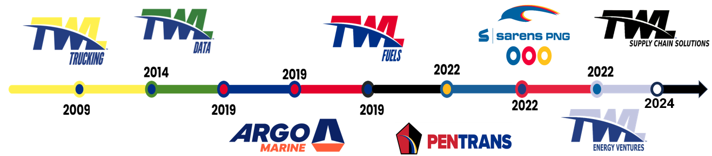
Evolution & Diversification
Strategic Growth Timeline
2009: Launched TWL Trucking (17 trucks, PGK 11M Oil Search loan).
2014: Founded TWL Data (aerial/GIS mapping across 3,000+ km² in Asia-Pacific).
2019: Acquired 50% of Pacific Project Logistics (rebranded as TWL Logistics → Argo Marine, 2024).
2022:
Formed PenTrans (PNG) with Pentagon (global freight/logistics leader).
Acquired 100% of Arran Energy, creating TWL Energy Ventures (upstream oil/gas).
2023: JV with SARENS (Belgium) for heavy-lifting (5,000-ton capacity).
2024: Launched TWL Supply Chain Solutions (3PL/4PL logistics).

Slide 4

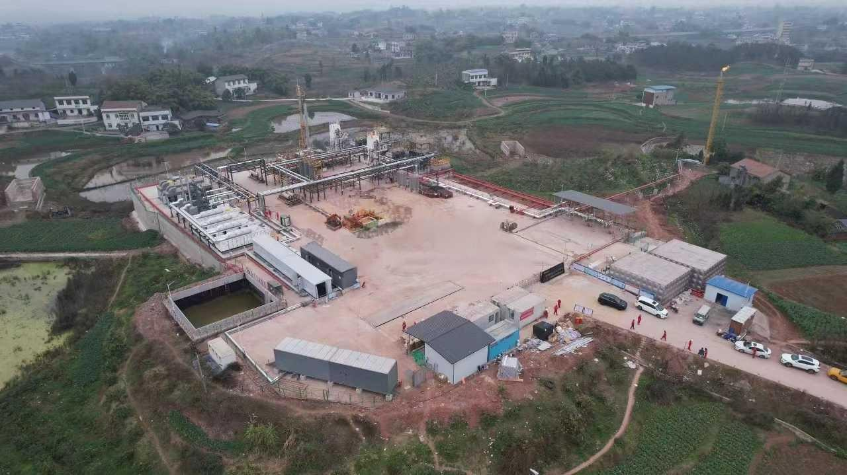
2022
In December 2022, TWL Group acquired 100% of Arran Energy and its subsidiaries via Share Purchase making TWL Energy Ventures (TWLEV) the first PNG landowner company to directly lead and participate in the upstream oil and gas business.
Petroleum assets include Five Petroleum Licences in the Western Province, PNG
PDL10- Stanley Gas Development & Gas to Electricity
APDL12 (PRL21, PRL28, PPL574) – Ketu Elevala Ubuntu Gas Development
APRL42 – NW Koko
Resource Volumes – 1.73 TCF (Gas 2C) & 73.8 MMbbls (Cond 2C)

Slide 5
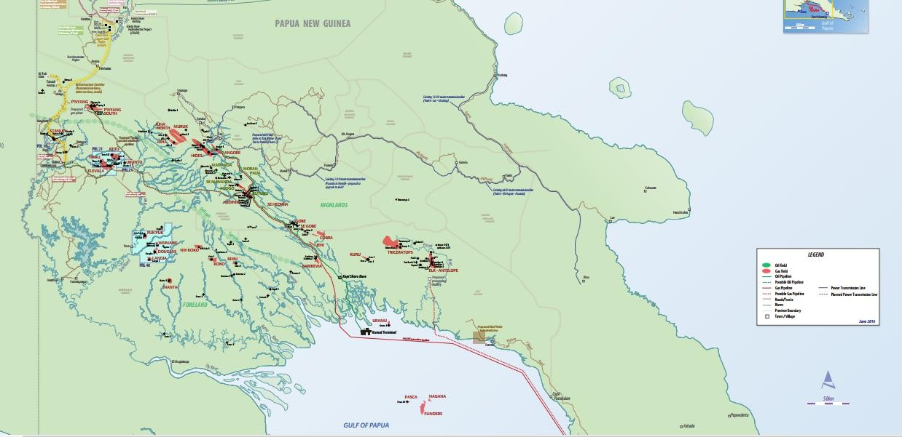

TWLEV–Resource Summary
 | Resource Volume (Gross) |  | TWLEV (Arran Equity)
License | Gas 2C (Bcf) | Cond 2C (MMbbl) | %
PDL 10 | 409 | 11.3 | 90.00
PRL 21 | 1,163 | 50.4 | 83.25
PRL 28 | 45 | 2.3 | 67.50
APRL 42* | 116 | 9.8 | 100.00
Total | 1,733 | 73.8

Slide 6
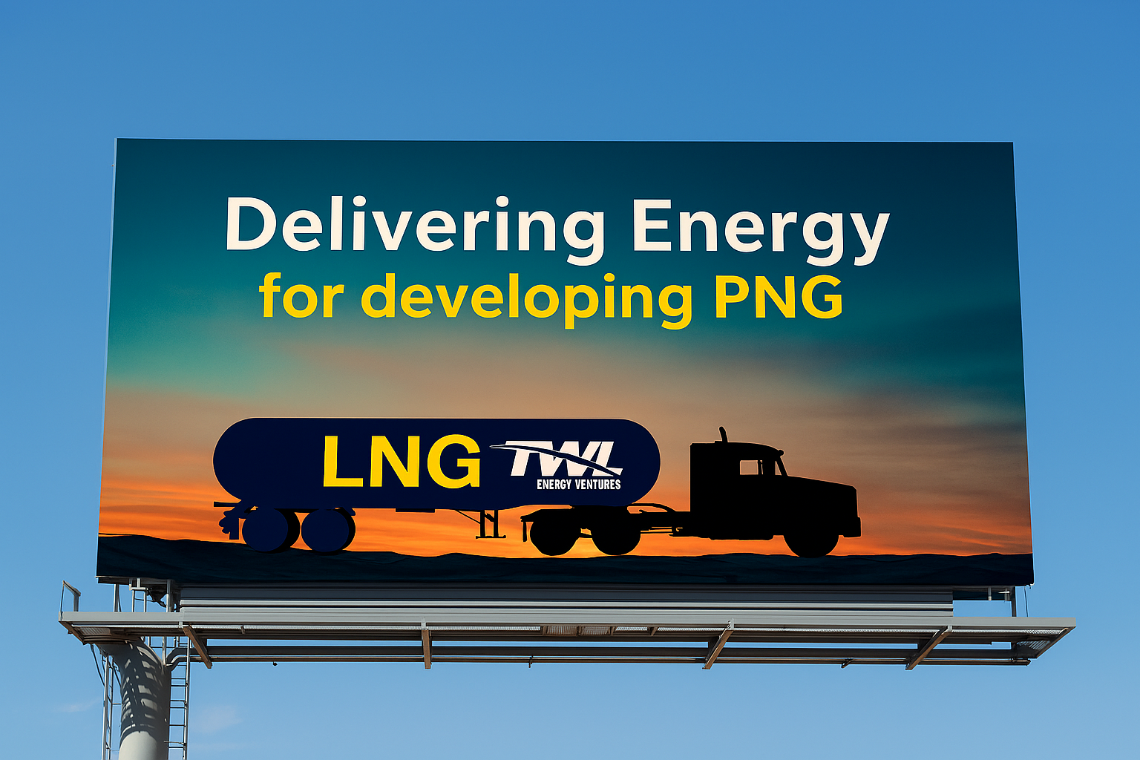

Slide 7
PNG Domestic Gas Market Utilisation

Slide 8

Vision
“Driving national progress through small-scale LNG and Innovative Gas Solution Technologies —powering local industry, transforming communities, and preserving our environment for future generations.”

Slide 9
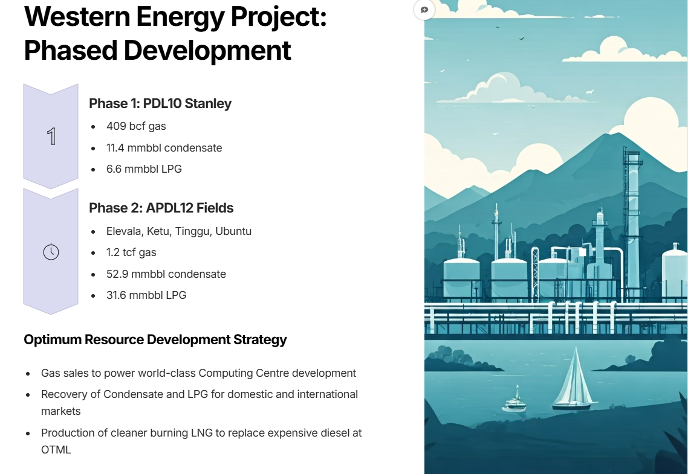
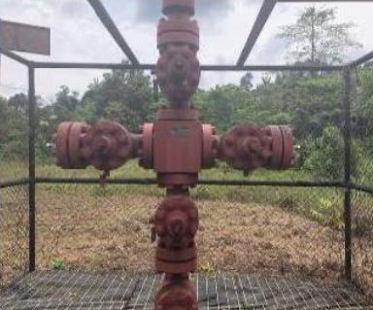
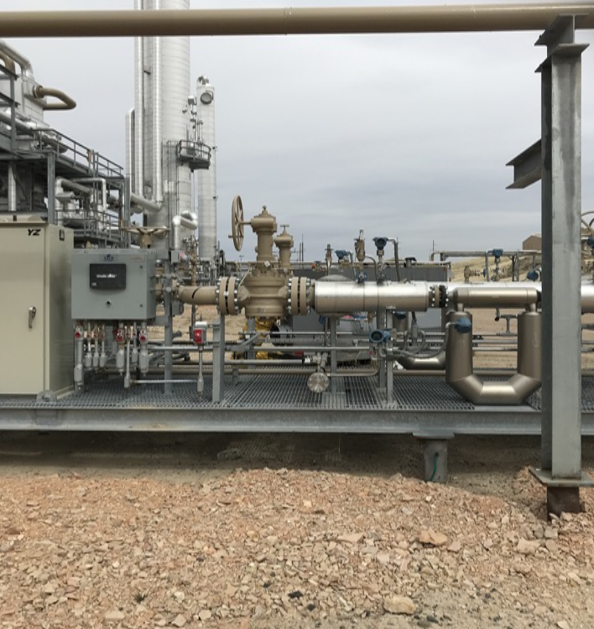
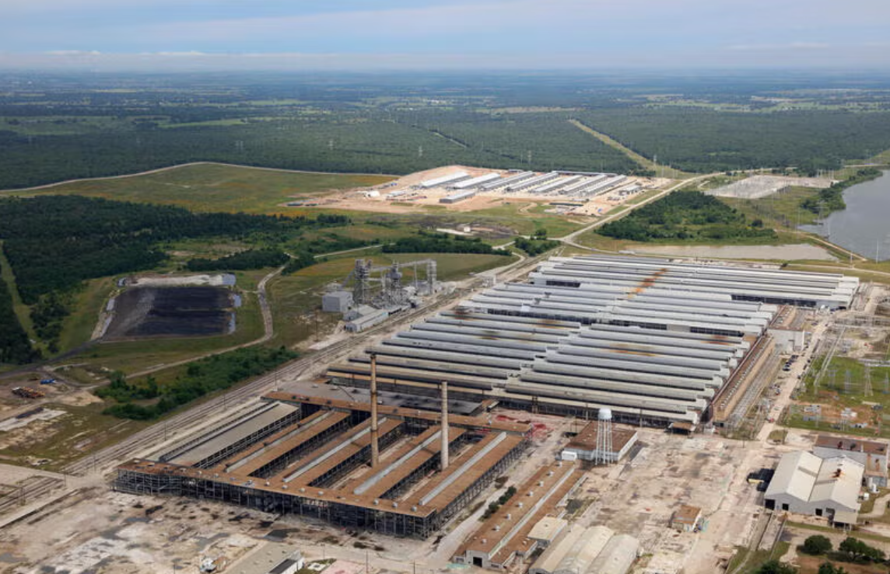
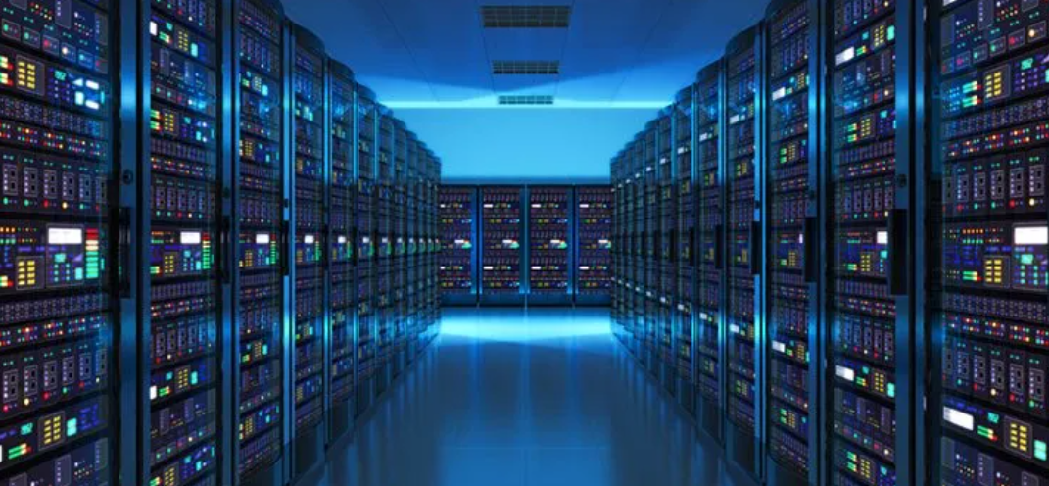
1
2

Slide 10
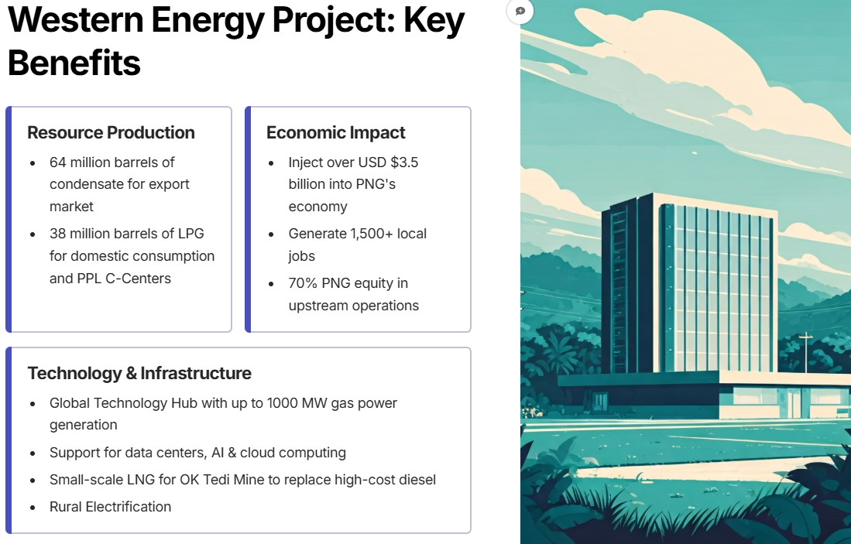

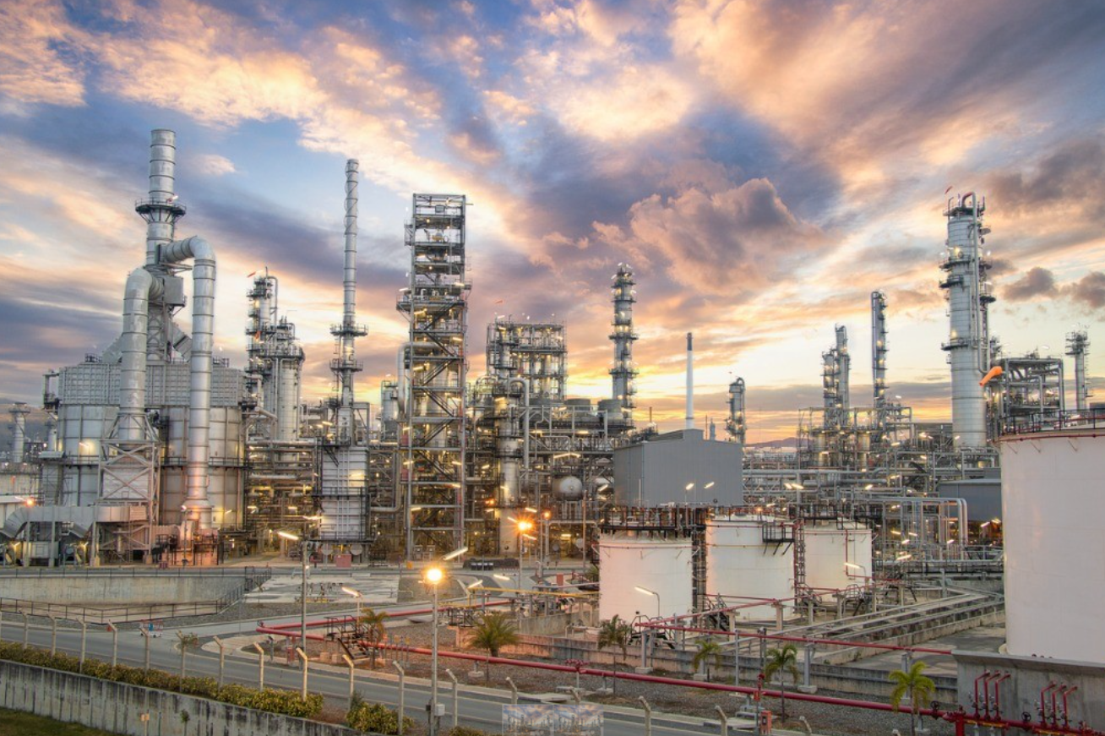
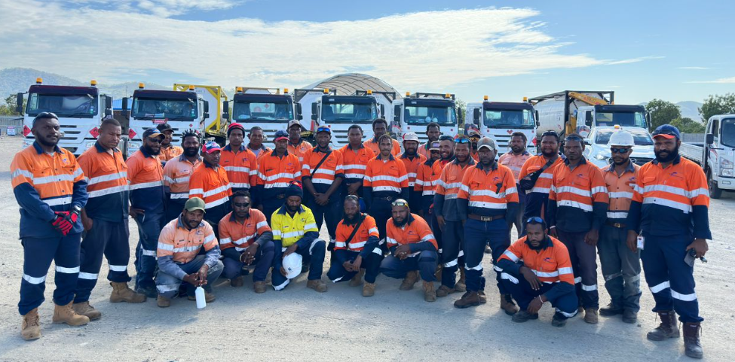

Slide 11
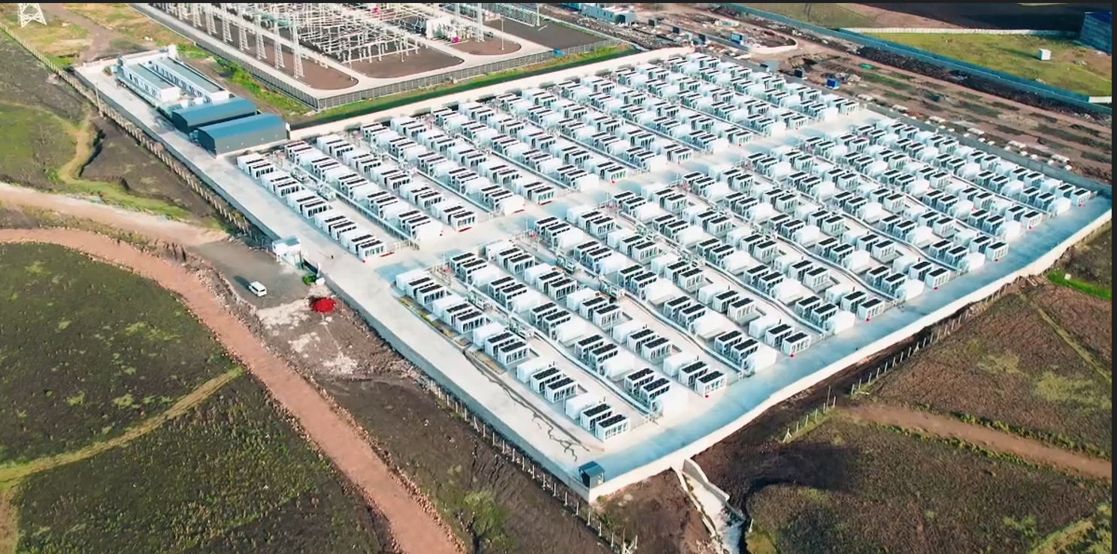

Slide 12
Focus Area 1 Powering Industry & Economic Growth
Deliver reliable and cost-effective LNG solutions for domestic industries, transport, and power generation.
Support import substitution by reducing reliance on expensive diesel and heavy fuel oils.
Catalyze downstream opportunities in manufacturing, logistics, and local enterprises.

Slide 13
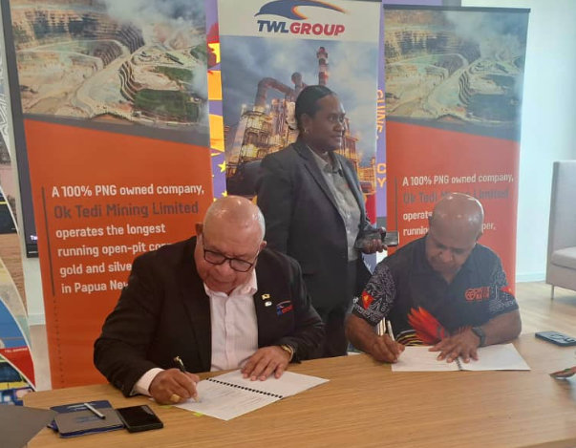
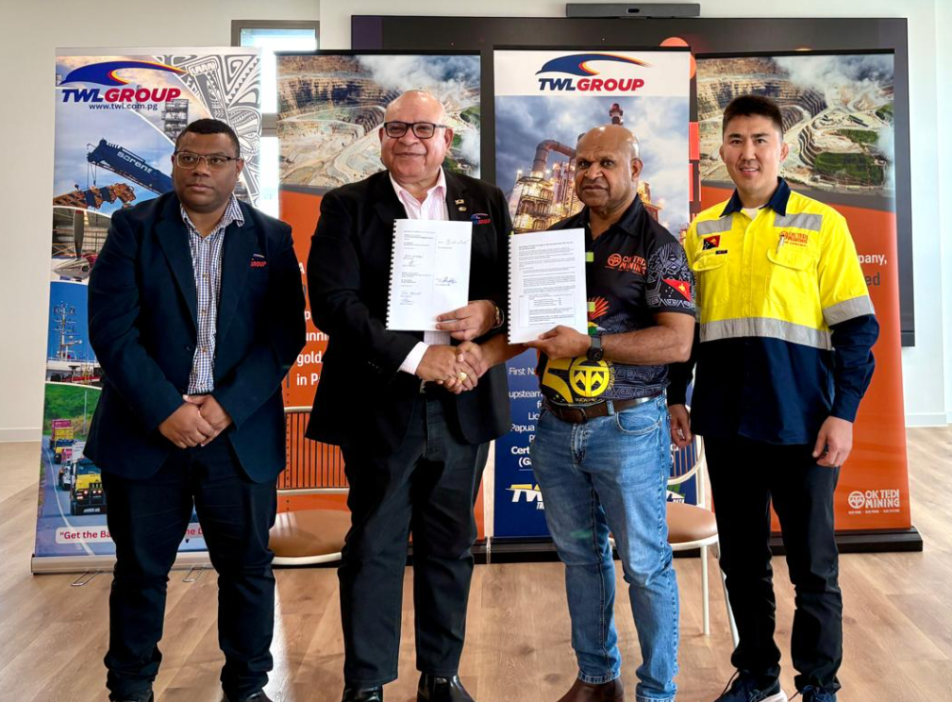
Stanley Gas Project – PDL 10
Signing of LNG Supply Termsheet with OK Tedi Mining Limited (OTML)

Slide 14
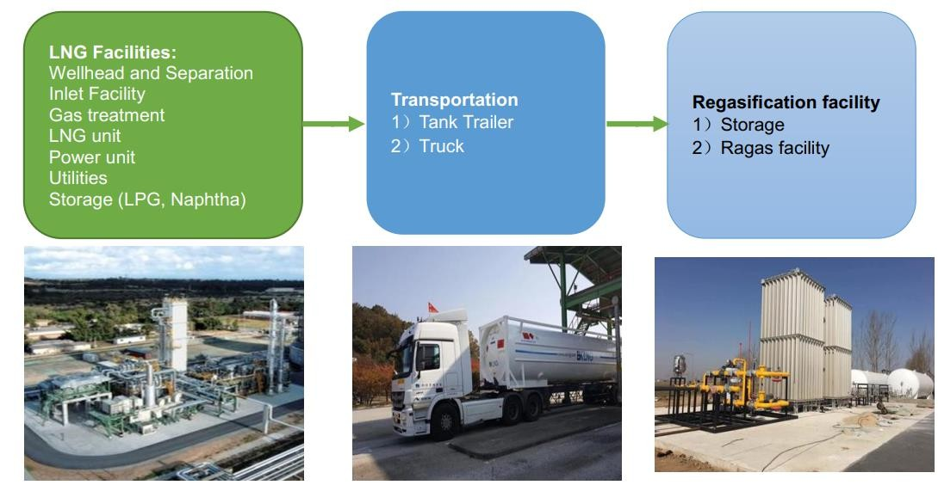
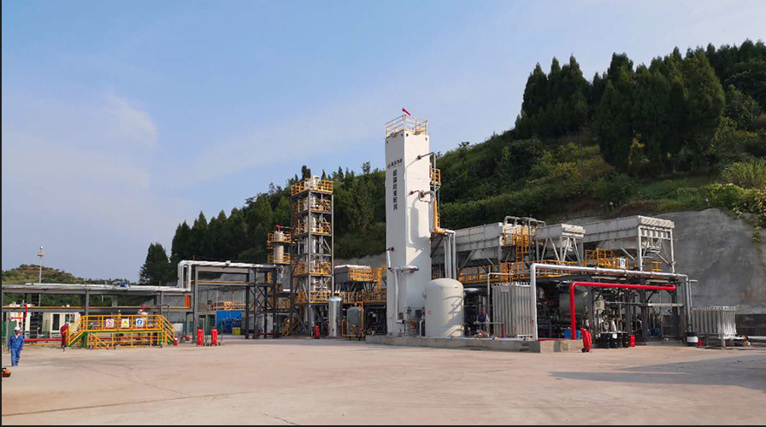
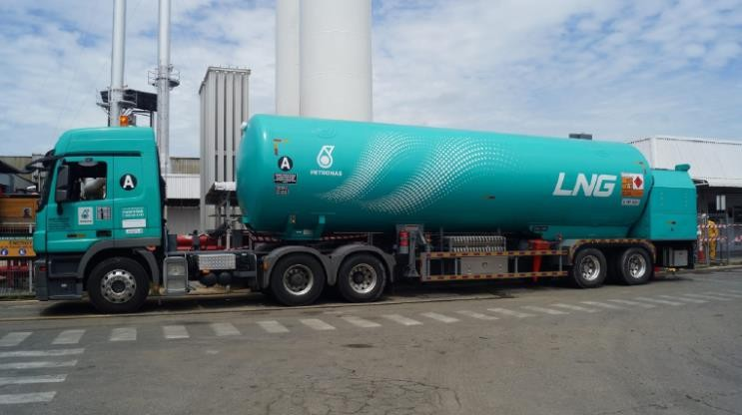
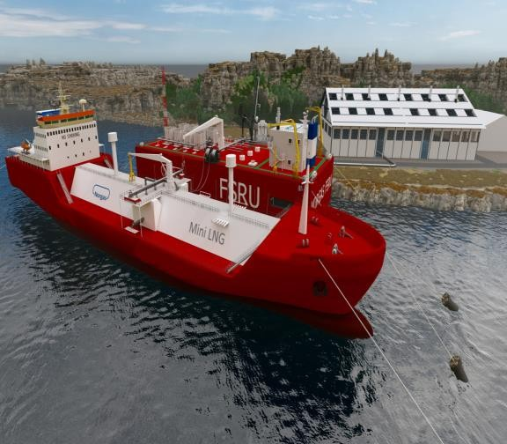
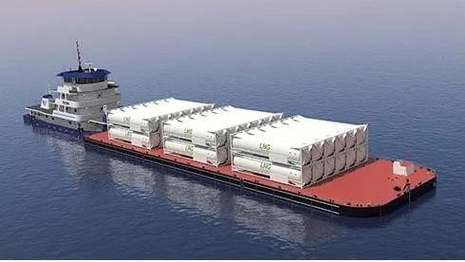
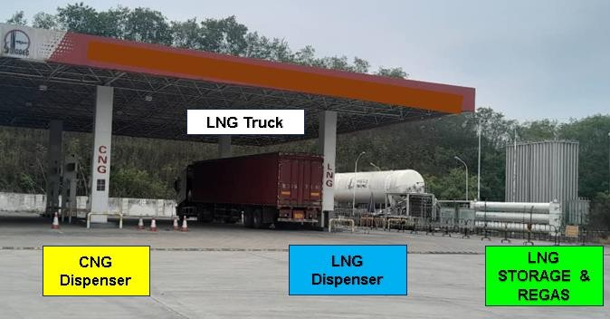
Stanley Gas Project – PDL 10
PNG’s First Small Scale LNG Project
First Train - Production capacity 40,000 – 50,000 Tons of LNG per Annum (TPA)

Slide 15
Small Scale LNG Value Chain
OK Tedi Mine - LNG Production & Supply Configuration

Slide 16
Focus Area 2 Transforming Communities & Expanding Access
Extend energy access to rural and remote communities through modular, scalable LNG and Natural Gas solutions.
Enable local businesses, schools, and health facilities to thrive with affordable, cleaner energy.
Prioritize inclusive partnerships with landowners and local governments for shared prosperity.

Slide 17

Focus Area 3 Preserving Environment & Stewarding Resources
Reduce
Reduce carbon and particulate emissions compared to traditional fuels.
Implement
Implement best-practice environmental management in LNG operations.
Commit
Commit to sustainable resource use, aligning with PNG’s climate commitments and global ESG standards.

Slide 18
Focus Area 4 Building Local Capacity & Shared Value
Invest in skills training, technology transfer, and workforce development for Papua New Guineans.
Foster joint ventures and SME participation in the LNG value chain.
Ensure benefits flow equitably to landowners, communities, and the wider economy.

Slide 19
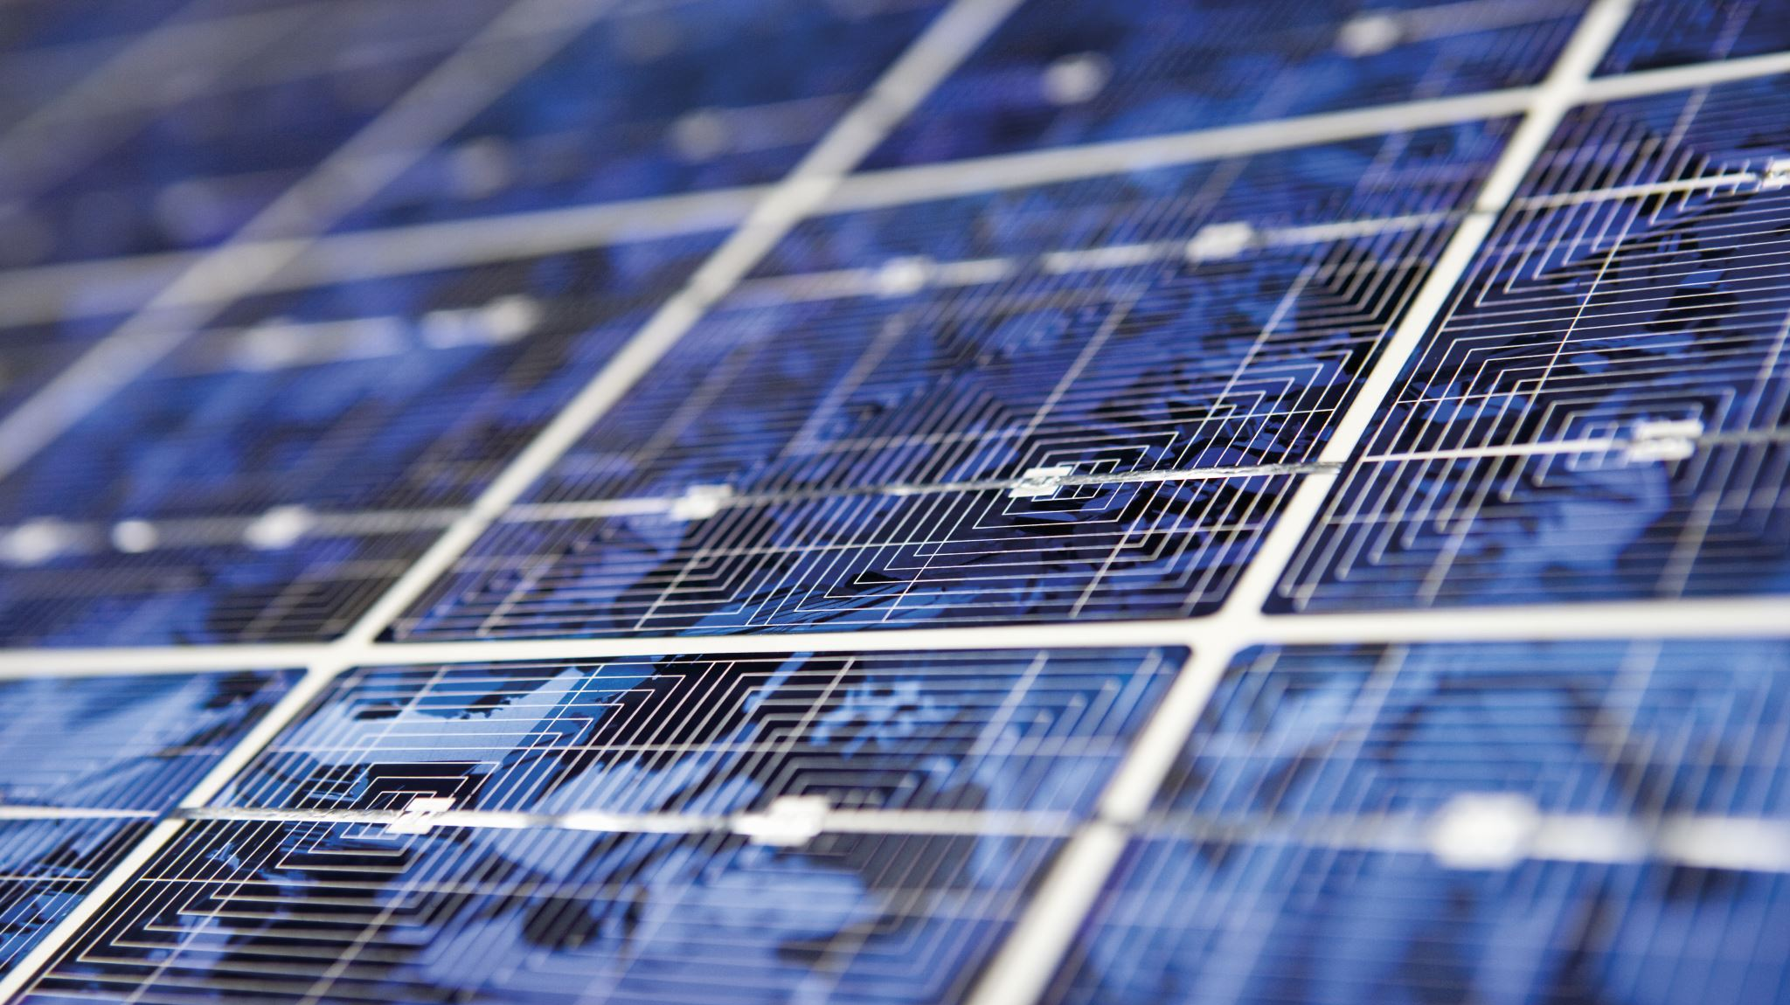
Focus Area 5 Strengthening PNG’s Energy Security & Pacific Leadership
Develop
Develop ssLNG and Natural Gas Solutions as a cornerstone of PNG’s diversified and resilient energy mix.
Position
Position PNG as a clean energy supplier to Pacific neighbors.
Showcase
Showcase PNG as a leader in innovative, sustainable small-scale LNG development.

Slide 20

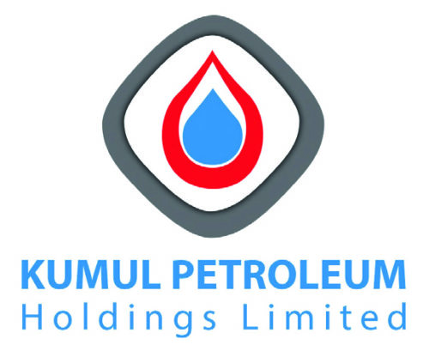


CHAPTER 7
Project Equity Structure
Our robust equity structure reflects a strong commitment to local participation and strategic international partnerships, setting a new benchmark for national resource projects.
Houpu BrightSpot
KPHL: Increasing National Stake
Arran Energy (TWLEV)
Local Stakeholders
.
Landowners & Provincial Governments: ensuring local participation and benefit.
70% PNG equity – sets national resource benchmark.

Slide 21
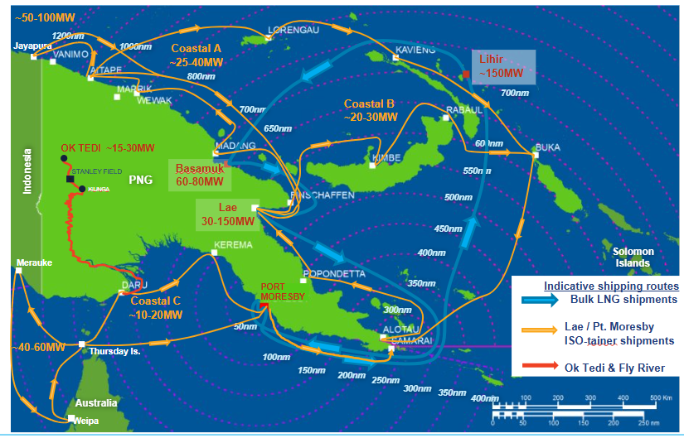
Potential of Domestic Natural Gas Market

Slide 22


Slide 23
End of Presentation

