Slide 1


Slide 2

Supporting landowner stakeholders in resource development areas: Providing access to banking and meeting AML Compliance
2025 PETROLEUM & ENERGY CONFERENCE
Paul Thornton, CEO

Slide 3


Placing our landowners at the centre of our mission.
Ensuring that our landowners, the true custodians of this country’s natural wealth, have fair, secure, and reliable access to banking and financial services is fundamental to Papua New Guinea’s development.
A bank is only as strong as the people it serves. And in PNG, that means placing our landowners at the centre of our mission.

Slide 4

Why Landowners Matter
Landowners are the backbone of our economy and communities.
Their well-being determines whether resource projects deliver long-term, sustainable benefits for Papua New Guinea.
Landowner groups have struggled with barriers to basic financial services, from distance to the nearest branch, to limited access to banking technology, to challenges in navigating compliance requirements.
NBC is determined to change that.

Slide 5

High transaction costs, little left as savings.
Landowners travel to town to withdraw majority of the payments.
Access to these payment involves PMV or boat fare.
Cost influences the decision to withdraw most of the payments in cash.
Cash is easily spent leaving less for savings.

Slide 6
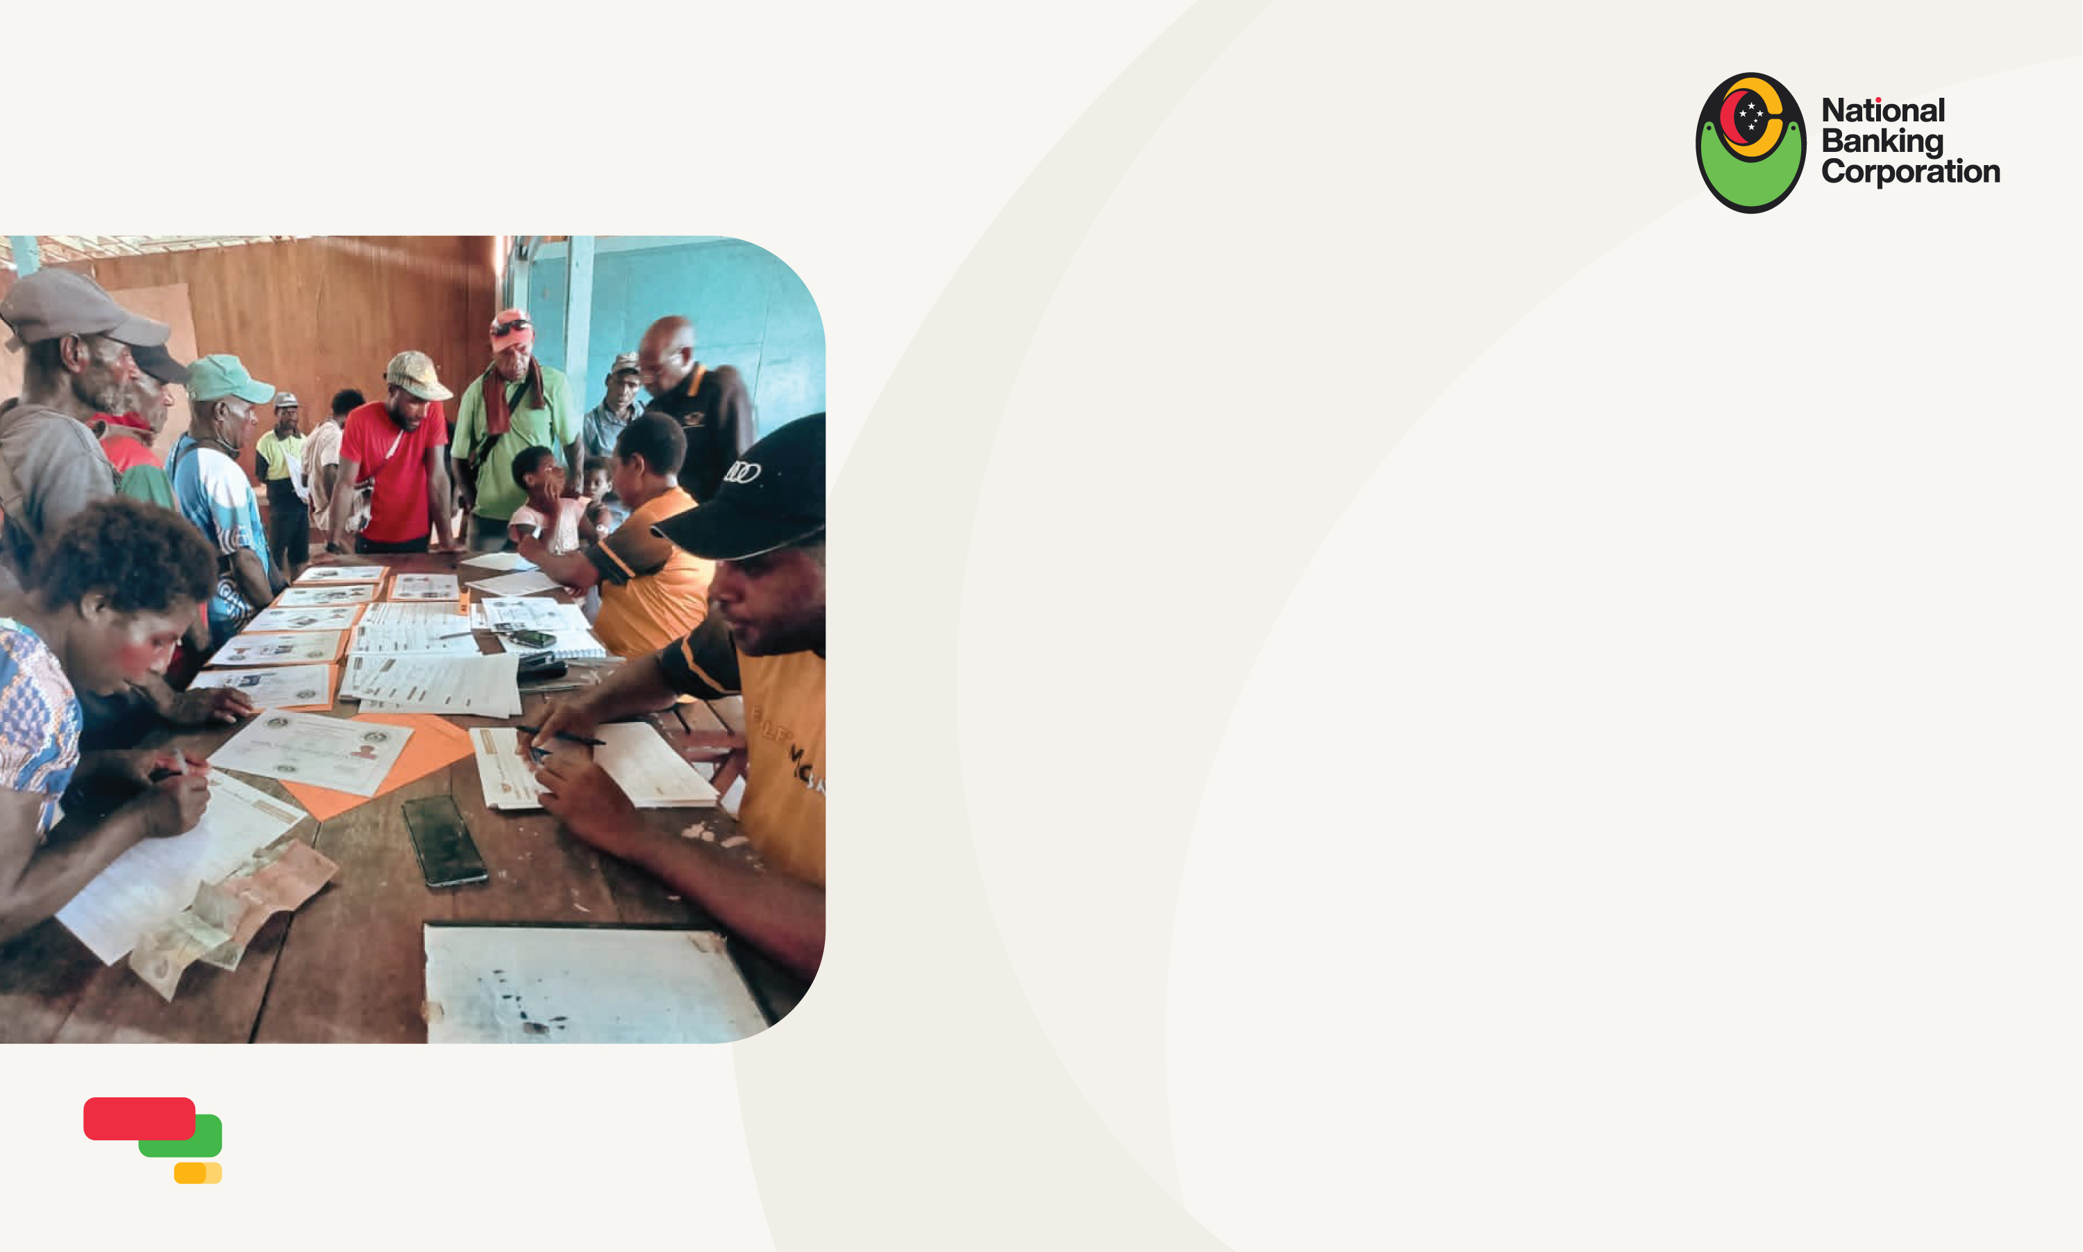
How can NBCL assist landowners in improving access to their royalty payments, without the need to incur expensive transport costs?
AGENCY BANKING
including bank-staffed agencies
ELECTRONIC PAYMENT
including financial literacy of people
in the payment eco-system
FINANCIAL INCLUSION
of the people living in the “payment
eco-system”, Leverage knowledge
that Resource Developers have & a
risk-based approach to customer
identification.

Slide 7

A cash economy can feed corruption and fraud.
Reducing cash through financial inclusion and a focused “payment eco-system” can reduce the opportunity for corruption and fraud.
It can also mean that landowners improve their real financial return.
Thank you!

