Slide 1
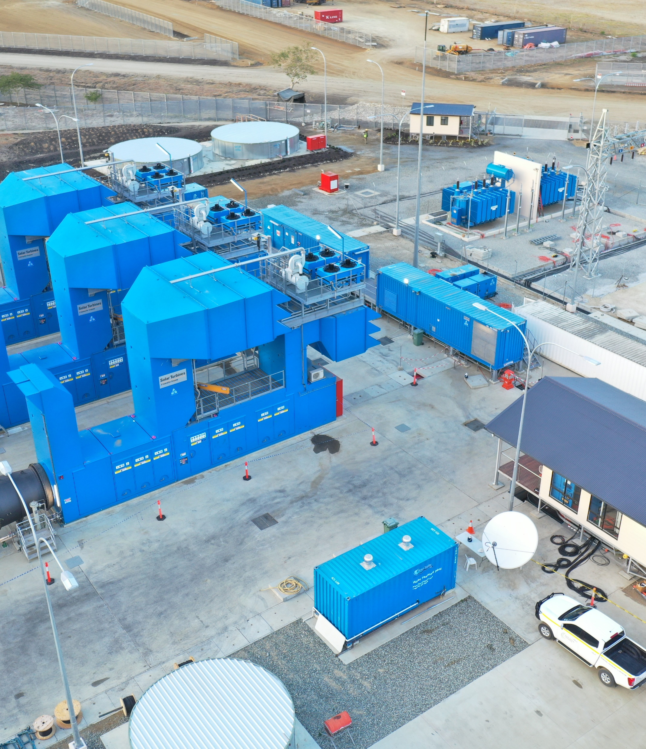

PNG’s Electricity Industry: Challenges, Opportunities, and Policy Directions
October 2025
Notes:
Good morning everyone
I’m James Nelson, CEO of Dirio
I’ll be presenting today on the challenges, opportunities and policy directions within PNG’s electricity industry
My analysis is mostly in the context of PNG government’s energy policy defined by the Medium Term Development Plans
I’ll give a brief overview of the market structure, policy and legislative framework, status of the industry today including challenges and opportunities, and finish with some thoughts on the way forward

Slide 2
Overview
Overview | Key Stakeholders | By the Numbers | Policy Context | Key Priorities and Challenges | Concluding Remarks
PNG’s population ~12m¹, formal sector employment of ~4.5%²
Three main grids: Port Moresby, Ramu, and Gazelle, and a further ~17 smaller networks
Broadly governed by the Electricity Industry Act 2002 (as amended), and the National Electricity Authority Act 2021 (as amended)
NEA clearly designated regulator of the industry, ICCC and PNG Power no longer retain any regulatory authority over the electricity sector
Technical standards are governed by the Grid Code, network access standards are directed by the Third Party Access Code, enforced by NEA
~15% of PNG’s population has access to an electricity grid³; Government target of 70% by 2030⁴
Major issues preventing further investment in PNG’s ESI are:
Creditworthiness of PNG Power (i.e. bankability); and
Commercial and policy framework to promote investment in rural electricity projects
¹ 2011 Census
² Kapil & Howes (2025)
³ World Bank Group (2018)
⁴ PNG Department of National Planning and Monitoring (2010)
Notes:
ICCC used to have regulatory authority over the electricity sector, and they delegated some regulatory authority to PNG Power
NEA is now the regulator, and has built a capable team to effectively regulate the industry all in-house
15% is connected to a grid, but extending access to include solar lights, that number is ~60%

Slide 3
Key Stakeholders
Overview | Key Stakeholders | By the Numbers | Policy Context | Key Priorities and Challenges | Concluding Remarks
“Single buyer model” market structure: a single, vertically-integrated utility who purchases electricity from generation companies to transmit and distribute to end-users who may own generation assets, but largely reliant on IPPs via long-term contracts to service their load⁵
PNG Power
455MW / 216MW
IPPs ~255MW / 206MW
PNG Power Generation
Dirio
Edevu
NiuPower
GNC Energy
PNG Forest Products
New Britain Palm Oil
Divune Development Corp.
PNG Power Dispatch Centre
PNG Power Transmission
PNG Power Distribution
End Users
⁵ Arizu et al. (2006)
Notes:
This is how the market is structured
It follows a single buyer model which is successfully followed in other jurisdictions around the world including the UAE, Malaysia, Indonesia, amongst others, and has historically been followed by a range of others, including Canada and Brazil.
Typically a transition model towards competitive markets
What we see in PNG is…refer to chart
And the NEA regulates the whole industry

Slide 4
By the Numbers
Overview | Key Stakeholders | By the Numbers | Policy Context | Key Priorities and Challenges | Concluding Remarks
 |  | Port Moresby | Ramu | Gazelle
# IPPs | # | 3 | 2 | 0
Installed/Available Generation | MW | 385 / 220 | 240 / 147 | 25 / 11
IPP Share | % | 49% | 25% | 0%
Technology Mix | % | Gas: 35% Hydro: 31% Diesel/HFO: 34% | Hydro: 56% Diesel/HFO: 44% | Hydro: 40% Diesel/HFO: 60%
Peak Demand (est.) | MW | 155 | 90-95 | 10
# Customers⁵ | # | 43,435 | 41,449 | 10,536
% using EasiPay⁵ | % | 95% | 83% | 95%
System Losses | % | 27% | 29% | 26%
SAIDI⁶ | Mins | 20,015 | 68,411 | 34,957
SAIFI⁷ | # | 169 | 729 | 489
⁵ World Bank Group (2018)
⁶ System Average Interruption Duration Index, total time of average customer blackout
⁷ System Average Interruption Frequency Index, average number of blackouts per customer per year
Notes:
Table shows 3 main grids and some key statistics about each one
System losses includes both losses down the line, and power theft
In Australia, with transmission lines routinely running long distances, technical losses are generally in the 5-10% range, which means power theft numbers in PNG are substantial but currently unquantified
System Avg Interruption Duration Index is a metric based on how many minutes per year the average customer is in blackout:
20,015 minutes is ~14 days
68,411 minutes is ~7 weeks
34,957 minutes is ~24 days
For reference: Australia 2024 was 250 minutes (~4 hours)
System Avg Interruption Frequency Index shows how many outages are experienced by the avg customer in a network
Australia in 2024 was 1.4

Slide 5
Policy Context
Overview | Key Stakeholders | By the Numbers | Policy Context | Key Priorities and Challenges | Concluding Remarks
Medium Term Development Plans set specific targets and identified responsible parties (i.e. NEA and PPL) for delivering those targets
Support from partners, such as PEP, World Bank, UN, and ADB
Constant target in MTDPs is household electrification rate
70% target estimated to cost in the range of US$1.8-3.6bn⁸
Private sector require certainty of cash flows and risk-adjusted return
Improving PPL’s financial position needs to also be a target
Indicator | Unit | MTDP I | MTDP II | MTDP III | MTDP IV
MTDP release date | Year | 2010 | 2016 | 2018 | 2023
Performance measurement year | Year | 2010 | 2017 | 2022 | 2027
Household electrification rate | % | 26.8 | 20 | 33 | 40
Hydro generation | MW | 430 | 250 | - | 520
Ggas generation | MW | 130 | 280 | - | 156
Geothermal generation | MW | 63 | 56 | - | 98
Diesel generation | MW | 100 | 100 | - | 150
Solar generation | MW | 4 | - | - | 22
Wind generation | MW | 7 | - | - | -
Biomass generation | MW | 14 | - | - | 22
Biogas generation | MW | 2 | - | - | -
Coal generation | MW | 30 | - | - | -
Households using pre-paid meters | % | 9 | - | - | -
Private sector generation capacity | MW | - | - | - | 1,100
⁸ The Earth Institute & Economic Consulting Associates (2017), Sharma, Heynen, Bainton, and Burton (2021)
Notes:
After some stark detail on the current performance of the grid, let’s look at PNG’s energy policy
Dept of National Planning created MTD Strategy in 2004, this became the basis for MTD Plans every few years to set milestones and delegate responsibility for target delivery
MTDPs also seek support from PNG Electrification Partnership (US, Aus, NZ, Japan), World Bank, UN, and ADB, amongst others
While other targets have come and gone from plan to plan, the constant has been increasing the household electrification rate
This target estimated to cost 1.8-3.6bn USD
If private sector are to be further involved in the industry development, we require returns commensurate with the level of risk we’re undertaking
Therefore, improving PPL’s financial position needs to also be a target

Slide 6
Policy Context (cont.)
Overview | Key Stakeholders | By the Numbers | Policy Context | Key Priorities and Challenges | Concluding Remarks
Tariff freezes from 2013 have hindered PPL’s ability to adequately recover costs and invest in its business
10% increase recommended by NEA not implemented, a 5% increase eventually passed in March 2025
Whether licensed or not, NEA Act (as amended) clearly legislates NEA’s regulatory authority over all electricity sector operators
Compared to other Pacific Island countries, PNG’s tariff is only higher than that of Fiji, Samoa, and Tuvalu⁹
Globally, tariff increases are politically sensitive, but PPL’s tight financial position should only lend weight to passing tariff adjustments on the grounds of sector sustainability
Given 4.5% formal sector employment, and a tax-free threshold, household affordability means tariff burden will need to be shifted to those who are more willing and able to pay higher tariffs
Private diesel generation is wide-spread, costing users at least K2.00/kWh vs ~K1.05/kWh from PPL
These customers clearly are willing and able to pay higher tariffs
⁹ Nikolov (2023)
Notes:
Looking a bit closer at PPL’s position:
In early 2013, tariffs were frozen which limited PPL’s ability to recover their costs of operations
NEA recommended a 10% increase in 2022, but only a 5% increase eventually made it through in March this year
But the NEA is the regulator, so regardless of whether or not an electricity company has a license, whatever the NEA says must be followed, or big fines will follow
To date, out of PNG Power and the 7 IPPs, only Dirio has converted their license from the ICCC to the NEA, and we now also have licenses to generate, distribute, and retail over ~15% of PNG’s land mass
A study in 2023 showed that compared to other pacific island countries, PNG’s tariffs were only higher than Fiji, Samoa, and Tuvalu, but with increases since then, PNG’s tariffs are lowest
But raising tariffs isn’t easy anywhere in the world – they carry huge political sensitivity – but with PPL in the financial position it is in, surely that must lend weight to passing tariff adjustments on the basis that it is ensuring the sustainability of the sector
Cost reflective tariffs can’t happen overnight, there will be a big adjustment, so a trajectory to achieving that is necessary
Consideration also needs to be given to how to share the tariff burden, given less than 4.5% of the population earns enough to pay tax
We know that a lot of businesses and manufacturers have diesel generators, as do some of the wealthier households
The cost of installing, maintaining and operating these diesel generators is at least 2 Kina/kWh as compared to a bit over 1 kina from the grid
So these customers are clearly willing and able to pay higher tariffs for reliable power, and perhaps should bear some more of the tariff burden in order to promote PPL’s sustainability

Slide 7
Key Priorities and Challenges
Overview | Key Stakeholders | By the Numbers | Policy Context | Key Priorities and Challenges | Concluding Remarks
Government priorities are:
Improve electricity access and reliability;
Ensure affordability; and
Ensure sustainability of electricity sector
Electricity is a proven pathway to improving household income and wealth, health, and education levels¹⁰
ADB and UNDP reports have described PNG as lower-middle income¹¹, improving access is critical to realising improved socio-economic outcomes
~15% of population has access to grid-connected electricity; 6% lives within 1km of an existing grid, however only 1/3rd of these households can afford the connection¹² → ~15% becomes ~17%
Therefore, electrifying rural regions is paramount to meeting the 70% goal, however challenging terrain means higher cost to connect to existing grids
Standalone mini-grids appear a reasonable solution, but commercialising these requires some level of grant funding and/or concessional finance terms to deliver affordable tariffs to those customers
¹⁰ Moore et al. (2020); Zhang et al. (2019)
¹¹ ADB (2025); UNDP (2023)
¹² USAID-PEP Activity (2022)
Notes:
What are the key priorities and challenges in the sector?
Government has set out their priorities, being…
Electricity access is a proven pathway to improving household income, wealth, health, and education levels
Given PNG has been categorised as lower-middle income by ADB and UNDP, more than ever should electrification be prioritised to achieve improved socio-economic outcomes for the population
Going back to the 70% target: we know that ~15% have access to grid-connected electricity, and there is a further 6% of the population who live within 1km of a grid
However, only a third of these can afford to connect, which means only an additional 2 percentage point increase from 15% to 17%
Rural regions need to be connected, but the challenging terrain that network lines have to traverse results in higher costs to connect these rural areas
So stand alone mini-grids appear to be a reasonable solution, but they need grant funding to reduce the upfront capex in order to make them affordable and sustainable for customers

Slide 8
Key Priorities and Challenges (cont.)
Overview | Key Stakeholders | By the Numbers | Policy Context | Key Priorities and Challenges | Concluding Remarks
Constrained by aging infrastructure, low cash collection rates, power theft, and governance challenges, PPL needs to be re-geared for success, this will involve:
Setting a trajectory towards implementing cost-reflective tariffs;
Conversion to prepaid metering; and
Increased investment in generation and network infrastructure.
NEA has developed tariff framework and taken through public consultation, now to be formalised
Given PPL’s substantial liabilities and low cash flow, investment in meter conversion, generation maintenance/refurbishment, and network improvement will be challenging
Finance from multilaterals, foreign governments, and aid agencies on concessional terms with strict oversight and governance controls in place can support the required investment by PPL
Greater coordination between these parties is also key to ensure strategic alignment on approach and outcome
Notes:
In terms of PPL, their profitability is constrained by aging infrastructure, low cash collection rates, power theft, and governance challenges
They need to be re-geared for success, which I think will involve:
Setting a trajectory towards cost-reflective tariffs
Converting customers to prepaid meters and
Increasing investment in the networks to improve reliability to customers, and then invest in refurbishing their generators to return supply capacity
The NEA has developed a tariff framework and brought it through public consultation, it just needs to be finalised and implemented
But in terms of investing in PPL’s infrastructure: they have substantial liabilities, and their cash flow isn’t strong enough to support new debt at commercial rates
So financial support from multilaterals, foreign governments, etc. on concessional terms will be critical to support the investment required – and which terms will have to include strict oversight and governance controls
These parties should also coordinate between themselves to ensure they are strategically aligned on approach and to seeing PPL’s success

Slide 9
Concluding Remarks
Overview | Key Stakeholders | By the Numbers | Policy Context | Key Priorities and Challenges | Concluding Remarks
NEA is the regulator, with broad economic and technical authority across the entire electricity sector (licensed or not)
Investment into rural electrification is critical to meet the government’s 70% target, but concessional finance is crucial to make these investments affordable for the customers
Single buyer model is a sound model, but PPL as an entity needs to turn around:
Increase tariffs;
Convert to prepaid metering;
Upgrade networks; and
Refurbish (non-diesel) generation units.
Notes:
I hope that’s been a useful presentation for everyone
I’d like to acknowledge the work of the NEA as regulator in their efforts to achieve the PNG Government’s energy policy targets. There’s more work to be done, but progress so far is promising
Achieving the government’s target of 70% electrification will mean pushing into rural areas of the country, but in order to meet the sustainability and affordability aspect of the government’s energy policy, grant funding will be needed to support the upfront investment into these rural mini grids
In the main centres of POM, Ramu, and Gazelle, the single buyer model is proven elsewhere in the world to be successful, but PPL just needs to be turned around which can be done through increasing tariffs, converting to prepaid metering, upgrading networks, and refurbishing PPL’s non-diesel generation units
Thank you all for your time

Slide 10

James Nelson
Chief Executive Officer
Dirio Gas & Power Company

