Slide 1
Gas Aggregation & Development Strategy and
Targeted Exploration in Papuan Basin
2025 PETROLEUM ENERGY CONFERENCE – PNG
Port Moresby
08 October 2025
Alex Goiye, General Manager - Subsurface & Geoscience, Kumul Petroleum Holdings Ltd
+675-76720501; agoiye@kumulpetroleum.com

Slide 2
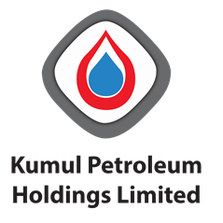
DISCLAIMER
“This presentation is intended only for use by Kumul Petroleum Holdings Limited for the purposes of its business and interests. Information contained in this presentation is considered proprietary and confidential in nature and remains the sole property of Kumul Petroleum Holdings Limited. Circulation, reproduction or use of this presentation is not permitted without the permission of Kumul Petroleum Holdings Limited. Kumul Petroleum Holdings Limited makes no claim, promise or guarantee of any kind about the accuracy, completeness or adequacy of the information and content of this presentation and expressly disclaims liability for errors or omissions in such content.”

Slide 3
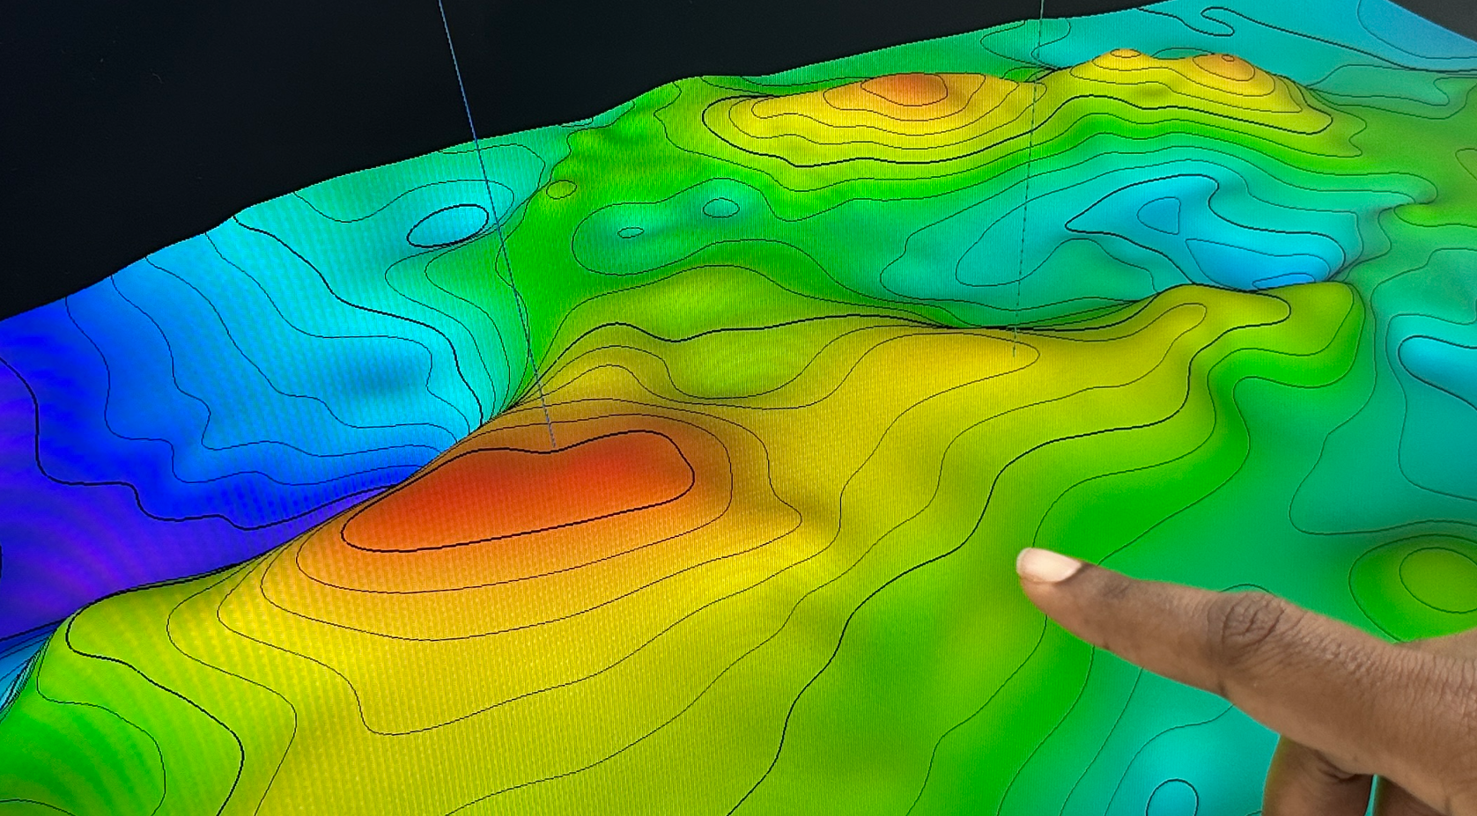
Kumul Petroleum – National PETROLEUM & Energy Company
  Vision : Building Papua New Guinea through our energy resources
  National petroleum & energy company and State nominee
  Key equity in PNG LNG Project and future participant in Papua LNG Project
  Equity partner in PDLs & PRLs
  Operator of 4 Petroleum Retention Licences – exploration and appraisal
  4 New Petroleum Prospecting Licence Applications pending
Notes:
Who are we?
KPHL is the national petroleum company and State nominee in all petroleum developments in PNG.
KPHL is mandated to participate in petroleum exploration, development, production, processing and marketing and downstream activities including petrochemicals, gas supply and power generation.
KPHL holds 19.2% equity in the PNG LNG Project, operated by ExxonMobil, & will take a 22.5% equity stake in Papua LNG Project, operator TotalEnergies.
KPHL pays annual dividends to the Government, funds nation-building projects (e.g. health sector infrastructure), community development & sports support.
KPHL is involved in utilizing some PNG gas in power generation – NiuPower.
KPHL operates 4 PRLs.
Strategy1: Invest in exploration, development, production of oil & gas reserves
Strategy2: Enter into Petroleum Midstream infrastructure
Encourage National building
Next 50 Years

Slide 4
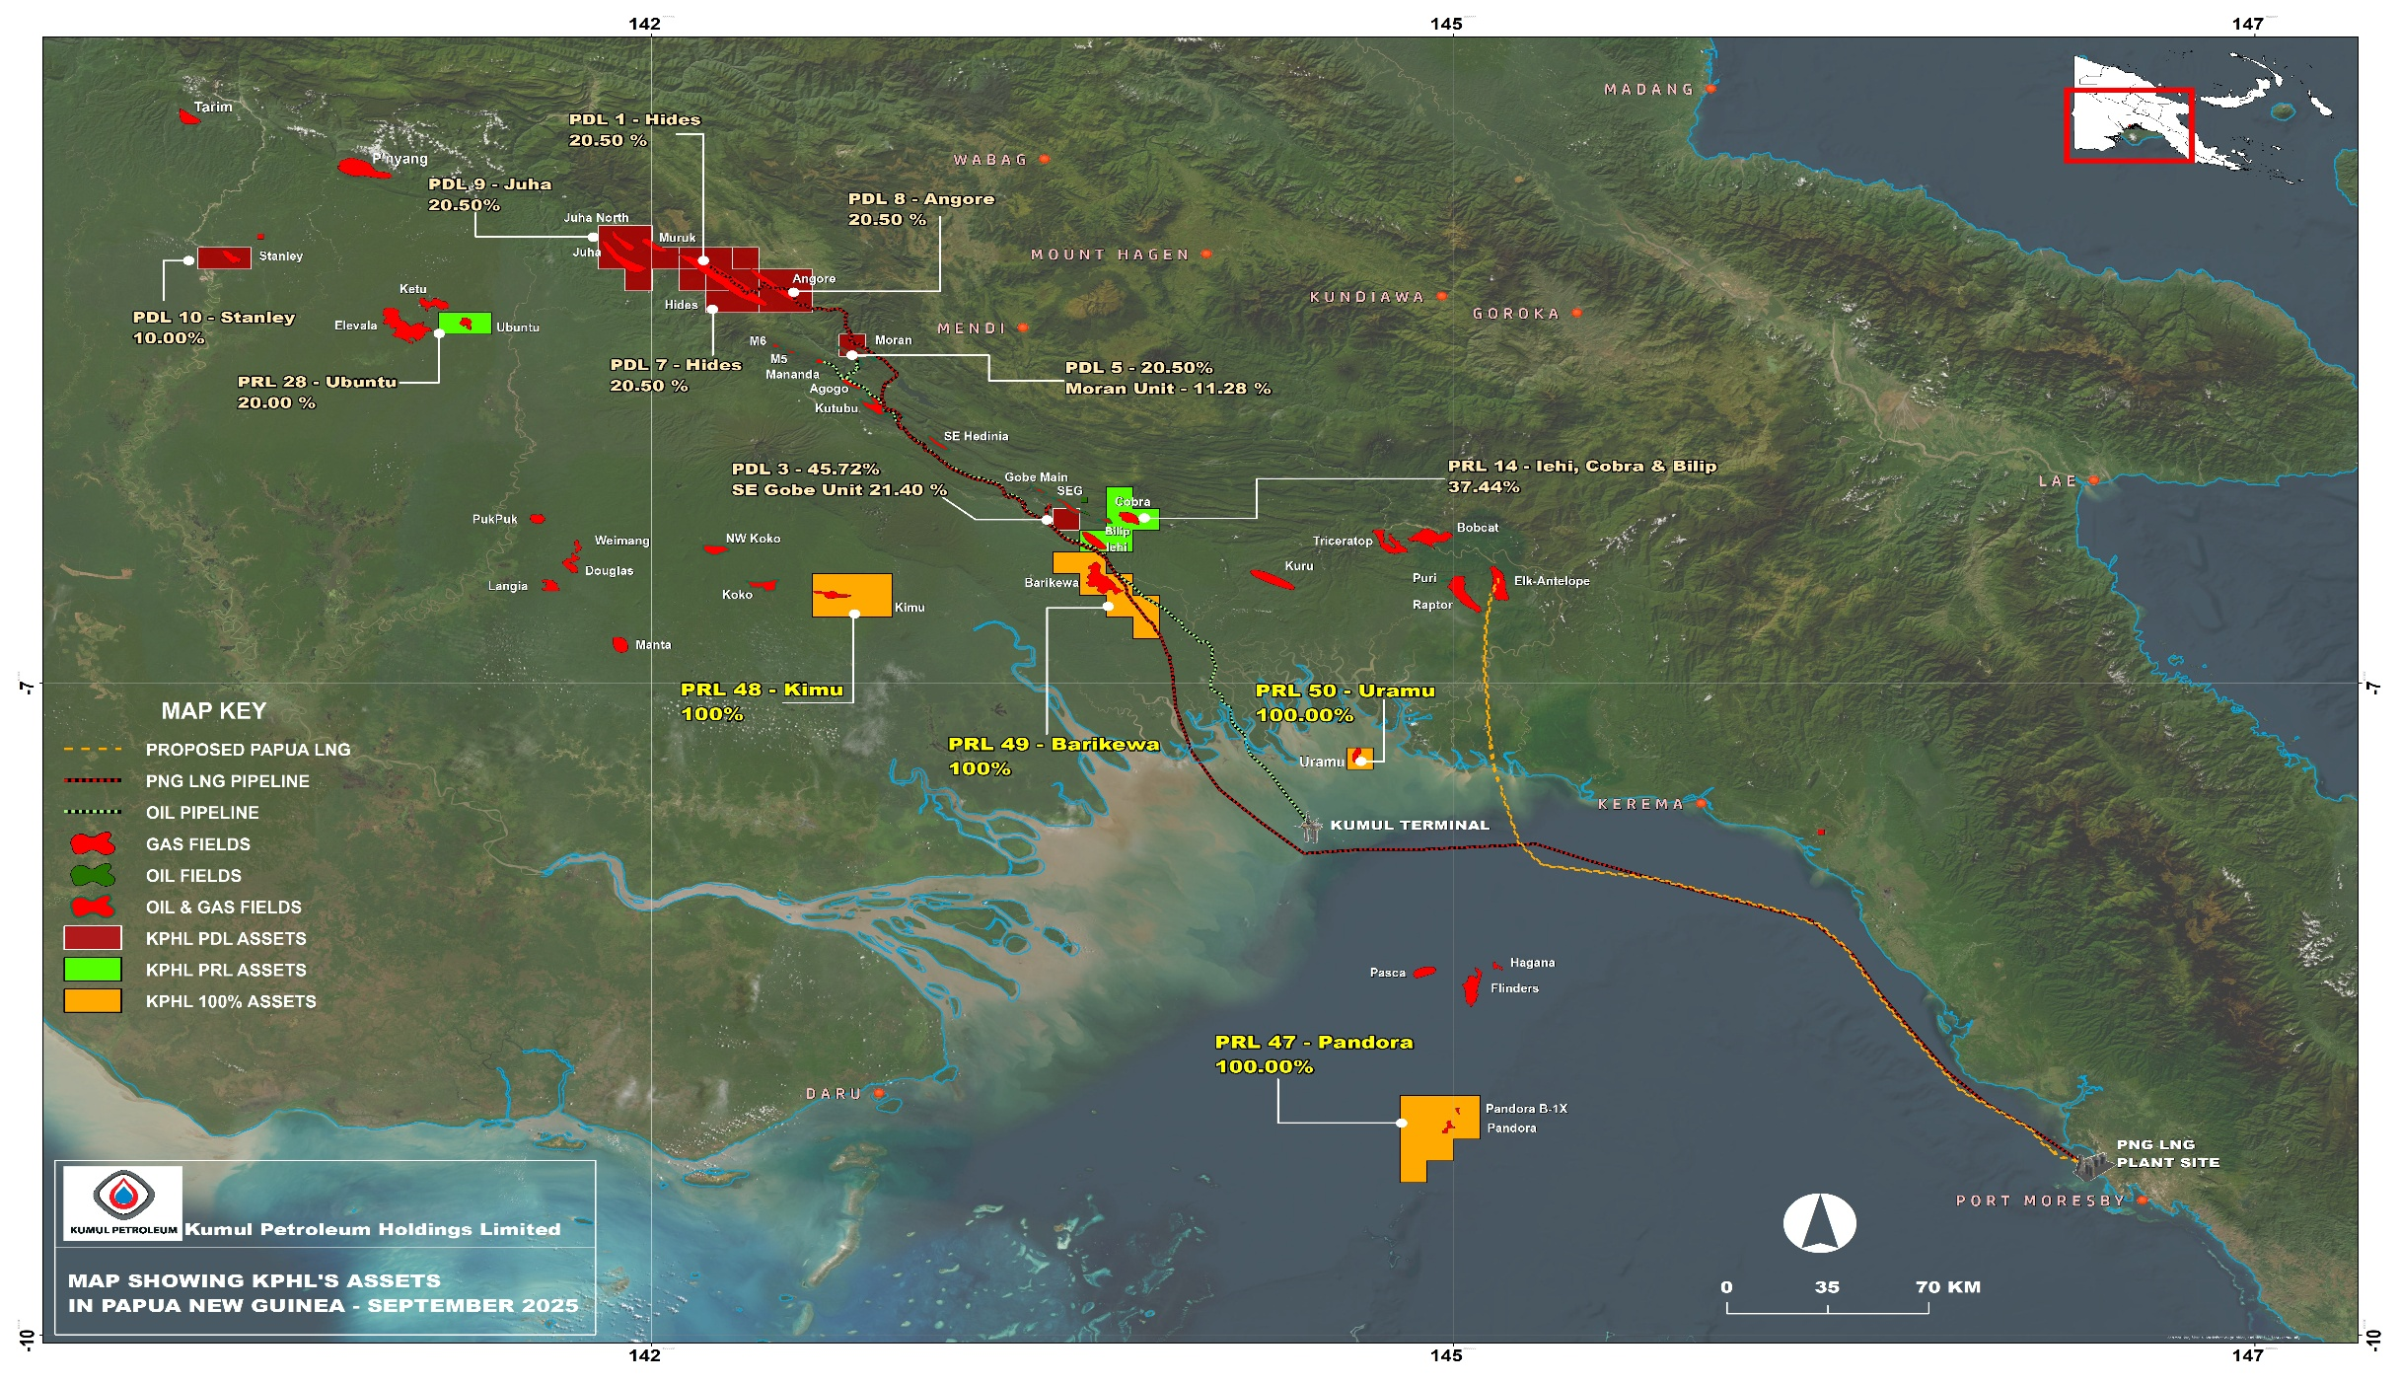
PAPUAN BASIN
Stranded Fields:
Ketu
Elevala
Ubuntu
Tingu
Douglas
Pukpuk
Langia
Weigmang
Aiema
Kimu*
Barikewa*
Bilip*
Cobra*
Iehi*
Uramu*
Pandora*
Flinders
Notes:
Develop the four (4) KPHL Licences, and adjacent fields, through evaluating development options to benefit the people of Papua New Guinea
Point out stranded field & KPHL PRLs
Why strategic approach for field?
Develop those fields and others can follow.
17 Fields Stranded because previous owners considered noncommercial – National resources
17 Discovered fields in the Papuan Basin are stranded fields.
Field have in-place volumes ranging from 50 BCF to 2400 BCF
Approx. 10-12 TCF gas in place for about 17 fields.
The list excludes Stanley & Pasca Fields
Individual field volumes are marginal for standalone development.
Gas aggregation development strategy required.
Kumul’s Western-Gulf Field Development strategy.
Develop 4 Fields: Pandora (PRL-47) , Kimu (PRL-48), Barikewa (PRL-49), Uramu (PRL-50).
Number of development options considered
Targeted exploration strategy
Most fields discovered in 1960s to 1990s.
Need creative solutions to marginal fields
Kumul Petroleum is working hard to create solutions – Bring stranded hydrocarbons to market

Slide 5
Stranded GAS - AGGREGATION STRATEGY
17 Discovered fields in the Papuan Basin are stranded fields.
Individual field volumes are marginal for standalone development.
Gas aggregation development strategy required.
Kumul’s Western-Gulf Field Development strategy.
Develop 4 Fields: Pandora (PRL-47) , Kimu (PRL-48), Barikewa (PRL-49), Uramu (PRL-50).
Number of development options considered
Targeted exploration strategy
Aggregation strategy lowers development cost for existing discoveries and opens new exploration opportunities.
Notes:
17 Fields Stranded because previous owners considered noncommercial – National resources
17 Discovered fields in the Papuan Basin are stranded fields.
Field have in-place volumes ranging from 50 BCF to 2400 BCF
Approx. 10-12 TCF gas in place for about 17 fields.
The list excludes Stanley & Pasca Fields
Individual field volumes are marginal for standalone development.
Gas aggregation development strategy required.
Kumul’s Western-Gulf Field Development strategy.
Develop 4 Fields: Pandora (PRL-47) , Kimu (PRL-48), Barikewa (PRL-49), Uramu (PRL-50).
Number of development options considered
Targeted exploration strategy
Most fields discovered in 1960s to 1990s.
Need creative solutions to marginal fields
Kumul Petroleum is working hard to create solutions – Bring stranded hydrocarbons to market

Slide 6
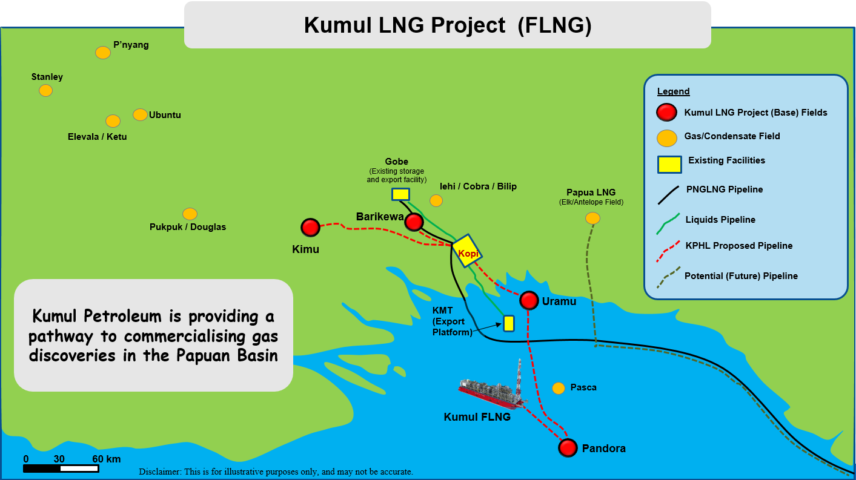
Western Gulf Fields Development Strategy (Kumul LNG)
Notes:
Kumul FLNG is one Option under evaluation
Point to the fields
Enable development of small fields under 1.0 TCF

Slide 7
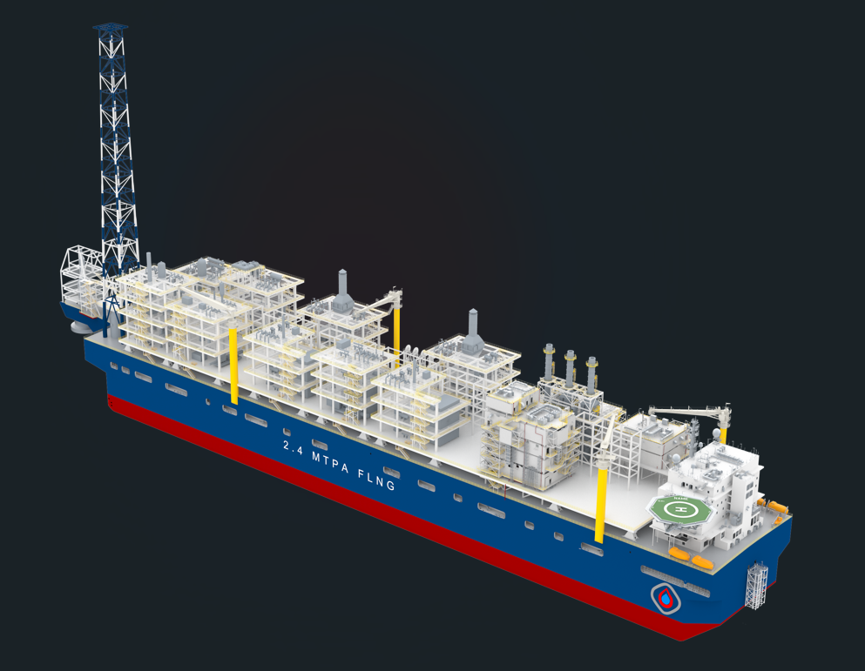
EXPLORATION & DEVELOPMENT
Western Gulf fields aggregation
Western Gulf fields development – Select phase study (Ongoing)
Central Support base to reduce exploration and development costs
Active exploration in surrounding fields
80 Km Seismic – a first for PNG’s national petroleum company (Q4/24-Q2/25)
Pre-FEED study on 1.5 MTPA FLNG option (Ongoing)
FLNG will enable existing and any new discoveries to be commercialised

Slide 8
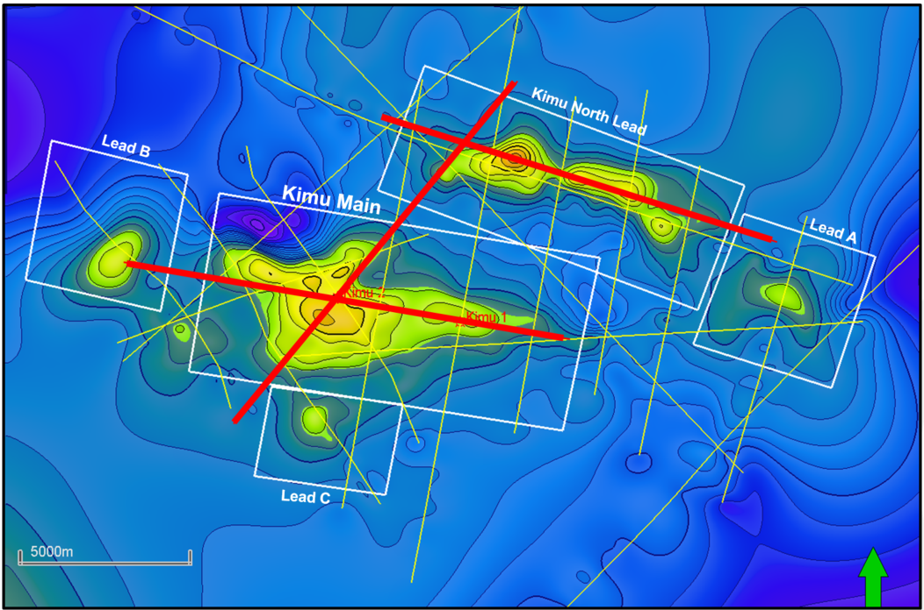
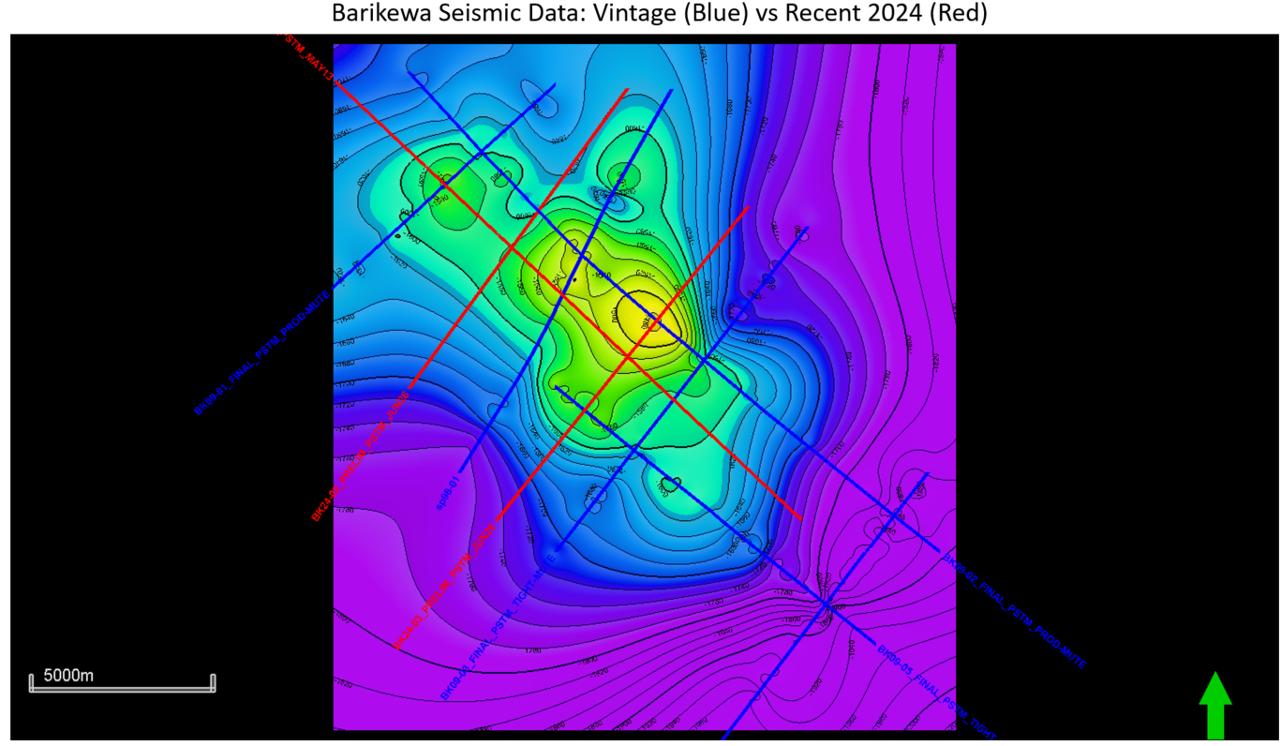
APPRAISALS
Kimu
KPHL is only company that acquired seismic 2024/25
40 km seismic shot over Kimu Field
40 km seismic shot over Barikewa Field
Strontium Isotope Stratigraphy (SIS)
Great improvement in seismic quality
Resources upgrade – Q1/2026
Encouraging upsides in offshore fields
  Uramu Field
  Pandora Field
Lead C
Barikewa

Slide 9
KUMUL FLNG OptION
Kumul FLNG is one of the gas development option;
~1.5 MPTA with potential for 2.4 MTPA;
Pre-FEED study by Wison;
FLNG Pre-FEED to be completed in Q4/2025
Notes:
One Development options that gives the best strategic option to opening the Papua Basin in FLNG
Developments Costs are critically been reviews at this stages and evolving.
We now have a better feel and understanding of how the FLNG project should look like.
We will continue to work on this until we get a solution that works for us.

Slide 10
Western GulF field DevELOpment – CURRENT STATE
Identify
Assess
Operate
Select
Define
Execute
2022 - 2024
FEED
Final Investment Decision
Ready For Start Up
Assess Report
Concept Select Report
Field Development Plan
We are here
Notes:
Indicate the previous list of work from Identify to Select phase – 2022-2024:
Resources Certification, Seismic Campaign, Assess Phase Studies, Prefeasibility studies.
We have Selected a few Options and have moved to Select Phase -
Select Phase – next 12-18 months
Our Select Phase work will help us to move forward to Define work.

Slide 11

LOOKING FORWARD
De-risk and upgrade existing resources
Acquire targeted petroleum acreage
Common pipeline and facilities
LNG development & gas sales
Enable third party marginal field development
Technology and partnership collaboration
Highly skilled & competent professional national workforce
NEXT 7 YEARS
Notes:
Current resource from 5 PRLs fields (Work ongoing to update resources)
Acquire exploration acreages
Develop Strategic Assets
Build our people
KPHL is building its technical manpower to be coming a commercial and technically competent partner of choice in the hydrocarbon Exploration & Development
We intend to build and operate an upstream asset within the next 7 years
We will not rest until we do!

Slide 12
CONTACTS
  Come and talk to us @ Kumul Petroleum booth
  Poster Presentations

