Slide 1
Kumul Minerals Holdings Ltd
Energy is the Building Block for Economic Growth

Slide 2
Disclaimer
Forward-looking statements
This presentation contains forward-looking statements, which may include but statements regarding: trends in economic outlook; commodity prices and currency exchange rates; demand for commodities; medium-term guidance; reserves and resources and production forecasts; operational performance; expectations; plans, strategies and objectives of management; climate scenarios; approval of certain projects and consummation of certain transactions; closure or divestment of certain assets, operations or facilities (including associated costs); anticipated production or construction commencement dates; capital expenditure or costs and scheduling; operating costs, including unit cost guidance, and shortages of materials and skilled employees; anticipated productive lives of projects, mines and facilities; provisions and contingent liabilities; and tax and regulatory developments.
Forward-looking statements may be identified by the use of terminology, including, but not limited to, ‘intend’, ‘aim’, ‘ambition’, ‘aspiration’, ‘goal’, ‘target’, ‘prospect’, ‘project’, ‘anticipate’, ‘estimate’, ‘plan’, ‘objective’, ‘believe’, ‘expect’, ‘commit’, ‘may’, ‘should’, ‘need’, ‘must’, ‘will’, ‘would’, ‘continue’, ‘forecast’, ‘guidance’, ‘trend’ or similar words. These statements discuss future expectations concerning the results of assets or financial conditions or provide other forward-looking information.
The forward-looking statements are based on management’s current expectations and reflect judgements, assumptions, estimates and other the information available as at the date of this presentation and/or the date of KMHL’s planning processes or scenario analysis processes. There are inherent limitations with scenario analysis, and it is difficult to predict which, if any, of the scenarios might eventuate. Scenarios do not constitute definitive outcomes for us. Scenario analysis relies on assumptions that may or may not be, or prove to be, correct and may or may not eventuate, and scenarios may be impacted by additional factors to the assumptions disclosed.
Additionally, forward-looking statements in this presentation are not guarantees or predictions of future performance, and involve known and unknown risks, uncertainties and other factors, many of which are beyond our control, and which may cause actual results to differ materially from those expressed in the statements contained in this presentation. KMHL cautions against reliance on any forward-looking statements or guidance, particularly in light of the current economic climate and the significant volatility, uncertainty and disruption arising in connection with the Ukraine conflict and COVID-19.
For example, our future revenues from our assets, projects or mines described in this presentation will be based, in part, upon the market price of the minerals, or metals produced, which may vary significantly from current levels. These variations, if materially adverse, may affect the timing or the feasibility of the development of a particular project, the expansion of certain facilities or mines, or the continuation of existing assets.
Other factors that may affect the actual construction or production commencement dates, revenues, costs or production output and anticipated lives of assets, mines or facilities include our ability to profitably produce and transport the minerals and/or metals extracted to applicable markets; the impact of foreign currency exchange rates on the market prices of the minerals or metals we produce; activities of government authorities in the countries where we sell our products and in the countries where we are exploring or developing projects, facilities or mines, including increases in taxes and royalties; changes in environmental and other regulations; the duration and severity of the Ukraine conflict and the COVID-19 pandemic and their impact on our business; political or geopolitical uncertainty; labour unrest; weather, climate variability or other manifestations of climate change; and other factors.
Except as required by applicable regulations or by law, KMHL does not undertake to publicly update or review any forward-looking statements, whether as a result of new information or future events. Past performance cannot be relied on as a guide to future performance.

Slide 3
Kumul Minerals Holdings Limited
The National Minerals Company
VISION: KMHL will be a responsible minerals company committed to create and enhance value in the entire chain of the minerals business.
Kumul Minerals Holdings Limited (KMHL) is established by the Kumul Minerals Holdings Limited Authorisation Act 2015 of the Parliament of the Independent State of Papua New Guinea.
KMHL is an independent commercial enterprise owned by the Peoples of PNG with a mandate to participate in the minerals sector in PNG.
KMHL is focused on investments in State Equity Option projects as well as direct and indirect investments in minerals assets.
KMHL is active in pursuing opportunities across the minerals value chain:
  Exploration and studies
  Mine development
  Mine operations and minerals processing
  Mine rehabilitation and closure
  Downstream processing
MISSION: KMHL will seek to:
Invest in high value assets in the complete chain of the mineral sector.
Prudently manage and maximise shareholders’ interests and returns in mineral assets.
Develop and grow a dynamic, skilled and motivated team in the mineral industry.
Grow the company to become a competitive player in the minerals sector.
Be environmentally friendly and socially responsible corporate entity.

Slide 4
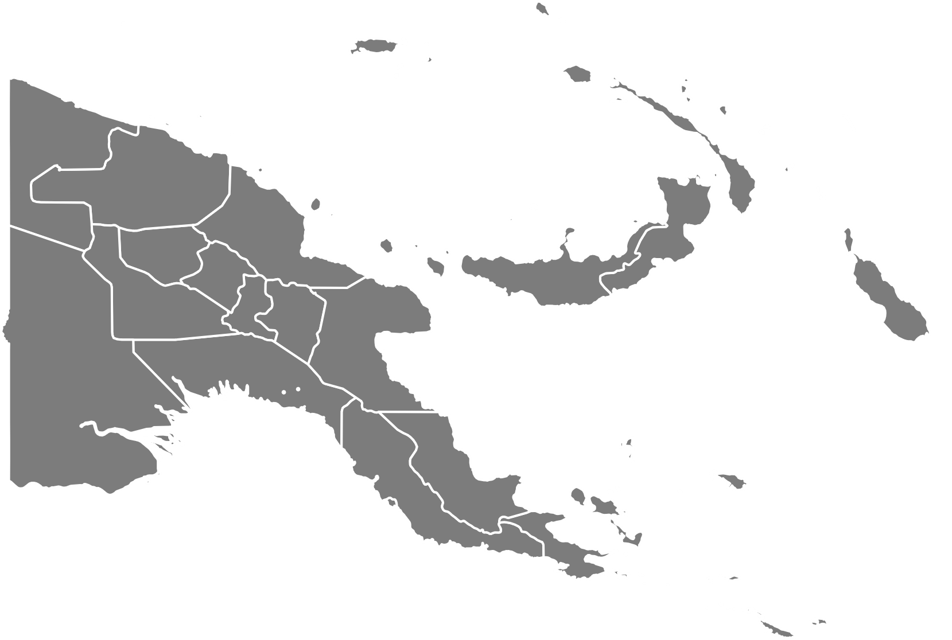
Kumul Minerals Holdings Limited
A strong mix of operating and development assets
KMHL’s role as the State nominee company for holding shares in Minerals Projects has resulted in the development of a strong portfolio.
KMHL intends to leverage this portfolio to enter into new investments and partnerships across the PNG minerals sector.
KMHL’s primary assets are:
  Ok Tedi Mining Limited – 67%
  New Porgera Limited – 36%
  Solwara 1 – 15%
  Tolu Minerals Limited – 3.2%
KMHL is also engaged in negotiations to secure significant holdings in future assets:
  Wafi-Golpu Joint Venture – 20%*
Solwara 1
Ok Tedi
Porgera
Wafi Golpu
Tolukuma
*The State of PNG has announced its intention to exercise its right to acquire 30% of the Wafi-Golpu Project, with 20% retained by KMHL and 10% to be shared by the Morobe Province and landowners, subject to completion of the permitting process.

Slide 5
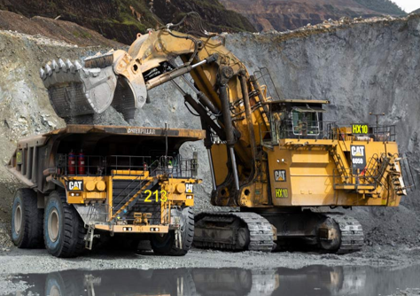
Energy in the Mineral Resources Sector
Energy is one of the main operating costs for mining operations
Energy costs vary widely among between mines and jurisdictions due to a variety of factors:
  Process intensity — hard rock requiring a lot of processing will use more energy.
  Mining method — large open-pit mines with long haul distances use lots of diesel whereas underground mines have different mixes (ventilation, dewatering, hoisting).
  Site remoteness and on-site power — remote and off-grid sites that run diesel gensets or isolated gas plants face higher energy unit costs. PNG is a clear example.
  Energy price volatility and fuel mix — spikes in prices push costs up quickly.
  Electrification and efficiency — switching to grid power, renewables, or introducing electric components (trolley assist, diesel-electric haul trucks, electric shovels) reduces the cost of fuel.

Slide 6
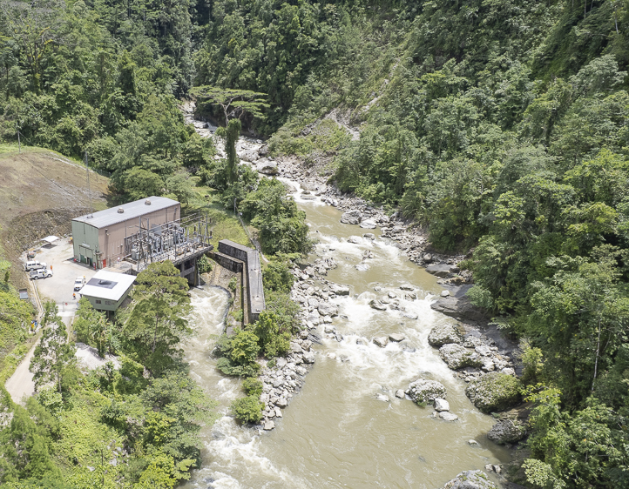
Energy in the Mineral Resources Sector
Countries with developed energy infrastructure have competitive advantage
Energy costs vary widely between countries also:
  Australia – 10%-30% of opex
  USA – 10%-30% of opex
  Canada – 8%-25% of opex
  China – 10-30% of opex
  Papua New Guinea – 15%-35% of opex
For remote mines in PNG the average percentage of energy costs in opex can be much higher.
PNG’s low grid penetration, reliance on on-site diesel or bespoke power plants, and remote logistics increase energy’s share of opex.
Energy solutions are a major component of any new mine development, and increase the cost and risk to developers.
Development of a robust energy infrastructure network in PNG would significantly improve the development outlook for the Mineral Resources Sector.

Slide 7
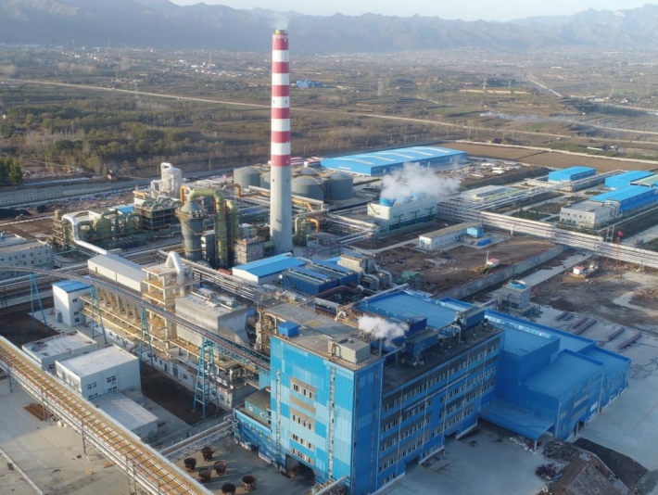
Sector Development Pipeline
Large scale development in PNG requires large scale power generation
  New mining projects that have advanced studies indicate significant demand for additional power in PNG:
    Wafi-Golpu Copper-Gold – 111MW diesel power generation plant
    Frieda River Copper-Gold – 600MW hydroelectric power plant
    Yandera Copper-Gold-Molybdenum – 225MW plant TBD
    Misima Gold – 50MW mixed diesel and solar
  Additionally, downstream projects in earlier stages of development have substantial power needs:
    Copper-Gold Smelter/Refinery
    Nickel-Cobalt Smelter/Refinery
    Gold Refinery

Slide 8
Energy for Downstream Processing
Preliminary results – financial assessment
Nickel Smelter-Refinery-Financial Assessment
Key Focus Areas
  Capital cost
  Operating cost
  Project profitability
  Investment return strategies
Initial Financial Insights
Estimated capital cost: US$2.3 billion for a 500kt/a facility
Profitability depends on:
  Access to competitively priced energy
  Reliable water supply
  Efficient logistics and infrastructure
Next Phase Priorities
Identify complementary projects to support the refinery:
  Example: Hydroelectricity development & Special Economic Zones

Slide 9
Energy for Downstream Processing
Preliminary results – financial assessment
Copper Smelter Refinery Financial Assessment Focus
Evaluation of:
  Capital cost
  Operating cost
  Project profitability
Exploration of measure to enhance investment returns
Key Financial Insights
Initial capital estimate: US$750 million for a 200kt/a facility
Profitability depends on:
  Access to competitively priced energy
  Reliable water supply
Next Phase Priorities
Identify complementary projects to support the smelter
  Example: Hydroelectricity development & Special Economic Zones
Strengthen infrastructure and utility integration

Slide 10

Importance of Energy in PNG
No economy can grow without the energy to develop and sustain it
  The minerals and energy sectors are tied to one another in the strongest way.
  Minerals projects stimulate energy development, and energy projects allow minerals projects to succeed.
  As the National Minerals Company, Kumul Minerals is committed to ensuring that all new developments also deliver benefits to the local and broader community of Papua New Guinea.
  This includes provision of energy and infrastructure to landowners and local grids.
  We encourage investment in and development of a robust and integrated national energy infrastructure, as it will be to the benefit of all.

Slide 11
Thank you.

