Slide 1

Cost of Generating Power From Renewable Energy Sources in PNG PETROLEUM & ENERGY CONFERECE 8th - 9th October – 2025 Stanley Hotel - Port Moresby, PNG Mr. Ronal Meketa Managing Director National Energy Authority
PETROLEUM ENERGY CONFERENCE 2025

Slide 2
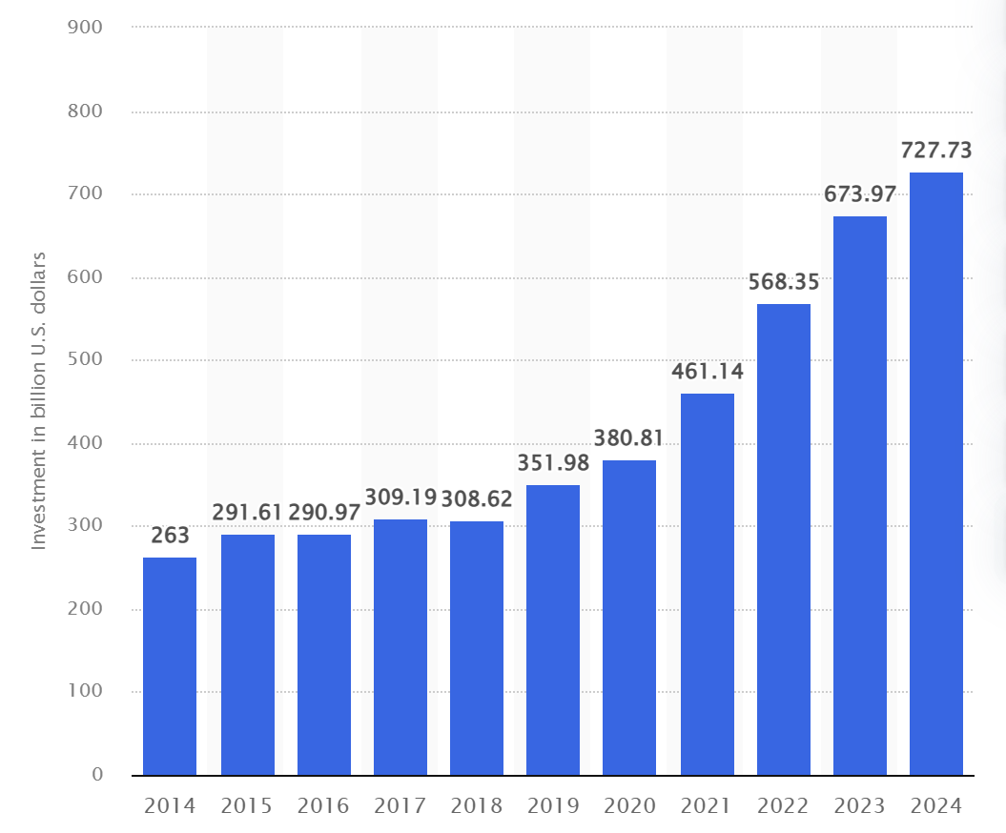
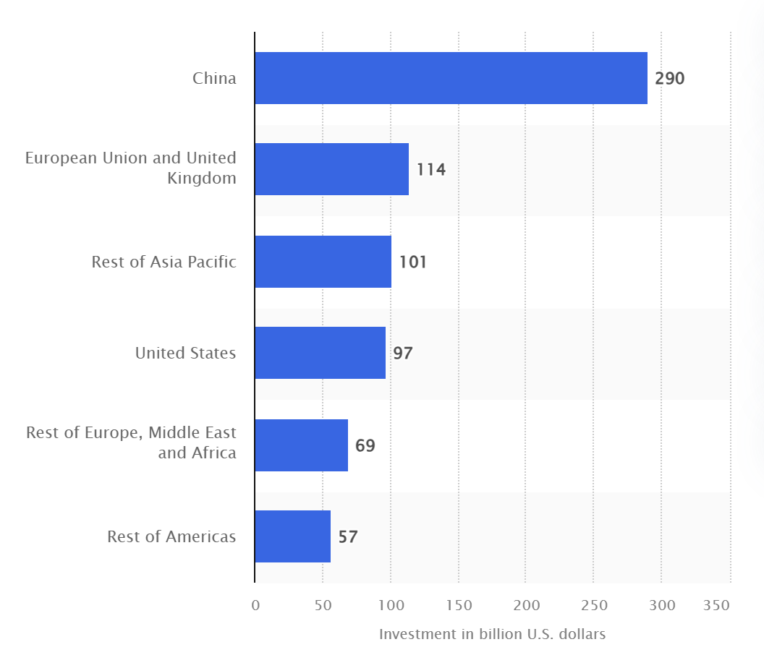
Renewable Energy Investment - Global Momentum
Worldwide investment in renewable energy 2014-2024
Global renewable energy investments 2024, by region
Source: BloombergergNEF, IEA
PETROLEUM ENERGY CONFERENCE 2025
Notes:
Graph 1
total new investment in renewable energy amounted to approximately 727.73 billion U.S. dollars worldwide. This was an eight percent increase from the previous year.

Slide 3
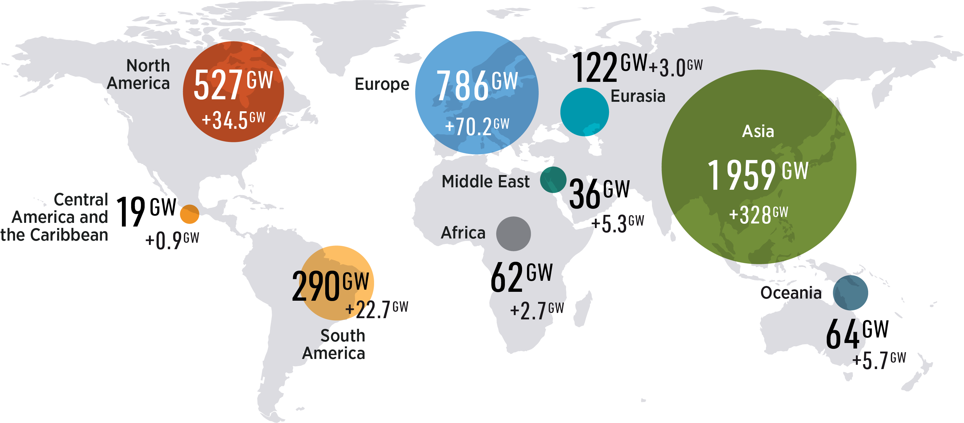
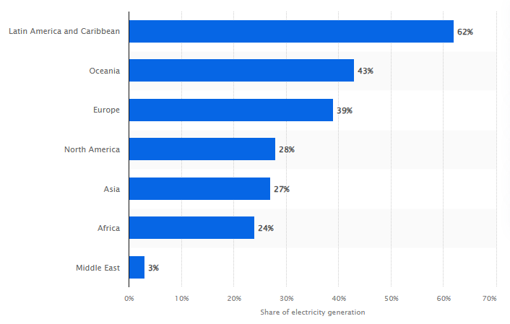
Regional Context: Asia Pacific & SIDS
• Asia Pacific leads growth, but disparities persist.
• SIDS face energy access and investment challenges.
PNG shares similar constraints.
• Pacific nations are advancing off-grid renewables and regional partnerships.
OCEANIA 43% RE
PETROLEUM ENERGY CONFERENCE 2025

Slide 4
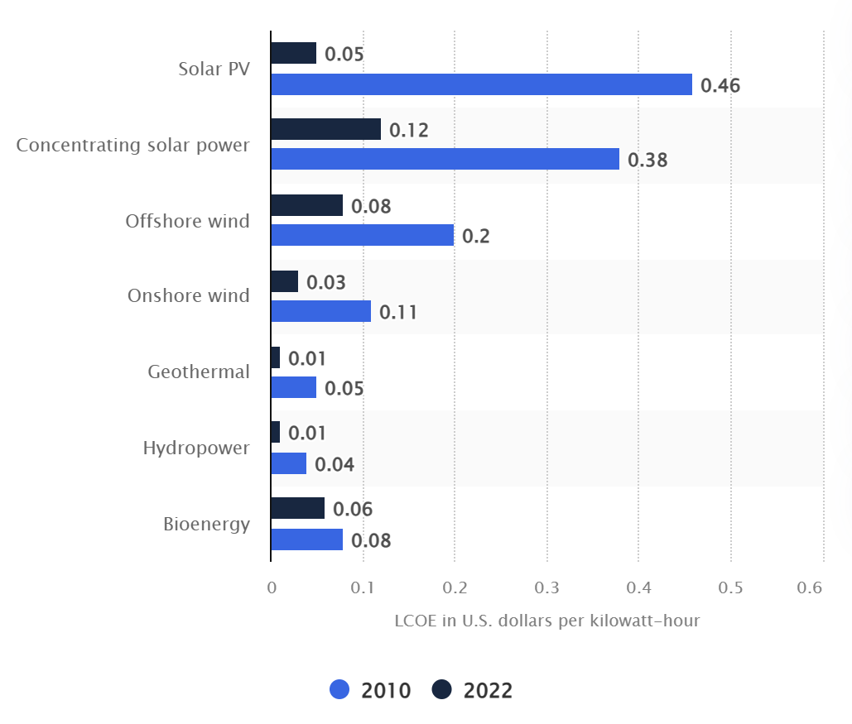
The Economics of Scaling Renewables Transition
Solar: ~USD 0.05/kWh,
Wind: ~USD 0.03/kWh,
Hydro: ~USD 0.06/kWh.
Source: IRENA
PETROLEUM ENERGY CONFERENCE 2025
Notes:
91% of new renewables in 2024 cheaper than fossil fuels.
In 2024, renewables avoided USD 467B in fossil fuel costs globally. In 2022, the global unit cost for generating electricity from hydropower was approximately $0.06 per kWh1. For solar photovoltaics, the levelized cost was around $0.05 per kWh worldwide2.
In the United States, wind power had an average levelized price of $0.0255 per kWh.
Overall, wind power was slightly cheaper in the U.S., while worldwide, costs for solar PV and hydropower were close .123

Slide 5
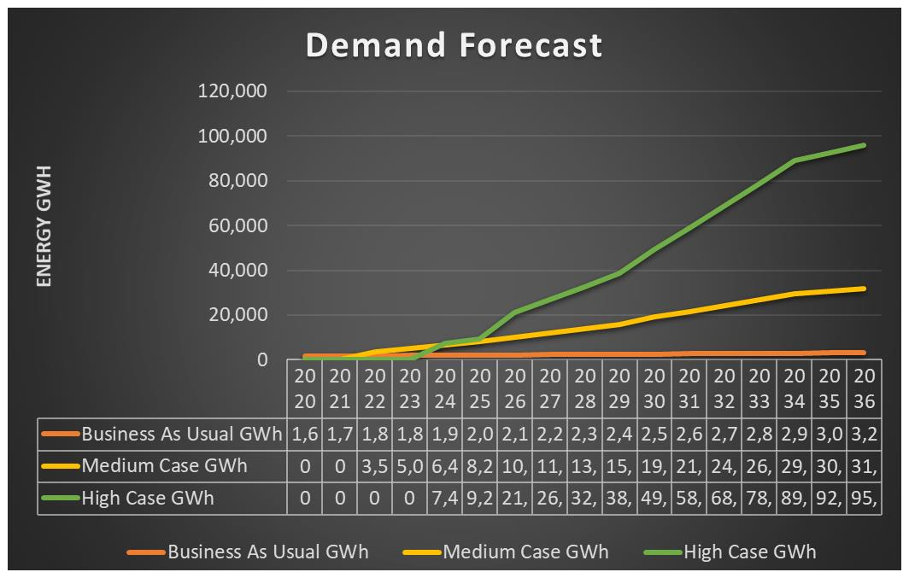
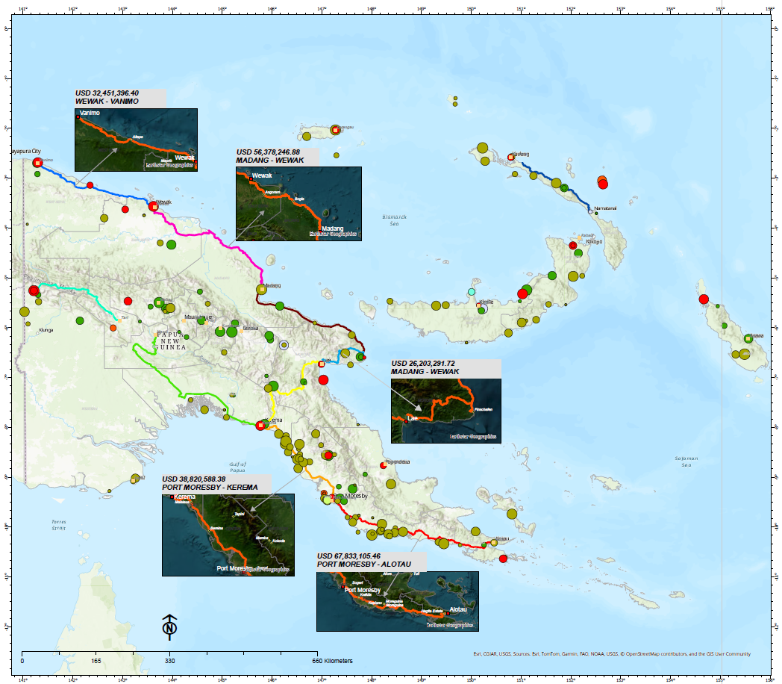
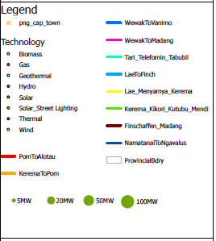
PNG's Renewable Transition – Demand Forecast
PETROLEUM ENERGY CONFERENCE 2025
Notes:
Business as Usual - Demand Forecast including natural center growth rates
Medium Case – BAU Demand Forecast + connection of new industries and growth in existing Mines
High Case – Medium Case Demand Forecast + connection of proposed new Mines

Slide 6
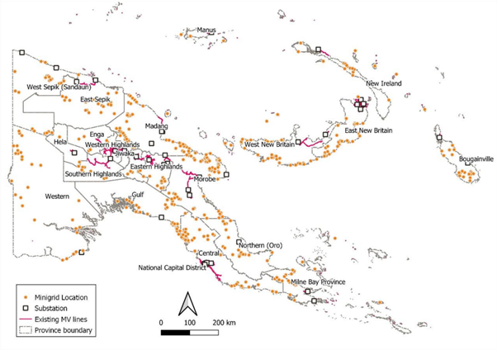
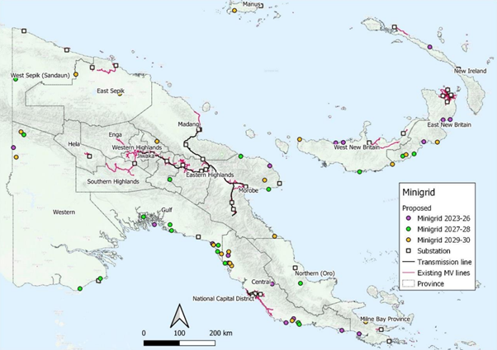
PNG's Renewable Transition – Mini-Grid Potentials
About 500 potential Mini-Grid Sites to be developed
57 viable mini grid scheduled as per the NEROP
PETROLEUM ENERGY CONFERENCE 2025

Slide 7
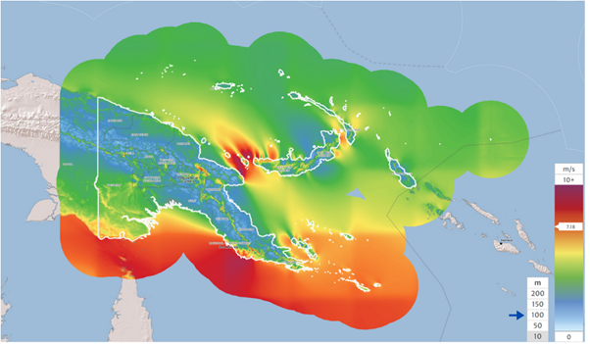
An emerging sector – Wind power (onshore / offshore)
PNG's Renewable Transition – Wind Power (onshore/Offshore)
Mean wind speed is around 4 – 5.6 m/s. A consistent strong wind with 7-10m/s. Some sites have about 10m/s and above which is like one of the largest Wind Farms in the UK (Hornsea). The potential Fixed Foundation is around 91 - 103 GW, and the potential Floating Offshore is 50 to 56 GW*. The nominal potential is up to about 160GW.
NEA is liaising with Sahul Energy, a Papua New Guinea-based developer, committed to driving sustainable
growth through the development of worldclass
energy infrastructure about the Continent-8 offshore development program.
PETROLEUM ENERGY CONFERENCE 2025

Slide 8
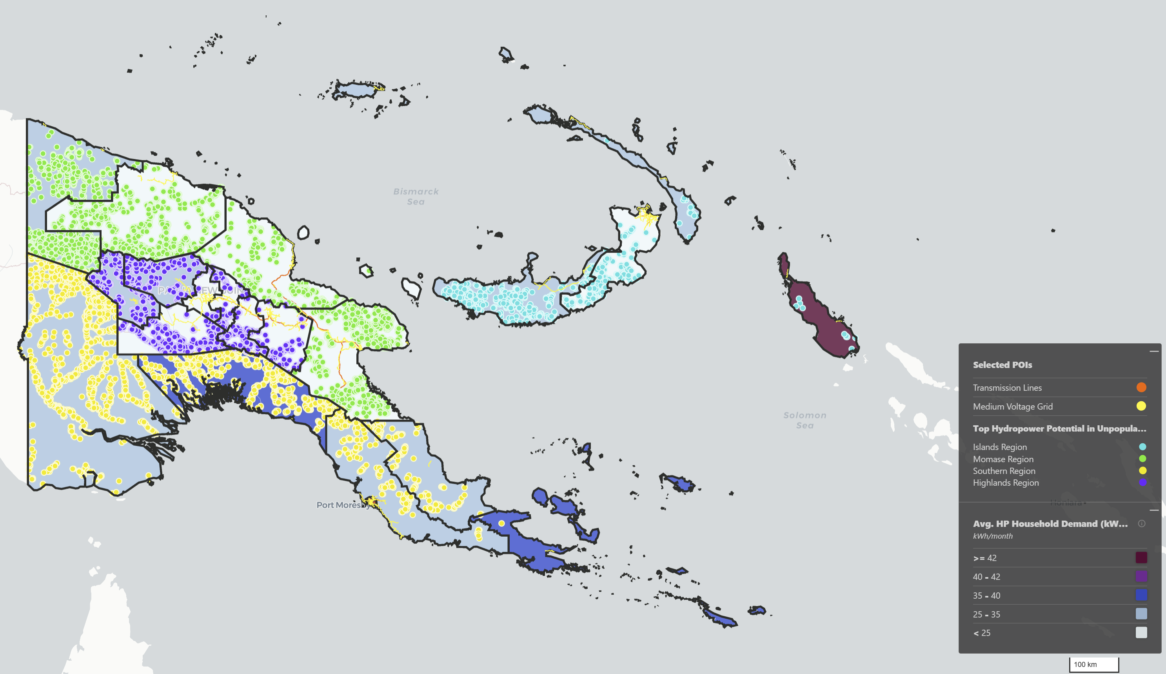
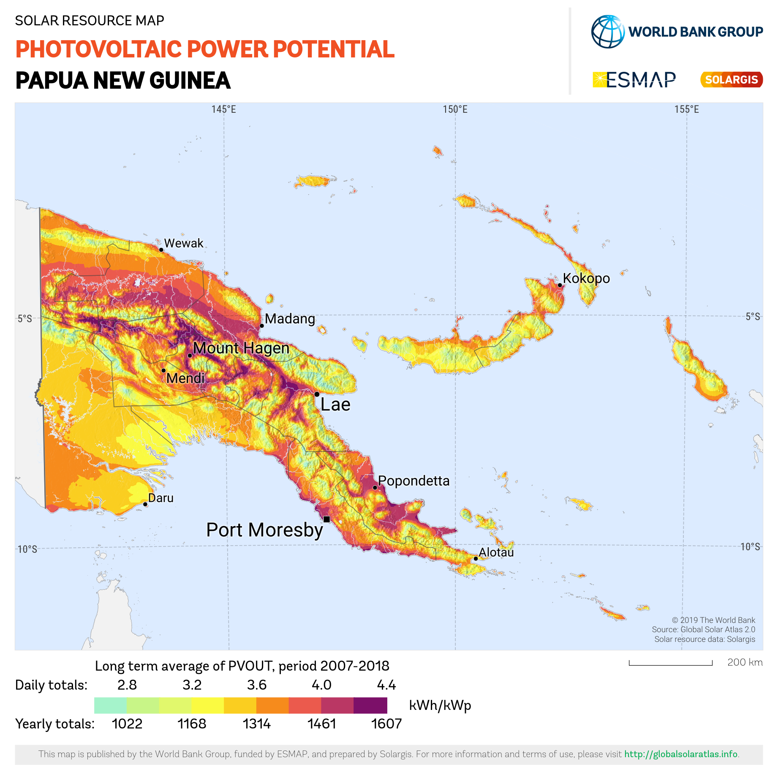
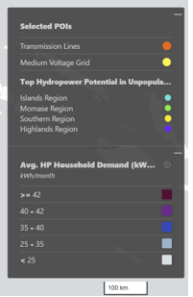
PNG's Renewable Transition – Hydropower and Solar Potential
PNG INVESTMETN CONFERECE 2025

Slide 9
Policy & Regulatory Framework - NEA Corporate Plan 2023-27 - Key Activities
Regulatory Framework - NEA Corporate Plan 2023-27 - Key Activities
Accelerate Energy Sector Development
Strengthen Domestic Energy Sector Regulation
Progress Corporate Development
Community awareness and outreach.
Local commercialization of energy access.
Landowner participation in energy projects.
Develop and administer effective economic regulatory arrangements.
Develop and administer effective technical regulatory arrangements.
Develop and implement efficient regulated tariffs and service standards.
Develop and administer effective
economic licensing arrangements.
Develop and administer robust and efficient contractual regime for IPPs.
Review and administer NEA’s industry
levy regime.
Develop and implement effective corporate governance arrangements.
Develop and implement effective human resource management policies, processes and practices.
Develop and implement effective performance and risk manaąement process and systems.
Establish effective IT technology and property management processes and systems.
Establish effective internal legal advisory services.
PNG INVESTMENT CONFERENCE 2025

Slide 10
Cost of Generating Power From Renewable Sources in PNG PETROLEUM & ENERGY CONFERECE 8th - 9th October – 2025 Stanley Hotel - Port Moresby, PNG Mr. Ronal Meketa Managing Director National Energy Authority
PETROLEUM ENERGY CONFERENCE 2025

