Slide 1


New Horizons | Growth and Renewal in Upstream
Joe Keith
Associate Director, Technical Research
October 8, 2025
PECPNG 2025

Slide 2
Disclaimer

Slide 3





Five macro trends shaping the upstream sector
Increasing recognition that the “energy transition” will not be a steep linear curve, which is reinstating the importance of oil & gas
Investor sentiment is going to drive how companies balance capital allocation between oil & gas, low-carbon and meeting shareholder returns
Tactics for growing upstream portfolios will differ by peer group and will take its own shape and form
Policy & Regulation which favors investors will retain and draw new capital
The sustained rise in costs could put brakes on how fast companies can regrow their portfolios

Slide 4
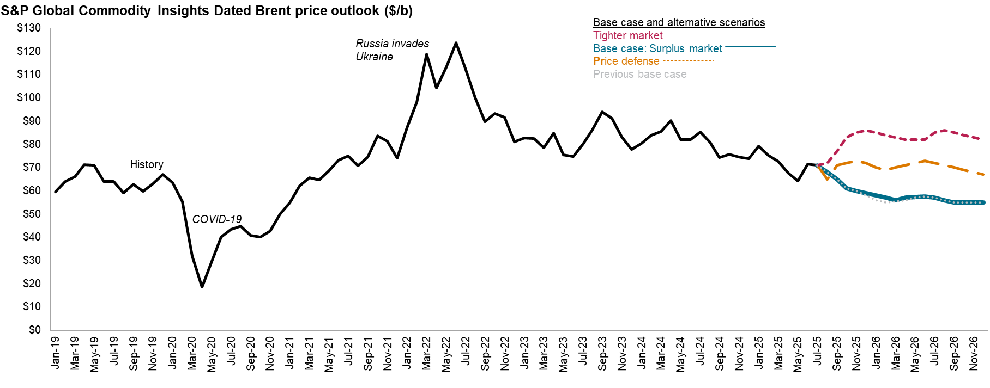
Oil Price Outlook | Price outlook sees a decline in Dated Brent prices by year-end as Chinese inventory builds slowly and OPEC supply increases
Data compiled Aug. 27, 2025.
Historical Dated Brent prices from Platts.
Source: S&P Global Commodity Insights.
© 2025 S&P Global

Slide 5
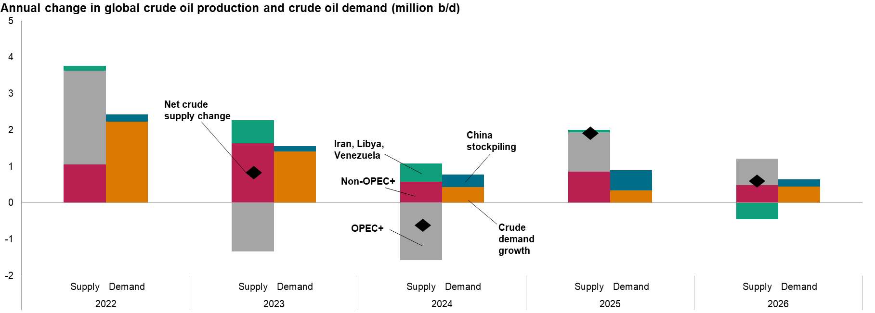
Oil Price Outlook | Increase in crude oil supply will outpace demand growth for crude oil in 2025 and 2026 resulting in inventory rise
Data compiled Aug. 27, 2025.
Condensate is included in crude oil production and demand. Crude oil demand consists of refining runs and direct use of crude oil.
Source: S&P Global Commodity Insights
© 2025 S&P Global

Slide 6
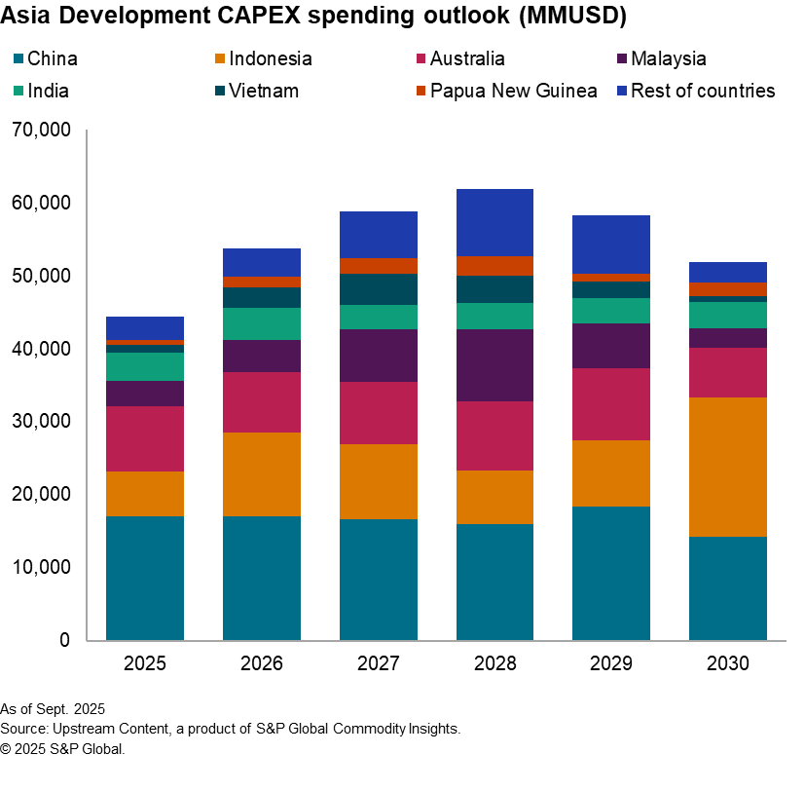
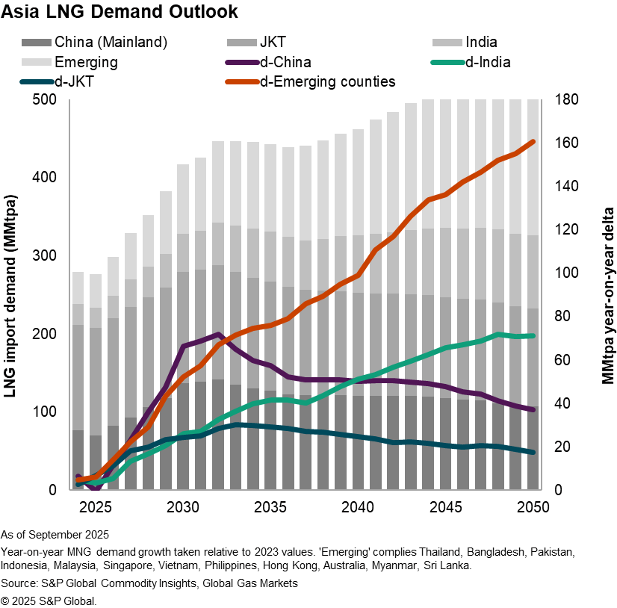
Fossil Fuel Resilience | Commercialization (and exploration) are crucial for regions where robust demand growth exists

Slide 7
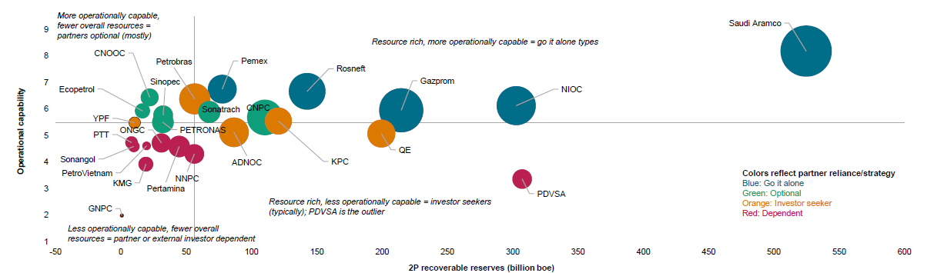
NOCs | Strategic directions will depend on operational capabilities and reserves base
NOCs: Total hydrocarbon reserves versus operational capability
Higher hydrocarbon reserves + operational capability - NOCs can “Go it alone”.
Strong operational capability allowing for effective management of reserves - NOCs can adopt an “Optional” strategy.
A reliance on government support, external partnerships and holding lower reserves - NOCs are “Dependent”.
Data compiled June 2025.
Source: S&P Global Commodity Insights.
© 2025 S&P Global.

Slide 8
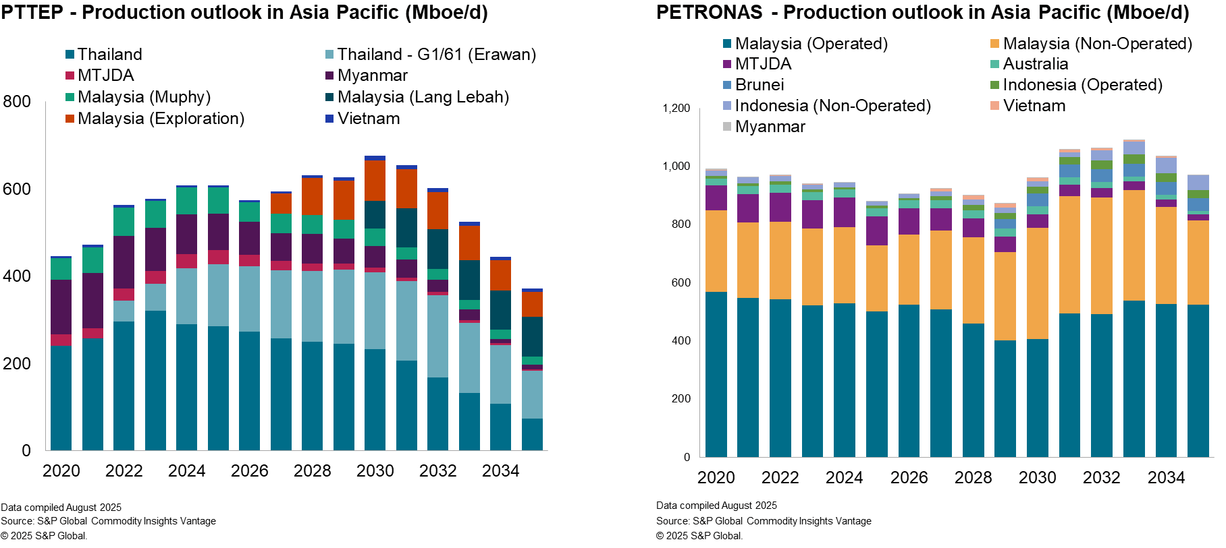
NOCs | Domestic and regional expansion for SE Asia

Slide 9
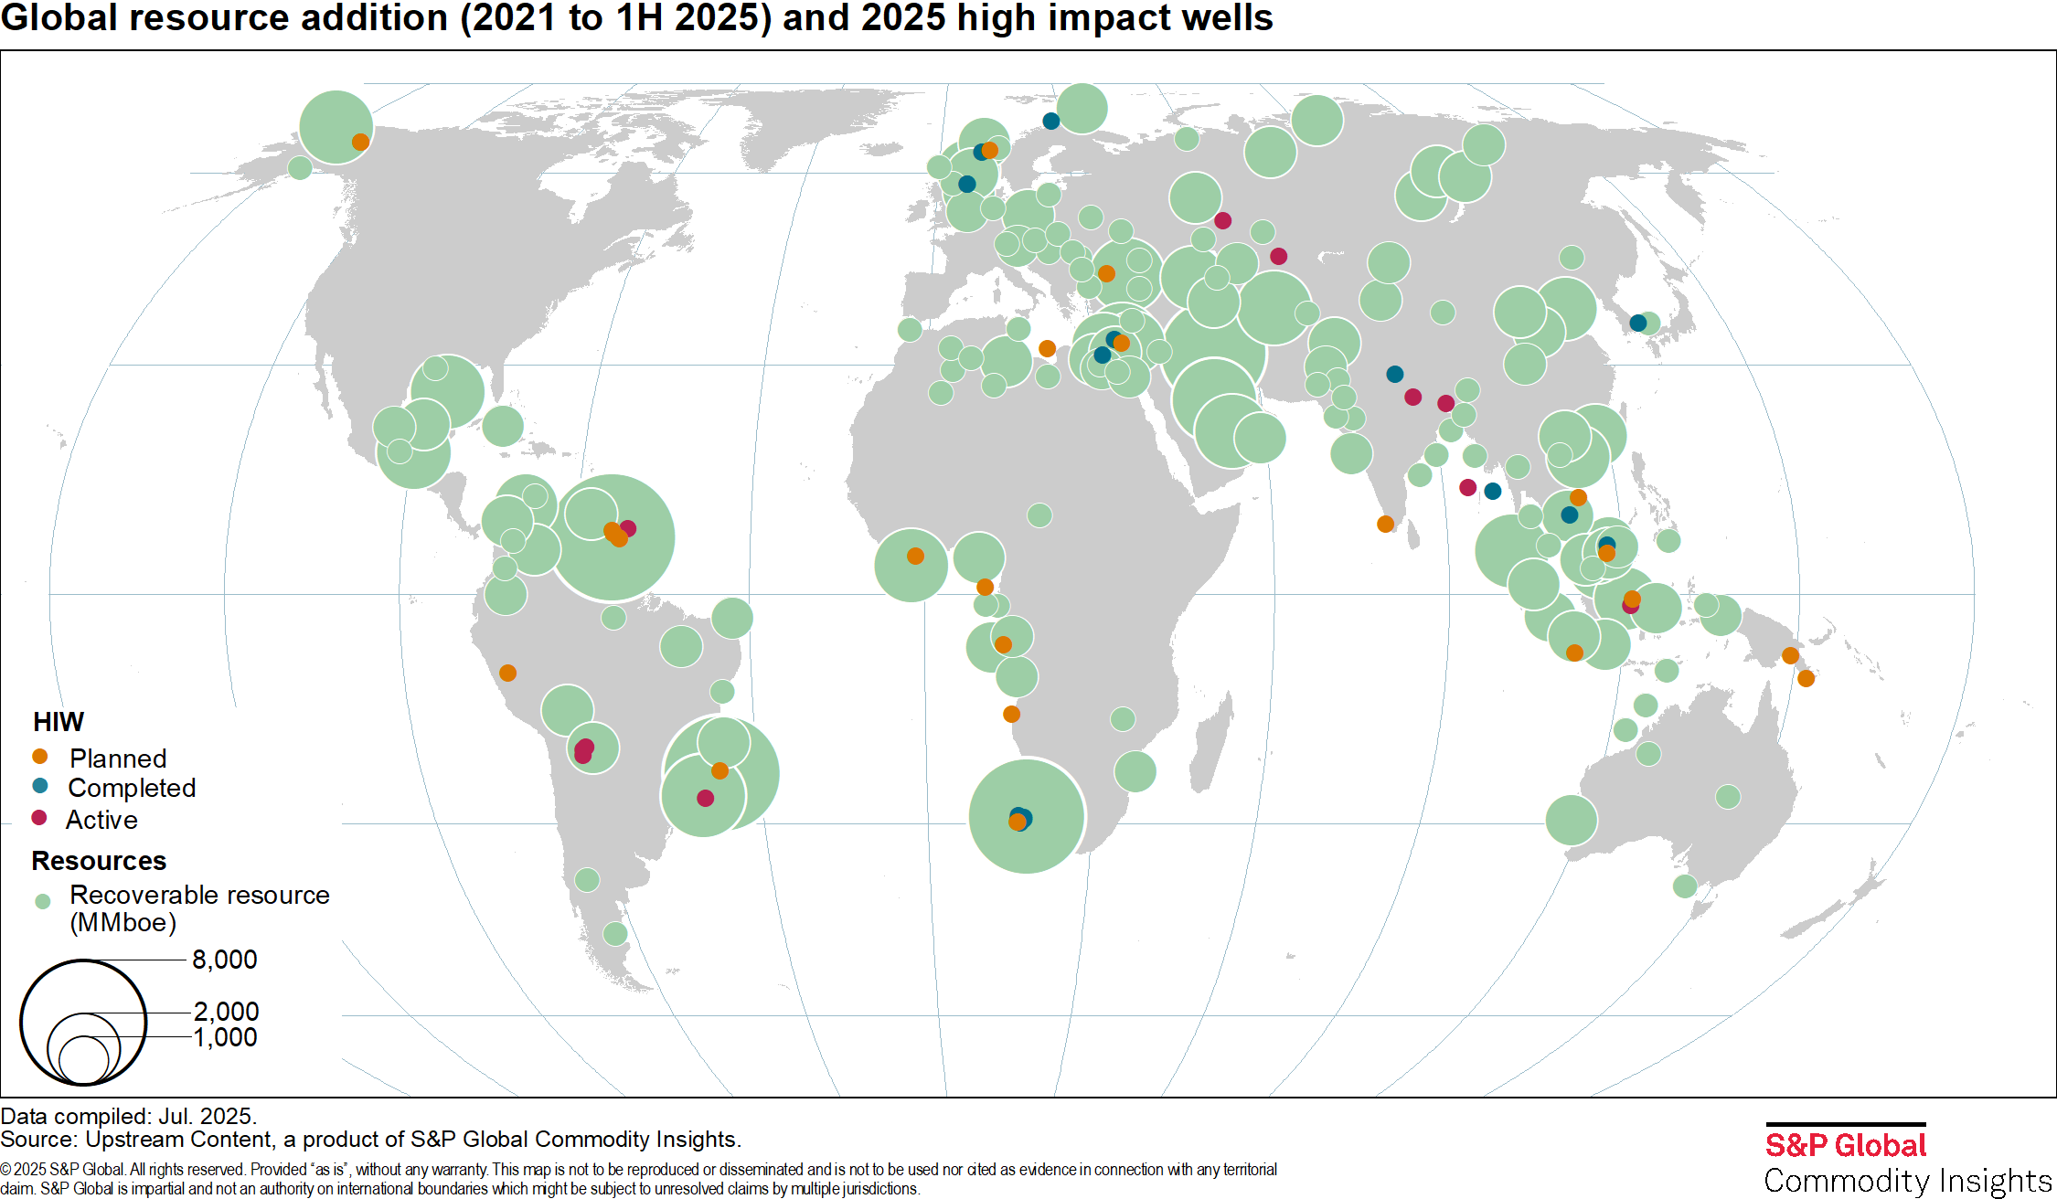
Exploration Strategy | If growth is back on the agenda, then where are the hotspots? Is it still a game of scale?
Global resource addition (conventional, 2021 to 1H 2025) and 2025/2026 high impact wells
9
Notes:
The era of ‘Advantaged’ basins, which have potential for scale, profitability and resilience; frontier/emerging basins grow in attractiveness
Emerging plays in immature basins, blind spots in mature basins deliver. Play openers targeted by selected HIWs

Slide 10
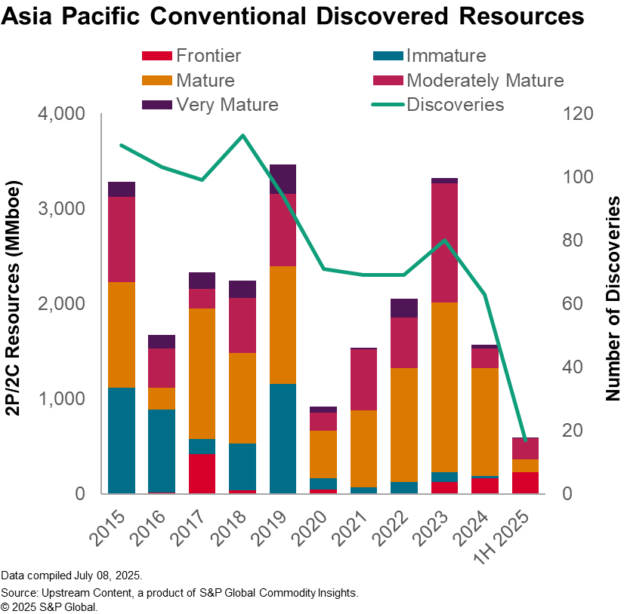
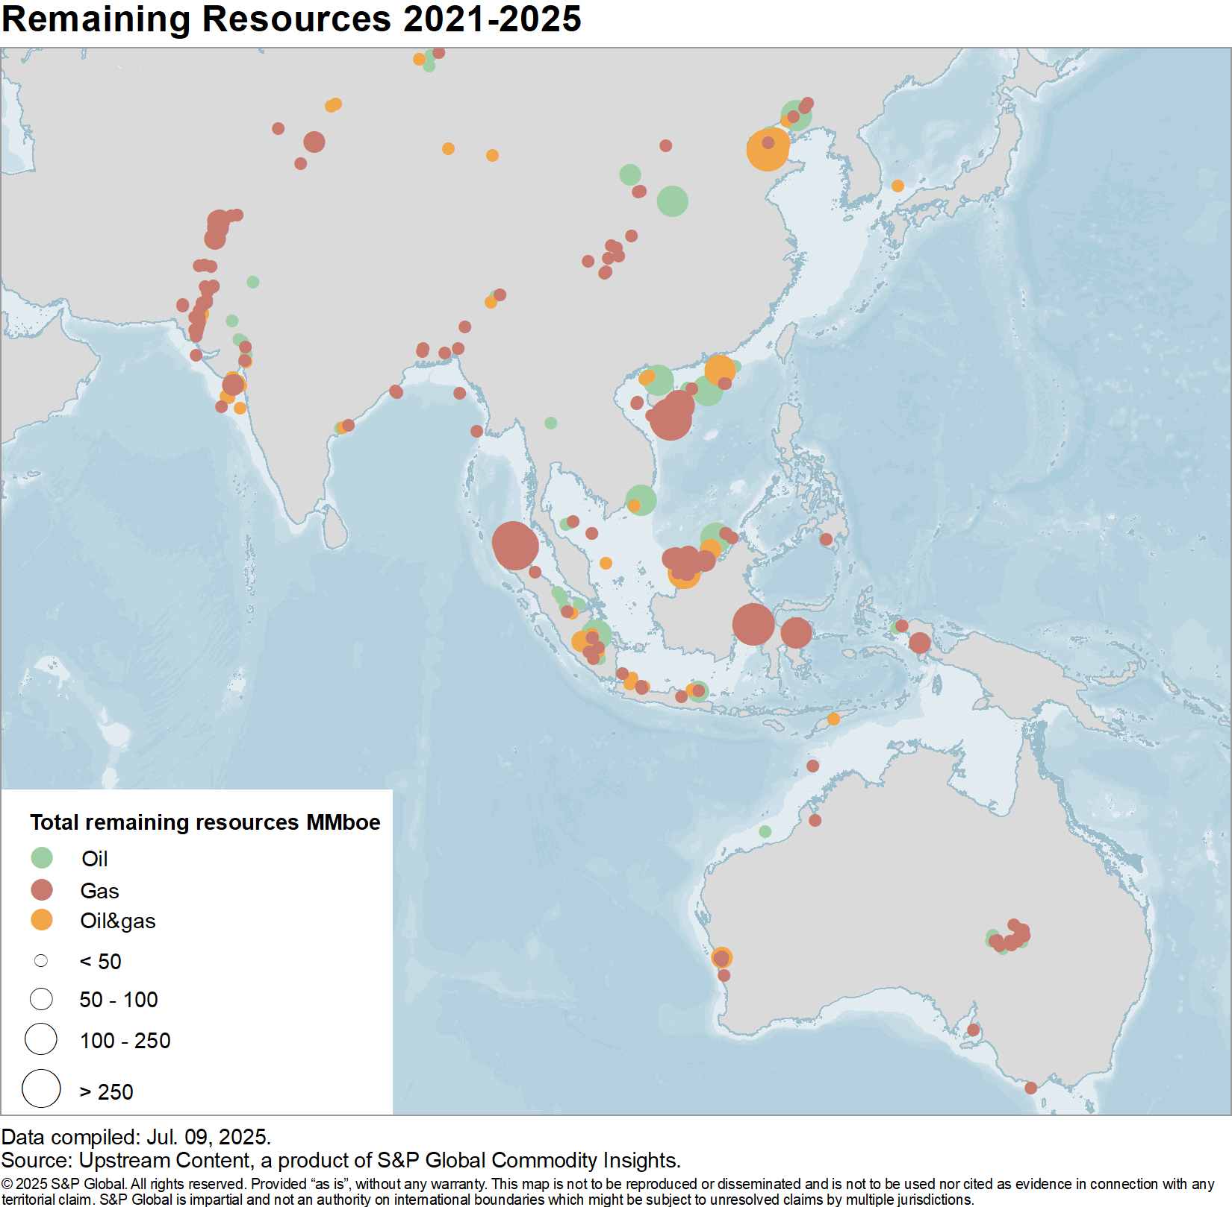
Exploration Strategy | Mature basins continue to deliver in Asia Pacific but are we drilling enough wells?
Asia Pacific Conventional Discoveries (2021 to 1H 2025)

Slide 11
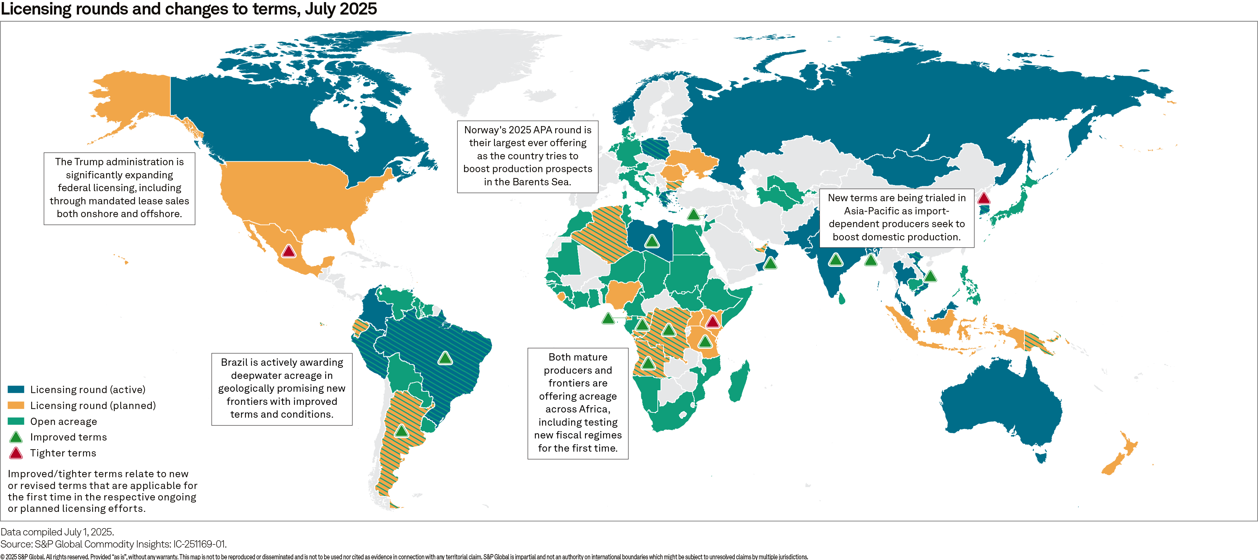
Bid Rounds & Country Entry | In 2025, around 40 countries are holding licensing rounds, with ~15 introducing changes to terms and widespread availability of open areas
Licensing rounds and changes to terms, 2025

Slide 12
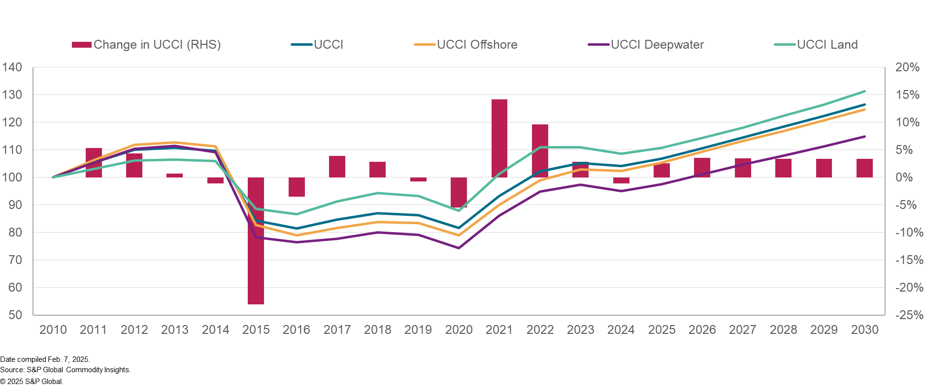
Cost | Increasing costs since 2021 present a key constraint to upstream
Upstream Capital Cost Indexes (UCCI), base year = 2010
12

Slide 13
Summary | Upstream investment appetite is back
Recognition that the “energy transition” will not be a steep linear curve, with energy security, affordability, and reliability taking precedent. Not an energy transition but energy addition
Investor sentiment is going to drive how companies balance capital allocation between oil & gas, low-carbon and meeting shareholder returns
Return to growth is back on the agenda for companies - basins that deliver scale, value and lower emissions, with a pathway to commercialization will be winners
The rise in costs could put brakes on how fast companies can grow their portfolios. We are already under a high-cost environment, which will be further strained with tariffs

Slide 14

Contact us
Primary contact
Joe Keith Joe.keith@spglobal.com
Contact us
Americas +1 800 597 1344
Asia-Pacific +60 4 296 1125
Europe, Middle East, Africa +44 (0) 203 367 0681
www.spglobal.com/en/enterprise/about/contact-us.html
www.spglobal.com
© 2025 S&P Global.
14

