Slide 1

The Next Phase of PNG’s Energy Growth
Bill Easson
Managing Director – DXP Energy Solutions

Slide 2
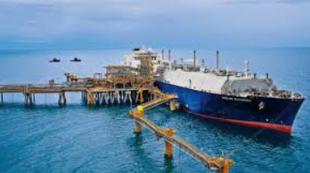
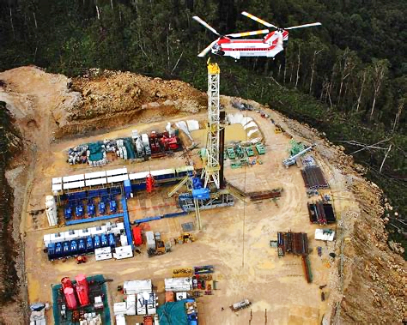
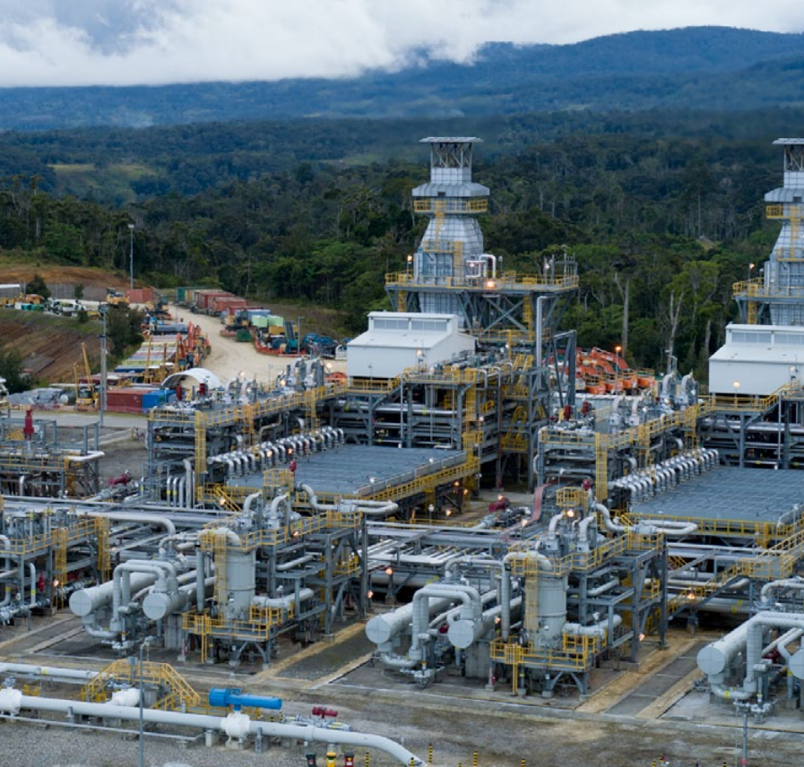
PNG’s Energy Journey

Slide 3
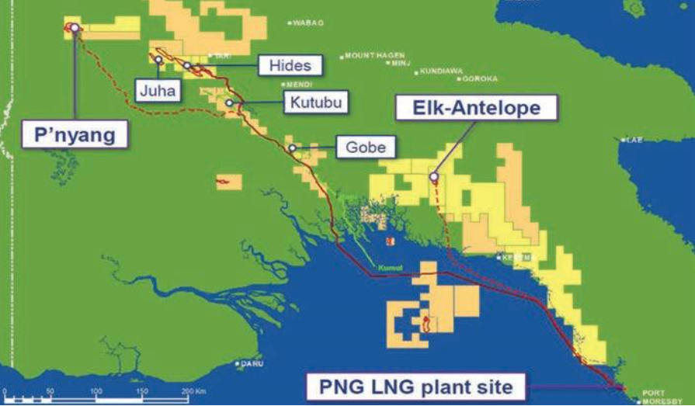
The Next Wave of Growth

Slide 4
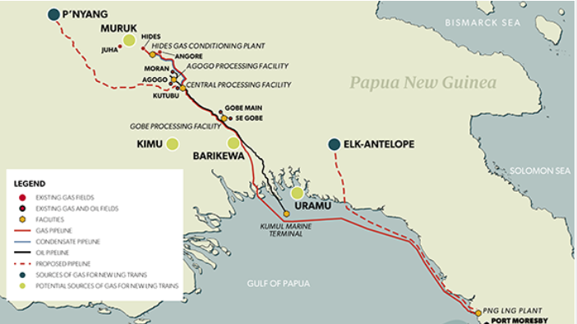

Unlocking the Value
Cost Competitiveness
Financing Constraints

Slide 5
The next phase of PNG’s energy growth is not just about gas – it’s about powering a nation

